Slide 1
Combining Structural Subtyping and External Dispatch
Donna Malayeri
joint work with Jonathan Aldrich
Notes:
I’ll be presenting my current work....
this is work in progress.

Slide 2
Motivation
Lots of code uses by-name subtyping
Lots of code uses structural subtyping
Can we have our cake and eat it too?
Notes:
nominal & structural subtyping each have their strengths and weaknesses
let's find a point in the design space where we can get the strengths of each.
along the way I'll include some pseudo-code examples of how things work in our calculus (note that some are fudged for presentation purposes)

Slide 3
Benefits of by-name subtyping
allows programmers to explicitly express design intent
makes it easy to define recursive types
necessary for efficient run-time subtyping tests and external/multimethod dispatch
Examples
  Java classes
  ML datatypes & dispatch
Notes:
other terms: nominal, declared
allows the progrmamer to express design intent explicity - a form of checked documentation. along with a name comes implicit behavioral semantics.
better error messages
recursive types
necessary for efficient run-time subtyping tests & external/multimethod dispatch. (I'll explain in a moment what i mean by those terms)

Slide 4
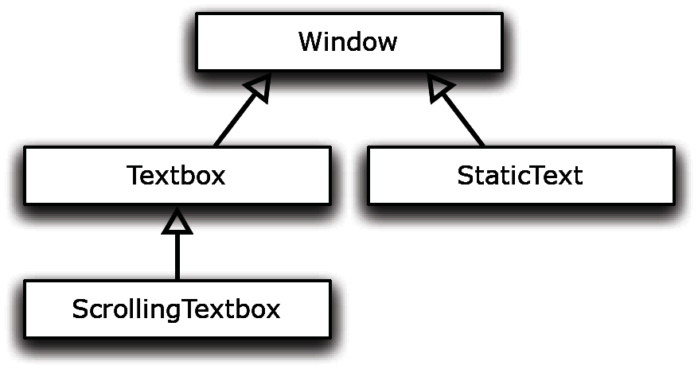
By-name subtyping in Unity
abstract brand Window (...) extends Top
concrete brand Textbox (...) extends Window
concrete brand StaticText (...) extends Window
concrete brand ScrollingTextbox (...) extends Textbox
Notes:
this illustrates the declared typing aspect of the system.
unity supports by name subtyping through brand declarations. here is a simplified illustraiton of how this works. (a running example, I’ll elaborate the elided portions further on).
borrowed term “brand” from Strongtalk => modula3

Slide 5
What is an external method?
conceptually part of an existing class
performs dispatch on objects of that
class’ type
doesn’t have to be in the same compilation unit as the class
closely related concept: multi-methods
  method dispatch can depend on any subset of function’s arguments

Slide 6
External methods: example
a proposed solution to the “expression” problem
abstract brand Window (...) extends Top
concrete brand Textbox (...) extends Window
concrete brand StaticText (...) extends Window
extensible types
external methods
fun paint ( t : Textbox ) = ...
fun paint ( t : StaticText) = ...
concrete brand ScrollingTextbox (...) extends Textbox
new type + new method
fun paint ( t : ScrollingTextbox) = ...
Notes:
I’ve said that names are essential for efficient external dispatch; let me explain what I mean by this term, and why it’s an important and useful concept. I’ve borrowed this concept from the Cecil language community.
the idea here is that names give you points of extension, as the external methods need something to hang on to.
new type + new method, without changing existing code

Slide 7
Alternatives to external methods
use the “Visitor” hack
  have to plan ahead, very hard to add to existing code
  makes it difficult to add new classes
  (and it’s hard to read double-dispatch code)
manually do a typecase (e.g., “instanceof” tests)
Notes:
when you need both method and class extensibility, the alternatives to external methods when you have a single dispatch language, are not very palatable.

Slide 8
Ok Donna, I’m sold on by-name subtyping and external methods
But haven’t people worked this out?
  Cecil language specification
  Millstein et al (TOPLAS ’04)
  Clifton et al (TOPLAS ’06)
  Lee and Chambers (ECOOP ’06)
Yes! I’m extending their ideas.

Slide 9
By-name subtyping has some disadvantages
difficult to add new subtyping relationships
can lose many opportunities for reuse
can lead to a proliferation of types
Notes:
- can be very hard to get two pieces of code to interact with each other if they don't use the right names

Slide 10
Structural subtyping to the rescue!
flexible and compositional
allows unanticipated reuse
no unnecessary proliferation of types
useful for data persistence & distributed computing
Examples: XML, record subtyping

Slide 11
Structural subtyping in Unity
val win = (title=“MyWindow”)
win : (title : string)
val textbox = (title=“MyTextbox”, text=“FOOL is fun”)
textbox : (title : string, text : string)
val scrollWin = (title=“ScrolllingWindow”, scroll=myScrollbar)
scrollWin : (title : string, scroll: Scrollbar)
¿_{textbox} · ¿_{win}
(title : string, text : string) · (title : string)
¿_{scrollWin} · ¿_{win}
(title : string, scroll: Scrollbar) · (title : string)

Slide 12
Paper contributions
a clean and uniform combination of structural and by-name subtyping
proof of type safety

Slide 13
Let’s put it all together
objects are tagged records
record extension (width or depth) yields subtypes
brand extension yields subtypes

Slide 14
Recap: by-name subtyping in Unity
abstract brand Window (...) extends Top
concrete brand Textbox (...) extends Window
concrete brand StaticText (...) extends Window
concrete brand ScrollingTextbox (...) extends Textbox
Notes:
this illustrates the declared typing aspect of the system.

Slide 15
...combined with structural subtyping
abstract brand Window (title : string) extends Top
concrete brand Textbox (title : string, currentPos : int) extends Window
concrete brand StaticText(title : string, text : string) extends Window
concrete brand ScrollingTextbox ( title : string,
currentPos : int,
s : Scrollbar) extends Textbox
Notes:
this illustrates the declared typing aspect of the system.

Slide 16
...combined with structural subtyping
abstract brand Window (title : string) extends Top
concrete brand Textbox (title : string, currentPos : int) extends Window
concrete brand StaticText(title : string, text : string) extends Window
concrete brand ScrollingTextbox ( title : string,
currentPos : int,
s : Scrollbar) extends Textbox
Notes:
this illustrates the declared typing aspect of the system.

Slide 17
...combined with structural subtyping
abstract brand Window (title : string) extends Top
concrete brand Textbox (title : string, currentPos : int) extends Window
concrete brand StaticText(title : string, text : string) extends Window
concrete brand ScrollingTextbox ( title : string,
currentPos : int,
s : Scrollbar) extends Textbox
Subtyping relationships
Window (title : string, s : Scrollbar) ≤ Window (title : string)
Textbox (...) ≤ Window (title : string)
ScrollingTextbox (...) ≤ Textbox (...)
ScrollingTextbox (...) ≤ Window (title : string, s : Scrollbar)
StaticText (...) ≤ Window (title : string)
StaticText (..., s : Scrollbar) ≤ Window (title : string, s : Scrollbar)
Notes:
this illustrates the declared typing aspect of the system.

Slide 18
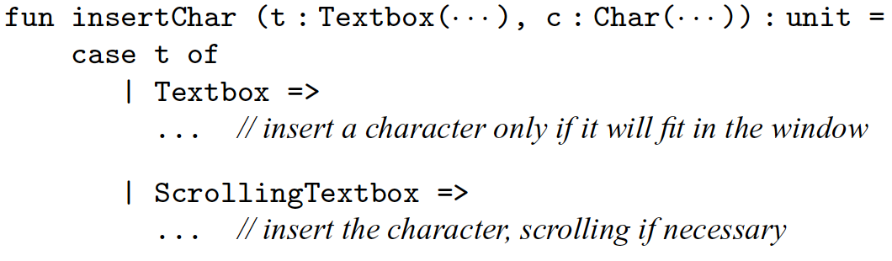
Writing functions
fixed number of characters
unlimited characters; scrolls if needed
each branch is semantically an external method
Notes:
Recall our running example. now we want to write some code to implement some functionality.
I said before that names come with an implicit behavioral specification—in this case, a suppose that a regular textbox accepts only a fixed number of characters, while a scrollingtextbox is unbounded.
Here we have notionally two methods, but it’s represented in our calculus by a case analysis. Note that unlike ML-style case analysis, the ordering of branches does not matter—the execution behavior is to pick the single most specific branch.
This is an example where the by-name aspect of the system is exploited, and the function insertChar does dispatch on the tag of its input value. Scrolling if necessary (perhaps by calling a scroll function). But that “scroll” function can operate on ANY window, provided it has a scrollbar.

Slide 19
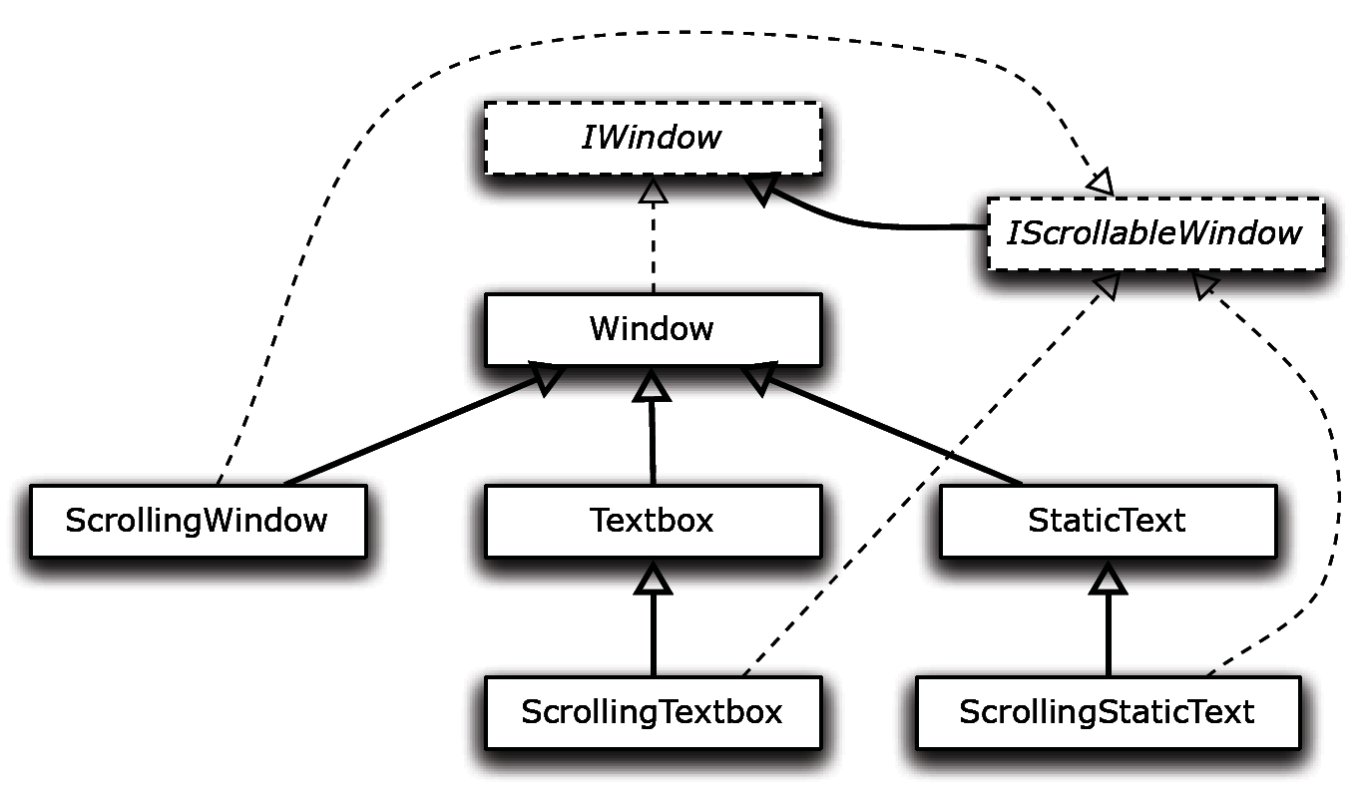
Comparison to Java
⇦ Unity
Java ⇨
Notes:
- note that in Java, you had to muck around with all these interfaces, just to get the structure of the program working properly. necessarily some code duplication (traits do remove some of this), but not in the relevant places (just for the structure, not hte behavior)
the important observation here is that java can only do this if you KNOW ahead of time what you even want.
even if you don’t know ahead of time, you can create clean unity example that is robust to a set of changes.

Slide 20
Recall:
objects are tagged records
record extension (width or depth) yields subtypes
brand extension yields subtypes
Notes:
so, before I get into the subtyping and then typing rules, let’s recall how records and brands interact to give you subtyping.

Slide 21
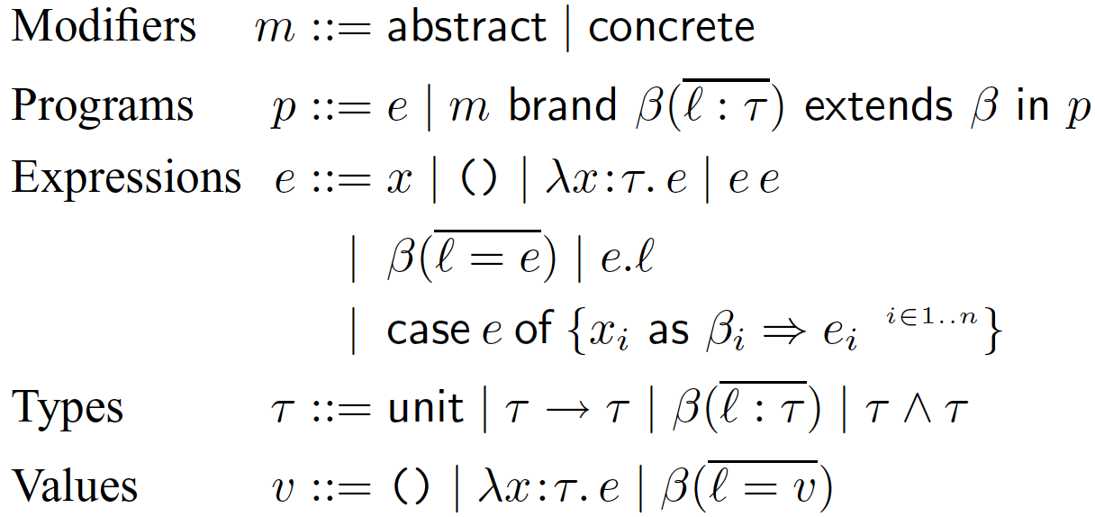
Grammar
Notes:
So here is our strategy: we start with the simply-typed lambda calculus, then add brand definitions and a case construct. in this CORE calculus, the brand definitions all have to be given up front, and the case statement isn’t quite external dispatch, but this is just because we are going to use prior techniques for dealing with this. the goal here is to isolate the fundamental issues before we actually make this a full-fledged language.

Slide 22


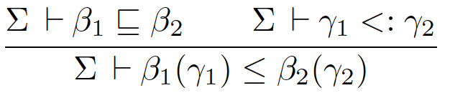
Subtyping
Sub-brand relation reflexive, transitive closure of the “extends” relation
Sub-record relation standard width and depth subtyping on records
Subtyping (·) combines sub-branding and sub-recording
Notes:
so this is how it works formally.

Slide 23

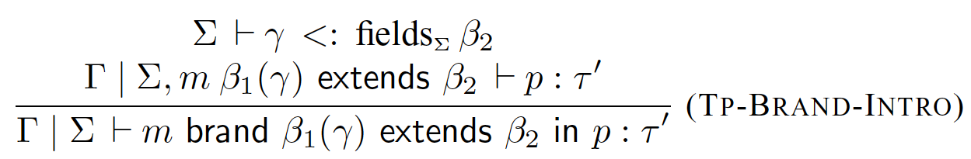

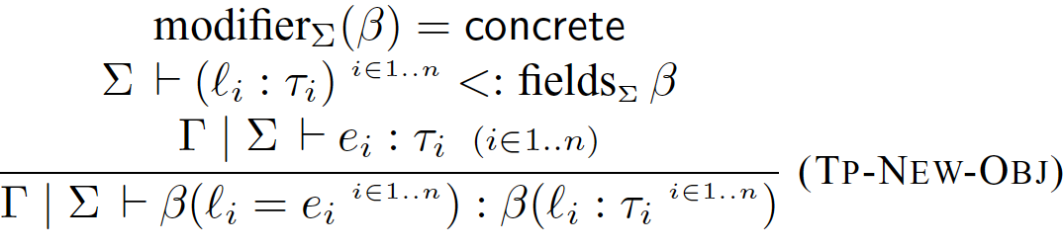
Typing rules
fields_{Σ} ¯ = the minimum fields that ¯ must have (according to Σ)

Slide 24
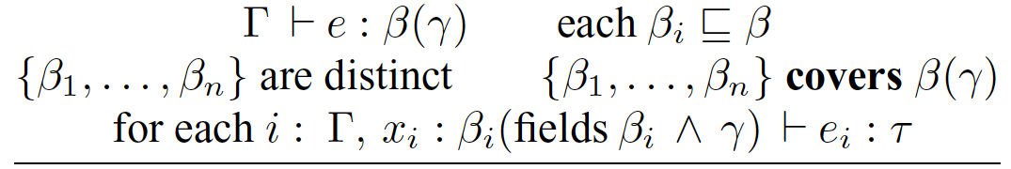
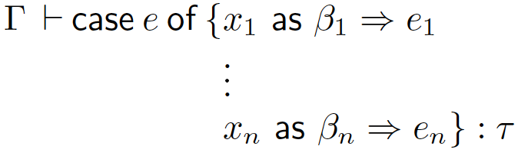
Case typing rule
type of the scrutinee
only meaningful labels
non-redundant
exhaustive

Slide 25
What covers means
abstract Window (title : string)
concrete Textbox (title : string,
currentPos : int)
concrete StaticText (title : string,
text : string)
concrete ScrollingTextbox
(title : string,
currentPos : int,
s : Scrollbar)
{Textbox, StaticText, ScrollingTextbox} covers Window(...)
{Textbox, StaticText} covers Window(...)
{StaticText} covers Window(currentPos : Position)
Position, int disjoint

Slide 26
Case typing rule
Notes:
in each branch, we know that the bound variable x_i has the tag that we just matched against, and so we know that it has the minimum fields associated with that brand. but actually, we can do better---we know we must also have the fields that the scrutinee had originally, that is the fields that are in \gamma.

Slide 27
Why intersection is useful
abstract brand List () extends Top
concrete brand Cons (head: int, tail : List())
extends List
concrete brand Nil () extends List
val n : List(c : Color, length : int)
case n of
cons as Cons => ...
| nil as Nil => ...
cons : Cons(head:int, tail:List(), c:Color, length:int)
Notes:
here’s an example of how this affects how code is actually typechecked.
this is an essential increase in expressiveness, because now we know more about this particular object. this also demonstrates why we chose this particular syntax for the case construct---you give just the brand name; this determines the record fields.

Slide 28

Summary
Unity supports structural and nominal subtyping in a unified type system
Future work:
  extensible brands & external methods
  polymorphism/row polymorphism
Thank you
Notes:
to do: cake

Slide 29
Unity supports structural subtyping
abstract brand AstNode() extends Top
concrete brand PlusNode (n1 : AstNode(), n2 : AstNode()) extends AstNode
concrete brand Num (val : int) extends AstNode
concrete brand Var (s : Symbol) extends AstNode
// highlight the text corresponding to “node” in the text editor
fun highlightNode (node : AstNode(loc : Location)) : unit = ...
val node1 = PlusNode(n1=Num(1), n2=Num(2))
val node2 = PlusNode(n1=Num(3), n2=node1, loc=LINE15)
    PlusNode(n1:Num, n2:Num, loc : Location)
    ≤ PlusNode(n1:Num, n2:Num)
    PlusNode(n1:Num, n2:Num, loc : Location)
    ≤ AstNode(loc : Location)
: PlusNode(n1:Num, n2:Num)
: PlusNode(n1:Num, n2:Num, loc : Location)

Slide 30
Unity supports structural subtyping
abstract brand AstNode ( ) extends Top
concrete brand PlusNode (n1 : AstNode(), n2 : AstNode()) extends AstNode
concrete brand Num (val : int) extends AstNode
concrete brand Var (s : Symbol) extends AstNode
// highlight the text corresponding to “node” in the text editor
fun highlightNode (node : AstNode(loc : Location)) : unit = ...
val node1 = PlusNode(n1 = Num(1), n2 = Num(2))
val node2 = PlusNode(n1=Num(3), n2=node1, loc=LINE15)
: PlusNode(n1:Num, n2:Num)
: PlusNode(n1:Num, n2:PlusNode(...), loc : Location)
highlightNode(node2);
⇦ legal call

Slide 31
Unity supports by-name subtyping
abstract brand AstNode() extends Top
concrete brand PlusNode (n1 : AstNode(), n2 : AstNode()) extends AstNode
concrete brand Num (val : int) extends AstNode
concrete brand Var (s : Symbol) extends AstNode
val n1 = PlusNode(n1 = 5, n2 = 6)
val n2 = PlusNode(n1 = Num(val=1))
⇦ ill-typed
⇦ ill-typed
Notes:
brands define the minimum fields that objects created with that brand must have

Slide 32
Unity supports by-name subtyping
concrete brand DebugPlusNode (n1 : AstNode, n2 : AstNode, loc : Location) extends PlusNode
concrete brand DebugNum ( val : int, loc : Location ) extends Num
concrete brand DebugVar ( s : Symbol, loc : Location, varName : string ) extends Var
// compile code to an output stream; output additional information for Debug* nodes
fun compile ( node : AstNode(), out : OutStream ) : unit =
case node of
| plus as PlusNode => compilePlus(dplus, out);
| num as Num => ...
| var as Var => ...
| dplus as DebugPlusNode =>
compilePlus(dplus, out); outputLocation(out, dplus.loc)
| dnum as DebugNum => ...
| dvar as DebugVar => ...
Notes:
this is how the dispatch works. need to define new brands if you want new behavior, but can use structural subtyping otherwise.

