Slide 1
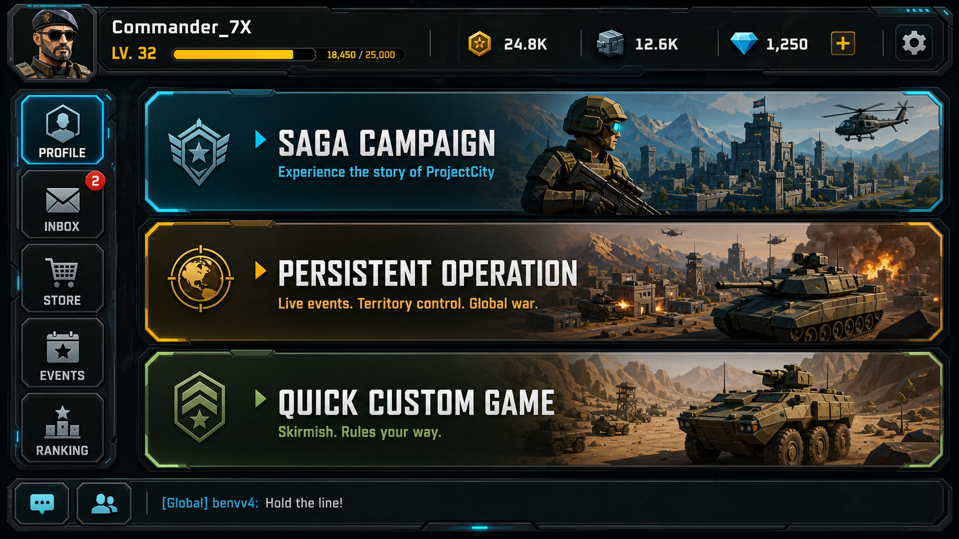

WARLINECAPTURE • AI-NATIVE GAME DEVELOPMENT
AI-Native Game
Development in 2026
From AI-assisted coding to orchestrated, human-approved production pipelines
CASE STUDY: WARLINECAPTURE
CODEX-CENTERED WORKFLOW
UNITY 6 DOTS/ECS
Design docs → Mockups → Assets → Implementation → Tests → Builds → Approval
Prepared from project README/docs, visual targets, and case-study notes
01

Slide 2
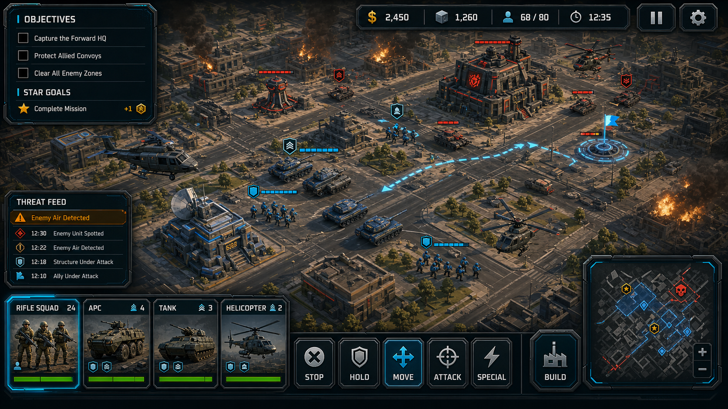
CORE THESIS
The shift is from tools
to production systems
The strategic advantage is not only better prompts or stronger models. It is a governed workflow where AI agents execute roles, validation closes the loop, and humans retain creative authority.
Prompt
→ Output
Human
+ AI assistant
Orchestrated agents
+ approval gates
WarlineCapture shows the 2026 pattern: AI production roles, human approval gates, visual QA, and automated validation.
WarlineCapture case study • AI-native game development • May 2026
02

Slide 3
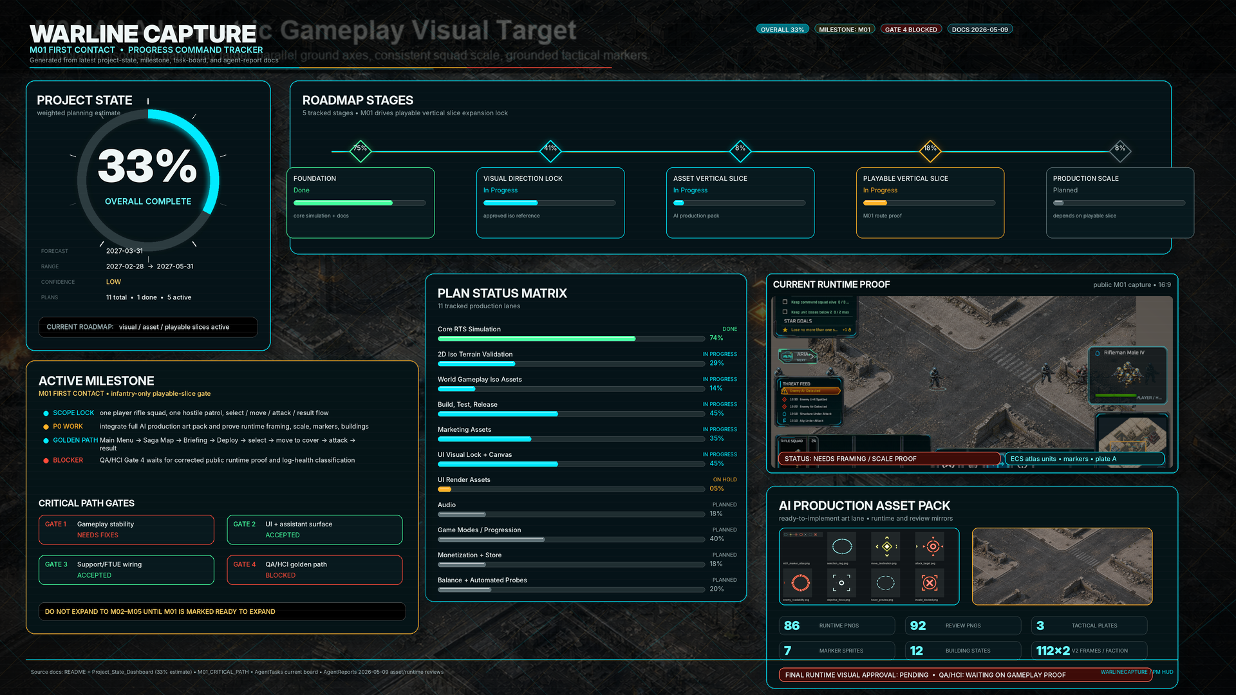
project snapshot
WarlineCapture at a glance
Unity 6 DOTS/ECS mobile-first RTS built around large-scale grid movement, tactical combat, base systems, configurable AI, and three product modes.
Unity 6
6000.4.0f1 editor
33%
current PM estimate
M01
First Contact gate
3 modes
Saga • Operation • Quick
Core simulation already exists
Units, roads, resources, production, AI economy/production/squads/combat, transport, radar warnings, minimap, runtime stats, Android build support.
GENERATED PROGRESS TRACKER
Product direction
Wrap the simulation in a polished mobile RTS structure: missions, objective/results, rewards, progression, persistence, and district consequences.
Source: WarlineCapture README and generated dashboard
03

Slide 4
positioning
Why this case study matters
The project is stronger than a normal “AI made a game” demo because it models the entire production chain.
Common AI demo
Prompt → Code → Demo
WarlineCapture workflow
Direction → Docs → Mockups → Assets → Code → Tests → Visual QA → Build → Approval
• Human direction becomes structured design and acceptance criteria. • Mockups become production targets and real Unity Canvas assets. • Codex executes engineering work inside architecture and validation gates. • AI can visually compare mockups with in-game captures and iterate honestly. • PM reports progress, blockers, and human-decision points automatically.
Core contribution: an AI-orchestrated game production framework, not only an AI-assisted coding session.
WarlineCapture case study • AI-native game development • May 2026
04

Slide 5
system architecture
Operating model: human-directed AI studio
Human Director
Vision • architecture • testing criteria • approval gates
PM Agent
milestones • blockers • dispatch • reports • metrics
Designer
Artist / UI
Developer / Codex
QA / HCI
Analytics / PI
Build
GDDs • specs
product coherence
mockups • assets
visual locks
Unity systems
refactors • fixes
tests • captures
visual compare
funnels • telemetry
DAU/MAU insights
CI • builds
logs • packaging
Replaceable agents: any lane can be handled by Codex, Claude Code, another AI agent, or a human specialist.
WarlineCapture case study • AI-native game development • May 2026
05

Slide 6
warlinecapture pipeline
End-to-end workflow: idea to milestone
01
Human creative direction
02
Game design docs
03
UI/gameplay mockups
04
Game-usable assets
05
Codex implementation
06
Validation loop
07
Milestone approval
concept • architecture • acceptance criteria
high-level GDD → detailed implementation specs
visual targets for screens and gameplay states
sprites • panels • icons • layers • prefabs
Unity systems • UI route wiring • fixes
code tests • Play Mode • captures • QA reports
visuals, mockups, Unity behavior, build results
PM Agent operating layer: source-of-truth docs, task board, lane ownership, reports, blocker escalation, next-task dispatch
The process is automated, but it remains human-approved at visual, gameplay, testing, and milestone gates.
WarlineCapture case study • AI-native game development • May 2026
06

Slide 7
workflow doc summary
Agent coordination workflow: the operating layer
The coordination workflow keeps docs, repository state, active agents, validation, reports, and PM decisions synchronized. It does not replace design docs; it makes them operational.
Source of truth
Project state JSON, generated dashboard, README/design index, task board, asset register
Lane ownership
Each lane owns a concrete area and must coordinate contract changes with dependent lanes
Completion reports
Every agent reports files changed, contracts touched, validation run/result, gaps, impacts, next task
Validation close-out
Tests, captures, build logs, and blocked/failed commands must be reported before new work starts
Blocker escalation
Waiting/blocking requires exact owner, file/report/asset/command, and fallback-work decision
Accepted progress requires repo files, named reports, validation evidence, and cross-lane ownership — not just “I finished.”
Source: WarlineCapture_Agent_Coordination_Workflow.md
07

Slide 8
responsibilities
Role of each agent lane
Lane
Owns
PM assistant
Intake, sync review, validation gate, priority ordering, progress tracking
Designer
Product coherence, design-index clarity, terminology, documentation pruning, design review
Gameplay / Codex
ECS systems, mission runtime, objectives, rewards, persistence, tactical map rendering
UI agent
Canvas screens, route wiring, tactical HUD, visual-lock implementation, UI tests
Art / Atlas
Sprite atlases, unit/building/VFX coverage, approval packages, readability references
QA / HCI
Public gameplay evidence, readability mode validation, capture comparison, acceptance checks
Build agent
Jenkins/builds, build-log inspection, failure-summary reports, CI handoff
Analytics / FTUE
FTUE funnels, tracking coverage, cohorts, A/B tests, telemetry review, design recommendations
Lane contracts make the system model-agnostic: swap an AI agent for another model or a human without changing the workflow.
Source: WarlineCapture_Agent_Coordination_Workflow.md
08

Slide 9
engineering discipline
Code architecture direction: preventing AI drift
Without direction, AI agents can produce inconsistent architecture: duplicated logic, scene-wide searches, public serialized fields, hard-coded values, and unclear ownership.
Architecture contract
Validation enforcement
• ECS-first gameplay; Canvas UI is the main non-ECS exception. • GameBootstrap owns runtime systems; new systems are plain classes unless ECS authoring is required. • Explicit Init(...) / BindDependencies(...) and typed provider APIs replace global lookups. • ScriptableObject configs hold tunables; scene/subscene authorings stay thin and config-driven. • Comments and completion reports explain intent, contracts touched, validation, and known gaps.
• Reject Object.Find*, GameObject.Find, Camera.main, Transform.Find path traversal, and broad scene-search patterns. • Run EditMode tests, Play Mode smoke tests, visual captures, and build checks after meaningful changes. • Treat missing validation, visual drift, and stale reports as blockers, not polish. • Only accepted reports, captures/tests, or explicit user approval update progress.
Clean architecture becomes enforceable when design rules are converted into tests and validation gates.
Sources: README architecture/runtime/performance/testing rules
09

Slide 10
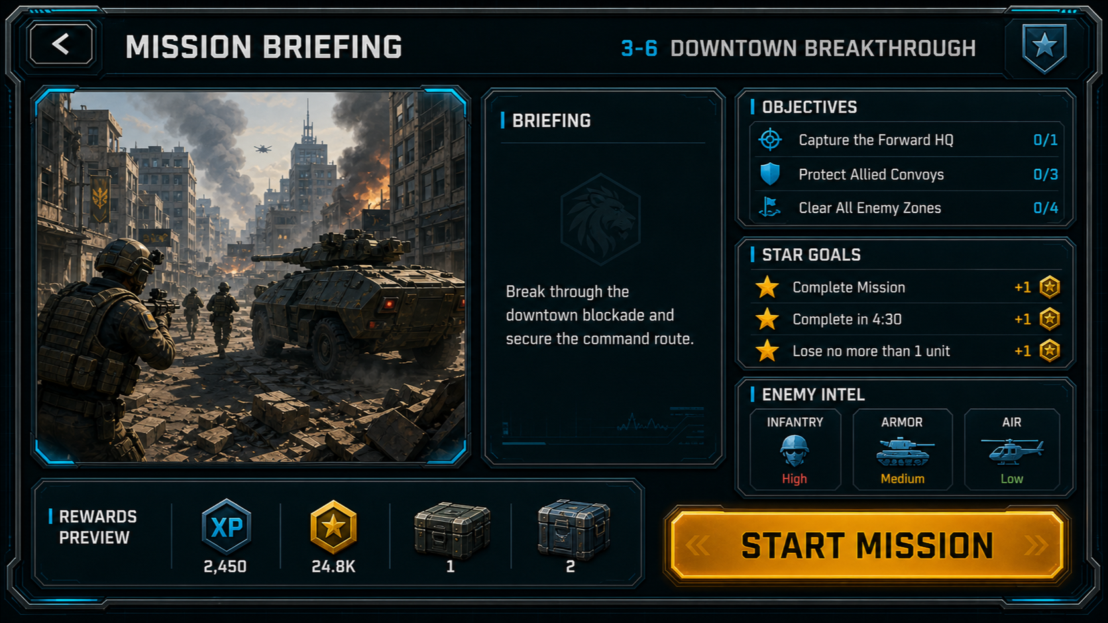
from ideas to specs
Design-first automation
Your high-level ideas become structured documents before implementation starts. This makes Codex execution easier to steer and easier to validate.
Human ideas
High-level GDD
Detailed specs
MISSION BRIEFING VISUAL TARGET
Acceptance + testing criteria
• Design index organizes product direction, visual locks, art, audio, monetization, marketing, and update rules. • M01 First Contact is the active playable-slice gate. • The PM-controlled task board routes each lane through current tasks, reports, and blockers.
Sources: Design/README.md and README.md
10

Slide 11
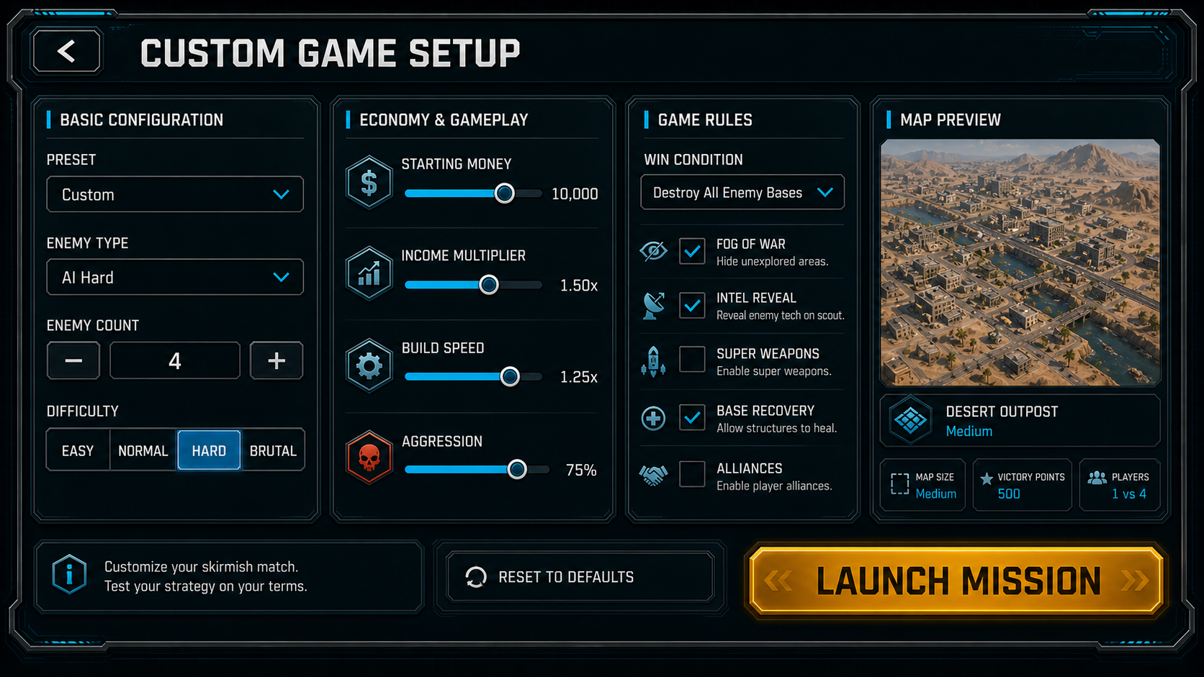
visual targets
WarlineCapture visual language
MAIN MENU
QUICK CUSTOM
BATTLE HUD
DARK GRAPHITE HUD PANELS
CYAN EDGE HIGHLIGHTS
GOLD CTA / PROGRESSION ACCENTS
MOBILE-READABLE MILITARY UI
PREMIUM 2D ISOMETRIC CONTEXT ART
The presentation now uses the same dark tactical HUD palette, cyan trims, amber CTAs, and visual-target screenshots.
Sources: VisualLock targets in the WarlineCapture repository
11

Slide 12
target-to-canvas workflow
Mockups become production targets
Layer pack
frames • icons • text
Real Unity
Canvas hierarchy
Runtime route
+ data wiring
APPROVED VISUAL TARGET
Core rule: the mockup is a comparison target, not the final shipped UI. Production screens must be decomposed into real responsive layout, panels, sprites, icons, TMP text, controls, states, and safe-area behavior.
Work proceeds screen-by-screen: target → canvas → route/runtime → capture comparison → tests → optimization.
Source: WarlineCapture_UIUX_Mockup_To_Canvas_Conversion_Plan.md
12

Slide 13
human-like inspection
Visual QA loop: mockup vs in-game result
AI visual
comparison
APPROVED TARGET
RUNTIME PROOF / CAPTURE CONTEXT
Mismatch report
+ targeted fixes
• AI evaluates layout, spacing, scale, color direction, readability, and style consistency. • It gives an honest opinion instead of only claiming completion. • Developer/UI/Artist lanes iterate until the Unity result matches the approved target. • Human approval remains the final authority for visuals and milestone completion.
WarlineCapture case study • AI-native game development • May 2026
13

Slide 14
engineering engine
Development loop: implement, test, validate
Spec
selected
Codex
implements
Code tests
logic + regressions
Unity Play Mode
runtime behavior
Visual capture
mockup comparison
QA report
pass / fail / blocked
Build
artifact
Code tests
unit behavior • data sanity • integration • regressions
Unity Play Mode tests
scene interaction • UI behavior • runtime errors • player-facing flow
Two-level testing
For games, code correctness is not enough: the engine must run, the scene must behave, and the result must match the target.
WarlineCapture case study • AI-native game development • May 2026
14

Slide 15
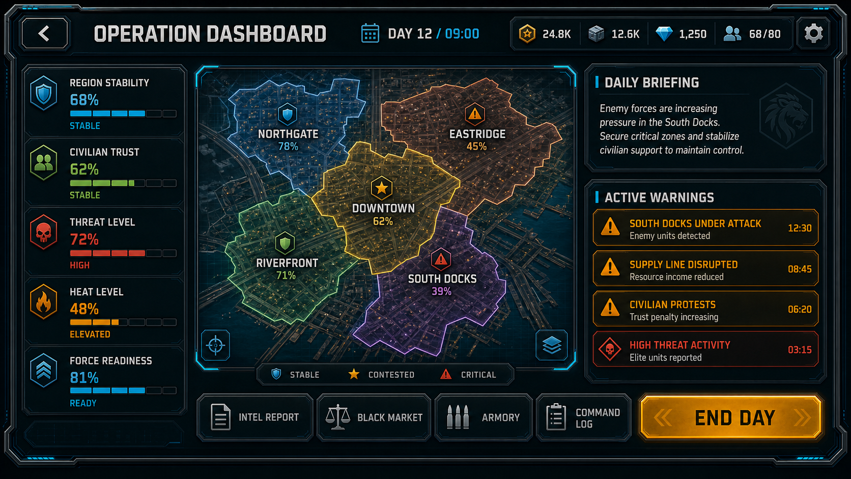
tool fit
Codex as the engineering execution layer
In this project, Codex functioned as the primary engineering execution agent — not just a coding assistant.
CODEX
• Solved Unity-running issues quickly in this project context. • Created/explained visuals and described what it was doing. • Worked smoothly through repo-driven, milestone-driven tasks. • Performed best when architecture rules, tests, and reports were explicit.
OPERATION DASHBOARD CONTEXT
Operational value
Repository access + command execution + Unity troubleshooting + testing + reporting + iteration.
Codex was strongest when used as a supervised execution engine inside a governed workflow.
Sources: project case notes + OpenAI Codex product information
15

Slide 16
Claude Code • Unity AI • Codex
Field report: agent fit matters
A powerful model is not automatically a production-ready game-development agent. The bottleneck is operational fit: files, Unity execution, context endurance, honesty, permissions, and smooth handoffs.
Dimension
Observed lesson from this project
Claude Code
Understood the process, but struggled with Unity execution, token/context limits, beta desktop friction, and model switching constraints.
Delivery reliability
A production agent must be honest when it cannot access files or complete the work.
Unity AI
Promising Unity-native direction, but not yet ideal for governed multi-agent automation; uncontrolled edits conflict with approval gates.
Codex
Better operational fit here: resolved Unity running, explained actions, and worked more smoothly through milestones.
Takeaway
Benchmark intelligence is not enough; evaluate agents by production behavior.
Frame this as a production-fit comparison, not tool-bashing: the goal is reliable orchestration.
WarlineCapture case study • AI-native game development • May 2026
16

Slide 17
2026 landscape
Latest AI tools & models: organize by role
Coding agents / IDEs
Codex • Google Antigravity • Claude Code • GitHub Copilot cloud agent • Cursor
Unity-native tooling
Unity AI Assistant • Unity AI Gateway • Unity MCP Server • Sentis
Frontier multimodal models
GPT-family • Claude/Opus • Gemini models
Visual + video generation
Sora • Veo • Runway • Midjourney • Firefly
Orchestration + validation
MCP • Agent SDKs • CI/CD • Play Mode tests • visual comparison
Project memory + governance
task boards • reports • source of truth • approval gates
Do not present tools as a ranked list. Present them as replaceable capabilities inside a governed pipeline.
Sources: OpenAI, Anthropic, GitHub Docs, Unity AI
17

Slide 18
control layer
Governance: autonomous execution under human authority
Human authority layer
vision • product direction • code architecture • testing criteria • visuals • milestone acceptance
Design
approval
Visual target
approval
Architecture
constraints
Unity test
acceptance
Milestone
sign-off
Agent execution layer
Design • Art • Development • QA • Build • PM tracking
• Agents can work autonomously inside boundaries, but approval gates prevent uncontrolled drift. • Reports and captures create traceability for human review. • Blockers are escalated when the next action needs a human decision or unavailable tool access.
WarlineCapture case study • AI-native game development • May 2026
18

Slide 19
ANALYTICS AGENT
Analytics Agent: instrument before launch
AI can audit the GDD, Unity scenes, UI flows, and gameplay code to propose a tracking plan — then wait for approval before Codex touches code.
Analytics Agent
Inputs reviewed
Creates a tracking contract: • event schema • required properties • trigger map in code • funnels and cohorts • dashboard questions • test coverage plan
Outputs delivered
• Game design docs • Unity scenes + prefabs • UI screens and buttons • Gameplay state changes • Economy / rewards • Tutorial and failure states
• Tracking plan for PM approval • Codex implementation tasks • QA analytics checks • BigQuery / Firebase / Mixpanel dashboard needs • Data-quality acceptance criteria
Plan
Approve
Implement
Validate
Dashboard
Analytics instrumentation becomes part of the production pipeline — not an afterthought.
WarlineCapture case study • AI-native game development • May 2026
19

Slide 20
UNITY ANALYTICS INSTRUMENTATION
AI decides where tracking belongs — then proves it
The agent should not randomly inject analytics calls. It proposes trigger points, event names, properties, and validation tests as a reviewable contract.
Unity trigger map
Event contract
Guardrails
UI action
button click • screen enter
• PM approves schema before code changes • Privacy / consent rules checked • No missing or duplicate events • Required properties validated • Test fails if event coverage breaks • Dashboards show data-quality warnings
mission_started mission_abandoned tutorial_step_completed unit_deployed reward_claimed
Tutorial gate
step start / complete / fail
Mission state
start • win • abandon • retry
Economy event
reward • spend • unlock
Required properties: mission_id, step_id, player_level, attempt_no, build_version, session_id
Gameplay signal
unit deploy • objective captured
Codex can add the tracking calls, but the analytics contract, privacy boundary, and acceptance tests stay human-reviewable.
WarlineCapture case study • AI-native game development • May 2026
20

Slide 21
PRODUCT INTELLIGENCE LOOP
From telemetry to design fixes
Analytics Agent reads Mixpanel, Firebase, BigQuery, playtest notes, and build telemetry; then turns player behavior into hypotheses, experiments, and implementation tasks.
Mixpanel
Firebase
BigQuery
Playtest notes
Analytics Agent
Detect issue
Explain
Propose fix
Implement
Measure
drop-off • churn friction • failure
cohort + funnel hypothesis
design task A/B candidate
Designer + Codex QA validates
retention + completion impact report
Example
Mission-2 drop-off detected → simplify objective, add guided UI hint, reduce first enemy wave pressure, ship A/B test, measure mission completion + D1 retention.
The PM agent receives the insight, risk, proposed experiment, owner agents, and success metric before work starts.
WarlineCapture case study • AI-native game development • May 2026
21

Slide 22
MATURE PROJECTS
Existing projects: AI as recovery layer
When a large Unity project has release candidates but weak DAU/MAU, AI shifts from creation to diagnosis, stabilization, and measured iteration.
1. Audit what exists
2. Diagnose the break
3. Intervene safely
• RC builds + change history
• Unity code architecture
• analytics coverage gaps
• crash / performance logs
• playtest notes and reviews
• onboarding and tutorial drop
• difficulty spikes
• unclear UI / goals
• economy bottlenecks
• churn after screens, missions, rewards
• small reversible changes
• approved tracking additions
• scoped Codex PRs
• Play Mode + regression tests
• A/B or soft-launch validation
For late-stage games, AI should start as an auditor — not as an uncontrolled rewriter.
WarlineCapture case study • AI-native game development • May 2026
22

Slide 23
RECOVERY LOOP
RC → DAU/MAU recovery loop
For mature projects, the workflow becomes evidence-led: diagnose the metric gap, ship small reversible fixes, and re-measure before scaling.
1. Evidence intake
2. AI diagnosis
3. Controlled experiment
• RC build history
• Mixpanel / Firebase / BigQuery
• crash + performance logs
• playtest notes and reviews
• existing event coverage
• find broken funnels
• detect missing tracking
• identify likely causes
• rank impact / risk / effort
• propose success metrics
• scoped Codex PR
• analytics validation tests
• Play Mode regression checks
• A/B or soft-launch variant
• post-change metric review
Repeat loop: measure → learn → prioritize → ship → re-measure. Every fix must be testable, reversible, and tied to a target metric.
WarlineCapture case study • AI-native game development • May 2026
23

Slide 24
SYNTHETIC PLAYTESTING
AI playtester agents before real playtests
Agents can simulate different player groups in Unity, produce pre-release telemetry, and expose obvious UX problems before real users arrive.
new player
impatient
strategy expert
spender / non-spender
low-end device
confused UI
completionist
How to make / train them
What they generate
• Define cohorts and play styles
• Condition agents with GDD, controls, goals, tutorial rules, telemetry schema
• Run scripted + exploratory Unity sessions
• Log action traces, screenshots, failures, confusion, and timing
• pre-release funnel data
• tutorial step friction
• failure and abandon points
• heatmaps / action traces
• bug repro steps
• design recommendations for PM + Designer
Personas → Unity play sessions → events to Firebase / Mixpanel / BigQuery → Analytics Agent → design fixes
Synthetic agents do not replace real users — they reduce noise and improve the first real playtest.
WarlineCapture case study • AI-native game development • May 2026
24

Slide 25
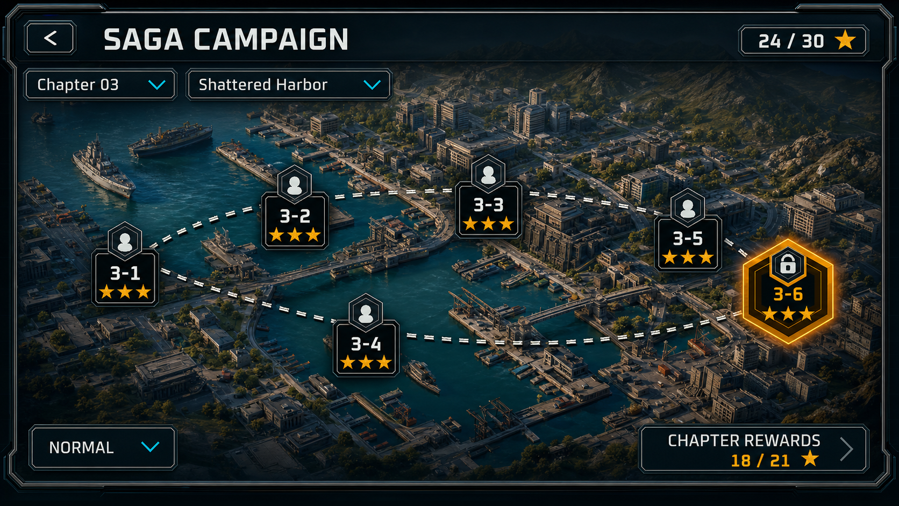
ENTERPRISE SCALE
From one-account workflow to enterprise AI studio
WarlineCapture is the smallest working unit of a scalable, role-based AI production model.
PERSONAL ACCOUNT PIPELINE
ENTERPRISE STUDIO PATTERN
Human Director
Game Director + Leads
vision • architecture • approvals
same orchestration pattern more owners + scoped permissions
creative authority • discipline ownership
PM Agent
PM Orchestration Agent
milestones • blockers • source-of-truth sync
dependencies • blockers • reports • approvals
Codex + Agents
Department Workspaces
design • art • dev • QA • build loop
artist agents • Codex agents • QA/build agents
Enterprise scaling principle: every person supervises a scoped agent workspace; lead agents consolidate work and report to the PM orchestration layer.
WarlineCapture case study • AI-native game development • May 2026
25

Slide 26
ENTERPRISE AGENT HIERARCHY
Lead agents coordinate supervised sub-agent teams
Enterprise AI collaboration is not one giant agent; it is a managed hierarchy of replaceable agents.
Executive Producer / Game Director
vision • budget • product goals • final authority
PM Orchestration Agent
milestone state • dependencies • blockers • approvals • reports
Art Lead Agent
Design Lead Agent
Engineering Lead
QA / Build Lead
Mockup agent
GDD agent
Codex gameplay
Play Mode tests
Asset generator
Mechanics
Codex UI
Visual comparison
Style QA
Economy / balance
Architecture validator
Regression
Icon / VFX
Level design
Test generator
Build / release
Example: an artist can run mockup, asset, and style-QA agents; those sub-agents report to the Art Lead Agent, which reports to PM.
WarlineCapture case study • AI-native game development • May 2026
26

Slide 27
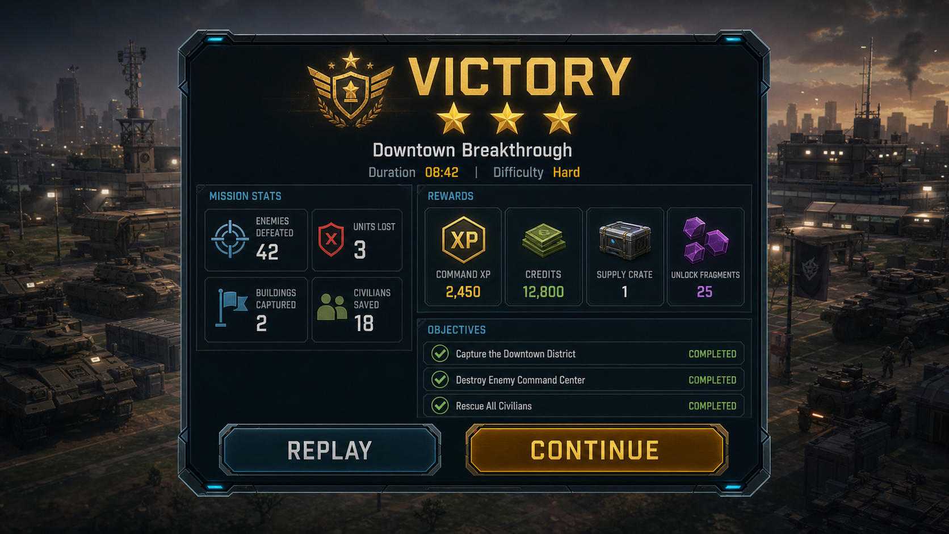
CLOUD COLLABORATION
Scoped agent workspaces, shared source of truth
Team members manage their own agents and Codex tasks, while the project keeps one governed state.
HUMAN OWNERS
CLOUD AGENT WORKSPACES
LEAD AGENTS → PM
Artist
mockups • assets style QA
Art Lead Agent
PM Orchestration Agent
milestones • dependencies approval requests
Designer
GDD • mechanics balance checks
Design Lead Agent
Engineer
Codex feature work refactor • review
Engineering Lead
Shared Source of Truth
repo + branches design docs asset library tests + builds
QA / Build
tests • captures release logs
QA Lead Agent
Governance guardrails
role-based permissions • branch/PR boundaries • approval gates • audit reports • rollback paths • replaceable models
Enterprise readiness = ownership + permissions + review + accountability + escalation.
WarlineCapture case study • AI-native game development • May 2026
27

Slide 28
recommendations
What to measure next: production, product + AI cost
Cycle time
idea → approved mockup → Unity result
Visual match quality
AI visual score + human rating
Validation rate
tests passed / failed / blocked
Agent reliability
honest reports, access failures, retries
Analytics coverage
event schema, funnels, missing triggers
Player funnel health
tutorial drop, D1/D7, mission abandon
Synthetic playtest coverage
AI billing / token usage
personas • sessions • pre-release friction
credits • tokens • billable runs • cost per approved milestone
Measure both the AI production system and the player experience it creates.
WarlineCapture case study • AI-native game development • May 2026
28

Slide 29
FUTURE
Where this points: the autonomous indie studio
One human director
Replaceable AI / human agents
Automated validation + builds
• Small teams can manage larger scopes by directing systems instead of manually touching every task. • Creative control shifts upward: vision, constraints, taste, architecture, and governance. • AI-native studios need better APIs for Unity execution, screenshots, Play Mode validation, and approvals. • The studio becomes an orchestration system.
Final thesis: AI will not replace game developers. It will replace fragmented workflows.
WarlineCapture case study • AI-native game development • May 2026
29

Slide 30
CLOSING
WarlineCapture is not just a game project.
It is a working example of a governed, Codex-centered, AI-orchestrated production pipeline.
Human vision → AI agents → validation → visual QA → builds → approval
WarlineCapture case study • AI-native game development • May 2026
30

Slide 31
appendix
Sources & project references
Project sources
External tool references
• WarlineCapture README — project setup, status, architecture, testing, UI/UX roadmap • Design/README.md — design index, visual direction, source-of-truth hierarchy • WarlineCapture_Agent_Coordination_Workflow.md — lanes, handoffs, reports, blockers • WarlineCapture_UIUX_Mockup_To_Canvas_Conversion_Plan.md — target-to-canvas rules • WarlineCapture_UIUX_MainMenu_Visual_Contract.md — Main Menu target and acceptance • VisualLock targets — Main Menu, Quick Custom, Battle HUD, Saga Map, Mission Briefing, Operation Dashboard, Mission Result
• OpenAI — Introducing Codex / Codex product page • Anthropic — Claude Code product page • GitHub Docs — Copilot cloud agent • Unity — Unity AI Beta, AI Gateway, MCP Server, Sentis • Case-study notes from this chat: Codex, Claude Code, Unity AI, mockup visual QA, approval gates • Analytics stack concepts — Mixpanel, Firebase, BigQuery, playtest funnels, and data-quality validation
• Case-study notes from this chat: mature-project recovery, analytics agent, synthetic playtester agents, AI cost telemetry
Repository: github.com/farhad2na2/WarlineCapture
WarlineCapture case study • AI-native game development • May 2026
31

