Slide 1

How Certain is Your Transformer?
CSE431 - NLP Summer 2022 Group 01

Slide 2
Group 05 - Members
Md Farhadul Islam
ID: 22341042
Dept. of CSE
Fardin Bin Rahman
ID: 20101592
Dept. of CSE

Slide 3
Paper Details:
Paper Title: How Certain is Your Transformer?
Authors: Artem Shelmanov, Evgenii Tsymbalov, Dmitri Puzyrev, Kirill Fedyanin, Alexander Panchenko, Maxim Panov
Publication Type: Conference Paper - In Proceedings of the 16th Conference of the European Chapter of the Association for Computational Linguistics
Date Published: April 2021

Slide 4
Abstract
Considers the problem of Uncertainty of Transformer based models
They investigate the applicability of uncertainty estimates based on dropout usage at the inference stage (aka Monte Carlo Dropout)
Conducted many experiments on NLP tasks and resulting uncertainty estimates improve the quality of detection of error-prone samples.
Special attention is paid to the construction of computationally inexpensive estimates via MCD and Determinantal Point Processes.

Slide 5
Introduction
Calculation of uncertainty in machine learning
Obtaining measures of uncertainty in predictions
NLU methods take advantage of deep pre-trained models
Obtaining reliable uncertainty estimations
Investigating various MC dropout based approaches
Use of MC dropout with pre-trained Transformer models
Applying modification to the MC dropout based on determinantal point processes

Slide 6
Related Work
Three dominating approaches to uncertainty estimation in neural networks
recent works that investigate uncertainty quantification
Bayesian UEs for the analysis of semantic parser predictions
Zhang et al. (2019) propose an additional training loss component
Experiments with convolutional NNs on text classification datasets
Xiao and Wang (2019) use NNs to parameterize a probability distribution
For quantifying model uncertainty, the authors leverage the MC dropout

Slide 7

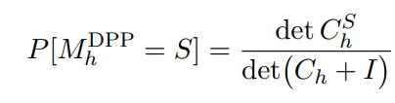
Uncertainty Estimation of Deep Transformer Neural Networks - Types of Dropout
Monte Carlo Dropout:
Monte Carlo Dropout with Determinantal Point Processes:

Slide 8



Uncertainty Estimation of Deep Transformer Neural Networks - Uncertainty Estimates
Sampled maximum probability:
Probability variance averaged over classes:
Bayesian Active Learning by Disagreement (BALD) proposed by Houlsby et al. (2011) describes the mutual information between outputs and model parameters:

Slide 9
Uncertainty Estimation of Deep Transformer Neural Networks - Classification Models
ELECTRA (Clark et al., 2020)
- A recent successor to BERT (Devlin et al., 2019).
- Based on the same Transformer architecture but takes advantage of the harder “replaced token detection” objective instead of the “masked language model” objective.
- Gives better pre-training capabilities.
- ELECTRA is regularized with multiple dropout layers, which facilitates the usage of the MC dropout. For example, the body of the “ELECTRA-base” model has 37 dropout layers.
DistilBERT (Sanh et al., 2019)
- Smaller Transformer obtained from the middle-size BERT (Devlin et al., 2019) ) via a distillation procedure (Hinton et al., 2015).
- Provides the faster inference and has smaller memory requirements but retains 97% of the language understanding capabilities of the original model according to Sanh et al. (2019).

Slide 10
Experiments - Experimental Setup
Calculate the ROC AUC score using the new ground truth labels and UEs and use this score as the main evaluation metric.
The baseline in this task is the UE calculated based on the maximal probability of the original deterministic model. They compare it to the estimates obtained using multiple stochastic predictions with activated dropout layers.
Three variants of estimates are calculated: 1) based on the model, in which MC dropout is applied to all dropout layers; 2) based on the model with the MC dropout applied only to the last layer; 3) based on the model with the DPP-based sampling applied to the last dropout layer. For calculating these UEs, they conduct 20 stochastic predictions.
For calculating UEs, the dropout rate for the MC dropout is 0.1.
For SST-2, The dropout rate for the MC dropout is 0.7. For MRPC, the “dropout rate” equal to 0.2 and for CoLA: 0.4. For DistilBERT, the “dropout rate” of 0.4 in all tasks

Slide 11
Experiments - Dataset
GLUE (Wang et al. (2018))
To evaluate UEs and dropout variants
Stanford Sentiment Treebank (SST-2; Socher et al. (2013))
The SST-2 task is to predict the sentiment of a given sentence (positive/ negative). The SST-2 dataset was randomly subsampled to 2% of the original size to emulate the situation with a small amount of training data.
Corpus of Linguistic Acceptability (CoLA; Warstadt et al. (2019))
The CoLA task is to determine whether the given sentence is grammatical or not.
Microsoft Research Paraphrase Corpus (MRPC; Dolan and Brockett (2005))
The MRPC task is to predict whether two given sentences are semantically similar or not.

Slide 12
Experiments - Model and Training Details
ELECTRAbase model with 110 million parameters
DistilBERT model with 66 million parameters obtained from the middle-size BERT.
The implementation of the models is provided by the Huggingface Transformers library (Wolf et al., 2020).
They follow the approach described by Clark et al. (2020) and Devlin et al. (2019): train for 4 epochs with 10% warm-up and a linear learning rate scheduler.
For all models and tasks, they use the same learning rate equal to 5 × 10 ^ - 5.
For ELECTRA and SST-2 and MRPC tasks, the batch size is 16. For ELECTRA and CoLA, the batch size is 32. For DistilBERT, the batch size is 32 for all tasks.

Slide 13
Experiments - Result & Discussion
The difference in the misclassification detection performance is statistically significant. Therefore, authors present the absolute values of the performance only for the baseline, while for other methods, they present the improvement over the baseline across multiple runs.
Applying the MC dropout to all dropout layers in the network always gives a reliable boost in the misclassification detection. The biggest improvement can be achieved for MRPC and ELECTRA: up to 7.5% ROC AUC.
On the contrary, the UEs based on the MC dropout applied only to the last layer do not perform well.
UEs that take advantage of the DPP-based masks applied to the last dropout layer are somewhere in the middle in terms of quality compared to the MC dropout variants.
Despite the fact that the DPP-based approach appears to be worse than applying the MC dropout on all layers, it is much faster since it is applied to only the last dropout layer.

Slide 14
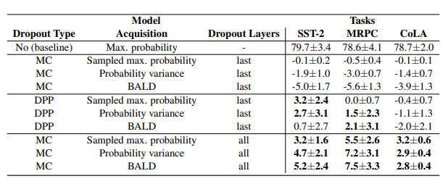
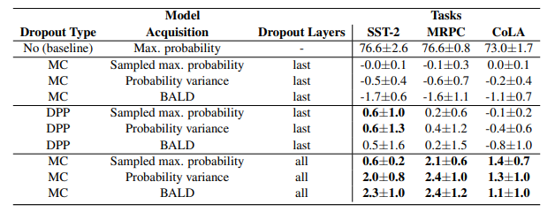
Experiments - Result & Discussion
ELECTRA
DistilBERT

Slide 15
Where can they improve - Our Review
There are more Transformer models, authors could have added them to show how the performance and uncertainty varies from a transformer variant to another.
The study focused on classification based tasks only, they could have added text-generation based task.

Slide 16
Conclusion
They show that by activating all dropouts in the model for stochastic predictions, one can beat the baseline deterministic uncertainty estimate by the significant margin in the binary misclassification detection task.
They also demonstrate that replacing the last dropout layer with the DPP dropout can make significant improvements, but less than the usage of the MC dropout on all dropout layers. Despite being inferior compared to the latter, the DPP dropout can provide a better trade-off between computation time and performance of error detection, which can be important for practical use cases.

Slide 17
Future Work
In future work, we are seeking to improve UEs quality obtained using the DPP dropout with the help of calibration (Safavi et al., 2020) and conduct experiments on sequence tagging tasks.

