Slide 1
Analyzing Mental Health Data
Farhad de Sousa
Math 550, Fall 2022

Slide 2
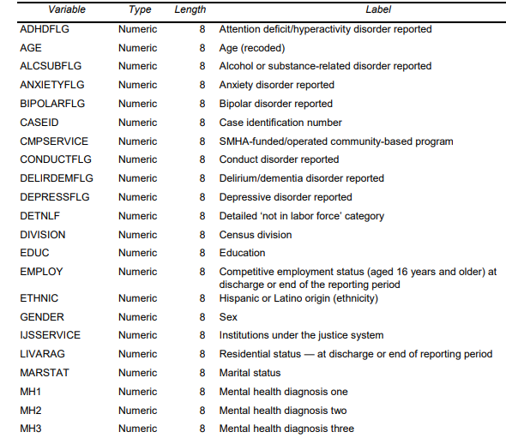
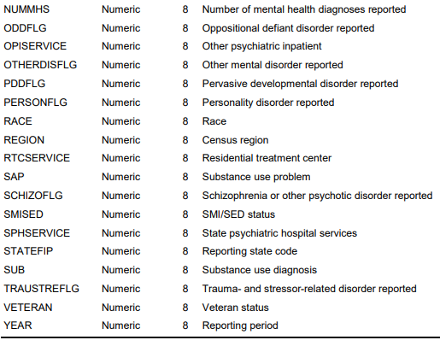
Data Set
Data collected for 2019 by the Substance Abuse and Mental Health Data Archive (SAMHDA); 6,362,044 data points, 40 features

Slide 3
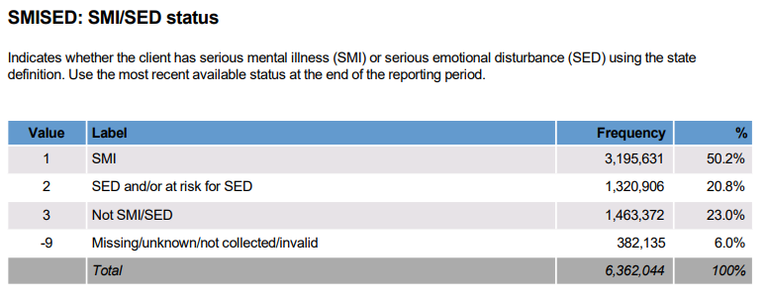
Goal of Analysis
Predict whether a new incoming patient is likely to be classified as Seriously Mentally Ill (SMI) or Seriously Emotionally Disturbed (SED)
SMI and SED status used to determine access to treatment, amount of financial aid, etc.

Slide 4
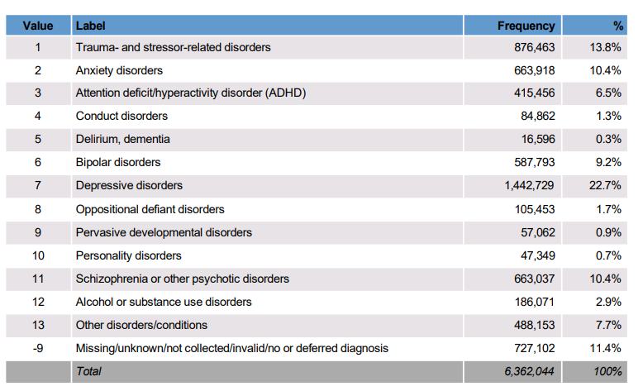
Other Possible Goals
Connections between substance use, homelessness, education, and the various types of disorders below (focus on inference, not prediction)
MH1:

Slide 5
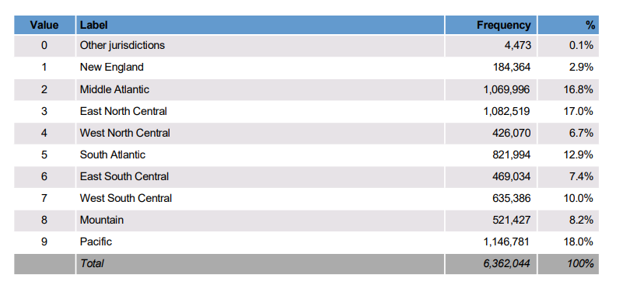
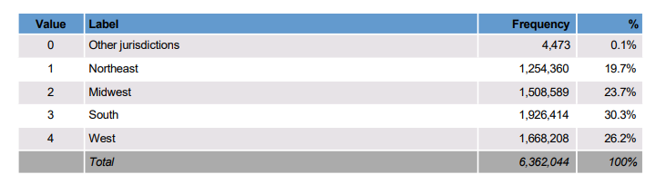
Other Possible Goals
How are different disorders distributed across different regions of the country (or by individual states)?
Division:
Region:

Slide 6
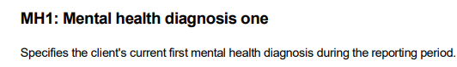


Other Possible Goals
Look at change in diagnosis based on treatments received

Slide 7
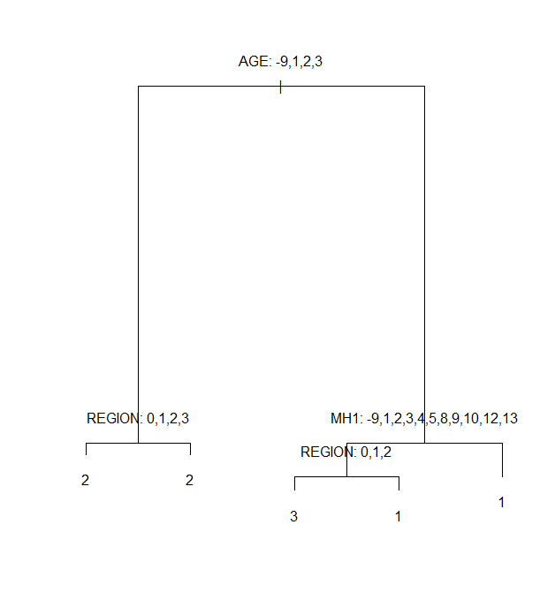
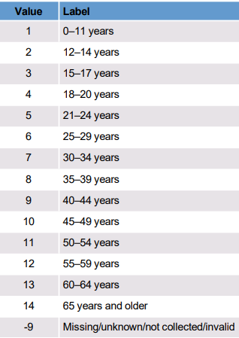
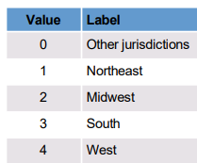
Method I: Simple Classification Tree
Age:
MH1:
Region:
Unexpectedly small tree!

Slide 8
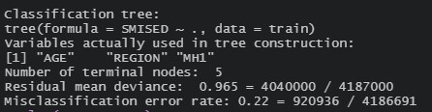
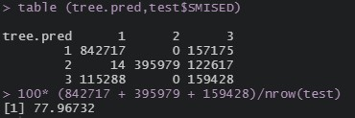
Method I: Classification Tree
Training Accuracy: 78%
Only three variables used for classification
Testing Accuracy: 77.96%
Lots of non-seriously ill people classified as SMI or SED

Slide 9

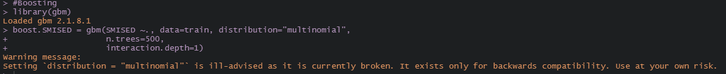
Ensemble Methods
Random Forest:
Boosting: Tried with Stumps. Ran for 30 mins, R terminated because multiclass classification with boosting is currently not fully functioning for some reason

Slide 10
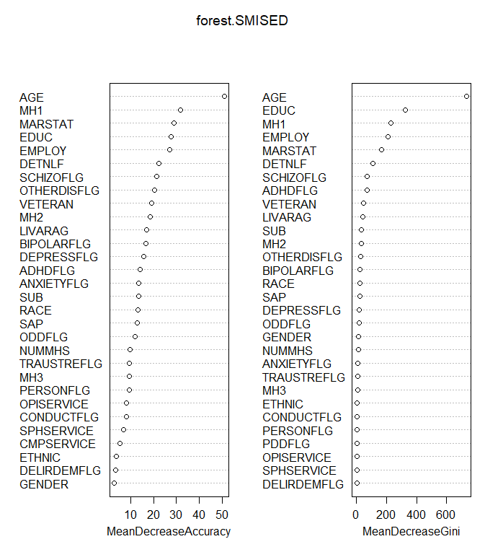
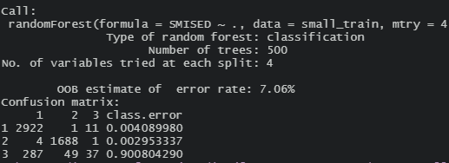
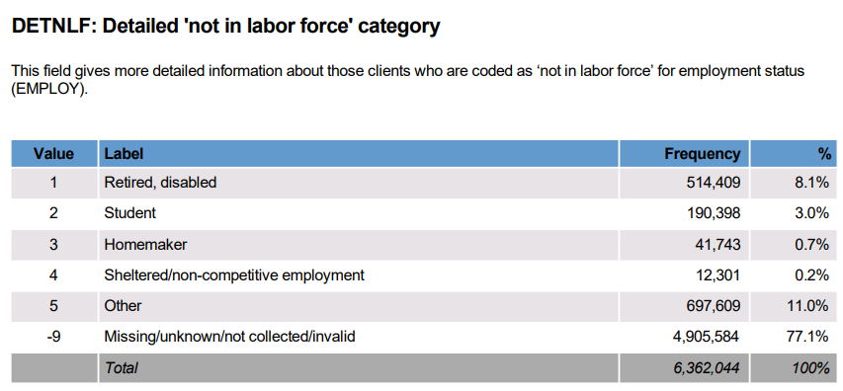
Method II: Random Forest
5000 data points in training set, 5000 in test set
500 trees, 4 variables in each split
Training accuracy ~ 95.32%
Out-Of-Bag accuracy ~ 92.94%
Testing Accuracy ~ 93.32%

Slide 11
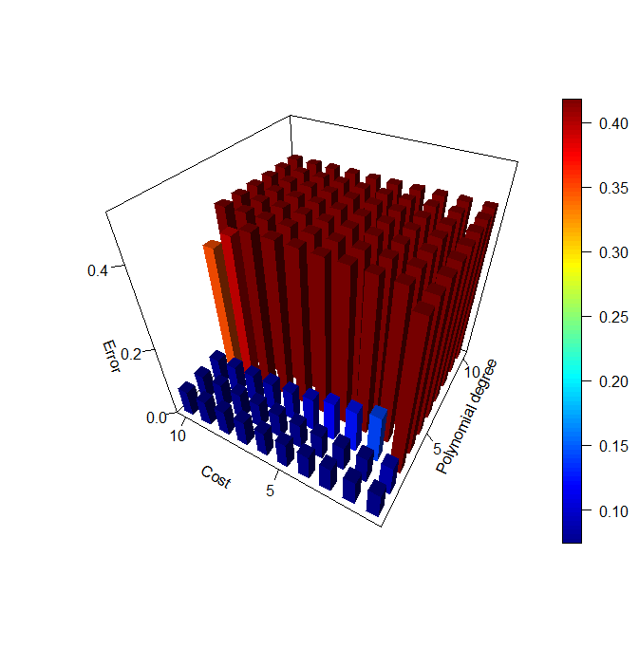
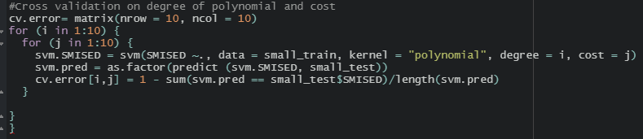
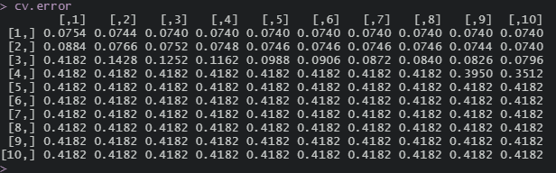
Method III: SVM
Polynomial Kernel, with soft SVM (Slack allowed)
Two hyper-parameters to tune:
Degree of polynomial
Cost (Slack)
Overfitting!
Cross-Validation!!

Slide 12

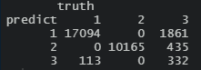
Method III: SVM
Tried training on full training set (4 million data points), ran for an hour, then gave up
Trained on 5000 data points: tested on 1.8 million
Training Accuracy: 92.54%
Testing Accuracy : 72.37%
Predicts everyone to have SMI/be SED – zero in third category
Trained on 100,000 data points, tested on 30,000:
Training Accuracy: 83.7%
Testing Accuracy: 91.97%
A few people in third category

Slide 13
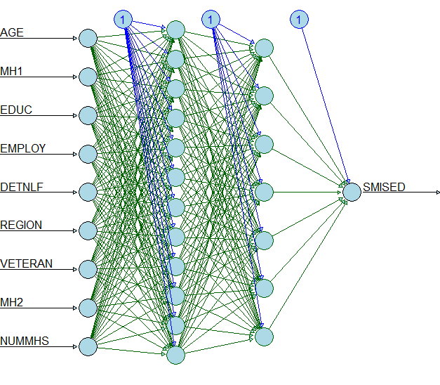
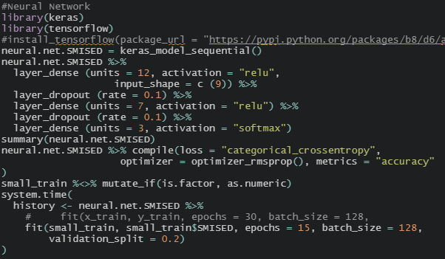
Method IV: Deep Learning
Attempt*
9 features (picked from random forest ranking)
12 neurons in 1st hidden layer, 7 in 2nd
609 parameters to learn
ReLU activation, softmax to convert to probabilities
One-Hot Encoding for 3 output neurons (diagram slightly wrong)

Slide 14


Conclusions
Age, region, type of diagnosis, marital status, education seem to be very important in determining SMI or SED
Ensemble methods are great!
Random Forest worked best
Only a little tuning needed
Computational restrictions considerable in real world problems (unlike HWs)
Deep learning is hard
☹

