Slide 1
OD Matrix Estimation from SUMO Traffic
36 zones vs 9 zones — Tehran, District 2
Marginal GNN + junction turn counts + doubly-constrained gravity

Slide 2
Executive summary
• Same recipe at both resolutions: predict per-zone production/attraction with a turn-count GNN, then rebuild the full OD by gravity / Furness.
• 36 zones (finer) scores HIGHER on correlation: OD cell-corr 0.78 vs 0.66, marginals 0.90/0.92 vs 0.82/0.80 — helped by 1.75× more training data.
• 9 zones (coarser) reproduces LINK FLOWS best: GEH < 5 on 94% of links — a well-calibrated, simulation-ready OD from only 2000 samples.
• Both land near their gravity ceiling (~0.86–0.88): the recipe is near-optimal; the residual gap is the inherent OD under-determination, not model capacity.
• Raw RMSE is NOT comparable across resolutions — 9 zones pack the same trips into 72 cells vs 1260, so per-cell values (and RMSE) are ~6× larger by construction.

Slide 3
The task and the method
• Inverse problem: edge-level SUMO measurements → OD matrix (origin×destination).
• Full OD from link counts is under-determined (cell-corr ~0.06–0.14).
• Fix 1 — reframe: predict the recoverable ZONE MARGINALS, not 1260/72 raw cells.
• Fix 2 — information: junction TURN COUNTS as GNN edge weights (marginal corr 0.5→0.9).
• Fix 3 — structure: rebuild the OD with doubly-constrained gravity (Furness).
• Inputs: 1897-edge road line-graph; node feats = static + flow/speed/density/traveltime + turn aggregates; edge weight = turn count.
• Splits stratified by 4 demand regimes (night · noon · morning-peak · evening-peak); metrics: marginal corr, OD cell-corr/RMSE, total-flow error, GEH on link flows.

Slide 4
The two configurations
 | 36 zones | 9 zones
TAZ grid (gridDistricts width) | 1000 m (6×6) | 3000 m (3×3-ish)
OD cells (off-diagonal) | 1260 | 72
Road network | 1897 edges, same net | 1897 edges, same net
Training samples | 3500 (test 750) | 2000 (test 300)
Model | marginal GNN, GraphConv | marginal GNN, GraphConv
Observation | turn counts (enriched) | turn counts (enriched)
Reconstruction | gravity / Furness, β=1.0 | gravity / Furness, β=0.7

Slide 5
Head-to-head results (test split)
metric | 36 zones | 9 zones | better
production corr | 0.904 | 0.816 | 36
attraction corr | 0.916 | 0.800 | 36
OD cell-corr | 0.784 | 0.660 | 36
reconstruction ceiling | ~0.86 | 0.884 | ≈
total-flow error | 0.132 | 0.186 | 36
normalised RMSE (÷mean) | 9.43 | 3.11 | lower
GEH < 5 (link flows) | not scored* | 94% | 9
*36-zone GEH was skipped at eval (split/size mismatch with the legacy per-sample flow files); the recipe is identical, so comparable link-flow realism is expected. Raw RMSE differs ~6× by cell-count and is not shown.

Slide 6
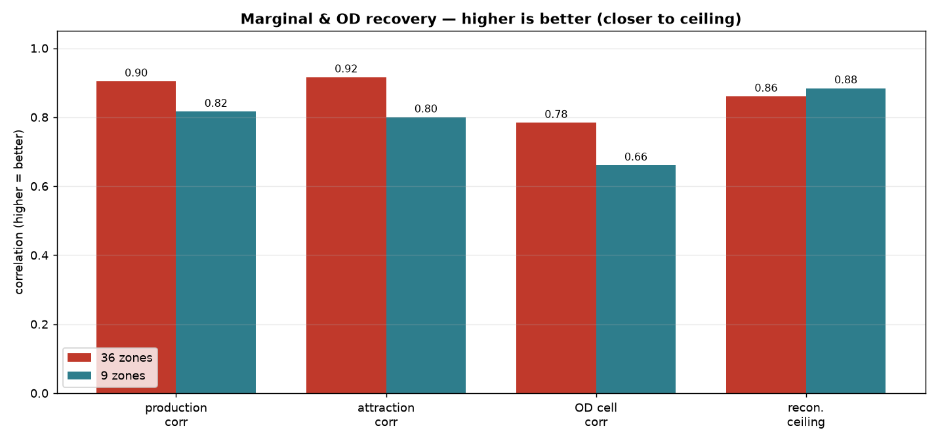
Marginal & OD recovery

Slide 7
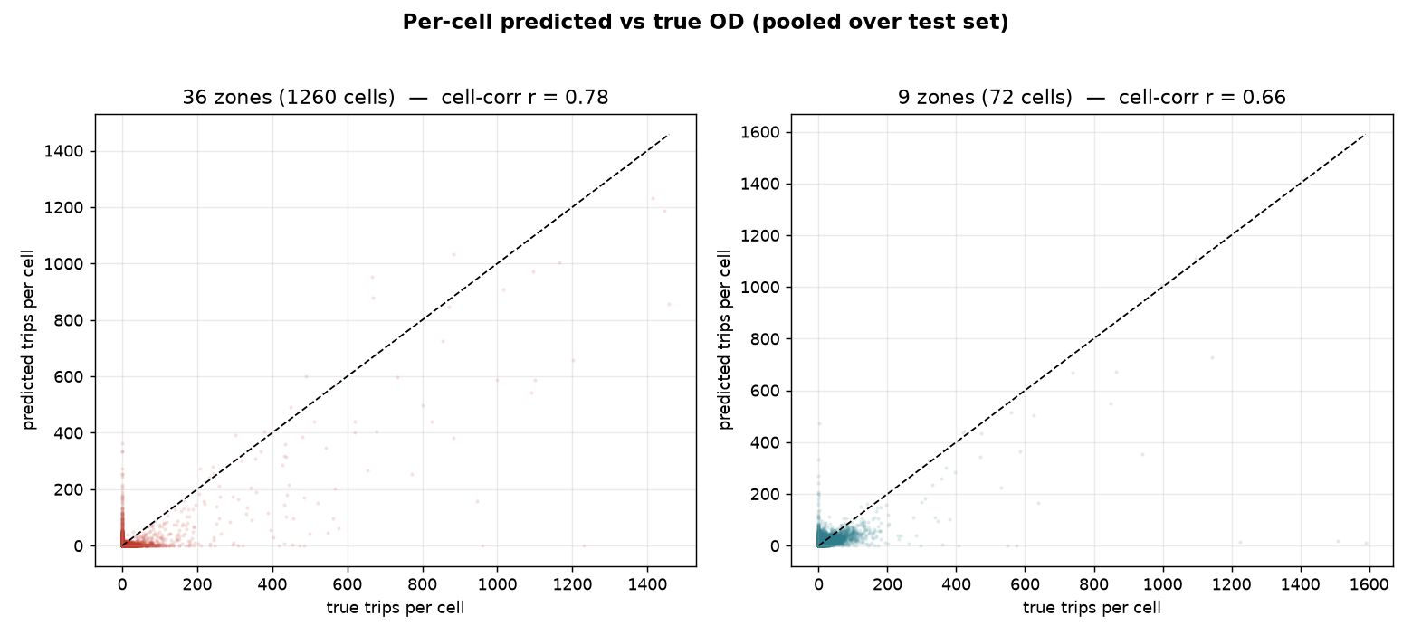
Per-cell accuracy (pooled test set)

Slide 8
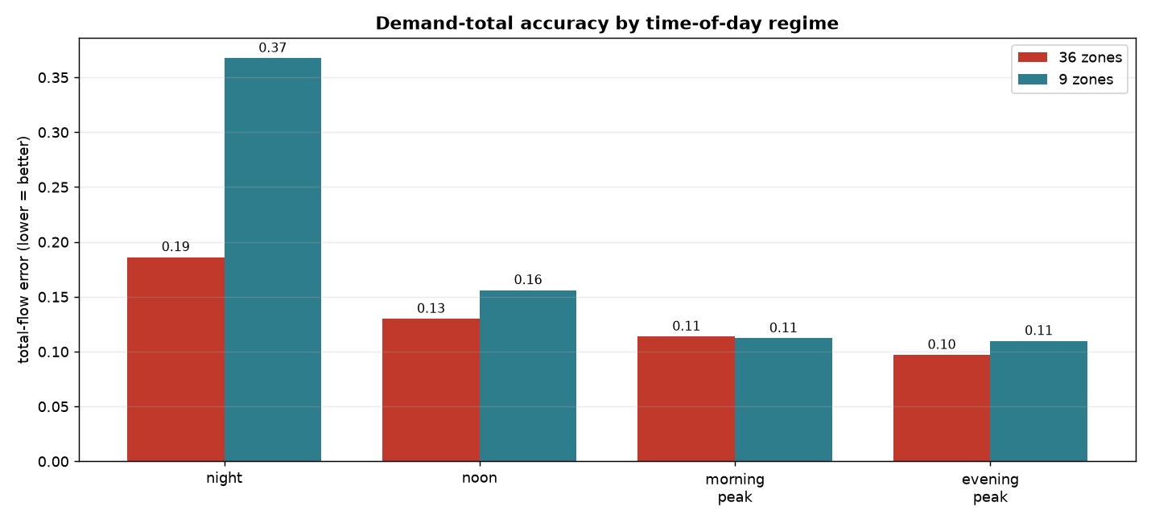
Accuracy by time-of-day regime
Both improve with demand (peaks easiest). 9-zone night is the weak spot (few trips spread over fewer cells → noisy marginals).

Slide 9
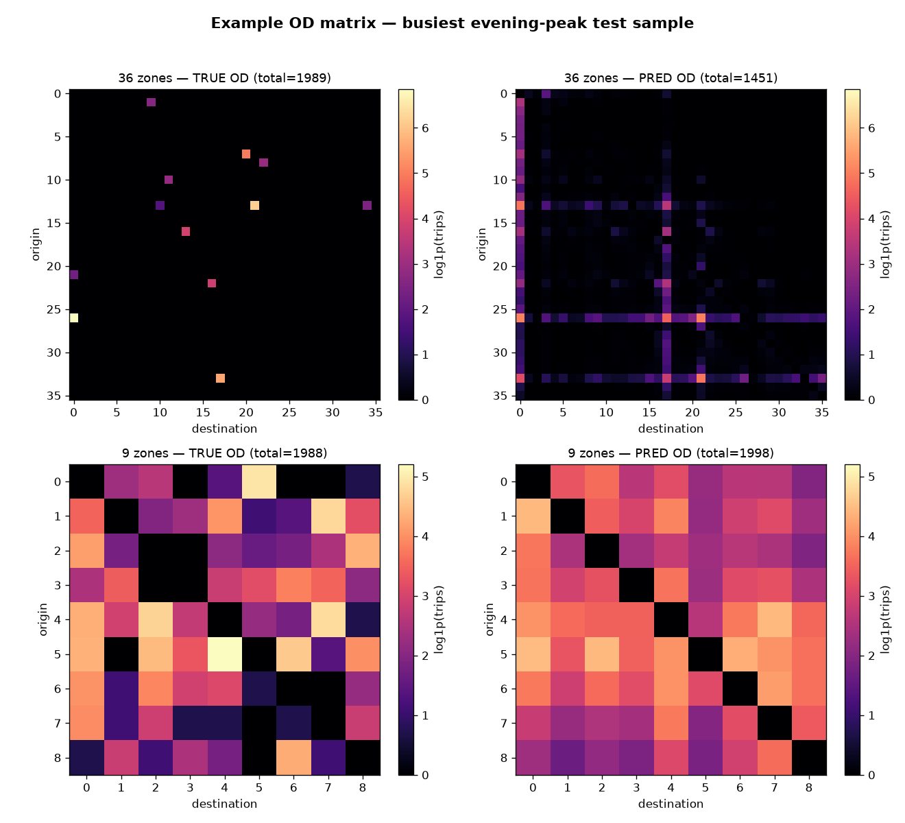
Example OD matrix (busiest evening peak)

Slide 10
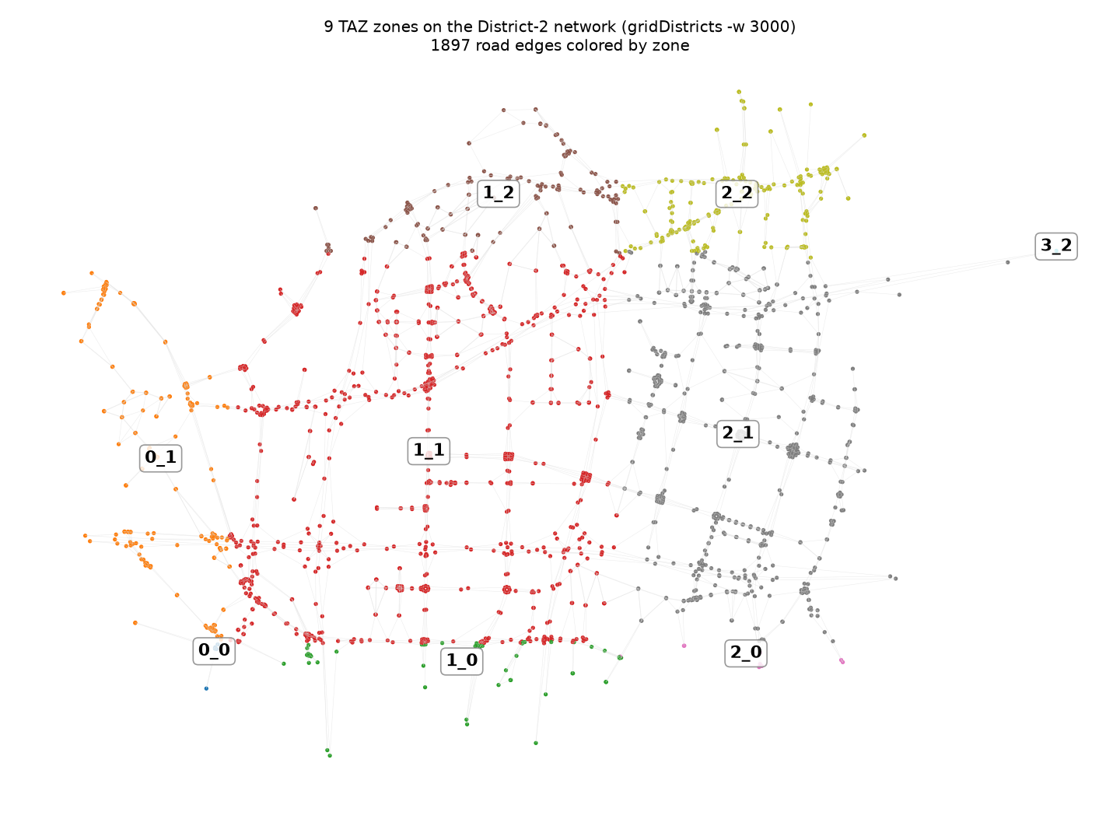
9-zone study — The 9 TAZ zones
gridDistricts width 3000. Note the imbalance — central 1_1 and 2_1 dominate while 3_2 / 2_0 / 0_0 are tiny edge cells: the source of the noisier 9-zone marginals.

Slide 11
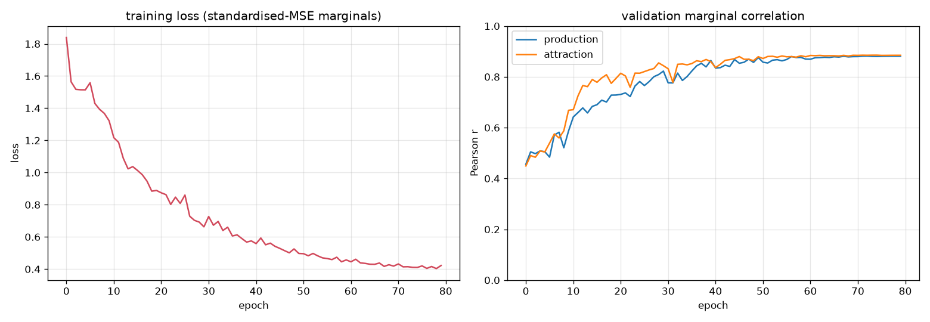
9-zone study — Training convergence
Per-zone standardized marginal-MSE loss; early-stopped on the validation split.

Slide 12
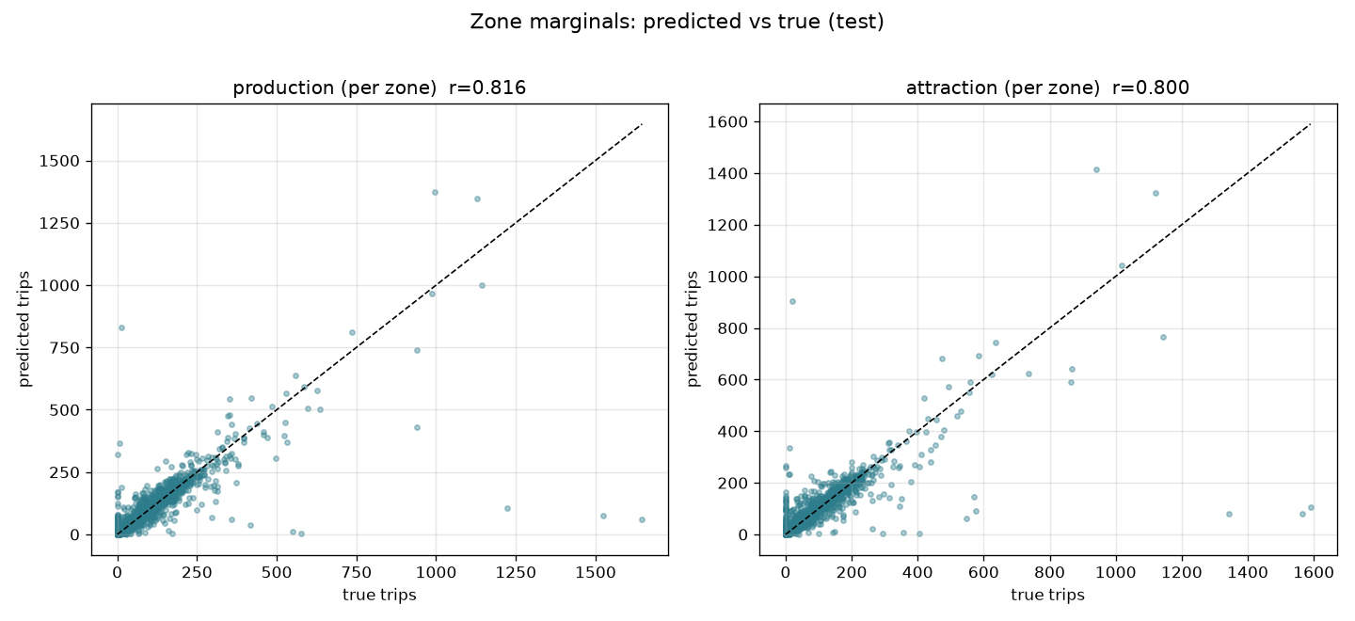
9-zone study — Marginal recovery (the GNN's actual target)
Per-zone production & attraction, predicted vs true — corr 0.82 / 0.80.

Slide 13
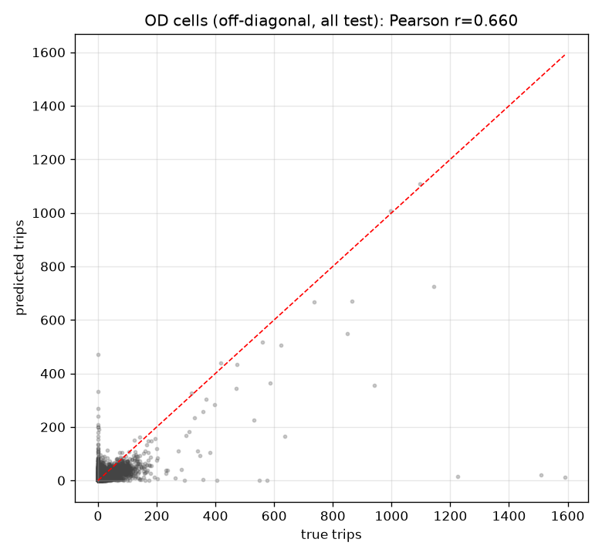
9-zone study — Full 9×9 OD per-cell accuracy
Pooled predicted vs true off-diagonal cells after gravity reconstruction — cell-corr 0.66.

Slide 14
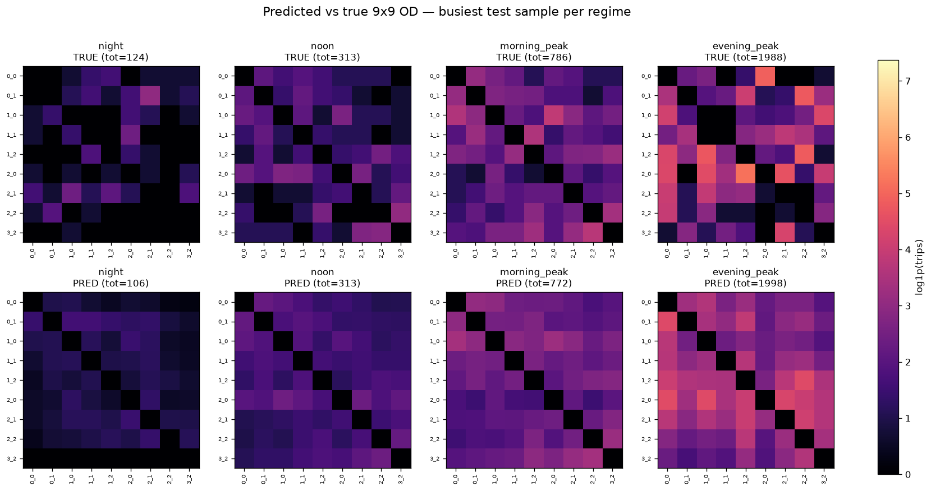
9-zone study — Example OD matrices by regime
Predicted vs true OD across night / noon / morning-peak / evening-peak — gravity-smoothed, right structure.

Slide 15
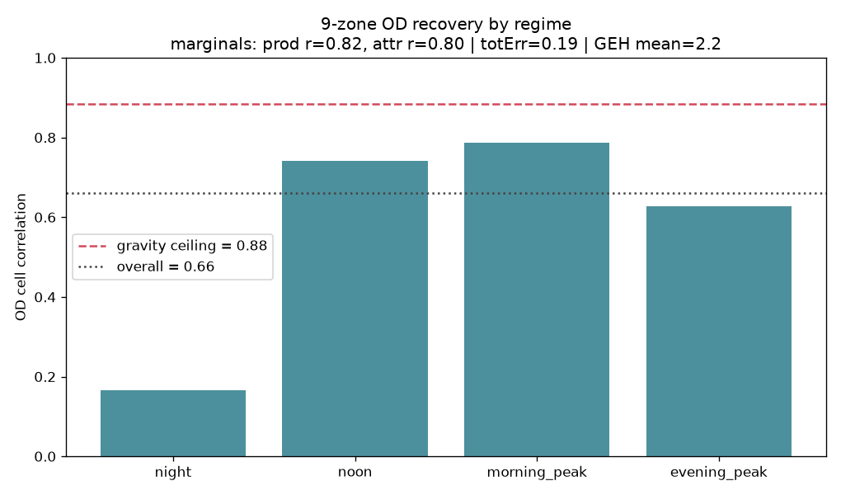
9-zone study — OD cell-corr by regime vs the ceiling
Peaks are strong (~0.74–0.79); night is the weak spot (0.17, sparse demand). Ceiling = 0.88.

Slide 16
Why the numbers differ
• More cells ≠ harder here: 36 zones had 1.75× the training data, so its marginal predictor generalises better → higher correlations.
• Zone balance matters: coarse grids still contain a few tiny edge-of-district zones with little traffic → noisy marginals that drag the pooled 9-zone score down.
• Scale effect: identical total demand over 72 vs 1260 cells makes 9-zone per-cell trips (and RMSE) ~6× larger — compare normalised RMSE / total-flow error instead.
• Coarser OD is more simulation-faithful: 9-zone link-flow GEH = 94% < 5 — excellent for SUMO what-ifs even though its cell-corr is lower.
• Both sit at the gravity ceiling → the limit is information (the observation), not the model. A heavier net or more epochs will not break it.

Slide 17
Conclusions & recommendations
• Pick resolution by purpose: 36 zones for fine spatial detail & highest correlations; 9 zones for a compact, simulation-ready OD with top link-flow realism.
• To improve EITHER model, add information, not capacity:
– richer observation (turn/link counts > travel time) — the biggest lever
– finer temporal resolution (e.g. 30-min slices) for time-varying demand
– more samples for the finer grid; balance/merge tiny zones
• Real-data path (Neshan travel times) is built separately — calibration, not learning, since travel time alone can’t identify the OD (see README_realworld).
• Reproduce: python -m src.evaluate (36z) · python -m src.zones9.train_eval --mode eval (9z) · python -m src.make_slides (this deck).

