Slide 1
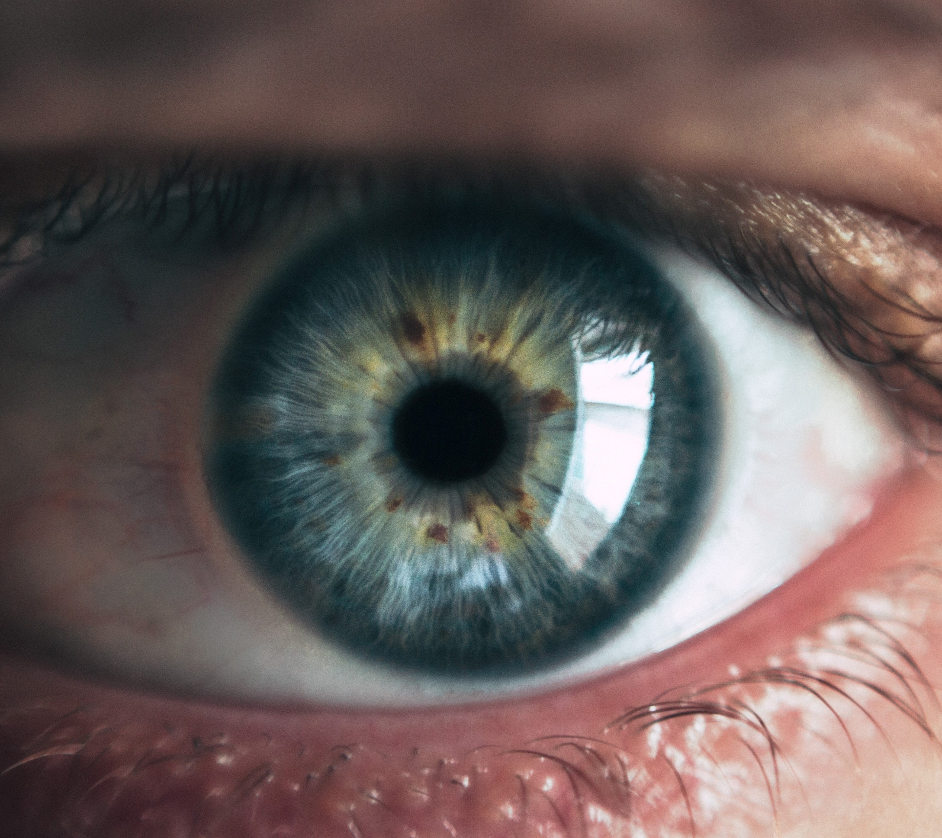

Diabetic Retinopathy Recognition
Data Science Diploma
Capstone Project
Farhad Raoufi
June 2020
https://unsplash.com/s/photos/eyes

Slide 2
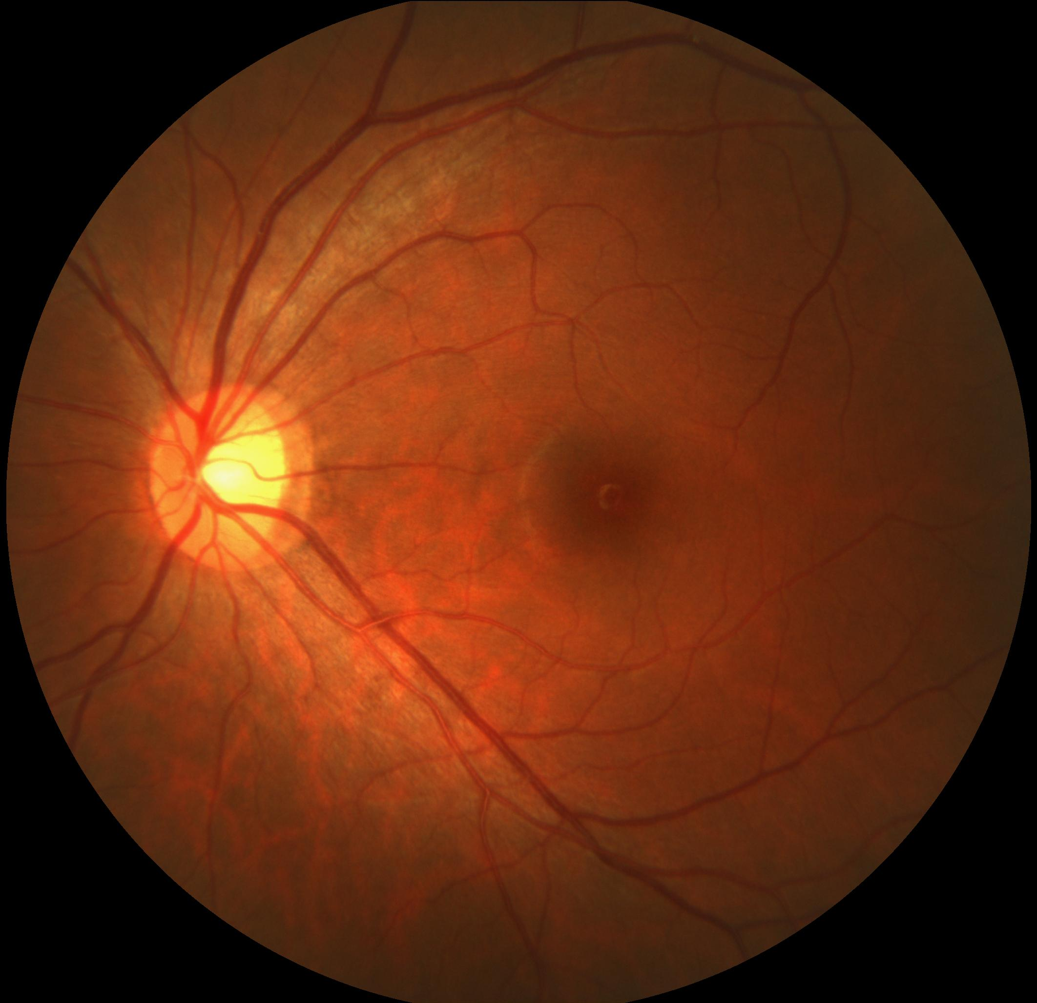
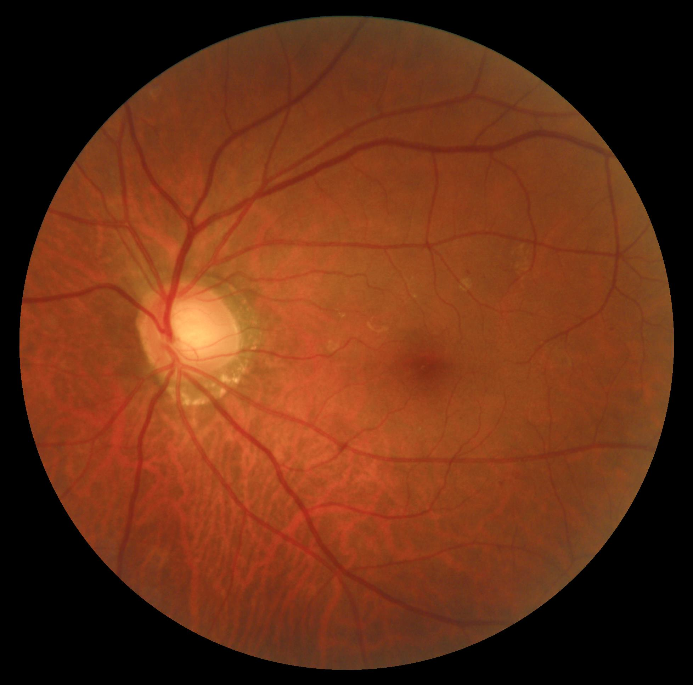
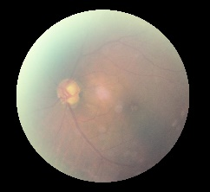
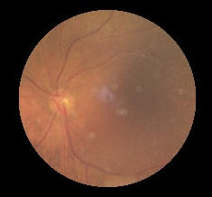

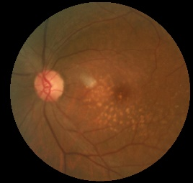
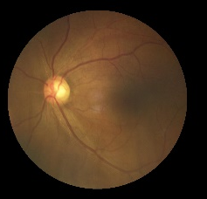
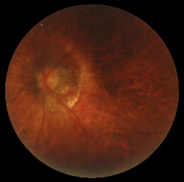
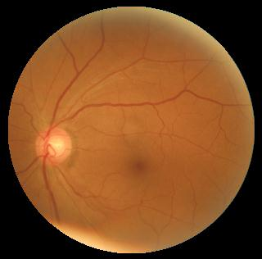
Background
Normal
Diabetic
www.diabetes.co.uk
Glaucoma
Cataract
Right and left eye images of 3500 patients
AMD
Hypertension
44%
30%
26%
Myopia
Other

Slide 3
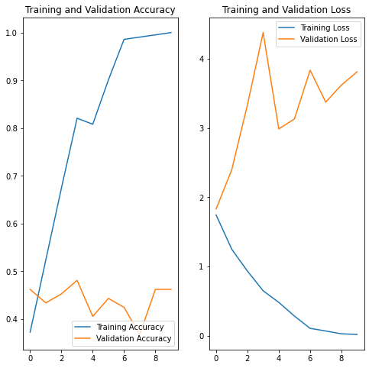
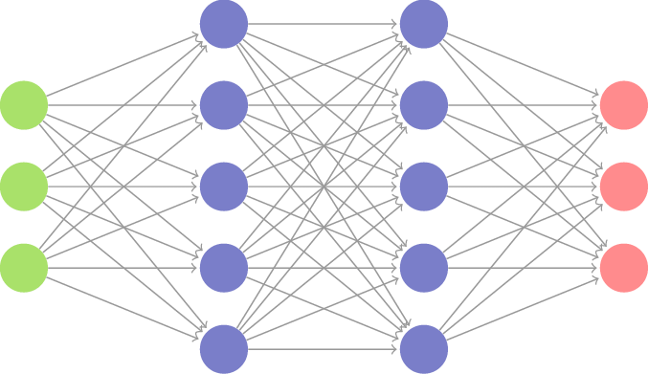

Methodology
www.diabetes.co.uk
Clean Dataset
Convolutional Neural Networks
Model Evaluation
60% Train
20% Validation
20% Test
Pre-trained Models
Research
Created my model
Train – Validation graphs
Confusion matrix
Bench marks

Slide 4
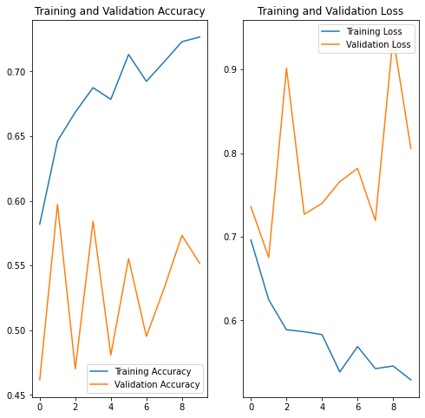


Transfer Learning
256
Normal
(N)
1024
256
Diabetic
(D)
512
1024
512
Other
(O)
Pre-trained Models
My customization
Challenges
MobileNet
VGG19
(224,224,3)
Adding 6 Dense layers
Adding MaxPooling
Image Augmentation
Collinearity (D,O)
Max accuracy :50%
Model memorizing

Slide 5
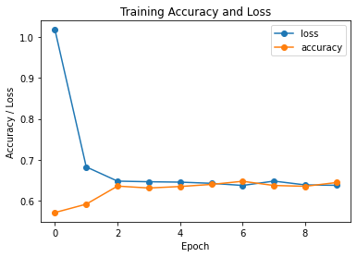
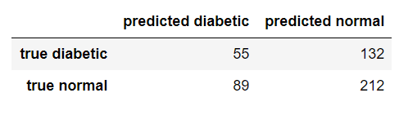
My Model
Con2D (32 , relu)
MaxPooling
BatchNormalization
Con2D (128 , relu)
BatchNormalization
Flatten()
Dense(1024)
Con2D (32 , relu)
MaxPooling
BatchNormalization
Con2D (256 , relu)
Dropout(0.5)
Dense(1024)
Con2D (64 , relu)
MaxPooling
BatchNormalization
Con2D (256 , relu)
MaxPooling
BatchNormalization
Dense(2, softmax)
Con2D (64 , relu)
MaxPooling
BatchNormalization
Con2D (512 , relu)
Dropout(0.5)
BatchNormalization
Diabetic
(D)
Normal
(N)
Con2D (128 , relu)
MaxPooling
BatchNormalization
54.71% Accuracy

Slide 6
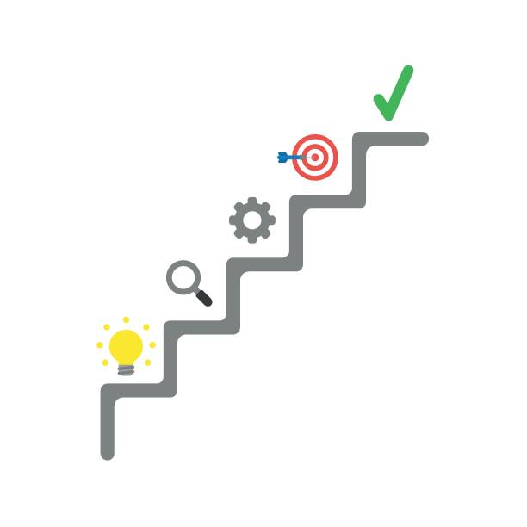

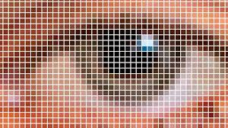
Capstone Journey
Model Accuracy
Next Steps!
Model Accuracy
Technical Skills
30% 54%
80% Improvement
Res: (1400,1400,3)
Already connected with filed experts
Improve my model
30% 54%
80% Improvement
Res: (1400,1400,3)
Run > 200 Epochs
Tried different models
Read scientific papers

Slide 7
Thank you!
Q & A
https://unsplash.com/s/photos/eyes

