Slide 1
Possible root-cause of the complaint
Farhad shadmand

Slide 2

Product, sub_product, issue
and sub_issue columns
find root and class

Slide 3

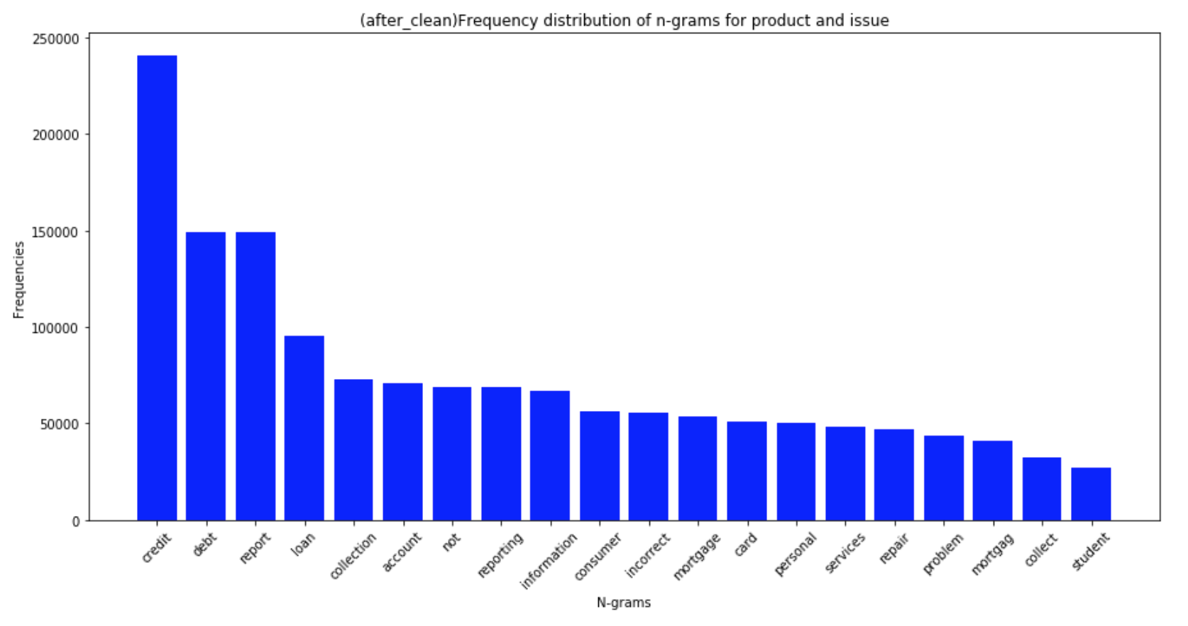
Frequency distribution :
Product, sub_product, issue and sub_issue columns

Slide 4
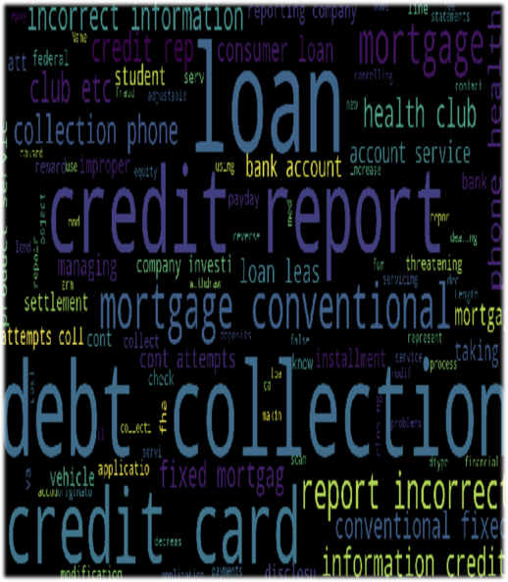
modified process
Product, sub_product, issue and sub_issue columns
1. Remove stop_words,
2. Add Product column to Nan Sub_product column,
2. Add Issue column to Nan Sub_Issue column,

Slide 5


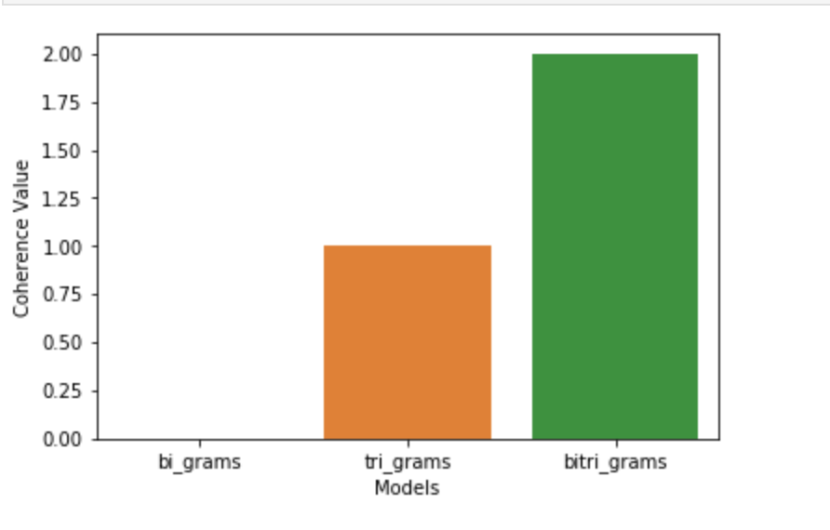
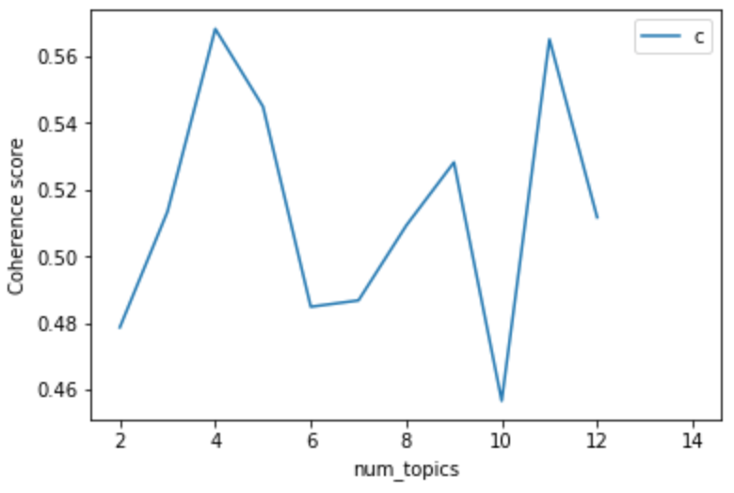
Use coherence for latent Dirichlet allocation (LDA)
used Function to display num_topics - LDA graph using c_v coherence
use 1 and 2 grams for bag of words
give more coherence.
Num_topics =11
with more coherence

Slide 6

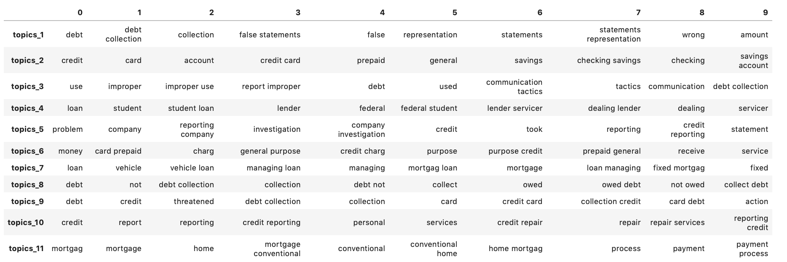
topics model vocabulary
Product, sub_product, issue and sub_issue columns

Slide 7

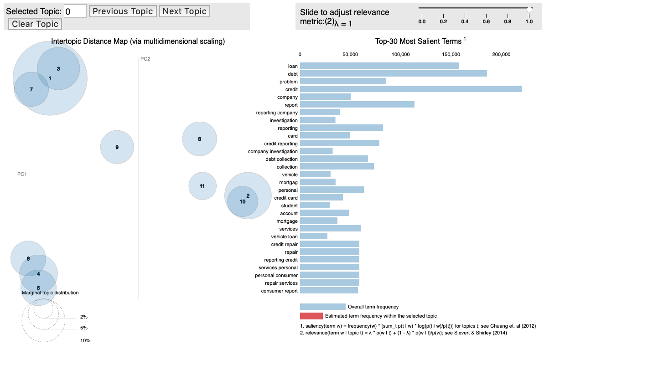
latent Dirichlet allocation (LDA)
Product, sub_product, issue and sub_issue columns
go to lad.html file

Slide 8

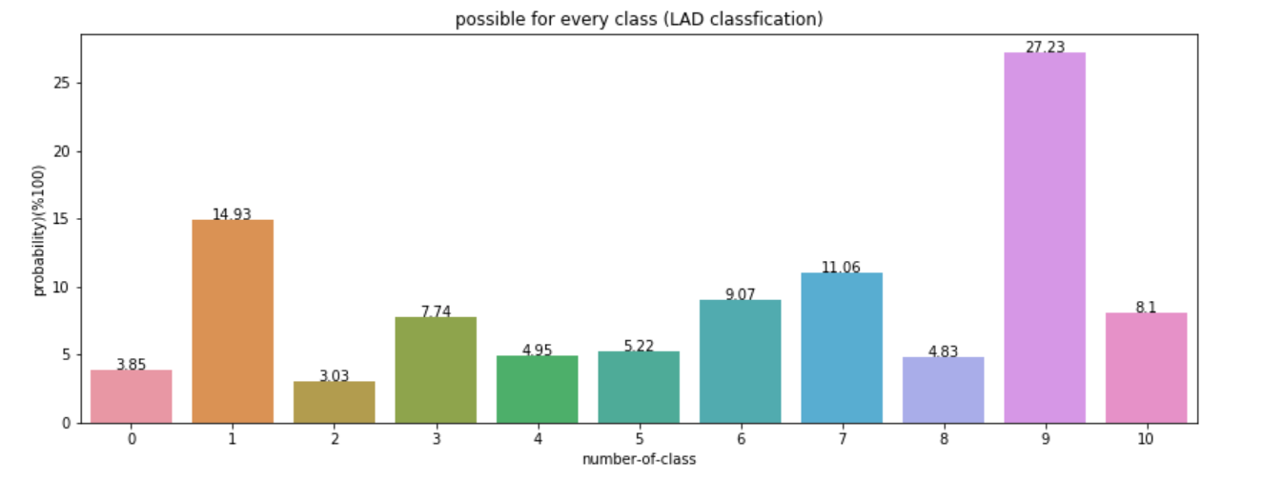
Possible root-cause
Product, sub_product, issue and sub_issue columns

Slide 9
What I should do:
Product, sub_product, issue and sub_issue columns
Use TI_TID and LDA.
Check topic words and find a great title for every group.
Remove some words according topic words. and check coherence.

Slide 10

similar Consumer complaint narrative column
check a mount of negative costumers’ massages

Slide 11

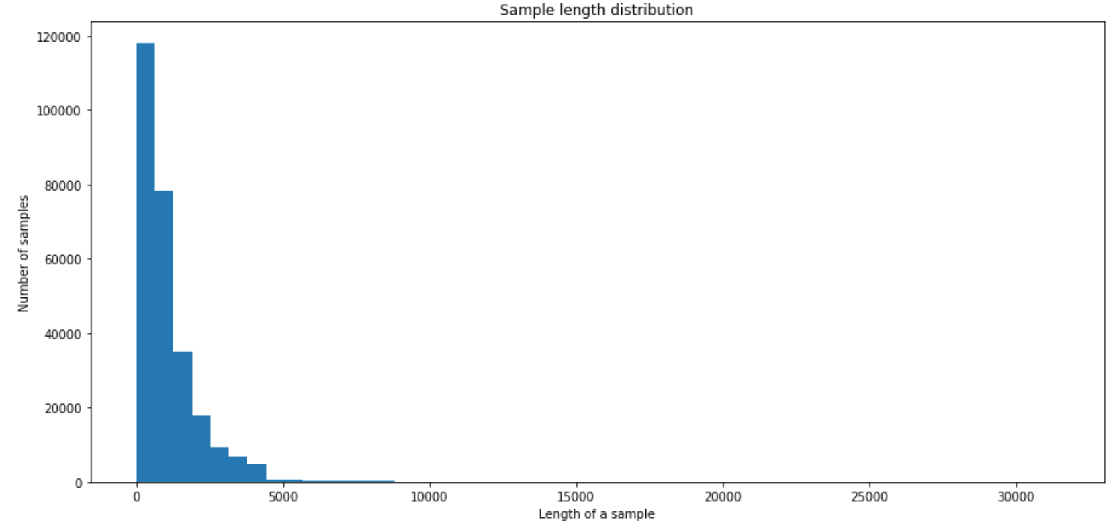
Words distribution of rows
Consumer complaint narrative column

Slide 12

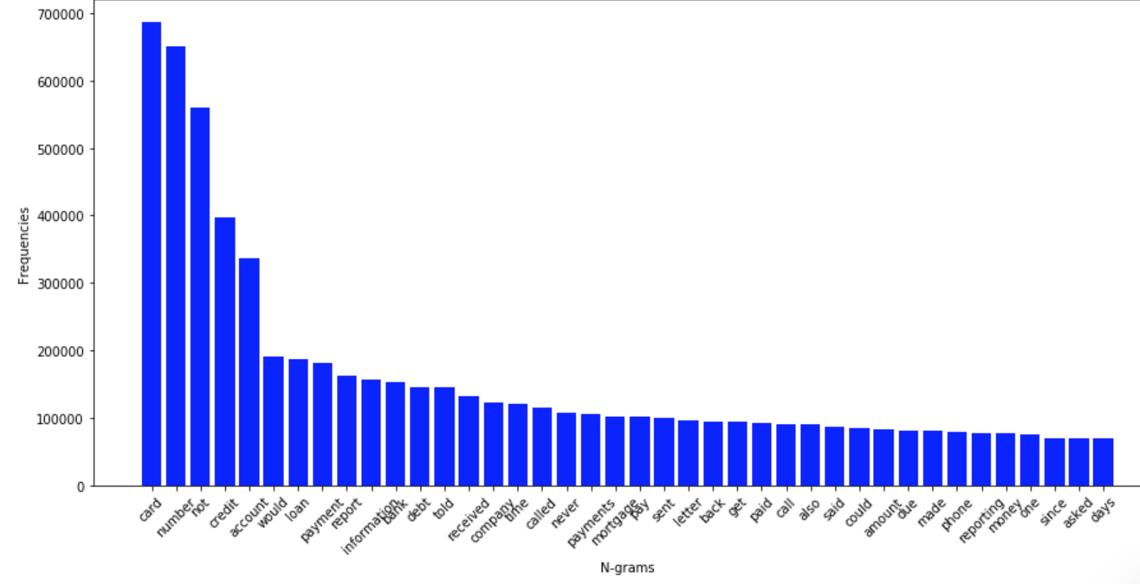
Fervency distribution after clean text
Consumer complaint narrative column

Slide 13
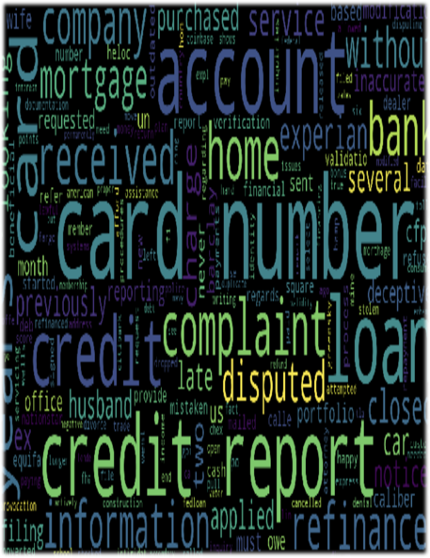
modified process
Consumer complaint narrative column
Remove stop words,
Replace number instead of xxx xxx
check spell of words,
Repetitious words from every rows.

Slide 14

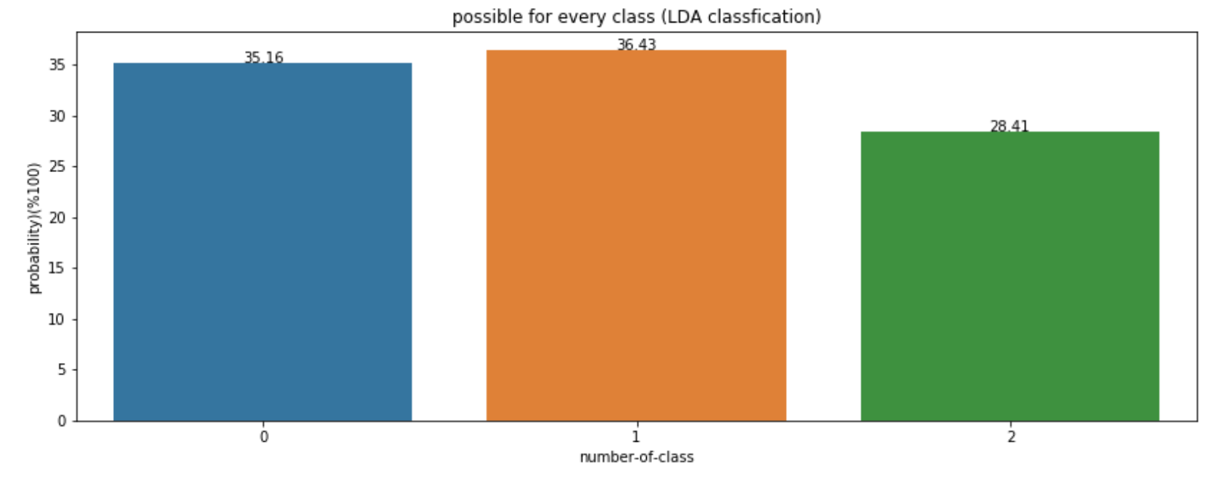
similar Consumer
Consumer complaint narrative column
not-good =1 , bad=2, so bad=3

Slide 15

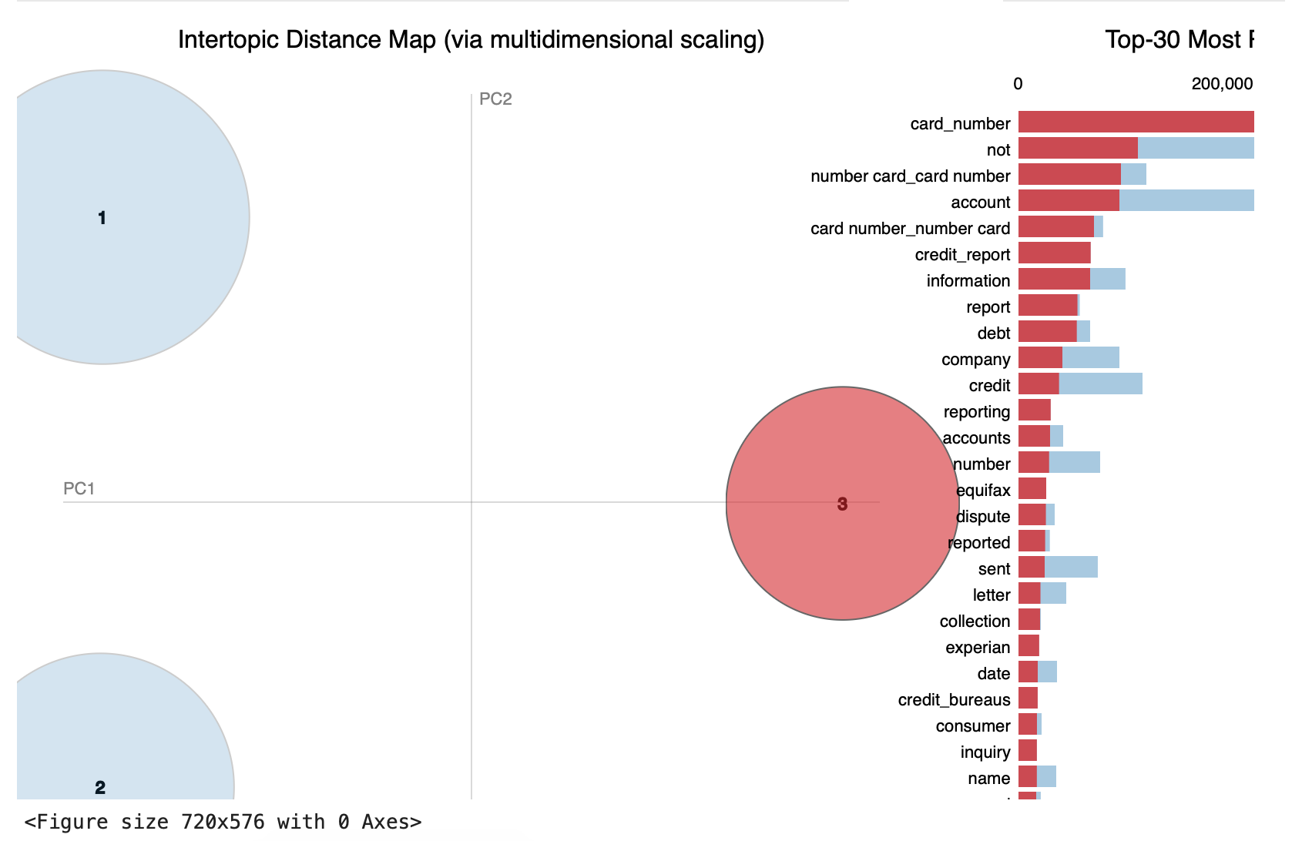
latent Dirichlet allocation (LDA)
Consumer complaint narrative column
go to lda_for_Consumer_complaint_narrative.html file

