Slide 1
How I Built My Course Website
THEA 3135 - Technology in Arts Management
5 Minute Presentation Project
Farhan Ahmed
April 1, 2026
Website: aurorastage.netlify.app
Notes:
Hello! My name is Farhan, and my presentation today is about how I built my website project for the Technology in Arts Management course. I chose this topic because it was the most significant thing I made and worked on for the course, and it also changed a lot over time as I added more pages and made improvements. So I thought it would be a fitting and natural thing to talk about.

Slide 2
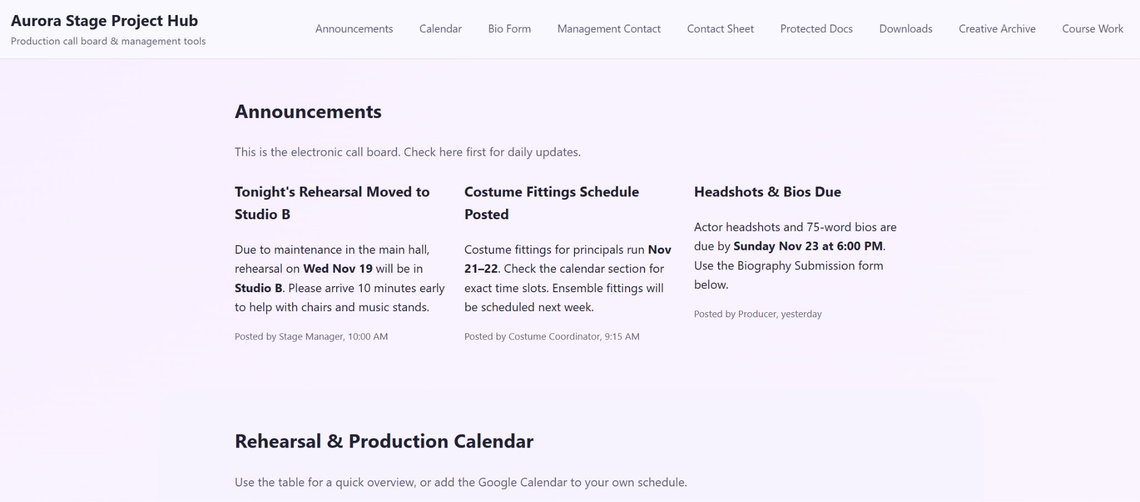
Project Overview
Built as a central course website
Organizes assignments, projects, and resources
Includes forms, downloads, protected files, and linked pages
Notes:
This project is a course website that I built to organize different kinds of material and information in one place. It was designed in the style of a theatre production or project hub, so it could hold things like assignments, project pages, forms, downloads, and protected documents in a clear and simple way. Over time, it became more than a basic homepage and started functioning as a fuller course project site.

Slide 3
Purpose of the Website
Keep course work in one place
Make important sections easy to access
Organize both public and protected content
Create a clean and usable layout
Notes:
The main goal of the website was to keep everything in one place and make things easier to access. I wanted the important parts of the site to be easy to find, especially things like announcements, assignments, project files, and shared resources. I also wanted the site to have a clear structure so it felt organized and not messy or scattered.

Slide 4
Key Features on the Homepage
Announcements
Calendar
Biography submission form
Management contact form
Contact sheet
Downloads and protected documents
Notes:
The homepage includes the main features of the site. There is an announcements section so updates are visible right away, and there's also a calendar section for scheduling information. I added a biography submission form, a management contact form, a contact sheet, downloadable forms, and a protected documents section. The goal was for the homepage to bring the most important parts of the site together in one place.

Slide 5
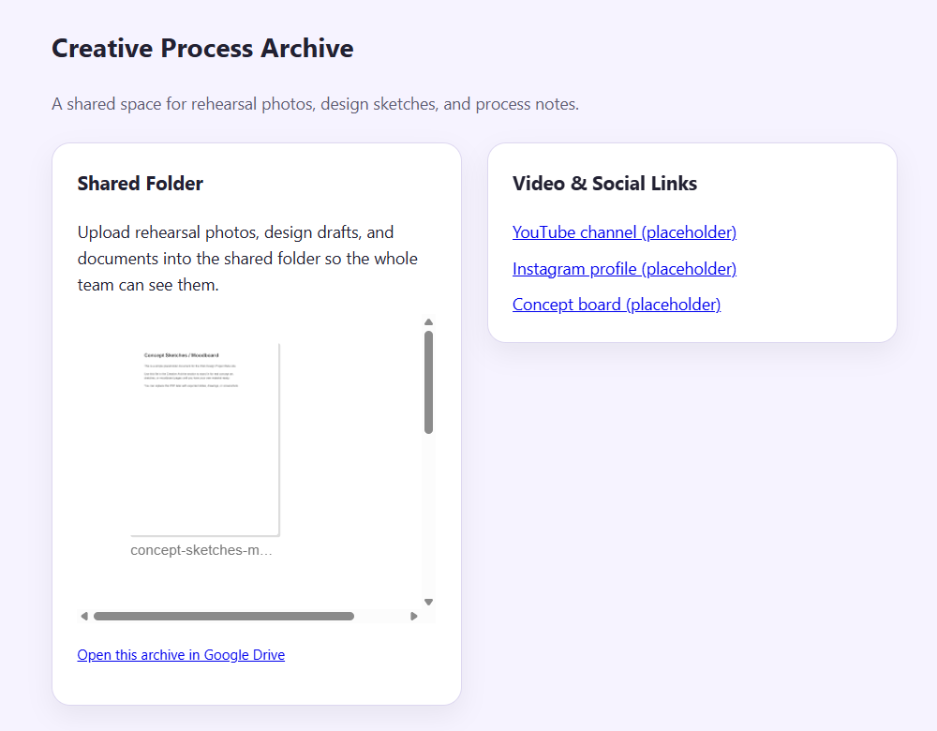
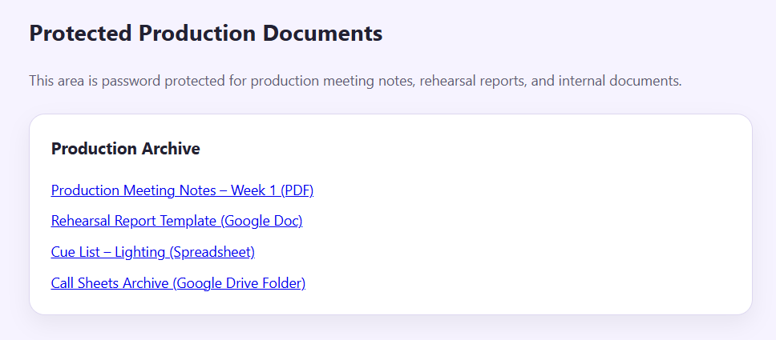
Protected and Shared Content
Password-protected production documents
Google Drive links for project files
Creative archive with shared folder embed
Public downloads for forms
Notes:
An important part of the site was including both protected and shared content. The protected section uses a password and gives access to documents like meeting notes, reports, and archive material. I used Google Drive for linked files and for the creative archive folder that is embedded directly into the site. For the public content, I included downloadable forms that anyone can access from the homepage.

Slide 6
Tools I Used
HTML
CSS
JavaScript
Google Drive
Google Calendar
GitHub
Netlify
Notes:
Rather than use a website builder, I built the site with code using HTML, CSS, and JavaScript. I also used Google Drive and Google Calendar for the embedded and linked content on the site. To host the site I used Netlify, which allowed me publish the site online for free. I also stored the code in a GitHub repository and connected that to Netlify, so whenever I push updates to the code repository, the latest version of the site gets deployed automatically.

Slide 7
Design and Layout Choices
Simple navigation bar
Clear homepage sections
Soft color palette
Card-based layout
Mobile-friendly design
Notes:
For the design, I wanted something simple and easy to read. I used a clear navigation bar and separated the homepage into sections so users can easily move through the site. I also used a soft color palette and card-style layout to keep the page looking clean. Another important part was making the layout responsive so it still works properly on smaller screens.

Slide 8
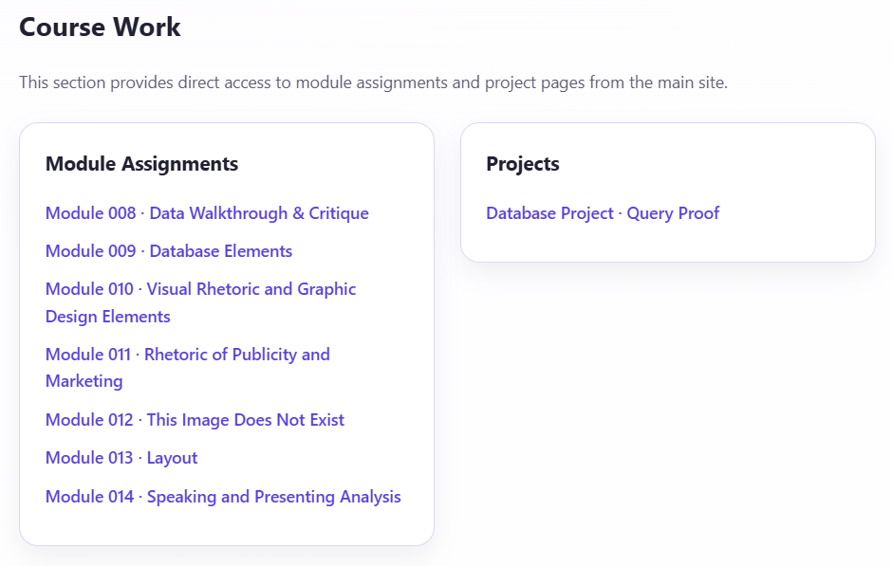
Course Work Section
Added direct links to module pages
Added project page links to the homepage
Improved navigation
Reduced dependence on direct URLs
Notes:
An improvement I later made was adding a Course Work section to the homepage. Before that, the module and project pages were only accessible through their direct links, which was not very convenient. Adding this section made the site easier to use because now those pages can be reached directly from the main page, making the site feel more complete.

Slide 9
Challenges and What I Learned
Organizing many sections without clutter
Making links and embeds work properly
Improving navigation over time
Learned more about website structure and usability
Notes:
One challenge I had was organizing a lot of different sections without making the homepage feel crowded. I also had to make sure the links, embedded folders, and calendar worked properly once everything was connected. Another part of the process was improving the navigation as the site grew. Overall, I learned a lot about structure, usability, and how small design changes can make a website easier to use.

Slide 10
Conclusion
Created a functional course website
Organized assignments, projects, and resources
Improved the site over time
Built a strong base for future updates
Notes:
Overall, this project helped me create a course website that's functional, organized, and easy to use. It gave me one place to keep assignments, project pages, resources, and shared files together. Throughout the course, I made changes that helped the site feel clearer and easier to navigate. In the end, it turned into a strong course website that brings my work together in one place.

