Slide 1
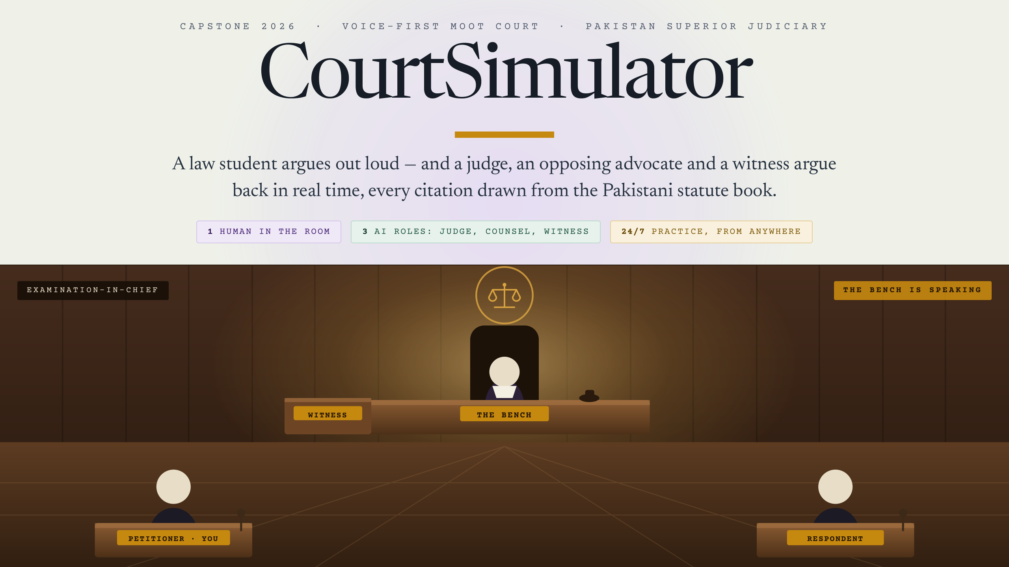
Notes:
CourtSimulator - a voice-first moot court for Pakistani law students.
The student argues out loud. A judge, an opposing advocate and a witness argue back in real time,
and every section of law they quote comes from the Pakistani statute book.
One human in the room. Three AI roles. Available 24/7.

Slide 2
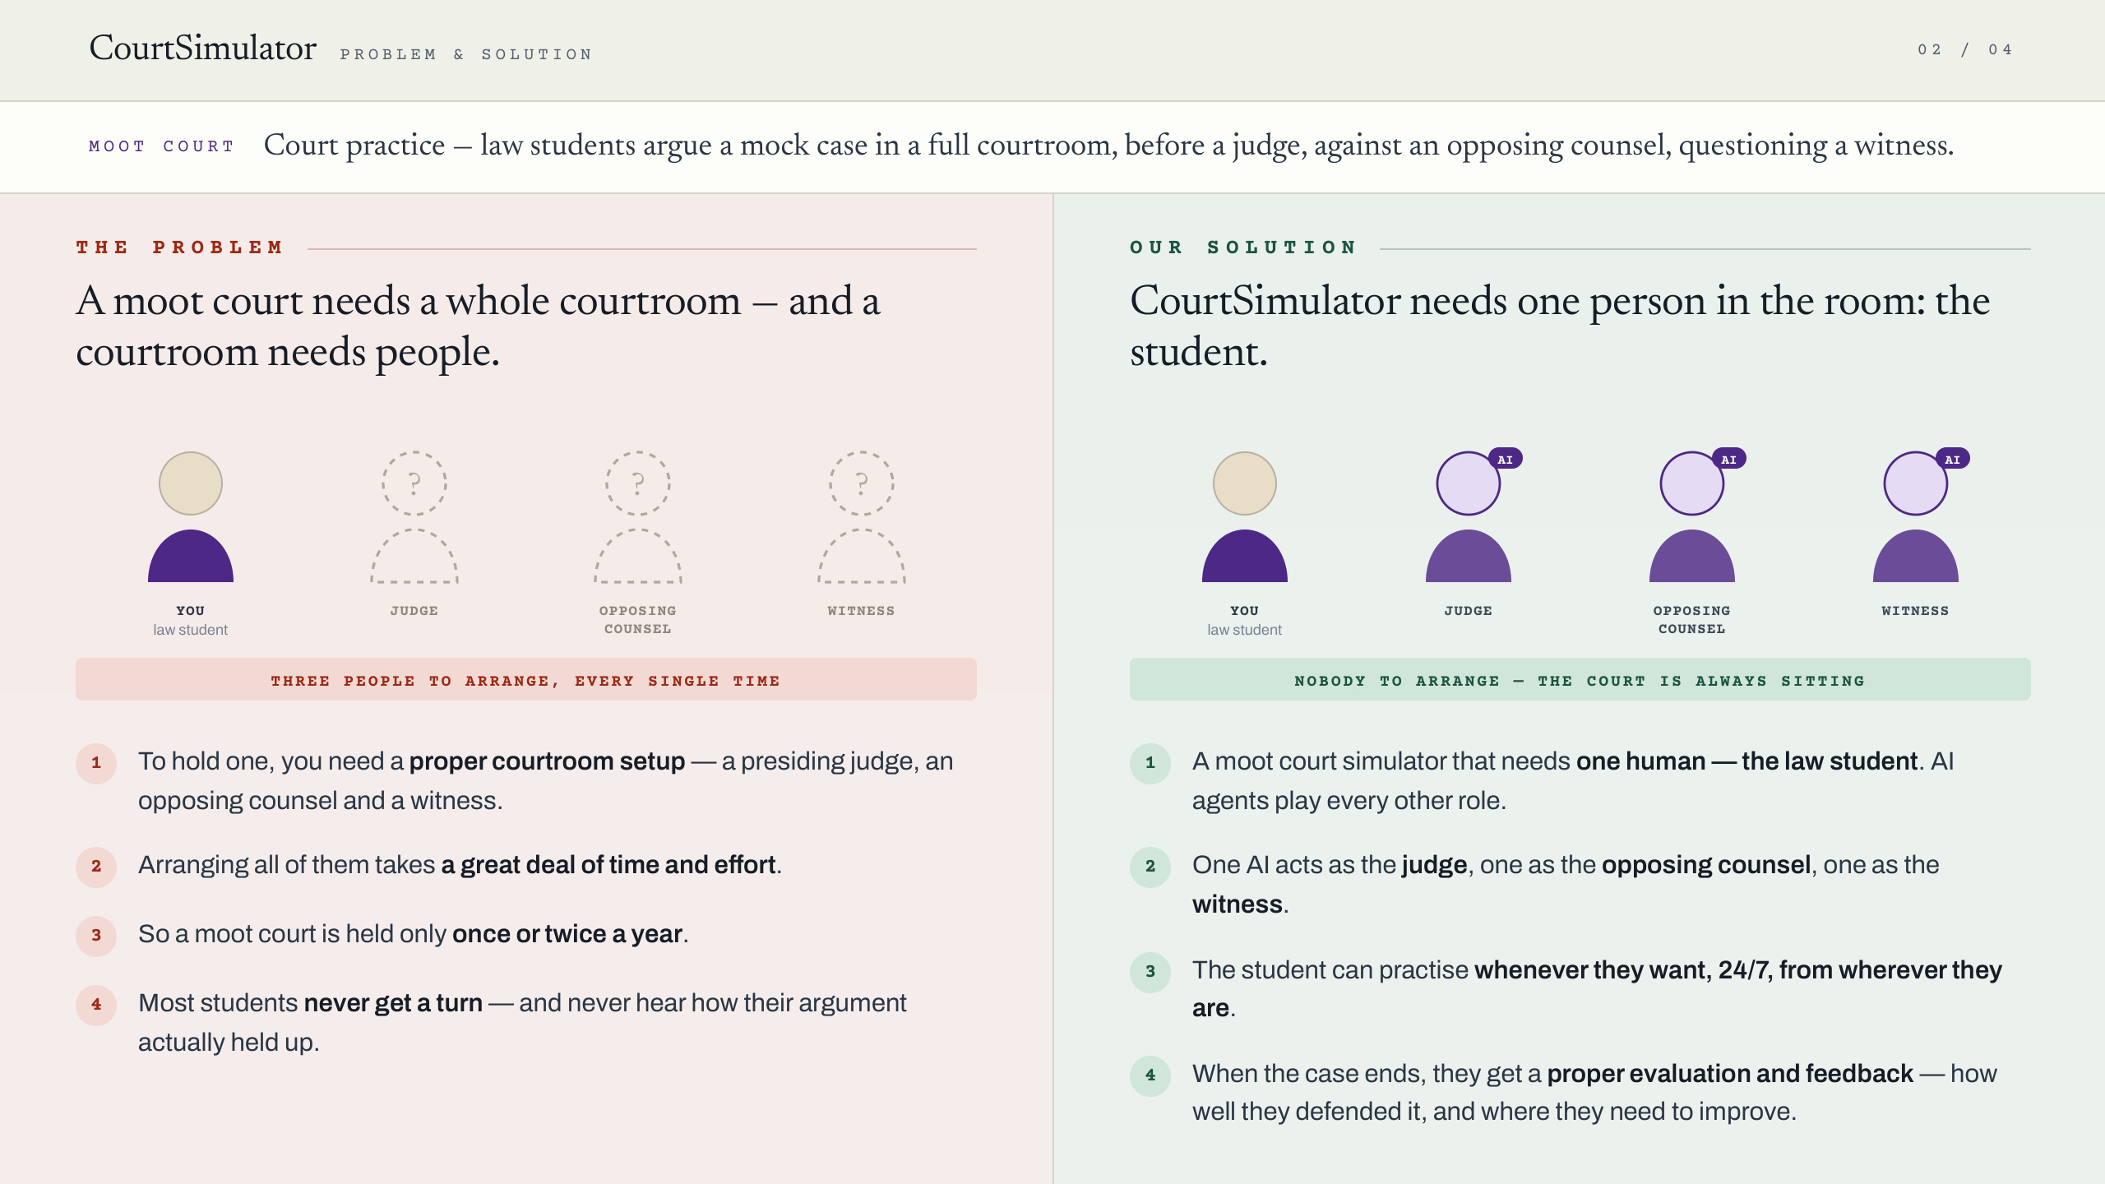
Notes:
First explain the term: a moot court is court practice - law students argue a mock case in a full
courtroom, before a judge, against an opposing counsel, questioning a witness.
THE PROBLEM
1. To hold one you need a proper courtroom setup - a presiding judge, an opposing counsel and a witness.
2. Arranging all of them takes a great deal of time and effort.
3. So a moot court is held only once or twice a year.
4. Most students never get a turn, and never hear how their argument actually held up.
OUR SOLUTION
1. CourtSimulator is a moot court simulator that needs one human - the law student. AI agents play every other role.
2. One AI acts as the judge, one as the opposing counsel, one as the witness.
3. The student can practise whenever they want, 24/7, from wherever they are.
4. When the case ends they get a proper evaluation and feedback - how well they defended it,
and where they need to improve.

Slide 3
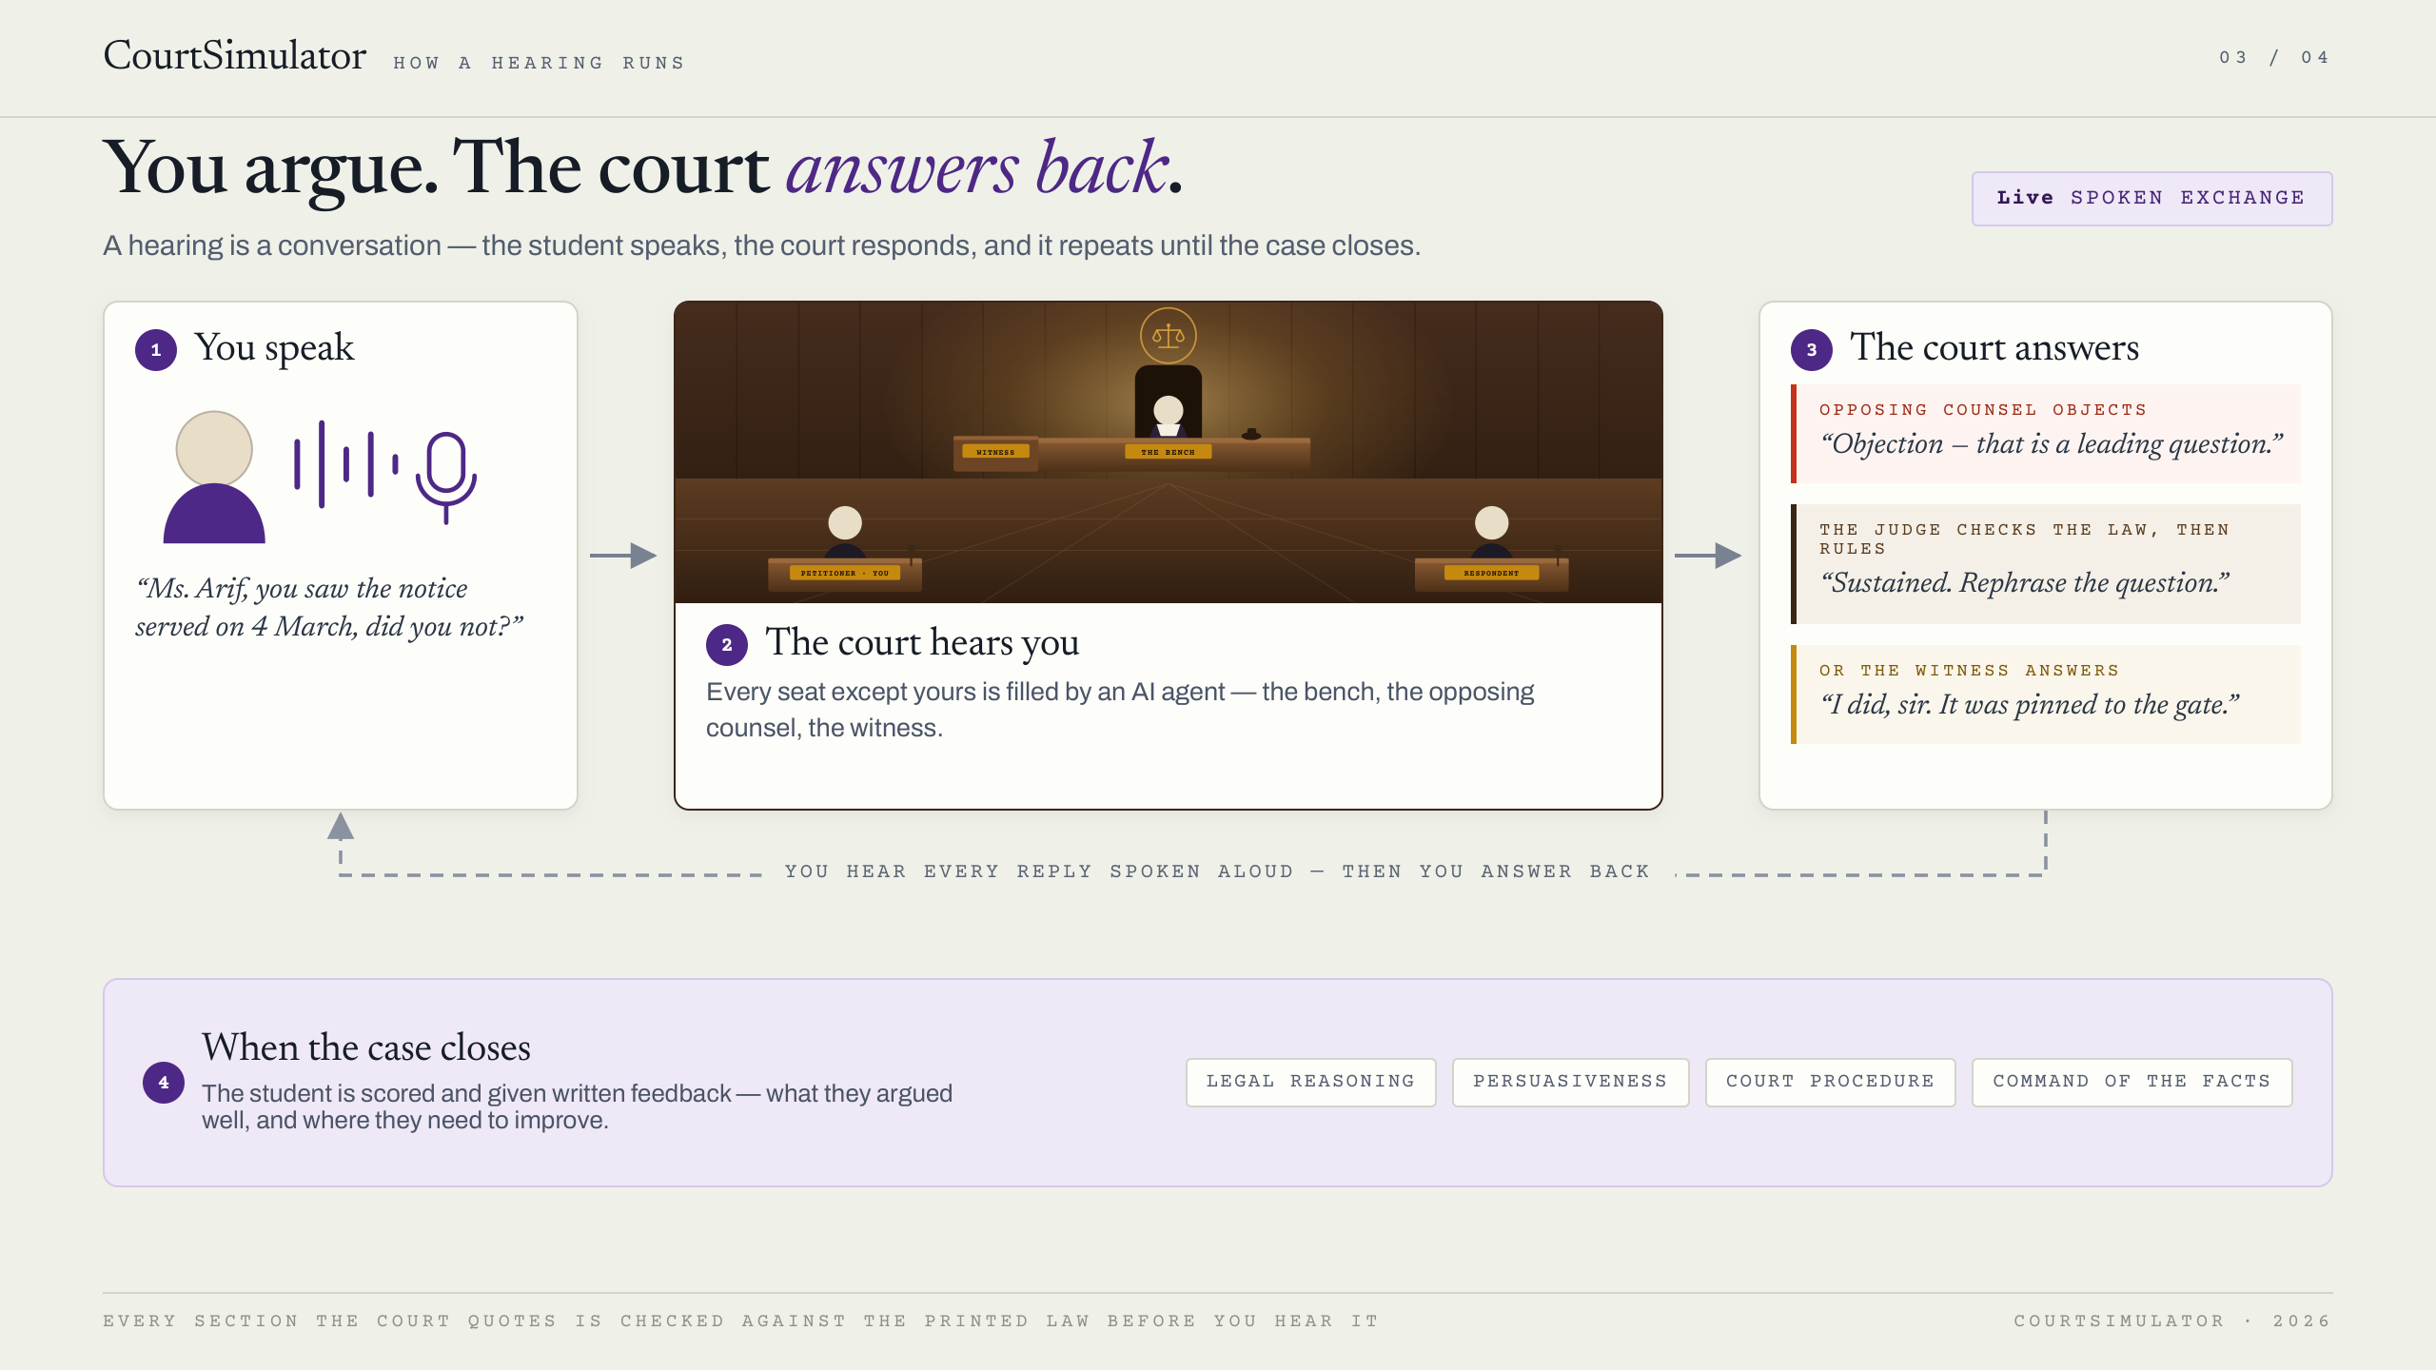
Notes:
A hearing is a conversation, not a form. Walk the four steps:
1. YOU SPEAK - the student puts a question to the witness, out loud, at the rostrum.
2. THE COURT HEARS YOU - every seat except the student's is filled by an AI agent:
the bench, the opposing counsel, the witness.
3. THE COURT ANSWERS - opposing counsel may object on its own initiative; the judge checks the
law and rules sustained or overruled; if overruled, the witness answers.
The student hears each reply spoken aloud, in a different voice, and then answers back.
That loop repeats through the whole hearing.
4. WHEN THE CASE CLOSES - the student is scored and given written feedback on legal reasoning,
persuasiveness, court procedure and command of the facts.
Point worth making: every section the court quotes is checked against the printed law before the
student hears it. It cannot invent a statute at them.

Slide 4
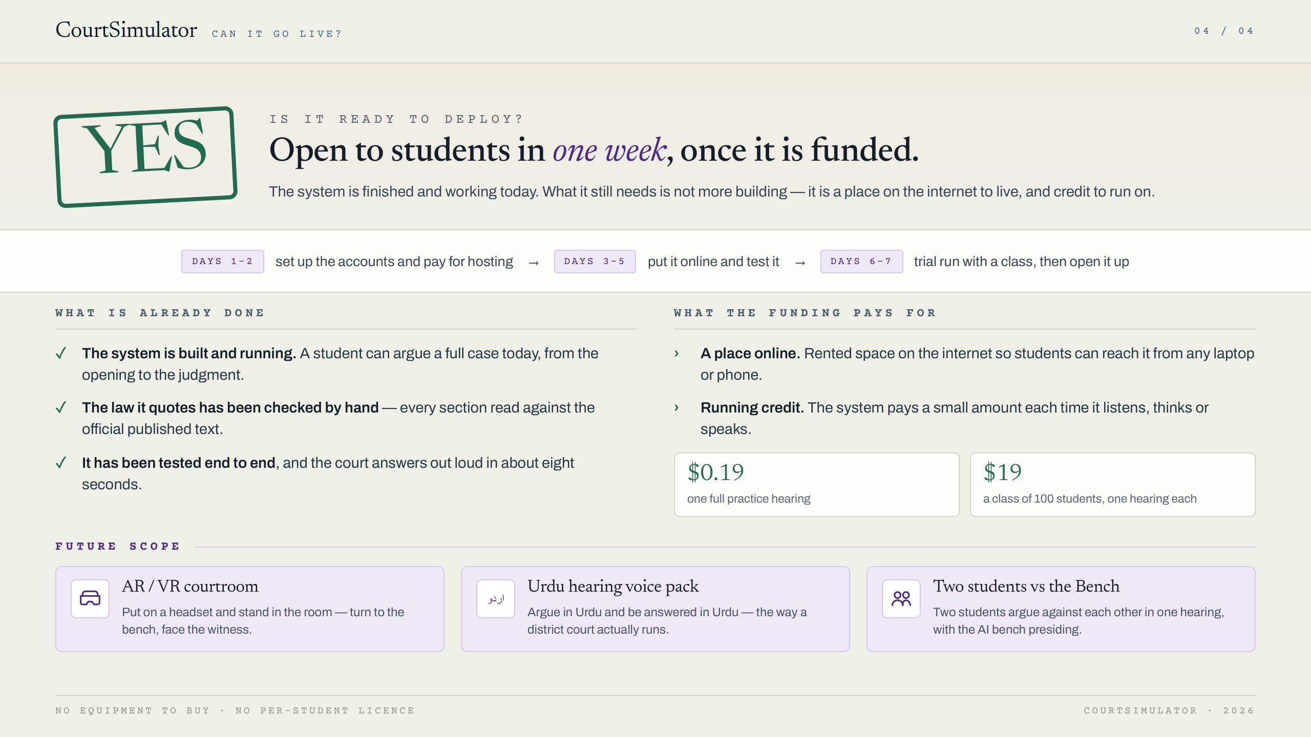
Notes:
Question: is it deployable? Answer: yes - open to students within one week, once it is funded.
The system is finished and working today. What it needs is not more building; it needs a place on
the internet to live, and credit to run on.
ALREADY DONE
- The system is built and running: a student can argue a full case today, opening to judgment.
- The law it quotes has been checked by hand against the official published text.
- It has been tested end to end, and the court answers out loud in about eight seconds.
WHAT THE FUNDING PAYS FOR
- A place online: rented space on the internet so students can reach it from any laptop or phone.
- Running credit: the system pays a small amount each time it listens, thinks or speaks.
- One full practice hearing costs about $0.19. A class of 100 students, one hearing each, about $19.
- No equipment to buy, and no per-student licence.
THE WEEK: days 1-2 accounts and hosting, days 3-5 put it online and test, days 6-7 trial run with a
class and then open it up.
FUTURE SCOPE: an AR/VR courtroom you stand up in; an Urdu hearing voice pack so a student can argue
and be answered in Urdu; and two students against the bench, arguing each other with the AI presiding.

