Slide 1
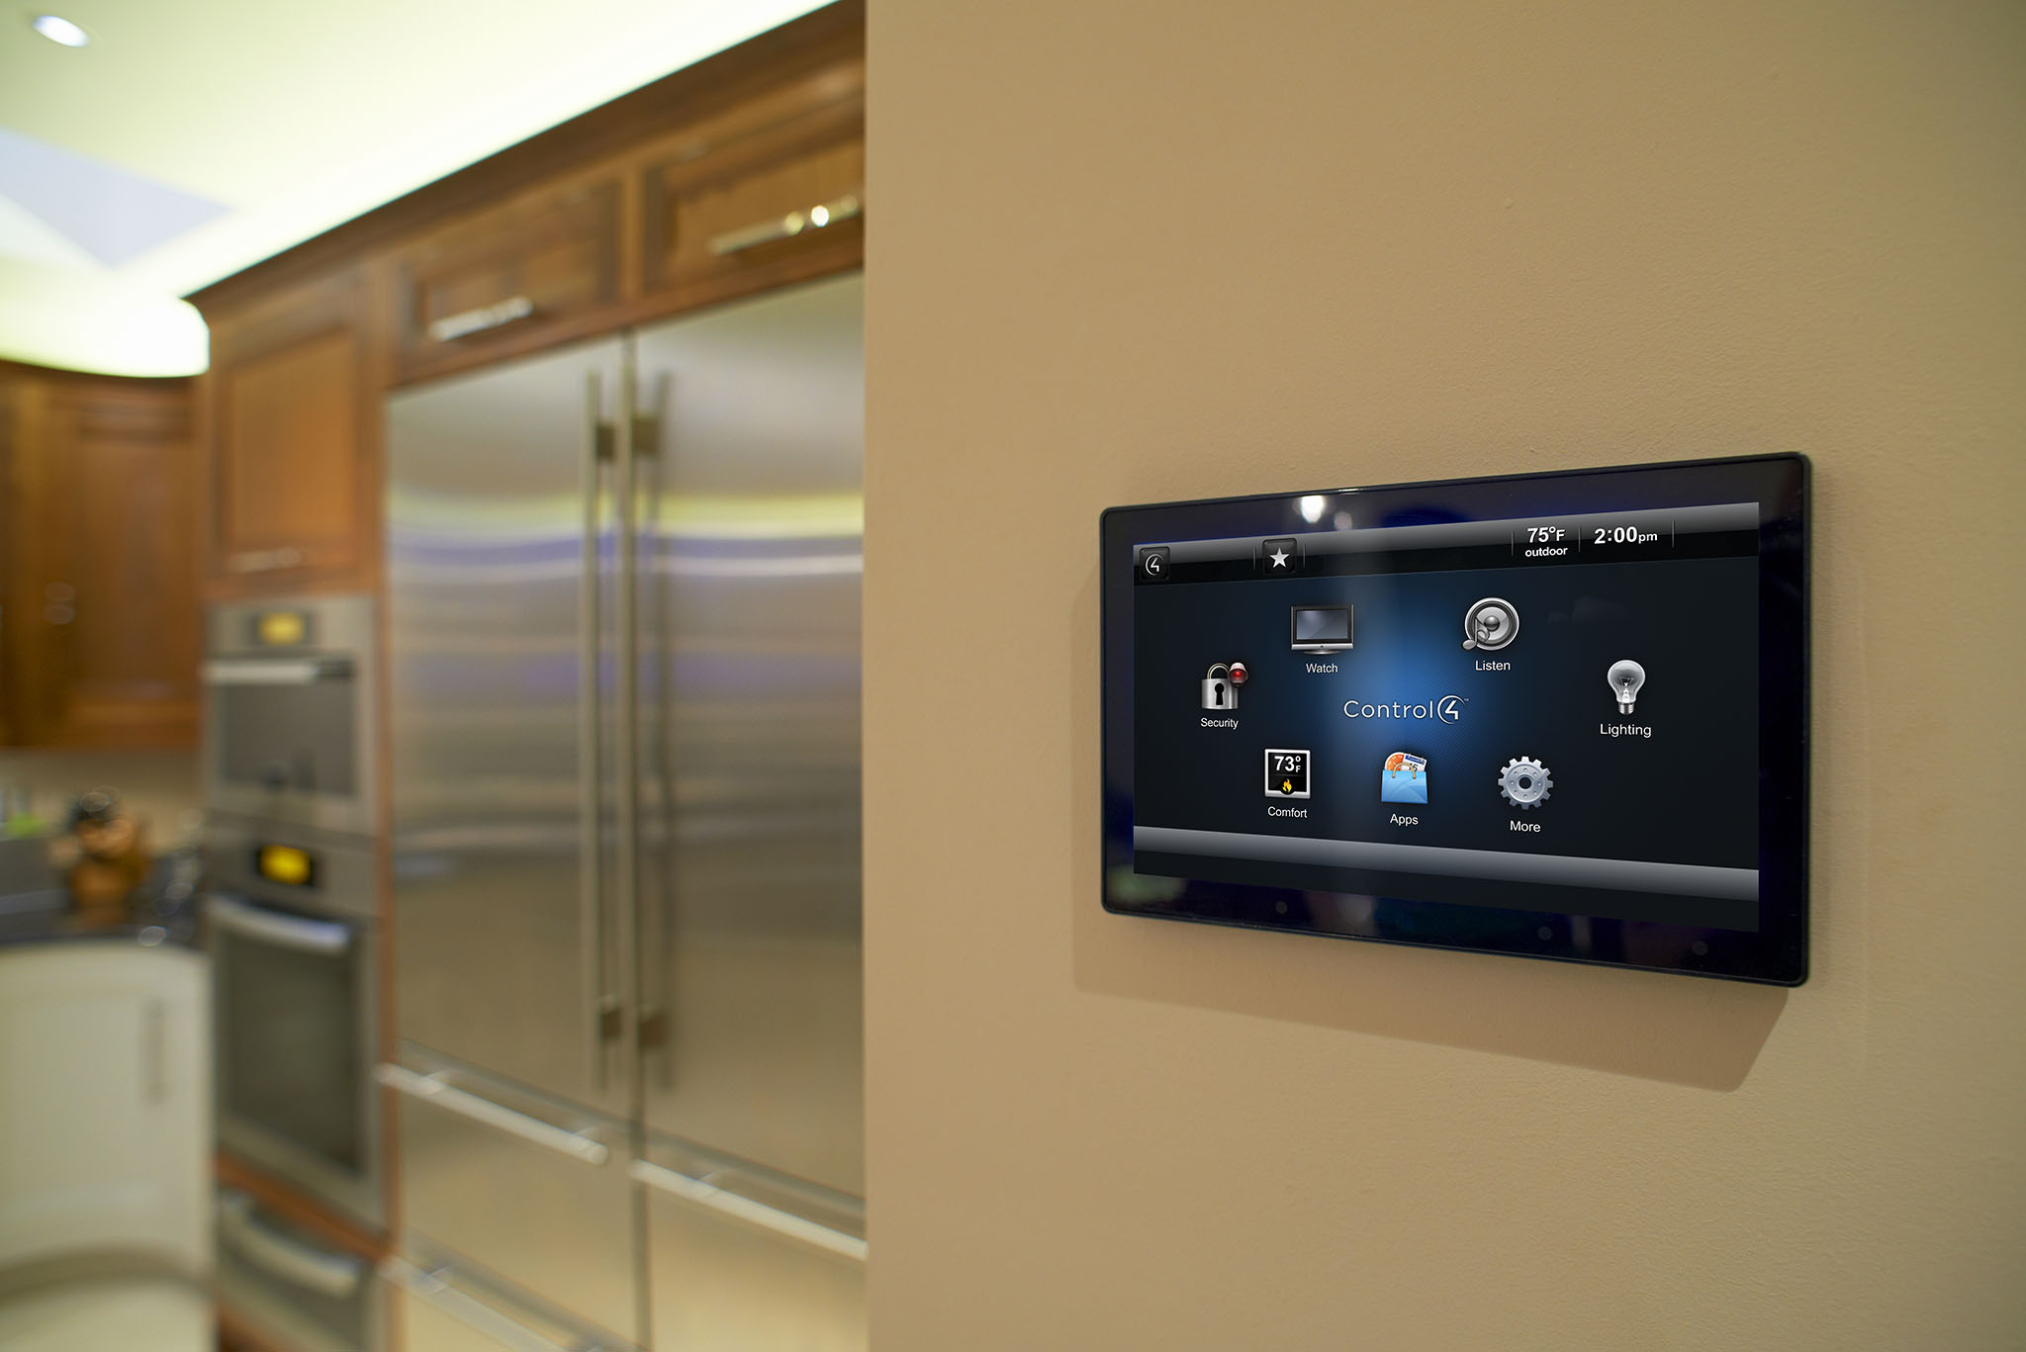
Smart Home System

Slide 2
Presented By:
Hasan,Morad
Shaker,Abu
Jabil,Farhan Hassan
Kowshik Chokraborty

Slide 3
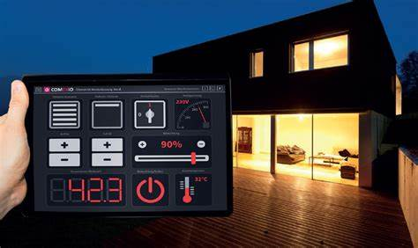
What is smart home ?

Slide 4

Why Smart Home?

Slide 5
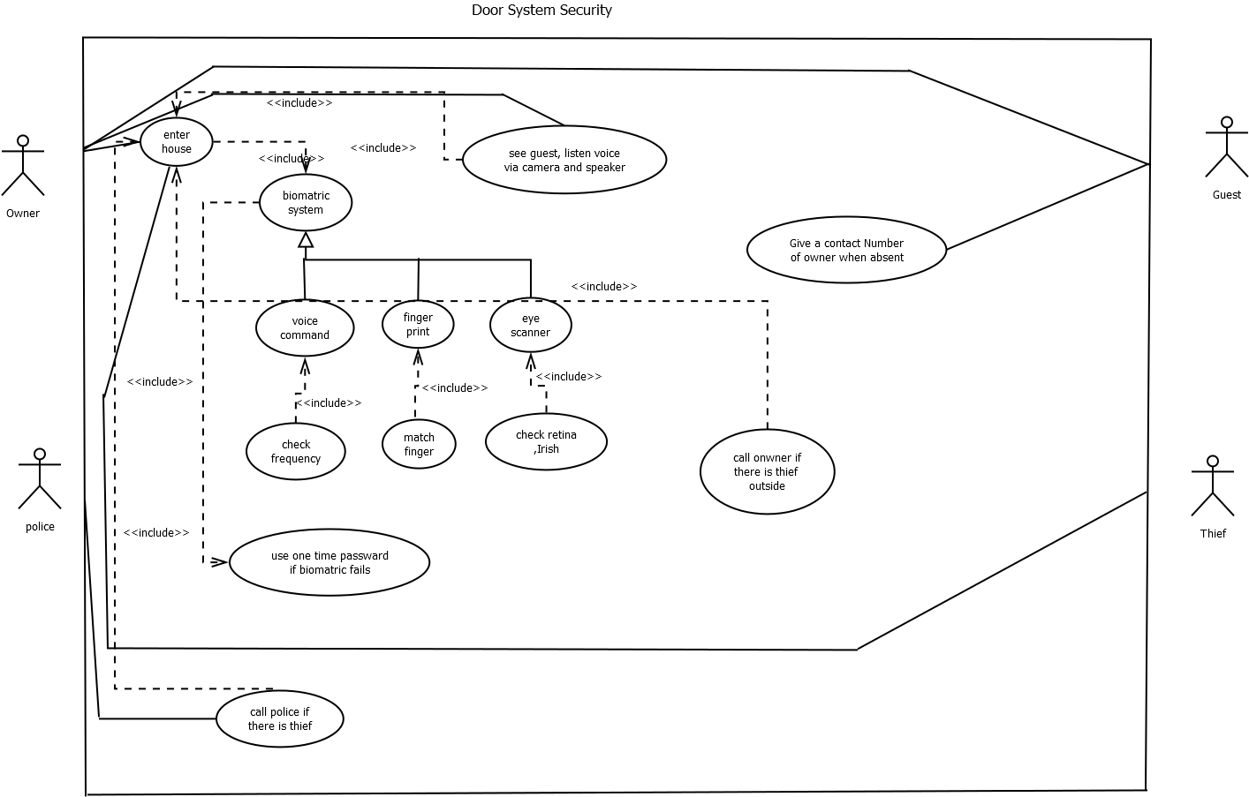
UML Diagram:
Use Case Diagram:

Slide 6
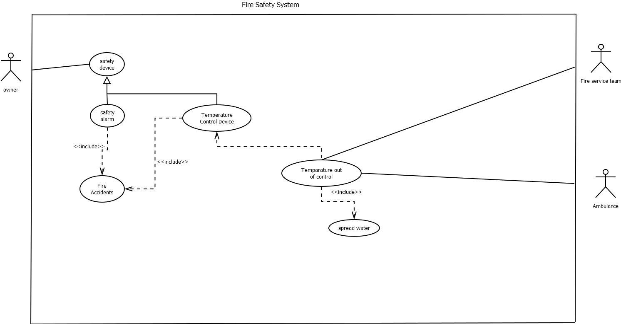

Slide 7
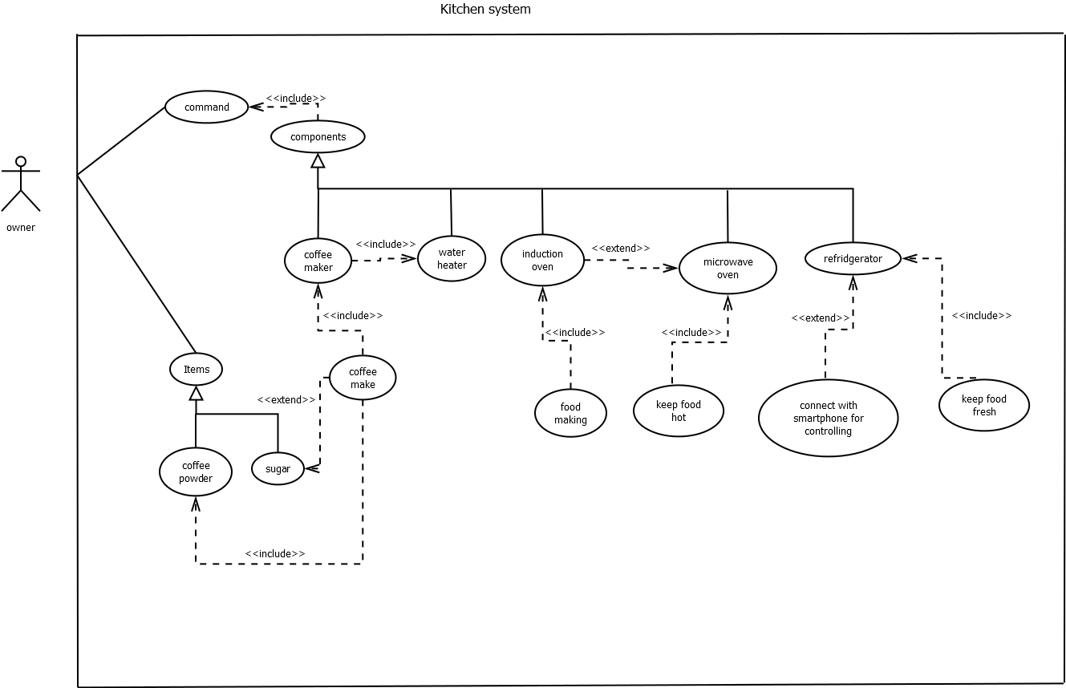

Slide 8
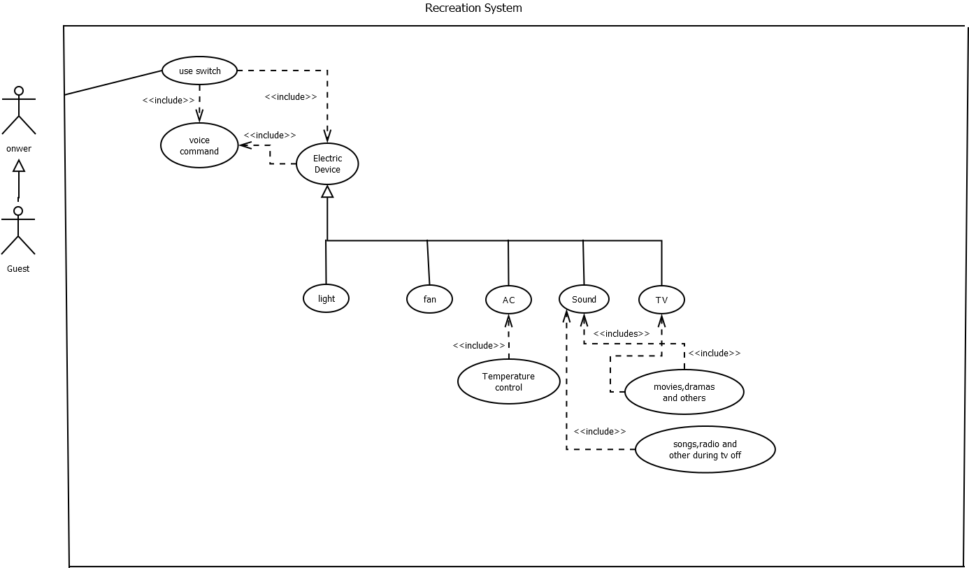

Slide 9
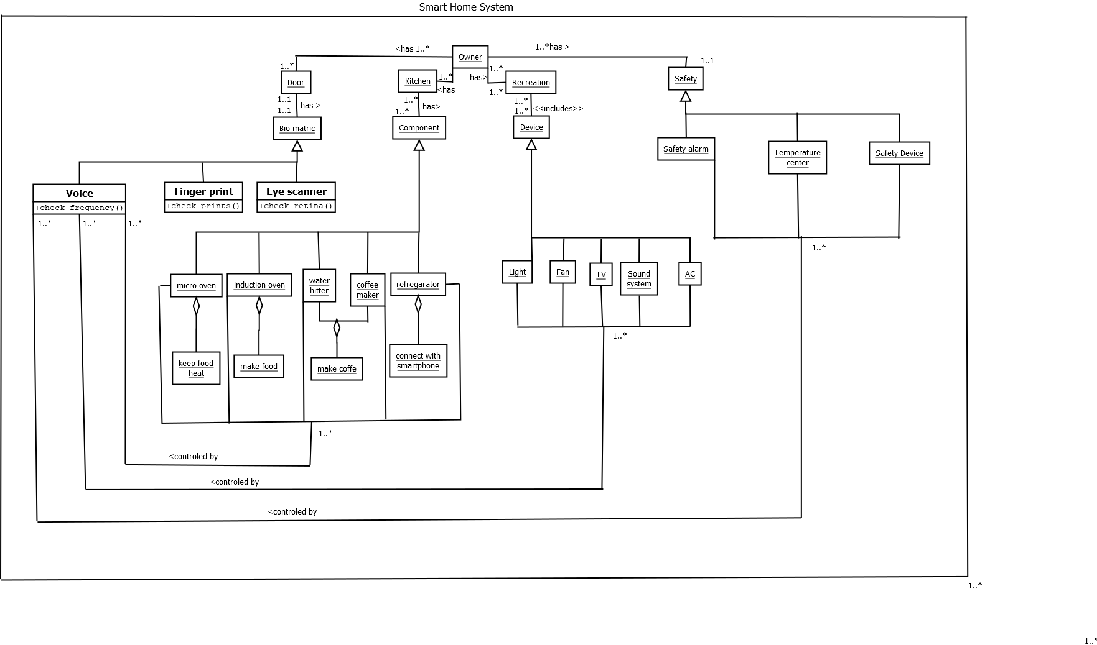
Class Diagram:

Slide 10
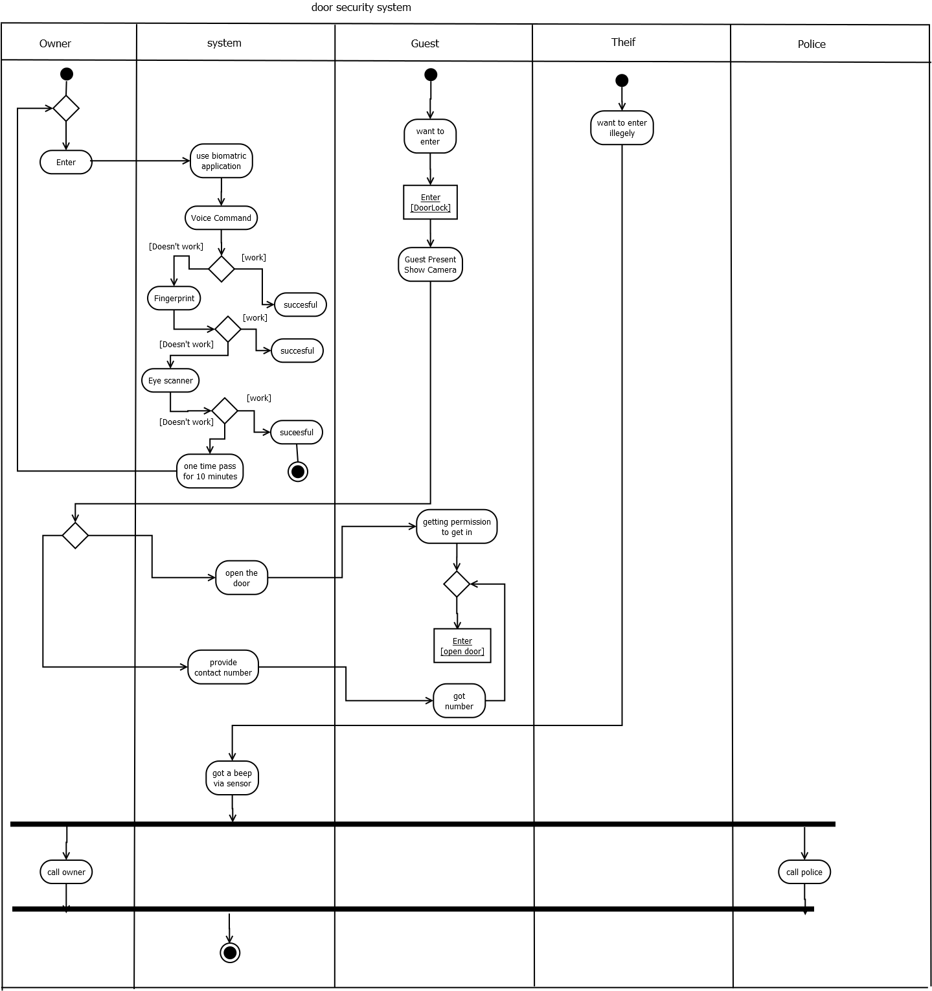
Activity Diagram:

Slide 11
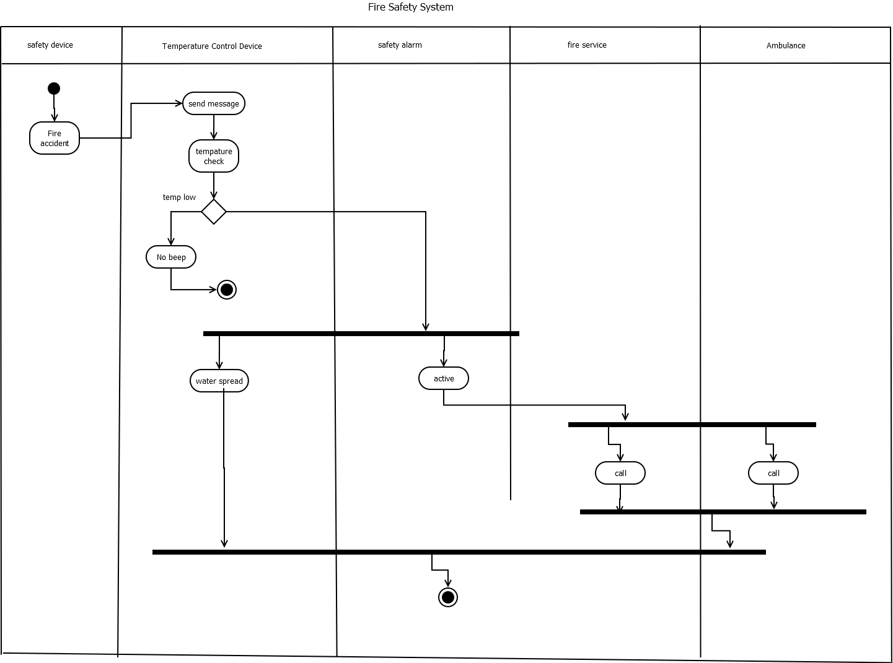

Slide 12
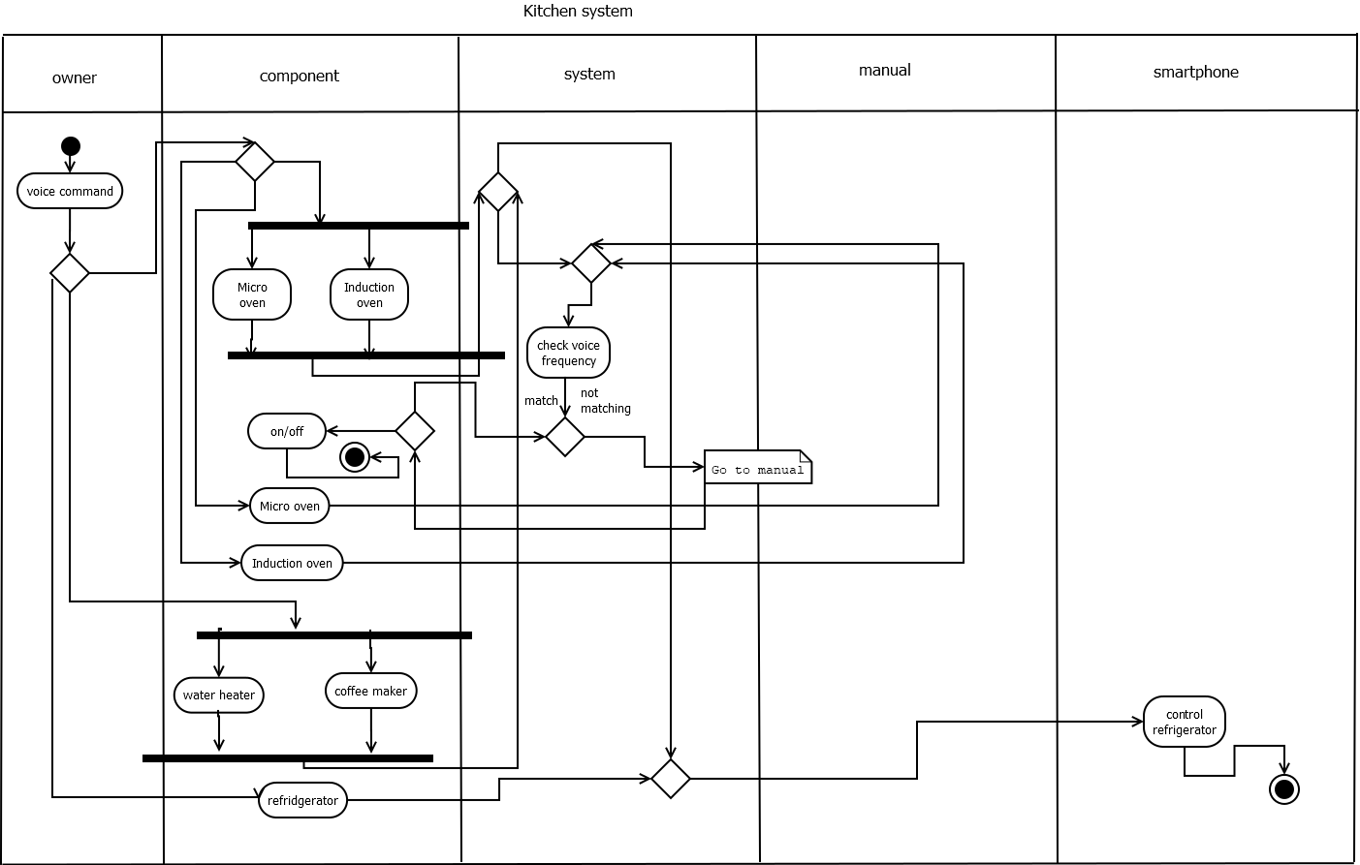

Slide 13
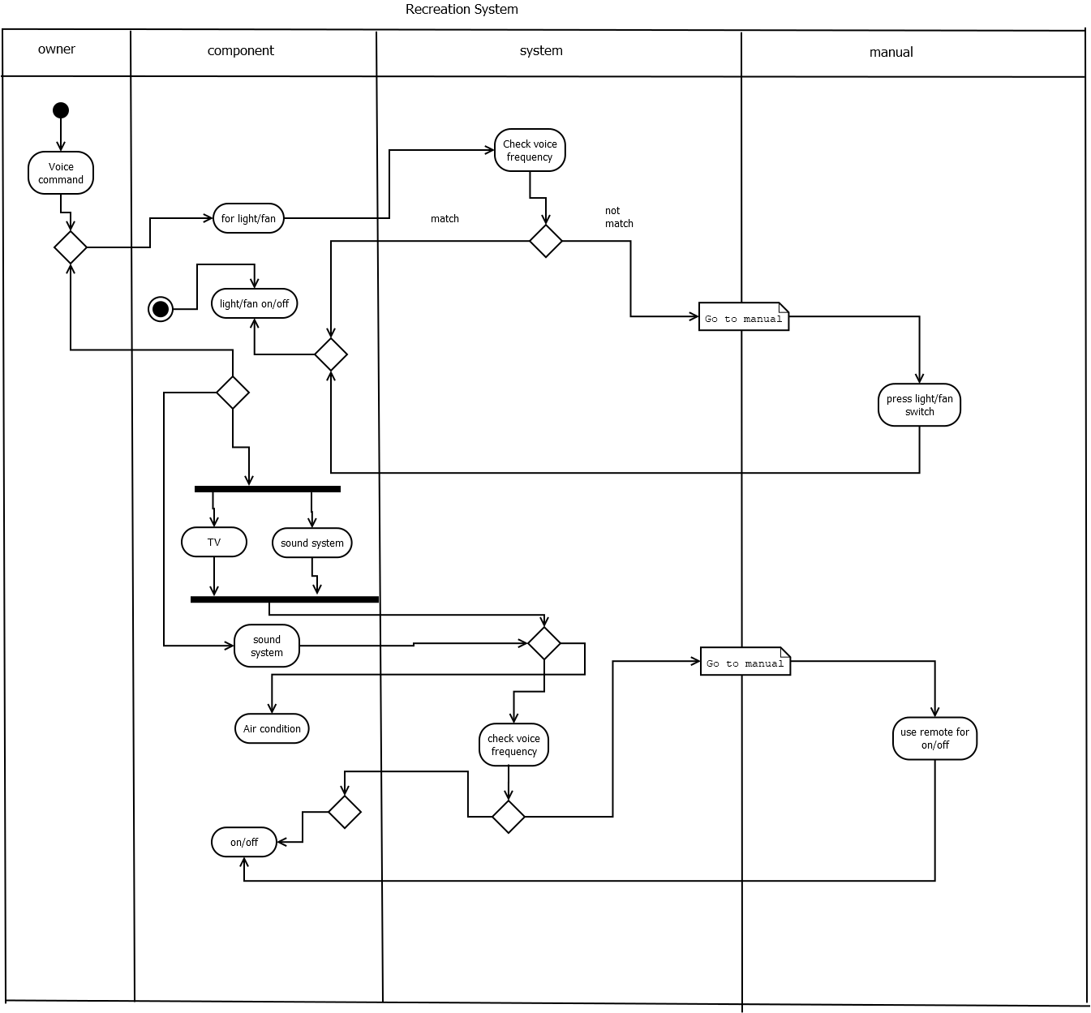

Slide 14
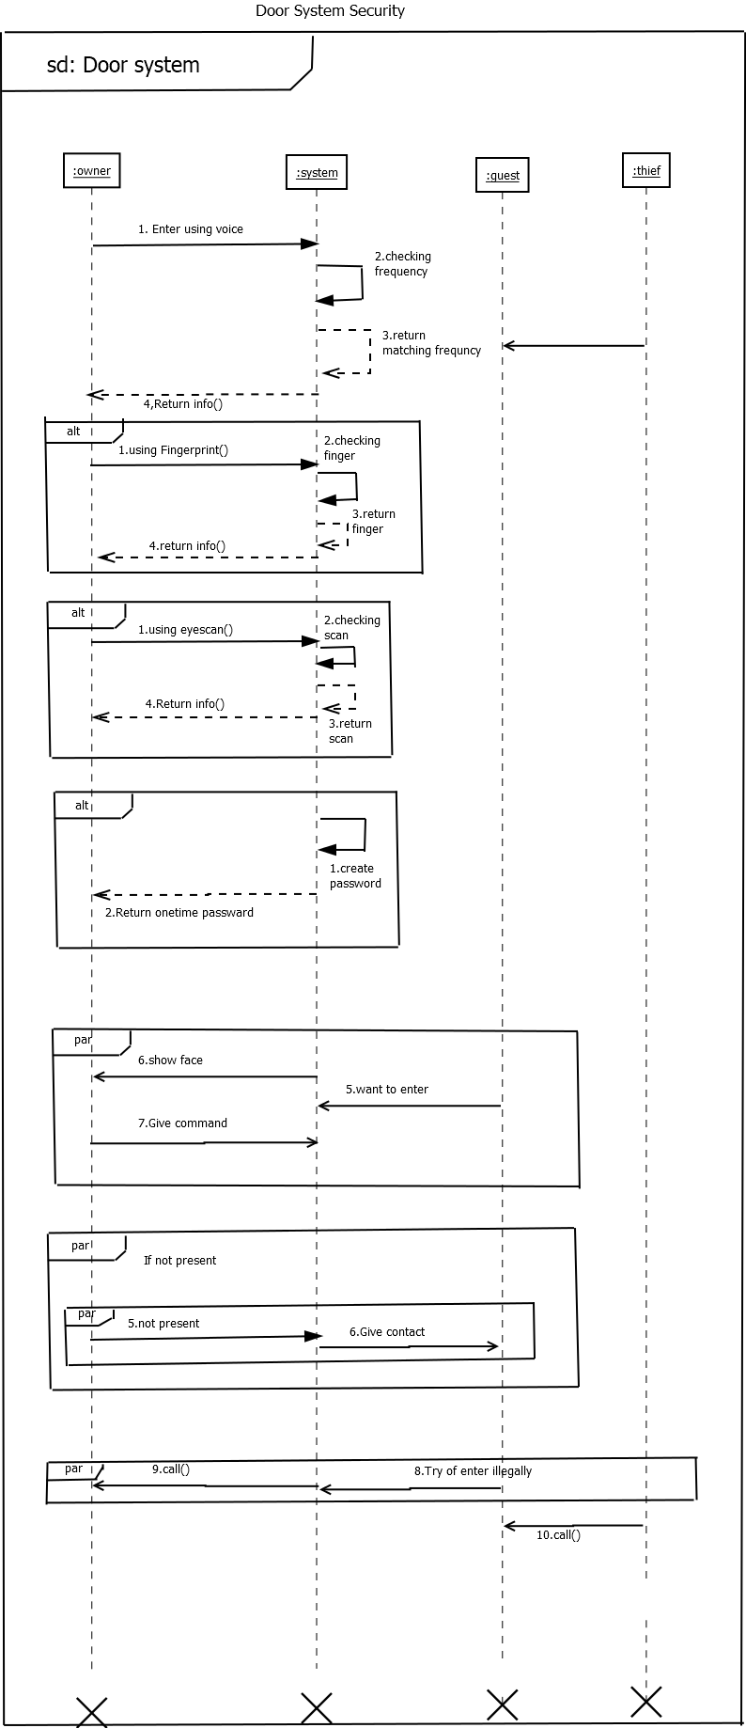
Sequence:

Slide 15
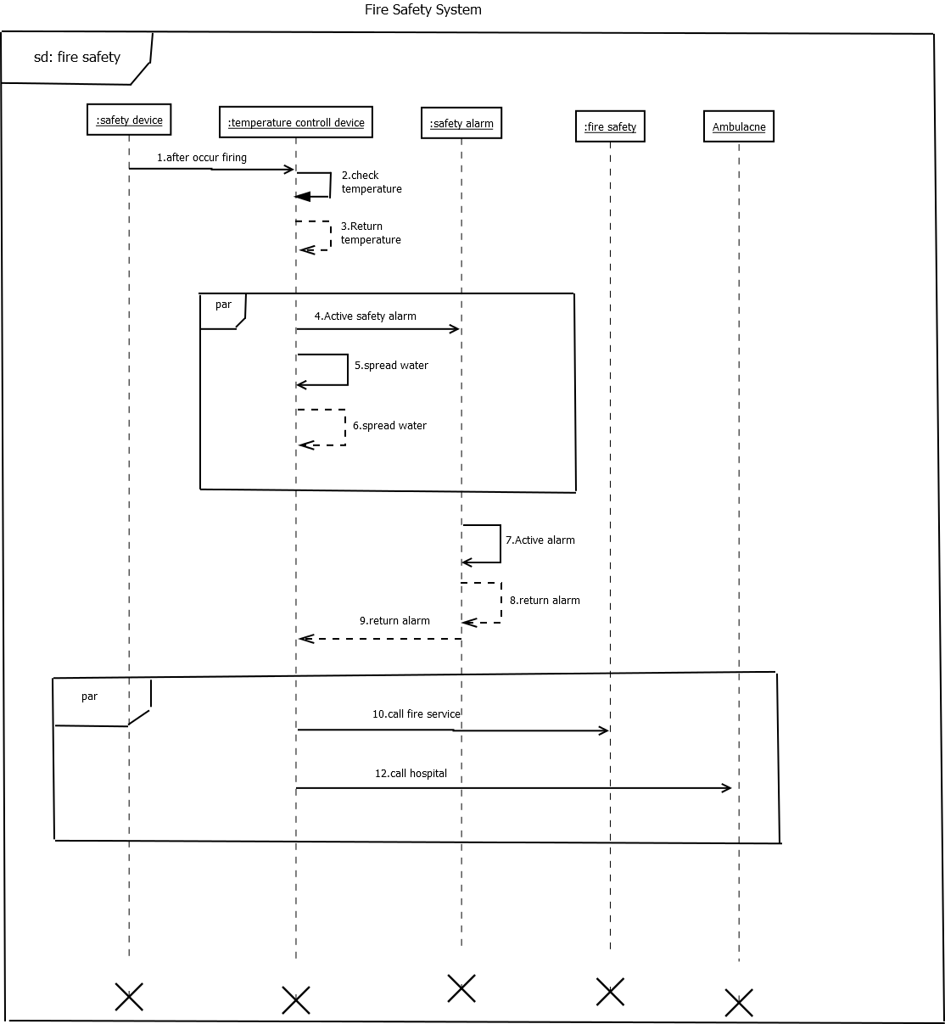

Slide 16
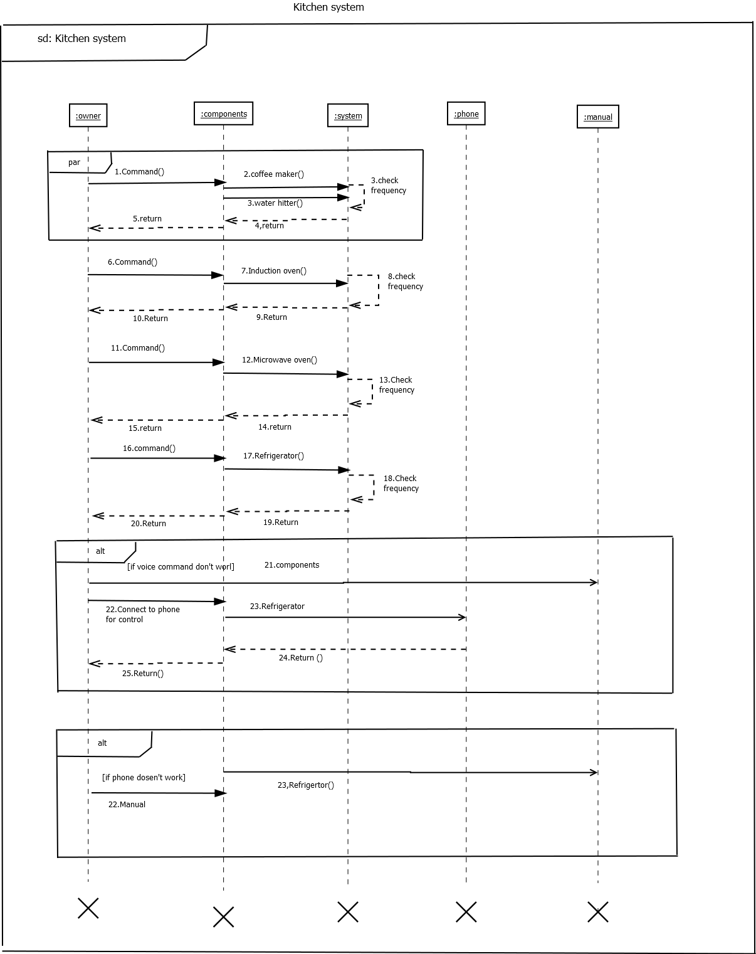

Slide 17
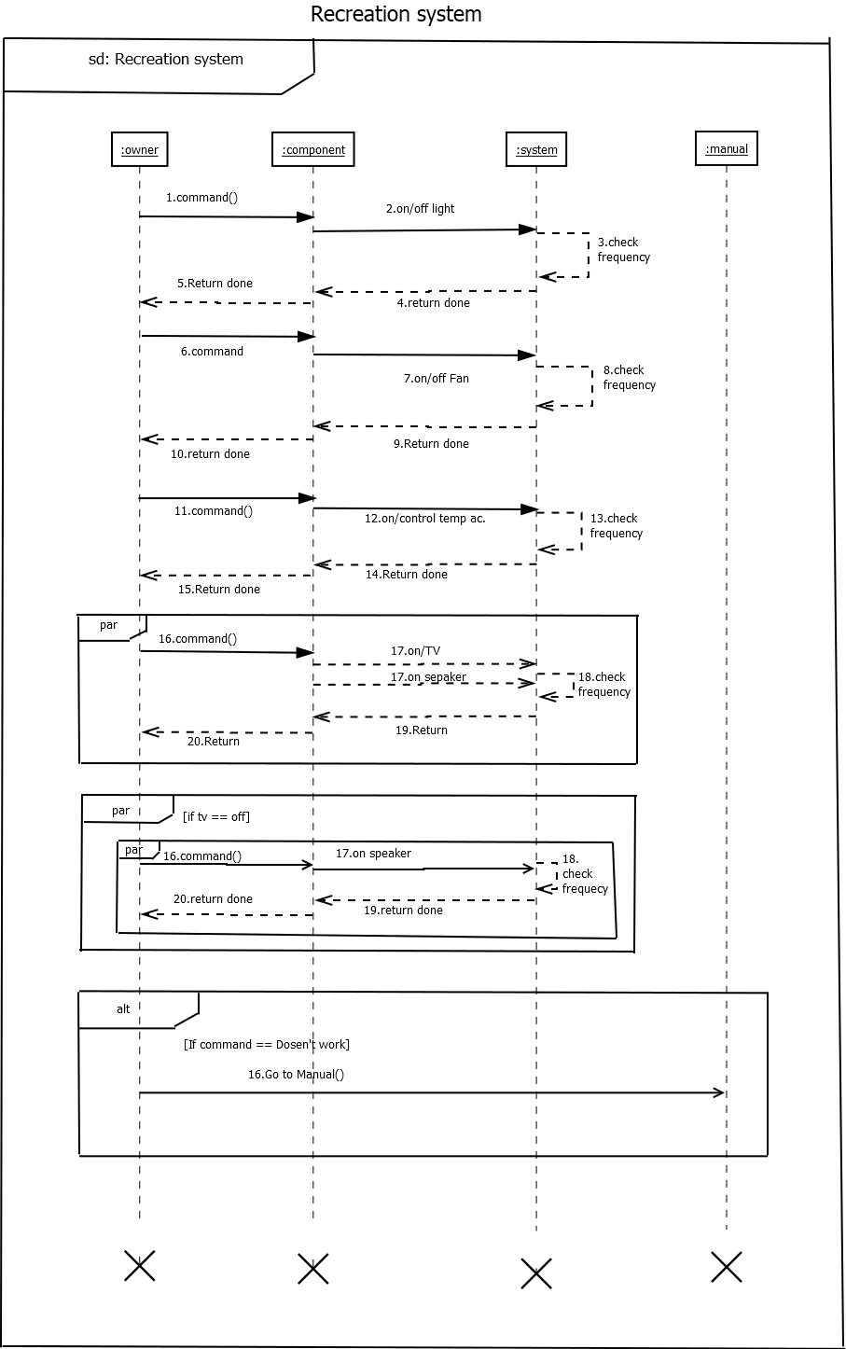

Slide 18
THANK YOU

