Slide 1
DOMAIN NAME SERVER/SYSTEM: DNS

Slide 2
The DNS is…
The “Domain Name System”
What Internet users use to reference anything by name on the Internet
The mechanism by which Internet software translates names to attributes such as addresses

Slide 3
The DNS is also…
A globally distributed, scalable, reliable database
Comprised of three components
  A “name space”
  Servers making that name space available
  Resolvers (clients) which query the servers about the name space

Slide 4
DNS as a Lookup Mechanism
Users generally prefer names to numbers
Computers prefer numbers to names
DNS provides the mapping between the two
  I have “x”, give me “y”

Slide 5
DNS as a Database
Keys to the database are “domain names”
  www.foo.com, 18.in-addr.arpa, 6.4.e164.arpa
Over 200,000,000 domain names stored
Each domain name contains one or more attributes
  Known as “resource records”
Each attribute individually retrievable

Slide 6
Global Distribution
Data is maintained locally, but retrievable globally
  No single computer has all DNS data
DNS lookups can be performed by any device
Remote DNS data is locally cachable to improve performance

Slide 7
Reliability
Data is replicated
  Data from master is copied to multiple slaves
Clients can query
  Master server
  Any of the copies at slave servers
Clients will typically query local caches

Slide 8
Dynamicity
Database can be updated dynamically
  Add/delete/modify of any record
  Only master can be dynamically updated
Modification of the master database triggers replication

Slide 9
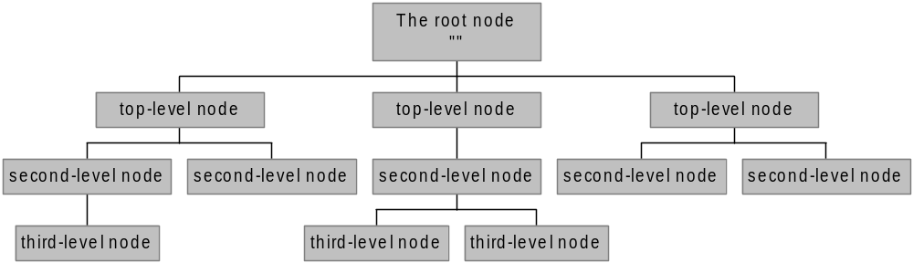
The Name Space
The name space is the structure of the DNS database
  An inverted tree with the root node at the top
Each node has a label
  The root node has a null label, written as “”

Slide 10
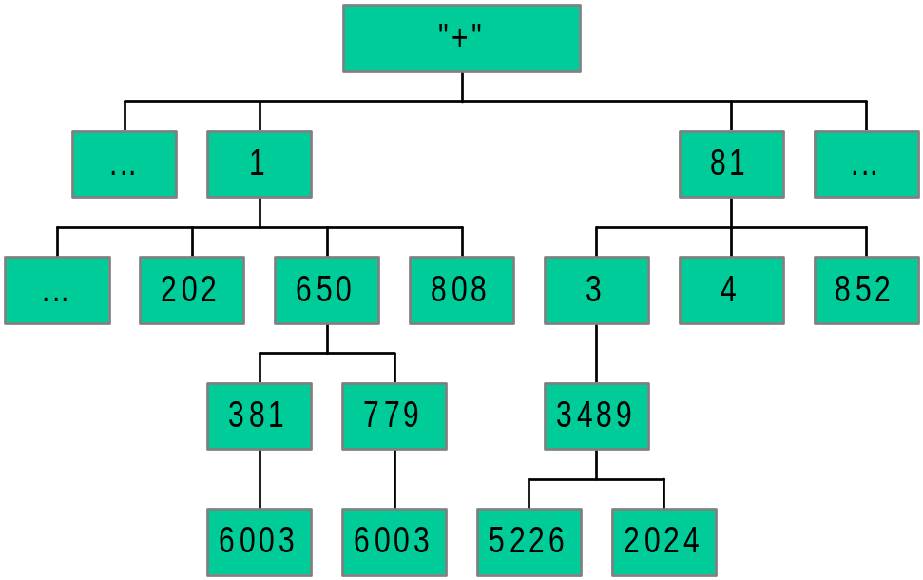
An Analogy
Root node maintained by the ITU (call it “+”)
Top level nodes = country codes (1, 81, etc)
Second level nodes = regional codes (1-402, 81-3, etc.)
Notes:
ITU: International Telecommunication Union
1: US/CA
81: JP

Slide 11
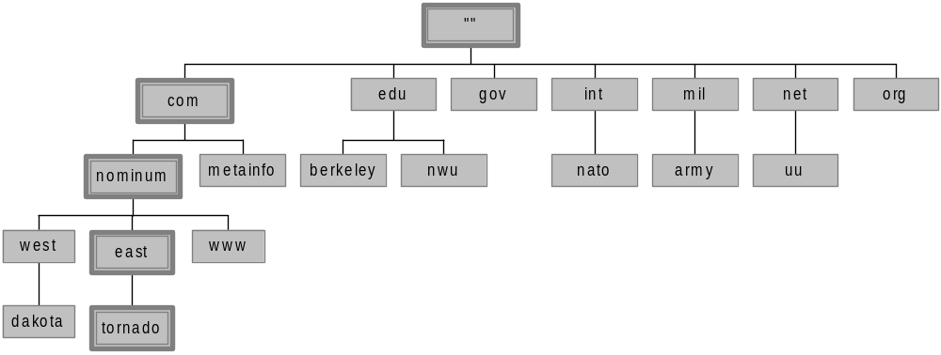
Domain Names
A domain name is the sequence of labels from a node to the root, separated by dots (“.”s), read left to right
  The name space has a maximum depth of 127 levels
  Domain names are limited to 255 characters in length
A node’s domain name identifies its position in the name space

Slide 12
Name Resolution
A DNS query has three parameters:
  A domain name (e.g., www.nominum.com),
    Remember, every node has a domain name!
  A class (e.g., IN), and
  A type (e.g., A)
Upon receiving a query from a resolver, a name server
  1) looks for the answer in its authoritative data and its cache
  2) If step 1 fails, the answer must be looked up

Slide 13
The Resolution Process
Let’s look at the resolution process step-by-step:
annie.west.sprockets.com

Slide 14
The Resolution Process
The workstation annie asks its configured name server, dakota, for www.nominum.com’s address
dakota.west.sprockets.com
What’s the IP address of www.nominum.com?
annie.west.sprockets.com

Slide 15
The Resolution Process
The name server dakota asks a root name server, m, for www.nominum.com’s address
m.root-servers.net
dakota.west.sprockets.com
What’s the IP address of www.nominum.com?
annie.west.sprockets.com

Slide 16
The Resolution Process
The root server m refers dakota to the com name servers
This type of response is called a “referral”
m.root-servers.net
dakota.west.sprockets.com
Here’s a list of the com name servers. Ask one of them.
annie.west.sprockets.com

Slide 17
The Resolution Process
The name server dakota asks a com name server, f, for www.nominum.com’s address
What’s the IP address of www.nominum.com?
m.root-servers.net
dakota.west.sprockets.com
f.gtld-servers.net
annie.west.sprockets.com

Slide 18
The Resolution Process
The com name server f refers dakota to the nominum.com name servers
Here’s a list of the nominum.com name servers. Ask one of them.
m.root-servers.net
dakota.west.sprockets.com
f.gtld-servers.net
annie.west.sprockets.com

Slide 19
The Resolution Process
The name server dakota asks a nominum.com name server, ns1.sanjose, for www.nominum.com’s address
What’s the IP address of www.nominum.com?
m.root-servers.net
dakota.west.sprockets.com
ns1.sanjose.nominum.net
f.gtld-servers.net
annie.west.sprockets.com

Slide 20
The Resolution Process
The nominum.com name server ns1.sanjose responds with www.nominum.com’s address
m.root-servers.net
dakota.west.sprockets.com
Here’s the IP address for www.nominum.com
ns1.sanjose.nominum.net
f.gtld-servers.net
annie.west.sprockets.com

Slide 21
The Resolution Process
The name server dakota responds to annie with www.nominum.com’s address
Here’s the IP address for www.nominum.com
m.root-servers.net
dakota.west.sprockets.com
ns1.sanjose.nominum.net
f.gtld-servers.net
annie.west.sprockets.com

Slide 22
THERE ARE TWO TYPES OF NAME RESOLUTION
ITTERATIVE NAME RESOLUTION
RECURSIVE NAME RESOLUTION

Slide 23
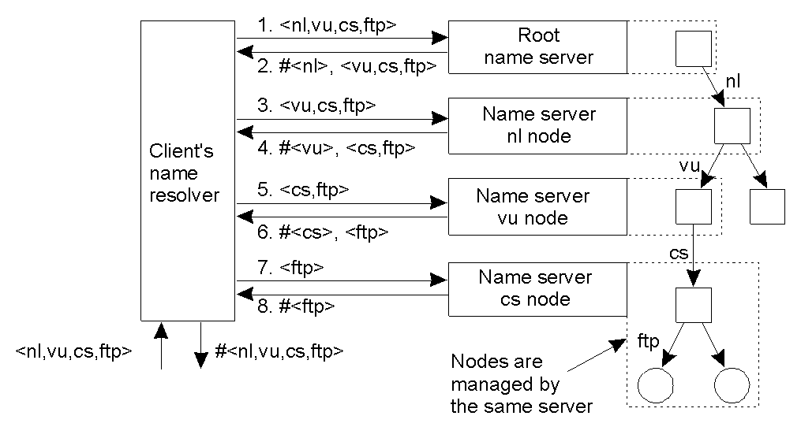
Iterative Name Resolution
The principle of iterative name resolution.

Slide 24
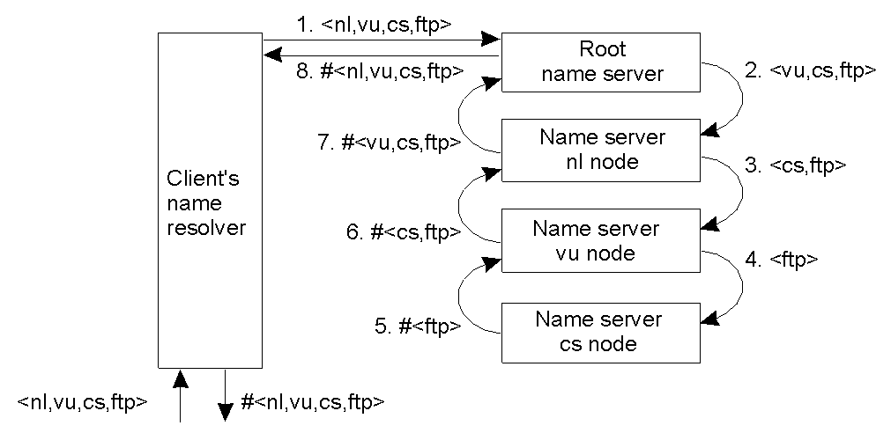
Recursive Name Resolution
The principle of recursive name resolution.

Slide 25
Registries, Registrars, and Registrants
Registry updates
zone
Master
updated
Registry
Zone DB
Registrar submits
add/modify/delete
to registry
Slaves
updated
Registrar
Registrar
Registrar
End user requests
add/modify/delete
Registrants

Slide 26
IMPLEMENTATION OF DNS
IN LOCAL HOST
IN LAN
IN INTERNET

Slide 27
IN LOCAL HOST
WE NEED TO CHANGE ENTRIES OF /ETC/HOSTS FILE AND WE ARE DONE.
127.0.0.1 localhost
127.0.0.1 localhost
10.2.0.30 cit

Slide 28
2. IN LAN
TO IMPLEMENT DNS SERVER FOR A LAN, WE NEED TO INSTALL DNSMASQ.
sudo apt-get install dnsmasq
Now by changing /etc/dnsmasq.conf to local area router configuration, dns server works in local area network.

Slide 29
3. IN INTERNET
WE NEED TO USE BIND 9.
WE MUST HAVE A SERVER AND A DOMAIN NAME

Slide 30
Questions?
?

