Slide 1
Linux Kernel Modules
Insertion and Deletion

Slide 2
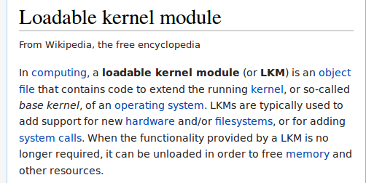
What exactly is a LKM?

Slide 3
What exactly does an LKM do?
Typically , a module might implement a device driver, a file system,or a networking protocol but in theory ,there is no restriction on what a kernel module is allowed to do.

Slide 4
Why Modularity?
Advantages
  1. Can be easily added and removed
  2. Aren't permanent, can be removed anytime
  3. Whole kernel doesn't have to be compiled again
  4. Can be compiled at runtime (ie no reboot)

Slide 5
Installing a new module!
Prelim: Install linux headers.
sudo apt-get install build-essential linux-headers-$(uname -r)

Slide 6
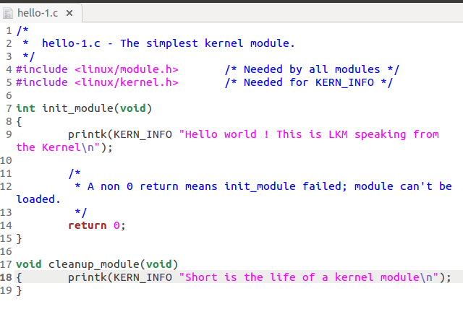

Slide 7
Kernel modules must have at least two functions: a "start" (initialization) function called init_module() which is called when the module is insmoded(inserted) into the kernel, and an "end" (cleanup) function called cleanup_module() which is called just before it is rmmoded(deleted).
If you see closely then you will find that we have used ‘printk’ instead of ‘printf’. This is because it is not a normal C programming, its a kernel level programming which is a bit different from normal user level programming.

Slide 8
Compilation
make
The purpose of the make utility is to determine automatically which pieces of a large program need to be recompiled, and issue the commands to recompile them.
To use make command you must write a file called the makefile that describes the relationships among files in your program, and the states the commands for updating each file.
Once a suitable makefile exists, each time you change some source files, this simple shell command:
make
suffices to perform all necessary recompilations.

Slide 9
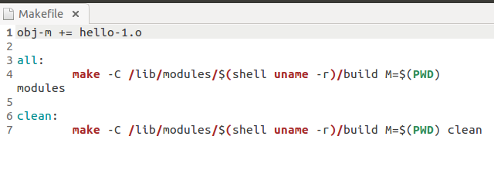
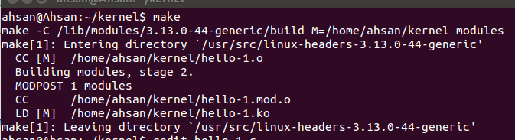

Slide 10
Loading LKM
After a successful compilation and creation of the module, now is the time to insert it in the kernel so that it gets loaded on run time. The insertion of the module can be achieved using the following two utilities :
modprobe
insmod

Slide 11
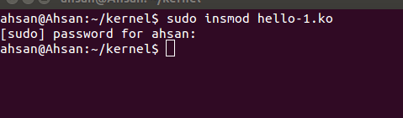
To see the presently loaded LKMs, do cat /proc/modules

Slide 12
Unloading LKM
To unload the LKM, the following command is used :
$ sudo rmmod hello-1.ko
Again, if this command does not give any error then that means the LKM is un-loaded successfully from the kernel.

