Slide 1
RAID
Shadab Khan
Saurabh Mehta
Shahnawaz Ahmad

Slide 2
Introduction
RAID stands for redundant array of independent disks. RAID is a data storage technology that combines multiple disk drive components into a logical unit for the purposes of data redundancy and performance improvement. Data is distributed across the drives in one of several ways, referred to as RAID levels, depending on the specific level of redundancy and performance required.

Slide 3
RAID Levels
RAID 0: It comprises striping (but no parity or mirroring). This level provides no data redundancy nor fault tolerance, but improves performance through parallelism of read and write operations across multiple drives. RAID 0 has no error detection mechanism, so the failure of one disk causes the loss of all data on the array.
RAID 1: It comprises mirroring (without parity or striping). Data are written identically to two (or more) drives, thereby producing a "mirrored set".
RAID 2: It comprises bit-level striping with dedicated Hamming-code parity. It is not used by any current commercially available systems.

Slide 4
RAID Levels (contd.)
RAID 3: It comprises byte-level striping with dedicated parity.
RAID 4: It comprises block-level striping with dedicated parity.
RAID 5: It comprises block-level striping with distributed parity. Unlike in RAID 4, parity information is distributed among the drives. It requires that all drives but one be present to operate. It requires ateast three disks.
RAID 6: It comprises block-level striping with double distributed parity. Double parity provides fault tolerance up to two failed drives.

Slide 5
RAID Levels (contd.)
RAID 0+1: It consists of striped sets in a mirrored set (minimum four drives; even number of drives) provides fault tolerance and improved performance but increases complexity.
RAID 1+0: It consists of mirrored sets in a striped set (minimum four drives; even number of drives) provides fault tolerance and improved performance but increases complexity.
The key difference from RAID 1+0 is that RAID 0+1 creates a second striped set to mirror a primary striped set.
These are called Nested or Hybrid RAIDs.

Slide 6
Advantages of RAID
RAID allows form of backup of the data in the storage array in the event of a failure.
RAID is hot swappable, that is, if a drive fails it can be swapped with a new one without switching the system off.
Ensures data reliability, increase in Input Output performance and shadowing/mirroring at a lower cost.
Provides Disk Stripping to write data to disk, which improves performance by the interleaving of the bytes or the group of bytes.
Reading and Writing of data can be done simultaneously.

Slide 7
Disadvantages of RAID
RAID doesn’t make data recovery any easier.
RAID doesn’t always result in improved system performance.
RAID controllers are costly.
Have to be maintained by highly paid consultants.
They may slower system performance.
Data security is a major concern.

Slide 8
Implementations
Software Based Implementation:
Software implementations are provided by many Operating Systems.
A software layer sits above the disk device drivers and provides an abstraction layer between the logical drives (RAIDs) and physical drives.
Server's processor is used to run the RAID software.
Used for simpler configurations like RAID 0 and RAID 1.

Slide 9
Implementations (contd.)
Hardware Implementation:
A hardware implementation of RAID requires at least a special-purpose RAID controller.
On a desktop system this may be built into the motherboard.
Processor is not used for RAID calculations as a separate controller present.

Slide 10
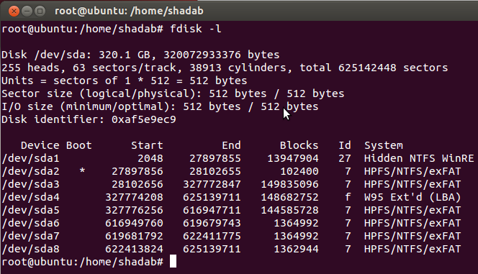
Implementing RAID 5
Identify the partitions (for RAID 5 the partitions should be of almost the same size. This is because RAID limits the extent of data access on each partition to an area no larger than that of the smallest partition in the RAID set.)
To view the mounted and unmounted partitions use
fdisk –l

Slide 11
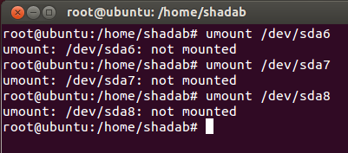
Implementing RAID 5
Unmount all the partitions:
umount <partition-name>

Slide 12
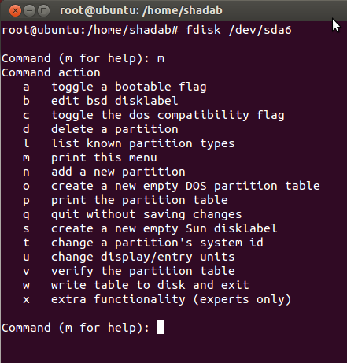
Implementing RAID 5
Prepare the partitions with fdisk. We need to change the type of each partition to type FD (linux raid auto-detect):
fdisk /dev/sda6
Use ‘m’ command for help:

Slide 13
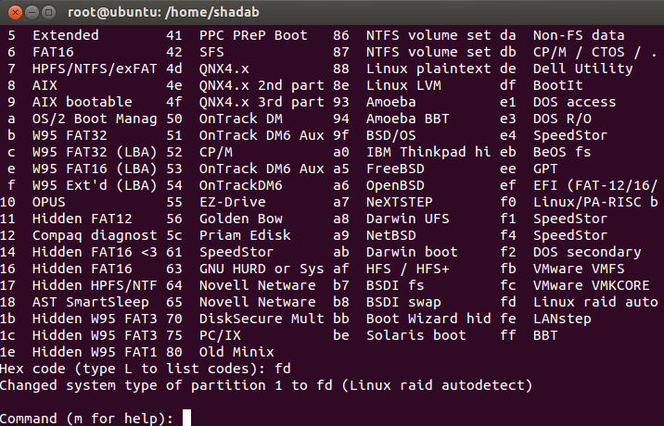
Implementing RAID 5
Use the ‘t’ command to change the type.
Specify the partition.
Set the ID type:
Use the ‘L’ command to get a full listing of ID types.

Slide 14
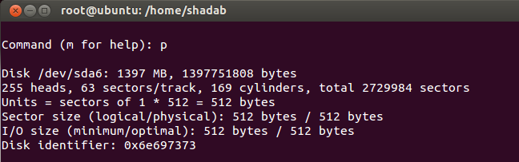
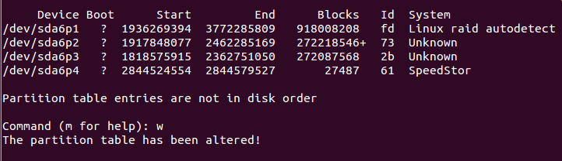
Implementing RAID 5
Make sure the changes were made:
use the ‘p’ command to get the new proposed partition table.
Save changes:
Use ‘w’ command to save the changes permanently.

Slide 15
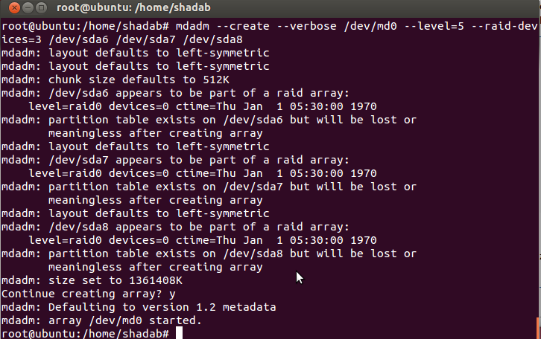
Implementing RAID 5
Repeat the above steps for all other partitions.
Prepare the RAID set.
Use the ‘mdadm’ command with the –create option to create the RAID set.
mdadm --create –verbose /dev/md0 --level=5 \ --raid-devices=3 /dev/sda6 /dev/sda7 /dev/sda8

Slide 16
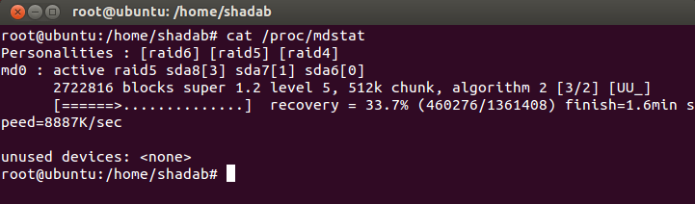
Implementing RAID 5
Confirm RAID is correctly initialized:
cat /proc/mdstat
The /proc/mdstat file provides the current status of all RAID devices. Confirm that the initialization has finished and there are no initialization related message (if there are, wait until there are none).

Slide 17
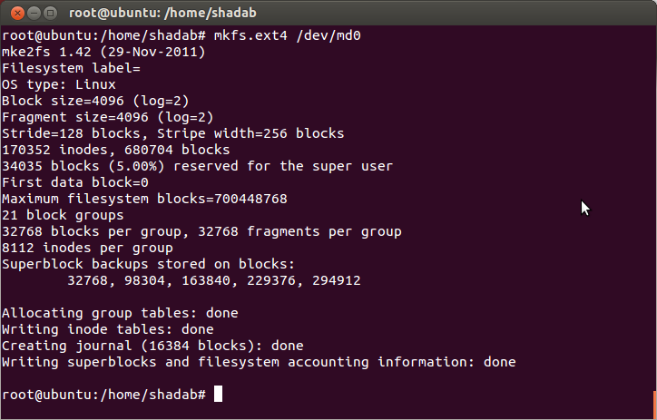
Implementing RAID 5
The new RAID set now needs to be formatted.
  Use mkfs.ext4 command.
  mkfs.ext4 /dev/md0

Slide 18
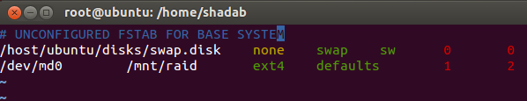
Implementing RAID 5
Create the mdadm.conf configuration file located in either the /etc or /etc/mdadm directory.
mdadm --detail --scan > /etc/mdadm/mdadm.conf
Create a mount point for RAID set.
mkdir /mnt/raid
Edit the /etc/fstab file.
The /etc/fstab file lists all the partitions that need to mount when the system boots. Add an Entry for the RAID set, the /dev/md0 device.
cat /etc/fstab
/dev/md0 /mnt/raid ext4 defaults 1 2

Slide 19
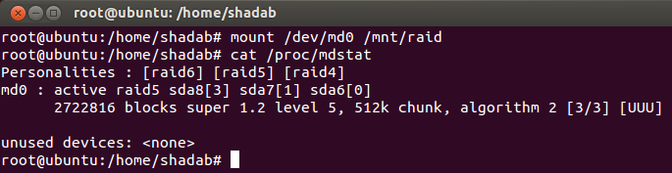
Implementing RAID 5
Make the entries for the partitions for /dev/sda6 /dev/sda7 /dev/sda8 as comments by putting a # before them or remove them entirely.
Mount the new RAID set.
There are two ways of doing this:
Auto-mounting: mount –a
Mounting manually: mount /dev/md0 /mnt/raid

Slide 20
Implementing RAID 5
Check the status of the new RAID set:
using the command
cat /proc/mdstat
Personalities : [raid5]
read_ahead 1024 sectors
md0 : active raid5 sda7[1] sda8[3] sda6[0]
4120448 blocks level 5, 32k chunk, algorithm 3 [3/3] [UUU]
unused devices: <none>

Slide 21
Thank You

