Slide 1
REAL TIME OPERATING SYSTEMS

Slide 2
WHAT IS RTOS?
A Real Time Operating System is an operating system tailor made for giving quick responses in real time applications. It is intended to serve Real Time application process data as it comes in, typically without buffering delays. RTOS is not characterized by the volume of work it can perform in a given time interval but rather the consistency in the time taken to do it.

Slide 3
DIFFERENCES BETWEEN RTOS AND GPOS
RTOS
Priority based scheduling
Kernel is pre-emptive either completely or upto maximum degree
Predictable behaviour
Priority inversion is a major issue
GPOS
Dynamically adjustable scheduling for optimised output
Kernel is non pre-emptive or have large non-preemptive code sections
No predicatbility
Priority inversion usually remains unnoticed

Slide 4
TYPES OF RTOS
HARD RTOS
Strict timing requirements
Optimized w.r.t. predictability and timing limits
Does not share critical resources such as CPU
Missing a single deadline causes system failure
Examples of application under hard real time
Defense applications
Fuel ignition controller for automobile engine
Life supporting medical equipment
Industrial control system

Slide 5
SOFT RTOS
Relatively tolerable timing deadlines
Tolerance is defined as a part of policy
Occasional deadline missing may not cause system failure
Examples of applications under soft real time
Audio processing
Real-time video processing
Network interface subsystem

Slide 6
FEATURES OF RTOS
Multitasking Capabilities : A RT application is divided into multiple tasks. The separation into tasks helps to keep the CPU busy.
Short Interrupt Latency : Interrupt Latency = Hardware delay to get interrupt signal to the processor + time to complete the current instruction + time executing system code in preparation for transferring execution to the devices interrupt handler.
Fast Context Switch : The time between the OS recognizing that the awaited event has arrived and the beginning of the waiting task is called context switch time(dispatch latency).This switching time should be minimum.

Slide 7
Control Of Memory Management : An OS should provide a way for tasks to lock its code and data into real memory so that it can guarantee predictable response to a interrupt.
Proper scheduling : An OS must provide the facility to schedule properly time constrained tasks.
Fine granularity Timer Services : Millisecond resolution is the bare minimum . Microseconds resolution is required in some cases.
Rich set of Inter Task Communication Mechanism : Message queues, shared memory , Synchronization –Semaphores, event flags

Slide 8
SCHEDULING IN RTOS
TYPES OF SCHEDULING POLICIES IN A RTOS
Co-operative Scheduling : It relies on the current process to give up the CPU.
Pre-emptive Scheduling :
Rate Monotonic Scheduling : Shorter the cycle duration of the process, greater the priority.
Round Robin Scheduling : Time Slices allocated to each process in a circular order.
Fixed Priority Pre-emptive Scheduling : The highest priority process is executed at any specific time.

Slide 9
EXAMPLES OF RTOS
LYNX OS
ENEA OSE : Embedded operating system used in 1.75 billion mobile handsets across the world.
QNX : Real time micro-kernel based operating system owned by Blackberry.
WINDOWS CE : RTOS developed by Microsoft. It uses an exclusive hybrid kernel.
FREE RTOS : Open source RTOS that occupies a very less amount of memory.

Slide 10
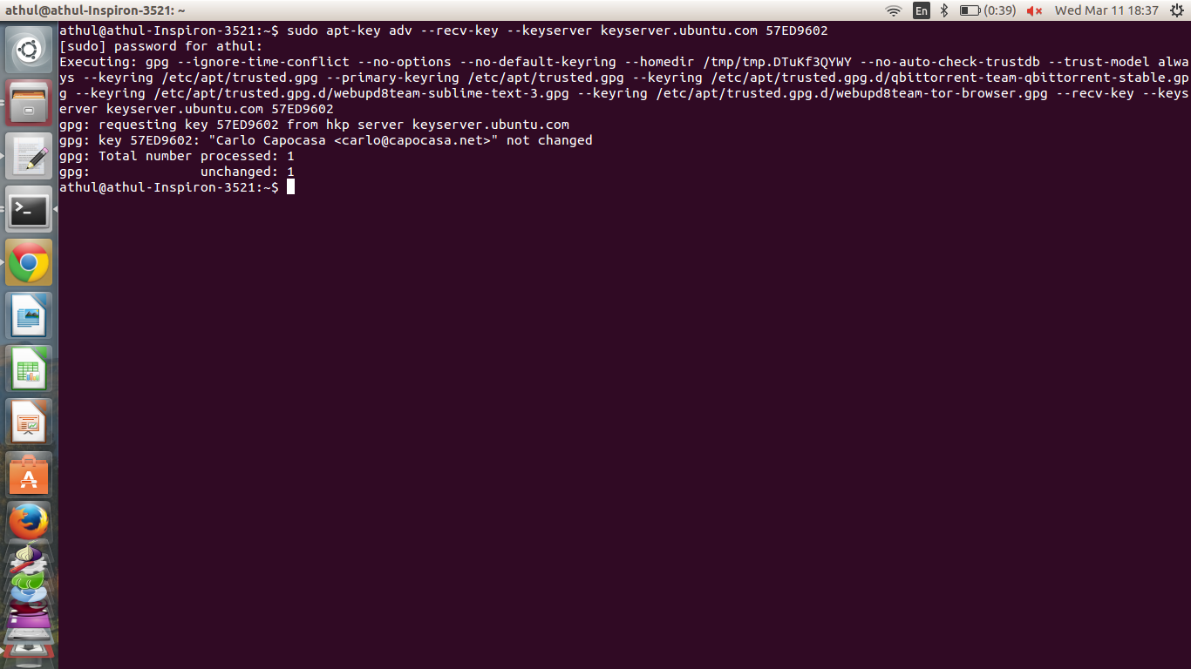
INSTALLING RTOS
1. Import the key to the keyring
sudo apt-key adv --recv-key --keyserver keyserver.ubuntu.com 57ED9602

Slide 11
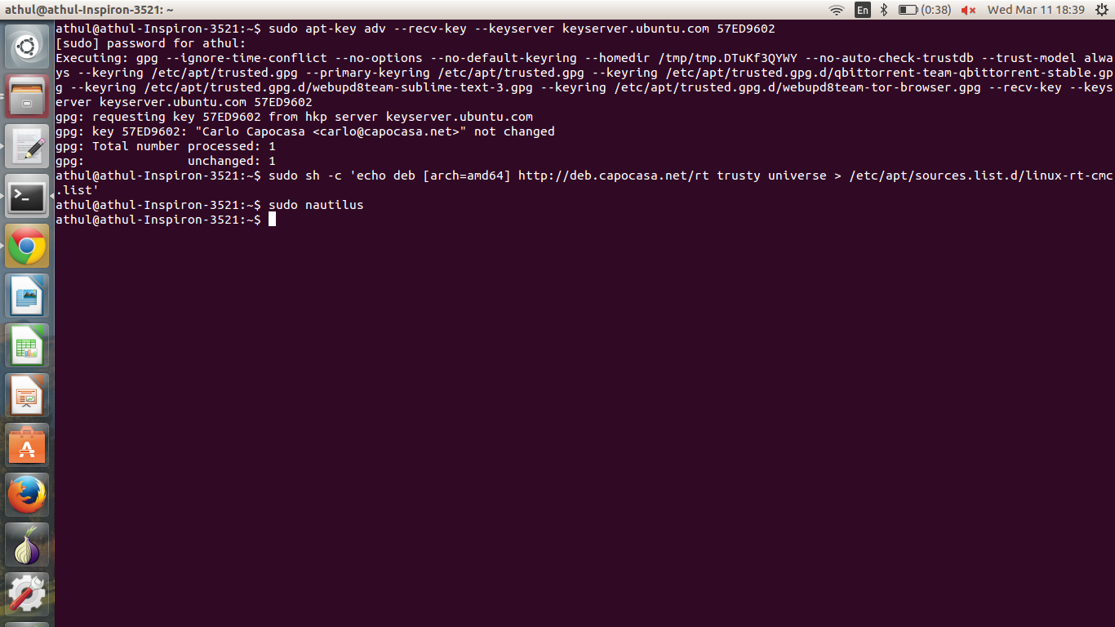
2. Add the repository sudo sh -c 'echo deb [arch=amd64] http://deb.capocasa.net/rt trusty universe > /etc/apt/sources.list.d/linux-rt-cmc.list'

Slide 12
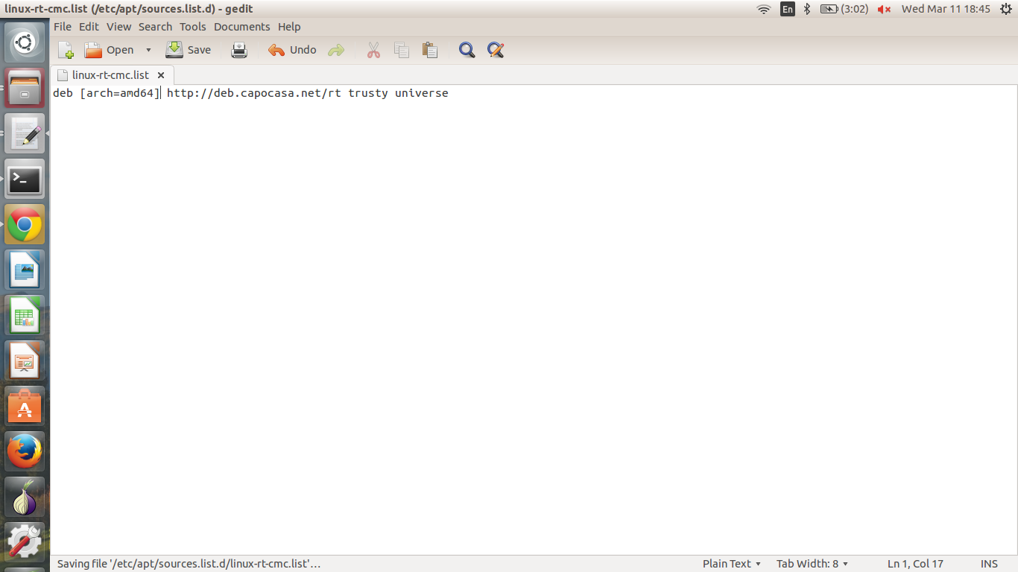
3. Check if linux-rt-cmc.list exists and verify its contents

Slide 13
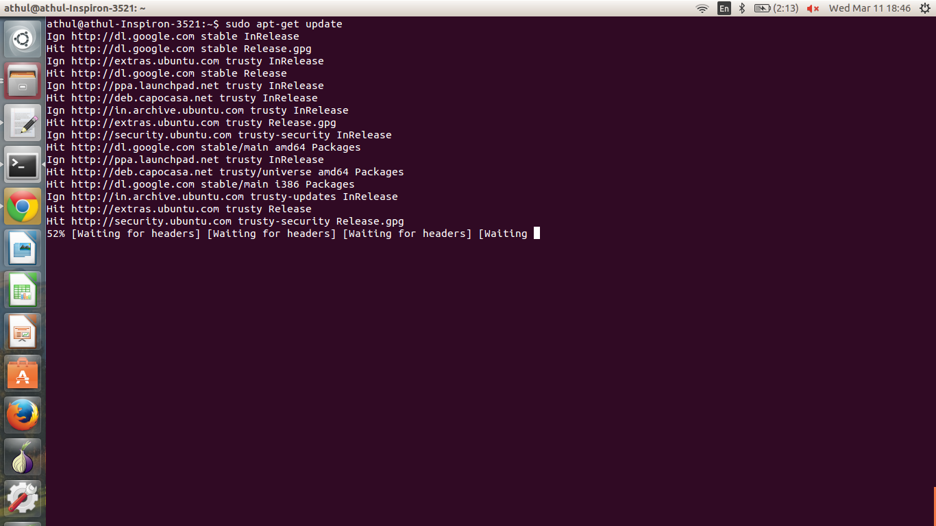
4. Update the sources sudo apt-get update

Slide 14
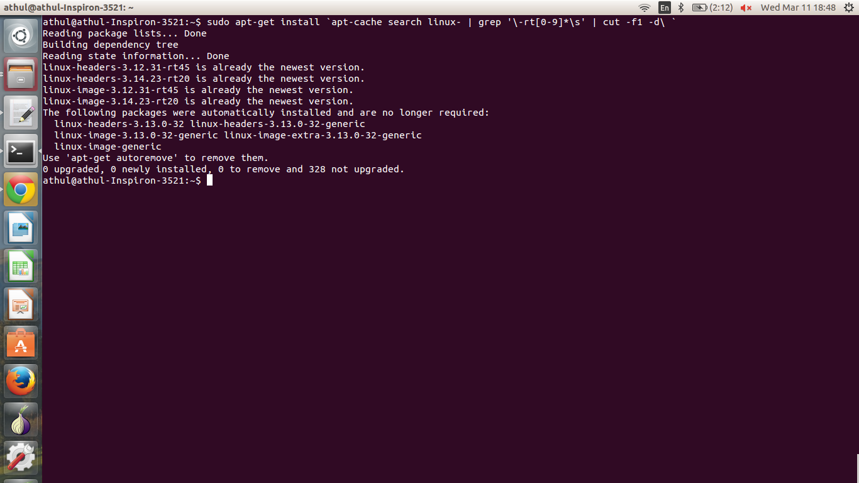
5. Install the patch sudo apt-get install `apt-cache search linux- | grep '\-rt[0-9]*\s' | cut -f1 -d\ `

Slide 15
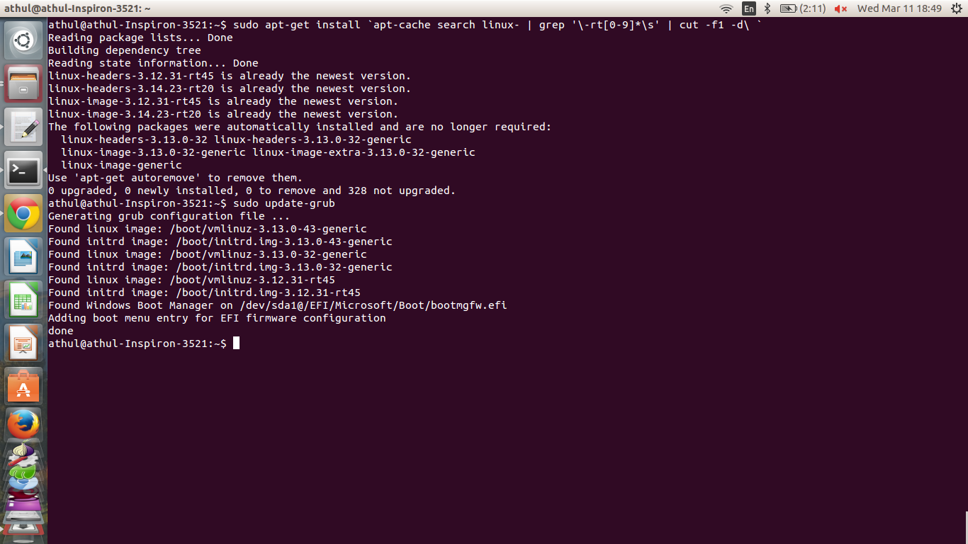
6. Update GRUB entries and reboot sudo update-grub

Slide 16
Final Notes
1. We have installed a Soft RTOS. A Soft RTOS is ideal for most users. In case you wish to install a Hard RTOS you can download the patch from
https://www.kernel.org/pub/linux/kernel/projects/rt/
2. It has also been reported that hard-freezes occur, after installation due to conflicts with AppArmor. Although we haven't faced any problems till now, in case of repeated hard-freezes it is advisable to remove the AppArmor.
sudo apt-get remove apparmor

Slide 17
A Presentation by
Asif Khan 12CSS14
Athul Biju 12CSS15

