Slide 1
SYSTEM CALLS AND IMPLEMENTATION

Slide 2
What is System Call?
A system call is the standard way an OS service is exported to a user program

Slide 3
What is a System Call?
Or we can re-state it as :
A system call is how a program requests a service from an operating system's kernel.
It may include, creating new processes or interacting with the kernel.
They act as an interface between the process and the operating system.

Slide 4
Why do we need SYSTEM CALL?
We not only stated what is a system call, but also specified it is needed by a process to interact with the operating system, OR to use an operating system's services.

Slide 5
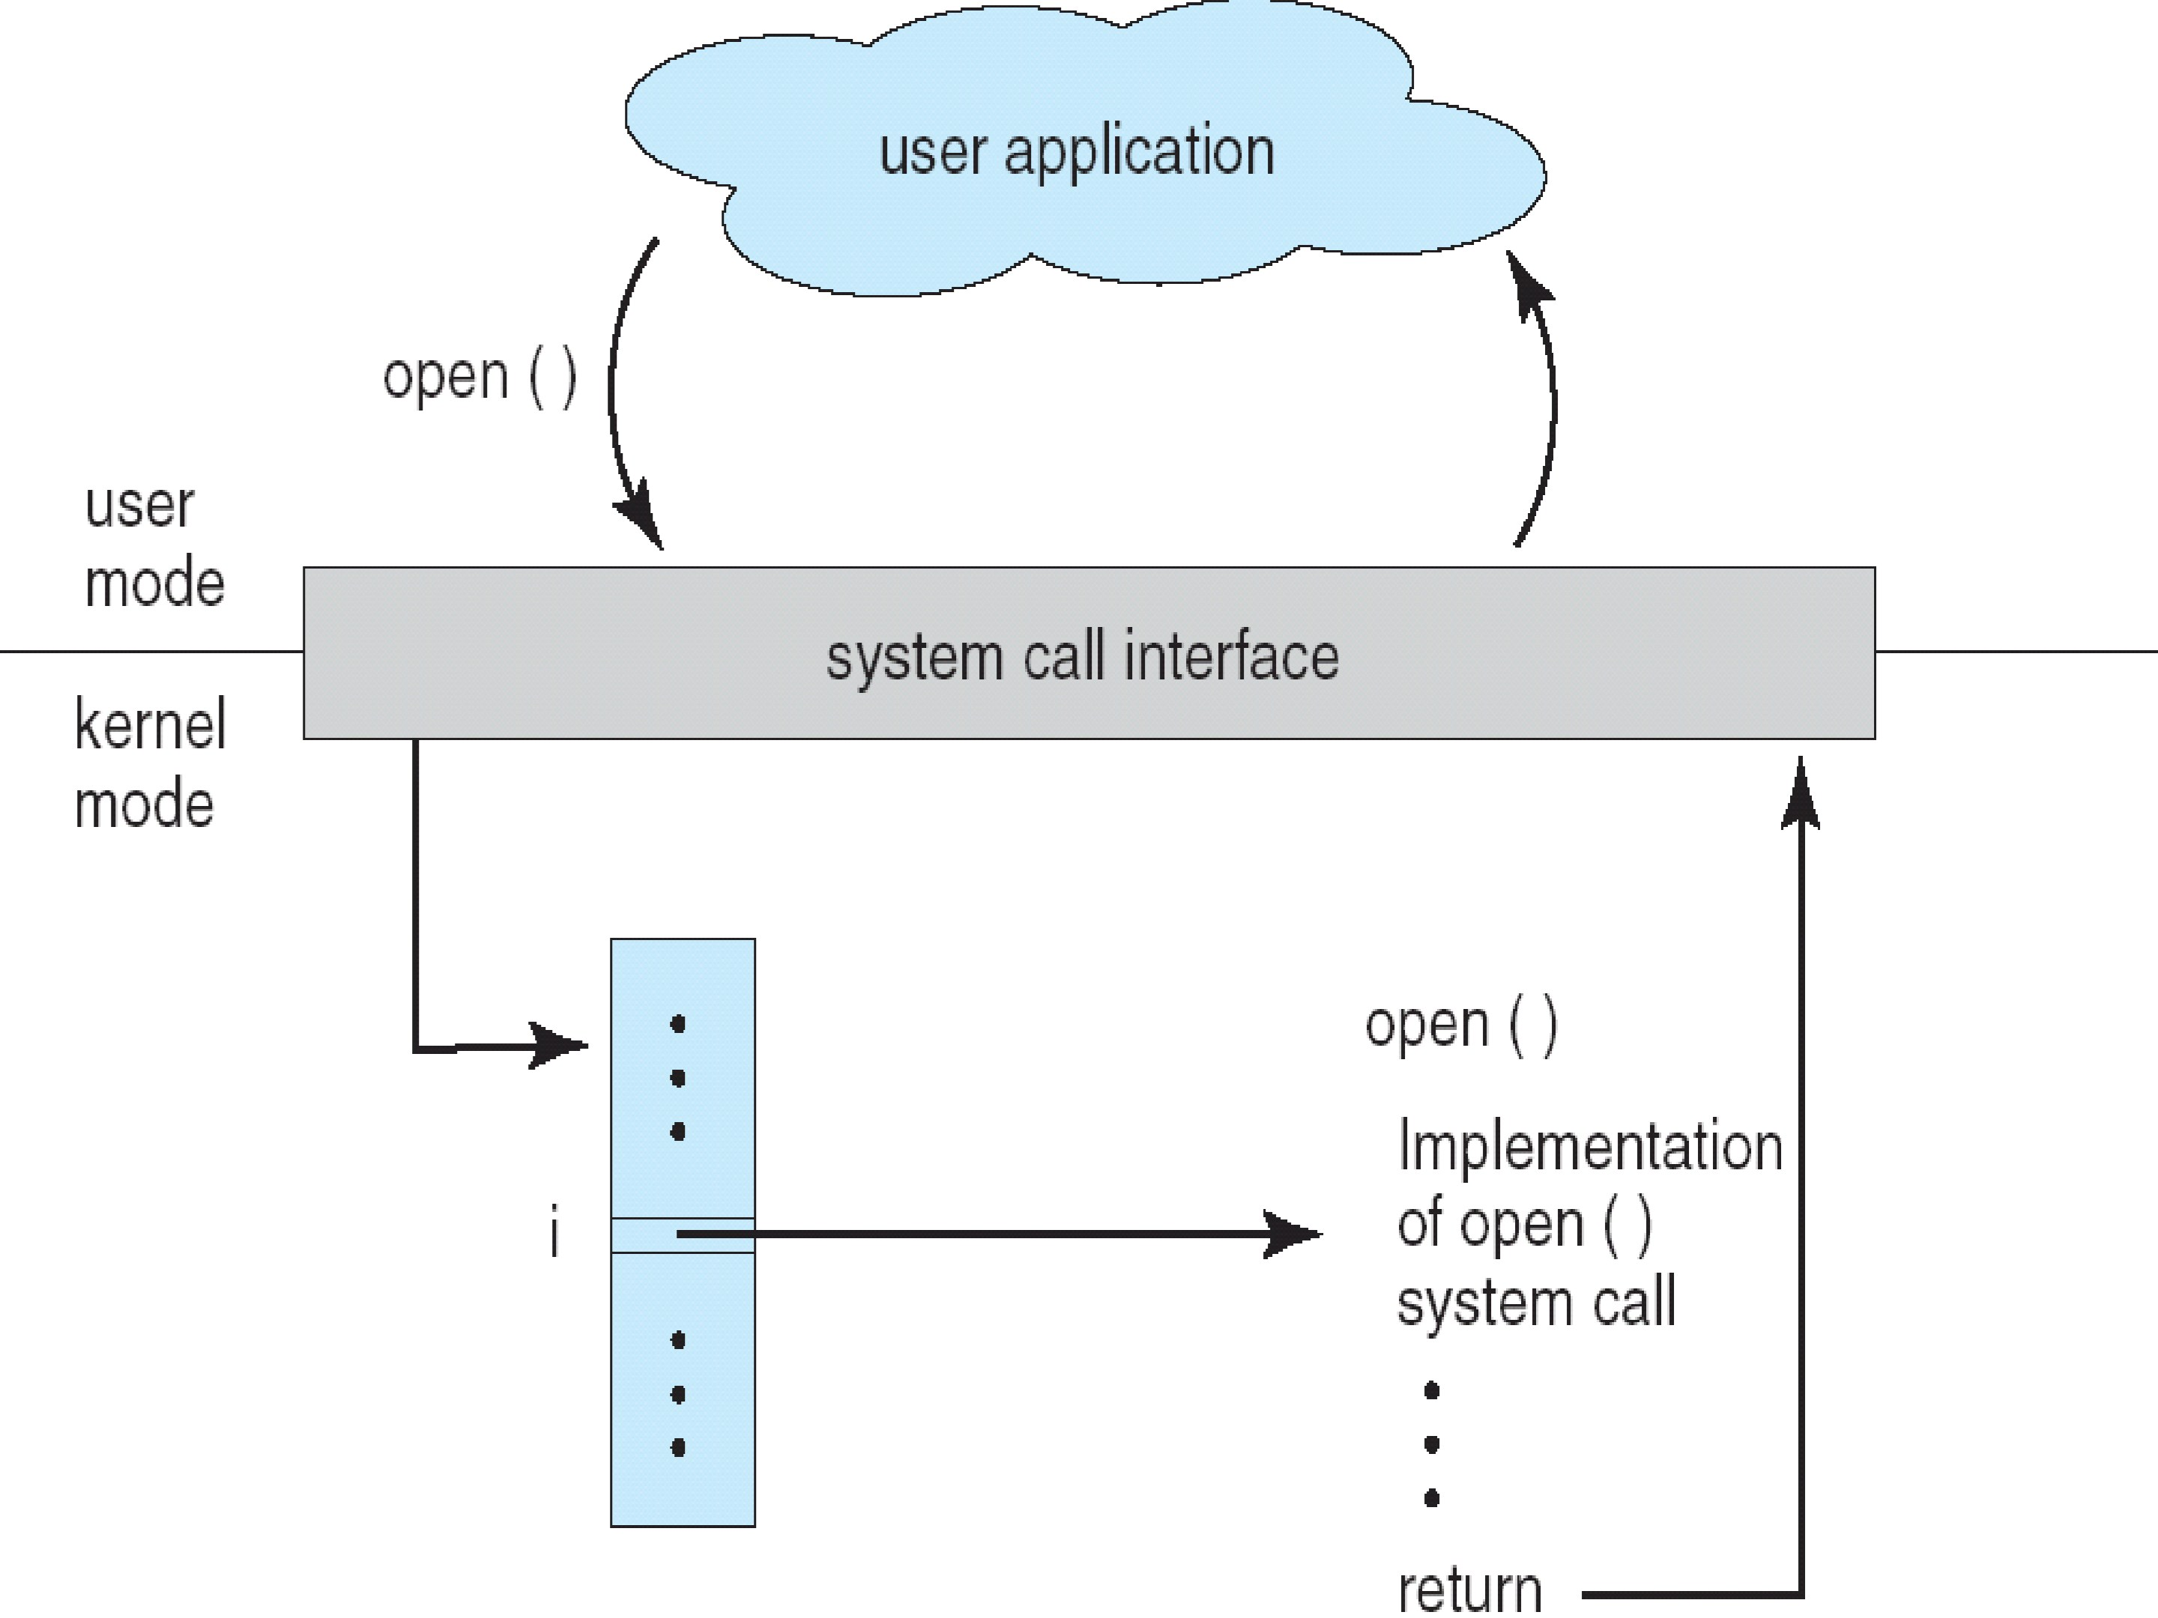
SYSTEM CALL INTERFACE

Slide 6
TYPES OF SYSTEM CALL?
Process control calls
Memeory management calls
File access calls
File and directory management calls
Other calls

Slide 7
SERVICES OF SYSTEM CALL?
Process controL and ipc
Memory management
Access to data in files
File and file system management
Device management
Communications
Other services

Slide 8
Steps followed to install a System call...

Slide 9
STEP 1:
Download the kernel source
1. Open the terminal and use the following command to download the kernel course file.
wget https://www.kernel.org/pub/linux/kernel/v3.x/linux-3.16.tar.xz
wget command :- gnu wget is a free utility for non-interactive download of files from the web.

Slide 10
STEP 2:
Extract the kernel source code
Extract the kernel source code from the linux-3.16.tar.xz file in /usr/src/ directory using the following command. since the downloaded tar file will be in downloads folder, use cd to change into downloads folder before executing the below command.
sudo tar -xvJf linux-3.16.tar.xz -C/usr/src/
now after extraction change to the kernel source directory using,
cd /usr/src/linux-3.16/

Slide 11
STEP 3:
Define a new system call sys_hello()
Create a directory hello in the kernel source directory:-
mkdir hello
Change into this directory
cd hello
create a “hello.c” file in this folder and add the definition of the system call to it as given below (you can use any text editor ).
gedit hello.c

Slide 12
STEP 3: contd..
Add the following code:-
#include <linux/kernel.h>
asmlinkage long sys_hello(void)
{
printk(“hello world\n”);
return 0;
}
Note: that printk prints to the kernel’s log file.

Slide 13
STEP 3: contd..
2. Create a “Makefile” in the hello folder and add the given line to it.
gedit Makefile
add the following line to it:-
obj-y := hello.o
this is to ensure that the hello.c file is compiled and included in the kernel source code.

Slide 14
STEP 4:
Add the hello directory to the kernel’s Makefile
Change back into the linux-3.16 folder and open Makefile
gedit Makefile
goto line number 842 which says :- “core-y += kernel/ mm/ fs/ ipc/ security/ crypto/ block/ ”
change this to “core-y += kernel/ mm/ fs/ ipc/ security/ crypto/ block/ hello/”
this is to tell the compiler that the source files of our new system call (sys_hello()) are in present in the hello directory.

Slide 15
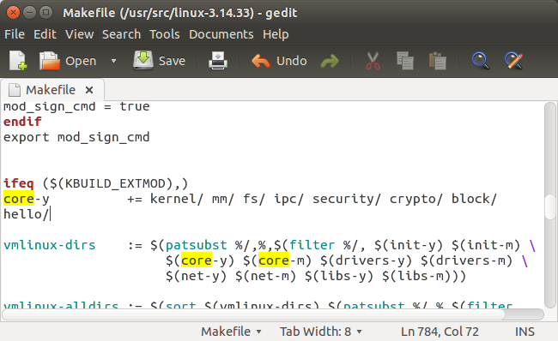
STEP 4: contd..

Slide 16
STEP 5:
ADD THE NEW SYSTEM CALL (SYS_HELLO() ) INTO THE SYSTEM CALL TABLE (syscall_64.tbl FILE)
if your system is a 64 bit system you will need to alter the syscall_64.tbl file.
cd arch/x86/syscalls
gedit syscall_32.tbl
add the following line in the end of the file :-
354 i386 hello sys_hello
354 – it is the number of the system call . it should be one plus the number of the last system call. (it was 354 in my system). this has to be noted down to make the system call in the userspace program.

Slide 17
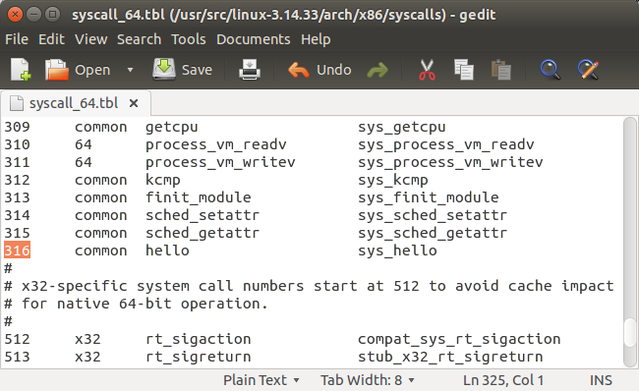
STEP 5: contd..

Slide 18
STEP 6:
ADDING THE PROTOTYPE OF SYSTEM CALL IN syscalls.h:
cd include/linux/
gedit syscalls.h
Write protype of the call:
asmlinkage long sys_hello(void); // at the end of file

Slide 19
STEP 7:
Compile AND INSTALL this kernel on your system.
To compile linux kernel the following are required to be installed.
(1) Gcc latest version,
(2) Ncurses development package
(3) System packages should be up-to date
Hence do the following in the terminal.
(1) sudo apt-get install gcc
(2) sudo apt-get install libncurses5-dev
(3) sudo apt-get update
(4) sudo apt-get upgrade

Slide 20
STEP 7: contd..
To configure your kernel use the following command:-
Sudo make menuconfig
Sudo make oldconfig
Now to compile the kernel ; do make .
Cd /usr/src/linux-3.16/

Slide 21
STEP 7: contd..
INSTALL THE KERNEL
sudo make –j 8
sudo make modules
sudo make modules_install
sudo make install
The files under /boot/ directory are:
System.map-3.0.0
Vmilunz-3.0.0
Intird.img-3.0.0
Config-3.0.0

Slide 22
STEP 7: contd..
Now :
shutdown -r now or reboot
After reboot you ca verify kernel version using the following command
uname -r

Slide 23
STEP 8:
TEST SYSTEM CALL
Create a “userspace.c” program in your home folder and type in the following code :-
#include <stdio.h>
#include <linux/kernel.h>
#include <sys/syscall.h>
#include <unistd.h>
int main()
{
long int temp= syscall(316);
printf(“System call sys_hello returned %ld\n”, temp);
return 0;
}

Slide 24
STEP 8: contd…
Now compile this program using the following command.
gcc userspace.c
Now run the program using the following command.
./a.out
You will see the following line getting printed in the terminal if all the steps were followed correctly.
“System call sys_hello returned 0“.
Now to check the message of the kernel you can run the following command.
dmesg
This will display “Hello world” at the end of the kernel’s message.

Slide 25
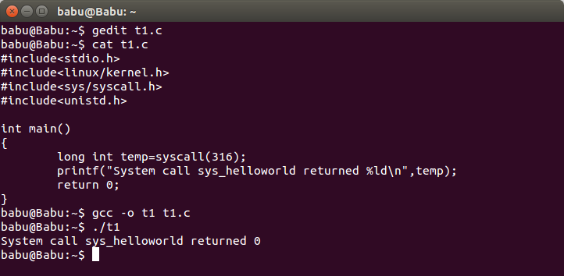
STEP 8: contd…

Slide 26
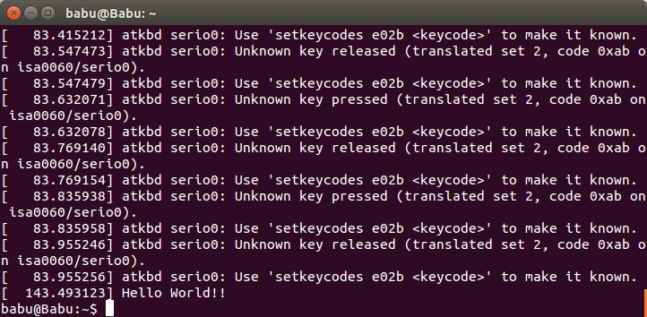
STEP 8: contd…

Slide 27
THAT’S ALL FOLKS
presented by:
12 css-24 Harshvardhan vashishtha
12 css-25 jeevan singh nayal

