Slide 1
APACHE WEBSERVER 2.0

Slide 2
WHAT IS APACHE....
Apache is a webserver package that work
under linux as well as under other operating systems
The name Apache was chosen out of respect to the Native American tribe Apache and its superioskills in warfare and strategy
Apache played a key role in the initial growth of the World Wide Web, quickly overtaking NCSA HTTPd as the dominant HTTP server

Slide 3
WHAT IS APACHE.........
the software is available for a wide variety of operating systems, including Unix, FreeBSD, Linux, Solaris, Novell NetWare, OS X, Microsoft Windows, OS/2, TPF, OpenVMS and eComStation
Apache is free and open-source software

Slide 4
Other Popular Servers
Nginx(engine x)
Microsoft IIS server
IBM lotus
Lighttpd

Slide 5
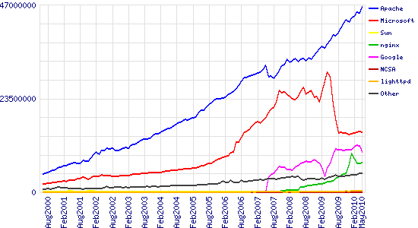
Stats of Web Server types

Slide 6
Why Apache is better choice
Lower costs, since there are no software licensing fees
Programming flexibility due to the open source
Enhanced security: Since Apache was developed for a non-Microsoft operating system, and the majority of malicious programs have traditionally been written to take advantage of vulnerabilities in Windows, Apache has always enjoyed a reputation as a more secure option than Microsoft’s IIS.

Slide 7
httpd
httpd is the Apache HyperText Transfer Protocol (HTTP) server program. It is designed to be run as a standalone daemon process.
A daemon is a program that is "an attendant power or spirit" (Webster's). It sits waiting for requests to come in and then forwards them to other processes as appropriate
When used like this it will create a pool of child processes or threads to handle requests

Slide 8
Installing Apache Server
Update Packages using Command
sudo apt-get update
Install Apache2 using command
sudo apt-get install apache2

Slide 9
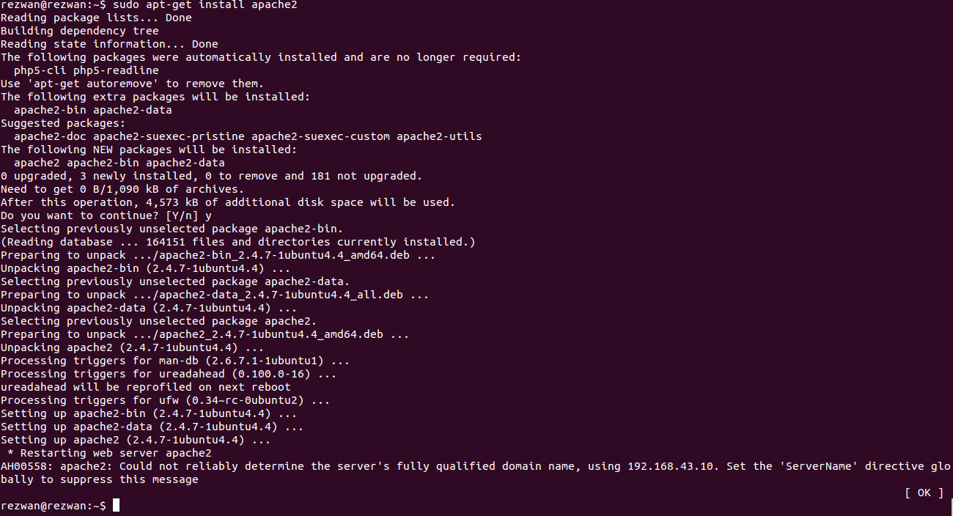

Slide 11
Basic Commands for Apache
Sudo service apache2 start
Sudo service apache2 restart
Sudo service apache2 status
Sudo service apache2 stop

Slide 12
Setting up the website
Make directory in var/www/ using command
sudo mkdir -p /var/www/point.co/html/
grant permission to apache2 for this directory
sudo chown -R apache:apache /var/www/
sudo chmod -R 755 /var/www/

Slide 13
Continued.....
Add the files of the website to the directory we created
/var/www/point.co/html/
Now create the configuration file and host for our website
sudo cp /etc/apache2/sites-available/000-default.conf /etc/apache2/sites-available/point.co.conf

Slide 14
Continued.......
Now edit the configuration file
run the following command
sudo vi /etc/apache2/sites-available/point.co.conf
ServerAdmin admin@point.co
ServerName point.co
ServerAlias www.point.co
DocumentRoot /var/www/point.co/html
ErrorLog ${APACHE_LOG_DIR}/error.log
CustomLog ${APACHE_LOG_DIR}/access.log combined

Slide 15
Continued...
Edit the hosts file in the directory
/etc/hosts/
127.0.0.1 point.co
Enable the site using the command
sudo a2ensite point.co.conf
Restart Apache and test your sites.
sudo service apache2 restart

Slide 16
Virtual Hosts
A virtual host is a web server that resides on one domain but acts as if it was on another. For example, suppose you control point.co and cis454.com. Instead of setting up 2 servers, you can set up a single machine that serves both domains.
Virtual hosting saves on machinery and allows for a lot of flexibility in setting up web servers

Slide 17
Setting up Virtual Host
create separate directory for each website
sudo mkdir -p /var/www/myblog.com/html/
sudo mkdir -p /var/www/mynewblog.com/html/
Grant permissions to Apache Server for these directories.....Run the following commands
sudo chown -R apache:apache /var/www/
sudo chmod -R 755 /var/www/

Slide 18
Setting up Virtual Host...cont
Now put the contents of all websites to be hosted in their respective directories
/var/www/myblog.com/html/
/var/www/mynewblog.com/html/
Now, Create Virtual Host directories for each website
copy the default Apache site configuration file and create our virtual hosts from it.
sudo cp /etc/apache2/sites-available/000-default.conf /etc/apache2/sites-available/myblog.com.conf
sudo cp /etc/apache2/sites-available/000-default.conf /etc/apache2/sites-available/mynewblog.com.conf

Slide 19
Setting up Virtual Host...contd
Now Virtual Hosts are created
Make changes to the configuration file for each host
sudo vi /etc/apache2/sites-available/myblog.com.conf
ServerAdmin admin@myblog.com
ServerName myblog.com
ServerAlias www.myblog.com
DocumentRoot /var/www/myblog.com/html
ErrorLog ${APACHE_LOG_DIR}/error.log
CustomLog ${APACHE_LOG_DIR}/access.log combined

Slide 20
Setting up Virtual Host...contd
Now map domain name to ip address
Many domains names are mapped to same ip and server recognise by domain name
127.0.0.1 localhost
127.0.0.1 myblog.com
127.0.0.1 mynewblog.com

Slide 21
Setting up Virtual Host...contd
The next things to do is enable the sites. To do that, run the commands below
sudo a2ensite myblog.com.conf
sudo a2ensite mynewblog.com.conf
Restart Apache Server
sudo service apache2 restart

Slide 22
Apache Web Server
Thanks
Prepared by
Mohd Rezwan (12CSS36)
Mohd Shoib khan (12CSS37)
Mohd Raghib Khan (12CSS35)

