Slide 1

BOOTLOADER
Building a customized bootstrapped loader
MADE BY:
AMAN ARORA (12CSS-10)
AMEEN M. KHAN(12CSS-10)

Slide 2
Bootstrap Loader
Bootstrapping/Booting usually refers to the starting of a self-sustaining process that is supposed to proceed without external input.
1
Technically, it is the initial set of operations that a computer system performs after electrical power to the CPU is switched on or when the computer is reset or when the operator invokes a LOAD function from the console, and ends when the computer is ready to perform its normal operations.
2

Slide 3
Bootstrap Loader
Often, multiple-stage boot loaders are used, during which several programs of increasing complexity load one after the other in a process of chain loading.
3
Chain loading is a method used by computer programs to replace the currently executing program with a new program i.e. chain loading replaces the currently executing program in its entirety.
4

Slide 4
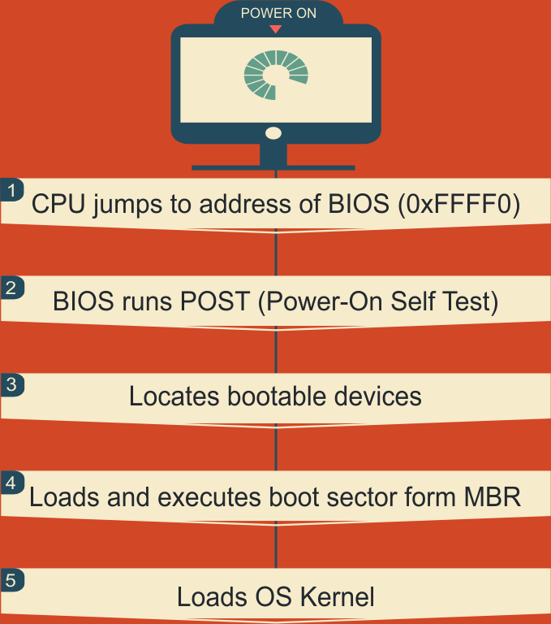
BOOT SEQUENCE

Slide 5
BIOS
1
BIOS is a set of computer instructions in
Firmware which control input and output operations.
2
It is the software code run by a computer when
it is first powered on.
The primary function of BIOS is code program embedded on a chip that recognizes and controls various devices that make up the computer.
3

Slide 6
POST
(Power-On Self Test)
1
Power-on self-test is a process performed by firmware or software routines immediately after many digital electronic devices are powered on.
2
POST includes routines to set an initial value for internal and output signals and to execute internal tests.

Slide 7
Boot Sector
1
A boot sector or boot block is a region of a hard disk, or other data storage device that contains machine code to be loaded into random-access memory (RAM) by a computer system's built-in firmware.
2
The purpose of a boot sector is to allow the boot process of a computer to load a program stored on the same storage device.

Slide 8
Master Boot Record
1
The MBR is a 512-byte sector, located in the first sector on the disk.
2
The MBR holds the information on how the logical partitions, containing file systems, are organized on that medium.
3
MBR ends with 2 bytes that are defined as magic number (0xAA55) which serves as a validation check of MBR.

Slide 9
Tasks of a BOOTLOADER
1
INITIALIZATION TASKS
Memory Setup and Initialization
System Peripheral Initialization
2
ACTUAL TASKS
Load the RAM-based File System like initrd and initramfs.
Load the Kernel with proper arguments
Jump to the start of the kernel
3
ADDITIONAL TASKS
Multiple Kernel boots .
Multiple way boots .

Slide 10
Stages of a BOOTLOADER
STAGE 1
STAGE 2
Resides in boot sector of disk
Loads the kernel from the boot disk into memory, prepare the system for executing the kernel, and jump to the kernel entry point.
Loaded by the BIOS
Must be covered in 512 bytes
Loads Segment Registers
Switch into protected mode and load the kernel into high (> 1 MB) memory.
Sets the stack pointer
Resets the disk controller
Repeatedly switch back and forth between real mode and protected mode while reading the kernel from the disk.
Reads the second stage BOOTLOADER and loads it into memory.
Small kernel can be preloaded entirely into low memory before transitioning into protected mode.
ASSIGNMENT DOMAIN

Slide 11
Examples of some Boot Loaders out there
GRUB
LILO
SYSLINUX
loadlin
RedBoot
BLOB (BootLoader Object)
Coreboot (Earlier called LinuxBIOS)

Slide 12
Tools Used
NASM (Netwide Assembler)
It is a freeware assembler used to produce binary programs, or boot images.
VMware
It is a virtual machines software.
Used for building, testing and debugging purposes.
Sublime Text
Used for writing the assembly code, in a virtualized Linux OS
WIN32diskIMAGER
It is a software use to make a bootable thumb drive.

Slide 13
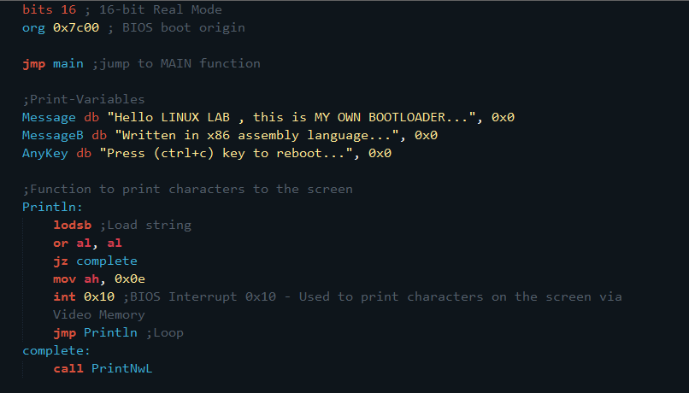
BOOTLOADER in Assembly
(1)

Slide 14
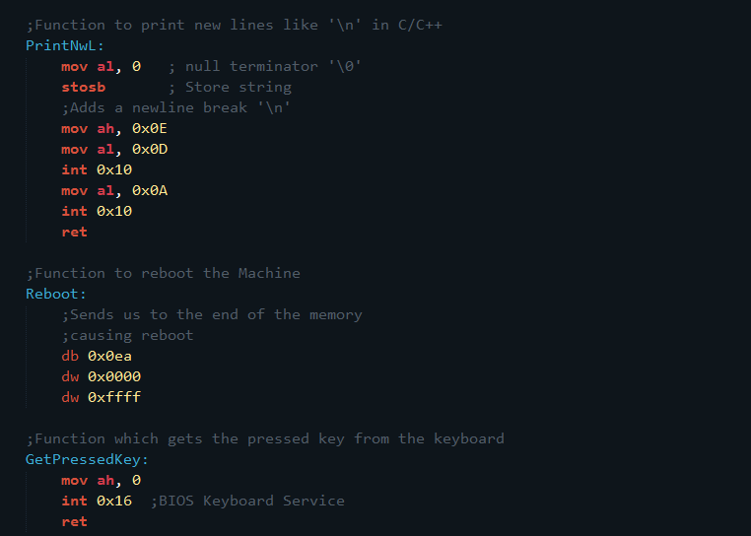
(2)

Slide 15
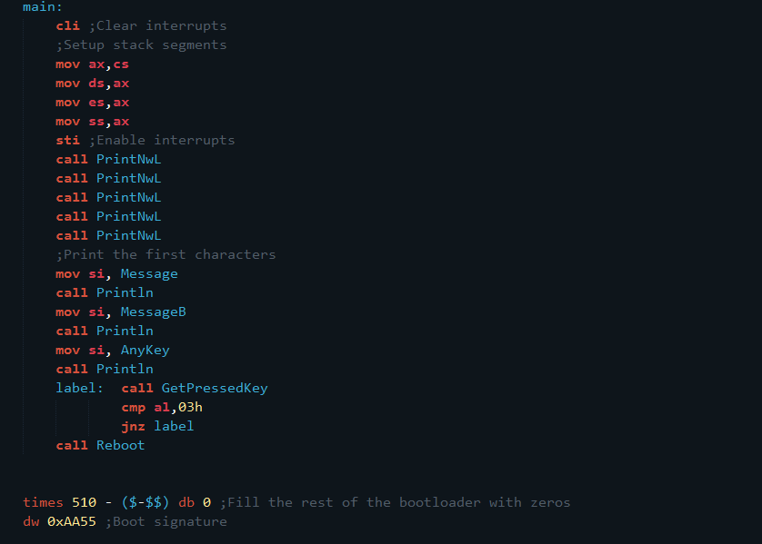
(3)

Slide 16
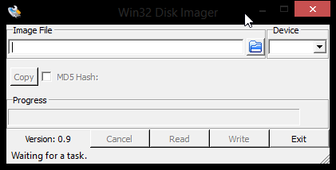
Building a Bootable Image
1
Build the assembler code
The following command builds the assembler code and produces a “.img” file, which is a bootable image.
2
Make a bootable device
Win32diskimager , a software which makes a bootable flash drive from the image file having img extension to it.
3
BIOS : change the boot order for flash drive with higher priority

Slide 17
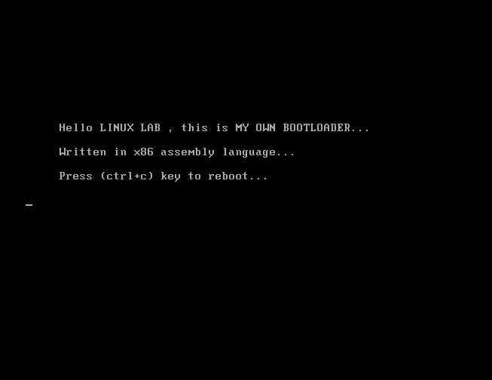
THE BOOTLOADER IN WORKING

Slide 18
THANK YOU!!!

