Slide 1
File Transfer Protocol
(FTP)

Slide 2
CONTENTS
CONNECTIONS
COMMUNICATION
COMMAND PROCESSING
FTP LOGIN
USING FILEZILLA

Slide 3
FTP uses the services of TCP. It needs two TCP connections. The well-known port 21 is used for the control connection and the well-known port 20 for the data connection.

Slide 4
FILE TRANSFER
Transferring files from one computer to another is one of the most common tasks expected from a networking or internetworking environment. As a matter of fact, the greatest volume of data exchange in the Internet today is due to file transfer.

Slide 5
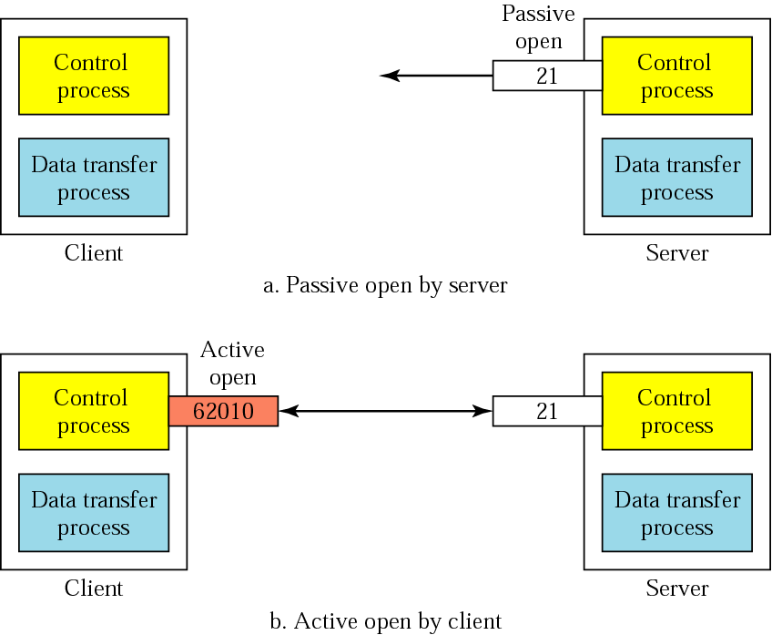
Connections: The control connection

Slide 6
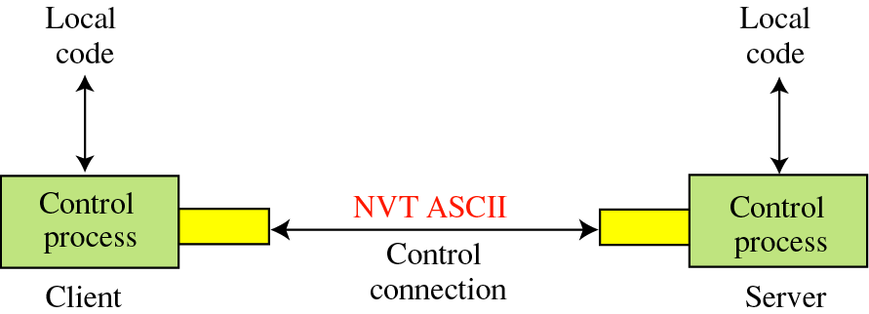
Communication
Using the control connection

Slide 7
The Data Connection
Uses Server’s well-known port 20
Client issues a passive open on a random port, say x.
Client uses PORT command to tell the server about the port number x.
Server issues an active open from port 20 to port x.
Server creates a child server/random port number to serve the client

Slide 8
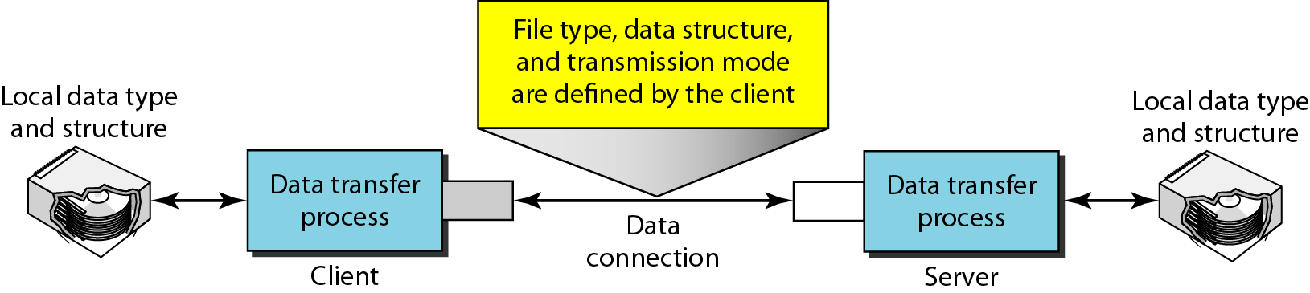
Using the data connection

Slide 9
FTP
LOGIN

Slide 10
VSFTDP
The Very Secure FTP Daemon (VSFTDP) is one of the more popular and robust FTP servers available for the Linux community.

Slide 11
How to install vsftpd? sudo apt-get install vsftdp

Slide 12
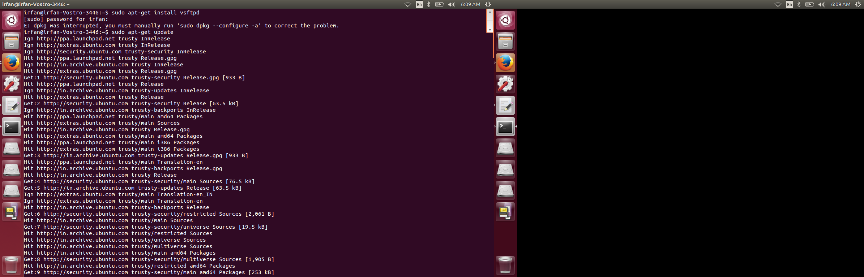

Slide 13
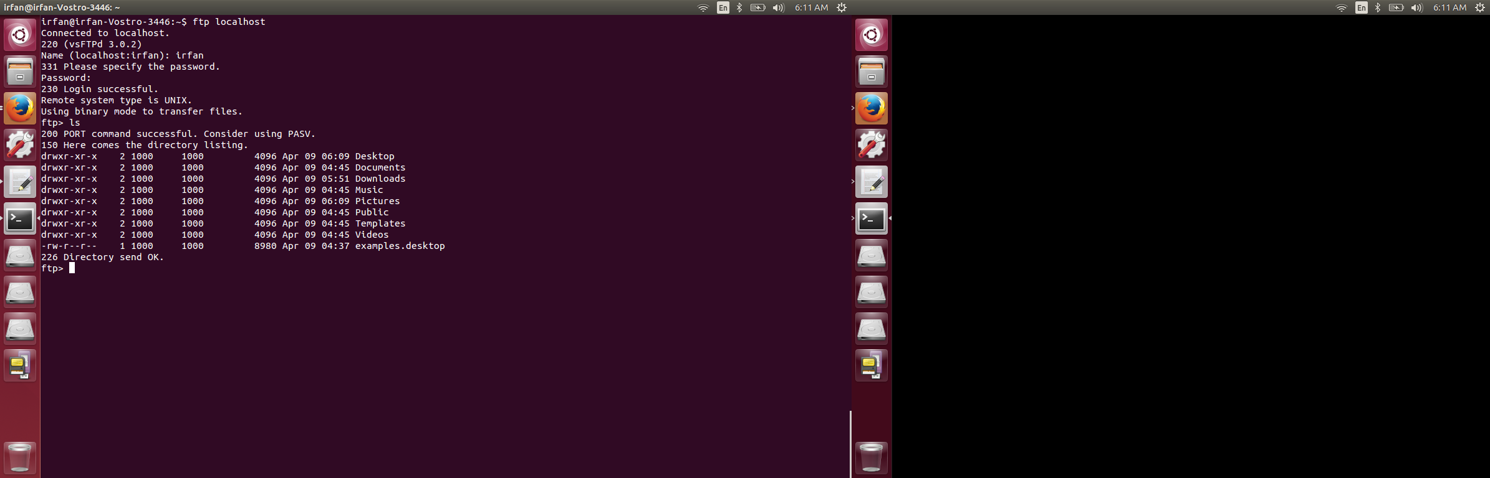
IMPLEMENTING FTP IN LOCAL HOST ftp localhost

Slide 14
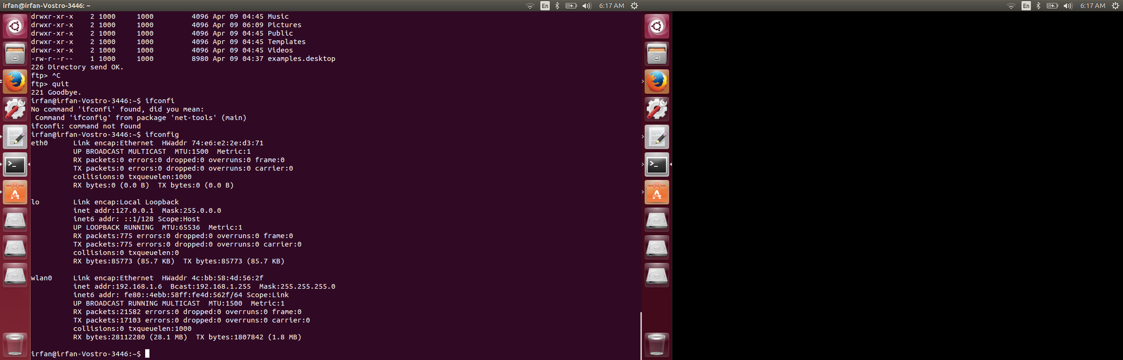
IMPLEMENTING FTP IN NETWORK 1. GETTING IP OF SERVER (ifconfig)

Slide 15
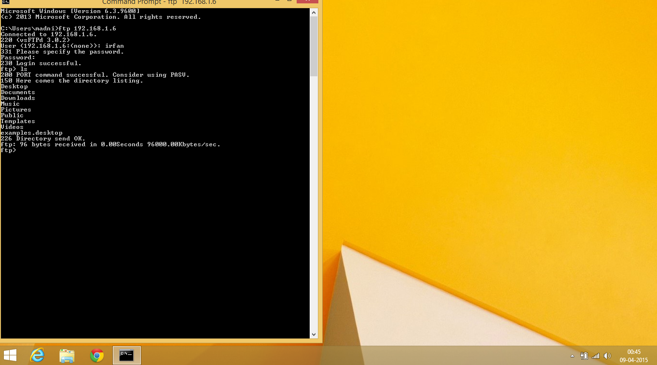
2. USING FTP SERVER VIA WINDOWS CLIENT (ftp [ip address of the server] )

Slide 16
FILEZILLA

Slide 17
WHAT IS FILEZILLA?
FILEZILLA IS FREE, CROSS PLATFORM FTP APPLICATION SOFTWARE.
ALSO SUPPORTS IPv6, WHICH IS THE LATEST VERSION OF INTERNET PROTOCOL.
FILEZILLA IS FREE AT UBUNTU SOFTWARE CENTER.
YOU CAN INSTALL FILEZILLA USING FOLLOWING COMMAND
( SUDO APT GET FILEZILLA)

Slide 18
