Slide 1
E.B.S.
Elastic Block Store

Slide 2
What is EBS ?
EBS is a block-level storage service within AWS that provides persistent, high-performance storage volumes for EC2 instances.
It is basically a way to store data in the cloud that persists even when your instance is turned off.

Slide 3
When to use EBS ?
When you want your data to be stored after the deletion of the instance.
For hosting databases.
It can be used to transfer data from your companies servers to cloud .

Slide 4
EBS volumes
volume is a block-level storage device that you can attach to Amazon EC2 instances.
Think of it as a virtual hard drive, allowing you to store data persistently, even if the EC2 instance is stopped or terminated.

Slide 5
Types of EBS volumes
gp2/gp3 - For general purpose.
io1/io2 - For heavy workloads , high performance and consistent IOPS.
st1 - For intensive workloads like data warehousing
sc1 - For storing infrequently used data. Usually cost effective.
standard - For less demanding workloads.

Slide 6
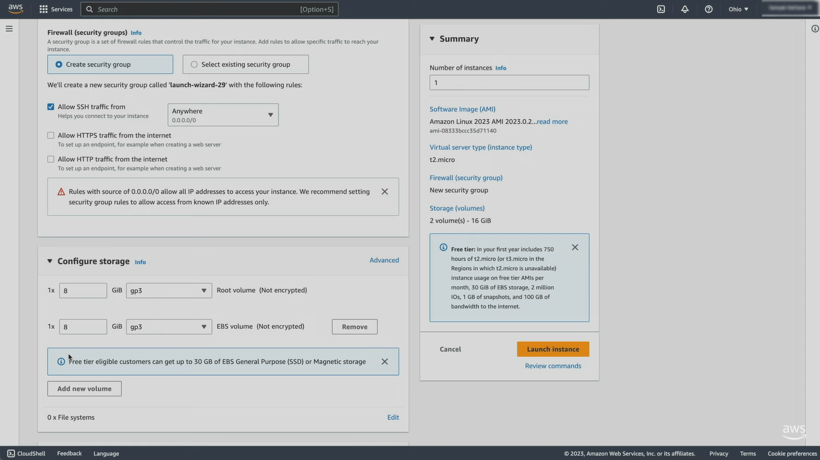
How to use EBS ?
Step 1. Create an EC2 instance, create key pair , then scroll down and click on add new volume under “configure storage”. Leave everything default and launch instance.
Step 2. Select the instance and navigate down to the storage option

Slide 7
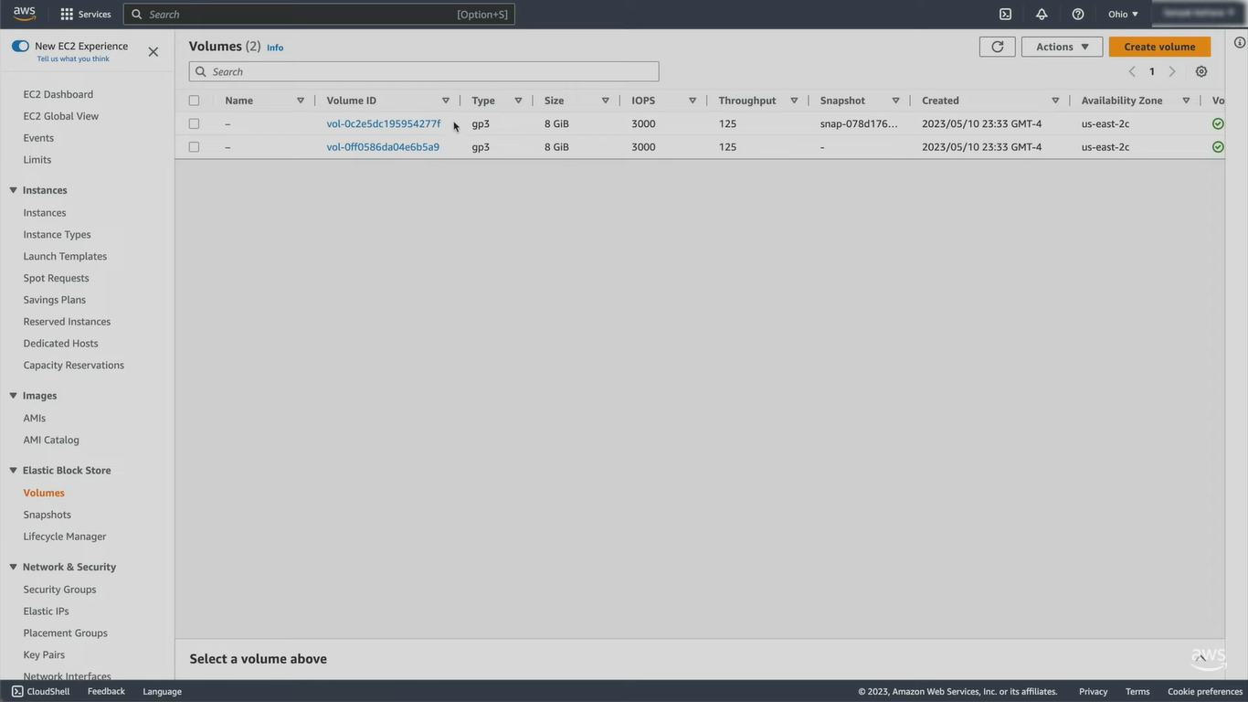
Step 3. Click on “volume” under elastic block store on left panel, you will see 2 volumes.

