Slide 1
E.F.S.
Elastic File System

Slide 2
What is elastic file system ?
In the simplest terms , EFS is like shared drive in the cloud that can be accessed by multiple servers or computers running in AWS.
EFS provides a fully managed system that can be accessed by multiple EC2 instances.
It is a useful thing as it helps in accessing the data simultaneously from different applications.

Slide 3
What is the purpose of EFS ?
The primary purpose of EFS is to provide reliable and easily manageable file system for various works , specially those that require shared access to data.
One of its key feature is that its serverless service, meaning that it automatically scales up or down as your file data needs change without doing any kind of changes manually.

Slide 4
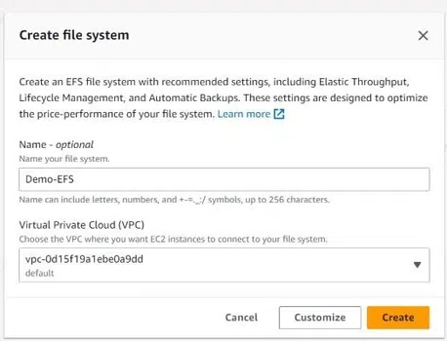
How to use EFS?
Step 1. Sign-in to your IAM account. Create an EFS from the AWS console. Choose the default VPC (virtual private cloud).

Slide 5
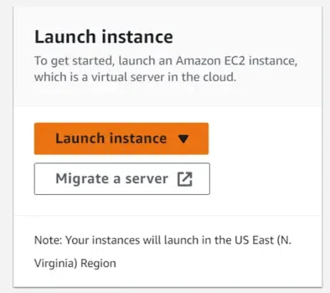
Step 2. Create one or more EC2 instances as per your requirement from the EC2 dashboard. Using the linux AMI.

Slide 6
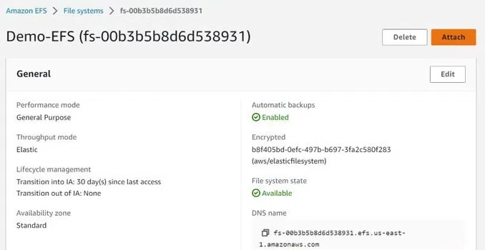
Step 3. Allow the EC2 instance security group to access EFS.connect to EFS from your instance. Basically there are 2 methods to do so but we will use linux method.

Slide 7
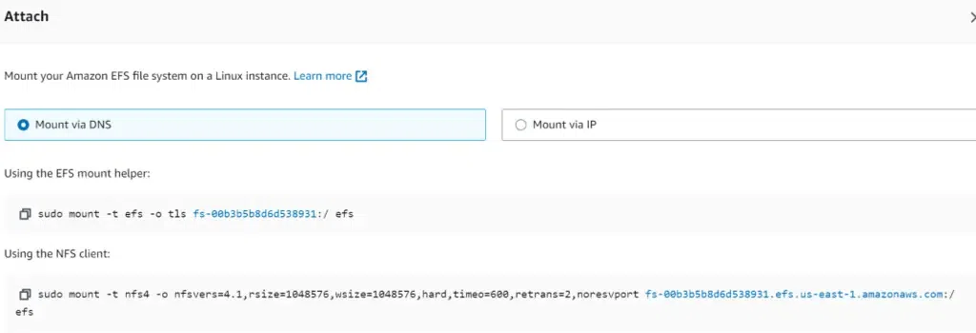
Step 4. Once you have connected to AWS EFS from your instance, you will have a folder in which any file created can be modified from any connected instance.

