Slide 1
Lambda

Slide 2
Why was lambda named as it is?
In mathematics , lambda in calculus are self contained functions that can be used as bricks for large problems.
Just like that in AWS lambda is a serverless service in which it automatically runs code without managing servers as well as scales up and down as per the requirements of the user

Slide 3
Purpose of lambda ?
As we know that lambda is a serverless service in AWS.
The main purpose of lambda is to reduce the overhead and the cost of maintaining the infrastructure (servers).
It is a service made with considering the cost of server maintenance , OS maintenance , and capacity maintenance.

Slide 4
Lambda v/s EFS
Lambda service focuses on computational tasks.
Lambda has temporary storage.
3rd point enables lambda functions to access files and data beyond their temporary storage.
Lambda can access wide range of use with EFS.
EFS service focuses on file access and storage.
EFS ha durable and scalable storage.
EFS can be used with Lambda to provide persistent storage
It extends lambda’s capabilities.

Slide 5
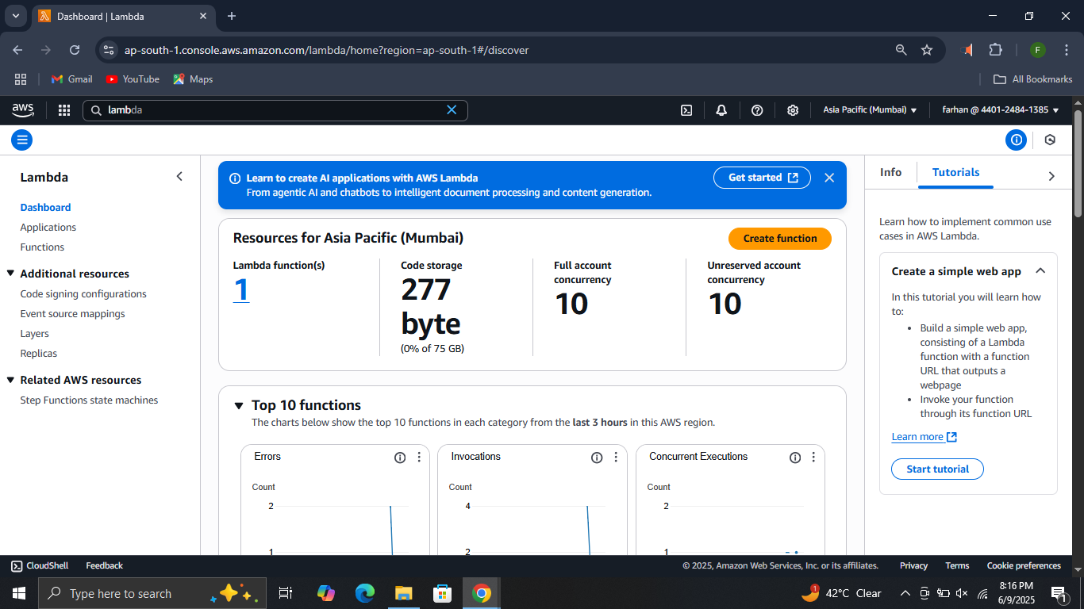
How to use lambda?
Step 1. Log in to your IAM account. Make sure you have administrator access. Click on functions in lambda console

Slide 6
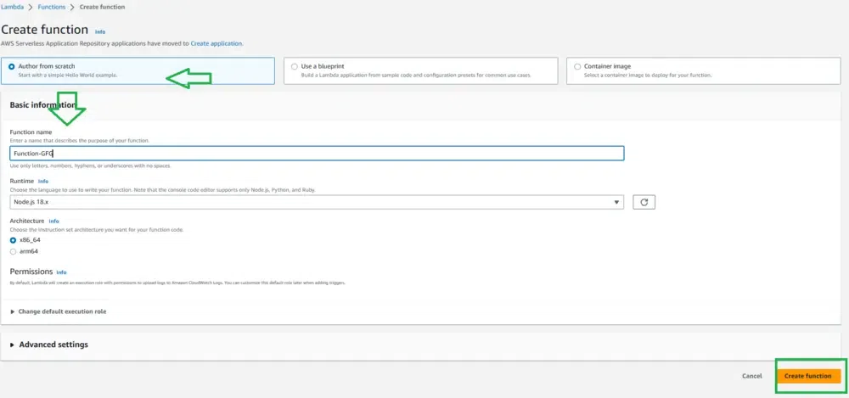
Step 2. Click on create function and do changes as shown below.

Slide 7
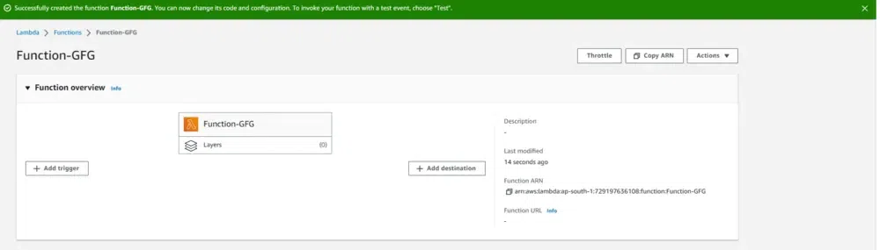
Step 3. Successfully your lambda function is created.

