Slide 1
S.N.S
Simple Notification Service

Slide 2
What is SNS?
In simple words, SNS is a simple notification service that lets applications quickly send notifications like SMS , e-mails , etc. to multiple users.
Think of it as a broadcast or a simple messaging service.

Slide 3
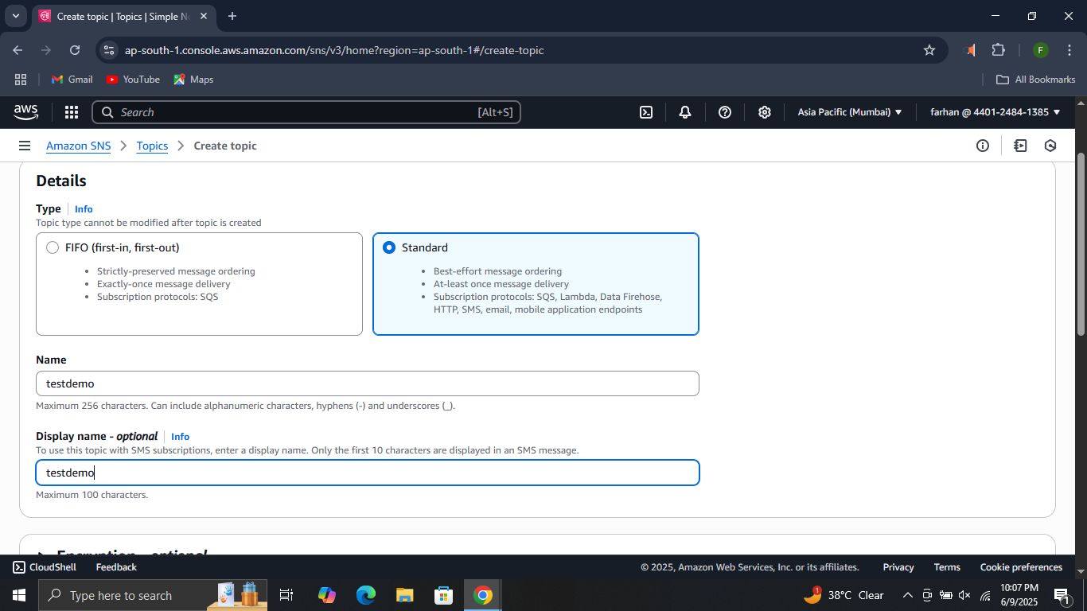
How to use SNS ?
Step 1. Navigate to SNS console. click on topics . then click on create topic.
Do these changes.

Slide 4
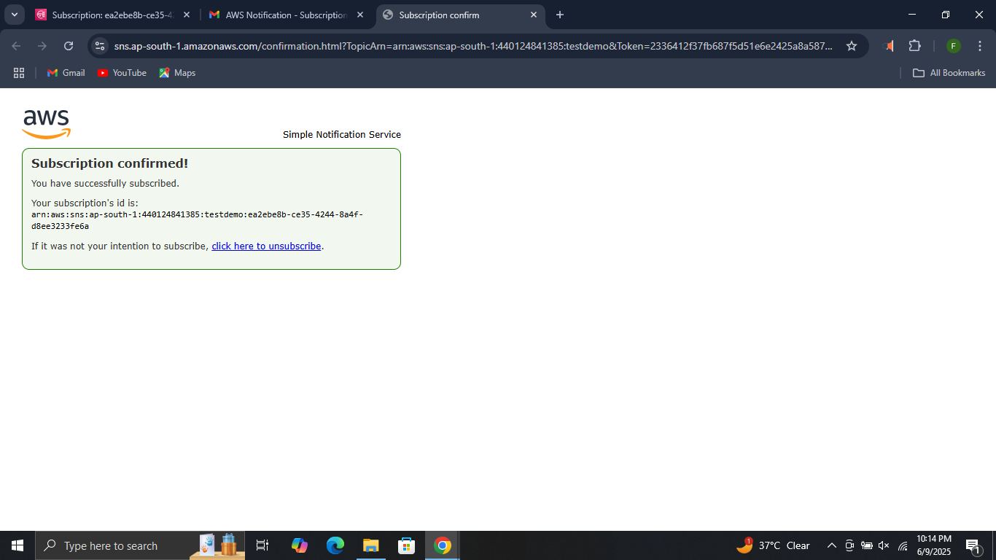
Step 2. Click on create topic. Scroll down and click on create subscription. Select the e-mail protocol and enter your e-mail. After receiving the email, click on confirm subscription in the mail.

