Slide 1
COMPUTER VISION / MACHINE LEARNING
Smart Bin
Classifier
TEST SNAPSHOT
60%
of images had all 10 quantities exactly right
From a bin photograph to a product-level quantity estimate and an order decision.
27.18%
0.0565
Prepared by Farhan Mohammed
Exact accuracy on present items
MAE across all product entries
A working Streamlit prototype for 10 catalogue products, evaluated on 200 held-out test images.
ResNet-18 • PyTorch • Streamlit • Prototype deployed using free services

Slide 2
02 · SCOPE & RULES
What counts as a correct order?
The final decision is based on the model's predictions, not hidden ground-truth labels.
Order is the scope
Every requested item matters
Extra items are ignored
Only products included in the customer's order are checked. Items outside the order are irrelevant.
PASS only when each requested product is predicted to have enough quantity. One missing or under-counted item means FAIL.
A product predicted in the bin but not included in the order does not affect the result.
Clarifications received and implementation assumptions
Catalogue: exclude products below the required frequency threshold. Blind evaluation: use reserved blind-split images only; never train, tune, or validate on them.
Ground-truth labels may construct/evaluate test cases, but the app's inference and PASS/FAIL logic must use model predictions only.
02 / 12

Slide 3
03 · PROJECT EXECUTION
72 hours, from data to demo
HOURS 0–12
HOURS 12–24
HOURS 24–40
Scope & setup
Data preparation
Model work
Read the brief, define order PASS/FAIL, catalogue threshold, evaluation split rules and free-tool constraints.
Inspect catalogue and labels, verify train/validation/test/blind splits, set up preprocessing and training inputs.
Train/refine ResNet-18 quantity model; review validation behavior, count imbalance and signs of overfitting.
HOURS 40–52
HOURS 52–64
HOURS 64–72
Metric debugging
Build the app
Test & submit
Reconcile evaluation metrics; separate whole-vector exact match from present-item accuracy and compare evaluation protocols.
Connect inference to Streamlit; add image upload, readable names, quantity inputs, order validation and downloadable results.
Test PASS/FAIL cases, fix hosted-app issues, polish README and deck, document limitations and free deployment.
03 / 12

Slide 4
04 · DATASET
What went into the model
The project uses a 2,000-image subset with a fixed 10-product catalogue.
Dataset split · 2,000 images
10 ASINs
0–5 units
Selected product catalogue.
Six quantity classes per product.
Train · 1,400
Validation · 200
Test · 200
Blind · 200
Label pattern · Many zeros
Quantity coverage
Many zero entries can make overall MAE appear low.
Six output classes per product: quantities 0 through 5.
Quantity coverage
Catalogue scope
Rare higher-count classes may need additional examples.
The model predicts quantities for 10 selected ASINs.
Dataset split is kept separate for training, validation, test evaluation and blind demonstration.

Slide 5
05 · MODELING
What we used, and what remains to compare
ResNet-18 is the implemented approach; alternatives are honestly labeled as future comparisons.
Frequency baseline
ResNet-18 quantity model
Detection / instance counting
Predict the most common training quantity for each product.
Why compare: establishes a simple, interpretable benchmark.
Status: proposed, not measured.
Predict six quantity classes for each of 10 products.
Why use it: transfer learning can extract visual features.
Status: implemented and evaluated.
Locate visible instances and count them.
Why consider it: could help with crowded scenes.
Status: future option; needs suitable annotations.
The current reported results are from the implemented ResNet-18 model.
05 / 12

Slide 6
06 · RESULTS
How well did the model work?
Held-out test set · 200 images · argmax quantity evaluation.
60.00%
0.0565
27.18%
1.0000
Whole-vector exact match
MAE across all entries
Exact accuracy on present entries
MAE on present entries
Why these metrics?
Order-level evaluation (separate)
Exact match shows fully correct images. MAE shows average count error. Present-only metrics reveal errors that a zero-heavy dataset can hide.
Synthetic orders: 79.25% accuracy; 0/200 invalid orders passed; 83/200 valid orders rejected in the earlier evaluation.
Interpretation: the model is a prototype. Present-item quantity estimation remains unreliable and needs improvement.
06 / 12

Slide 7
07 · FAILURE ANALYSIS
Where the model can fail
Five failure patterns observed or to investigate from model behavior.
MISSED PRODUCT
A requested product predicted as 0.
UNDERCOUNT
Predicted count is below the true count.
Add crowded scenes and examples for higher quantities.
FALSE PRESENCE
A product is predicted when absent.
RARE QUANTITIES
Classes 3–5 have fewer examples.
Improve label balance and collect additional examples.
METRIC MISMATCH
App output and offline argmax metrics differ.
Keep evaluation protocols separate and document threshold logic.
07 / 12

Slide 8
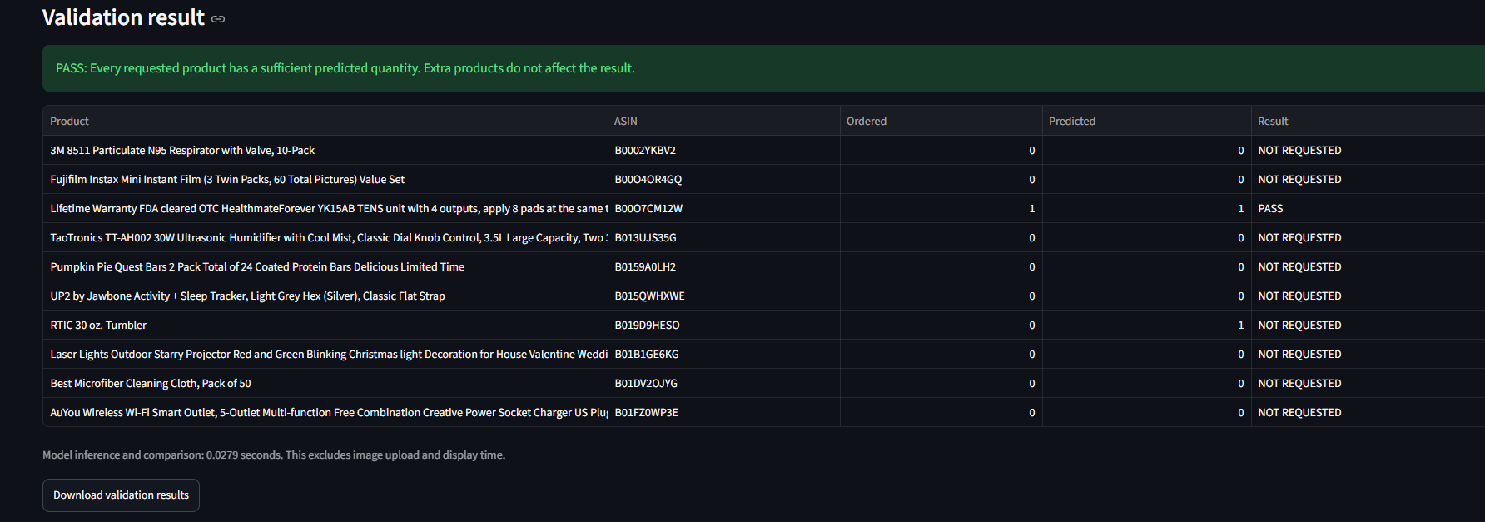
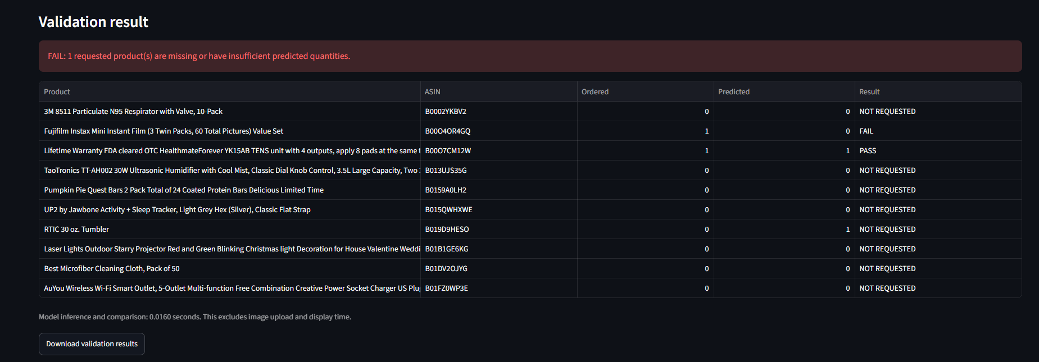
08 · APP WALKTHROUGH
From image upload to order decision
Architecture flow and screenshots from the deployed Streamlit app.
01
Upload image
02
Preprocess
03
ResNet-18
04
Compare
05
Report
JPG / PNG
Resize + normalize
10 × 6 logits
Order vs prediction
PASS / FAIL + CSV
PASS
Requested quantity 1, predicted quantity 1.
FAIL
Requested quantity 1, predicted quantity 0.
Order rule: check only products in the order. If any requested item is missing or under-counted, FAIL; ignore unrequested items.
08 / 12

Slide 9
09 · PRODUCTION READINESS
Deploy, monitor, retrain
Prototype deployment used free services; production costs depend on usage and service levels.
Deploy safely
Monitor behavior
Retrain responsibly
Version model, code, catalogue and dependencies. Add smoke tests and a rollback path.
Track latency, errors, product-level misses, prediction distribution and human overrides.
Use reviewed new labels. Tune on training/validation data and keep the test set protected.
CURRENT COST
PRODUCTION COST
All services used for the prototype were free, according to the developer.
Not estimated: expected traffic, compute, storage, monitoring and support requirements are unknown.
09 / 12

Slide 10
10 · AI-ASSISTED DEVELOPMENT
Check the code, not just the answer
AI-assisted development supported code refinement and debugging.
The warning sign
How it was caught
What changed
Accuracy metrics did not reconcile as expected, and parts of the code appeared to overfit.
The evaluation outputs were checked instead of accepting generated code at face value.
AI-assisted code was refined to improve reliability, then the metrics were reviewed again.
10 / 12

Slide 11
11 · NEXT STEPS
What needs to improve before real use
Separate measured results from planned work.
Model quality
Data quality
Evaluation
Present-item exact quantity accuracy is 27.18%; don't rely on the model alone for inventory decisions.
Collect more varied images, improve coverage for rare counts and inspect per-product label distributions.
Run a frequency baseline and analyze five actual test errors on the same held-out split.
Keep test-set results untouched during model selection. Use training and validation data for tuning.
11 / 12

Slide 12
12 · DECISION SUMMARY
A useful prototype, with clear next steps
For a non-technical manager
WHAT IT DOES
Estimates quantities for 10 selected products from a bin photograph.
HOW IT SCORES
All 10 quantities were exactly right on 60% of 200 held-out test images.
KEY CAUTION
Present-product exact quantity accuracy was 27.18%; errors remain material.
WHAT WORKS
The Streamlit demo validates orders and produces downloadable results.
NEXT MOVE
Improve data, inspect real failures and require human verification before operational use.
Farhan Mohammed • Smart Bin Classifier • 12 slides
12 / 12

