Slide 1


AMC ENGINEERING COLLEGE,BENGALURU-83
(Approved by , Permanently Affiliated to
VTU, Belagavi, Accredited by NAAC & NBA)
DEPARTMENT OF ARTIFICIAL INTELLIGENCE & MACHINE LEARNING
MAJOR PROJECT PHASE II ON
Florabot: AI-IoT based plant health monitoring system
GUIDED BY:
DR DEEPA
(Assistant prof AIML)
GROUP MEMBERS
1AM23AI018 : FARHAN AHMED
1AM23AI032 : LIBA SHASMEEN
1AM23AI030 : KHUSHI RAY
1AM23AI054 : SHIVANI KUMARI

Slide 2
CONTENT
ABSTRACT
INTRODUCTION
PROBLEM STATEMENT
LITERATURE PAPER
ARCHITECTURE
HARDWARE / SOFTWARE
DATASET DETAILS
PROGRESS
CONCLUSION
10. GANTT CHART
11. SDG’s
12. REFERENCES
Dept of AIML 2025-26

Slide 3
ABSTRACT
The proposed project presents an autonomous plant-monitoring and smart-irrigation rover designed for indoor environments such as offices and hospitals. The system integrates IoT components , a camera module, deep learning , and autonomous navigation to deliver continuous plant care with minimal human intervention.The onboard camera captures images analyzed by a deep-learning disease detection model to evaluate plant health. Moving via predefined paths, the rover activates targeted irrigation when necessary and transmits real-time alerts to a remote dashboard. By combining mobile robotics, smart irrigation, and AI into a single platform, this solution overcomes the limitations of stationary monitoring systems to reduce water waste, minimize manual labor, and ensure early disease detection for indoor plants.
Dept of AIML 2025-26

Slide 4
INTRODUCTION
Plants in offices, hospitals, and indoor environments require regular monitoring and watering to maintain their health. The proposed system uses an autonomous rover to monitor and care for multiple plants . A camera captures plant images for health assessment and disease detection using deep learning. Based on image data, the system predicts whether a plant requires irrigation or further attention. The rover uses line-following or autonomous navigation through Bluetooth to move between predefined plant locations. An automatic irrigation mechanism waters plants whenever required, and the system provides plant-status information and alerts to users, enabling efficient and intelligent plant care.
Dept of AIML 2025-26

Slide 5
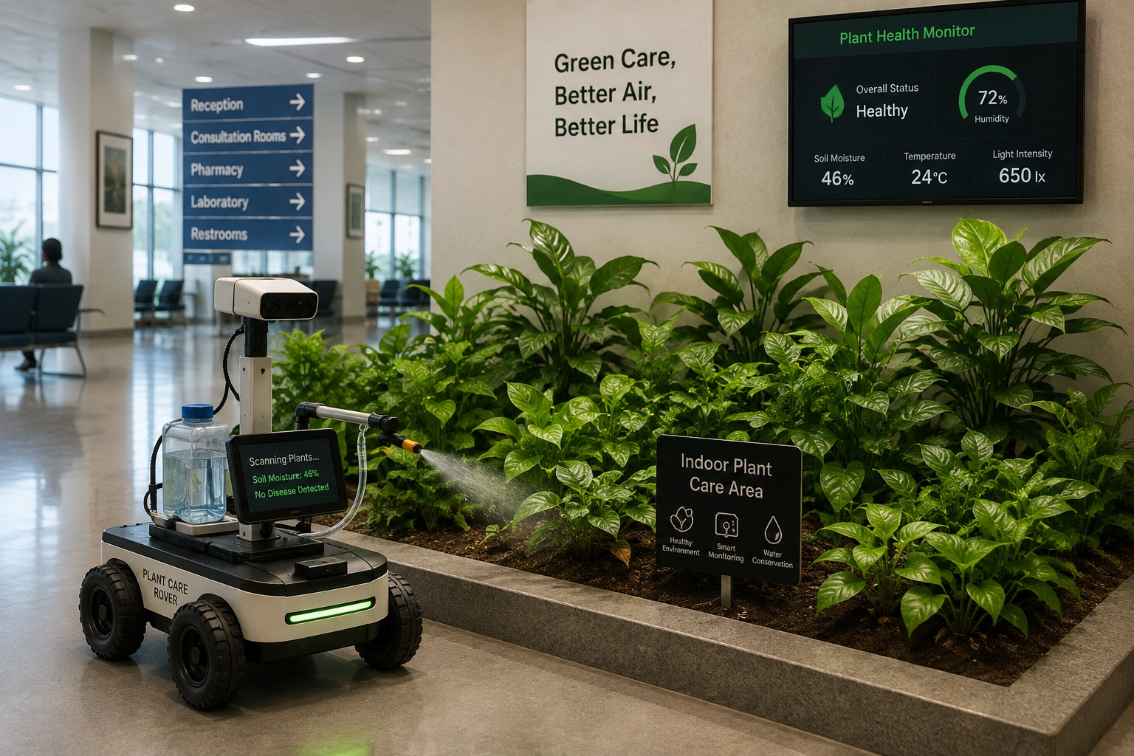
PROBLEM STATEMENT
360°
Problem Statement
Manual monitoring and watering of indoor plants is time-consuming and can lead to underwatering, overwatering, and delayed disease detection . There is a need for an autonomous system that can monitor plant conditions, detect diseases, navigate between plants, and provide irrigation when required.
Objectives
Develop an autonomous rover for monitoring and maintaining indoor plants.
Use a deep-learning mechanism for detecting plant health and diseases.
To implement automatic navigation and smart irrigation based on the plant’s requirements.
Dept of AIML 2025-26

Slide 6
LITERATURE SURVEY-1
360°
Smart Farming Robot for Detecting Environmental Conditions in a Greenhouse ,
Author: Rosero-Montalvo et al., IEEE Access, 2023
Uses:
Autonomous robot for greenhouse monitoring
Collects temperature, humidity, CO₂ and light data
Techniques:
K-Means clustering
PID-based movement
LoRa communication
Ultrasonic sensors + Raspberry Pi
Results:
Classified zones as Optimal, Standard and Deficient
Over 90% agreement with farmer assessment and around 5% sensor error
Limitation:
No image-based plant disease detection
Tested only in greenhouses
Predefined navigation routes
Relevance to Flora-Bot:
Provides a foundation for autonomous monitoring
Authors suggest computer vision and automatic water-pump control as future work.
Dept of AIML 2025-26

Slide 7
LITERATURE SURVEY-2
360°
Real-Time Plant Disease Dataset Development and Detection of Plant Disease Using Deep Learning ,
Author:D. S. Joseph et al., IEEE Access, 2024
Uses:
Real-world plant leaf images
Deep learning for disease classification
Dataset for real-time disease detection
Techniques:
Image preprocessing & augmentation
Transfer learning
CNN-based classification
Proposed MRW-CNN
Results:
Pretrained models achieved >90% accuracy
MRW-CNN achieved >95% accuracy
Limitation:
Focused on agricultural crops, not indoor plants
Environmental variations and multiple diseases on one leaf need further study
Relevance to Flora-Bot:
Supports using CNN + real-world leaf images for plant disease detection.
Dept of AIML 2025-26

Slide 8

LITERATURE SURVEY-3
°
MS-Net: A Novel Lightweight and Precise Model for Plant Disease Identification
Author: Authors of MS-Net, Frontiers in Plant Science, 2023
Uses:
Lightweight plant-disease identification.
Classification of healthy and diseased leaves.
Efficient deployment on devices with limited computing resources.
Techniques:
MobileNetV3-based CNN with skip connections.
Improved Whale Optimization Algorithm (WOA).
Bias loss function and plant-classification pretraining.
Results:
Achieved 99.8% accuracy on PlantVillage.
Achieved 97.8% accuracy on an apple-leaf dataset with complex outdoor backgrounds.
Reduced model complexity compared with several existing models.
Limitation:
Evaluated on specific datasets and crop categories.
Does not implement an autonomous agricultural rover.
Does not perform irrigation or automated treatment.
Relevance to Flora-Bot:
Supports lightweight CNN-based plant-disease detection.
Provides techniques for improving model efficiency on Raspberry Pi hardware.
Dept of AIML 2025-26

Slide 9
LITERATURE SURVEY-4
°
PMVT: A Lightweight Vision Transformer for Plant Disease Identification on Mobile Devices
Author: Guoqiang Li, Yuchao Wang, Qing Zhao, Peiyan Yuan and Baofang Chang, Frontiers in Plant Science, 2023
Uses:
Disease classification on mobile and resource-constrained devices.
Recognition of diseases across multiple crop types.
Techniques:
Plant-based Mobile Vision Transformer (PMVT).
Convolutional Block Attention Module (CBAM).
MobileViT-based architecture.
Results:
Achieved 93.6% , 85.4% , 93.1% accuracy on wheat , coffee, rice disease images.
Developed a mobile application for plant-disease identification.
Limitation:
Does not implement an autonomous rover.
Focuses on disease identification rather than automated treatment.
Performance on Flora-Bot's specific PlantDoc and PlantVillage dataset combination would need separate testing.
Relevance to Flora-Bot:
Provides an alternative to MobileNetV2 for disease classification.
Offers a useful comparison for selecting a lightweight model for Raspberry Pi deployment.
Dept of AIML 2025-26

Slide 10
LITERATURE SURVEY-5
360°
Improving Plant Disease Classification Using Deep Learning & Explainable AI
Author:Nigar et al., IEEE Access, 2024
Uses:
Deep learning for plant disease classification
Explainable AI to understand predictions
Mobile-based disease detection
Techniques:
CNN & Transfer Learning & LIME for explainable predictions
EfficientNetV2L, MobileNetV2, ResNet152V2
TensorFlow Lite for mobile deployment
Results:
EfficientNetV2L achieved ~99.63% accuracy
LIME explains individual model predictions
Demonstrated through a mobile application
Limitation:
No autonomous rover or irrigation
Mainly uses existing datasets
Limited realistic environmental conditions
Relevance to Flora-Bot:
Supports high-accuracy CNN disease detection
XAI can help explain why a leaf is classified as diseased.
Dept of AIML 2025-26

Slide 11

LITERATURE SURVEY-6
°
Vegetable Disease Detection Using an Improved YOLOv8 Algorithm in the Greenhouse Plant Environment
Author: Xuewei Wang and Jun Liu, Scientific Reports, 2024
Uses:
Detects vegetable diseases in greenhouse environments and Identifies diseased regions in plant images.
Supports automated crop monitoring under complex backgrounds.
Techniques:
Improved YOLOv8n object-detection model.
C2fGhost module to reduce computational complexity.
Lightweight GhostConv operations.
Results:
Improved disease detection performance compared with the original YOLOv8 model.
Reduced model parameters through lightweight network components.
Designed for vegetable disease detection in greenhouse conditions.
Limitation:
Focuses on disease detection rather than autonomous plant treatment.
Greenhouse evaluation does not guarantee performance in every outdoor environment.
Requires separate testing for deployment on Raspberry Pi hardware.
Relevance to Flora-Bot:
Directly relates to greenhouse crop monitoring and automated disease detection.
Can inform future experiments with real-time plant monitoring on Flora-Bot.
Dept of AIML 2025-26

Slide 12
LITERATURE SURVEY
COMPARISON TABLE
Paper | Technique Used | What it solves | Advantages | Key Limitations
Smart Farming Robot for Detecting Environmental Conditions in a Greenhouse: Rosero-Montalvo et al., IEEE Access, 2023 | K-means clustering, PID-based movement, LoRa communication, ultrasonic sensors, Raspberry Pi | Monitors greenhouse environmental conditions and classifies zones based on plant-growth conditions. | Over 90% agreement with farmer assessment; approximately 5% sensor error; supports automated environmental monitoring. | No plant-disease detection; tested only in greenhouses; depends on predefined routes
Real-Time Plant Disease Dataset Development and Detection of Plant Disease Using Deep Learning: D. S. Joseph et al., IEEE Access, 2024 | image preprocessing, data augmentation, transfer learning, CNN, pretrained models, MRW-CNN | Detects plant diseases from real-world leaf images captured under different backgrounds, lighting and disease conditions. | MRW-CNN achieved over 97% accuracy across maize, rice and wheat test datasets; supports real-world disease classification | Focuses mainly on agricultural crops; environmental variation and multiple diseases on one leaf require further investigation.
Dept of AIML 2025-26

Slide 13
LITERATURE SURVEY
COMPARISON TABLE
Paper | Technique Used | What it solves | Advantages | Key Limitations
MS-Net: A Novel Lightweight and Precise Model for Plant Disease Identification : Frontiers in Plant Science, 2023 | MobileNetV3, skip connections, Whale Optimization Algorithm, bias loss function, transfer learning | Improves plant-disease classification while reducing model complexity for resource-constrained devices. | Reports 99.8% accuracy on PlantVillage and 97.8% on a complex-background apple-leaf dataset; designed for efficient inference | Evaluated on specific datasets and crops; no rover integration; Raspberry Pi performance requires testing.
PMVT: A Lightweight Vision Transformer for Plant Disease Identification on Mobile Devices: Li et al., Frontiers in Plant Science, 2023 | MobileViT, PMVT, CBAM attention, inverted residual structures, feature fusion | Identifies diseases across crop types using a lightweight vision-transformer architecture suitable for mobile devices. | Reports 93.6% accuracy on wheat, 85.4% on coffee and 93.1% on rice datasets; offers an alternative to conventional CNNs. | Accuracy varies by crop; inference speed on Raspberry Pi needs evaluation; no autonomous navigation or treatment.
Dept of AIML 2025-26

Slide 14
LITERATURE SURVEY
COMPARISON TABLE
Paper | Technique Used | What it solves | Advantages | Key Limitations
Improving Plant Disease Classification With Deep-Learning-Based Prediction Model Using Explainable Artificial Intelligence : Nigar et al., IEEE Access, 2024 | CNN, transfer learning, EfficientNet-B0, MobileNetV2, ResNet-50, LIME | Classifies plant diseases and explains which image regions influence model predictions. | Reports 99.69% accuracy; LIME provides visual explanations; useful for interpretable disease classification. | No autonomous rover or irrigation; dataset performance may not generalize to real-world conditions; explanations do not guarantee correct predictions.
Vegetable Disease Detection Using an Improved YOLOv8 Algorithm in the Greenhouse Plant Environment : Wang and Liu, Scientific Reports, 2024 | YOLOv8n, C2fGhost, GhostConv, Occlusion Perception Attention Module, feature fusion | Detects and localizes vegetable-disease regions in greenhouse images, including complex backgrounds and partial occlusion. | Lightweight detection architecture; combines attention and feature extraction; suited to greenhouse disease monitoring. | No autonomous rover or automated treatment; generalization to other environments is uncertain; real-time Raspberry Pi performance requires testing.
Dept of AIML 2025-26

Slide 15
ARCHITECTURE
Sensing & Data Collection
Camera captures leaf images, while soil/environmental sensors and GPS collect plant and location data.
Edge Processing & AI
Raspberry Pi processes the images and runs the trained ML model to detect healthy/diseased leaves and calculate confidence.
Hardware Control & IoT
ESP32 controls the motors, sensors, and water/pesticide pumps, communicating with the Raspberry Pi
Backend & Database
FastAPI receives AI results, sensor data, GPS and robot status, and stores them in PostgreSQL.
Dashboard & Action
React dashboard displays plant health, alerts, maps and robot status; the operator can approve treatment, which sends commands back to the ESP32.
Dept of AIML 2025-26

Slide 16
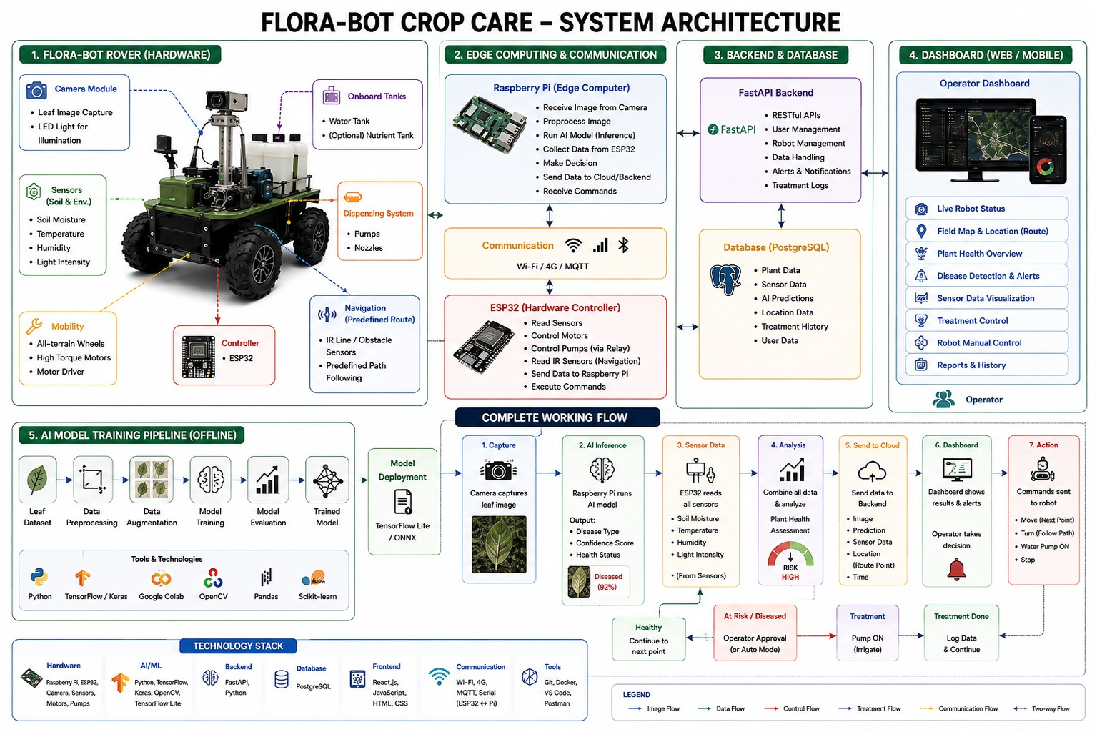
ARCHITECTURE
Block Diagram
Dept of AIML 2025-26

Slide 17
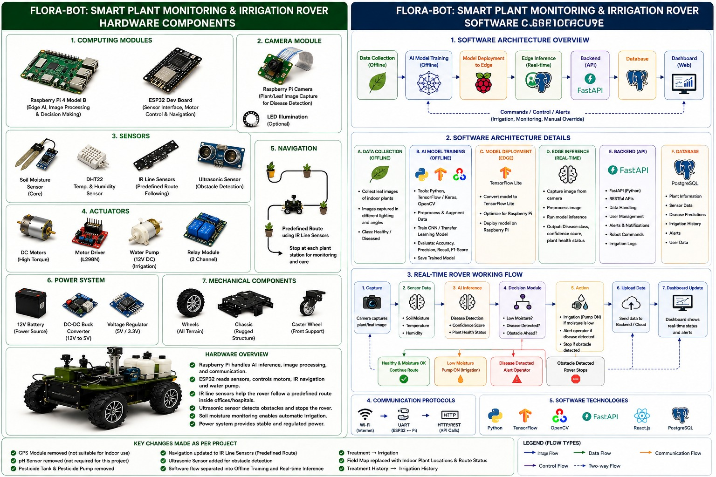
HARDWARE AND SOFTWARE
Dept of AIML 2025-26

Slide 18
DATASET DETAILS
PlantVillage Dataset
Scale: About 54,300 images across 38 classes (14 crop types).
Environment: Controlled, studio-style single-leaf images.
Primary Use: Baseline CNN training and fundamental disease classification.
PlantDoc Dataset
Scale: About 2,500 images across 30 classes (13 crop types).
Environment: Real-world, in-the-wild images with complex backgrounds .
Primary Use: Testing object detection (YOLO) and rover camera robustness.
Deep-Plant-Disease Dataset
Scale: About 248,000+ images across 55 species and 175 disease categories.
Environment: Massive scale with high diversity across mixed conditions.
Primary Use: Fine-tuning advanced deep learning models and handling rare pathologies.
Dept of AIML 2025-26

Slide 19
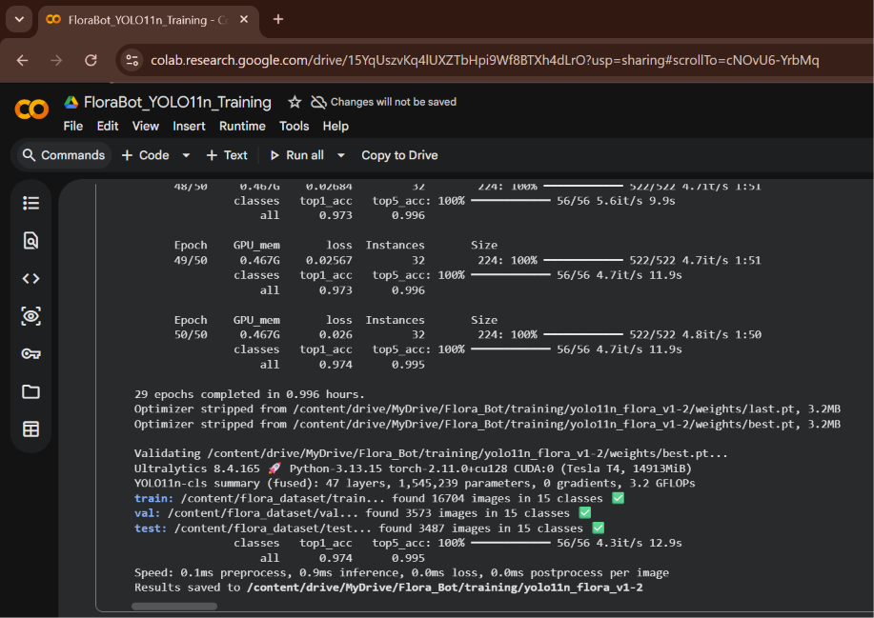
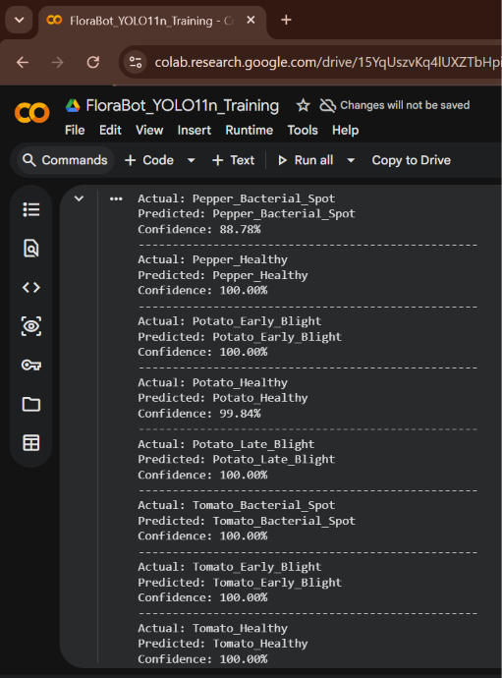
PROGRESS
Dept of AIML 2025-26

Slide 20
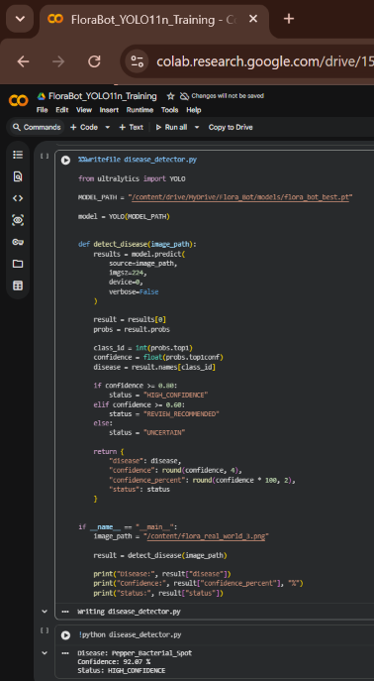
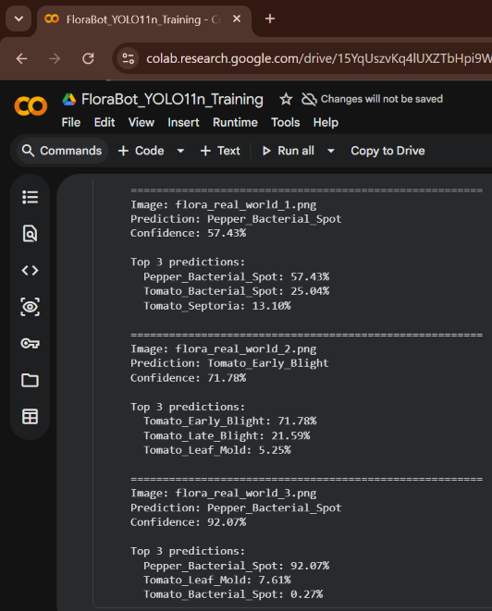
PROGRESS
Dept of AIML 2025-26

Slide 21
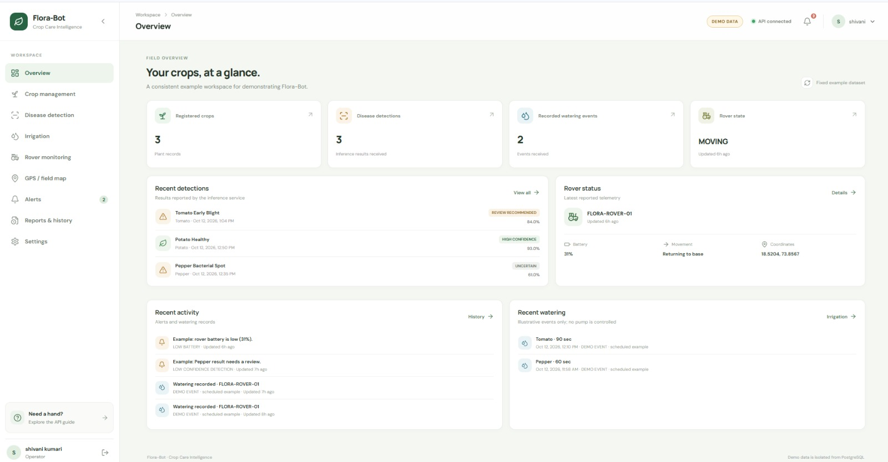
PROGRESS
Dept of AIML 2025-26

Slide 22
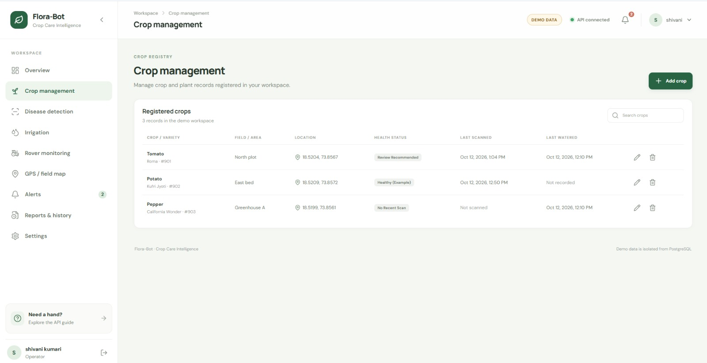
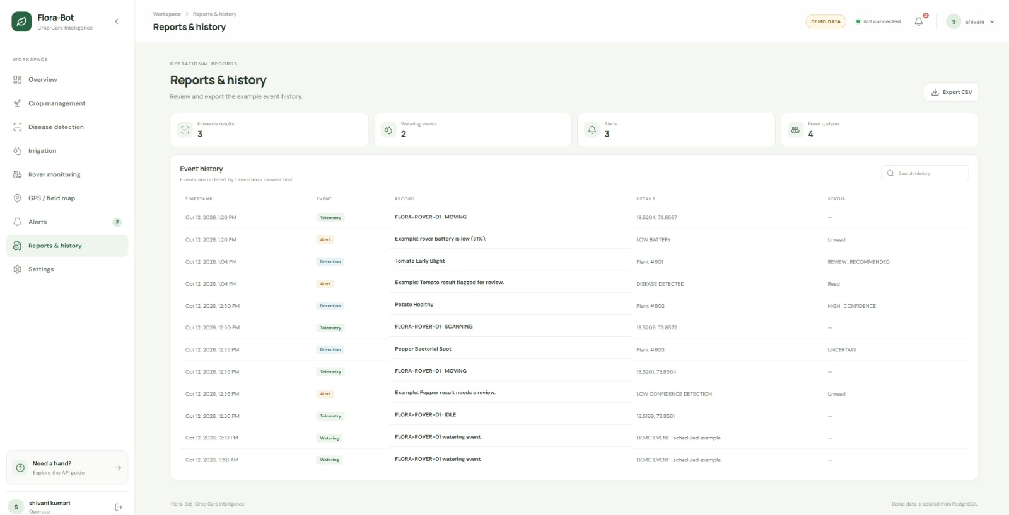
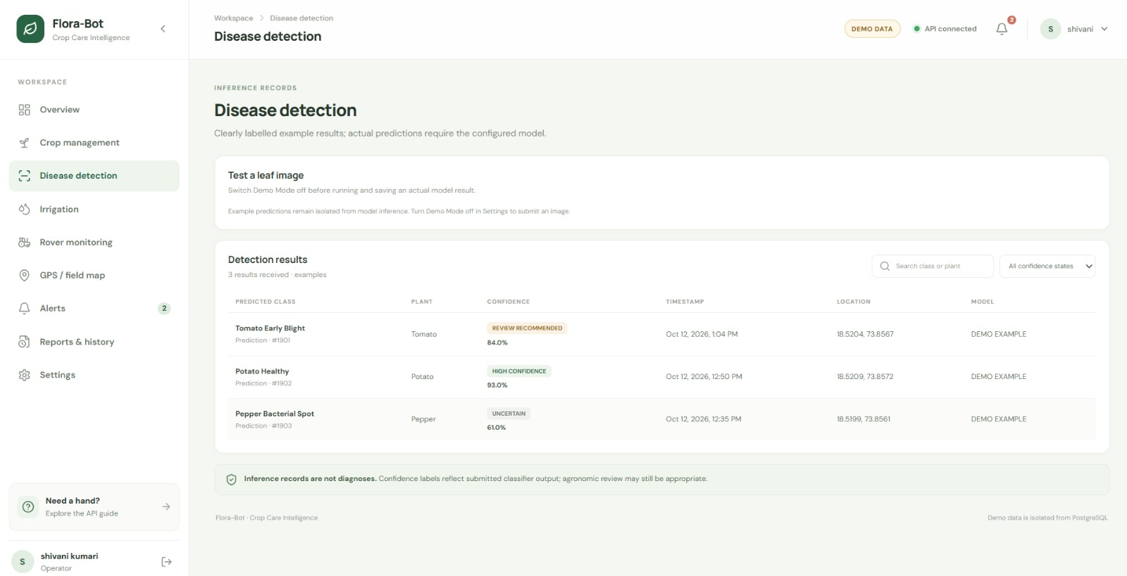
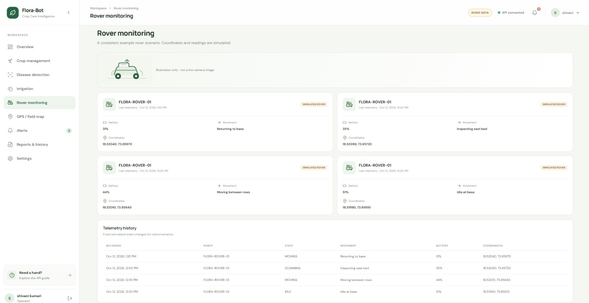
PROGRESS
Dept of AIML 2025-26

Slide 23
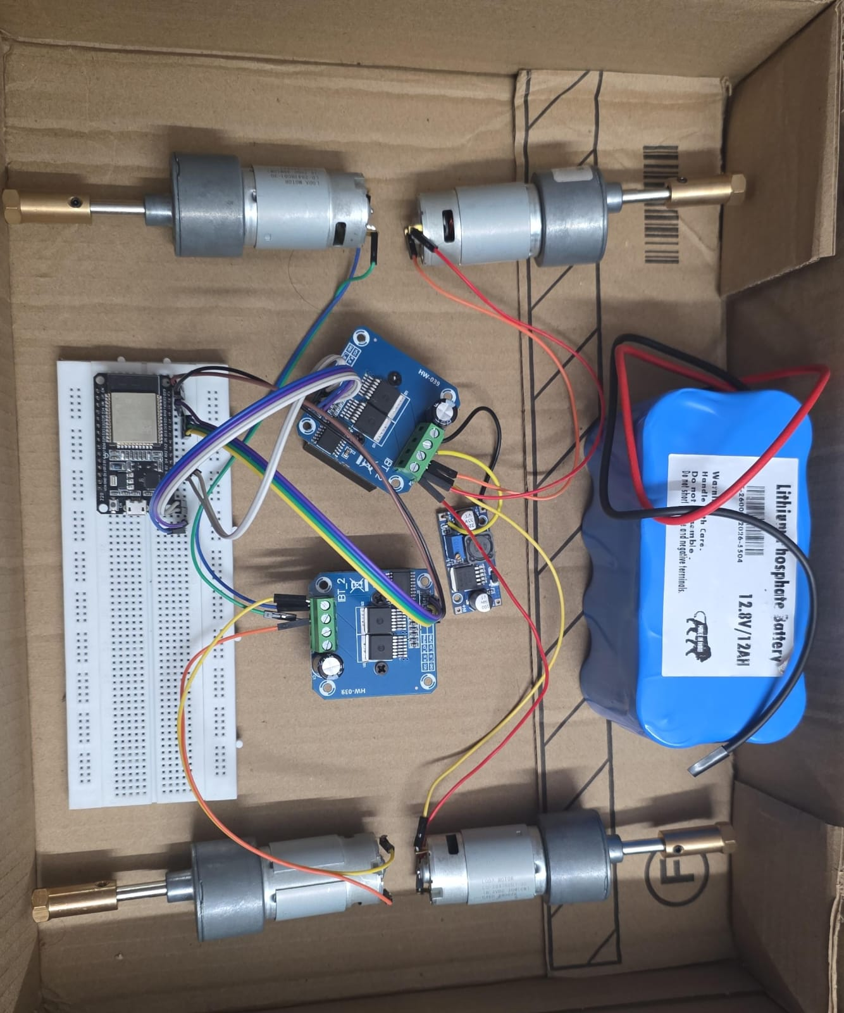
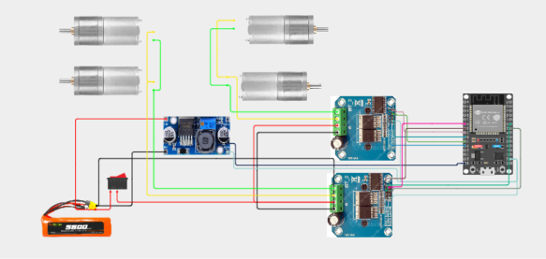
PROGRESS
Dept of AIML 2025-26

Slide 24
PROGRESS
PROBLEMS WHILE INTEGRATING HARDWARE
COMPONENTS | STATUS | REASON | OBSERVATION
DC-DC BUCK CONVERTER | DAMAGED | HIGH VOLTAGE OF BATTERY | POWER LED NOT WORKING
ESP32 | DAMAGED | CONNECTED DAMAGED BUCK CONVERTER TO ESP32 | SIMPLE BLINKER PROGRAM NOT WORKING
RASPBERRY PI (4GB) | NOT PURCHASED | OVER EXPENSIVE
RASPBERRY PI 5/8 MP CAMERA | NOT PURCHASED | COMPATIBLITY ISSUES WITH OTHER SBC
12V 12aH BATTERY | WORKING | TOO HIGH VOLTAGE | DAMAGED 2 COMPONENTS BUCK AND ESP32
Dept of AIML 2025-26

Slide 25


CONCLUSION
Flora-Bot Crop Care is a smart robotic system that integrates robotics, IoT, computer vision, and artificial intelligence to automate plant health monitoring and crop care. The rover captures live leaf images , detects plant diseases using a trained deep learning model, and automatically sprays water or pesticides when needed. This reduces manual labor , conserves water, and minimizes chemical usage while improving plant health. The system also provides real-time monitoring through an operator dashboard. With future enhancements such as autonomous navigation and cloud connectivity, Flora-Bot Crop Care has the potential to become an efficient and scalable solution for smart agriculture.
Dept of AIML 2025-26

Slide 26
GANTT CHART (Phase 2)
ACTIVITY | AUGUST | SEPTEMBER | OCTOBER | NOVEMBER
LITERATURE SURVEY
HARDWARE
SOFTWARE
MODEL TRAINING
DOCUMENTATION
Dept of AIML 2025-26

Slide 27
Sustainable Development Goal
(SDG’s)
SDG 2 – Zero Hunger
FloraBot supports sustainable agriculture by using AI-based plant disease detection and smart irrigation to improve plant health, reduce crop losses, and enhance agricultural productivity
SDG 6 – Clean Water and Sanitation
FloraBot promotes efficient water management by monitoring soil moisture and providing irrigation only when required, thereby minimizing water wastage.
SDG 9 – Industry, Innovation and Infrastructure
FloraBot integrates Artificial Intelligence, IoT, Robotics, Computer Vision, and Edge Computing to develop an innovative and intelligent plant health monitoring system.
SDG 12 – Responsible Consumption and Production
FloraBot encourages responsible use of natural resources by reducing unnecessary water consumption and enabling targeted application of pesticides based on real-time plant health analysis.
SDG 15 – Life on Land
FloraBot helps protect plant ecosystems through continuous monitoring, early disease detection, and timely treatment, contributing to healthier and more sustainable plant life.
Dept of AIML 2025-26

Slide 28
REFERENCES
[1] D. Rosero-Montalvo, A. Ponce, M. V. Garcia, and R. V. Sanchez, “Smart Farming Robot for Detecting Environmental Conditions in a Greenhouse,” IEEE Access, vol. 11, pp. 1–16, 2023.
[2] D. S. Joseph, S. Mathew, P. Thomas, and R. K. George, “Real-Time Plant Disease Dataset Development and Detection of Plant Disease Using Deep Learning,” IEEE Access, vol. 12, 2024.
[3] S. Nigar, M. A. Rahman, F. Islam, and M. R. Hossain, “Improving Plant Disease Classification With Deep-Learning-Based Prediction Model Using Explainable Artificial Intelligence,” IEEE Access, vol. 12, 2024.
[4] Li et al., "PMVT: A Lightweight Vision Transformer for Plant Disease Identification on Mobile Devices," Frontiers in Plant Science, 2023.
[5] Wang and Liu, "Vegetable Disease Detection Using an Improved YOLOv8 Algorithm in the Greenhouse Plant Environment," Scientific Reports, 2024
[6] "MS-Net: A Novel Lightweight and Precise Model for Plant Disease Identification," Frontiers in Plant Science, 2023.
Dept of AIML 2025-26

Slide 29
REFERENCE TABLE
PAPER | REFERNCE
Smart Farming Robot for Detecting Environmental Conditions in a Greenhouse : Rosero-Montalvo et al., IEEE Access, 2023 | https://ieeexplore.ieee.org/document/10146280
Real-Time Plant Disease Dataset Development and Detection of Plant Disease Using Deep Learning : D. S. Joseph et al., IEEE Access, 2024 | https://ieeexplore.ieee.org/document/10414062
MS-Net: A Novel Lightweight and Precise Model for Plant Disease Identification : Frontiers in Plant Science, 2023 | https://www.frontiersin.org/journals/plant-science/articles/10.3389/fpls.2023.1276728/full
PMVT: A Lightweight Vision Transformer for Plant Disease Identification on Mobile Devices : Li et al., Frontiers in Plant Science, 2023 | https://www.frontiersin.org/journals/plant-science/articles/10.3389/fpls.2023.1256773/full
Improving Plant Disease Classification With Deep-Learning-Based Prediction Model Using Explainable Artificial Intelligence : Nigar et al., IEEE Access, 2024 | https://ieeexplore.ieee.org/document/10599267
Vegetable Disease Detection Using an Improved YOLOv8 Algorithm in the Greenhouse Plant Environment: Wang and Liu, Scientific Reports, 2024 | https://www.nature.com/articles/s41598-024-54540-9
Dept of AIML 2025-26

Slide 30
THANK YOU
Dept of AIML 2025-26

