Slide 1

Diabetes Prediction System Using Machine Learning
TEAM MEMBERS
Farhan Shaik
Sohailuddin Mohammed
Sivaleela Yarmala

Slide 2
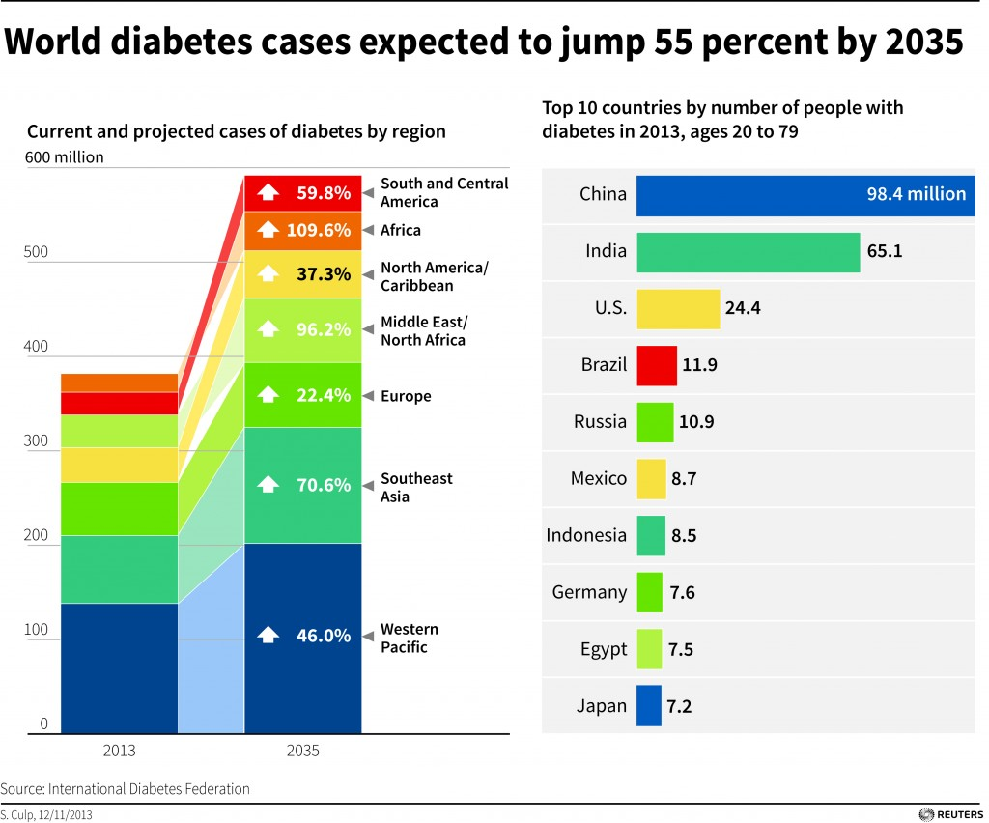
PROBLEM
Diabetes is one of the deadliest disease in the world which is rapidly increasing.
Cause of diabetes vary depending on the genetic makeup family, history, ethnicity, health etc.,
It is an illness caused because of high glucose ;level in a human body.
Diabetes should not be ignored if it is untreated then diabetes may cause some major issues in person like heart related problems, kidney problem, blood pressure, eye damage, it can also affect other organs of human body.
Good thing is diabetes can be controlled if it is predicted earlier.
To achieve this goal our project will do early prediction of diabetes in a human body or a patient.

Slide 3
SOLUTION
The aim of our project is to design and implement diabetes prediction using machine learning methods and performance analysis of those methods.
The techniques we are using are support vector machine-nearest Neighbour, decision Tree, logistic regression ,random forest.
Applying machine learning techniques to analyze the performance of these methods will help to find accuracy of the model.
It will help to figure out the responsible/important feature which play a major role in prediction.
Our result shows that random forest achieved higher accuracy compared to other machine learning techniques.
Diabetes can be controlled if it is predicted earlier. Machine learning techniques will provide better result for prediction by constructing models from datasets collected from patients.

Slide 4




TOOLS
Python
Numpy
Pandas
Sklearn
Flask
Pycharm
Google Collab
CRISP-DM METHODOLOGY
Business Understanding
Data Collection
Data Cleaning
Exploratory Data Analysis
Model Building
Model Evaluation
Deployment

Slide 5
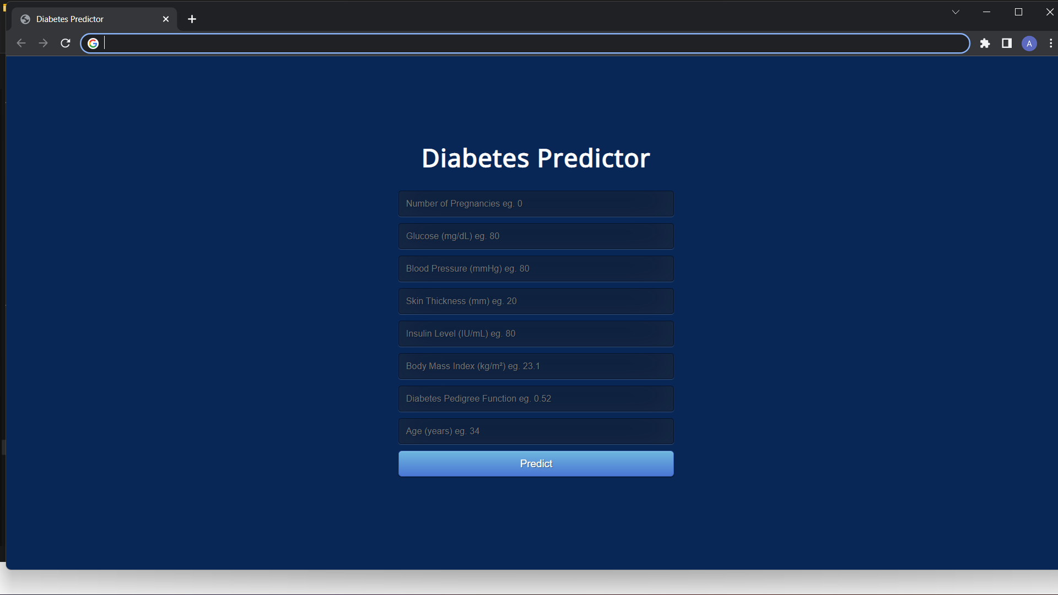
Diabetes Predictor Web app
This is the front end of our project, where you can fill the attributes to predict the diabetes

Slide 6
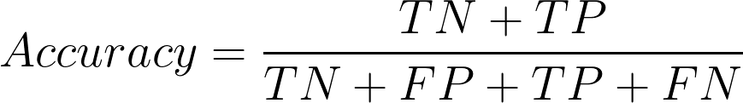
Evaluation Methodolgy
To check the accuracy of our model we have implemented the below techniques
CONFUSION MATRIX:
A confusion matrix is a table that is often used to describe the performance of a classification model(on a set of test data for which the true values are known.)
True positives(TP): These are cases in which we predicted yes (they have the disease),and they do have the disease.
True negatives(TN): We predicted no, and they don’t have the disease.
False positives(FP): We predicted yes, but they don’t have the disease.
False negatives(FN): We predicted no, but they do have the disease.
ACCUARCY SCORE:

