Slide 1
3D Human Pose Estimation
Farhanur Rahim Ansari, Vidhey Oza, Minji Lee
Notes:
Minji - 1-5
Vidhey - 6-11
Farhan - 12-14
Points for Presentation: (https://www.youtube.com/watch?v=fGWNIguWPbs)
(We’ll make use of these points in our presentation. For the report pick up any point and elaborate on them and fit them in any place they look good)
How to estimate 3D pose for monocular RGB images?
One-step methods directly estimate 3D poses from RGB images in an end-to-end fashion
Two step methods first predict 2D keypoints from RGB images and then lift them to 3D poses
Advantages of two-step methods
Compatible with existing 2D pose estimation algorithms
Avoid the influence of the environment backgrounds and human surface features
Has better generalization in the wild
Main Challenges
Depth Ambiguity: The same 2D pose can be reconstructed to different 3D poses
Jitter: The motion estimated from monocular RGB images will yield visual jitter
Self-occlusion: As human are articulated objects, self occlusion will inevitably occur
Solution: Gast-Net
Exploits spatial and temporal information to address depth ambiguity, jitter and self-occlusion.
Construct global correlation driven by pose semantic
Combine Temporal Convolutional Networks and Graph Attention Block
Compared to the result estimated from a single RGB image, the motion estimated from long term frames is smoother
With local attention graph, it can mitigate the depth ambiguity for these joints with only first order neighbor
With global attention graph, it can more effectively combine temporal consistency to address self occlusion
With exploiting spatial information, in the case of self-occlusion, it generates more accurate 3D poses.
Even if there is half body occluded, the method still can reconstruct valid 3D structure

Slide 2
Project Goal
Perform 3D human pose estimation on monocular RGB images and videos, and make an interactive tool that helps in using this technology with convenience.

Slide 3
Summary of Phase 1
Phase 1
Phase 2
Pipeline
Scalability
Prototype
Interactive tools

Slide 4
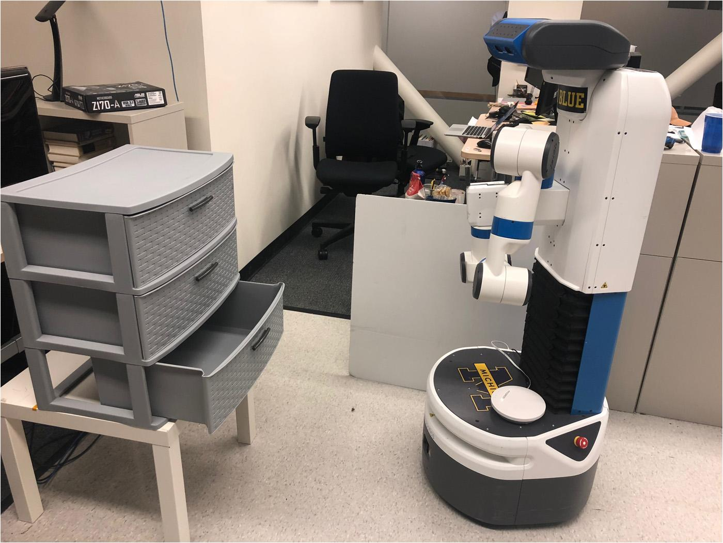
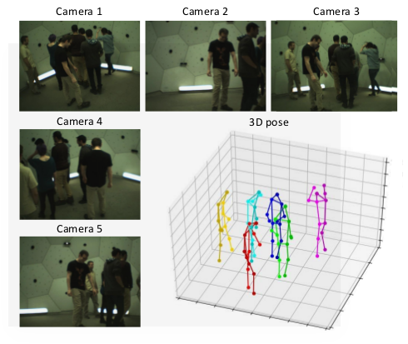
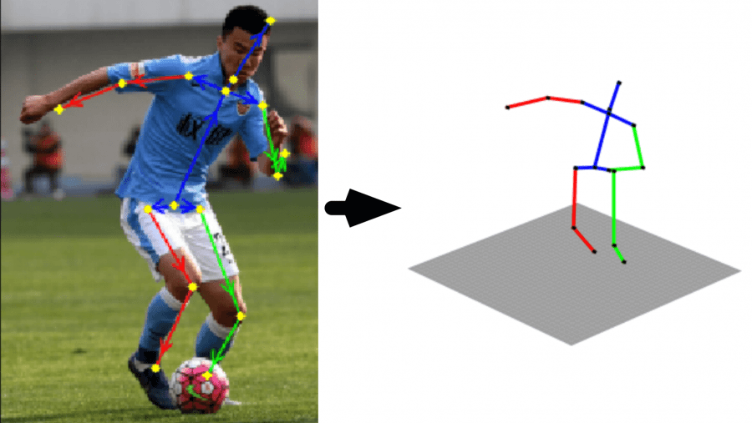
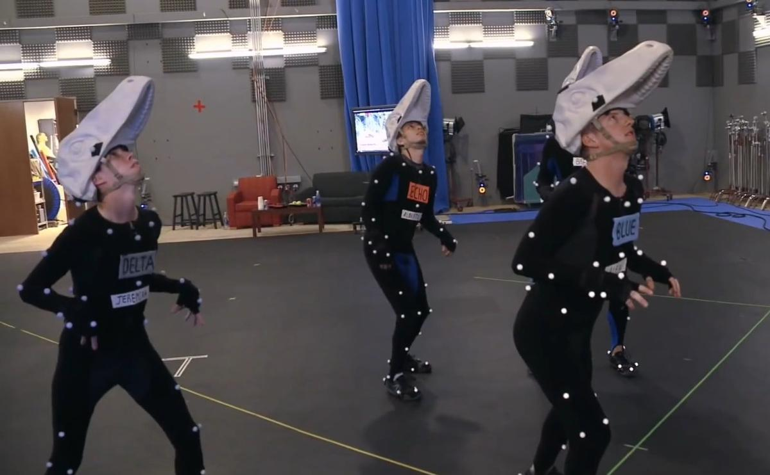
Where Can We Use It?
Robotics
Surveillance
Motion Capture
CGI

Slide 5
What are the main challenges?
Self Occlusion
Depth Ambiguity
Jitter

Slide 6
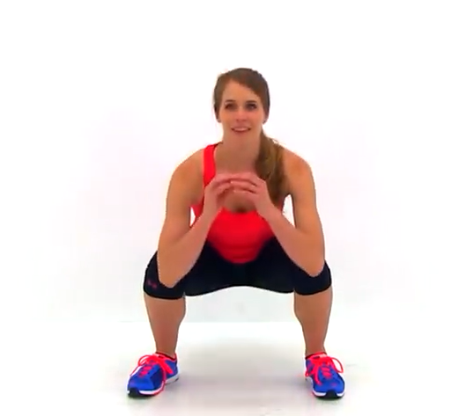
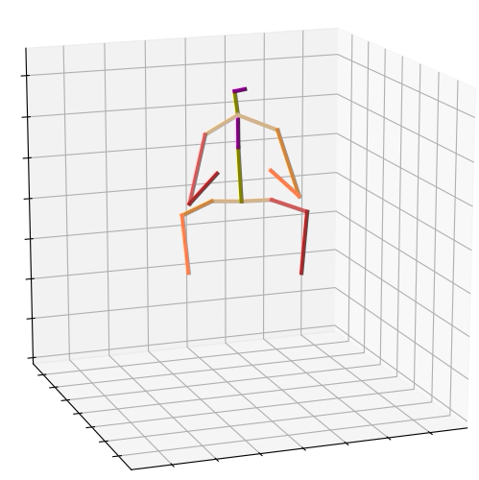
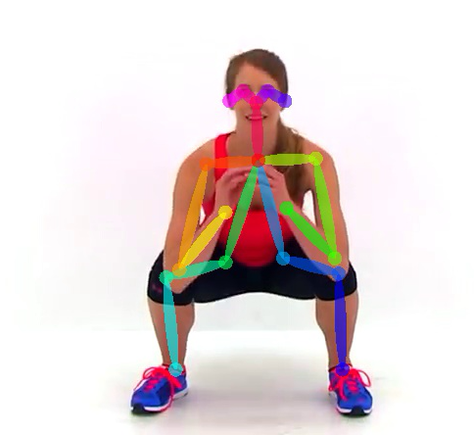
How to estimate 3D pose from monocular RGB Image?
One step method directly estimates 3D poses from RGB images in an end-to-end fashion
Two-step method first predict 2D keypoints from RGB images and then lift them to 3D poses.
3D Pose Estimation
One-step Method:
2D Keypoint Prediction
3D Pose Reconstruction
Two-step Method:

Slide 7
Why two-step methods?
Compatible with existing 2D pose estimation methods
Avoids influence of background and human surface features
2D pose acts as auxiliary output for better convergence
Has better generalization in the wild
Notes:
small points

Slide 8
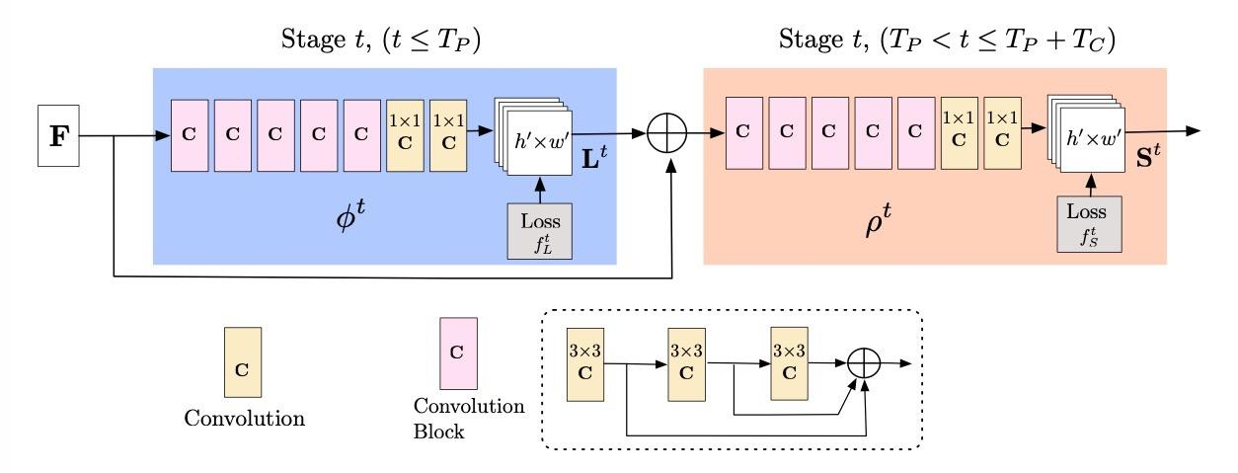
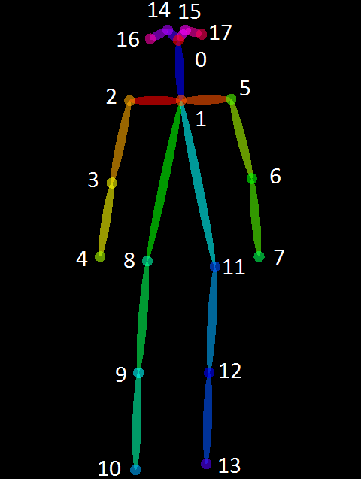
OpenPose (Input-to-2D)
(Top): OpenPose Architecture for the multi-stage CNN.
(Right): 18 Keypoint skeleton for COCO Dataset
Notes:
overview
architecture
blue: PAF, orange, confidence maps
skeleton
18pt

Slide 9
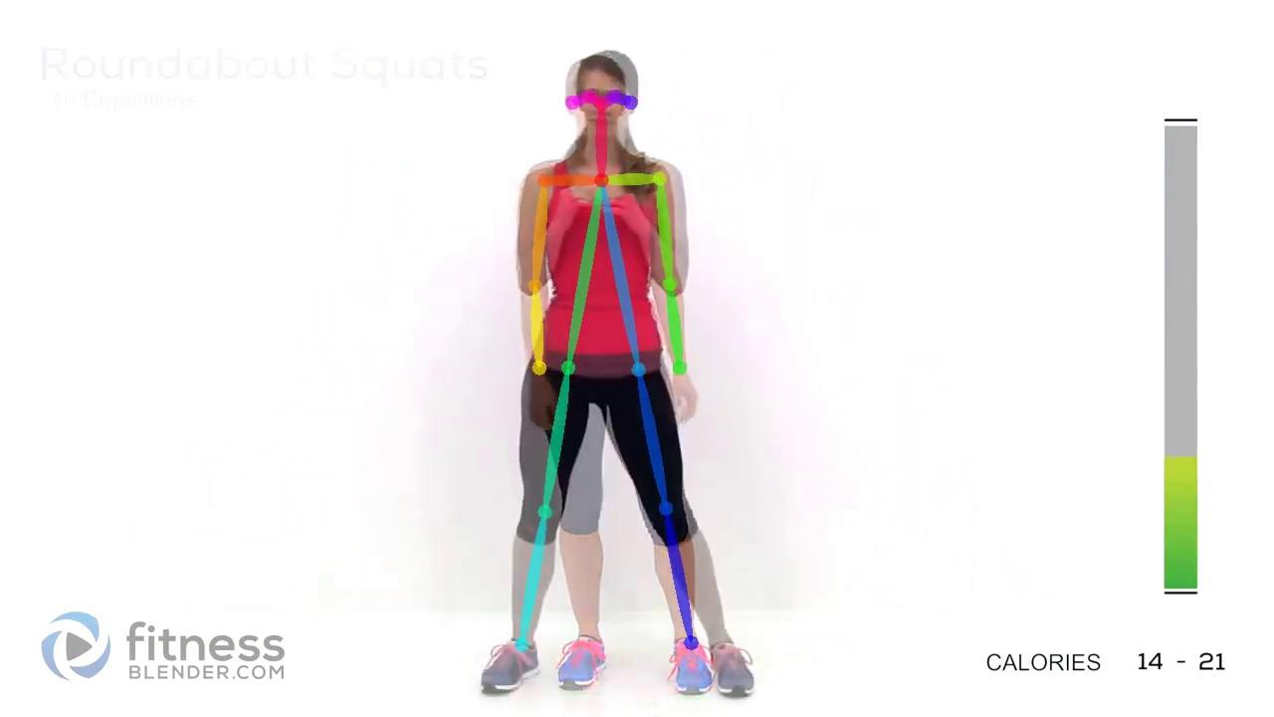
OpenPose Output
Squats: 2D keypoint prediction

Slide 10
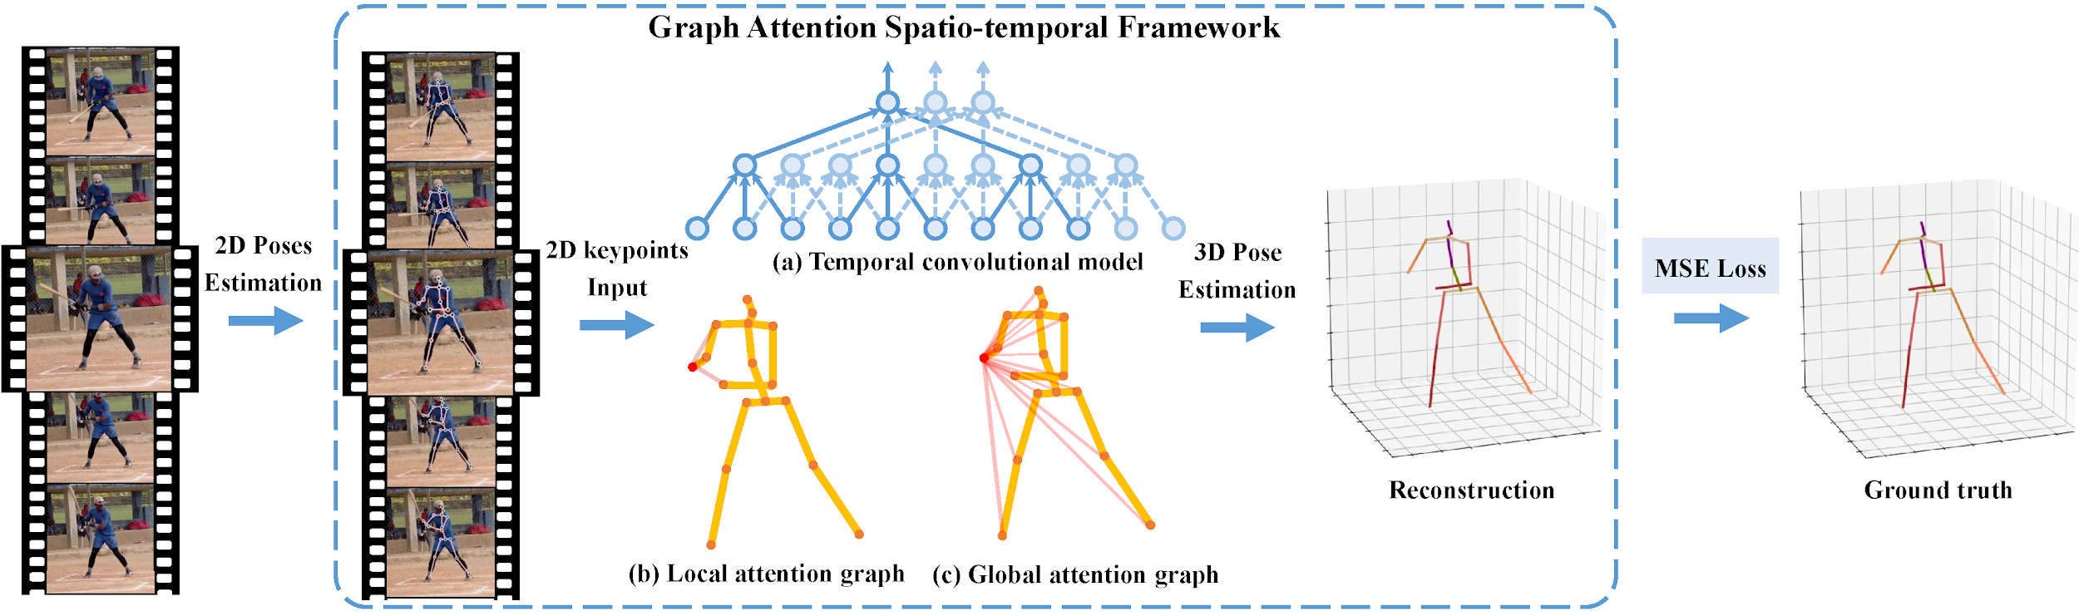
GAST-Net (2D-to-3D)
Fig: Schematic overview of GAST-Net Framework
Notes:
temporal conv model
local attention
global attention

Slide 11
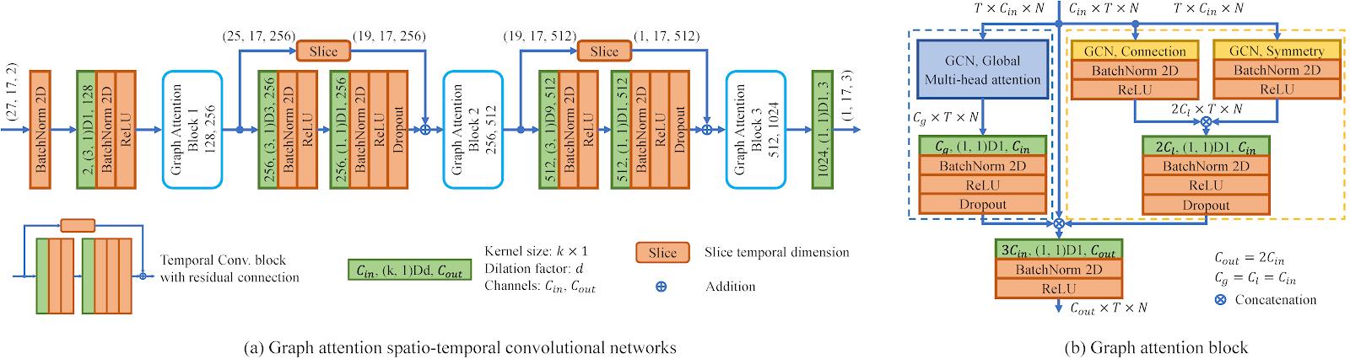
GAST-Net (2D-to-3D)
Fig: GAST-Net Architecture
Notes:
Overview
Architecture
graph attention = global + local
int -- att -- temp -- att -- temp -- att -- out

Slide 12
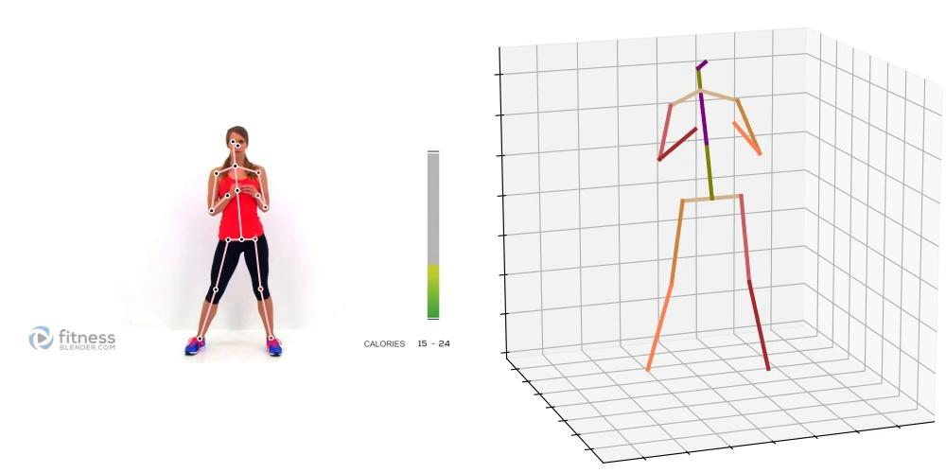
GAST-Net Output
Squats: 3D pose reconstruction using 2D Keypoints

Slide 13
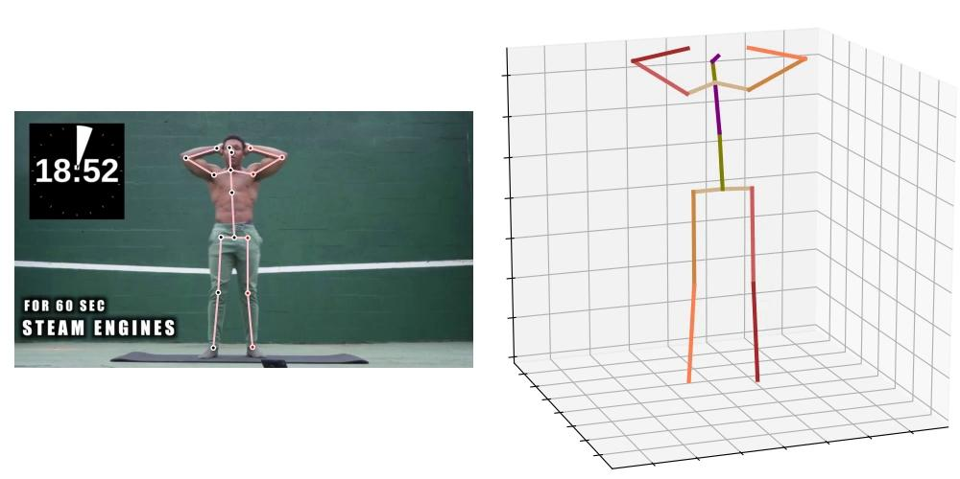
Unstable 3D Estimation because of Jittering
Complicated exercises makes the 2D keypoints tracking difficult
Notes:
Indoor - guy video
jitter: The motion estimated from monocular RGB images will yield visual jitter
Flickering - Not stable pose - too much movement - difficult to track skeleton points.
Not smooth 3D
Higher FPS - More Frames rate- should be used by model. Time + Frame = GAST-Net
Inherent with any model

Slide 14
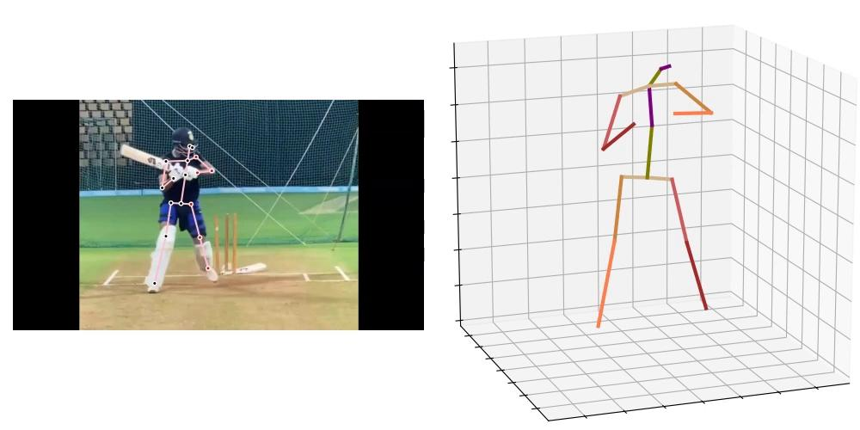
Self occlusion makes the estimation go haywire
Hidden body parts are difficult to assign a keypoint
Notes:
Cricket
Self occlusion - Body parts blocked
Self-occlusion: As human are articulated objects, self occlusion will inevitably occur
Hands not visible - keypoint goes wrong
GAST-Net works properly
Problem with openpose - output format needs to be tweaked for GAST-Net input

Slide 15
Future Work
Fixing existing problem
Retraining model
Improving results
Developing interactive tool for application usage
Improving Scalability
Notes:
Fixes-
Tweak OpenPose output
Retrain model to lower flickering - Qualitative improvement
Scalibility
Make the model lightweight
Decrease processing time
Interactive tool
Figure out better platform and tools. Application or web app. model runs fast

Slide 16
Thank You!
Farhanur Rahim Ansari, Vidhey Oza, Minji Lee

