Slide 1
3D Human Pose Estimation
Farhanur Rahim Ansari, Vidhey Oza, Minji Lee

Slide 2
Project Goal
Perform 3D human pose estimation on monocular RGB images and videos, and make an interactive tool that helps in using this technology with convenience.

Slide 3
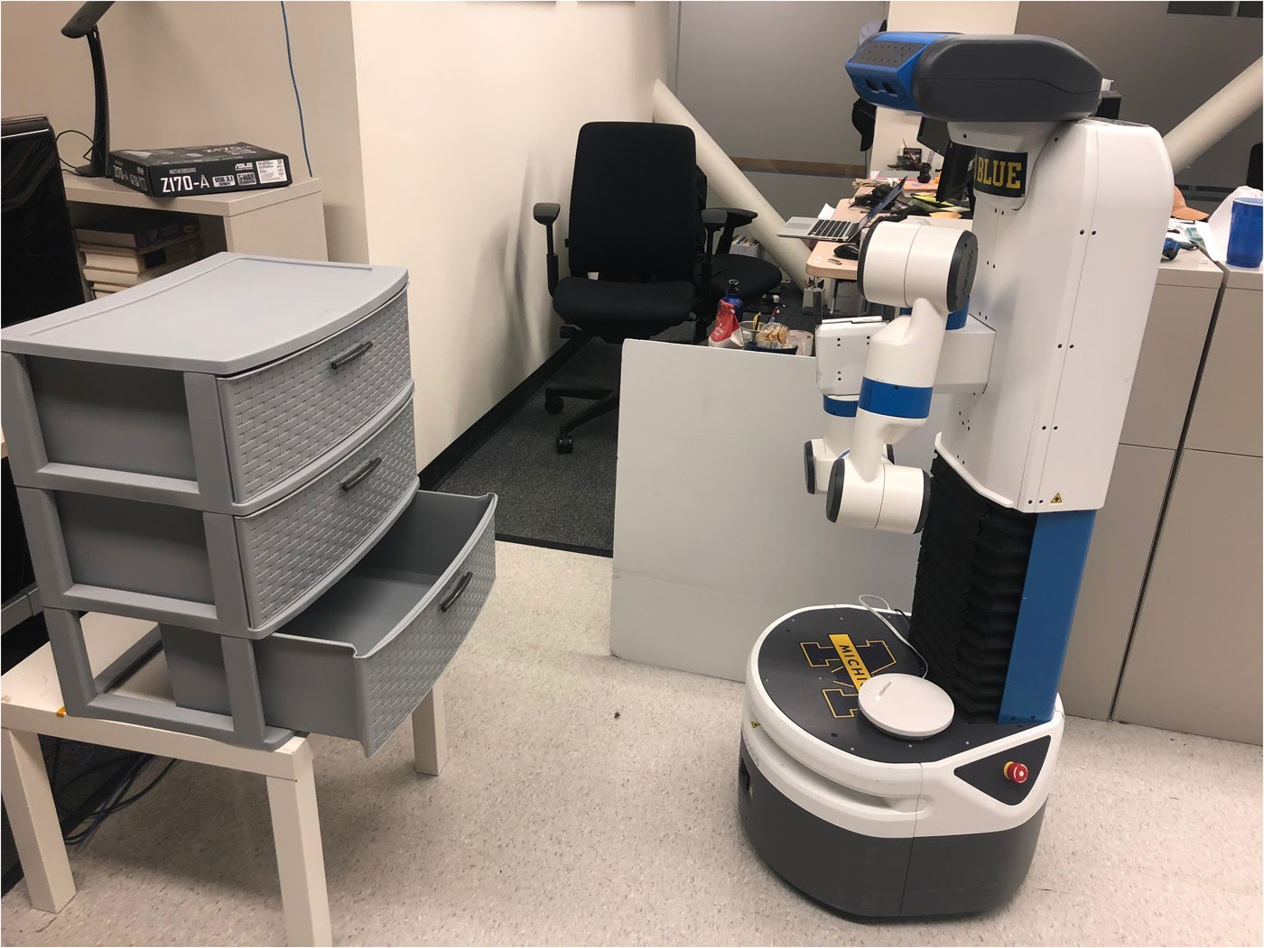
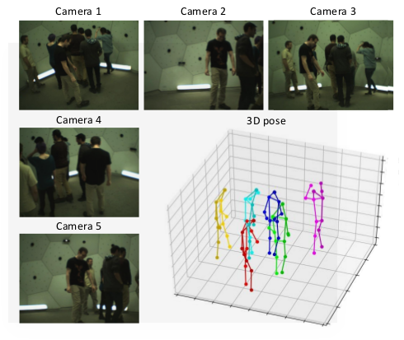
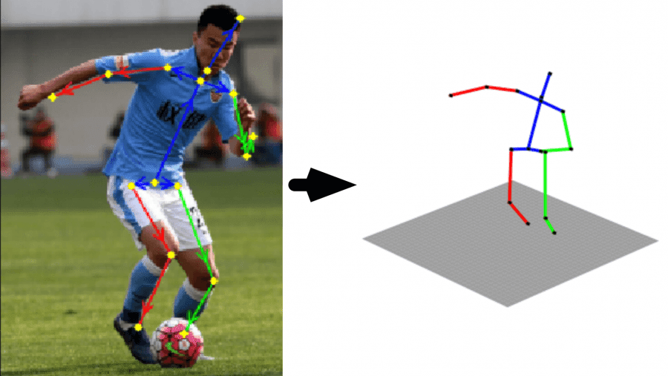
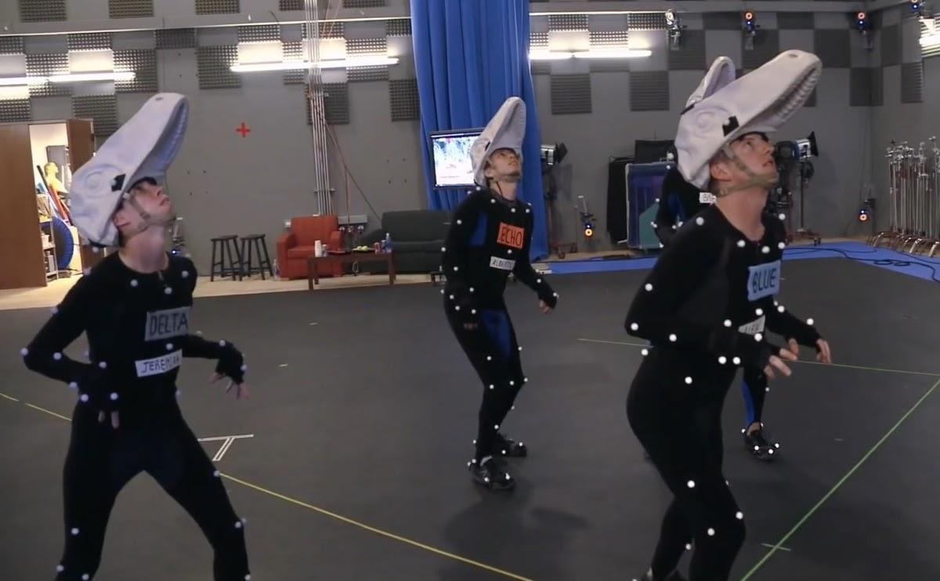
Where is this useful?
Robotics
Surveillance
Motion Capture
CGI

Slide 4
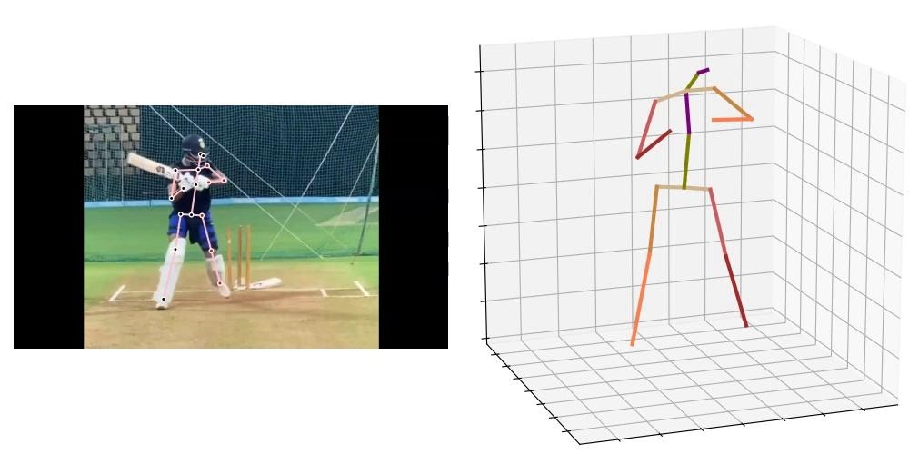
Challenges - Self-Occlusion + Depth Ambiguity
Cricket batsman practicing different shots
Self-occlusion- one of the arm and leg are hidden behind the batsman’s body
Depth Ambiguity- How far the different body parts are from the camera is difficult to access

Slide 5
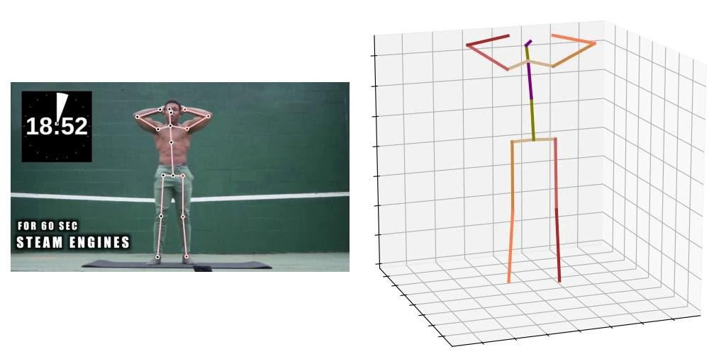
Challenges - Jitter
Man doing jumping jacks and stem engines
Jitter- Because of the lesser number of frames to cover this complicated exercise the final output is a bit jittery or shaky

Slide 6
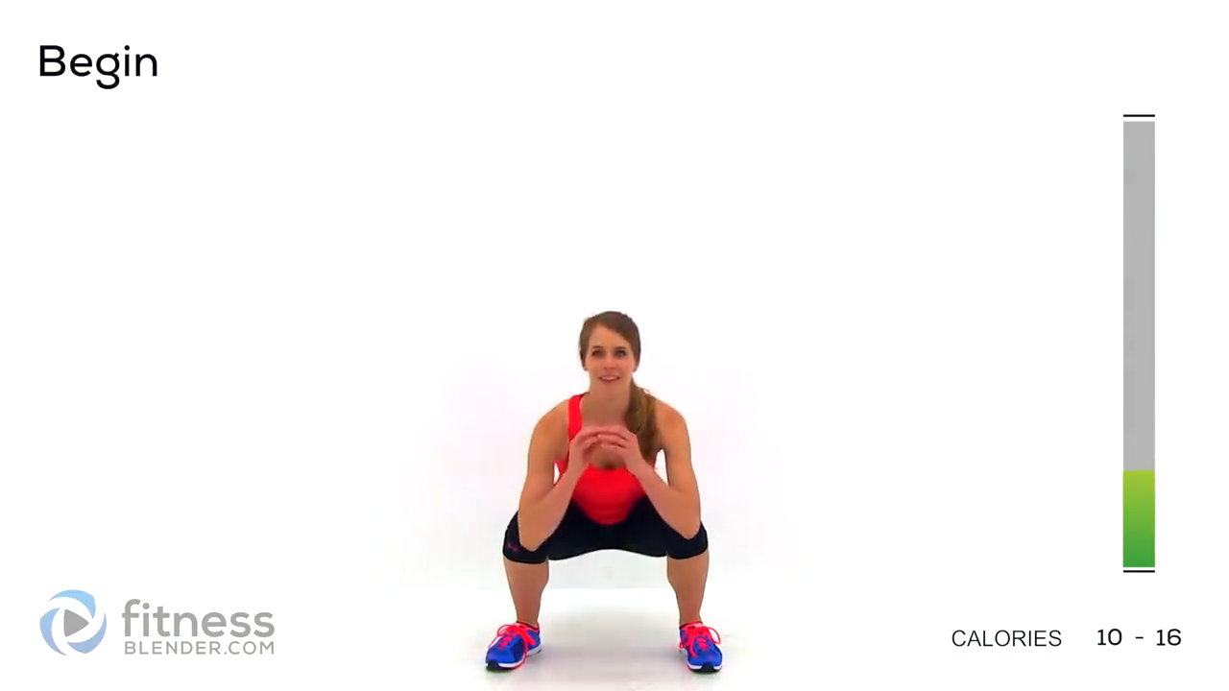
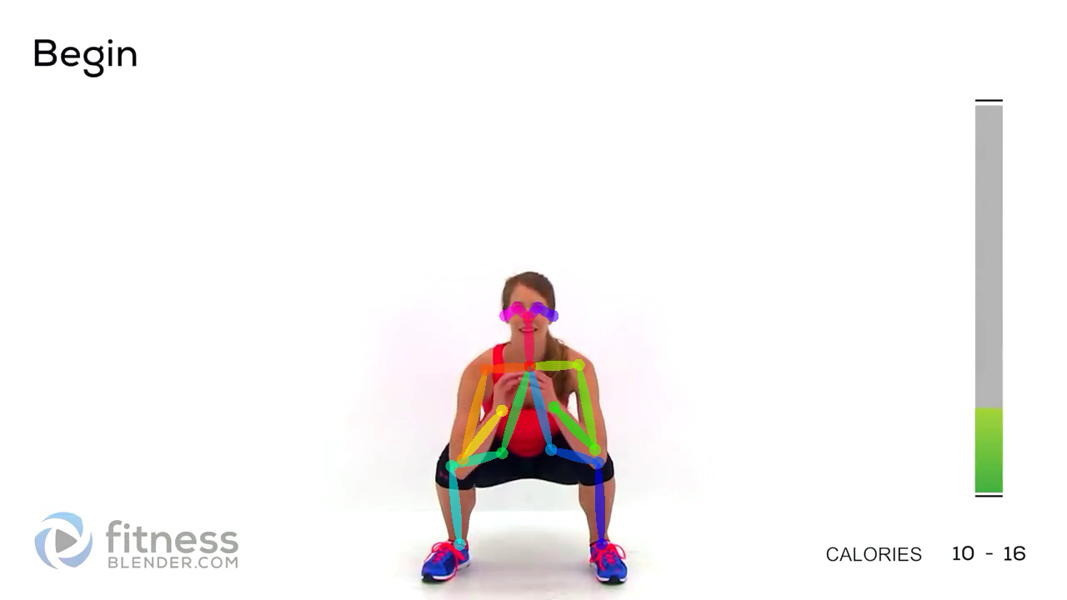
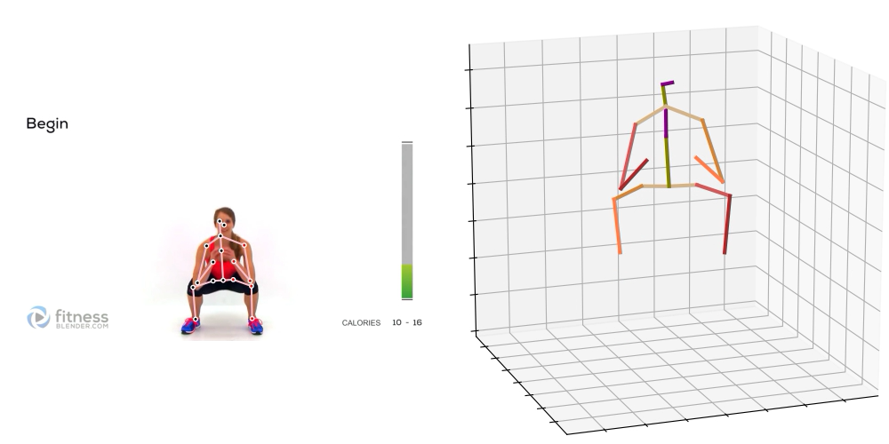
Approach
Two-step method first predict 2D keypoints from RGB images and then lift them to 3D poses.
Two-step Method:
2D Keypoint Prediction
3D Pose Reconstruction

Slide 7
Why two-step methods?
Compatible with existing 2D pose estimation methods
Avoids influence of background and human surface features
2D pose acts as auxiliary output for better convergence
Has better generalization in the wild
Notes:
small points

Slide 8
3D-HPE Pipeline
Input (Video)
HR Net
(Input-to-2D)
2DHPE (JSON)
GAST-Net
(2D-to-3D)
3DHPE
(Video)
Notes:
First slide for Vidhey

Slide 9
Dataset
HR-Net
COCO
42.7 GB
330K images
250K people
MPII Dataset
12.9 GB
25K images
40K people
GAST-Net
Human3.6M
3.6m 3D human poses
17 activities
11 actors
HumanEva-I
13.6 GB
6 activities
4 actors
Notes:
Last slide for Farhan

Slide 10
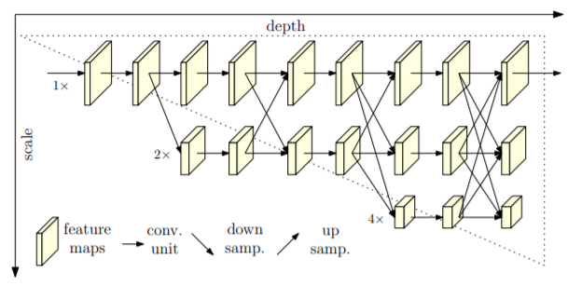
HRNet
Fig: Architecture of HRNet Framework
Notes:
Illustrating the architecture of the proposed HRNet. It consists of parallel high-to-low resolution subnetworks with repeated information exchange across multi-resolution subnetworks (multi-scale fusion).
The model has high-to-low subnetworks and low-to-high subnetworks that in the end generate heatmaps of each keypoint of the pose, and then pick out the highest confidence point from there to get the keypoint.
Do not talk about OpenPose unless asked.

Slide 11
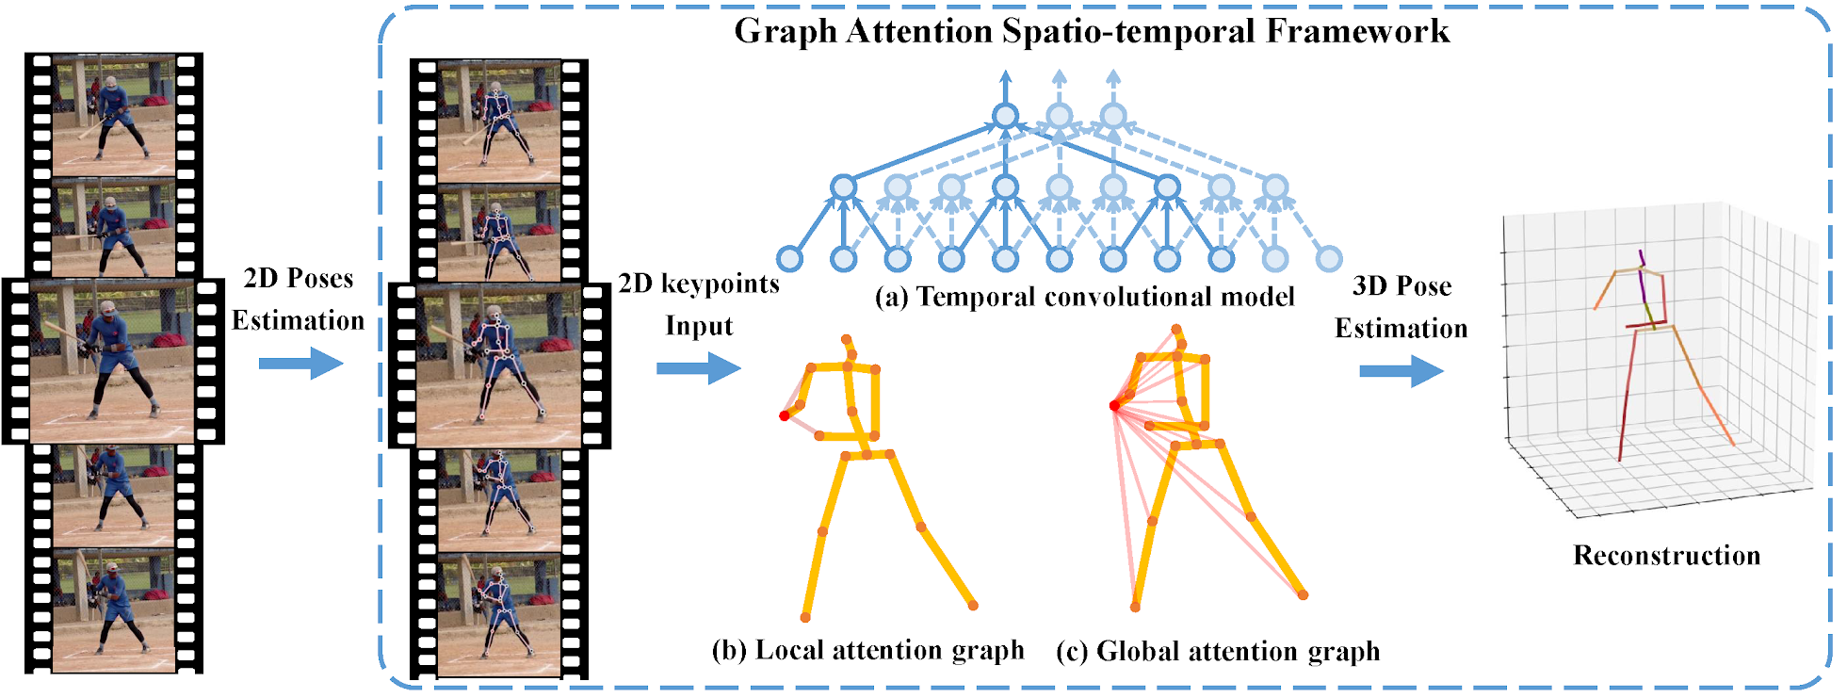
GAST-Net
Fig: Schematic overview of GAST-Net Framework
Notes:
3 kinds of sub-networks
temporal
local attention
global attention

Slide 12
Quantitative Performance
Evaluation Metrics-
mAP: Mean Average Precision
MPJPE: Mean Per Joint Positioning Error
Observation: HRNet and GAST-Net both outperform the benchmarks (or are very close), but their real novelty is being able to achieve similar performance on random unseen data
mAP | COCO | MPII
HRNet | 91.5 | 92.3
CPN | 74.9 | 77.0
Integral Pose | 67.8 | -
SimpleEnsemble | - | 91.5
MPJPE | Human3.6M | HumanEva-I
GAST-Net | 23.11 | 21.2
Pavllo | 34.5 | 35.2
Notes:
HRNet
mAP at object keypoint similarity > 0.5 (the only param with results provided by most models)
OKS = gaussian normalized distance between ground truth and predictions
Benchmarked against state of the art – CPN, Integral Pose, Mask-RCNN
GAST-Net
MPJPE = avg. error across keypoints
Benchmarked against OpenPose (non-ML), Pavllo (popular, state of the art)
In GAST-Net for Human3.6M Benchmark (Wang) performs better, it not only exploited spatial and temporal information but also adopted pose refinement and motion loss to regular reconstructed 3D poses. In our work, we only model spatio-temporal information through a simple network and use a common MPJPE loss without using any bells and whistles. In addition, we also report the results when using ground truth 2D poses, which yield approximately 13.5mm improvements in MPJPE.

Slide 13
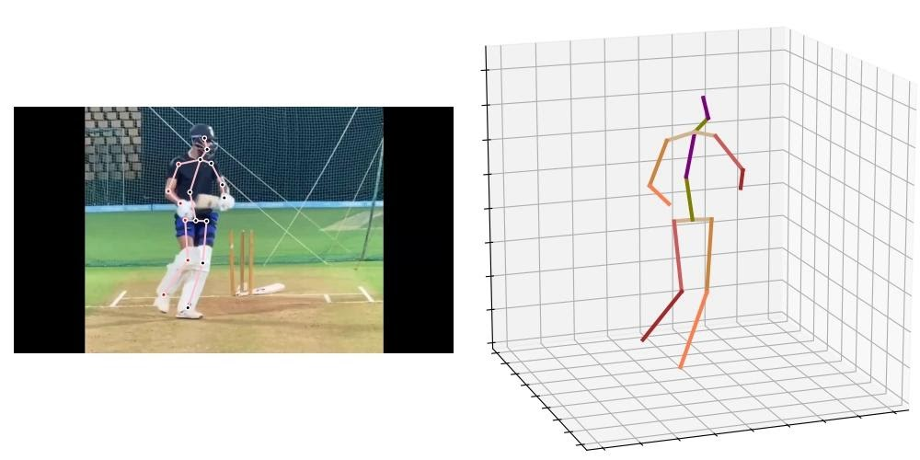
Issues Fixed - Occlusion
Self-occlusion occurring due to side profile view overcomed

Slide 14
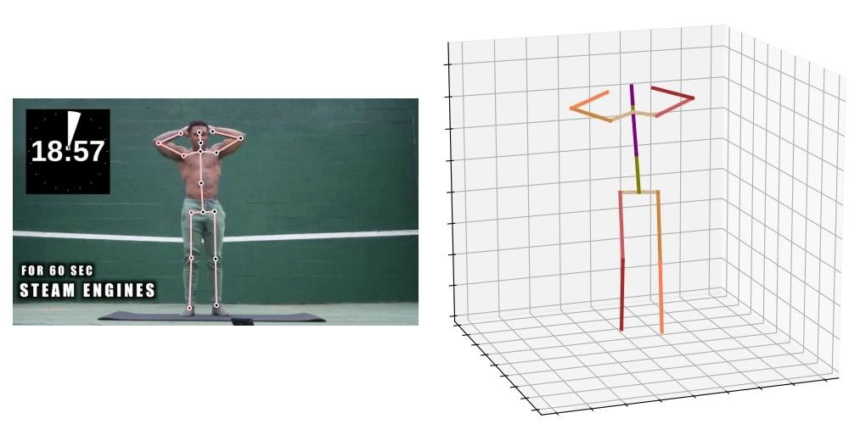
Issues Fixed - Jitter
Due to proper formatting in pipeline, jitter is reduced

Slide 15
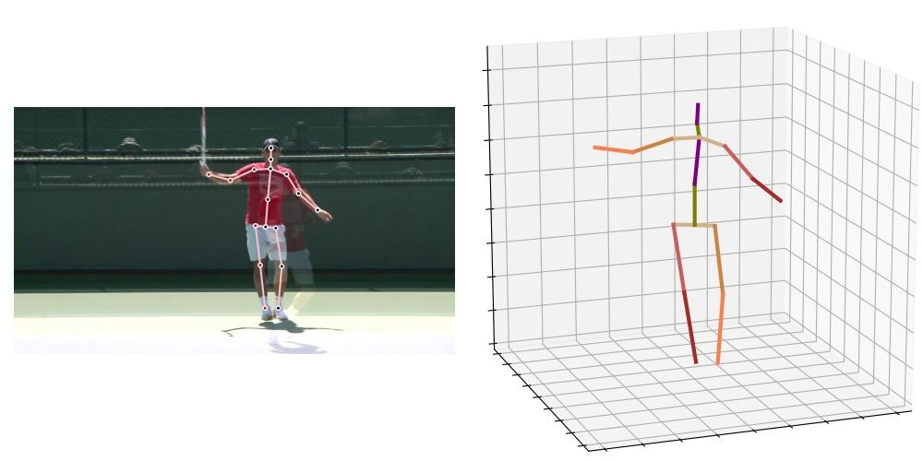
How can I use this?
Notes:
sport technique analysis
kinematic sequencing
easy comparison with ideal techniques from multiple angles
Last slide for Vidhey

Slide 16


Building Web Applications
Python-based free and open-source web framework
Version 3.1.4
Pre-built sqlite database
Made index.html, after_index.html
Ubuntu 18.04.4
15.3GB memory
CPU
Notes:
First slide for Minji

Slide 17
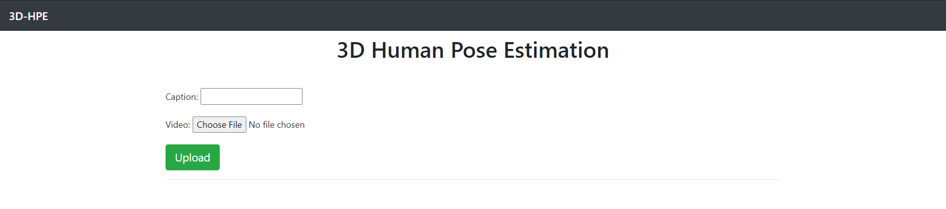
Demo Time!!
Home Page

Slide 18
Conclusion
Did a thorough research of the field
Tried working on multiple datasets and models
Set up pipelines for project (HR-Net, GAST-Net)
Fixed issues (Jittery, Occlusion, and depth ambiguity)
Set up web application with Django and AWS

Slide 19
Thank you!

