Slide 1

INTERNSHIP COMPLETION
Internship
Completion
Presentation
Mohd Farhan · Data Science Intern at Kode To Career

Slide 2
01 · THE EXPERIENCE
Completed a two-month Data Science internship
Period
1 June 2026 – 31 July 2026
Organisation
Kode To Career, a skill-development and career-learning organisation
Role
Data Science Intern with Python teaching responsibility
Programme
B.Tech Computer Science and Engineering, IILM University

Slide 3



02 · THE SHIFT
The internship closed the gap between theory and practice
Classroom concepts became a complete working rhythm.
From theory
Into practice
Then shared it
Moved from classroom concepts to a complete data science workflow.
Combined programming, data preparation, visualisation, modelling and communication.
Added a second responsibility: making Python understandable for beginners.

Slide 4

03 · THE WORKFLOW
I followed a repeatable data science workflow
Collect & Load
Clean Data
Explore Patterns
Feature & Train
AI assistance supported the workflow alongside the work; conclusions remained documented, committed and presented.

Slide 5






04 · THE TOOLSET
The toolset covered the full working stack
Python
NumPy + Pandas
Matplotlib + Seaborn
analysis, modelling and teaching
numerical computing and data manipulation
exploratory visualisation
Scikit-learn
Jupyter, Colab, VS Code, Git and GitHub
AI coding assistants
regression, classification, clustering and evaluation
generation, explanation and debugging with manual verification
experimentation, documentation and version control

Slide 6
05 · THE LEARNING LOOP
Every assignment followed learn → apply → explain
01
02
03
04
Learn
Apply
Review
Explain
Learn the concept through documentation and guided practice.
Apply it to a practical assignment or mini-project.
Review code quality, naming, documentation and correctness.
Explain the idea clearly through notebooks or teaching.

Slide 7




06 · TEACHING RESPONSIBILITY
For one month, I taught Python to a learner batch
Week 1
Week 2
Python basics, variables, data types, input/output and conditions
Loops, strings, lists, tuples, sets and dictionaries
Week 3
Week 4
Functions, modules, file handling and exceptions
Object-oriented Python, NumPy/Pandas introduction, assessment and mini-project

Slide 8




07 · LEADERSHIP IN PRACTICE
Teaching turned technical knowledge into leadership
Prepared
Made ideas clear
Prepared daily sessions, notebooks, examples, practice questions and weekly assessments.
Used analogies, live coding and step-by-step dry runs for difficult concepts.
Adapted
Balanced
Adjusted for different learning speeds and treated debugging as a learning opportunity.
Balanced teaching preparation with personal assignments and project work.

Slide 9
08 · OUTCOMES
The internship produced both technical and professional growth
Technical
Professional
Python, NumPy, Pandas, visualisation, machine learning basics, Git and AI-assisted development.
Communication, mentoring, time management, discipline, feedback and empathy.
Evidence of completion
Practical assignments, projects, version-controlled work and a certificate from Kode To Career.

Slide 10
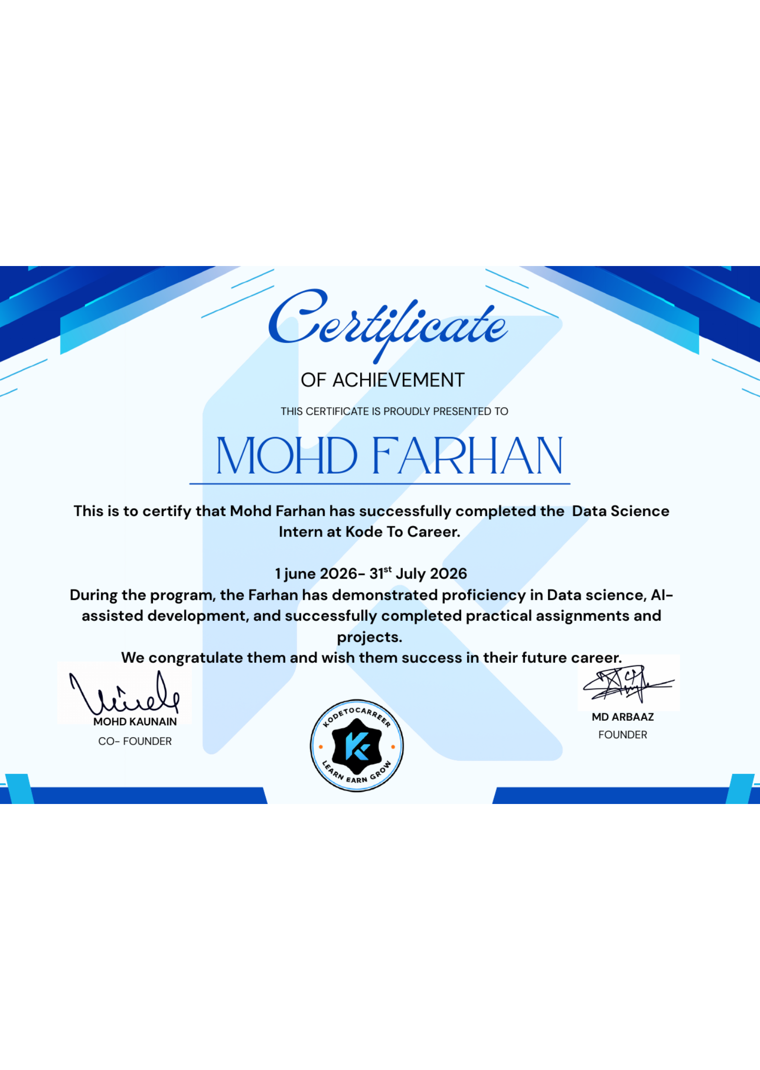
09 · COMPLETION
Internship completed — ready for the next step
Completed the Data Science Internship from 1 June 2026 to 31 July 2026.
Built practical confidence across the data science life cycle.
Strengthened my profile with project experience, a recognised certificate and teaching experience.
Next direction: continue building data science and AI capability while mentoring others.

