Slide 1
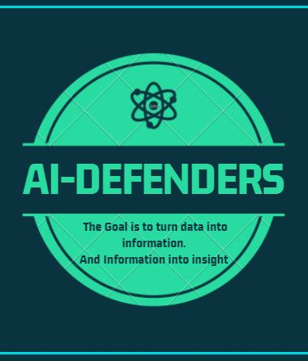
Advertising & Sales Prediction using ML
Team:
Farhan Ali
Ehsan Ali
Aqib Ali

Slide 2
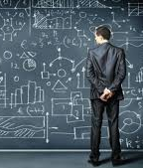
Introduction The main goal of this project is to predict the sales of a product based on advertisements. For this purpose, we have taken the following scenario: A company spends some money for advertising into three different channels such as television, radio and newspaper for increasing the sales. so, we are going to build a Machine Learning model which will predict the sales based on the amount which is company spend for each platform.

Slide 3

How can AI help us to solve this problem? We can solve this problem using Multiple Linear Regression technique of Supervised Machine Learning. Multiple Linear Regression Linear Regression with multiple variables is known as Multiple Linear Regression. In simple Linear Regression we have a single independent variable to predict the value of a dependent variable whereas in Multiple Regression two or more independent variables are used to predict the value of a dependent variable.

Slide 4

Dataset We are going to use advertising data which is available on KAGGLE. The advertising data set consists of the sales of a product in 200 different markets, along with advertising budgets for three different media: tv, radio, and newspaper.

Slide 5

Working… The Regression Equation is a Linear equation of the form: y=β0+β1x1+β2x2+⋯+βnxn β0: constant or y intercept of line β1, β2,…βn: coefficient of input features x1,x2,…xn: input feature y: output

Slide 6
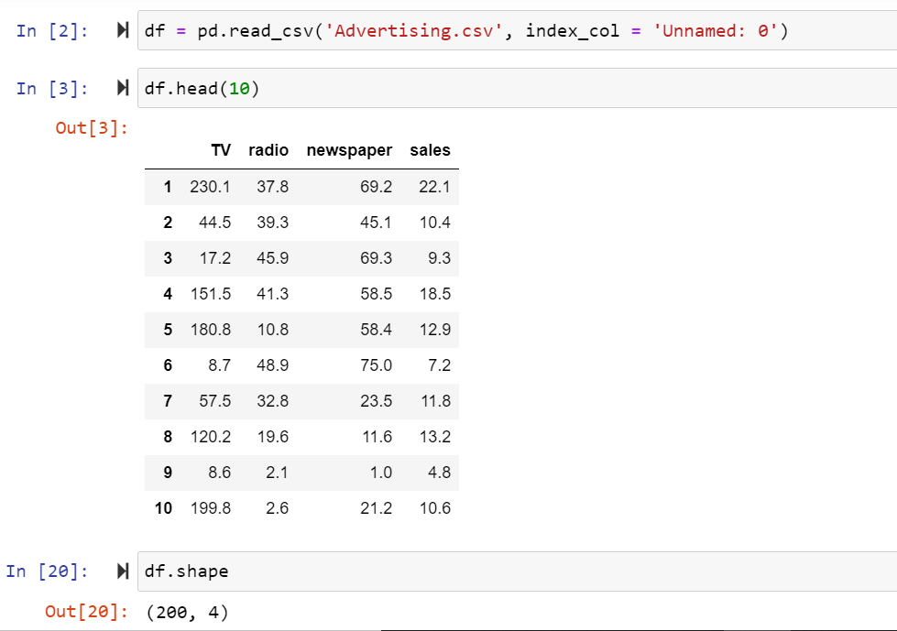
Data Overview

Slide 7
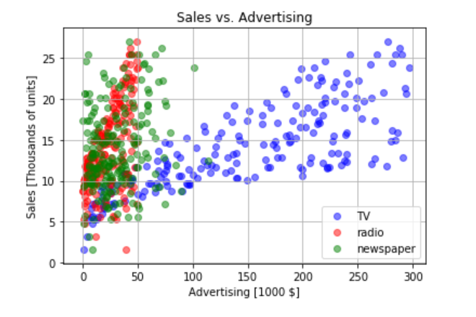
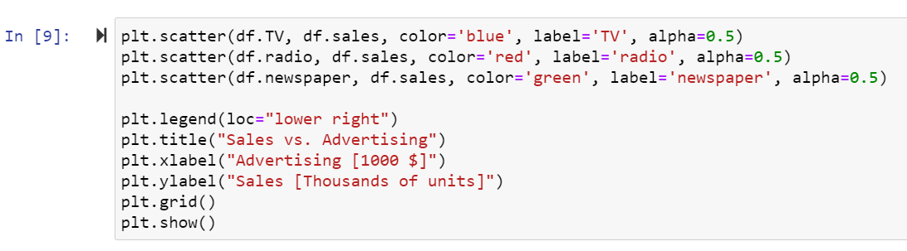
Visualizing the Dataset

Slide 8
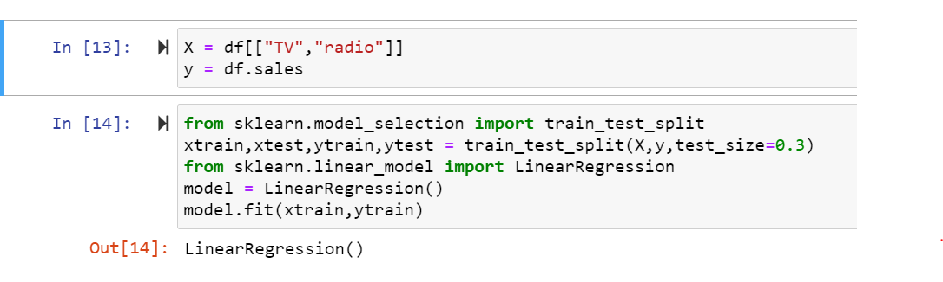
Splitting data into train and test

Slide 9
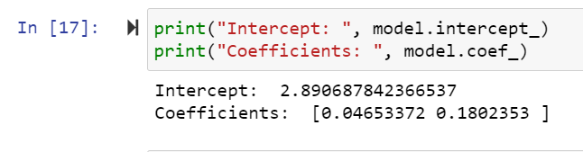
Weights

Slide 10
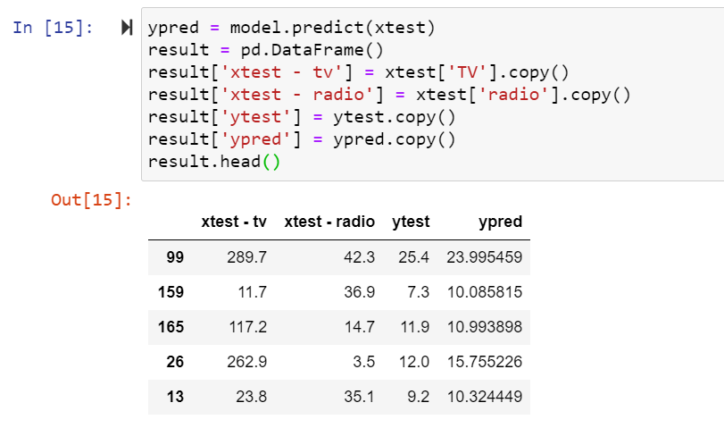
Making Predictions

Slide 11
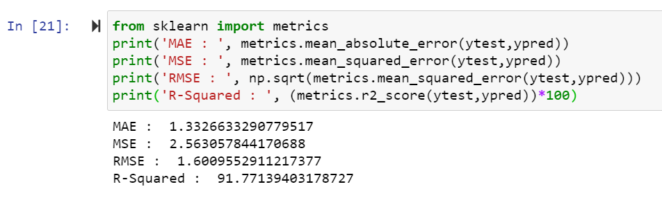
Accuracy and Error rate

Slide 12

Applications and Benefits

Slide 13

Thank You
Any Queries?

