Slide 1

NATURAL LANGUAGE PROCESSING
TEAM MEMBERS :
FARHAN SHAIK
MASTANVALI SHAIK SIVALEELA YARMALA

Slide 2


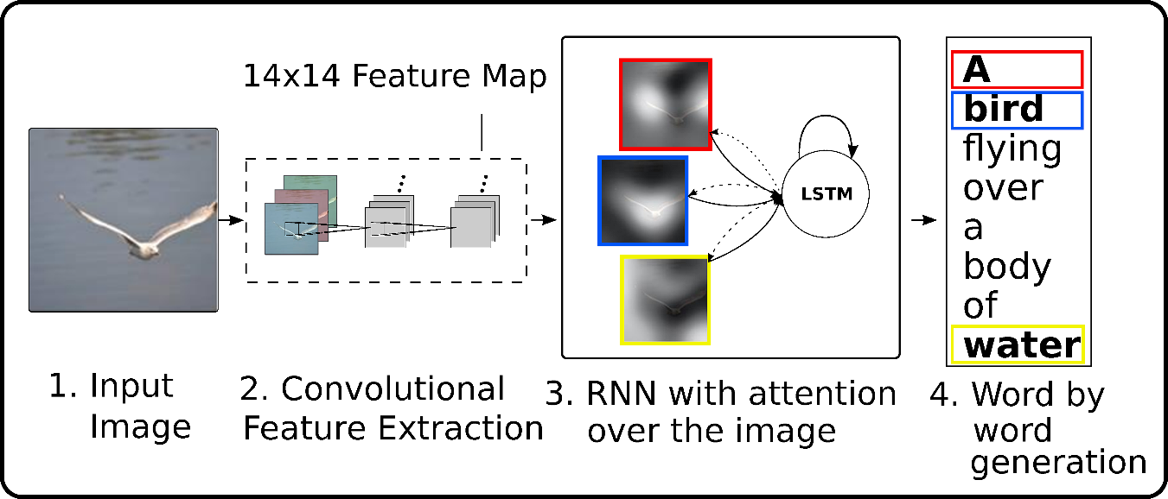
PROJECT TOPIC
IMAGE CAPTION GENERATION USING CNN AND LSTM

Slide 3

STATEMENT OF PROJECT OBJECTIVES
The objective of this project is to develop an image caption generator using deep learning techniques. The system will be able to generate captions for images that accurately describe the contents of the image. The model will be trained on a large dataset of images with corresponding captions, using a combination of convolutional neural networks (CNN) and recurrent neural networks (RNN) to extract features from the image and generate the caption.
To build an image caption generator model we have merged CNN with LSTM.
Image Caption Generator Model(CNN-RNN model) = CNN + LSTM.
CNN- To extract features from the image.
LSTM- To generate a description from the extracted information of the image.

Slide 4

STATEMENT OF VALUE
Search engines implement automated picture captioning to extract and provide relevant search results to users based on annotation keywords, to categorize personal multimedia collections, for automatic product labeling in online catalogs, in computer vision development, and other fields of business and research.
The project will contribute to the field of deep learning and natural language processing and demonstrate the potential of these technologies in real-world applications.

Slide 5
REVIEW OF STATE OF WORK AND RELEVANT WORKS
https://github.com/christiandimaio/Image-Captioning-with-Python
https://ieeexplore.ieee.org/document/8697360

Slide 6
APPROACH
DATASET: FLICKER DATA SET
https://www.kaggle.com/datasets/adityajn105/flickr8k
Tools and technologies: NLTK, Jupyter notebook, PyTorch, TensorFlow

Slide 7
DELIVERABLES
PowerPoint presentation of the project
Project report
Project source files
Project demo video
Project code and .MD file on Github Respository

Slide 8
EVALUATION METHODOLOGY
Based on the captions produced they should be appropriate to the images given as input from the dataset.
BLEU: It is the score on how well our model translates the image to the description
METEOR: Meteor score gives us how well our outcome and predicted text match.
argmax ACCURACY: It is calculated to see batch improvements while training our model.

