Slide 1

CONFIGURE SNOWSQL on Windows
SnowSQL is the command line client for connecting to Snowflake to execute SQL queries and perform all DDL and DML operations, including loading data into and unloading data out of database tables.
SnowSQL is an example of an application developed using the Snowflake Connector for Python; however, the connector is not a prerequisite for installing SnowSQL. All required software for installing SnowSQL is bundled in the installers

Slide 2
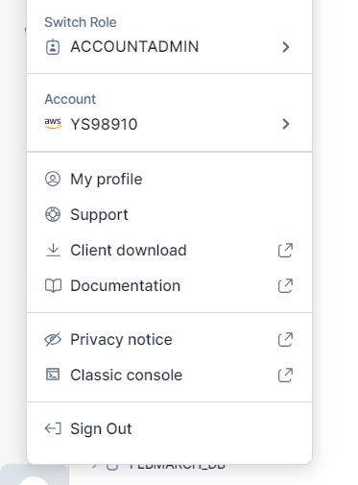
STEP 1: Download SNOWSQL(CLI)
Download the SNOWSQL from https://developers.snowflake.com/snowsql/ here and select your OS. Otherwise you visit client download from Snowsight and it wil take you to download pages.

Slide 3
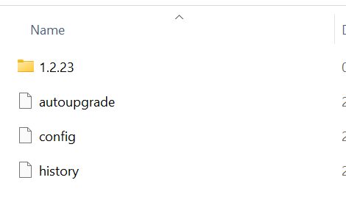
STEP 2: Install the file
Once you have downloaded , you will have snowsql.exe file.
Installed by clicking on snowsql.exe file.
Visit path in your local machine /users/username/.snowsql
.snowsql file will be in your local user folder.

Slide 4
STEP 3: Set up AccountName
Open Command Prompt (CMD)
1– Check the snowsql version : snowsql –v
2-Connect to snowsql :
snowsql –a account_name –u username
3- Select database name : Use Databasename
Accountname : Go in snowsight >> Admin >> Accounts >> Click on pin (https://prvrdhu-tnb13210.snowflakecomputing.com) Copy that URL and Highlighted will be your account name.
Username : Which you have used to set up your account
Username :

Slide 5
STEP 4: Ready with Snowsql
When you are going to hit the : snowsql -a accountname -u username
You will be asked to put the password

Slide 6
STEP 5: Select Database & Schema
You can select DATABASE , SCHEMA by USE DATABASE <DBNAME>;
USE SCHEMA <SCHEMANAME>;
USE WAREHOUSE WH;
USE DATABASE ;
USE SCHEMA

