Slide 1
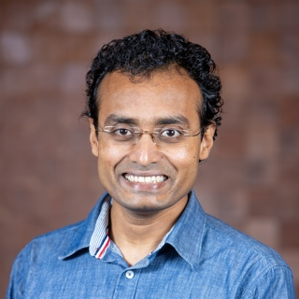
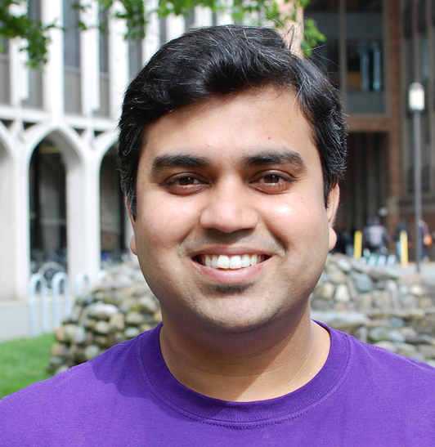
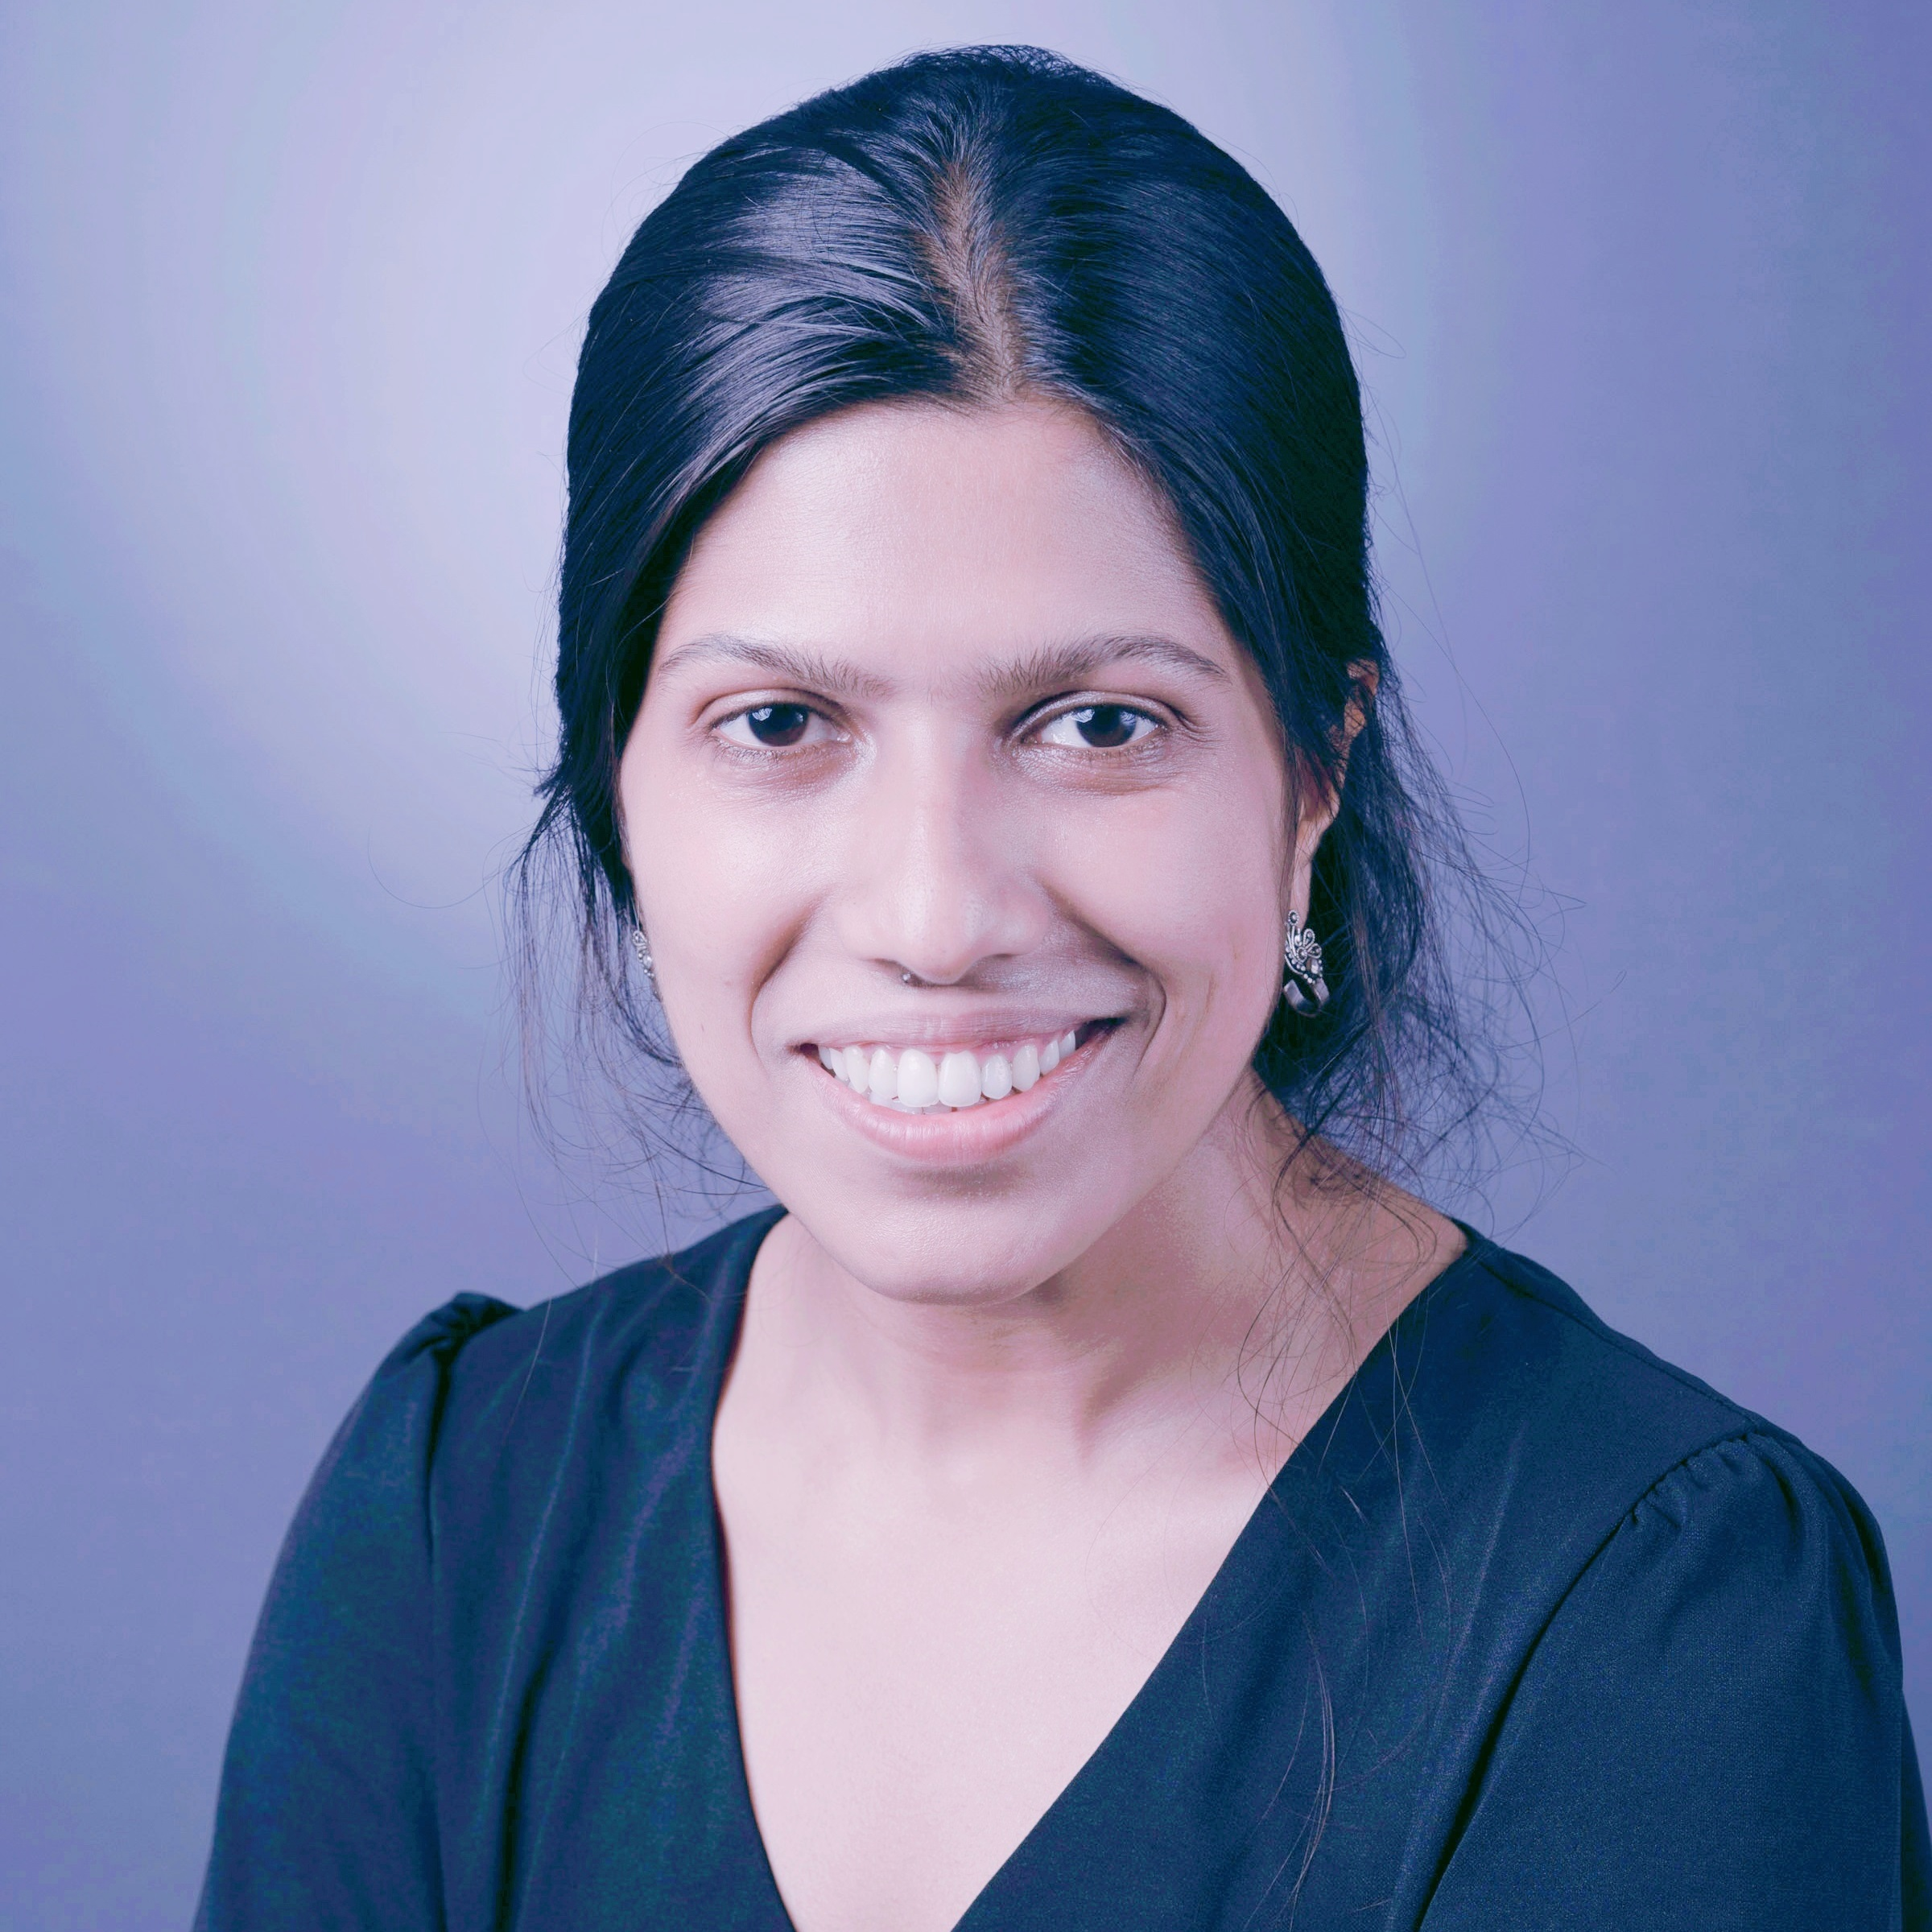
Examining Source Effects on Perceptions of Fake News in Rural India
Farhana Shahid
Shrirang Mare
Aditya Vashistha
Notes:
To find answer, me and my colleagues Shri and Aditya conducted a study called “Examining Source Effects on Perceptions of Fake News in Rural India”
And I’m Farhana, a second yr PhD student at Cornell- who will be presenting this work to you.

Slide 2
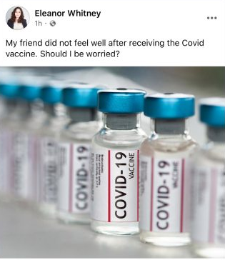
Who posted the content?
Image source: Tech Crunch
Notes:
Suppose, you came across a post on social media saying, “My friend did not feel well after receiving the covid vaccine. Should I be worried?”
How would you respond?
Does it matter to you: who posted the content?

Slide 3
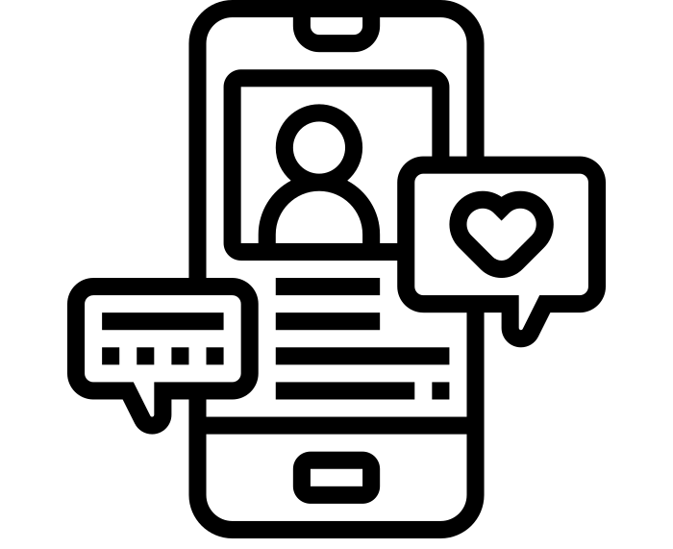
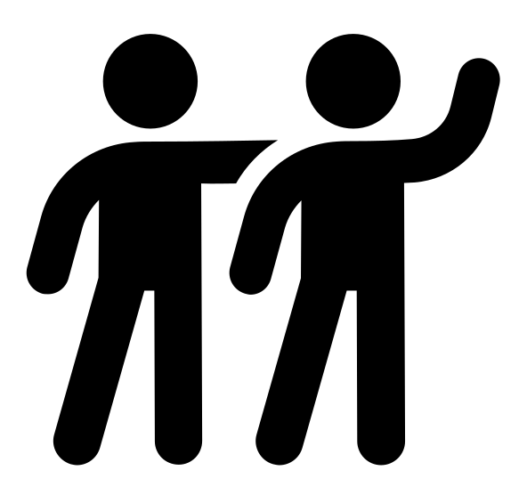

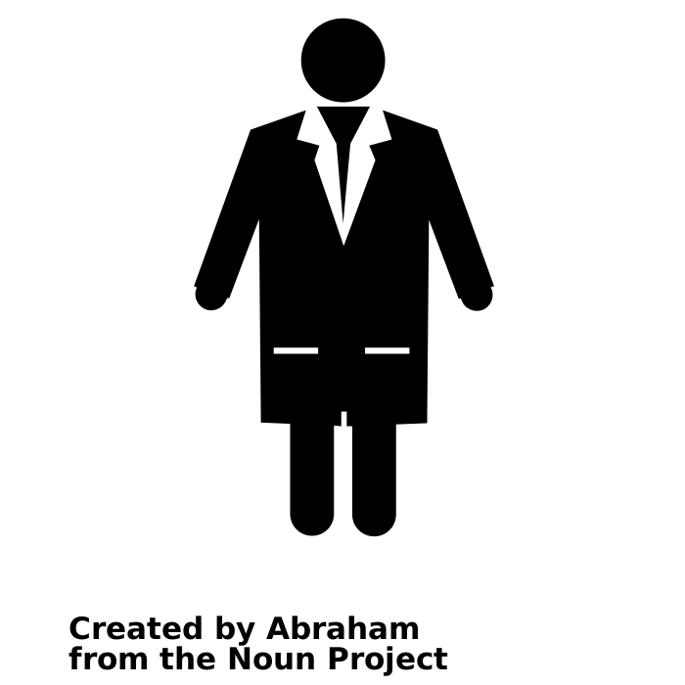

Do Sources Impact Our Perceptions of Online News?
Trusted news media
Person who shared the post
Trustworthy friend and family
Global North
Government sources
Scientists
Global South
Notes:
So the question is: do sources impact how we perceive online news?
Prior research shows that people perceive the news as credible when it comes from Trusted news media.
Whereas, others found that some users care more about who shared a news rather than the media who reported it
Moreover, some users perceived a post as more credible when it came from a trustworthy friend or family member
Now, these observations are informed by the experiences of mainstream social media users in the Global North.
Do they equally apply to users in the Global South?
A couple of studies show that when it comes to health related information, users in the Global South trust government sources and scientists more.
So, we can see that there are differences in who do people trust online. However, to the best of our knowledge, there’s no systematic study investigating how do different sources impact people’s trust in online news?

Slide 4
Do Sources Impact Our Perceptions of Online News?
How do different sources impact people’s trust in online news?
Does source effect vary for users from different demographics?
Notes:
So, we can see that there are differences in who do people trust online. However, to the best of our knowledge, there’s no systematic study investigating how do different sources impact people’s trust in online news? It’s also not clear if source effect varies for users from different demographics.

Slide 5
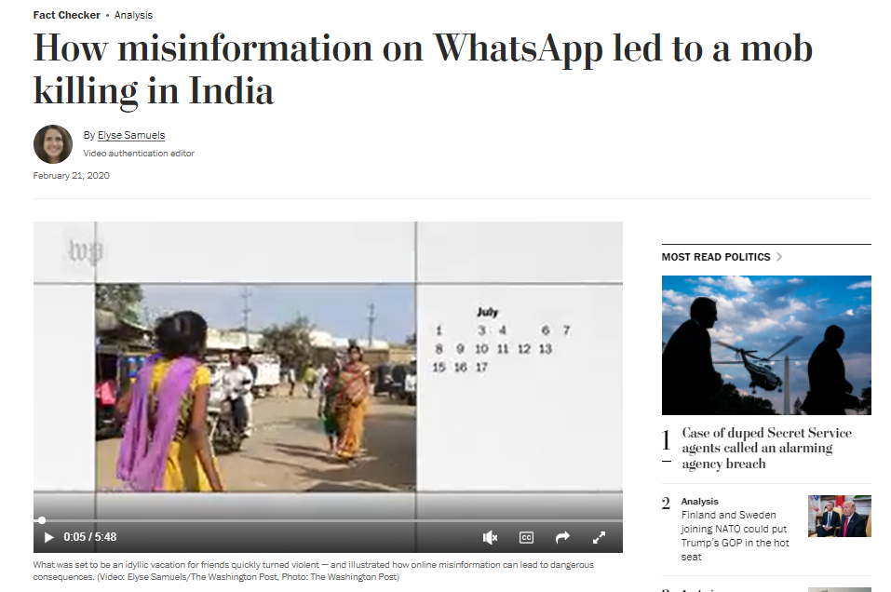
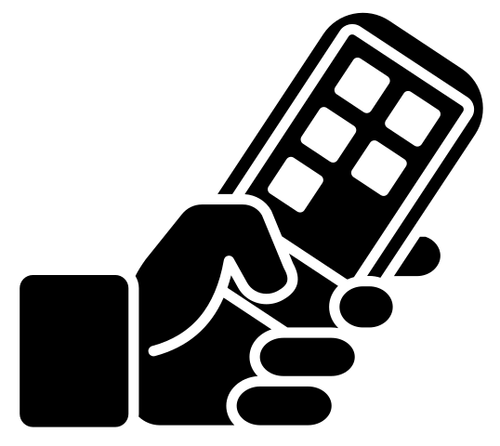



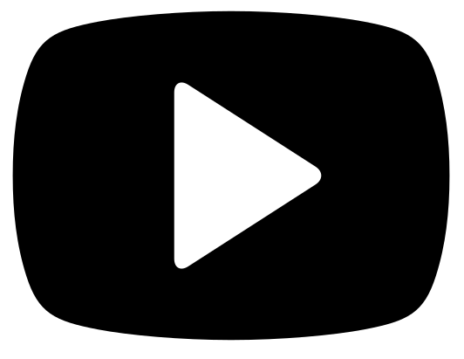
Misinformation in India
Increasing popularity of social media platforms
Image Source: Washington Post
Notes:
In our study, we focus on rural social media users whose perceptions and needs are usually ignored in the mainstream studies related to misinformation.
The location of our study in India, much of the growth of the Internet is now driven by rural users as urban users seems to have hit a plateau. Now, most of these new users are also first time Internet users and thus, susceptible to the harms of misinformation that often led to communal violence.

Slide 6
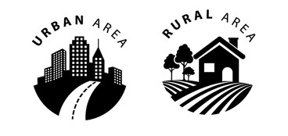
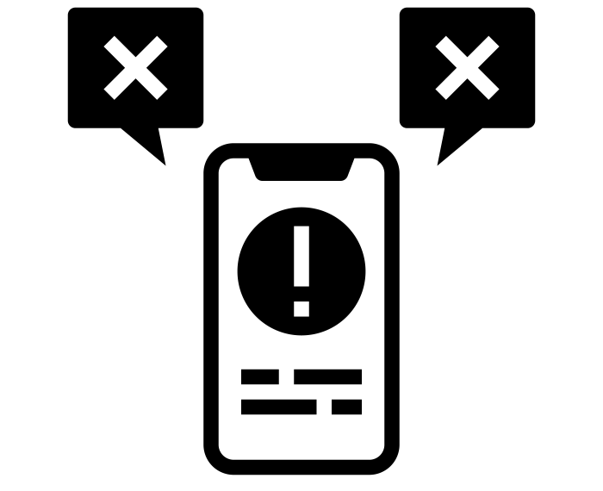
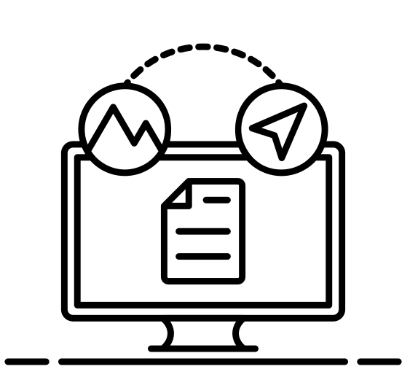
Our Research Questions
Do social media users in rural and urban areas perceive credible and fake news differently?
How do source effects impact their trust in credible and fake news?
How do source effects impact their attitude towards sharing credible and fake news?
Notes:
Therefore, to understand what drives people’s trust in online news we broadly ask three research questions:
Do social media users in rural and urban areas perceive credible and fake posts differently?
How do source effects impact their trust in credible and fake posts?
How do source effects impact their attitude towards sharing credible and fake posts?

Slide 7

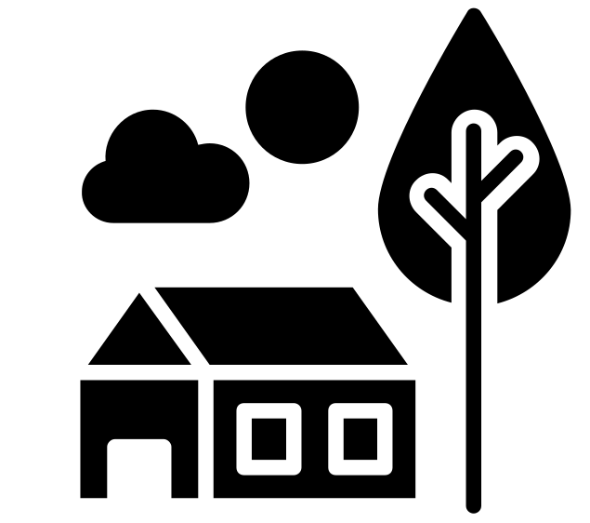
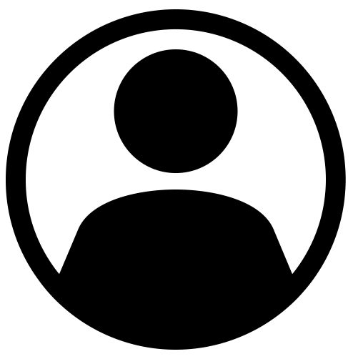
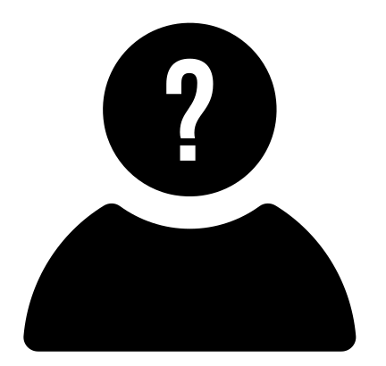
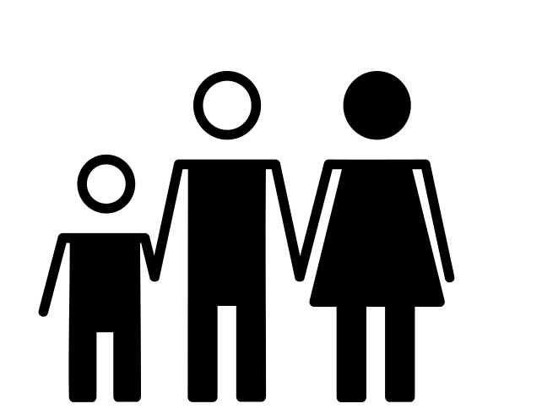
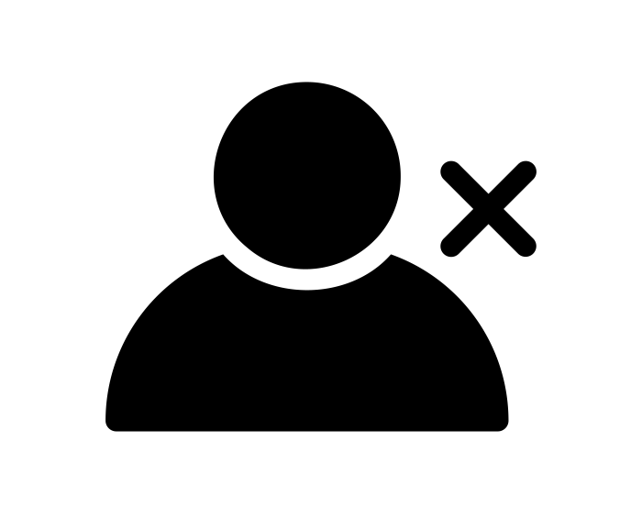
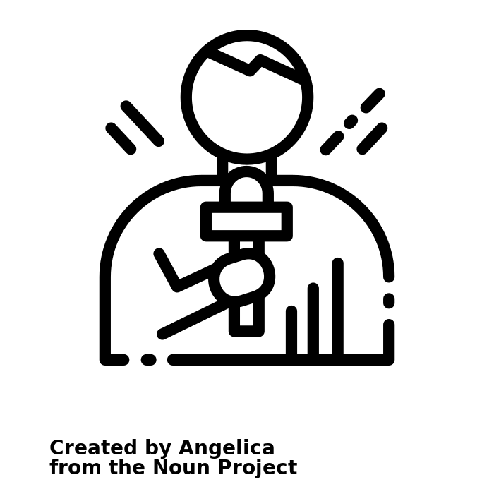

Methodology
319 urban social media users
(Amazon MTurk Workers)
159 rural social media users
Stranger
Friend
Family
No source
6 credible and 3 fake news
News media
Journalist
Celebrity
Notes:
We conducted a quantitative experiment with 319 urban and 159 rural social media users in India
We showed 6 credible and 3 fake posts to all of our participants.
In the baseline, we displayed Facebook posts with redacted username and profile photo.
We included 6 different sources in our test case. These are: Stranger, Friend, Family, News media, Journalists, and Celebrity.

Slide 8
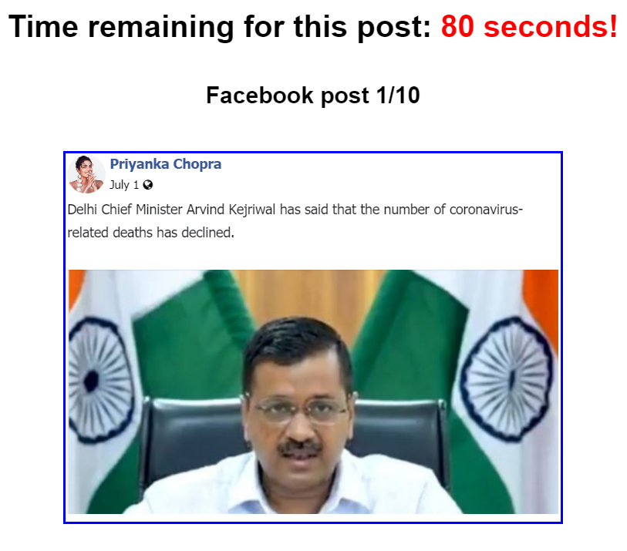
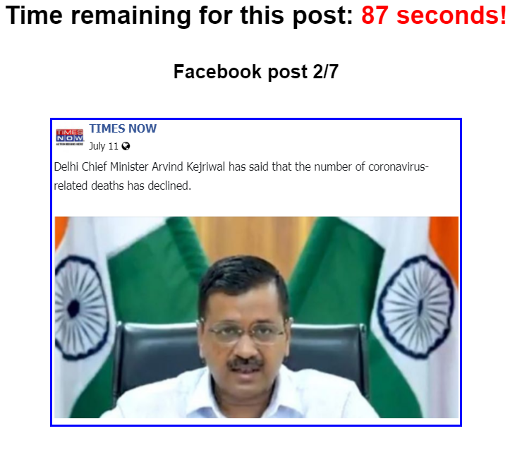
Methodology
Post displayed to participants in Celebrity source condition
Post displayed to participants in News Media source condition
Notes:
We showed same posts to our participants in all source conditions. For example, this is a sample post that was shown to the users in Celebrity and News Media source condition.

Slide 9
Methodology
How much do they trust the post?
Will they share the post or not?
If yes, with whom will they share the post?
Public, Friends, Friends except, Specific friends
A post displayed to participants in Celebrity source condition
Notes:
For each post, we asked our participants:
How much they trusted the post?
Will they share the post or not?
If yes, with whom will they share the post?
Public, Friends, Friends except, Specific friends
For more details of our implementation, please check the Methods section of the paper.

Slide 10


Differences Between Rural and Urban Social Media Users
Urban social media users
Rural social media users
Distinguish between credible and fake posts
Sharing tendency
Shared credible posts more than fake posts
Shared both types of posts equally
Sharing audience
Broader audience (e.g., public)
Social circle (e.g., friends)
Notes:
As of our participants, we observed that urban users could distinguish between credible and fake posts whereas rural users failed to do so.
Besides, urban users were more willing to share credible posts than the fake ones and rural users wanted to equally share both types of posts. Urban users were more willing to share the posts with a broader audience whereas rural users preferred to share the posts within their close circles.

Slide 11
Source Effect on User Perceptions of Trust and Sharing Tendency
Trusted and shared fake posts from Family more
Urban social media users
Family
Trusted and shared fake posts from Journalists and News media more
Journalist
News media
Rural social media users
Notes:
Now concerning source effect, we observed that urban users tended to trust and share fake posts from their personal networks such as family members significantly more than the other sources.
On the contrary, rural users were significantly more susceptible to trust and share fake posts from public sources such as Journalists and news media.
For more details, please check our Findings.

Slide 12
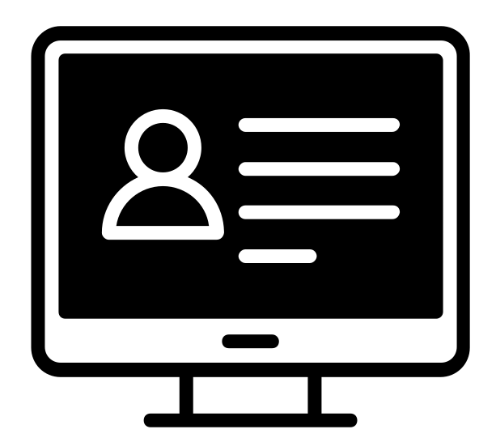


Design Interventions to Counteract Source Effect
Reminder that shared content might represent the views and biases of the post creators
Reminder to cautiously approach posts from verified accounts
Fact-checking organizations may prioritize news from hyper-partisan websites and journalists
For rural users create credibility indicators citing journalistic sources
Notes:
Now based on our findings, we propose several design recommendations to counteract source effect.
Since urban users are prone to trust fake news from their close circle, users should be reminded that shared content might represent the views and biases of the post creators.
On the other hand, considering rural users’ susceptibility to fake news from public sources, users should be reminded to cautiously approach posts from verified accounts. Besides, local Fact-checking organizations may prioritize news from hyper-partisan websites and journalists. In addition, to make an appeal to rural users, credibility indicators should be designed to cite journalistic sources.

Slide 13
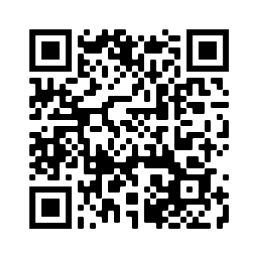

Thank You!
fs468@cornell.edu
Notes:
That’s all for this presentation. For more details, please read our paper. If you have any questions please feel free to email us. And thanks for listening.

