Slide 1




Learning from Tweets: Opportunities and Challenges to Inform Policy Making During Dengue Epidemic
Farhana Shahid
Aditya Vashistha
Shahinul Hoque Ony
Takrim Rahman Albi
A. B. M. Alim Al Islam
Sriram Chellappan
Notes:
Hello I’m Farhana Shahid presenting our recent paper: “Learning from Tweets: Opportunities and Challenges to Inform Policy Making During Dengue Epidemic”.

Slide 2


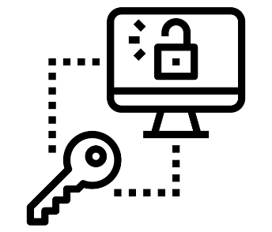
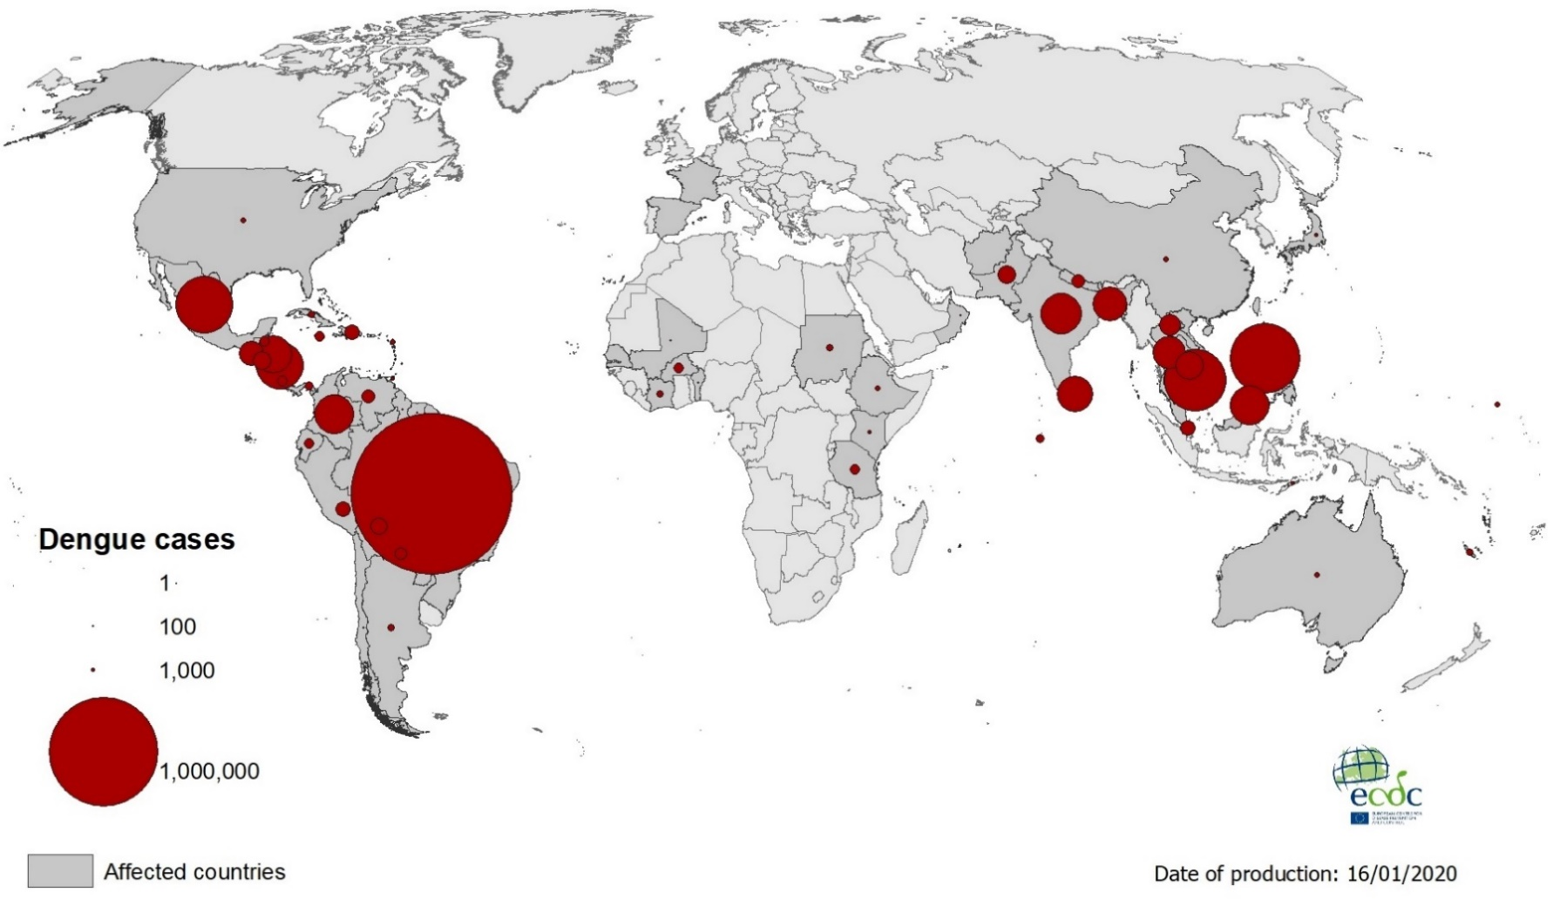


Epidemic within low-resource communities
Bangladesh
Poor government
infrastructure
Poor access to data
India
Mexico
Philippines
Vietnam
Brazil
Low Internet
penetration
Low adoption
of social media
4.2 Million dengue cases in 2019!
Notes:
The novel corona virus pandemic has captured our attention throughout the year! Infectious diseases have been around us all along!
Dengue is a mosquito-borne infectious disease that ravages the countries worldwide almost every year! In 2019, dengue infected the record highest people across the globe! However, the low-resource countries are hit hard in the face of such infectious diseases!
Poor government infrastructure, poor access to insufficient government health data, etc., complicate disease crisis response plan within low-resource communities.
Even social media based disease surveillance is difficult within these regions due to low Internet penetration and poor adoption of social media platforms!

Slide 3


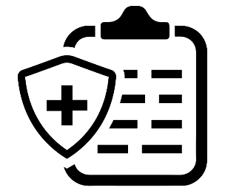
Research Questions
RQ1: What can dengue related tweets reliably tell us about the public health issues in Bangladesh?
RQ2: How Twitter data can guide public health policy for dengue epidemic in Bangladesh?
Dengue related tweets
Public health issues
Public health policy
Notes:
In the face of these challenges, we turn our attention to the 2019 Dengue Epidemic in Bangladesh.
We address two research questions through our work: what can dengue related tweets reliably tell us about the public health issues in Bangladesh?
Also, how Twitter data can guide public health policy for dengue epidemic in Bangladesh?

Slide 4




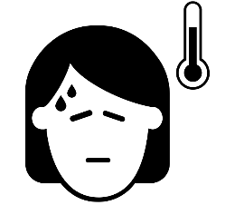

Methodology
28k Dengue related tweets
Biterm topic model
Dengue related data from government reports
Public conversation around dengue
Location
Hospital
Dengue cases
Blood donation
Notes:
To find answer: we collected dengue related tweets in the context of Bangladesh.
We used data mining and text mining techniques to extract information about Locations, Hospitals, Number of dengue cases, and Blood donation requirement for critical dengue patients!
Besides, we applied biterm topic model to identify the topics that captured public attention during the epidemic.
In addition, we collected dengue related data from government health reports. For more details, please have a look at the Methods section of our paper.
Our quantitative analyses on Twitter and government health data reveal several interesting observations. However, we are reporting a few key findings here! To learn more please have a look at the main paper!

Slide 5
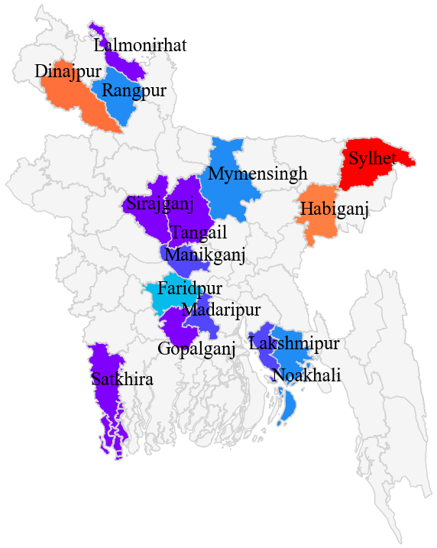


Shortcomings in Government Health Reports
Local news and print media
Higher cases of dengue in these areas as per tweets compared to government reports

Slide 6
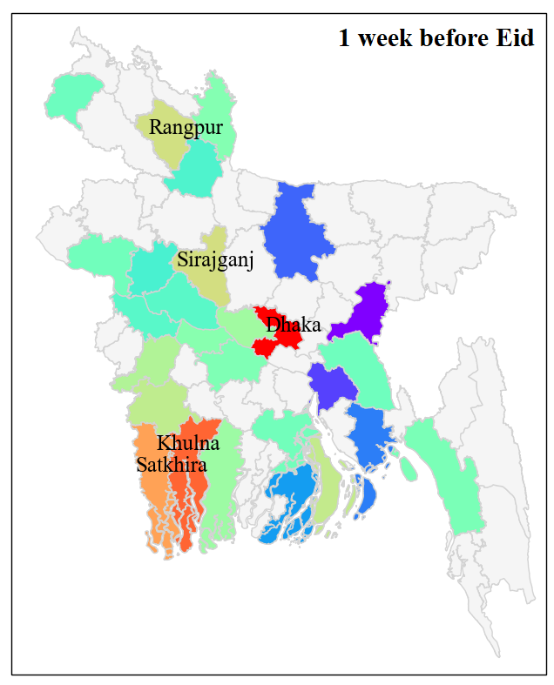
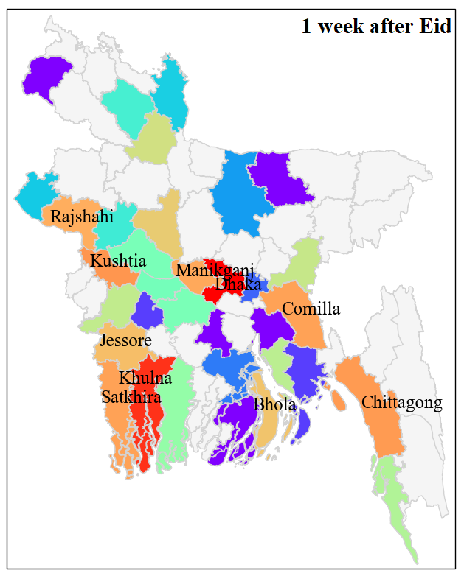
High-transmission during Eid
Significantly greater cases of dengue after Eid-ul-Adha!
Dengue cases 1 week before Eid
Dengue cases 1 week after Eid

Slide 7
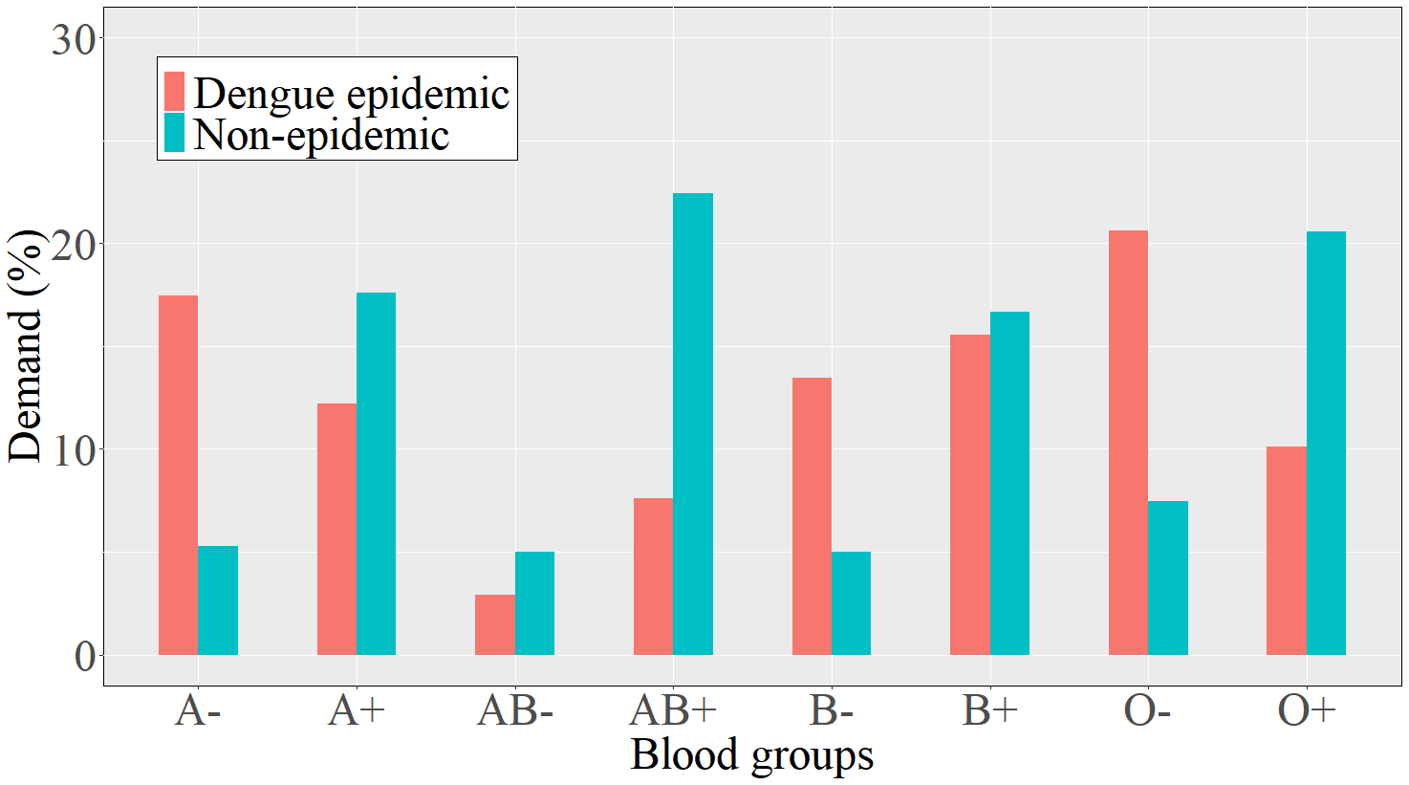

Gendered Effects and Blood Demands
Women died more of dengue than men
Significantly greater demand for Rh- blood groups during dengue epidemic

Slide 8
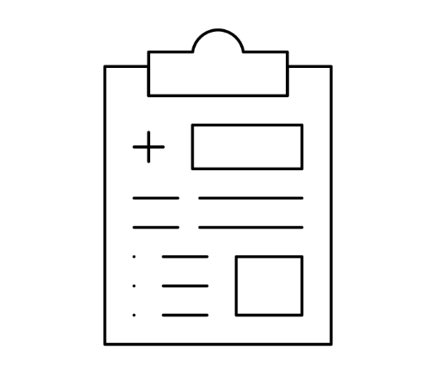


Better Monitoring and Projections
Shortcomings in government health records
Verified information from
trusted news sources
Cases of infection in remote areas of the country
Notes:
Now, if we think about the implications of these findings we can see that tweets can reveal the shortcomings in government health reports. Given the scarcity of resources within low-income communities, there are often cases of underreporting in the rural areas. Integrating and verifying information from trusted news sources can give us a real picture of the epidemic across the country.

Slide 9
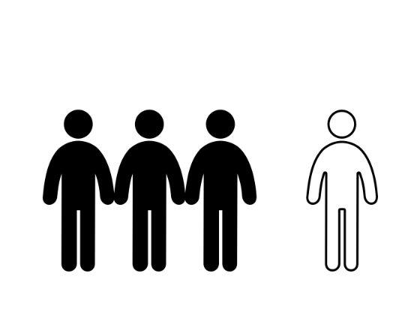
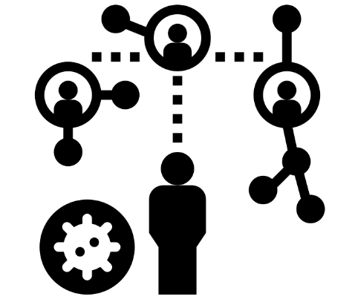
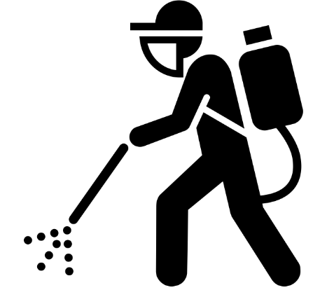
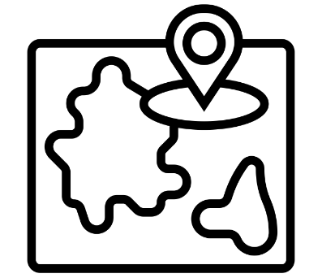

Actionable Insights for Policy
Disease spread during Eid
Destroy Aedes at transportation hubs
Raise awareness to discourage infected people to travel
Highly infected areas
Reallocate limited resources to highly infected areas
Notes:
We observed high transmission of dengue during Eid. …
Besides, tweets

Slide 10
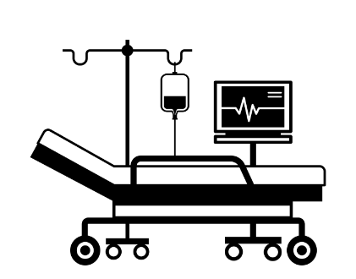
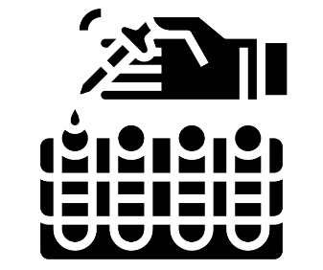
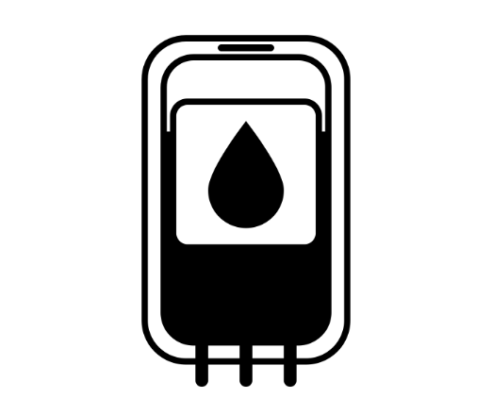
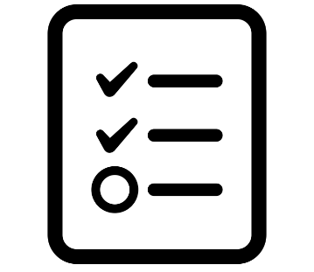
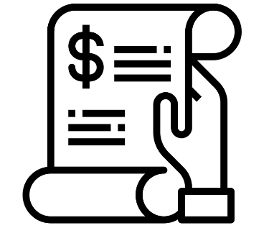
Maintaining Healthcare Services
Shortage of diagnosis and treatment facilities
Preserve Rh- blood groups
Anomaly in test results
Excessive hospital bills
Identify areas for improvement and regulation

Slide 11
Thank You!
Farhana Shahid
fs468@cornell.edu

