Slide 1

Staff Sphere
A project management web app
Developed by
Farhana Islam
Date : October 4, 2023

Slide 2
Introduction
StaffSphere serves as a System for Employee Management and Project Collaboration. It empowers organizations to efficiently manage their workforce, project portfolios, and operational processes. The system provides modules for creating employees, managing profiles, forming teams, assigning team members, creating projects, task assignment and maintaining message logs .
Technology Stack:
Front-end: HTML5, CSS5, Bootstrap5, JavaScript, and the Vue.js framework (using pinia).
Back-end: Firebase

Slide 3
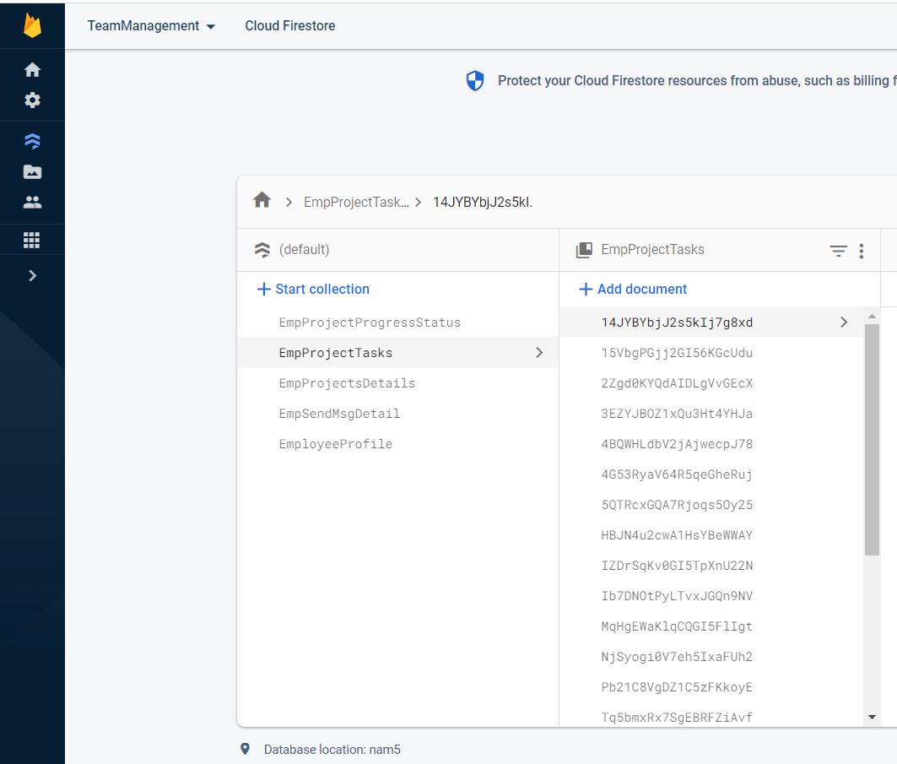
Backend Data Structure
"I've incorporated Firebase services into my project for backend development.
Firebase Authentication: This handles user login and ensures only authorized users can access this application.
Firebase Database: It's for organizing project and storing data neatly.
Firebase Storage: It’s for storing images and files.
EmployeeProfile
EmployeeProjectDetails
EmployeeProjectTasks
EmpProjectProgressStatus
EmpSendMsgDetails

Slide 4
Firebase data collection
1. EmployeeProfile: This collection will store the profiles and personal information of project all staff members.
2. EmployeeProjectDetails: This collection detailed information about the projects of staff Sphere.
3.EmployeeProjectTasks: This collection will contain data related to the specific tasks assigned to each employee within their respective projects.
4. EmpProjectProgressStatus: It will record the progress and status updates of each project, providing a clear overview of project advancement.
5. EmpSendMsgDetails: This collection will serve as a repository for messages and communication details between project staff members.

Slide 5
Key Features and Modules StaffSphere offers an array of essential features and modules, including:
Employee Creation: A user-friendly module for effortlessly adding new employees to the system.
Profile Management: Convenient tools for maintaining and updating employee profiles, ensuring accurate and current information.
Team Member Assignment: Simplified processes for assigning team members to specific projects and tasks.
Project Creation: Effortless project initiation, enabling organizations to manage their project portfolios efficiently.
Task Allocation: Streamlined task assignment and tracking for enhanced project management.
Message Log System: An integrated messaging system that ensures effective communication by providing each employee with a dedicated message log.

Slide 6
User Dashboards
In this system, I 've designed three distinct user dashboards, each tailored to specific roles:
Admin Dashboard: This dashboard is for administrators and provides access to key administrative functions, allowing them to manage employees , projects and make high-level decisions.
Team Leader Dashboard: Team leaders have their own dashboard, which focuses on team management, task allocation, and monitoring project progress.
Employee Dashboard: The employee dashboard is designed for individual contributors, offering a view of their tasks, responsibilities, and progress within the projects they're involved in.

Slide 7
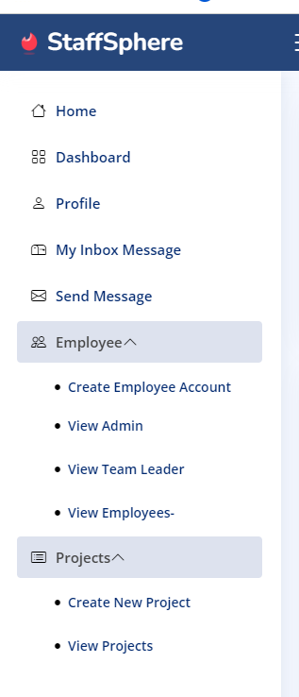
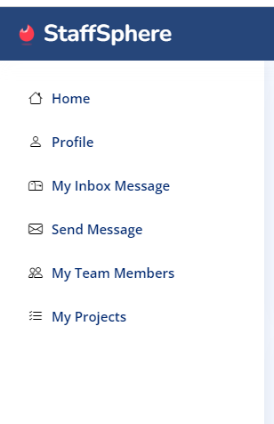
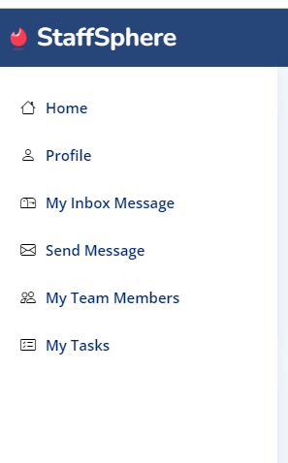
Admin
Team Leader
Employee

Slide 8
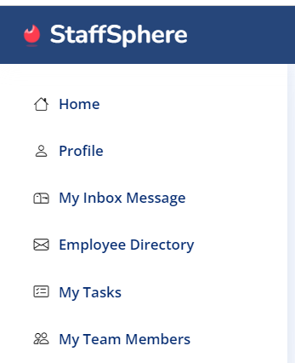
Common features for All Dashboard Users
Home
Profile
My Inbox Message
Employee Directory
My Tasks
My Team Members

Slide 9
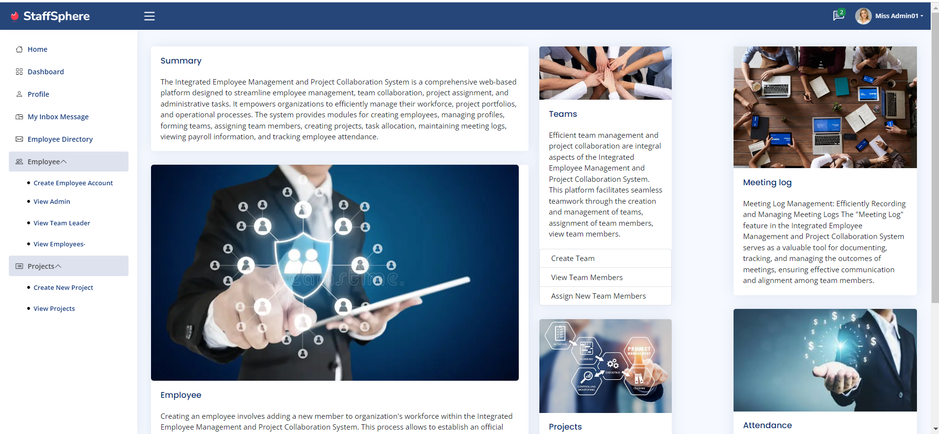
Staff Sphere Homepage The StaffSphere homepage is your gateway to streamlined Employee Management and Project Collaboration. Access essential modules for employee profiles, team formation, project creation, and seamless communication right from the homepage

Slide 10
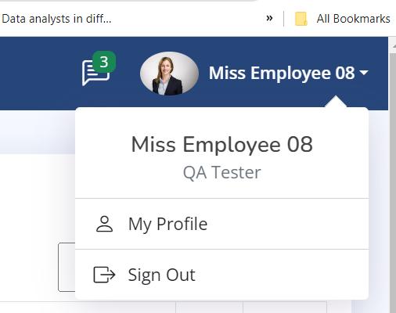
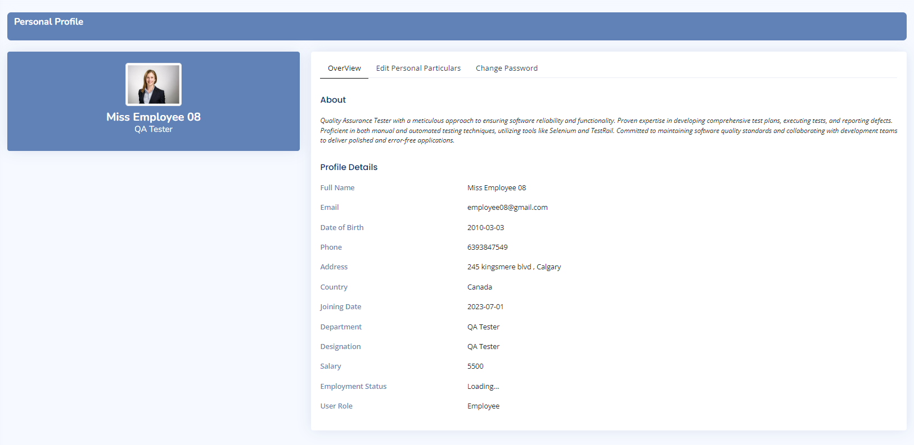
Personal Profile After logging into the application, all users will be able to access and view their own profiles directly from the header.

Slide 11
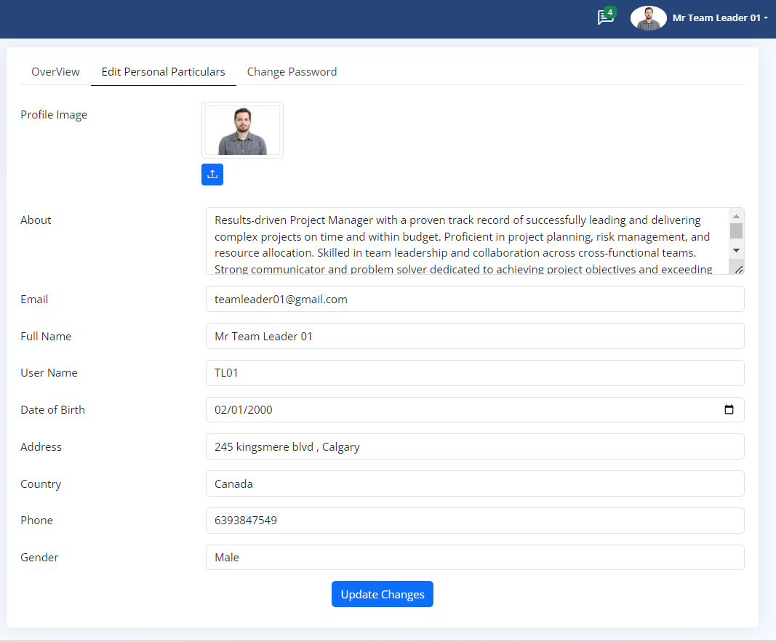
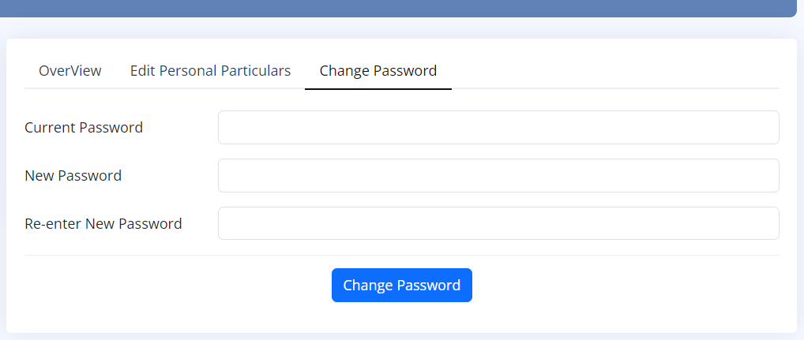
Personal Profile
All users, whether they are Admins, Team Leaders, or Employees, have the ability to view and edit their own profiles, upload profile pictures, and change their login passwords within this web application.
Upload Profile Image

Slide 12
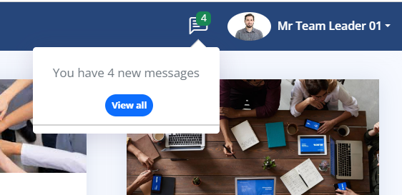
Unread Message Notification -All users
"When users log into the application, they can immediately see unread message notifications in their header, ensuring that they stay informed and never miss important messages."

Slide 13
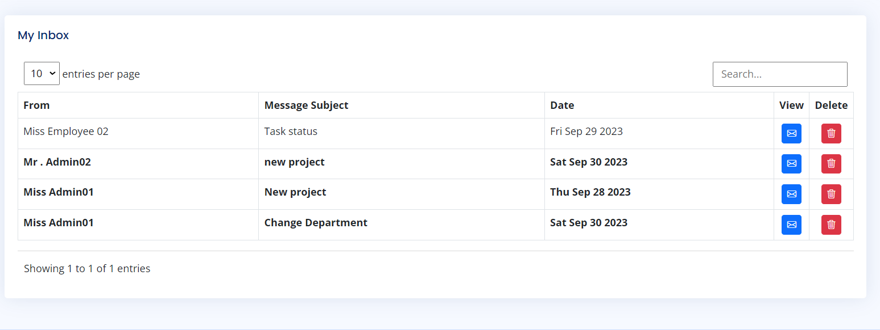
My Inbox All users in the system have their personal 'My Inbox,' where they can conveniently access both read and unread messages. They can also reply to senders directly from this inbox, ensuring seamless communication within the system.
"Clicking this button takes all users directly to the 'Send Message' page, where they can compose and send messages to specific recipients with ease."
"Users can independently delete their own messages."

Slide 14
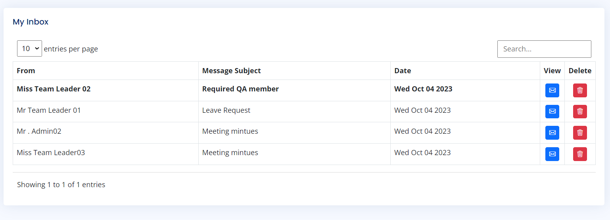
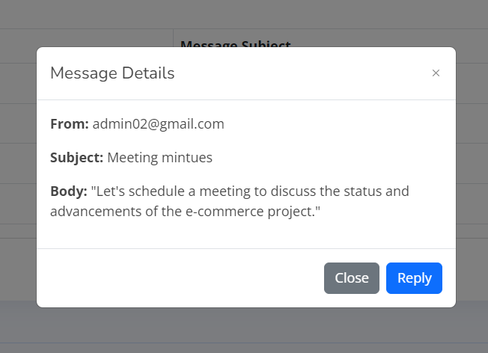
My Inbox By clicking this button, users can view their messages and respond to the sender.

Slide 15
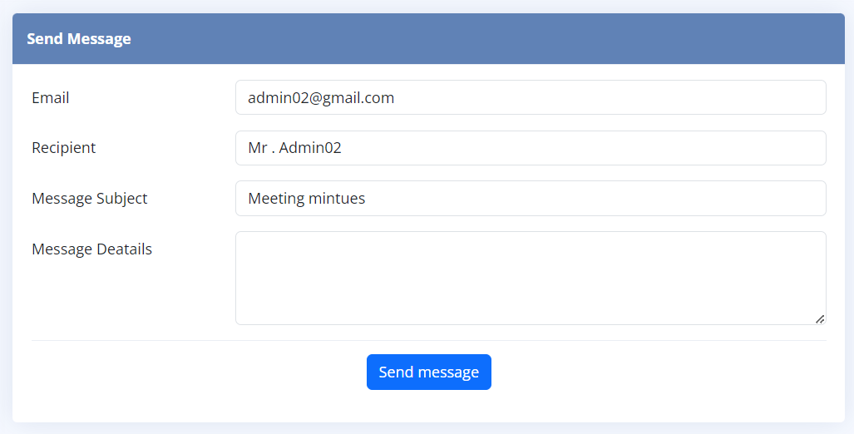
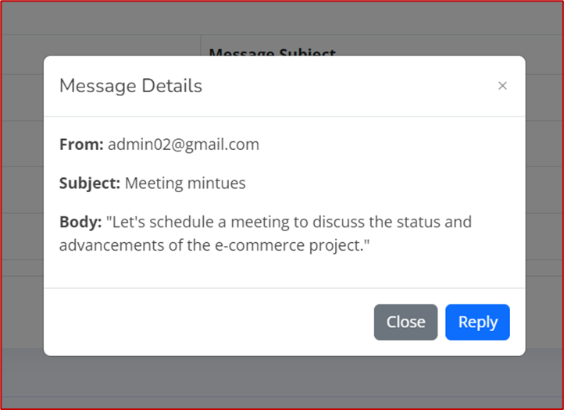
My Inbox Clicking on this "Reply" button allows users to send a direct message to the recipient.

Slide 16
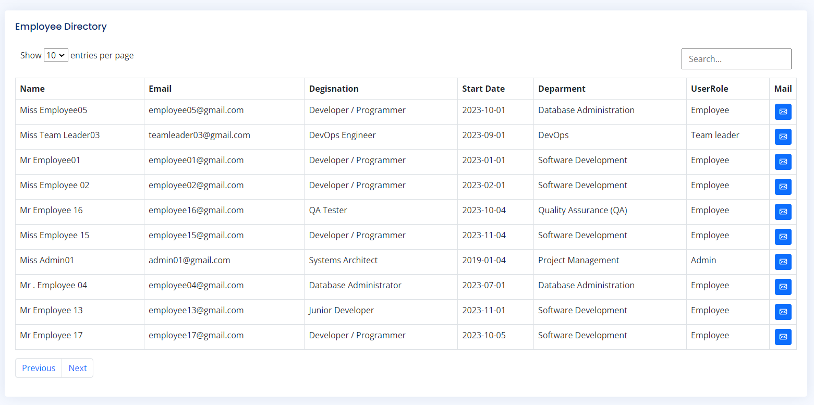
Employee Directory Employee Directory with Filtering and Search for Sending Messages to Any User.

Slide 17
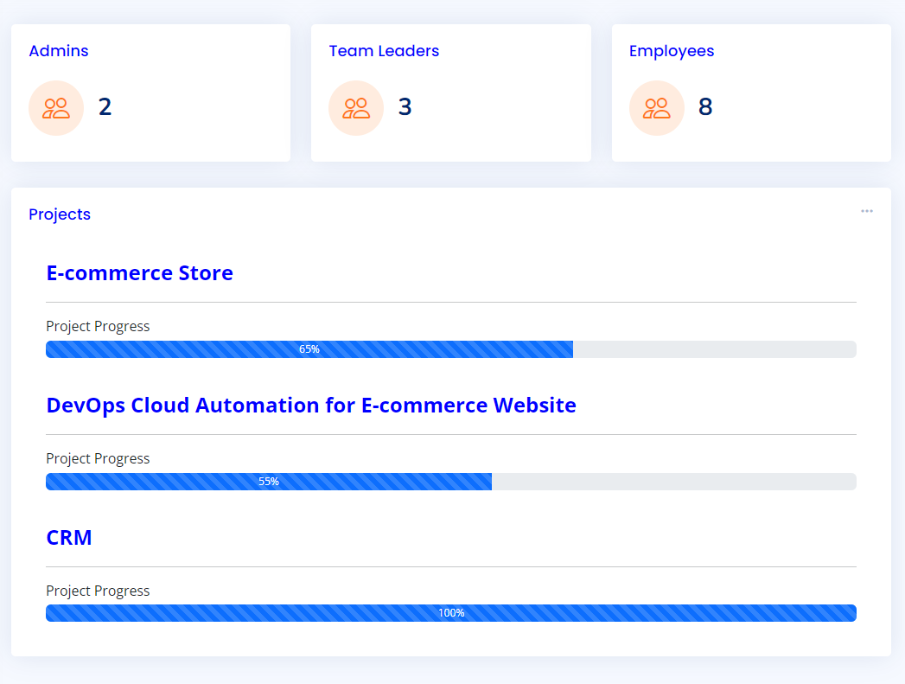
Admin Dashboard Admins can view a detailed dashboard that gives them a quick overview of essential Employees and Projects key metrics. This includes the total number of employees, team leaders, projects, and project progress and allocated task statuses.

Slide 18
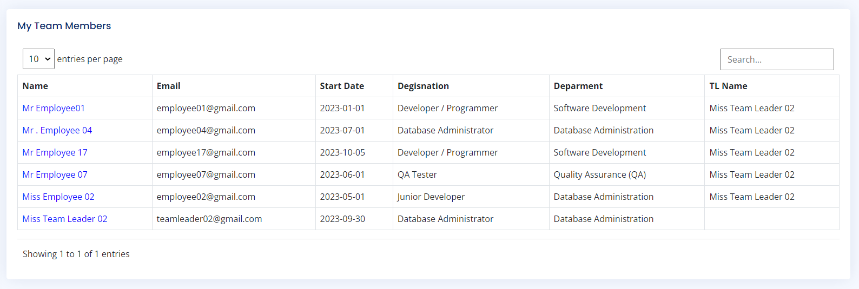
My Team Members In the designated 'My Team Members' section, users can conveniently locate their team members along with their respective team leader, facilitating efficient communication and collaboration within the organization.

Slide 19
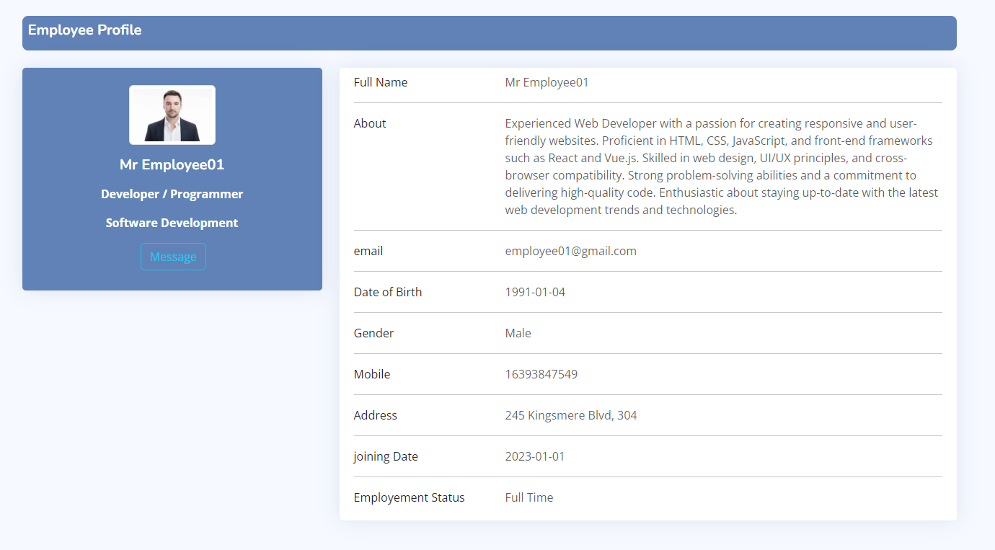
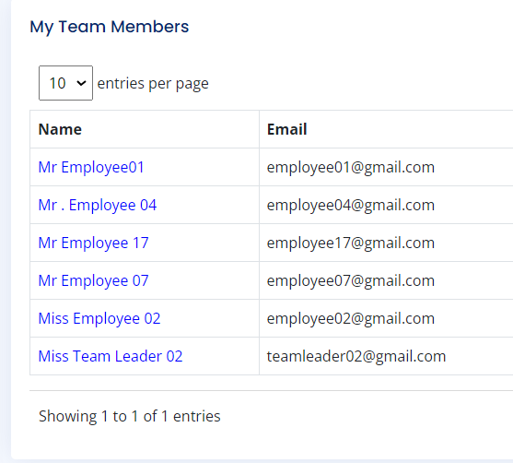
My Team members Users have access to view their team members' profiles and send direct messages for notifications, all in one place

Slide 20
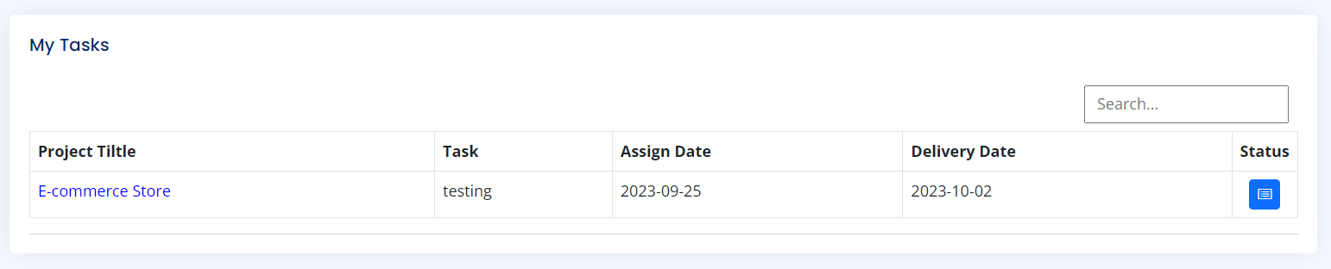

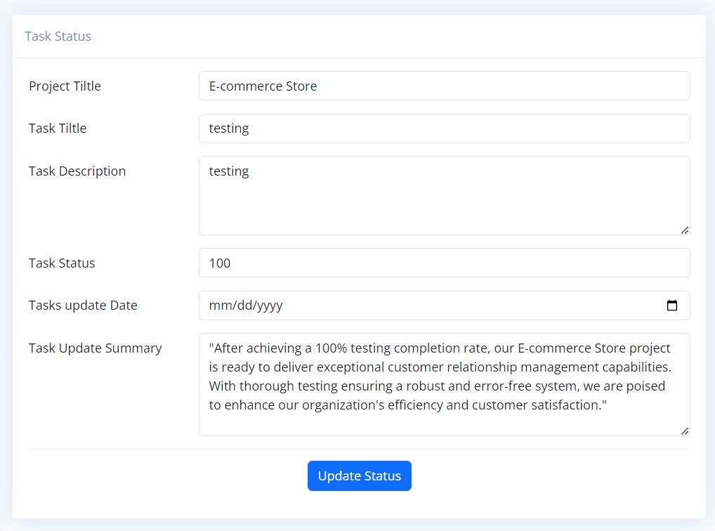
My Task
"When Team leader /Employee log in, they have access to 'My Tasks' where they can view a list of assigned tasks and update their status. This feature empowers employees to stay organized and keep track of their tasks efficiently."

Slide 21
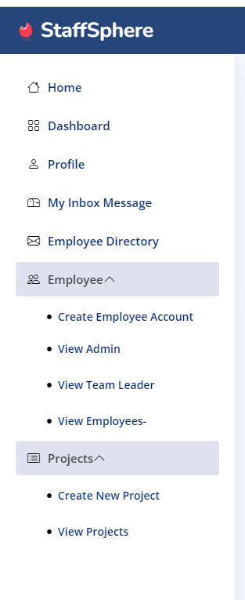
Admin Dashboard In the Admin Dashboard, administrators have comprehensive control. They can create new employee accounts, manage employee profiles, view, edit, update, and delete privileges. Additionally, admins can initiate new projects, assign projects to team leaders, and maintain seamless integration between employee and project management

Slide 22
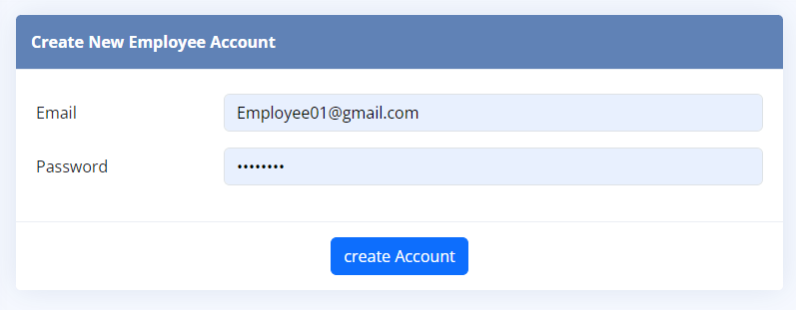
Create new Employee Account Only administrators possess the ability to create new employee accounts

Slide 23
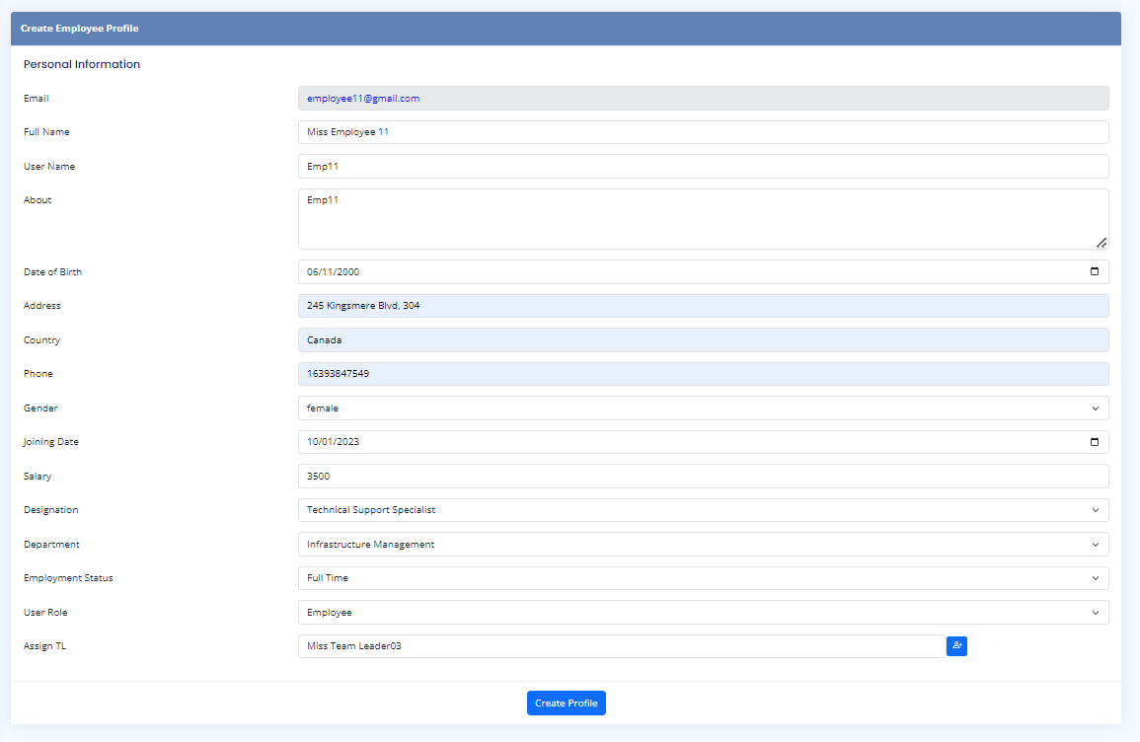
Create Employee Profile
This employee account profile covers various details, such as personal information, job title, department, user role, and additionally provides administrators the capability to designate a Team Leader for the employee.

Slide 24
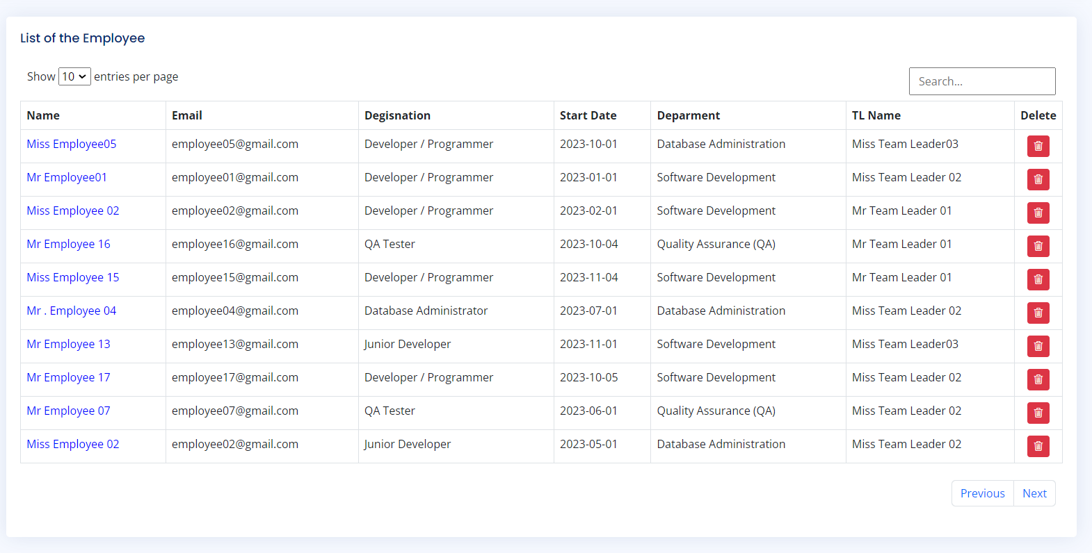
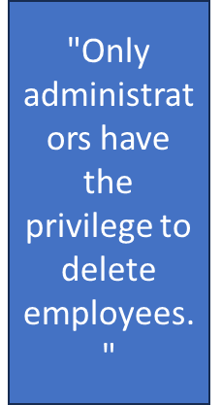
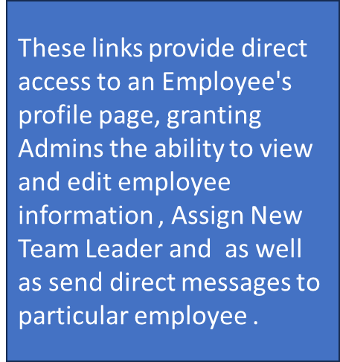
View Employees The Admin holds the authority to access and view the list of employees, including their profiles, with the capability to edit them. Furthermore, the Admin is empowered to delete both employees and team leaders."

Slide 25
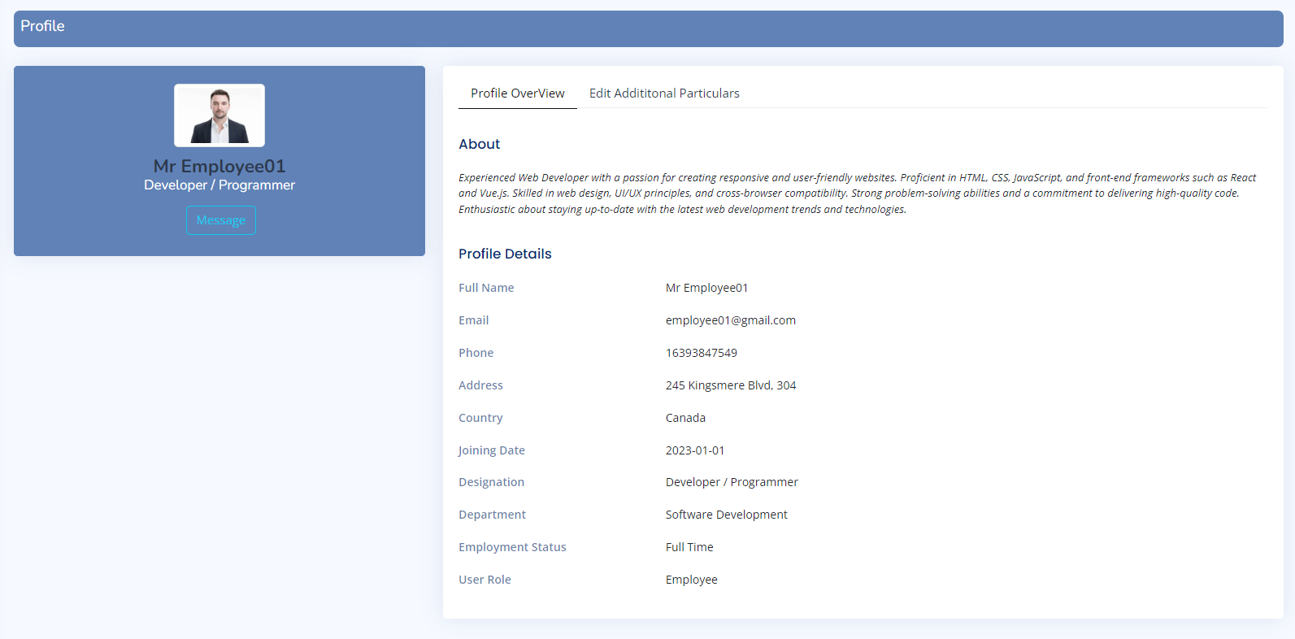
Employee profile The Employee Profile section encompasses both Personal Information and Additional Employee Details, providing a comprehensive overview of individual staff members.

Slide 26
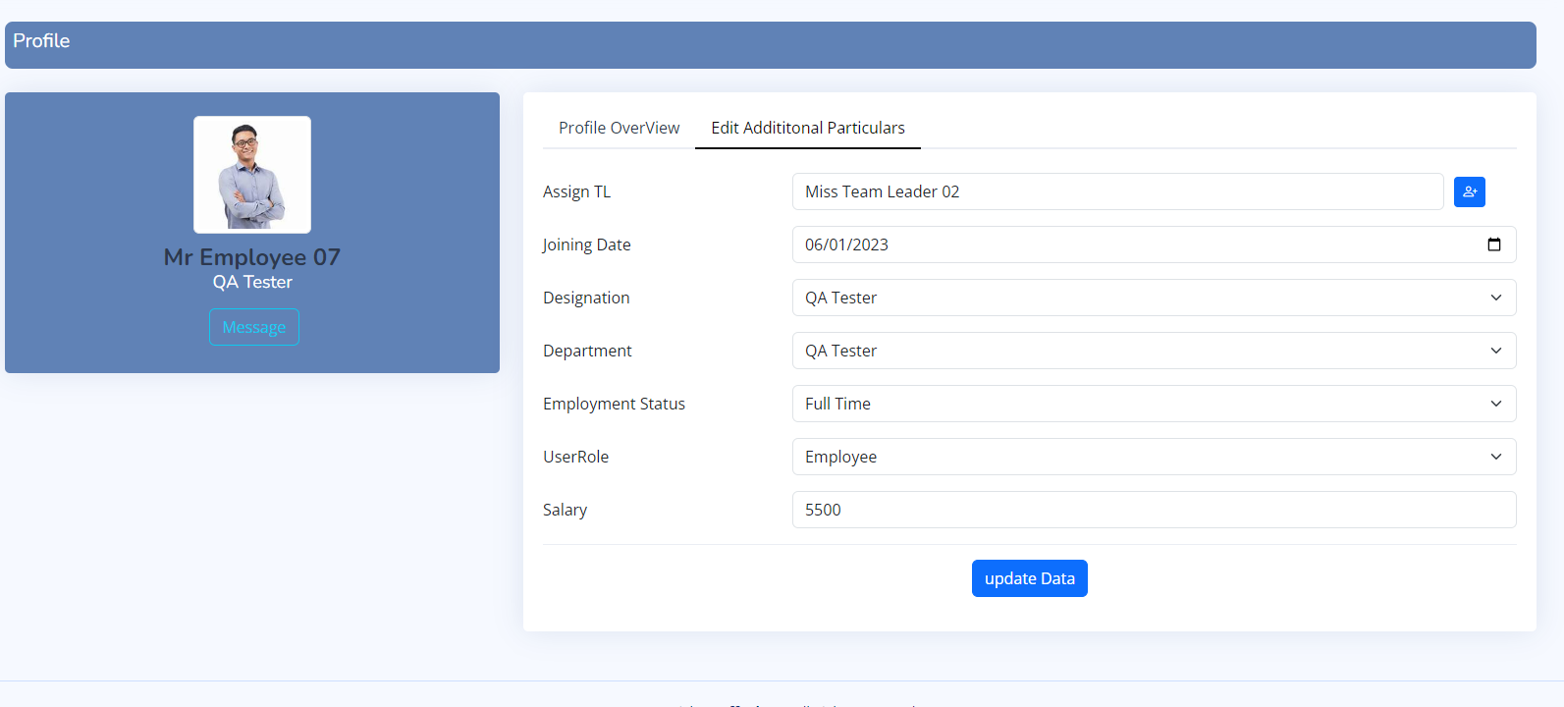
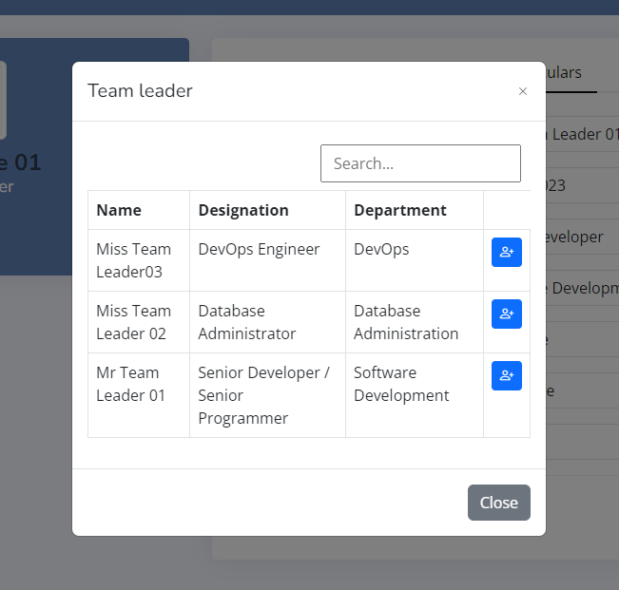

Employee Profile The Admin has the authority to select a Team Leader for a specific employee and edit various aspects, such as updating the designation, department, and salary. They can also assign a new Team Leader to that employee as needed.

Slide 27
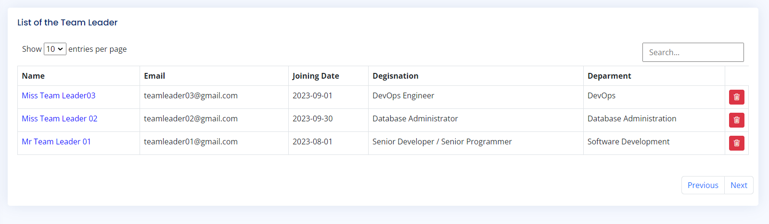
View Team Leader Additionally, the Admin has the capability to view, edit, and revoke permissions for Team Leaders.

Slide 28
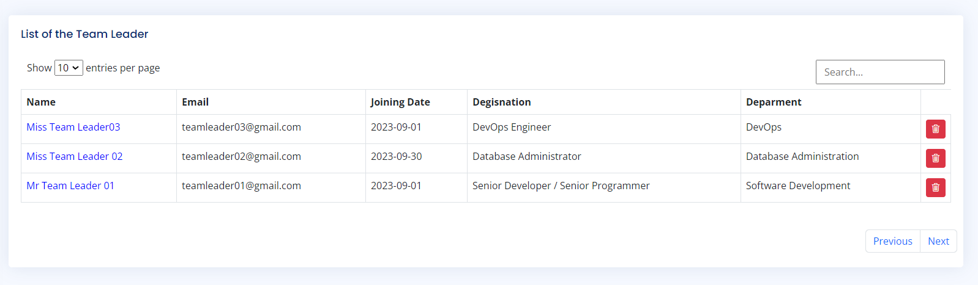

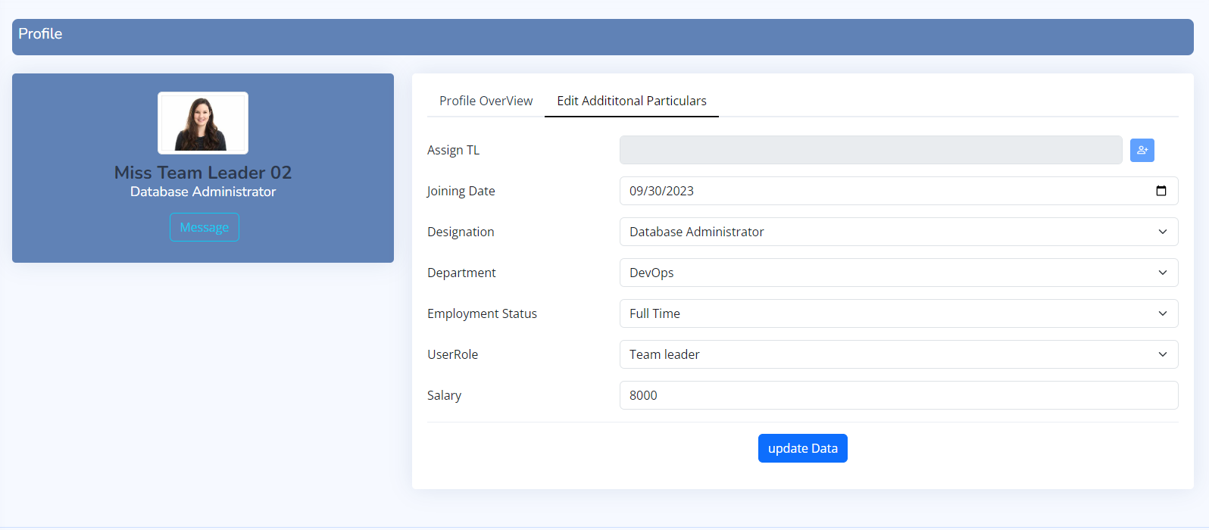

Team Leader
This link directs admin to the team leader profile page, where admin has the authority to both view and edit particular information profiles and delete the Team Leader

Slide 29
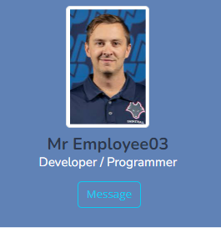

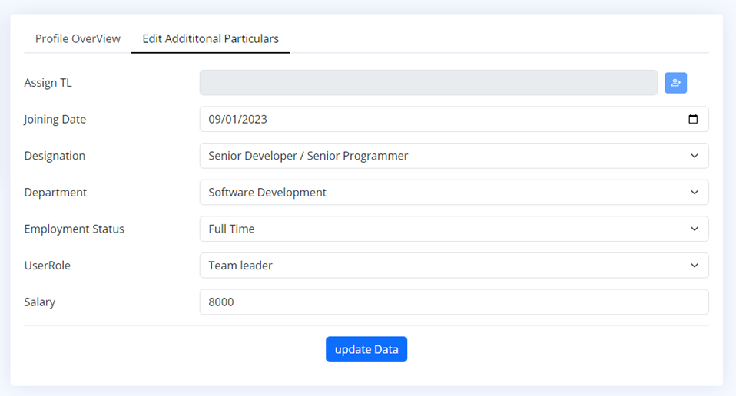
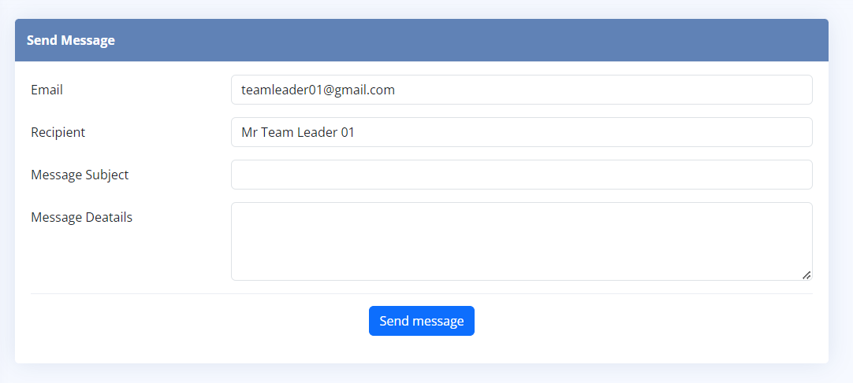
Admin should be able to edit and update their Additional information, and also send direct message from this page.

Slide 30
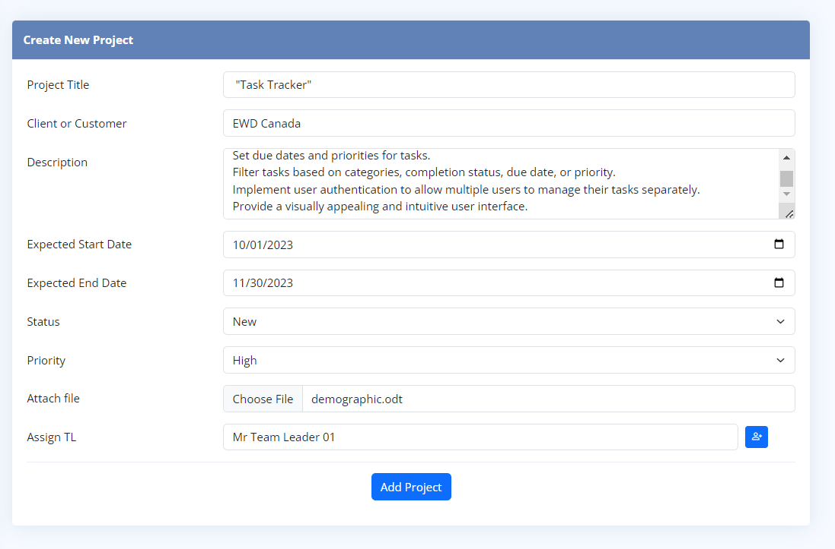
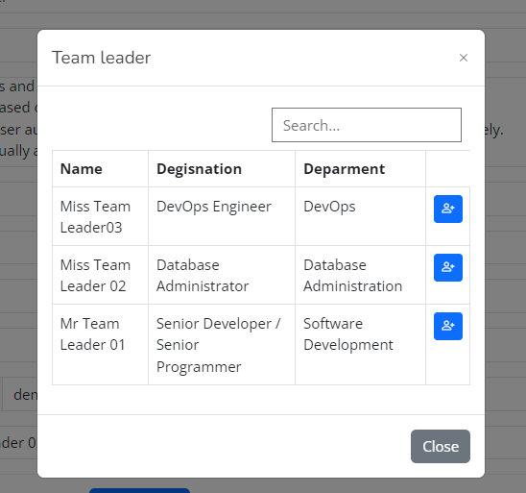
Create Project With the Admin role, Admin have the authority to initiate new projects effortlessly. This includes specifying project details such as the title, client information, project description, and expected delivery date. Additionally, Admin can conveniently upload project files and assign a Team Leader to oversee and manage the project's successful execution."

Slide 31
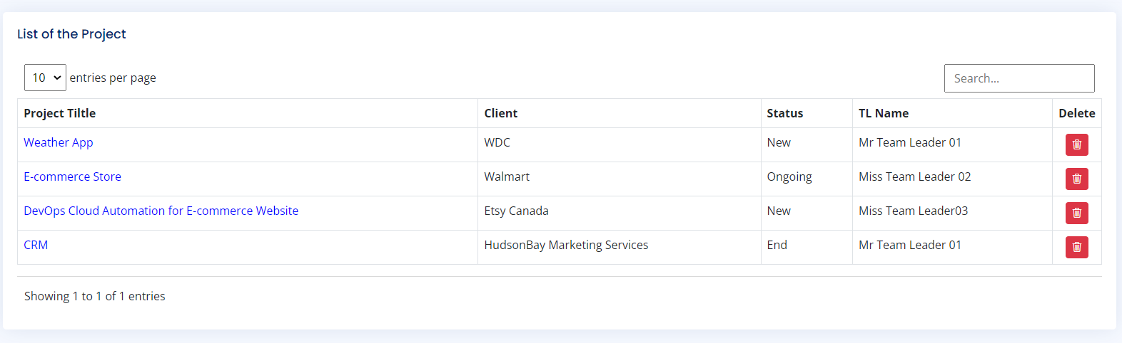
List of the project
"Only administrators have the authority to delete projects."
This link takes to a specific project summary page where user can find project details, its progress, and the task status of a particular employee.

Slide 32
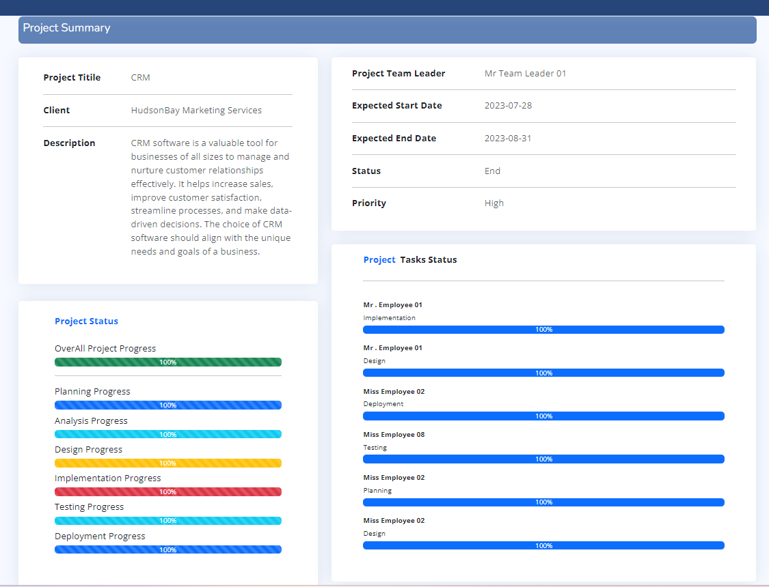
Project Summary This page serves as the central hub for our project. The project summary not only help in monitoring project progress and task status but also provides valuable insights into individual employees' contributions and the level of involvement of team leaders within the project.

Slide 33
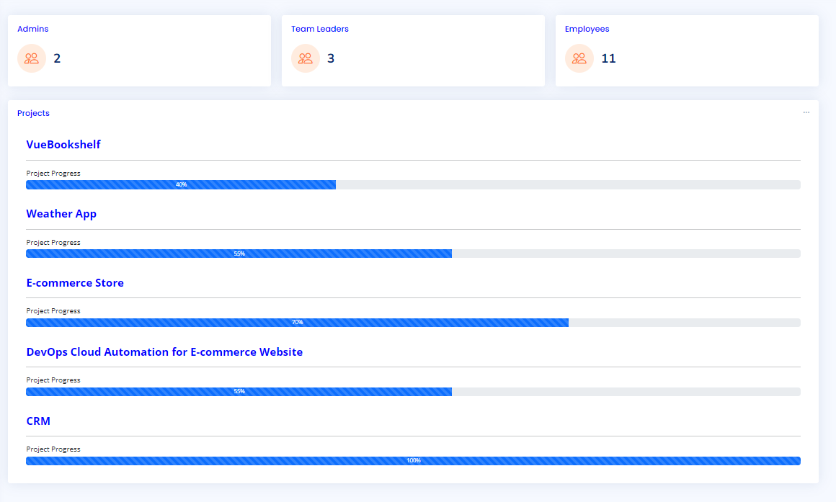
Admin Dashboard Within the Admin Dashboard, Admin can access a comprehensive overview of organization's structure and project landscape. Here, Admin have the ability to view the number of users with Admin, Team Leader, and Employee roles. Admin can also access a list of all active projects and obtain individual project summaries, providing you with a centralized hub to monitor and manage your organization's activities and resources efficiently.

Slide 34
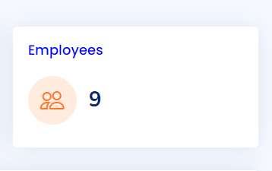
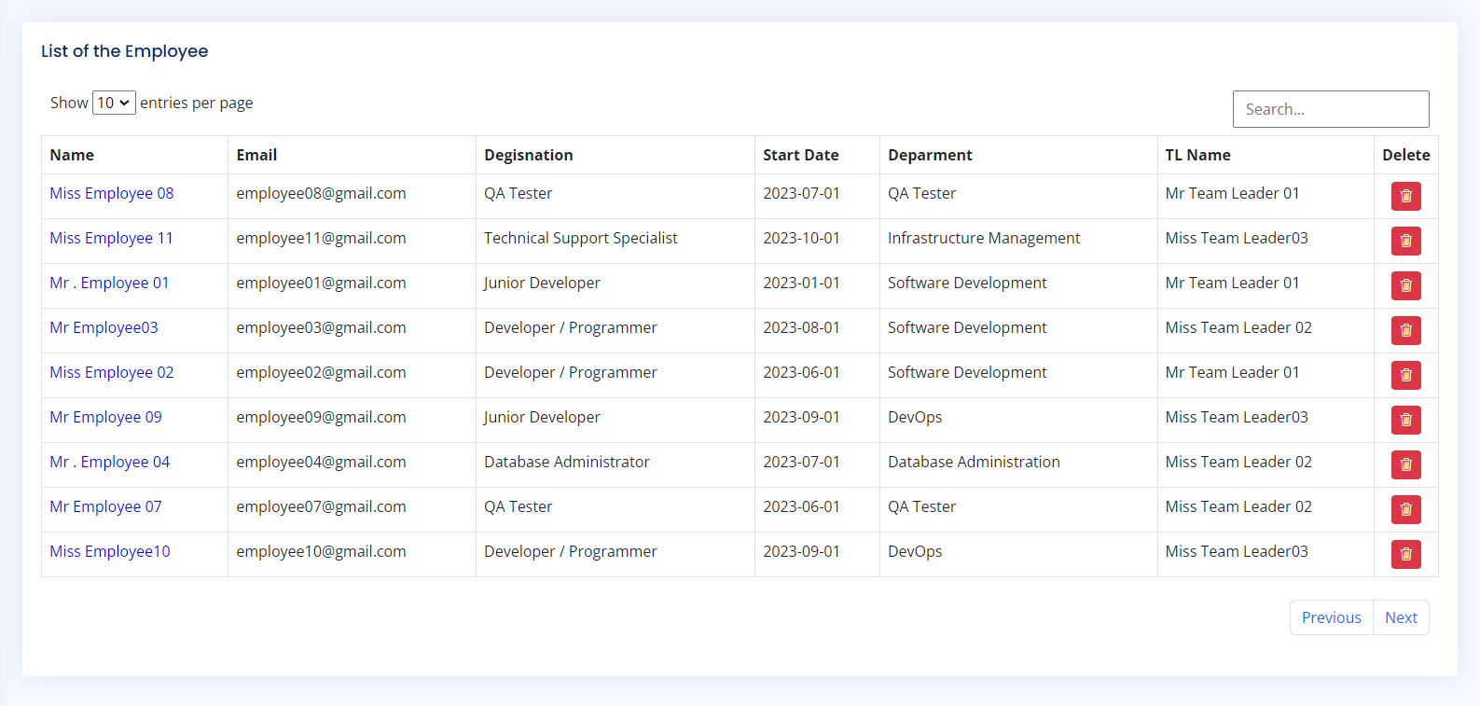
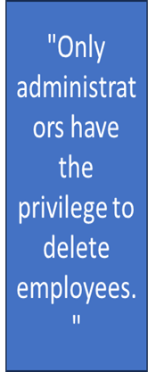
List of the Employee The Employees count is a direct reflection of the total users holding employee roles
These links provide direct access to an Employee's profile page, granting Admins the ability to view and edit employee information , Assign New Team Leader and as well as send direct messages to particular employee .

Slide 35
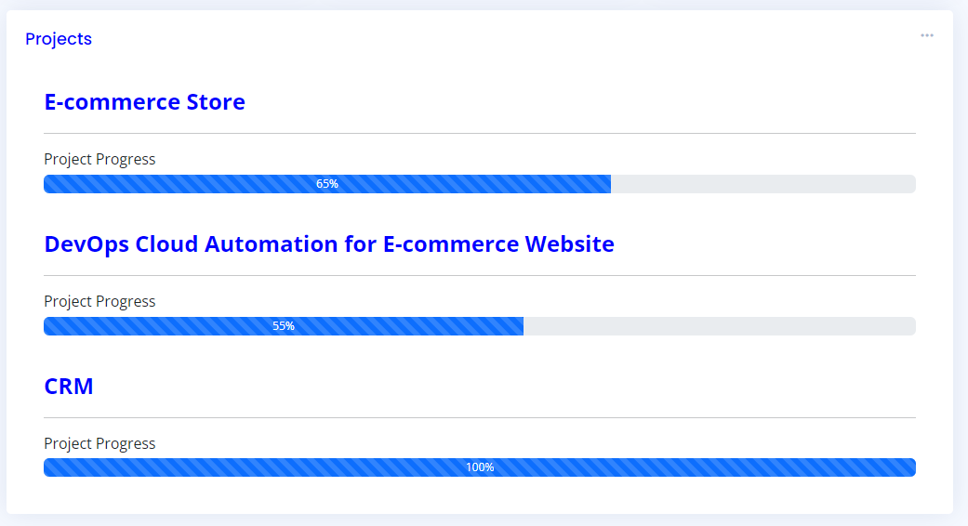
Project This link directs list of the Projects and projects details status. Admins can oversee and Project progress and the allocation of tasks within projects.
This link leads to a list of projects.
This link takes to a specific project summary page where user can find project details, its progress, and the task status of a particular employee.

Slide 36
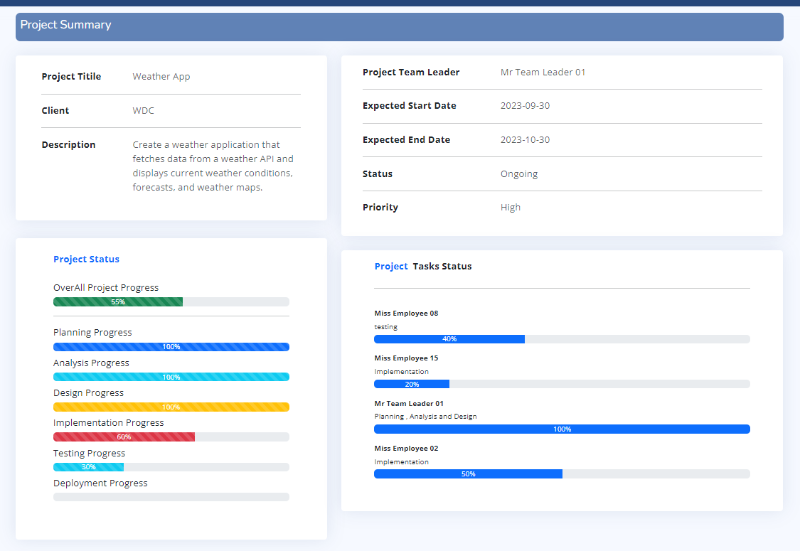
Project Summary

Slide 37
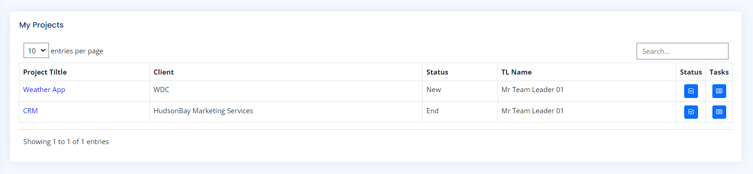
Team Leader- My projects When users log in as team leaders, they gain access to 'My Projects,' where they can create tasks for their team members within the project and track project progress based on the status of individual employee tasks. This feature empowers team leaders to efficiently manage their teams and project workflows.
"Clicking this button provides access to the project progress status."
This button allows for the creation of new tasks, assigned to team members based on the selected project."

Slide 38
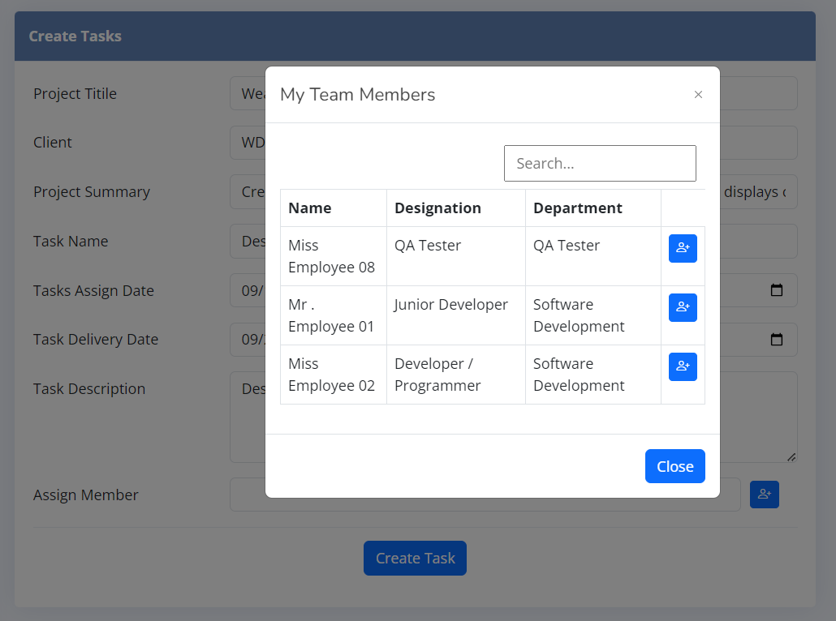

TeamLeader-Create tasks Team leaders can select a project, specify the task details, assign it to a particular team member, set deadlines, and provide any necessary instructions. This feature ensures that tasks are clearly defined and effectively distributed among team members, streamlining project management and collaboration.

Slide 39


TL-Project Progress Team Leaders can monitor and update project status on the 6 steps of the SDLC model, based on the employee task status . They can mark projects as complete and include comments or notes to ensure alignment with the chosen SDLC model. This empowers Team Leaders to efficiently track and manage project progress.

Slide 40

In this manner, every project is systematically tracked, taking into account the contributions of each employee and team member. The StaffSphere project stands as a cornerstone for seamless integration of all users and fostering effective project collaboration. It not only empowers employees by simplifying task management and facilitating smooth communication but also serves as a powerful tool for monitoring project progress and task status. Furthermore, it provides invaluable insights into individual employees' contributions and underscores the pivotal role of team leaders within each project, enhancing overall productivity and success."

Slide 41
Thank you

