Slide 1
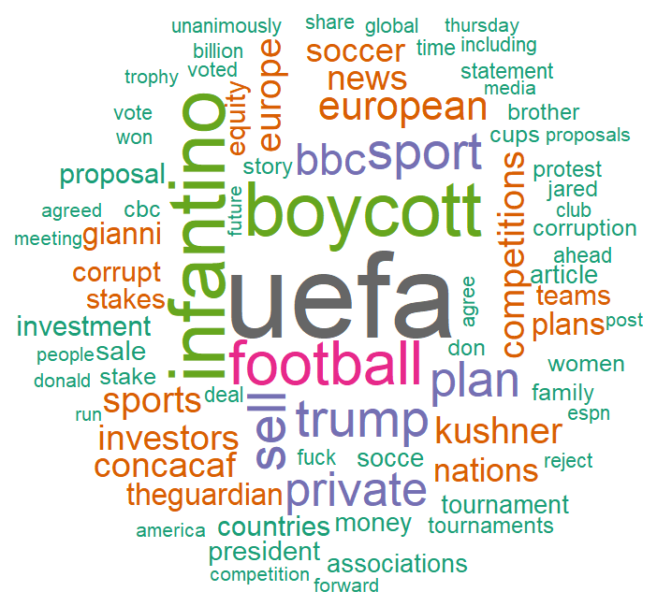
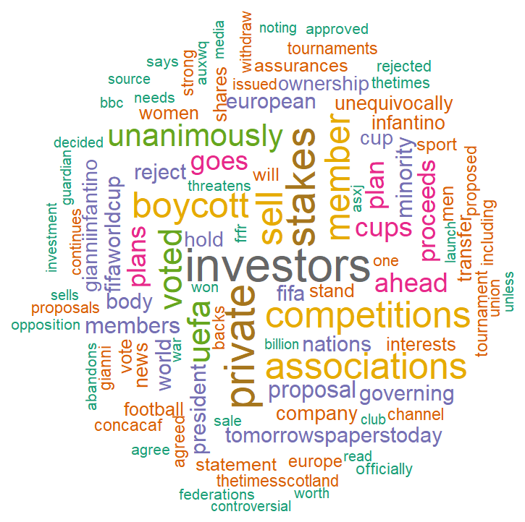
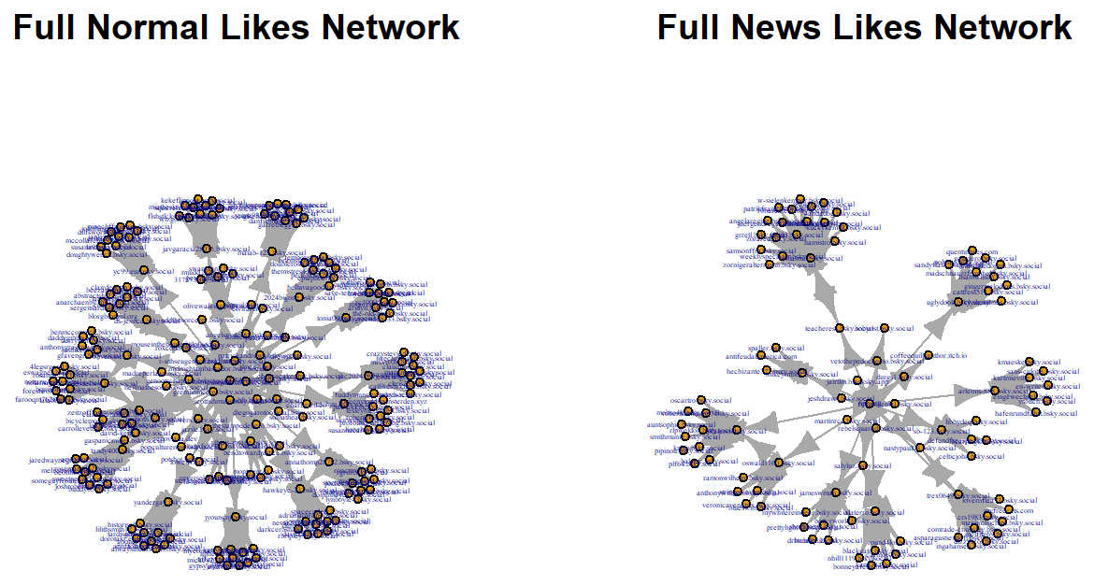
Annelise Tough · Neville Georgiades · Farhana Akter
FIFA World Cup 2026 Discussion on Bluesky
COMP3020 Social Web Analysis · Group 18
Western Sydney University · Group Project Poster
28 September 2026
Data Collection & Cleaning
Text & Content Analysis
Clustering
Section 2.1 · Farhana / 2.2 · Neville
Section 2.2 · Neville
Section 2.4 · Farhana & Annelise
Collected Bluesky posts mentioning “FIFA World Cup” (1 Jun–31 Jul 2026) with the atrrr package's search_skeet(), sorted by latest, limit 1,000.
793 English posts, 12–319 characters (median 151), 1–59 words (median 25). After removing stop-words and search terms, 2,627 distinct words remained.
TF-IDF vectors, cosine (MDS) distance. No clear elbow in SSW from k=1–15; k=8 chosen.
1,030
998
793
posts collected
after de-dup &
blank-text removal
English-language
posts analysed
Cluster 7 alone = 487 of 793 posts (61%) — one dominant topic.
Hypothesis Testing
Section 2.3 · Neville
Cluster 1 — Explored in Detail
Do posts mentioning a host country (USA, Canada, Mexico) differ in engagement from posts that don't?
n = 41 of 793 posts (5%)
67.9 vs 34.5
14 vs 779
mean engagement:
mentions vs no mention
posts mentioning a
host country vs not
Wilcoxon rank-sum test (engagement is right-skewed with many zeros, so normality fails for a t-test): W = 3792.5, p = 0.044 — significant at α = 0.05.
Host-country posts reached 85.7% engagement vs 62.8% for others — but only 14 of 793 posts mentioned a host country.
Word cloud of the 793 English posts — the news story's vocabulary (“uefa”, “infantino”, “boycott”) dominates over general World Cup talk.
Top terms: investors, private, stakes, sell — an investment/sale framing, not sport.
Network Analysis
Section 2.5 · Annelise
Research question: is the Bluesky likes-network more dense with a news account as the seed, or an ordinary account? Seed posts: the single most-liked skeet by itismashagain.bsky.social (normal) and by npr.org (news); edges run from seed → likers → people who liked the likers' own posts.
218 / 232
101 / 107
normal seed: nodes / edges
news seed: nodes / edges
Both networks: ~93–94% of nodes have in-degree 2. By degree and closeness, the seed account itself is most central in both; by betweenness, a different bridge takes over — tandy400.bsky.social (normal), pfalcon.bsky.social (news).
Full two-hop likes networks — the news-site seed is visibly tighter and more interconnected than the normal-user seed.
Conclusion
Limitations
A single viral UEFA/Infantino news story dominated this one-day snapshot of 1,030 World-Cup posts: it drove the word frequencies, produced one giant text cluster (61% of posts), and shaped which accounts anchored the likes networks. Host-country mentions showed significantly higher engagement (p = 0.044), and a news account's likes network was more than twice as dense as an ordinary user's — both patterns specific to this story and this sample, not World Cup discussion in general.
Bluesky-only and English-only data; the search term “FIFA World Cup” can miss relevant posts and match unrelated link previews; engagement counts are a snapshot that changes after collection; k = 8 was chosen without a clear elbow; and the two ego-networks have different sizes by construction, so their densities are suggestive, not strictly comparable.

