Slide 1
Heart Rate Monitoring System During Physical Exercises
Mentor: dasi shivakrishna
Team members:
Shanmukh.G
Jaswanth.V
Nagendra.K
Sai Manish

Slide 2
Introduction
Objectives
Block Diagram
Bandpass filter
Signal Decomposition
Tempporal difference
Sparse Signal reconstruction
Spectral Peak Tracking

Slide 3
Introduction
PPG stands for photoplethysmographic .
It measures the pressure pulse of the wrist . So we get a signal corresponding to the heart beat.
Because of the intense motion of the wrist that a large amount of noise is added to the signal. This noise is called motion artifact(MA).

Slide 4
Objectives:
To reduce the MA signal in the PPG.
To measure the number of beats.

Slide 5
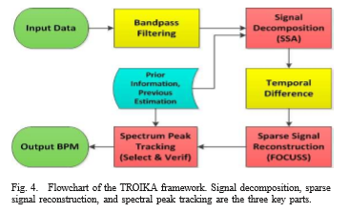
Block Diagram:
Bandpass filter.
Signal decomposition.
Temporal Difference.
Sparse signal reconstruction.
Spectral peak tracking.

Slide 6
Bandpass Filter
We know that the frequency of the heart beat signal lies between 0.4 to 5 Hz.
We filter the rest of the frequencies so as to reduce the noise.

Slide 7
Signal Decomposition
We used the SVD technique to decompose the signal into three parts.
The SVD of an mxn matrix real or complex is a factorization of the form U∑V*.
Where U and V are real or complex unitary matrices.
∑ is an mxn rectangular diagonal matrix with non negative real numbers on the diagonal.

Slide 8
SVD
Our data is a 1xm matrix. So we have U as 1x1, ∑ as 1xm,V as mxm.
So based on our signal we identify the components of noise and remove them.

Slide 9
Temporal Difference
We subtract two consecutive samples to reduce noise.
It can be done with different orders for required number of accuracy.
Since the signal is periodic it is justified as it still remains periodic unless all the samples are almost same.

Slide 10
Sparse Signal Reconstruction
The following equation is used to further reduce the noise in the signal Y=φX+n ;
Φ_{m,n} =e^{j2πmn/N} ;
X_{e} min(||Y-φX||₂² ) + λ g(x);
Where λ is a regularization parameter and g(x) is an l _{p} - norm function.
By using this we approximate X_{e} removing n.

Slide 11
Spectral Peak Tracking
Here we measure the approximate distance between two beats and approximate magnitude of them.
By using this we track the number of beats.
Here we measure if the required peak value is present in a small range around that sample.

Slide 12
References
TROIKA: A General Framework for Heart Rate Monitoring Using Wrist-Type Photoplethysmographic Signals During Intensive Physical Exercise.

