Slide 1
Design of data acquisition system for electric bikes to develop drive cycle for Peshawar

Slide 2
Group Members:
Muhammad Osama (18jzele0234) (Group leader)
Ansar Ullah (18jzele0268)
Yashib Ahmad (18jzele0270)
Supervisor:
Dr. ZakaUllah Zahid
Co-Supervisor:
Dr. Umar Shareef

Slide 3
OUTLINEs
Goal of the project
Block Diagram
Interfacing of Current Sensor
Interfacing of Voltage Sensor
Interfacing of GPS
Interfacing of 9-Axis Motion Sensor
Interfacing of Memory Module

Slide 4
Goal of the project:
The goal of this project is to optimally use the battery in electric bike to extend the range of the bike. This project will mainly focus on the following objectives.
Designing data acquisition system for the electric bike.
Collecting data from the Electric bike through that data acquisition system to develop Drive-Cycle for Peshawar.

Slide 5
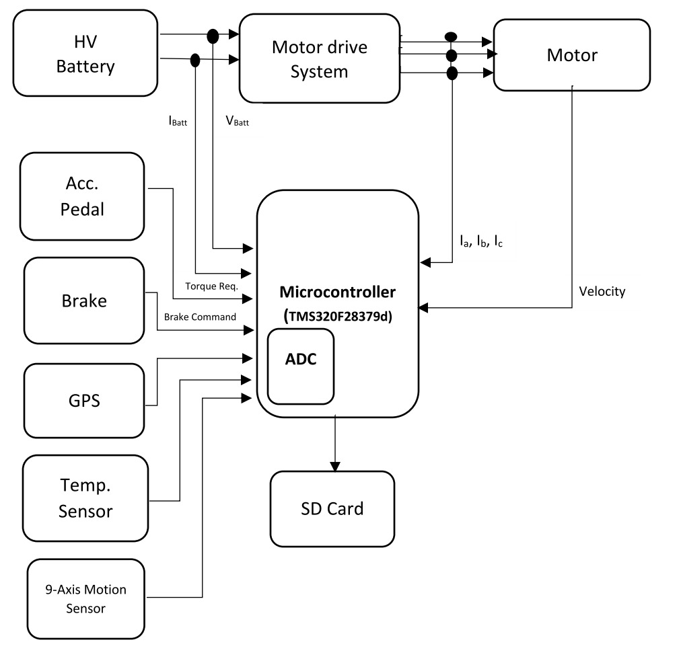
Block Diagram

Slide 6
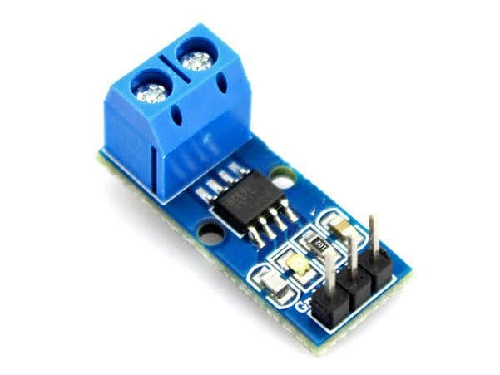
Interfacing Current sensor with Arduino
The current sensor used in this project is ACS712
Current flows through the onboard hall sensor circuit in its IC
The hall effect sensor detects the incoming current through its magnetic field generation
Once detected, the hall effect sensor generates a voltage proportional to its magnetic field that’s then used to measure the amount of current

Slide 7
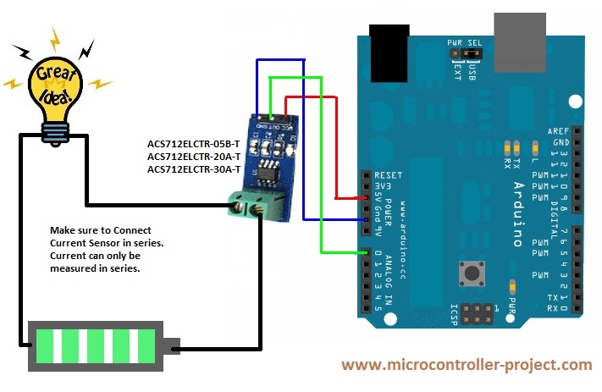
Interfacing Current sensor with Arduino
This sensor has 3 pins
GND should be connected to the GND of the Arduino
VCC should be connected to 3.3v of the Arduino
OUT should be connected to A0 of the Arduino

Slide 8
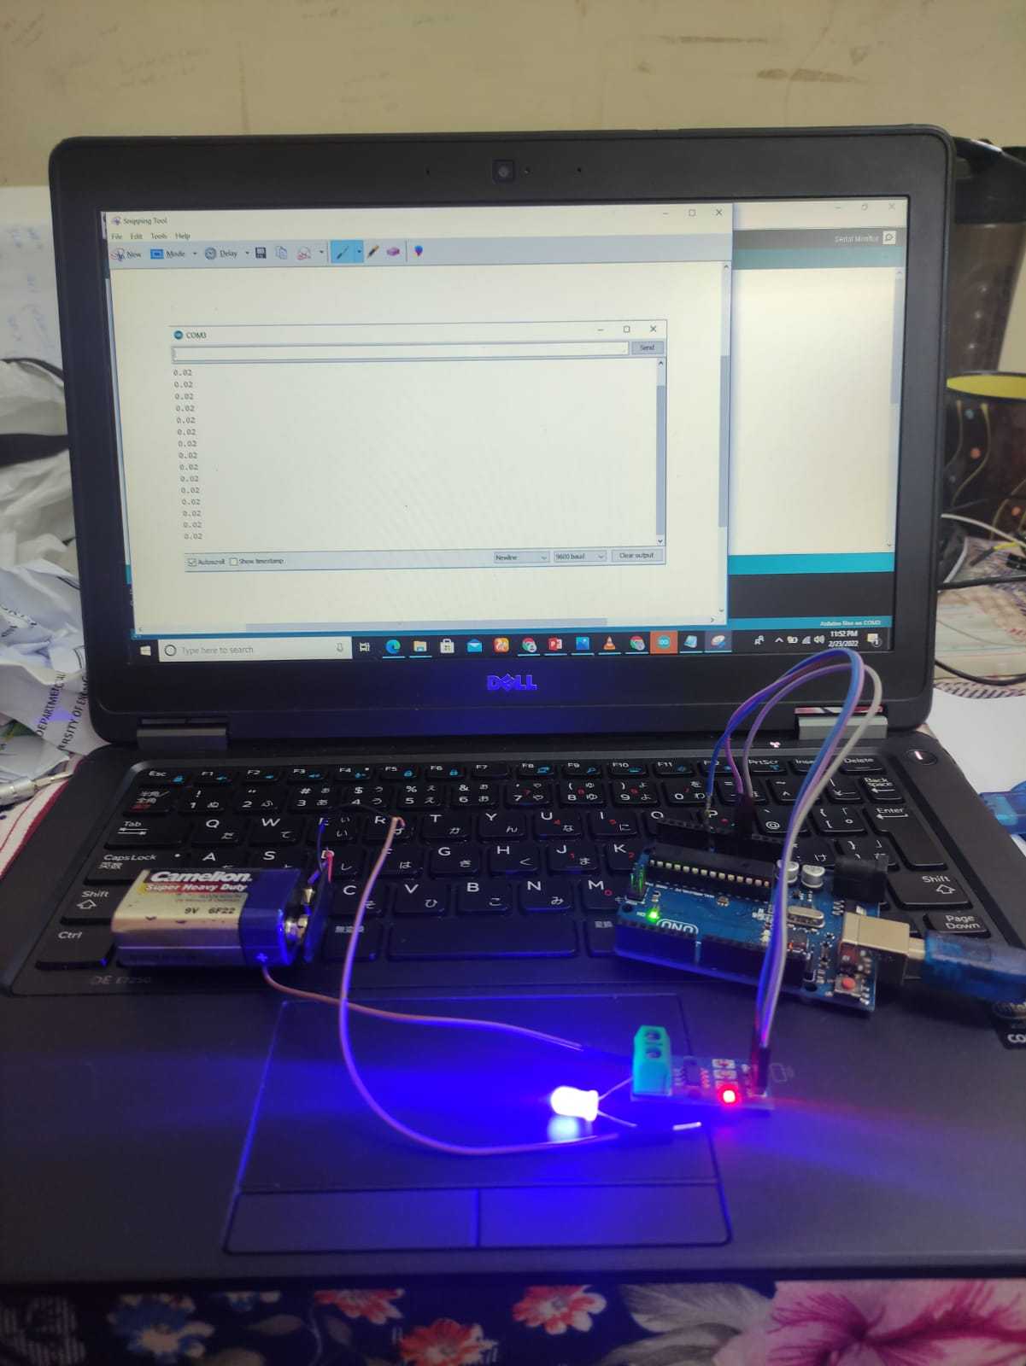
Interfacing Current sensor with Arduino

Slide 9
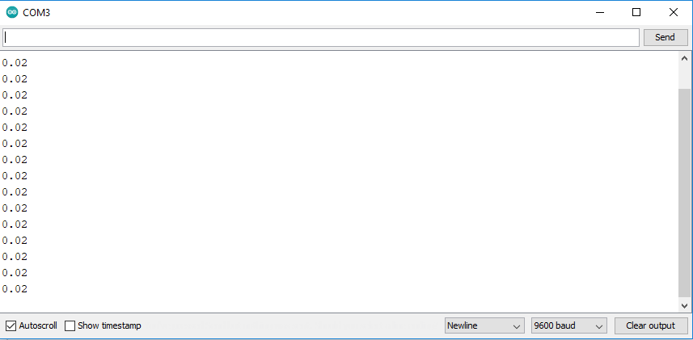
Readings of the Current sensor

Slide 10
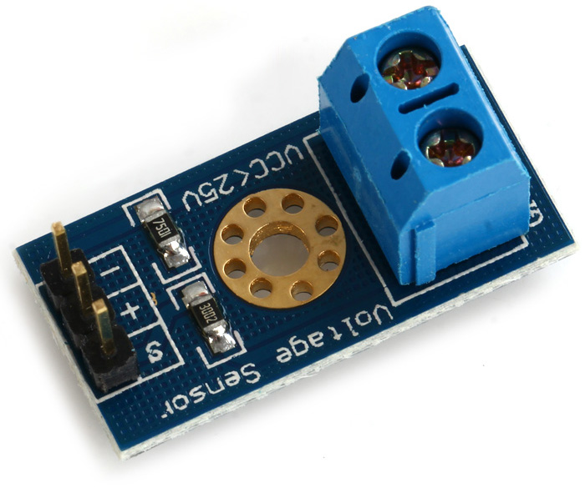
Interfacing voltage sensor with Arduino
The voltage sensor used here is DG-301.
It can measure voltage from 0v-25v.
It is small, portable and reliable.
It is simple circuitry and easy to interface.

Slide 11
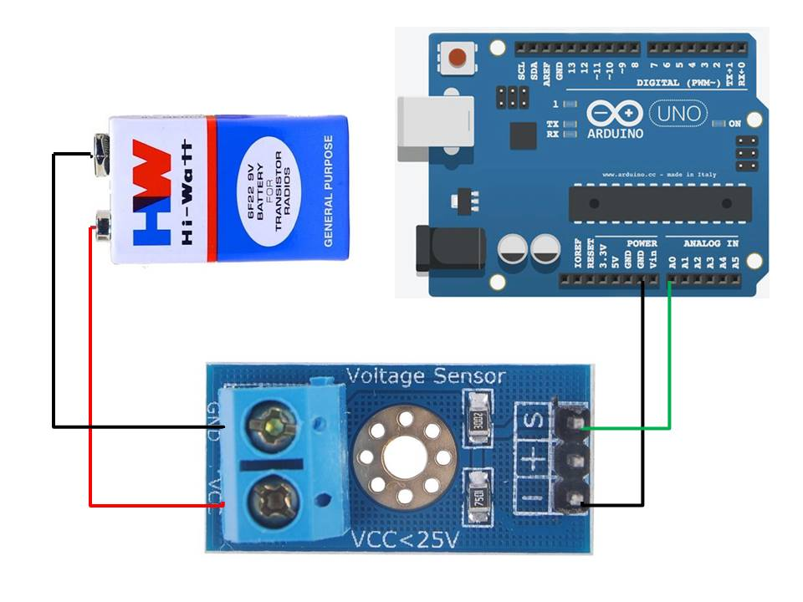
Interfacing voltage sensor with Arduino
The module has five pins S,+, -, VCC and GND.
“S” is connected to analog input pin.
“+” is not connected to any pin.
“-” is connected to ground.
VCC is connected to the positive power supply pin.
GND is connected to the negative power supply pin.

Slide 12
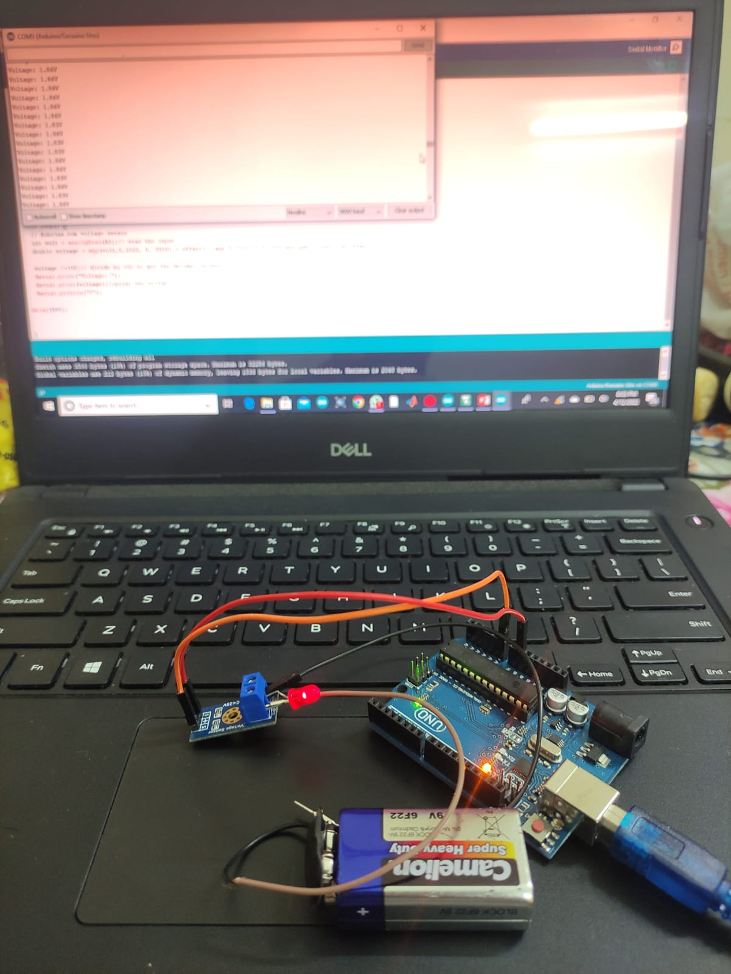
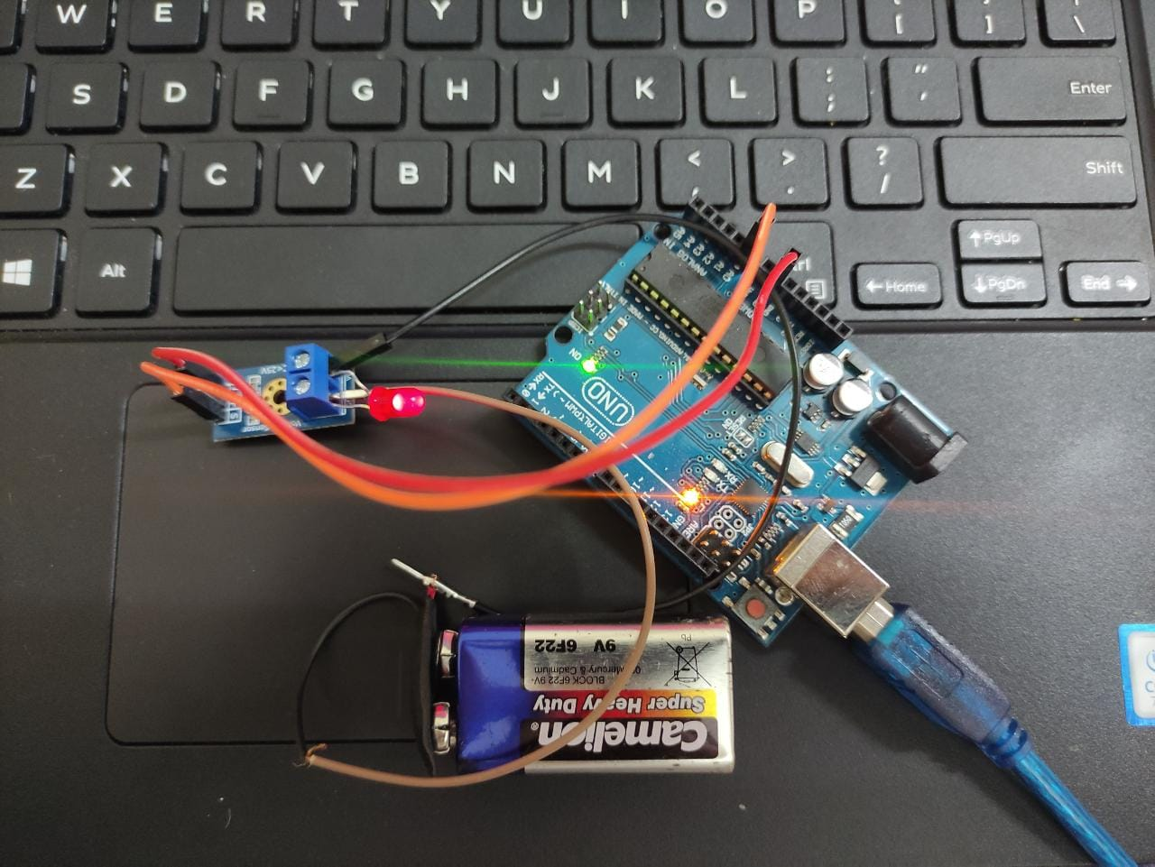
Interfacing voltage sensor with Arduino

Slide 13
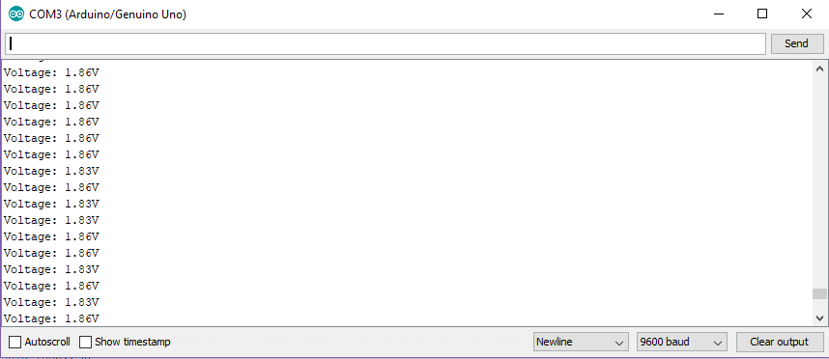
Readings of the voltage sensor

Slide 14
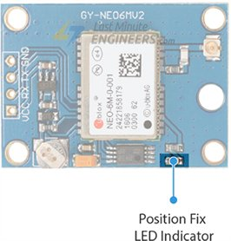
Interfacing GPS with Arduino
The GPS sensor used in this project is UBLOX NEO 6M.
It has 2.5m horizontal position accuracy.
It has navigation update of 1Hz.
It has position fix LED indicator.

Slide 15
Interfacing GPS with Arduino
It has four pins VCC, GND, TX , RX.
VCC is used for power and is connected to 3.3v port of the Arduino
GND is attached to the GND of the Arduino
TX and RX are used for communication and are connected to digital pin 3 and 4 of Arduino.

Slide 16
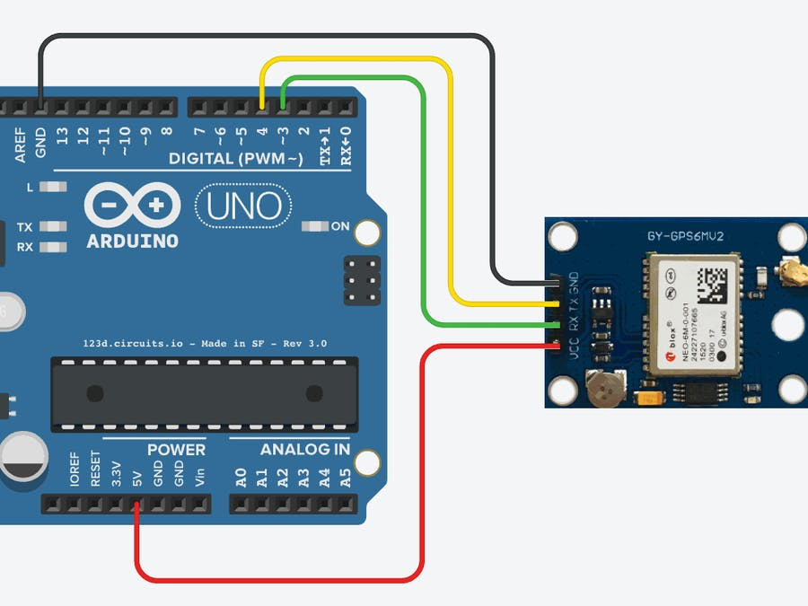
Interfacing GPS with Arduino

Slide 17
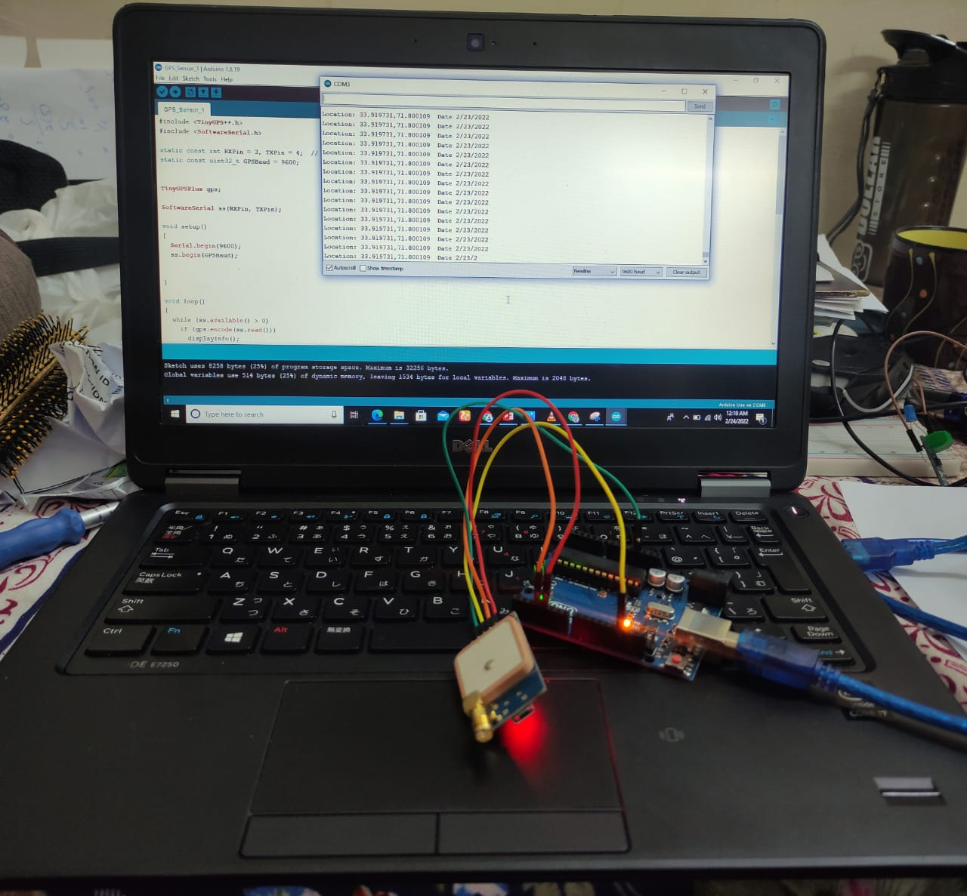
Interfacing GPS with Arduino

Slide 18
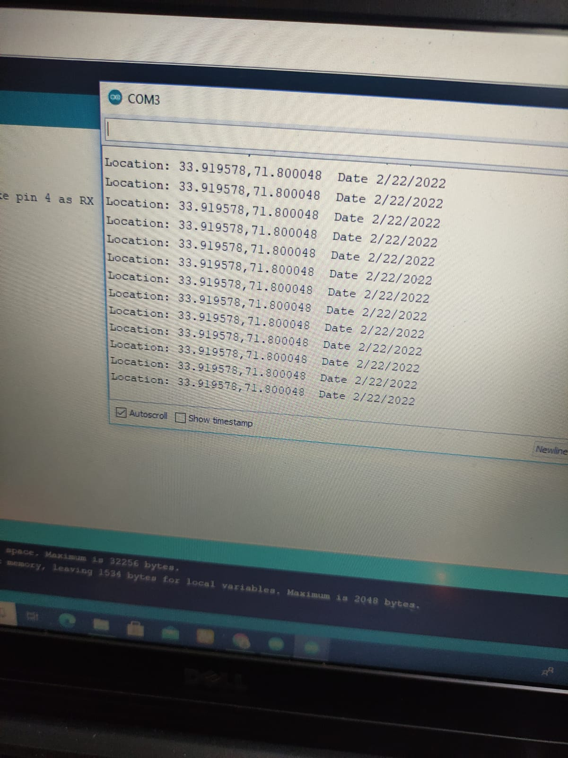
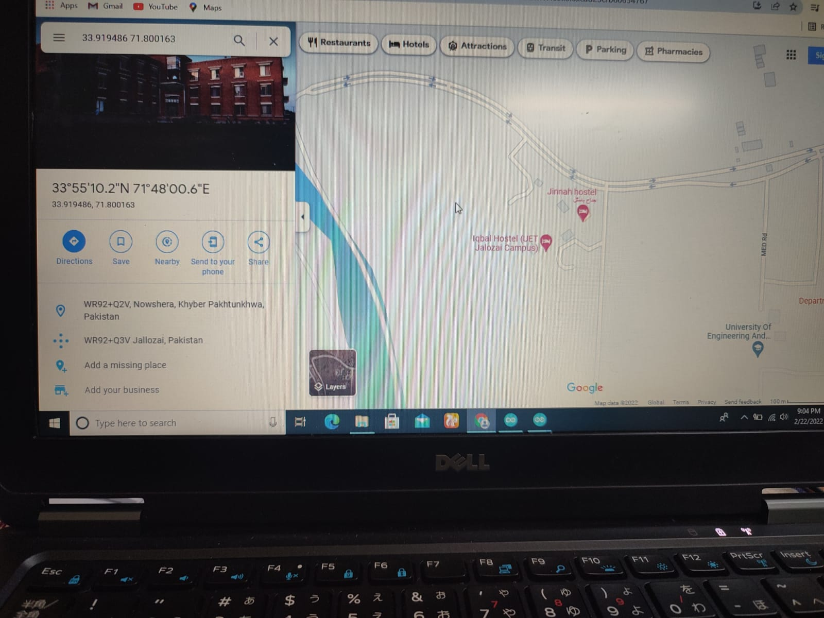
Result of Gps sensor

Slide 19
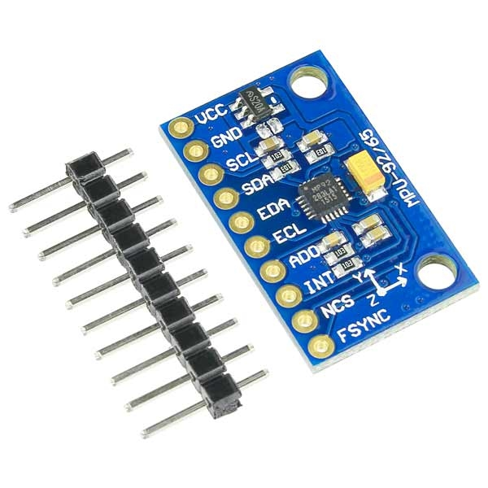
Interfacing 9-Axis motion sensor
The sensor used in this project is MPU-9250.
It comprised of the following.
Three-axis MEMS rate gyroscope Sensor.
Three-axis MEMS accelerometer Sensor.
Three-axis MEMS magnetometer Sensor.

Slide 20
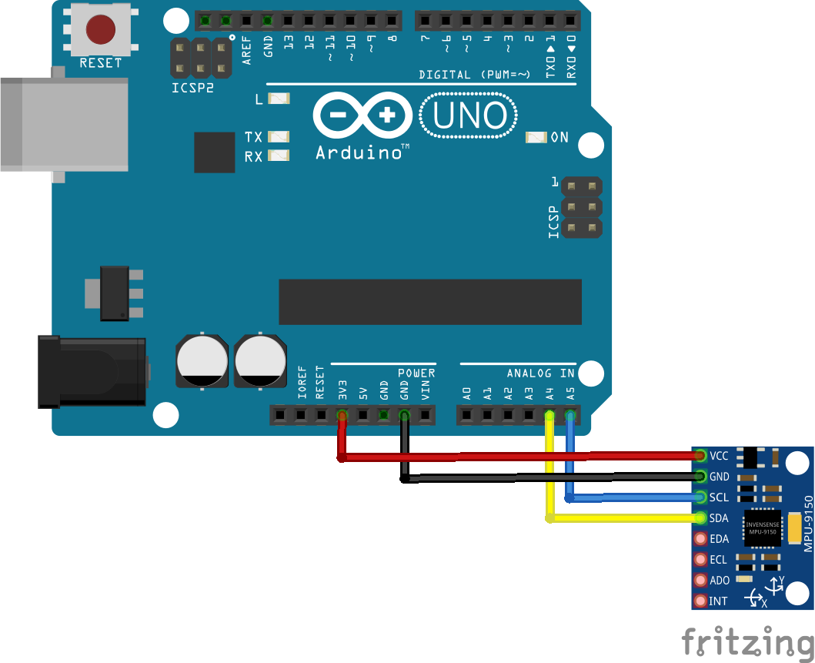
Interfacing 9-Axis motion sensor
It has 10 pins VCC,GND,SCL,SDA,EDA,ECL,ADO,INT,NCS and FSYNC.
VCC is connected with 5v pin of the Arduino.
GND is connected to GND of the Arduino.
SCL is connected to A5.
SDA is connected to A4.

Slide 21
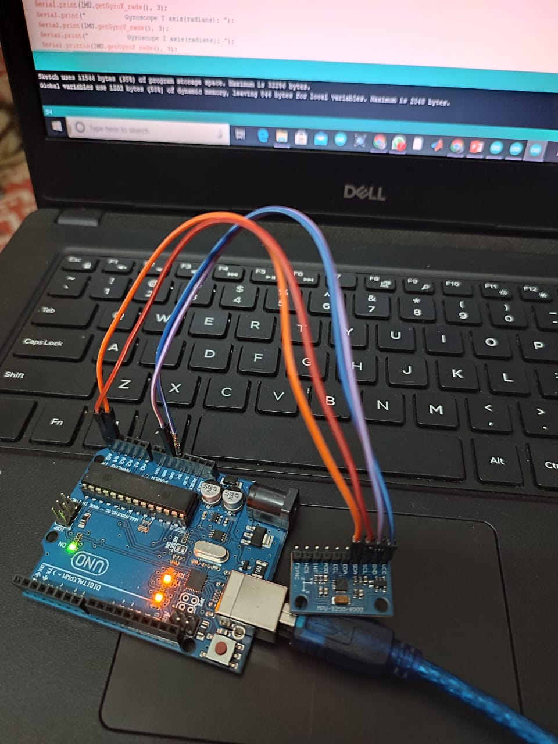
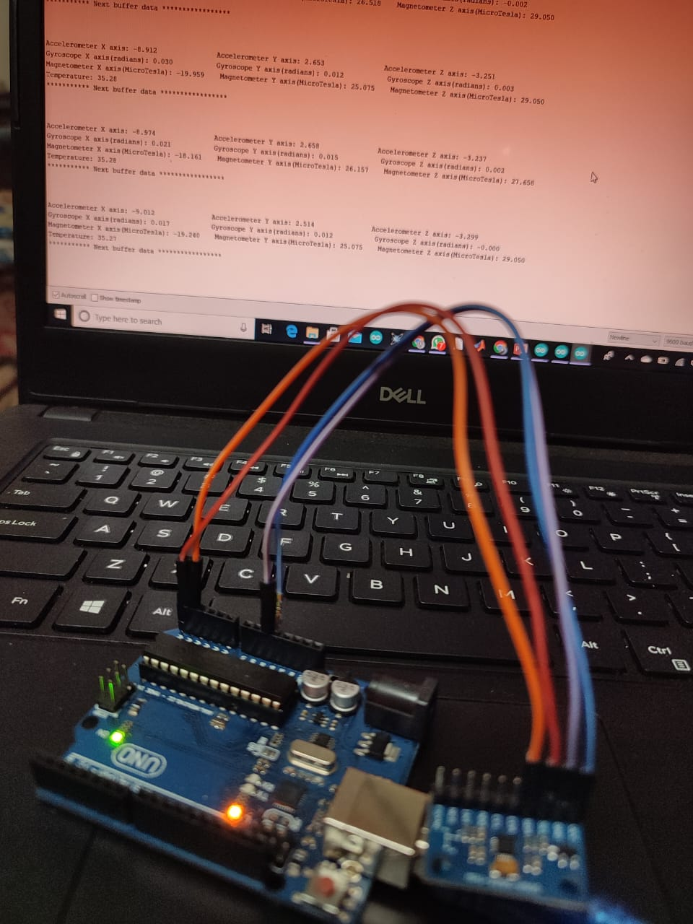
Interfacing 9-Axis motion sensor

Slide 22
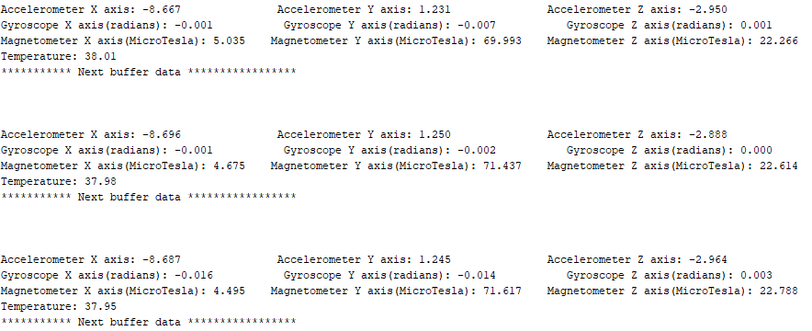
Readings of the 9-Axis motion sensor

Slide 23
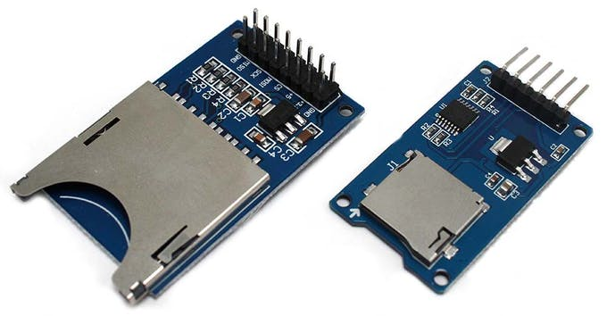
Interfacing SD card module with Arduino
The SD and micro SD card modules allow you to communicate with the memory card and write or read the information on them. The module interfaces in the SPI protocol.

Slide 24
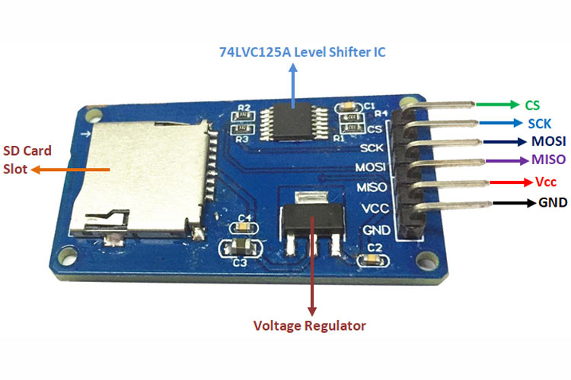
Interfacing SD card module with Arduino
PINS OF THE SD CARD MODULE:

Slide 25
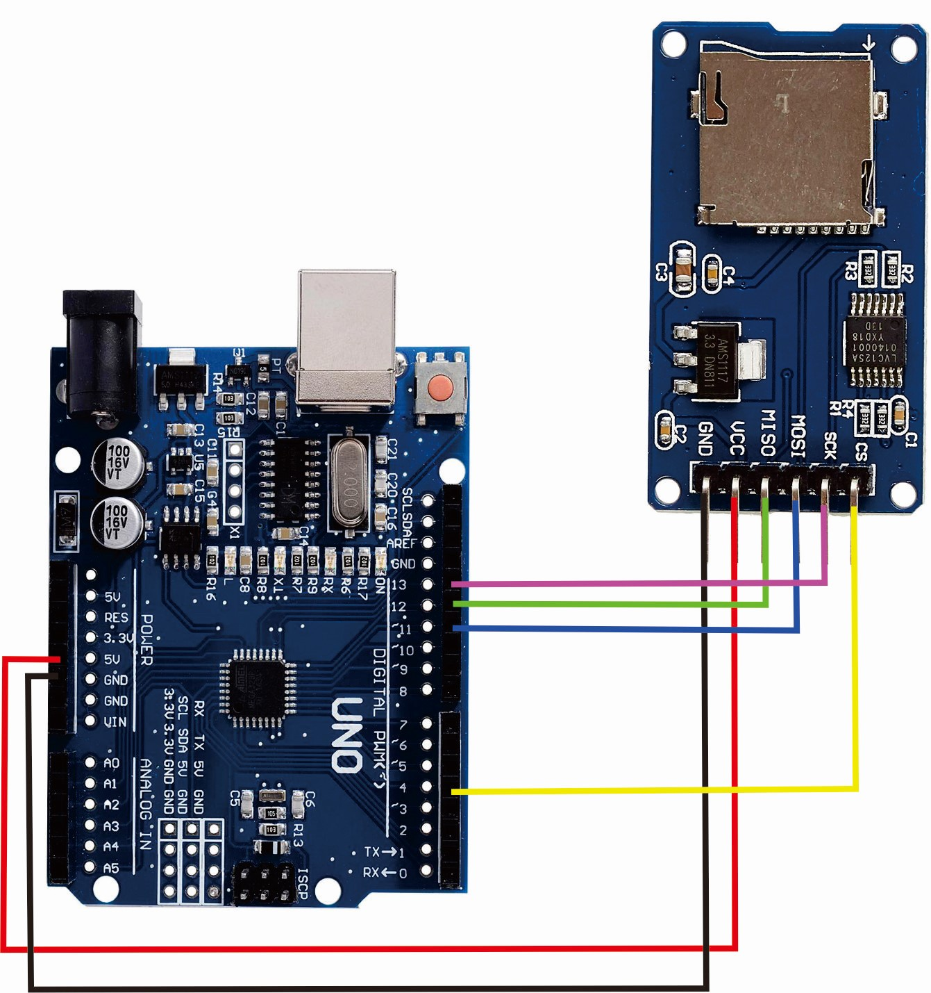
Interfacing SD card module with Arduino

Slide 26
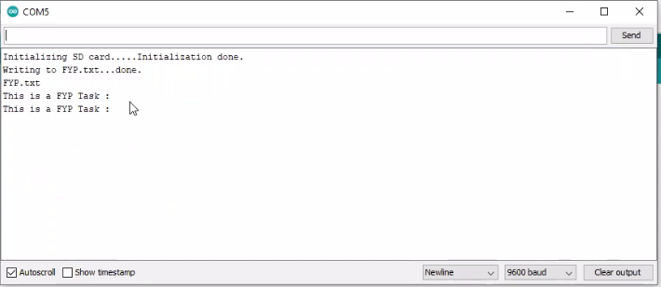
Result of SD card module

Slide 27
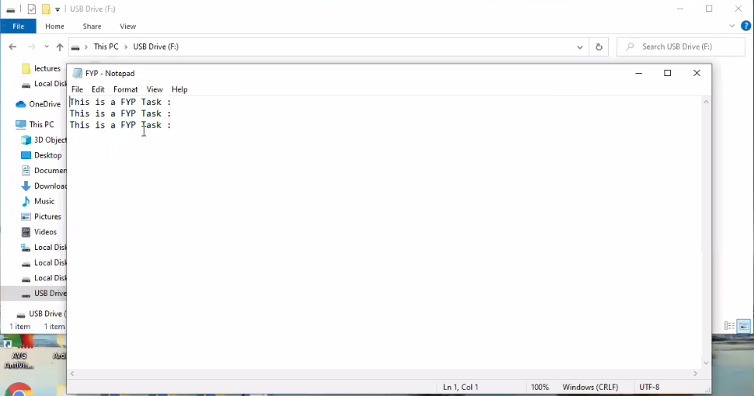
Result of SD card module
The file was successfully stored in the SD card

Slide 28
CONCLUSION
Testing Phase of the Sensors is completed.
All the Sensors are working perfectly fine.

Slide 29
What to do next?
Interfacing Sensors with Microcontroller (TMS320F28379D)
Interfacing Memory with Microcontroller (TMS320f28379D)
Testing of the System

Slide 30
Thank You !

