Slide 1


New Button Design
Experimental Design and A/B Testing
Ahmad Farhan Amin – Batch 12
pacmann.io
© 2022 – Pacmann AI

Slide 2
Outline
Project Goals
Hypotesis
Experiment Design
A/A Test
A/B Test
References

Slide 3
Project Goals & Hypotesis
Notes:
Transisi antar outline

Slide 4


Project Goals
This project is done with the purpose to prove that changing the download button to a new button design will encourage our customer to click more to our download link
Old Design
New Design

Slide 5
Hypotesis
We set this following to be our hypotesis
𝐻0: CTR 𝐶𝑜𝑛𝑡𝑟𝑜𝑙 >= CTR 𝑇𝑟𝑒𝑎𝑡𝑚𝑒𝑛𝑡
𝐻1:CTR 𝐶𝑜𝑛𝑡𝑟𝑜𝑙 < CTR𝑇𝑟𝑒𝑎𝑡𝑚𝑒𝑛𝑡
Null hypotesis determines that there would be no difference in CTR between Control and Treatment
H1 determines that Treatment would have higher CTR than control
Control = The old button that is currently being used
Treatment = A button that would direct our user to download our app

Slide 6
Experiment Design
Randomization Unit = User's IP Adress
Target Randomization Unit = Our website visitor, regardless the visitor logged in or not.
Sample Size
Confidence Level ( 𝛼 ) 5%,
Power ( 1−𝛽 ) 80%
Difference Control & Treatment ( 𝛿 ) 1%
Standar Deviasi populasi ( 𝜎) 0.125
We assign those numbers because we believe the number is appropriate to set for performing A/B test, due to the size of sample that would be needed, we decided to do the project for 2 Weeks
Sample needed per grup: 2500
Sample nededed total : 5000

Slide 7
A/A Test
Notes:
Transisi antar outline

Slide 8
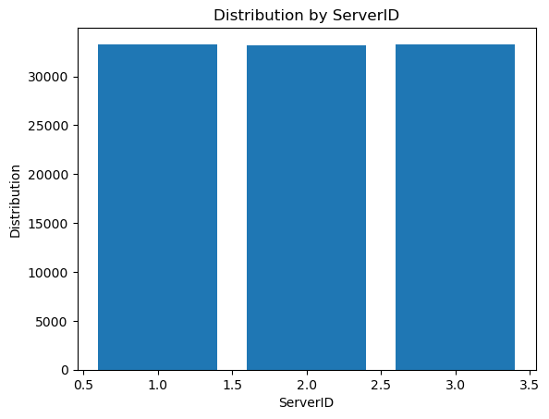
A/A Test
Grup Control A:
Control Visit: 2458
Observasi control: 24941
CTR Control: 0.0985525840984724
-----------------------------------
Grup Treatment A:
Control Visit: 2446
Observasi control: 24941
CTR Treatment: 0.09807144861874023
___________________________________
Confidence Interval : 95%
Z-statistic: 0.180
p-value: 0.572
Confidence Interval (Upper & Lower bounds) :
(-0.005707856057668389, 0.004745499250237824)

Slide 9
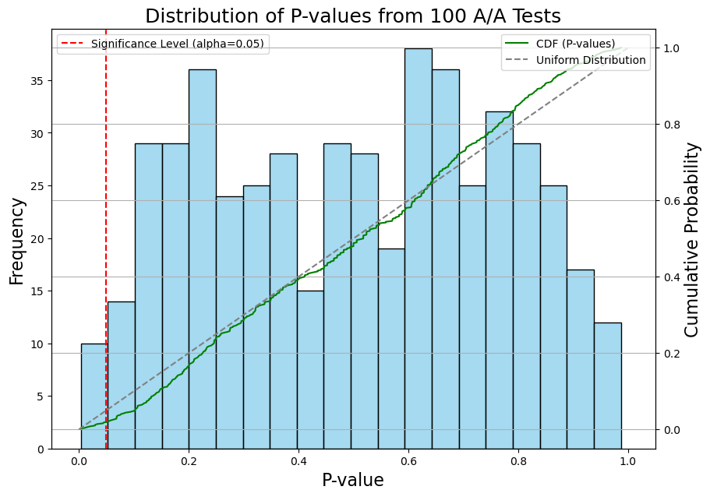
A/A Test (Simulation)
Perform kolmogorov smirnof (KS) test
P-value: 0.07376685360956925
Decision : Fail to Reject Null Hypothesis

Slide 10
A/B Test
Notes:
Transisi antar outline

Slide 11
Initial A/B test
Grup Control A:
Control Visit: 253
Observasi control: 2500
CTR Control: 0.1012
Grup Treatment B:
Control Visit: 221
Observasi control: 2500
CTR Treatment: 0.0884
Initial Test
Variant | Sessions | Clicks | Conversion Rate | Lift Over Baseline | P-Value | P(Best) | X-Loss
A | 2500 | 266 | 10.64% |  |  | 91.67% | 3.53%
B | 2500 | 213 | 8.52% | -2.12% | 0.995 | 8.33% | 13.89%

Slide 12
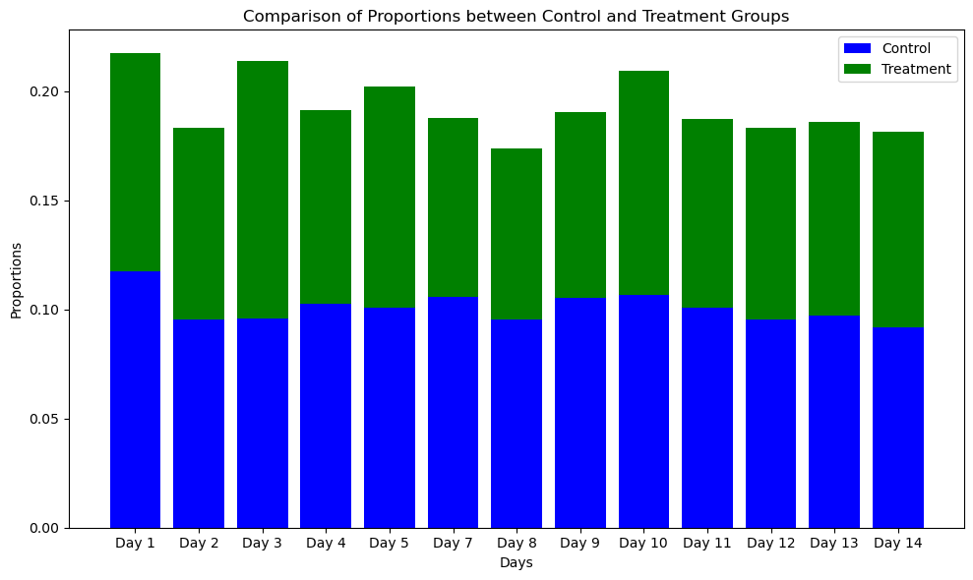
A/B test (14 Days)

Slide 13
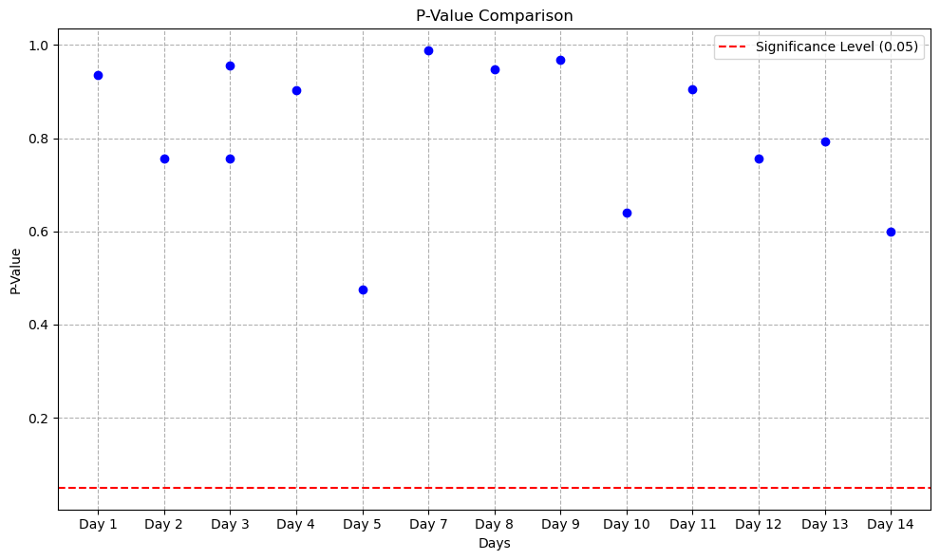
A/B test (14 Days)

Slide 14
A/B test (14 Days)

Slide 15
A/B test (14 Days)
Test Result |  | Session : 1500/day
Day | Control Visit | Control Rate | Treatment Visit | Treatment Rate | Z-Statistic | P-Value | Lift Over Baseline
1 | 159 | 10.60% | 130 | 8.67% | 1.795 | 0.964 | -1.93%
2 | 173 | 11.53% | 128 | 8.53% | 2.735 | 0.997 | -3.00%
3 | 152 | 10.13% | 147 | 9.80% | 0.305 | 0.620 | -0.33%
4 | 161 | 10.73% | 126 | 8.40% | 2.173 | 0.985 | -2.33%
5 | 159 | 10.60% | 153 | 10.20% | 0.359 | 0.640 | -0.40%
6 | 166 | 11.07% | 142 | 9.47% | 1.444 | 0.926 | -1.60%
7 | 156 | 10.40% | 128 | 8.53% | 1.746 | 0.960 | -1.87%
8 | 155 | 10.33% | 159 | 10.60% | -0.239 | 0.406 | 0.27%
9 | 154 | 10.27% | 139 | 9.27% | 0.923 | 0.822 | -1.00%
10 | 193 | 12.87% | 127 | 8.47% | 3.904 | 1.000 | -4.40%
11 | 152 | 10.13% | 148 | 9.87% | 0.243 | 0.596 | -0.27%
12 | 146 | 9.73% | 159 | 10.60% | -0.785 | 0.216 | 0.87%
13 | 162 | 10.80% | 147 | 9.80% | 0.901 | 0.816 | -1.00%
14 | 145 | 9.67% | 156 | 10.40% | -0.668 | 0.252 | 0.73%

Slide 16
Conclusion
Notes:
Transisi antar outline

Slide 17
Conclusion
Final Result (2 weeks)
Variant | Sessions | Clicks | Conversion Rate | Lift Over Baseline | P-Value | P(Best) | X-Loss
A | 21000 | 2233 | 10.63% |  |  | 100.00% | 0.00%
B | 21000 | 1989 | 9.47% | -1.16% | 0.995 | 0.00% | 12.38%
Grup Control A:
Control Visit: 2141
Observasi control: 21000
CTR Control: 0.10195238095238095
-----------------------------------
Grup Treatment B:
Control Visit: 1898
Observasi control: 21000
CTR Treatment: 0.09038095238095238
Confidence Interval : 95%
Z-statistic: 4.022
Confidence Interval (Upper & Lower bounds) :
(0.005933305845928513, 0.017212175748786793)
Decision : Fail to Reject Null Hypothesis

Slide 18
Thank You
Notes:
Transisi antar outline

Slide 19
Reference
Bayesian Calculator
A/A Testing
A/B Testing
Metrics

Slide 20
Recommendation
Things you need to upgrade

