Slide 1

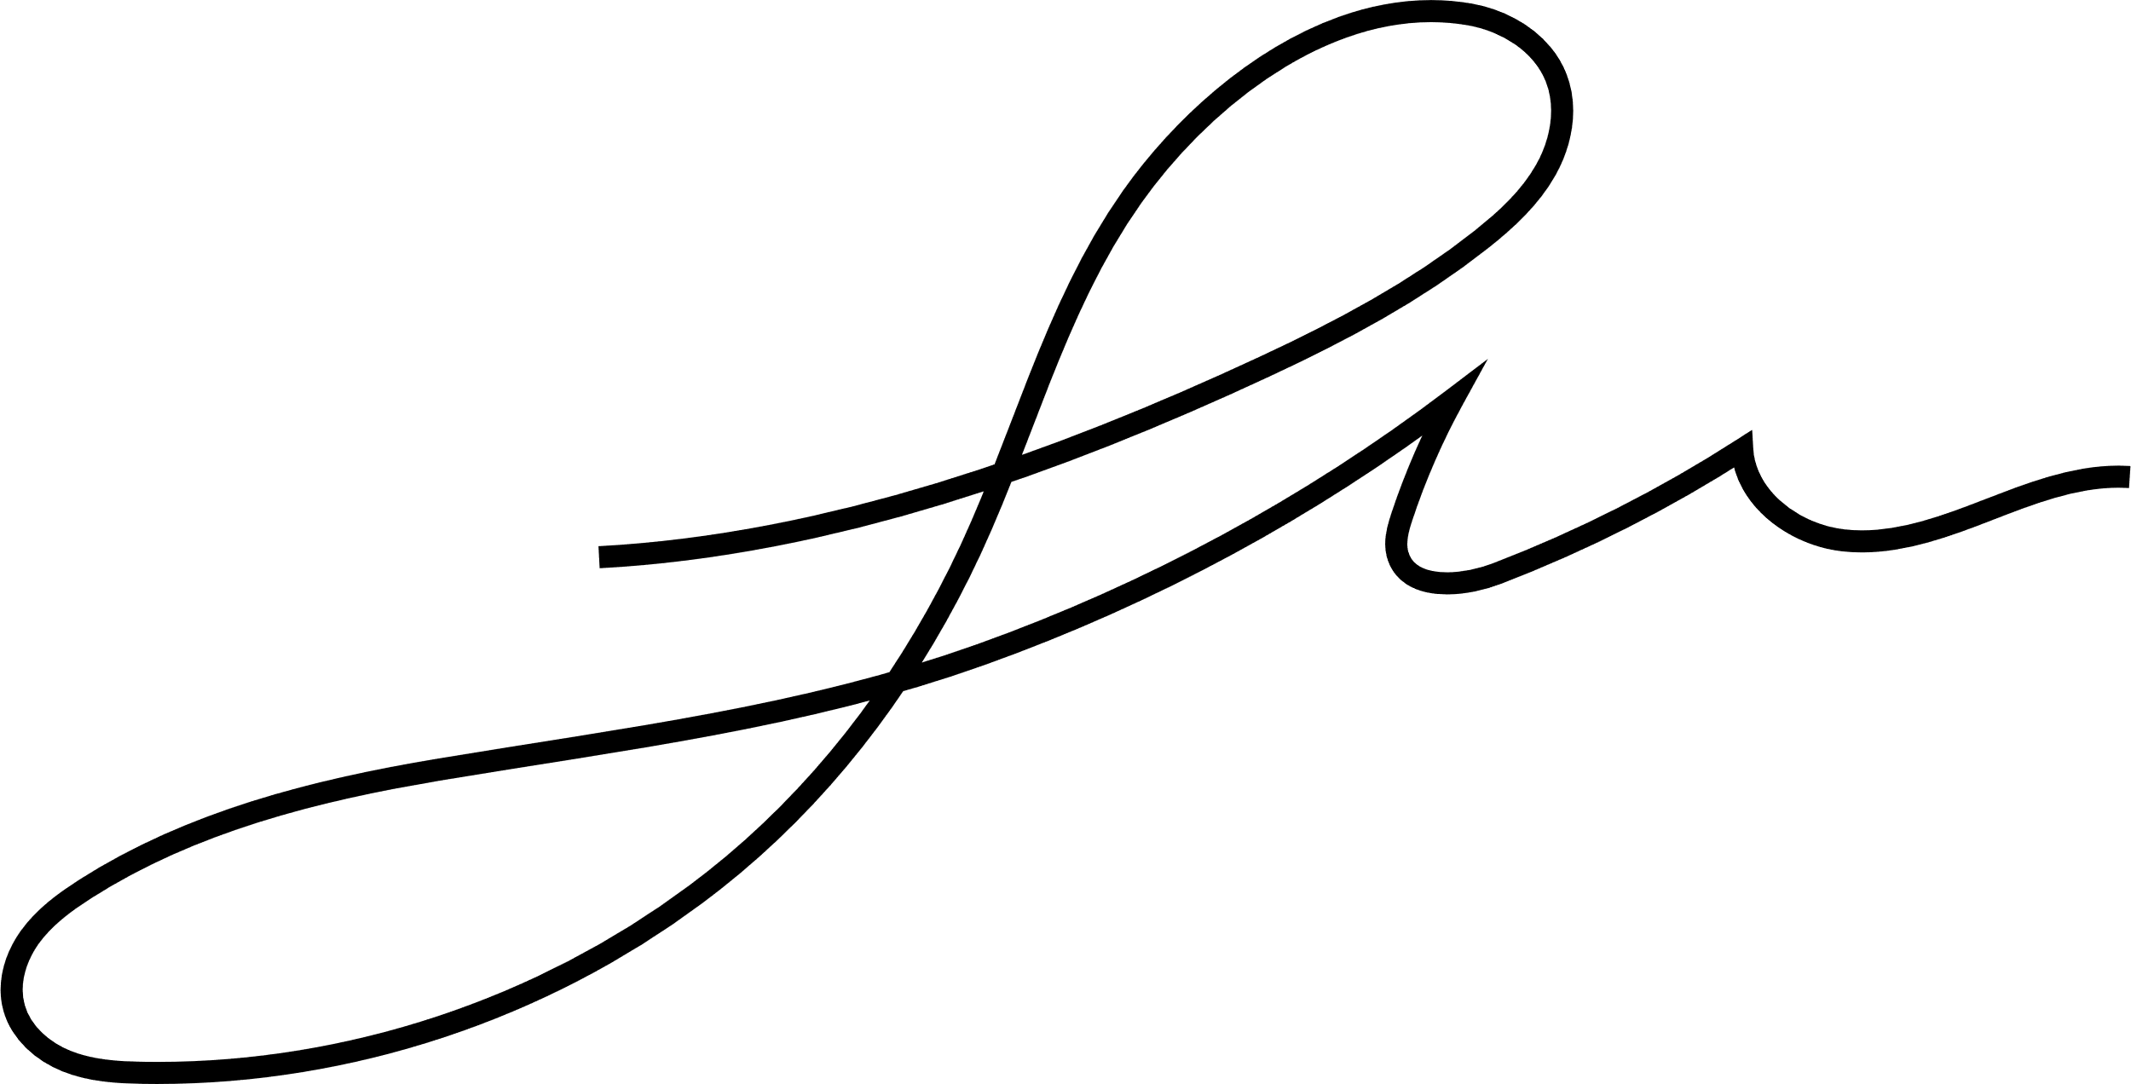



ZECSER BUSINESS LLP
17-06-2025
Offer Letter
To,
Aiswarya Sasidharan
Subject: Offer of Python Developer (Trainee)
Dear Aiswarya Sasidharan,
We are delighted to extend an offer for the position of Python Developer (Trainee) at Zecser Business LLP. Based on your interest, skills, and potential, we are confident in your ability to grow with us and contribute effectively.
1. Training Period:
Duration: 2 Months (Training Phase)
Nature: This will be a full-time, unpaid training focused on real-world Python project development, process adherence, and upskilling.
Start Date: 17-06-2025
Compensation: No stipend will be provided during this phase.
2. Probation period
Duration: 4 Months (Probationary Period)
Designation: Junior Python Developer
You will be contributing to live projects and be part of the development team during this time.
Salary Range: 8000 - Above
+91 7025661998
recruitments@zecser.com
Heiley Offices, Kakkanad, Kochi

Slide 2
ZECSER BUSINESS LLP
3. In-House Employment Opportunity:
Upon successful completion of the 2-month training and 4-month probation period (total 6 months), and subject to a satisfactory performance evaluation, you will be eligible for a basic salary and formally appointed as a full-time Junior Python Developer
A new employment letter will be issued with revised terms and conditions, salary structure, and benefits applicable as a regular employee.
4. Working Conditions
Work Hours: Full-time engagement, Monday to Friday (timings as per company policy).
Location: Remote
You are expected to maintain discipline, follow project deadlines, and collaborate actively with the team.
5. Termination Policy
Either party may terminate this agreement with 7 days' notice during the training or probation period.
The company reserves the right to terminate without notice in the event of misconduct, non-performance, or breach of policy.
+91 7025661998
recruitments@zecser.com
Heiley Offices, Kakkanad, Kochi

Slide 3

ZECSER BUSINESS LLP
6. Document Submission
Please submit the following documents along with your acceptance of this offer:
Copy of your educational and relevant certificates
Government-issued ID proof
Passport-size photograph
We are excited to have you join us and look forward to a successful journey together.
Warm regards,
Archana D
HR Manager
Zecser Business LLP
Candidate Acceptance
I, Aiswarya Sasidharan accept the offer for the position of Python Developer
(Trainee) at Zecser Business LLP, under the terms and conditions mentioned above.
Signature: ___________________________
Date: ___24-06-2025____________________________
+91 7025661998
recruitments@zecser.com
Heiley Offices, Kakkanad, Kochi

