Slide 1
Enhancing Performance Insights: A Data-Driven Approach

Slide 2
Introduction
Introduction to QuantumLeap Innovations: Welcome to our presentation on "Enhancing Performance Insights: A Data-Driven Approach" by QuantumLeap Innovations. We are a dynamic and forward-thinking firm dedicated to pushing the boundaries of innovation and excellence in the echnology.
Project Objectives: Today, we embark on a journey to unlock the full potential of our organization's performance. Our primary objective is to harness the power of data to elevate our success in the current year. We are committed to providing you with valuable insights that will drive QuantumLeap Innovations to new heights.

Slide 3

Data Sources and Tools Used
Data Sources: Our analysis is grounded in reliable data sources. We primarily utilized data from our SQL server, which serves as the backbone of our analysis. This internal data provides a wealth of information about our operations.
Additional Sources: In addition to our SQL server, we also considered external reputable data sources to complement our analysis. These external sources [mention the specific sources, if any, e.g., industry reports, government data] enriched our insights.
Technical Tools: To ensure comprehensive analysis and reporting, we employed the following technical tools:
SQL (Structured Query Language): SQL was pivotal for data handling, extraction, and query execution. It allowed us to extract and manipulate data efficiently from our SQL server.

Slide 4

Python: Python served as our data analysis and manipulation tool. Its versatility enabled us to perform advanced analytics and preprocess data effectively.
Business Intelligence Tool: Excel was employed for data visualization and presentation. It enabled us to create compelling reports and visualizations.

Slide 5
Data Extraction and Preprocessing
Data Extraction: The foundation of our analysis was laid through meticulous data extraction. We retrieved essential datasets from our SQL server, ensuring we had access to up-to-date and accurate information.
Data Cleaning: Clean, high-quality data is paramount. To achieve this, we conducted a thorough data cleaning process. This involved identifying and handling missing values, outliers, and inconsistencies. We wanted our analysis to be based on reliable data.
Data Transformation: Data often requires transformation to make it suitable for analysis. We performed data transformations such as converting data types, scaling, and encoding categorical variables.
Data Integration: Integration of data from multiple sources was a critical step. We harmonized data from external sources with our internal data to create a unified dataset.
Data Sampling: To ensure efficiency in analysis, we employed data sampling techniques when necessary. This allowed us to work with manageable subsets of the data while preserving representativeness.

Slide 6
Data Analysis and Key Findings
Sales Analysis: Our analysis delved into monthly sales trends over time, revealing patterns and seasonality. We identified opportunities for demand optimization and inventory management.
Employee Performance: By assessing employee sales performance, we recognized top performers and areas for improvement. Insights were gained into motivating and incentivizing our workforce.
Customer Analysis: Analyzing customer registration and spending behavior helped us understand customer segments and tailor marketing strategies for enhanced engagement and loyalty.

Slide 7
Cont..
Product Performance: We assessed product performance, identifying top-performing products and categories. This information guides product promotion and stocking decisions.
Departmental Insights: Our analysis included department-wise employee counts and average salaries. We sought to ensure equity and efficiency across departments.

Slide 8
Recommendations for Improving Performance
Short-Term Recommendations:
Optimize inventory management to reduce carrying costs.
Launch targeted promotions for top-performing products.
Implement employee recognition programs to boost motivation.
Long-Term Recommendations:
Develop customer segmentation strategies for personalized marketing.
Establish continuous employee training and development programs.
Enhance the online shopping experience to increase customer retention.

Slide 9
Visualizations
Visualizations: We have generated a variety of visualizations, including line charts, bar graphs, histograms, and pie charts, to illustrate key findings and support decision-making.

Slide 10
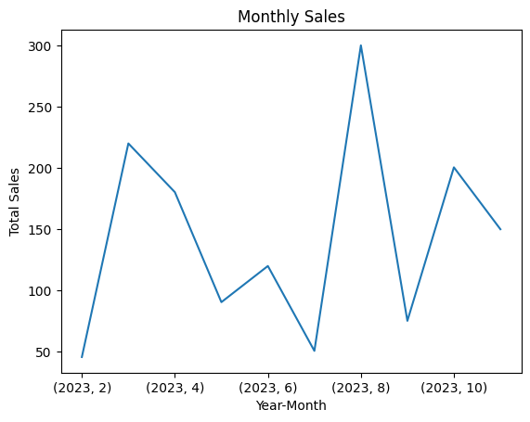
Monthly Sales Trends Over Time

Slide 11
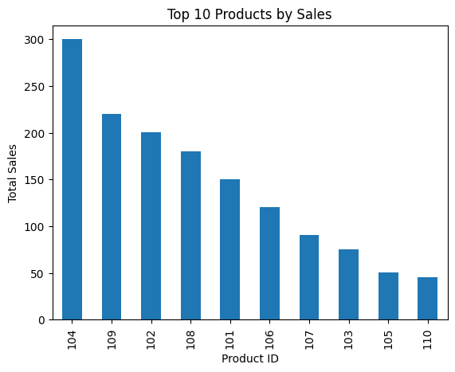
Top Performing Products by Sales

Slide 12
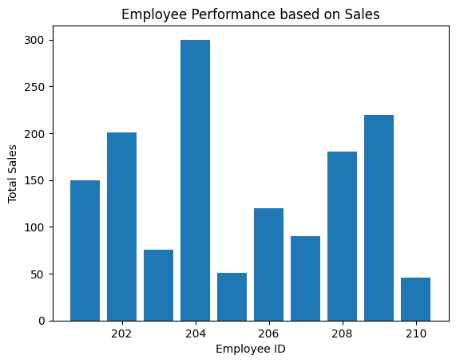
Employee Performance based on Sales

Slide 13
Conclusion and Potential Impact
Recap of Key Points: In conclusion, our analysis revealed significant insights, from sales trends to employee performance and customer behavior. We have identified areas for improvement and growth.
Potential Impact: The implementation of our recommendations has the potential to enhance sales, employee satisfaction, and customer loyalty. It can lead to improved operational efficiency and cost control.

Slide 14
Acknowledgment of Limitations
Data Quality: We acknowledge that data quality plays a crucial role. Despite rigorous preprocessing, there may still be data inaccuracies or missing values.
Data Availability: Our analysis primarily relied on internal data sources, and limited access to external data sources may have constrained our insights.
Time Constraint: The analysis was conducted within a specified timeframe, which may have limited the depth of exploration and refinement of recommendations.
Assumptions: Some recommendations are based on assumptions and may require further validation.

Slide 15
Next Steps and Future Areas of Investigation
Future Steps: Consider real-time data integration for dynamic decision-making. Explore advanced customer segmentation and employee analytics.
Competitor Benchmarking: Analyze industry best practices and identify opportunities for differentiation.
Customer Feedback Analysis: Dive deeper into customer feedback data to enhance product and service improvements.
Supply Chain Optimization: Explore supply chain optimization to reduce costs and improve product availability.

Slide 16
Q&A Session
Open for Questions: We invite your questions and discussions. Please feel free to ask about any aspect of our analysis, findings, or recommendations.
Engage with Our Team: Our project team members are here to provide insights and clarify any queries you may have. Let's engage in a fruitful discussion.

Slide 17
The End

