Slide 1
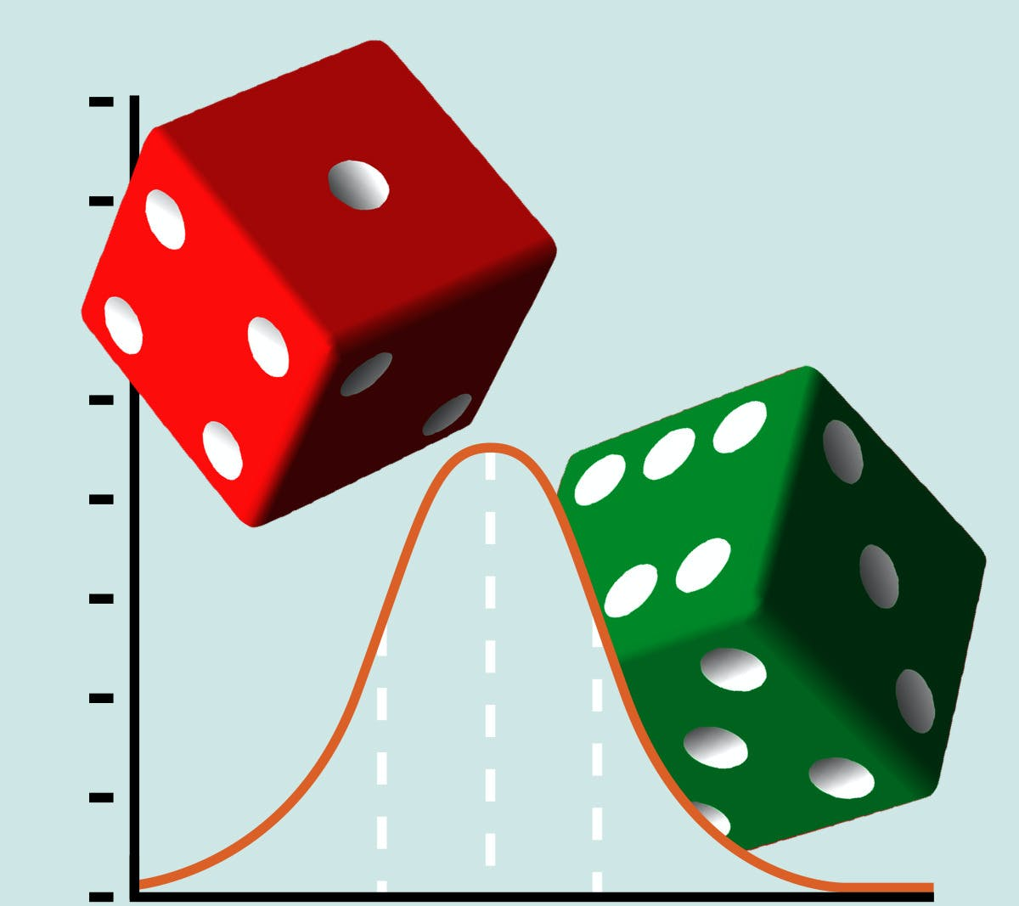
Probability
Submitted by:
Shahid sattar(2335)
Aliza Nawaz(2338)
FARHAN HAIDER(2340)
MUHAMMAD UZAIR(2345)
Awais Ahmed(2353)

Slide 2


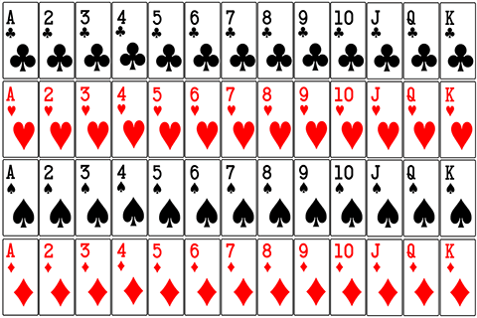
Introduction
Probability is a branch of mathematics that deals with the occurrence of a random event.
EXAMPLE

Slide 3
What is Sample Space?
Sample space is an organized listing of all possible outcomes from an experiment.
They are sometimes referred to as sample points.
The sample space of an experiment is denoted by “S”.
Example:
The simplest experiment to which probability applies is one with two possible outcomes.
One such experiment consists of examining a single bulb from a box of 30 pieces to see whether it is defective or not.

Slide 4
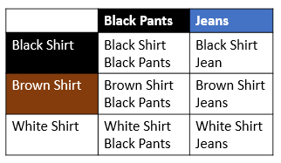
Common Ways To Organize A Sample Space
1. Listing the elements:
For example, when we roll a die, there are six possible outcomes we list the elements as: {1,2,3,4,5,6}.
2. Using an outcome table:
A table of outcomes is a table where the first row and first column represent the possible outcomes in each event. For instance, the first column would be each shirt, and the first row would be each pair of pants. Then we simply fill in the table with the possible outcomes.

Slide 5
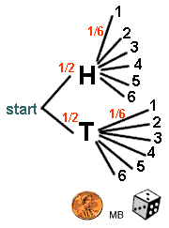
3. Drawing a tree diagram.
A tree diagram is a drawing with "line segments" pointing out all of the different possible "paths" for the outcomes.
For example:
The sample space for tossing one coin and rolling one die in tree diagram is shown below:

Slide 6
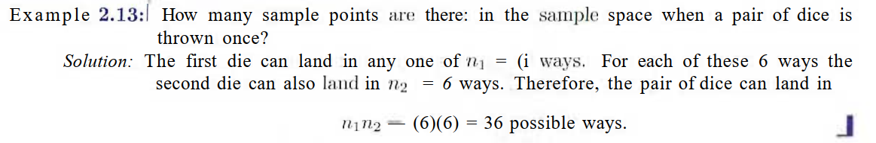
Example

Slide 7
Events
Events in probability can be defined as a set of outcomes of a random experiment.
The sample space indicates all possible outcomes of an experiment.
Thus, events in probability can also be described as subsets of the sample space.
Example: Suppose a fair die is rolled. The total number of possible outcomes will form the sample space and are given by {1, 2, 3, 4, 5, 6}.
Let an event, E, be defined as getting an even number on the die.
Then E = {2, 4, 6}.
Thus, it can be seen that E is a subset of the sample space and is an outcome of the rolling of a die.

Slide 8
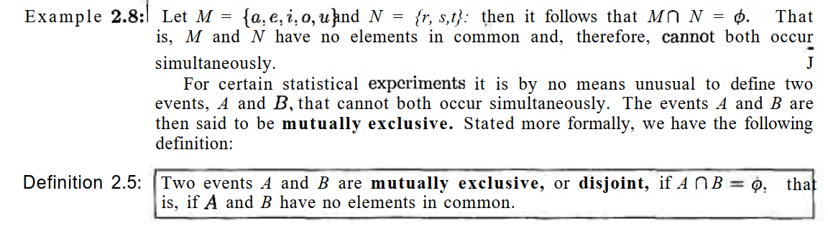
Mutually Exclusive Events
Events that cannot occur at the same time are known as mutually exclusive events.

Slide 9
WHAT IS BAYE’S THEOREM
In statistics and probability theory, the Bayes’ theorem is a mathematical formula used to determine the conditional probability of events.
Essentially, Bayes’ theorem describes the probability of an event based on prior knowledge of the conditions that might be relevant to the event.
Bayes’ rule is used on various occasions including medical testing for a rare disease.

Slide 10
When We Use Baye’s Theorem?
suppose that a product was randomly selected and it is defective.
What is the probability that, this product was made by machine P,?
Questions of this type can lie answered by using the following theorem, called Bayes' rule

Slide 11
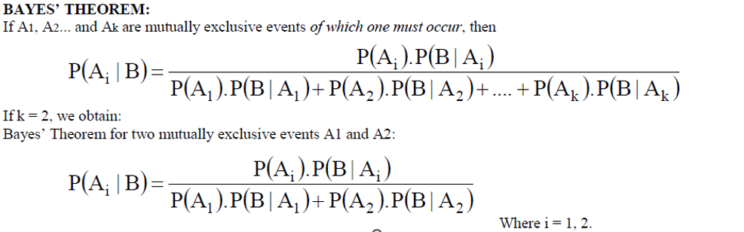
Formulas

Slide 12
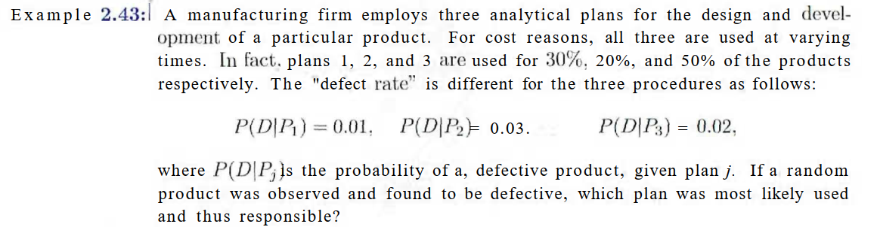
Examples

Slide 13
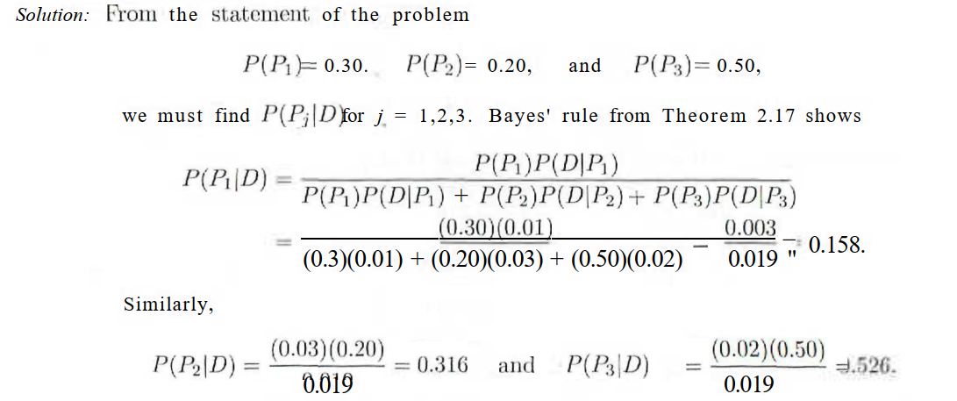

Slide 14
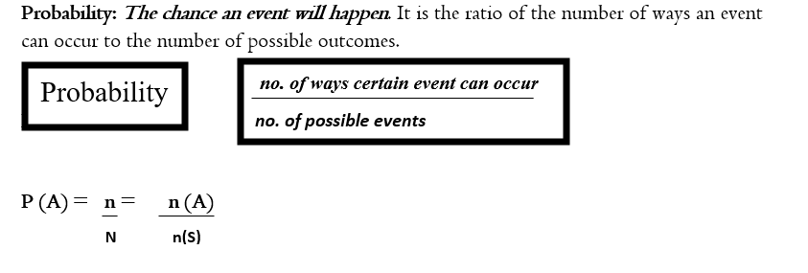
Probability of an Event

Slide 15
Conditions
A probability is a number ranges from 0 to 1.
0 for an event which cannot occur.(Impossible)
1 for an event which can occur.(Certain)
0 ≤ P (E) ≤ 1.
Given the two events "A" and "B",
P (A) > P (B)
If and only if event "A" is more likely to occur the event "B".

Slide 16
Example
Find the probability of getting 53 Sundays in a leap year.
Solution:
A leap year has 366 days. So, it has 52 weeks and 2 days.
So, 52 Sundays are assured. For 53 Sundays, one of the two remaining days must be a Sunday.
For the remaining 2 days we can have
Sample space=S= (Sunday, Monday), (Monday, Tuesday), (Tuesday,
Wednesday), (Wednesday, Thursday), (Thursday, Friday),
(Friday, Saturday), (Saturday, Sunday).

Slide 17
total number of possible outcomes =n(s) = 7.
Number of favorable outcomes for the event E= n(A) = 2
[ (Sunday, Monday), (Saturday, Sunday)].
Probability=P(A) = n(A)/n(S) = 2/7

Slide 18
What Is Conditional Probability?
Conditional probability is the probability of one event occurring with some relationship to one or more other events.
Conditional probability is defined as the likelihood of an event or outcome occurring, based on the occurrence of a previous event or outcome.
Conditional probability is calculated by multiplying the probability of the preceding event by the updated probability of the succeeding, or conditional, event.

Slide 19
Examples
Conditional probability could describe an event like:
Event A is that it is raining outside, and it has a 0.3 (30%) chance of raining today.
Event B is that you will need to go outside, and that has a probability of 0.5 (50%).
A conditional probability would look at these two events in relationship with one another, such as the probability that it is both raining and you will need to go outside.
Conditional probability is used in many areas, in fields as diverse as calculus, insurance, and politics.
However, this fact is conditional on many things, such as the probability of rain clouds forming.

Slide 20
Key Takeaways
Conditional probability refers to the chances that some outcome occurs given that another event has also occurred.
It is often stated as the probability of B given A and is written as P(B|A), where the probability of B depends on that of A happening.
Conditional probability can be contrasted with unconditional probability.
Probabilities are classified as either conditional, marginal, or joint.
Bayes' theorem is a mathematical formula used in calculating conditional probability.

Slide 21
Formula
The formula for conditional probability is:
P(B|A) = P(A and B) / P(A)
which you can also rewrite as:
P(B|A) = P(A∩B) / P(A)

Slide 22
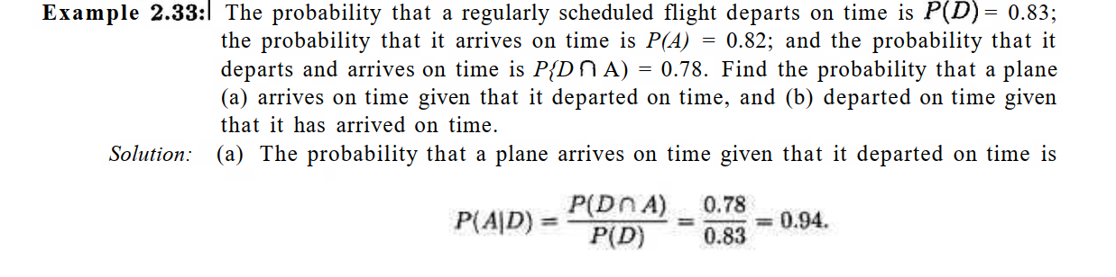
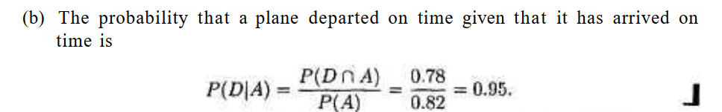

Slide 23
Conclusion
The purpose of probability can be thought of as its use informally in our daily lives to plan or make decisions.
Formal probability theory is a fundamental tool used by researchers, healthcare providers, insurance companies, stockbrokers, and many others to make decisions in contexts of uncertainty.
Like on a day in which the probability of precipitation was forecast at 80 percent, but skies were sunny all day, you also have to consider that there was a 20 percent chance that it wouldn’t rain. Still, you made a wise decision to take an umbrella based on the probability you were given.

Slide 24
Thank you

