Slide 1
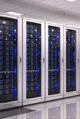
Introduction
Name : Farhan Ishaq Choudhary Roll No. : mscs23024

Slide 2
Project Overview
File System
Distribute Cloud Computing
Storage and Snapshot
Microservices

Slide 3
Problem Statement
Improve Performance
Improve flexibility
Add More Storage and remove old
Data Storage Lose threat reduction
Load Balance

Slide 4
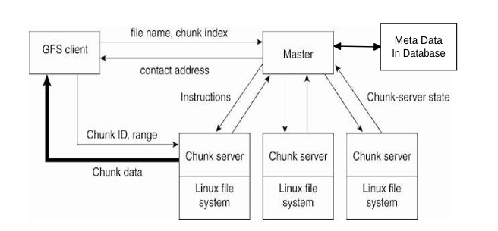
Solution

Slide 5
Development Process
Architecture of file system
Network in Systems
Client Interface
Rest Apis
Technology

Slide 6
Results and Feedback
Improvement in performance
Flexibility in Hardware Resource
Storage Security and lose minimization
Hardware Cost reduction

