Slide 1
THE HIVE
Presented by:
Shahriar Fahim(1805113)
Azizur Rahman Anik(1805115)

Slide 2
INTRODUCTION
THE HIVE is a Security Incident Response Platform
It is a collaborative platform for the security analysts (like github )
This tool can be integrated with other security tools (such as CORTEX and MISP) to automate the process of analyzing the security incidents more accurately and efficiently
Purpose of using this Tool: To detect any security incident quickly and analyze that incident in a collaborative platform to solve any security issue efficiently

Slide 3
KEY COMPONENTS
Type of users : Admin and user
Organization : Admin can create an organization and create users .In an organization there are multiple users who deal with a particular type of security incident
Case : A user of an organization can create a case for a particular incident
Task : For each case there can be one or more task to solve that particular incident .each task can assingned to one or more user(like github issue)
Observables : Elements of a case on which the user (security analysts) will report their analysis.(e.g. IP address , hash of malicious files )

Slide 4
TWO IMPORTANT FEATURE
Creating a case for a security incident,setting observables ,assign tasks to users
Analyzing an observable of a case using CORTEX

Slide 5
Cortex
An integral part of the platform TheHive
Serves as an analysis and orchestration engine
Automate the execution of various analysis tasks and security operations related to incident response.
Makes api calls to various threat intelligence feeds and collects the results.

Slide 6
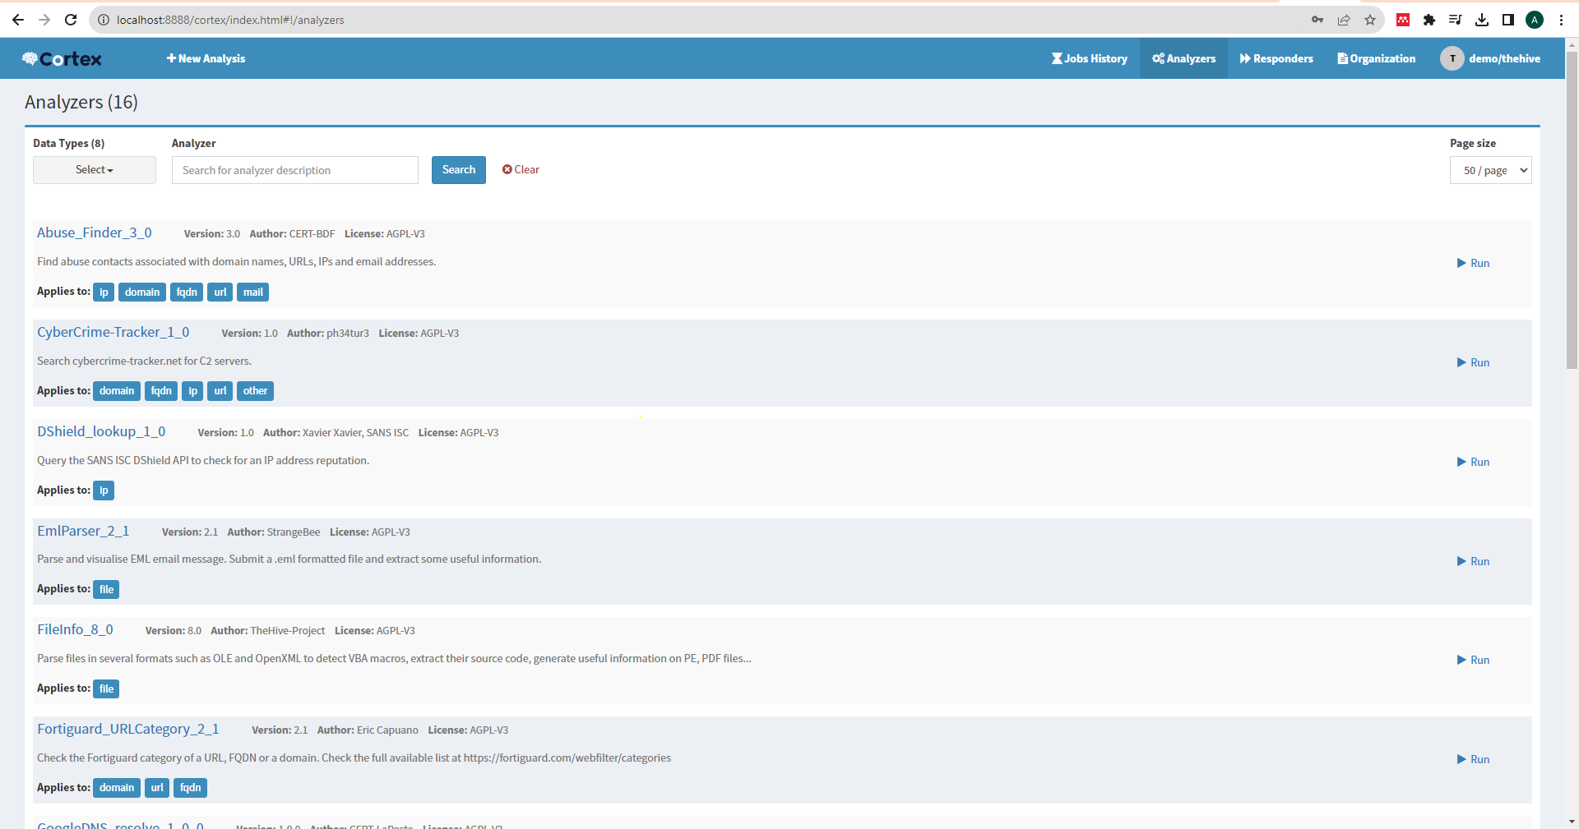
Cortex Analyzers

Slide 7
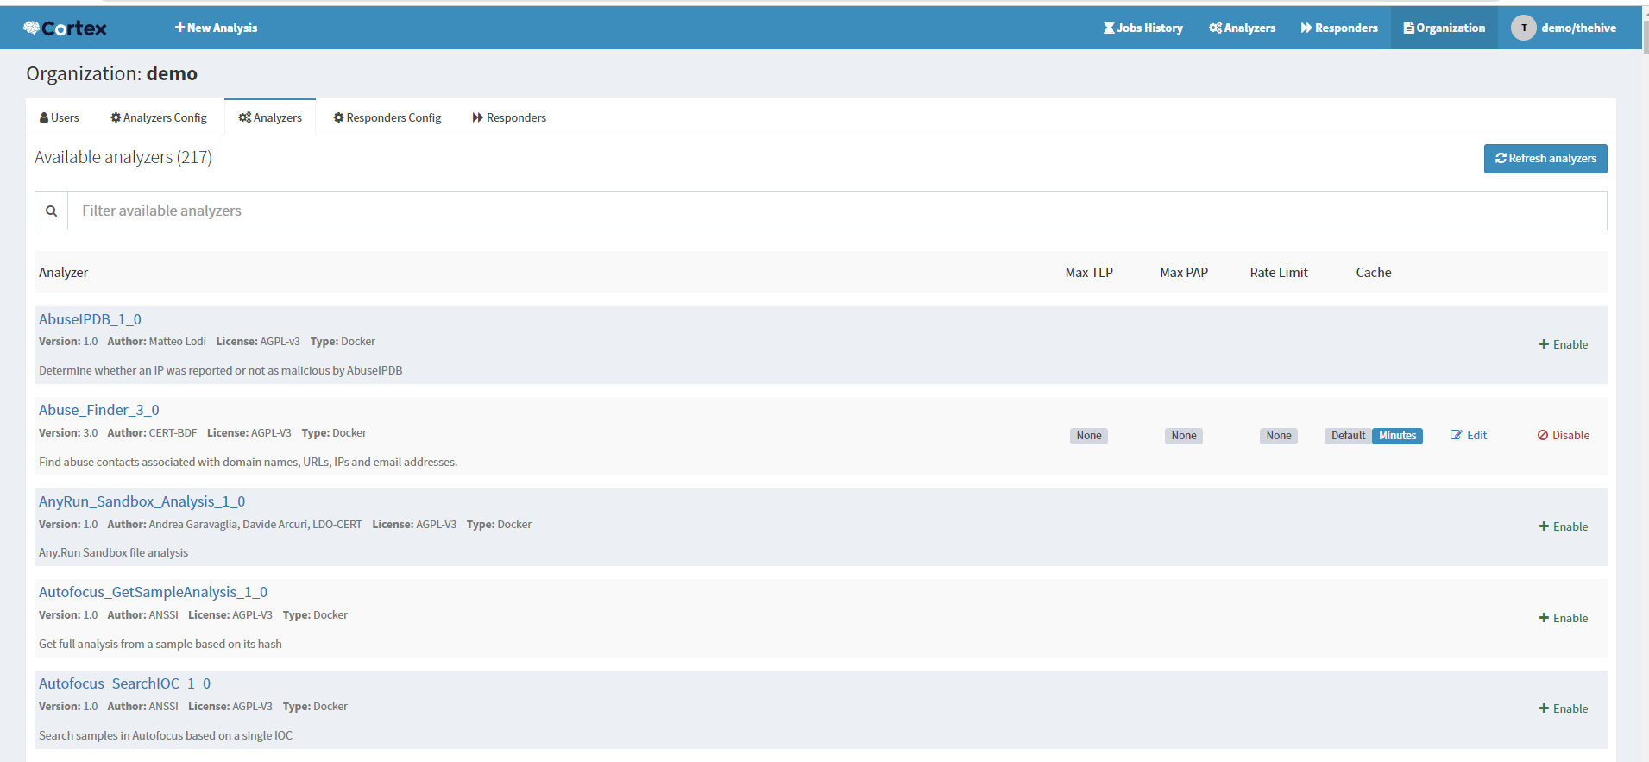
Enabling an Analyzer

Slide 8
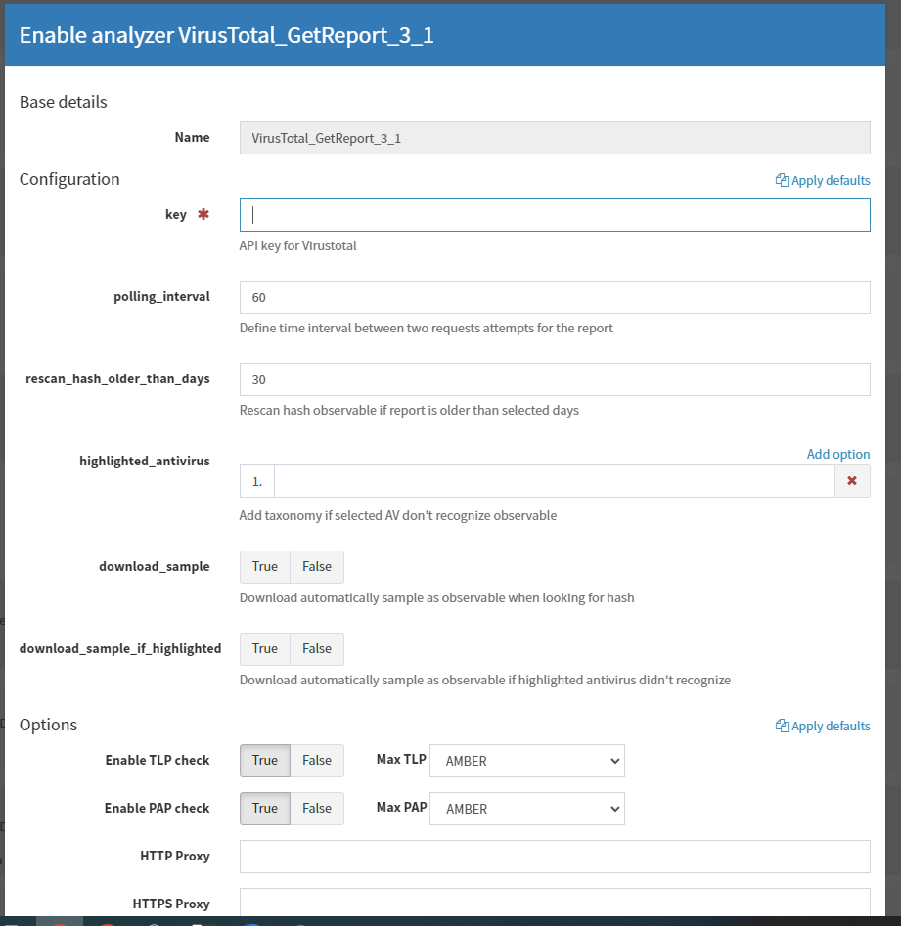
Enabling an Analyzer

Slide 9
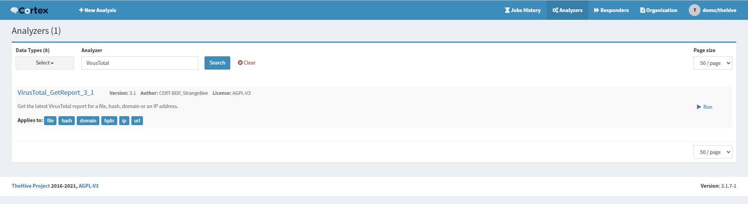
Enabling an Analyzer

Slide 10
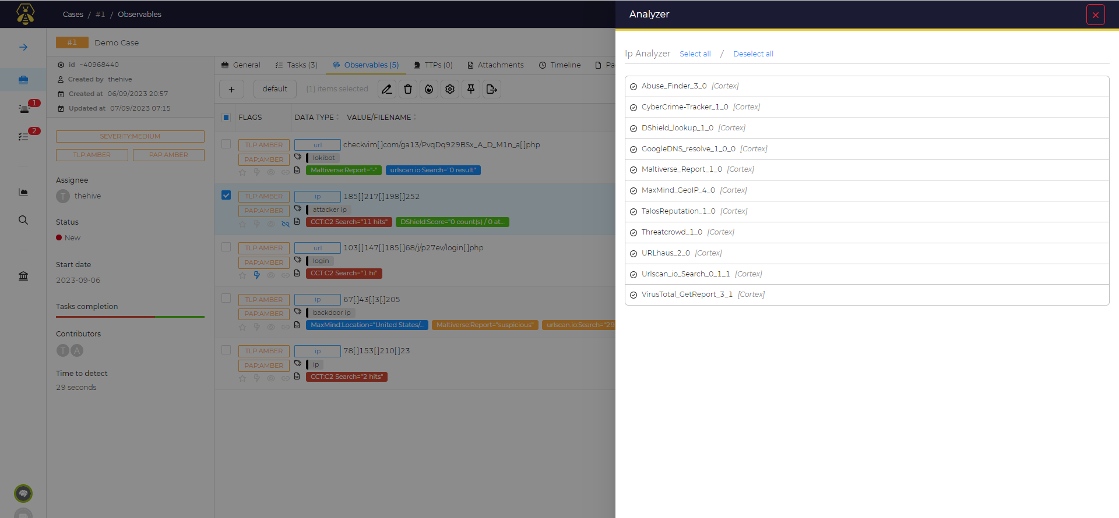
Enabling an Analyzer

Slide 11
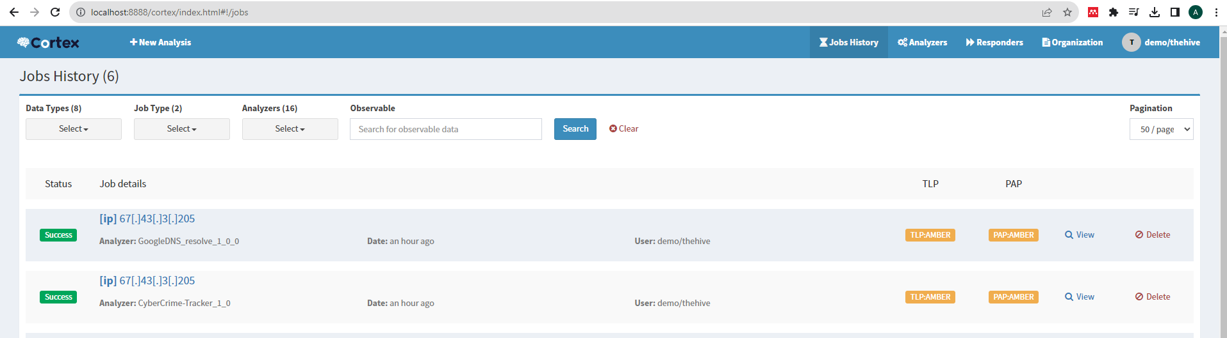
How To Use Cortex in TheHive
The training VM has cortex integrated with TheHive and an user and an admin account is provided
Otherwise, one can install it manually following the commands from the documentation.

Slide 12
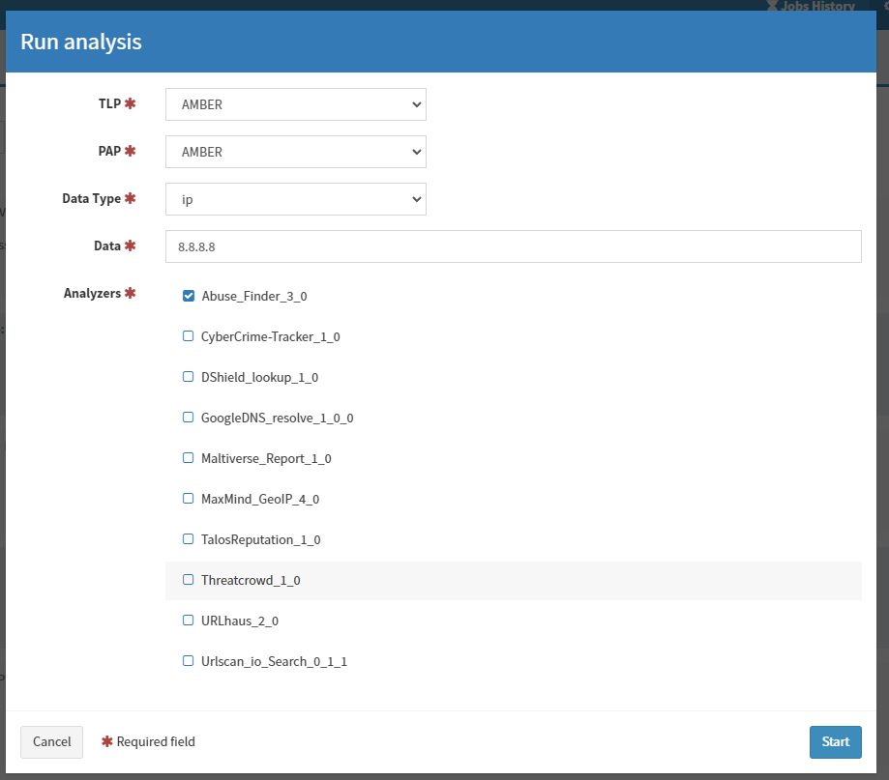
Running an Analyzer from Cortex

Slide 13
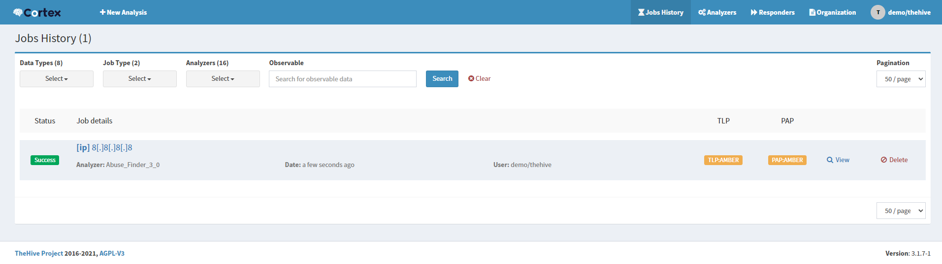
Running an Analyzer from Cortex

Slide 14
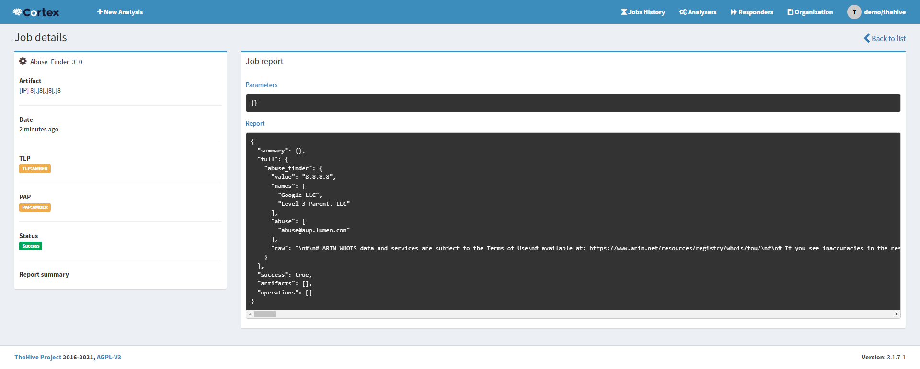
Running an Analyzer from Cortex

Slide 15
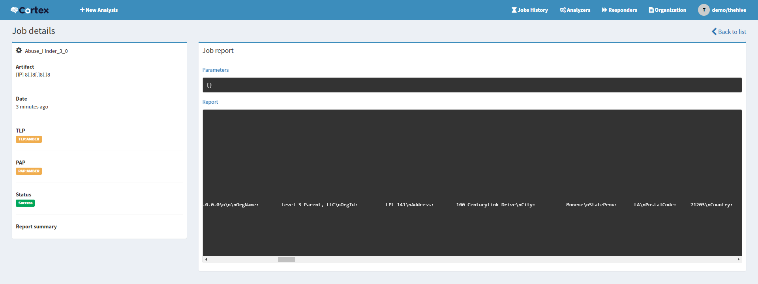
Running an Analyzer from Cortex
Problem with raw results: Not so human readable.
Solution: Add templates from admin panel of TheHive

Slide 16
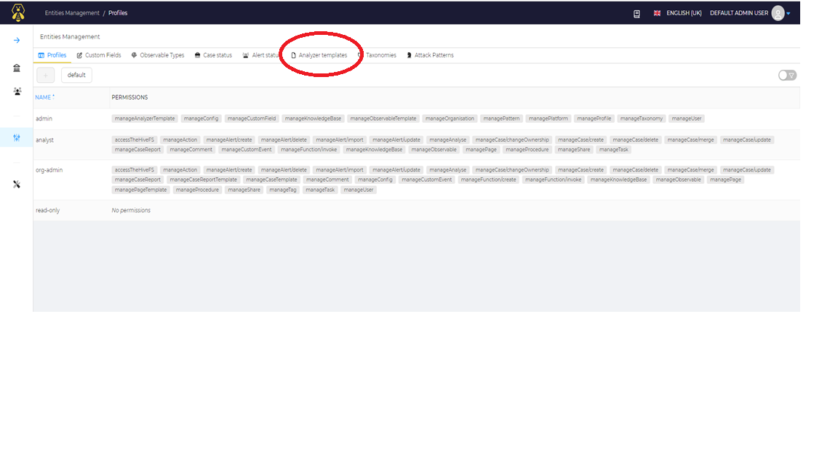
Adding Templates from TheHive

Slide 17
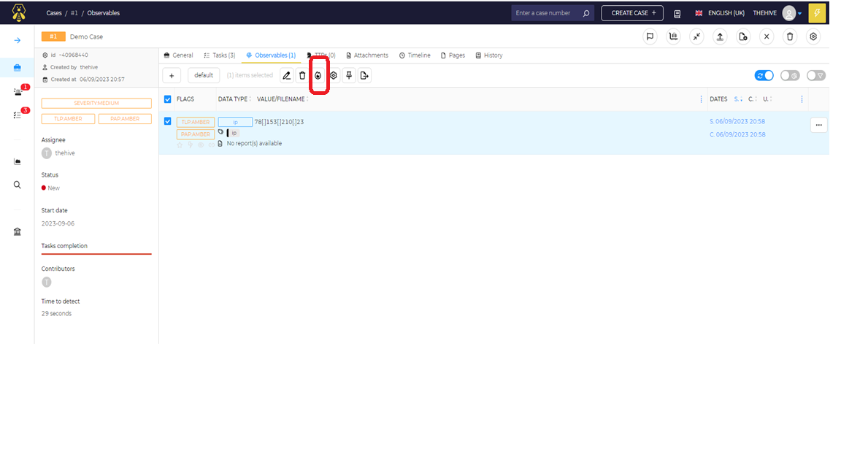
Analyzing Observables from TheHive
To analyze an observable from Hive with Cortex, select an observable first and go to analyzer.

Slide 18
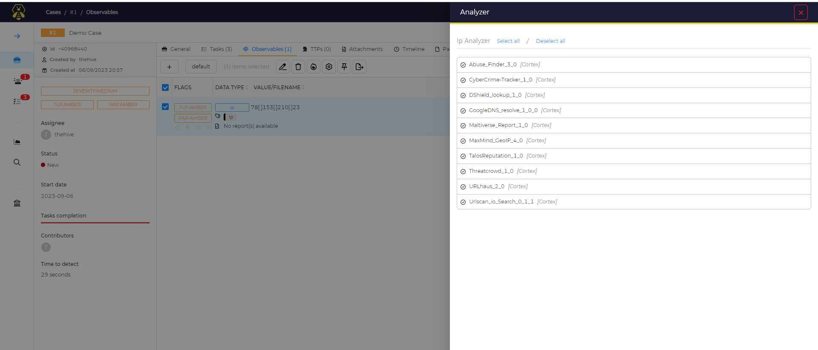
Analyzing Observables from TheHive

Slide 19
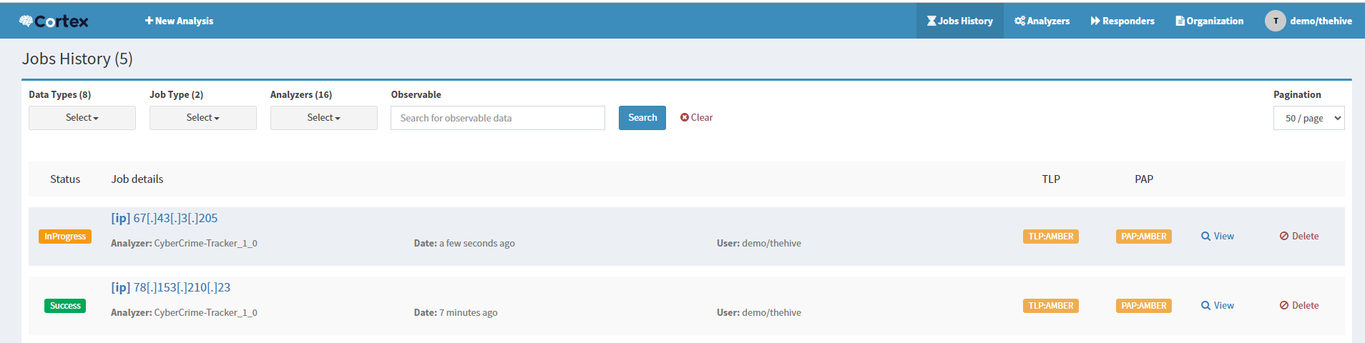
Analyzing Observables from TheHive
Running an analyzer on an observable automatically fires the analyzer from the cortex
The Analysis Report can be found in both Cortex and Hive

Slide 20
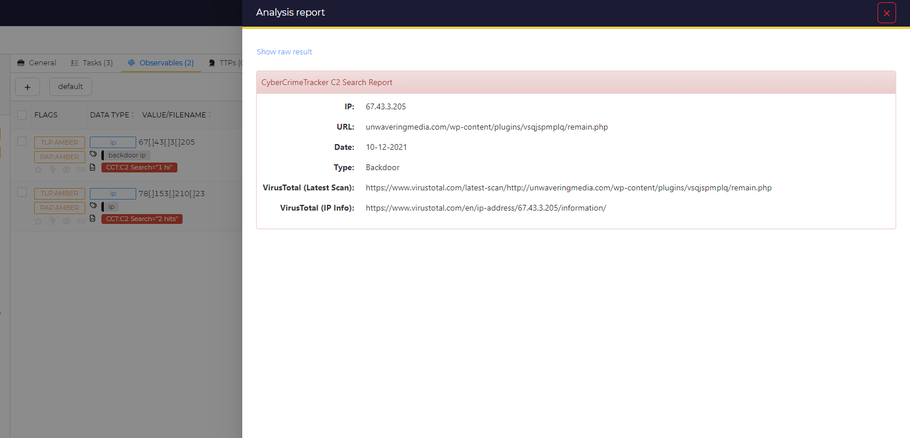
Analyzing Observables from TheHive
Adding templates make the analysis report more human readable

Slide 21
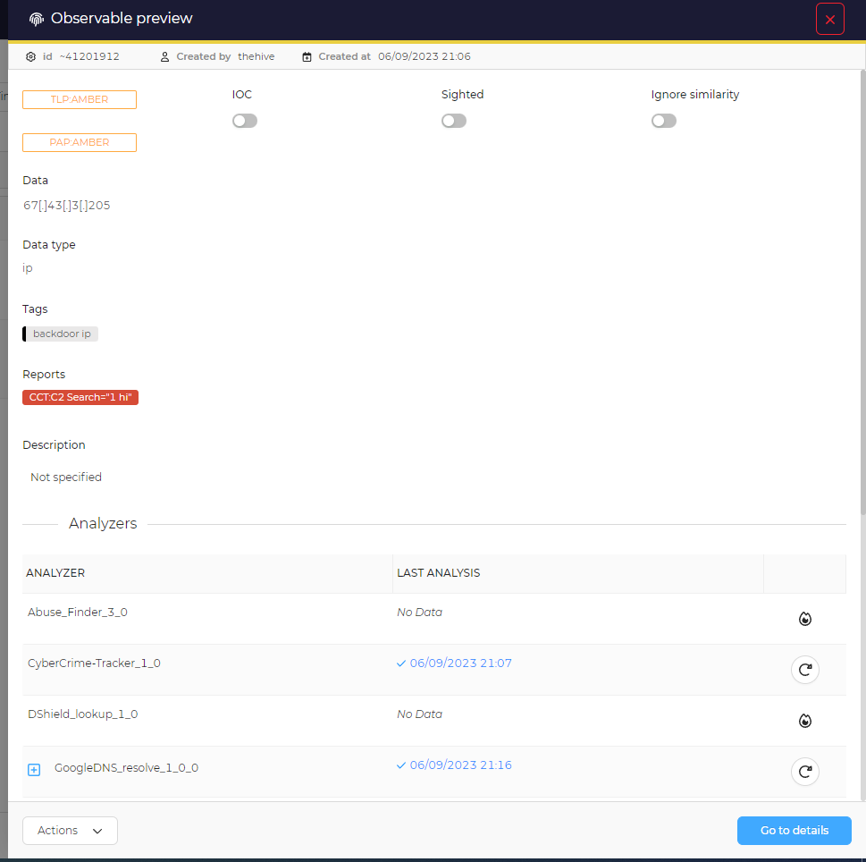
Analyzing Observables from TheHive
All the analyzing history can be found in the “Preview” section of observables.

