Slide 1

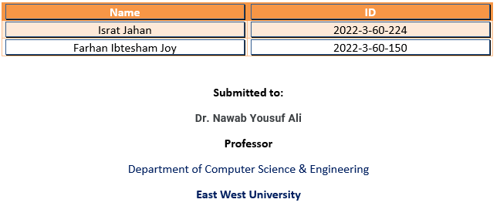
A Presentation on a dynamic cpu benchmarking tool
Course code: CSE 360
Course name: Computer Architecture
Section: 07 (Fall 24)
Presented by:

Slide 2


Slide 3

Learnings :
Introduction to CPU Benchmarking
Project Overview
Tools and Technologies
CPU Information Extraction
Benchmarking Process
Visualization of Results
Future Enhancements
Conclusion

Slide 4

Introduction To CPU BENCHMARKING
Performance Measurement
System Comparison
Optimization and Decision-Making

Slide 5
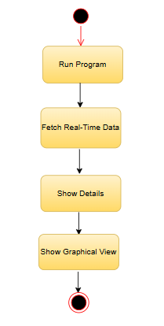
Project Overview
Purpose :
To get detailed info
To get idea of power transmission Capability
To know place of improvement
FIG: Project Overview

Slide 6





Tools And Technologies
Python
Matplotlib
Platform
Psutil
Google Co-Lab

Slide 7
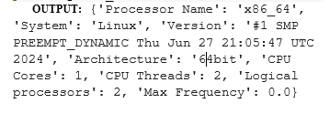

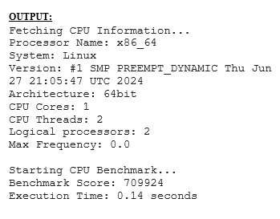
CPU INFORMATION EXTRACTION
Figure: Real time calculation
Figure: Real time data fetched
Figure: Realtime CPU information

Slide 8
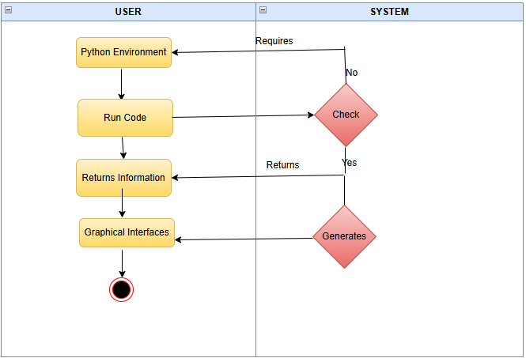
Benchmarking Process
OS Information
Hardware Information
Python Version Information
System Monitoring
Process Management
Cross platform compatibility
Data Visualization
Customized graphs
Integration with other libraries

Slide 9
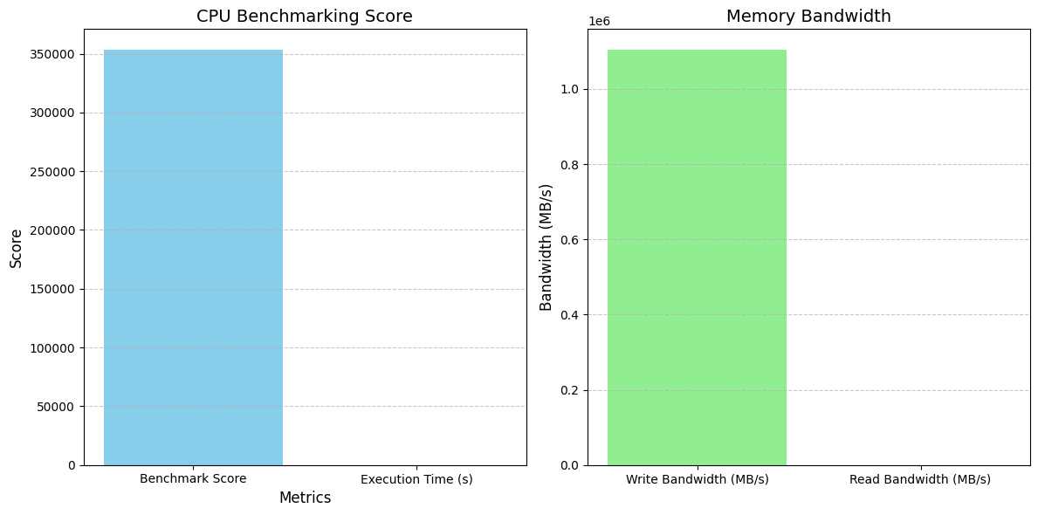
Visualization Of Results

Slide 10
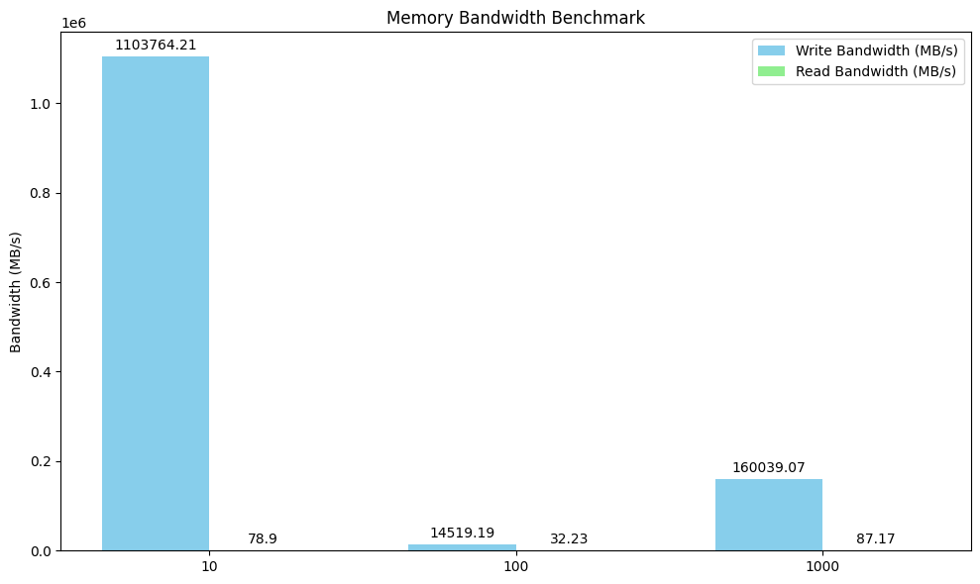
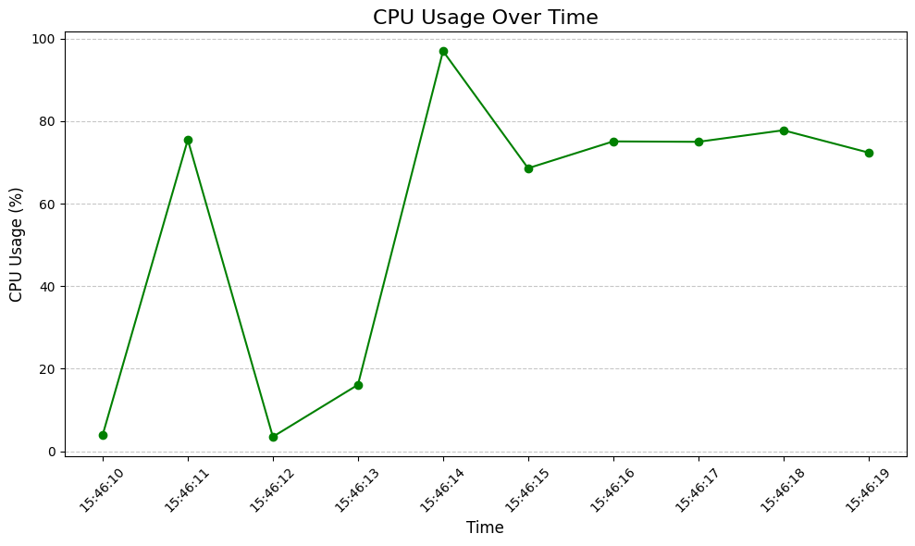

Slide 11
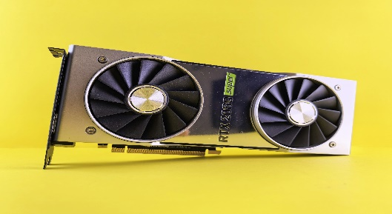

Future Enhancements & Conclusions
Support for GPU benchmarking.
Integration with cloud systems for remote benchmarking.
Advanced analytics and report generation.
Compatibility with mobile devices.
Emphasize the potential for real-world use cases.

Slide 12
THE END

