Slide 1

LEBAK 3 - MALIMPING (B301) — BANTEN
LEBAK 5 (B3GU) — BANTEN
Jenis | Stok Fisik | Out. SO | Intransit | Stok Admin
NPK | 1,196.80 | 46.00 | 0.00 | 1,150.80
Jenis | Stok Fisik | Out. SO | Intransit | Stok Admin
NPK | 1,068.25 | 0.00 | 0.00 | 1,068.25
CCTV Depan (Tidak tersedia)
CCTV Dalam (Tidak tersedia)
CCTV Depan (Tidak tersedia)
CCTV Dalam (Tidak tersedia)

Slide 2
TSM CIBEUREUM (B325/C3AL) — JAWA BARAT
TSM 2CIPATUJAH (C363) — JAWA BARAT
Jenis | Stok Fisik | Out. SO | Intransit | Stok Admin
NPK | 2,173.95 | 60.00 | 63.00 | 2,176.95
Jenis | Stok Fisik | Out. SO | Intransit | Stok Admin
Urea | 977.40 | 0.00 | 0.00 | 977.40
CCTV Depan (Tidak tersedia)
CCTV Dalam (Tidak tersedia)
CCTV Depan (Tidak tersedia)
CCTV Dalam (Tidak tersedia)
TSM 1AWIPARI (B3HB/C324) — JAWA BARAT
TASIKMALAYA 4 (B3GT) — JAWA BARAT
Jenis | Stok Fisik | Out. SO | Intransit | Stok Admin
Urea | 2,206.15 | 35.00 | 212.80 | 2,383.95
Jenis | Stok Fisik | Out. SO | Intransit | Stok Admin
NPK | 912.50 | 0.00 | 0.00 | 912.50
CCTV Depan (Tidak tersedia)
CCTV Dalam (Tidak tersedia)
CCTV Depan (Tidak tersedia)
CCTV Dalam (Tidak tersedia)

Slide 3
GUNUNG KIDUL PKG (B3AR) — DI YOGYAKARTA
GPP SLEMAN (B3D4/F347) — DI YOGYAKARTA
Jenis | Stok Fisik | Out. SO | Intransit | Stok Admin
NPK | 364.35 | 116.00 | 183.20 | 431.55
Jenis | Stok Fisik | Out. SO | Intransit | Stok Admin
NPK | 389.00 | 49.00 | 0.00 | 340.00
Urea | 2,493.40 | 72.00 | 120.40 | 2,541.80
CCTV Depan (Tidak tersedia)
CCTV Dalam (Tidak tersedia)
CCTV Depan (Tidak tersedia)
CCTV Dalam (Tidak tersedia)
BGR GUNUNG KIDUL (F346) — DI YOGYAKARTA
BANTUL 2 (B3F7) — DI YOGYAKARTA
Jenis | Stok Fisik | Out. SO | Intransit | Stok Admin
Urea | 1,339.20 | 113.00 | 228.00 | 1,454.20
Jenis | Stok Fisik | Out. SO | Intransit | Stok Admin
NPK | 649.00 | 56.00 | 0.00 | 593.00
CCTV Depan (Tidak tersedia)
CCTV Dalam (Tidak tersedia)
CCTV Depan (Tidak tersedia)
CCTV Dalam (Tidak tersedia)

Slide 4
BANYUMAS 3 - WANGON (B328) — JAWA TENGAH
BANYUMAS WANGON 2 (F3CJ) — JAWA TENGAH
Jenis | Stok Fisik | Out. SO | Intransit | Stok Admin
NPK | 1,692.20 | 73.00 | 0.00 | 1,619.20
Jenis | Stok Fisik | Out. SO | Intransit | Stok Admin
Urea | 2,148.70 | 90.00 | 90.60 | 2,149.30
CCTV Depan (Tidak tersedia)
CCTV Dalam (Tidak tersedia)
CCTV Depan (Tidak tersedia)
CCTV Dalam (Tidak tersedia)
BATANG - KASEPUHAN (B3CP/F397) — JAWA TENGAH
BGR BOJONG, PURBALINGGA (F322) — JAWA TENGAH
Jenis | Stok Fisik | Out. SO | Intransit | Stok Admin
NPK | 372.40 | 42.00 | 191.25 | 521.65
Urea | 1,376.90 | 68.00 | 0.00 | 1,308.90
Jenis | Stok Fisik | Out. SO | Intransit | Stok Admin
Urea | 2,862.35 | 46.00 | 19.40 | 2,835.75
CCTV Depan (Tidak tersedia)
CCTV Dalam (Tidak tersedia)
CCTV Depan (Tidak tersedia)
CCTV Dalam (Tidak tersedia)

Slide 5
BGR NGADIROJO, WONOGIRI (F330) — JAWA TENGAH
Jenis | Stok Fisik | Out. SO | Intransit | Stok Admin
Urea | 282.75 | 265.00 | 106.40 | 124.15
CCTV Depan (Tidak tersedia)
CCTV Dalam (Tidak tersedia)

Slide 6
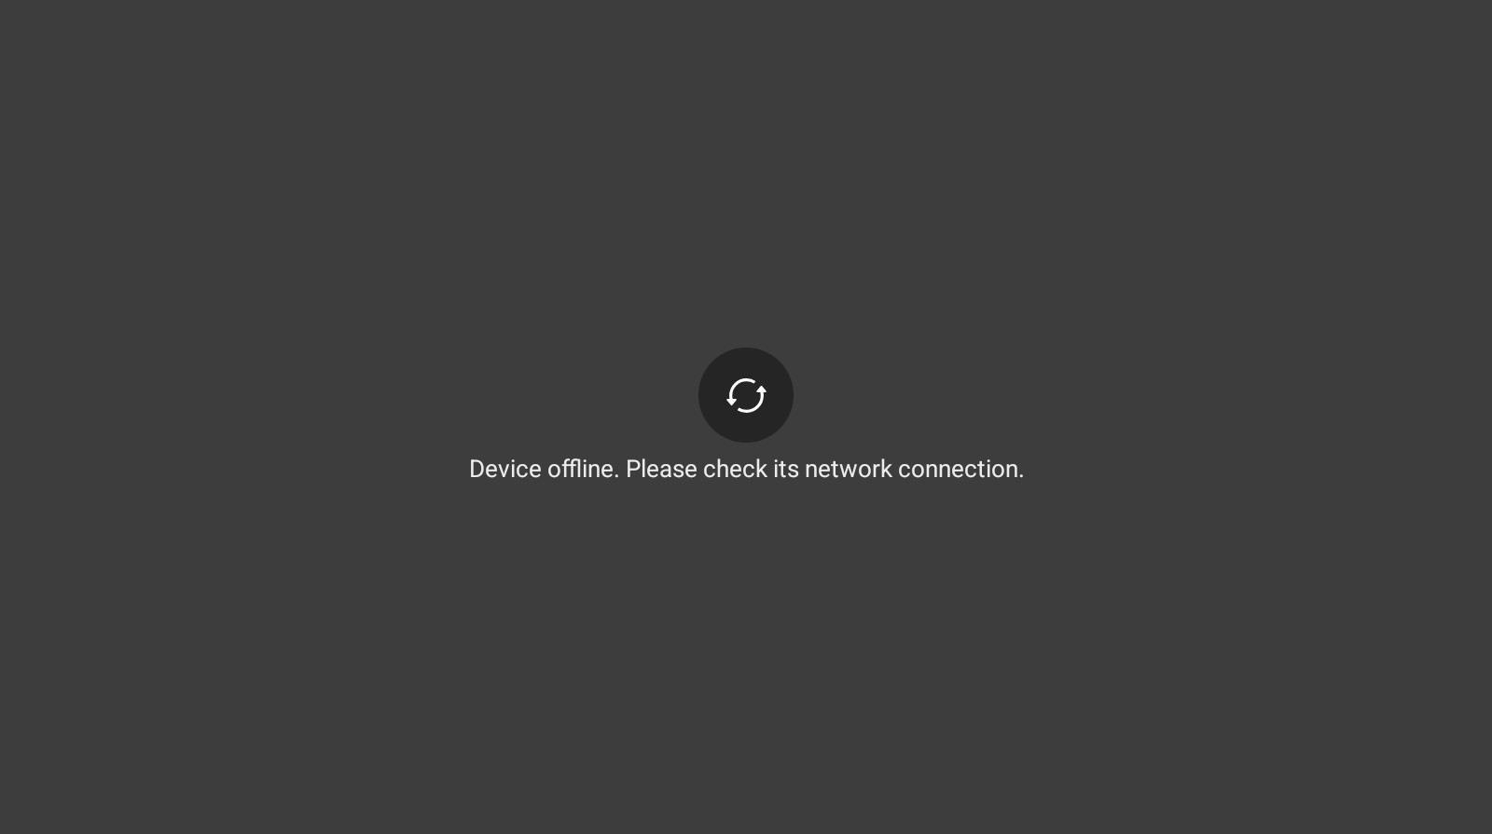
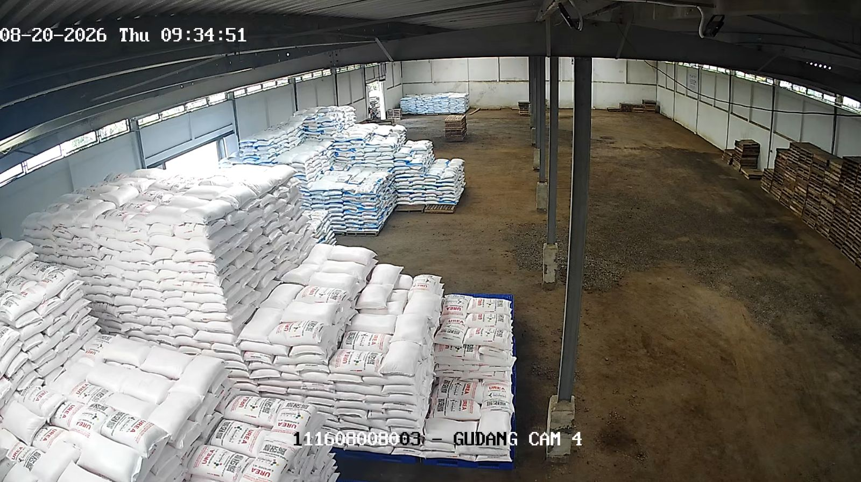
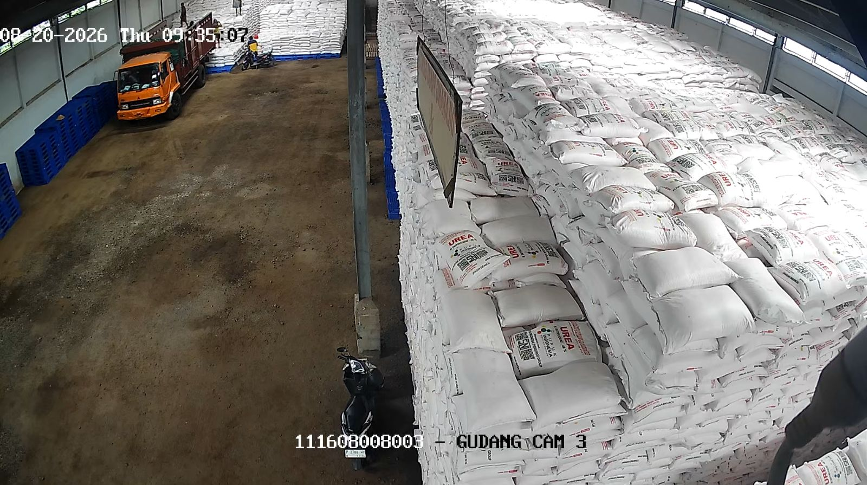
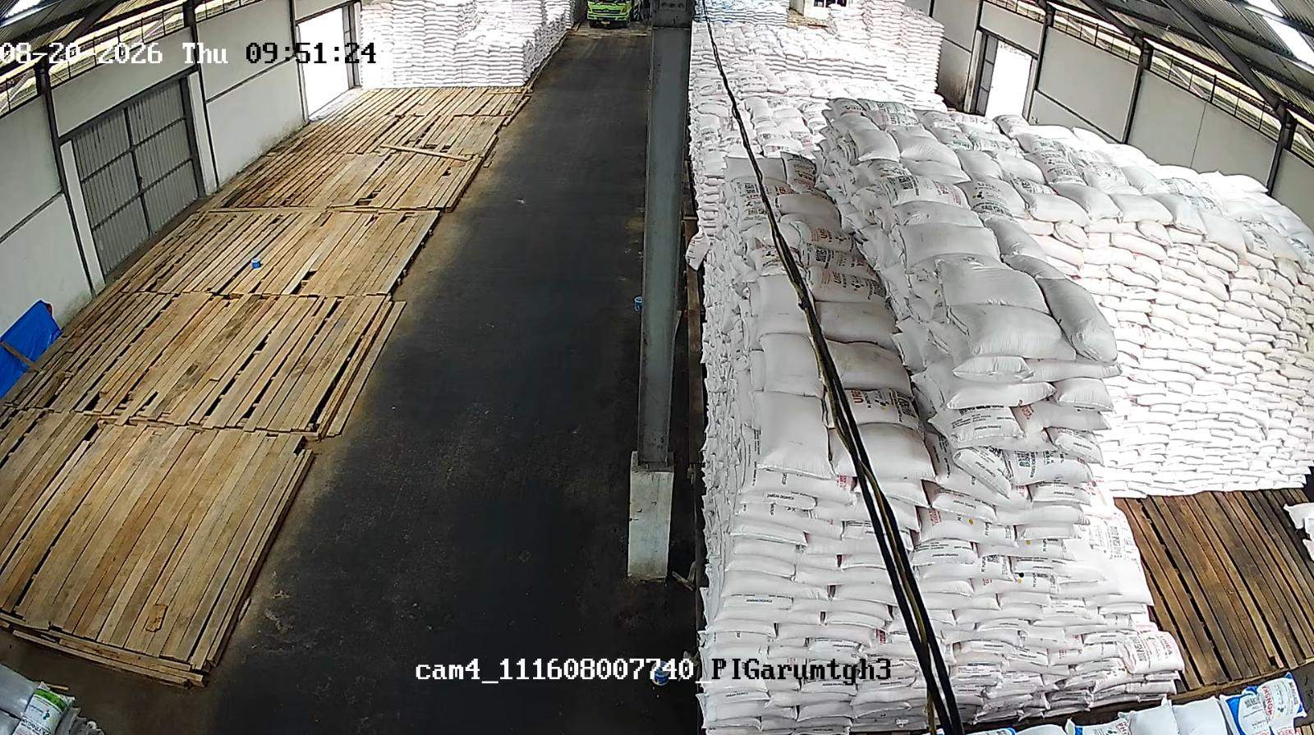
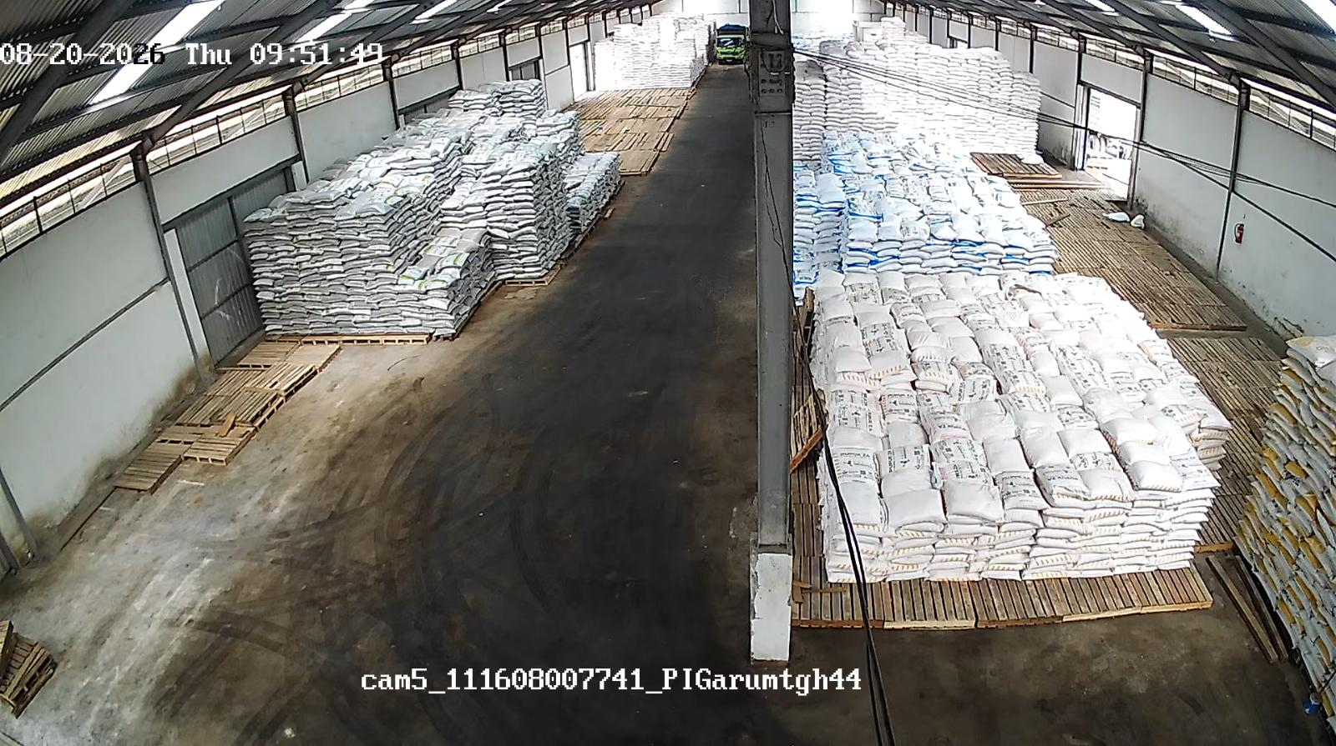
Bojonegoro - Sumberejo (B372) — JAWA TIMUR
GPP Banyuwangi - Kabat (B3DW/D307) — JAWA TIMUR
Jenis | Stok Fisik | Out. SO | Intransit | Stok Admin
NPK | 243.30 | 115.00 | 0.00 | 128.30
Urea | 3,744.15 | 132.00 | 187.50 | 3,799.65
Jenis | Stok Fisik | Out. SO | Intransit | Stok Admin
NPK | 171.90 | 81.00 | 315.25 | 406.15
Urea | 1,579.95 | 245.00 | 0.00 | 1,334.95
GPP Bangkalan - Keleyan (B3BV) — JAWA TIMUR
GPP Blitar - Garum (B3CS/D3AH) — JAWA TIMUR
Jenis | Stok Fisik | Out. SO | Intransit | Stok Admin
NPK | 148.80 | 0.00 | 116.00 | 264.80
Urea | 1,063.00 | 0.00 | 0.00 | 1,063.00
Jenis | Stok Fisik | Out. SO | Intransit | Stok Admin
NPK | 184.50 | 405.00 | 123.20 | -97.30
Urea | 931.25 | 283.00 | 36.20 | 684.45
CCTV Depan (Tidak tersedia)
CCTV Dalam (Tidak tersedia)

Slide 7
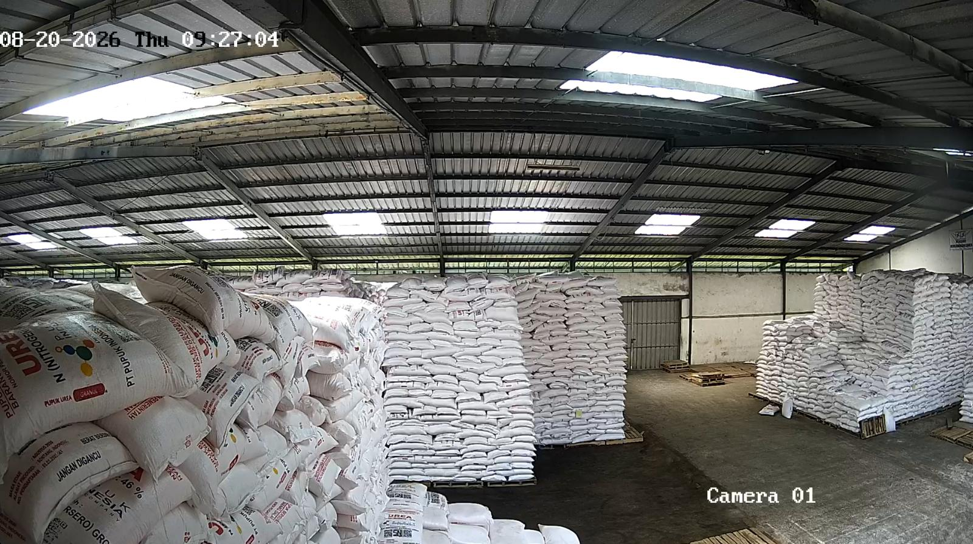
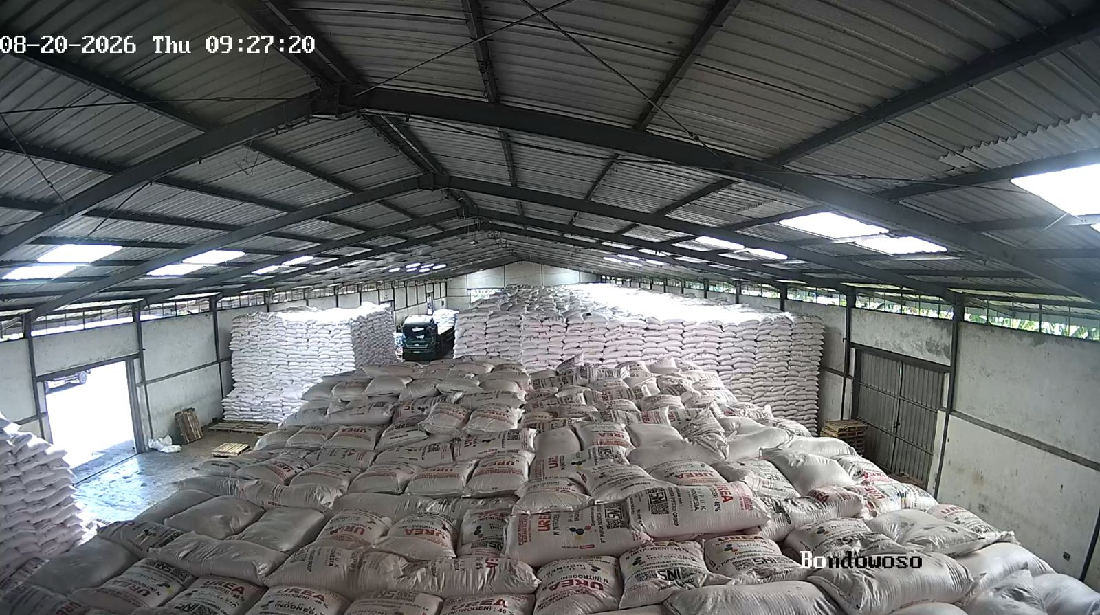
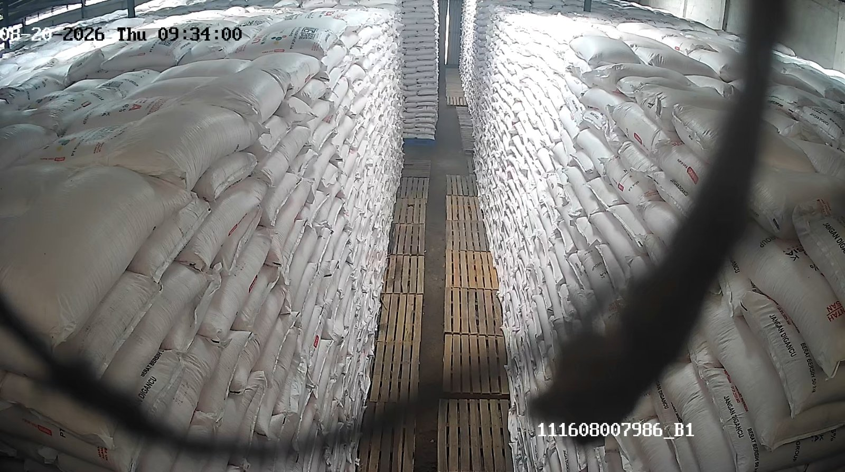
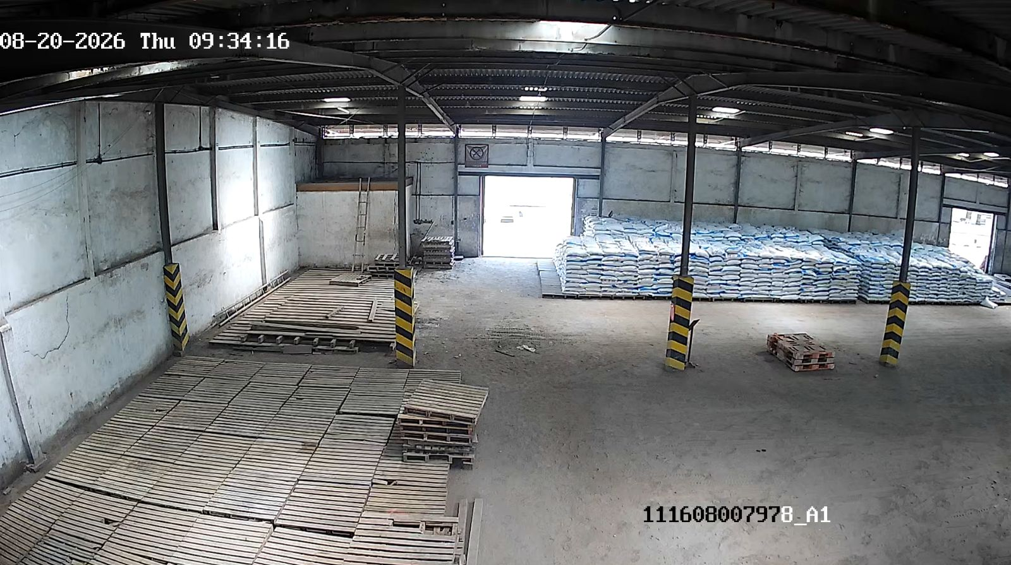
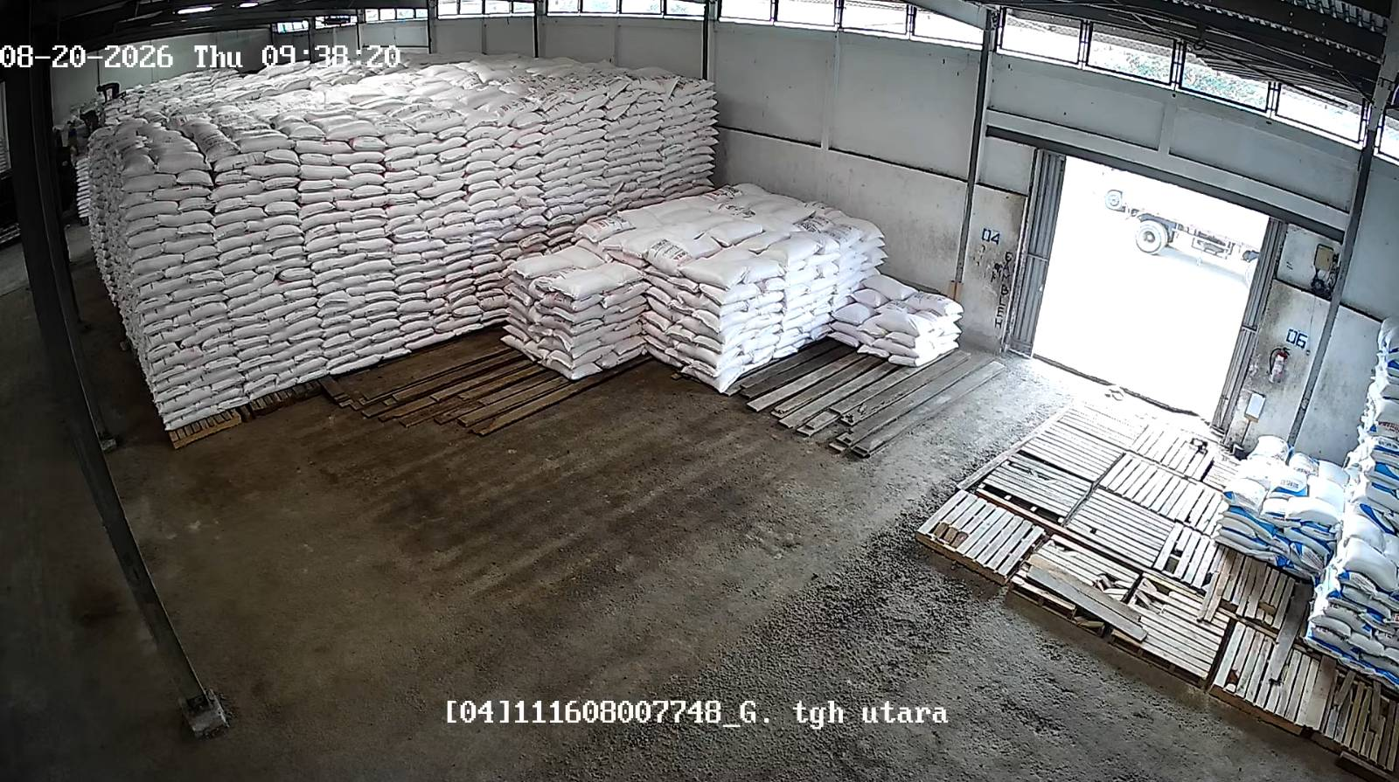
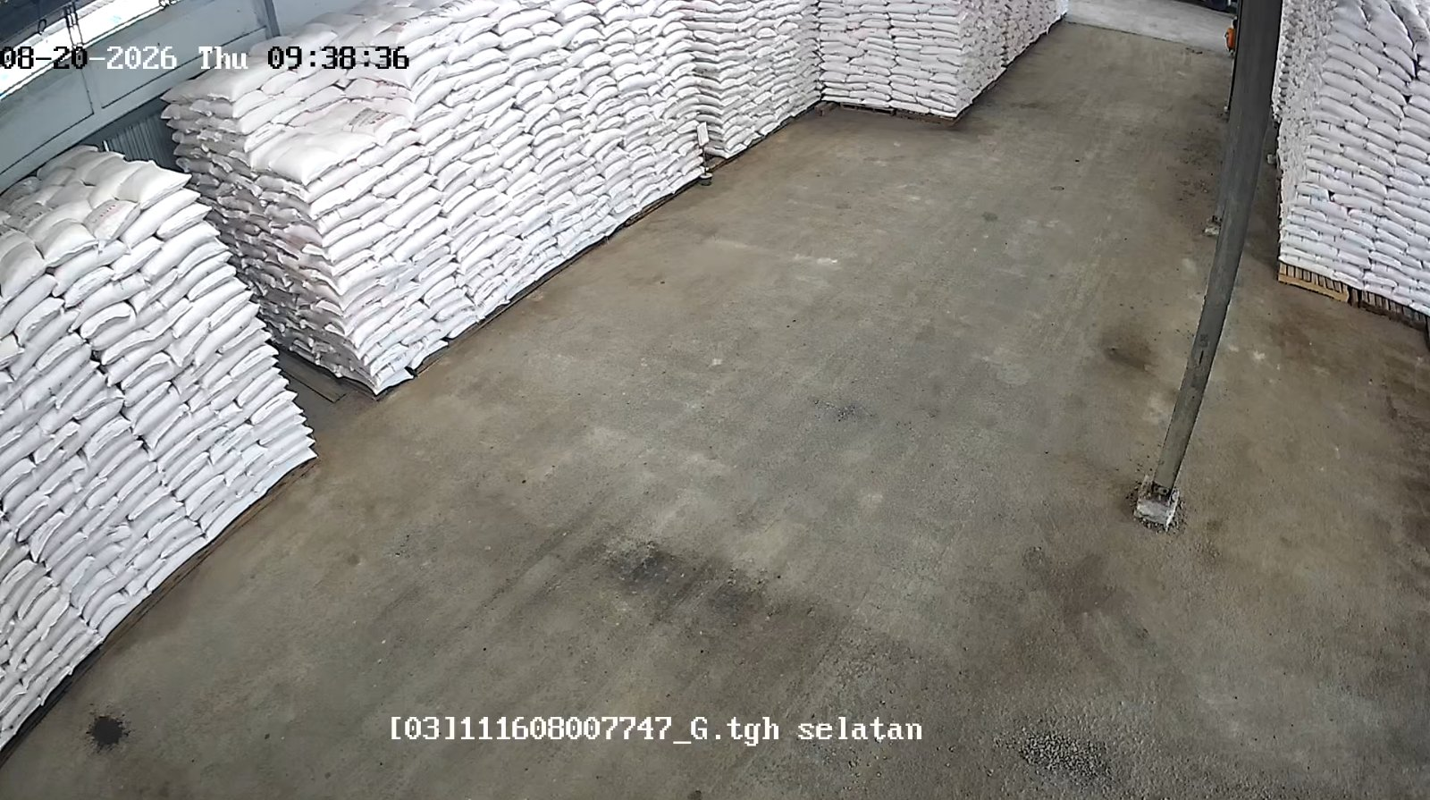
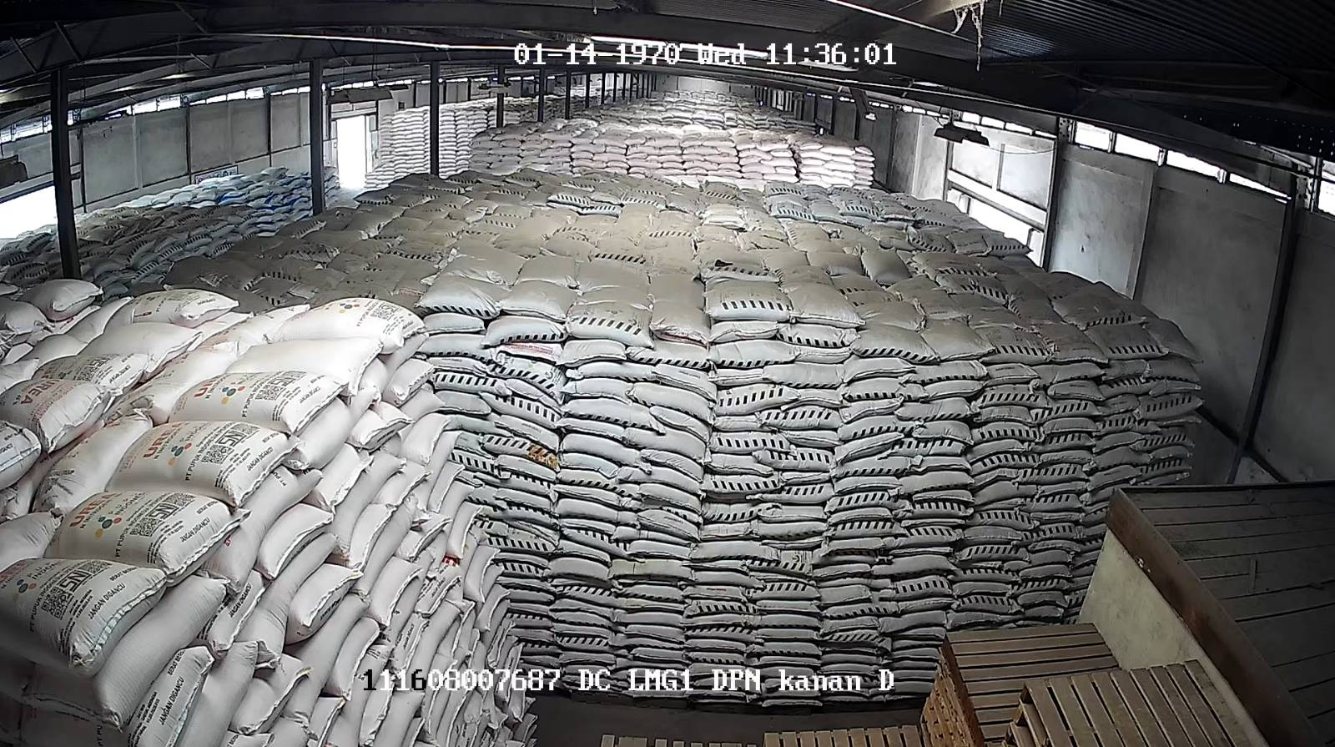
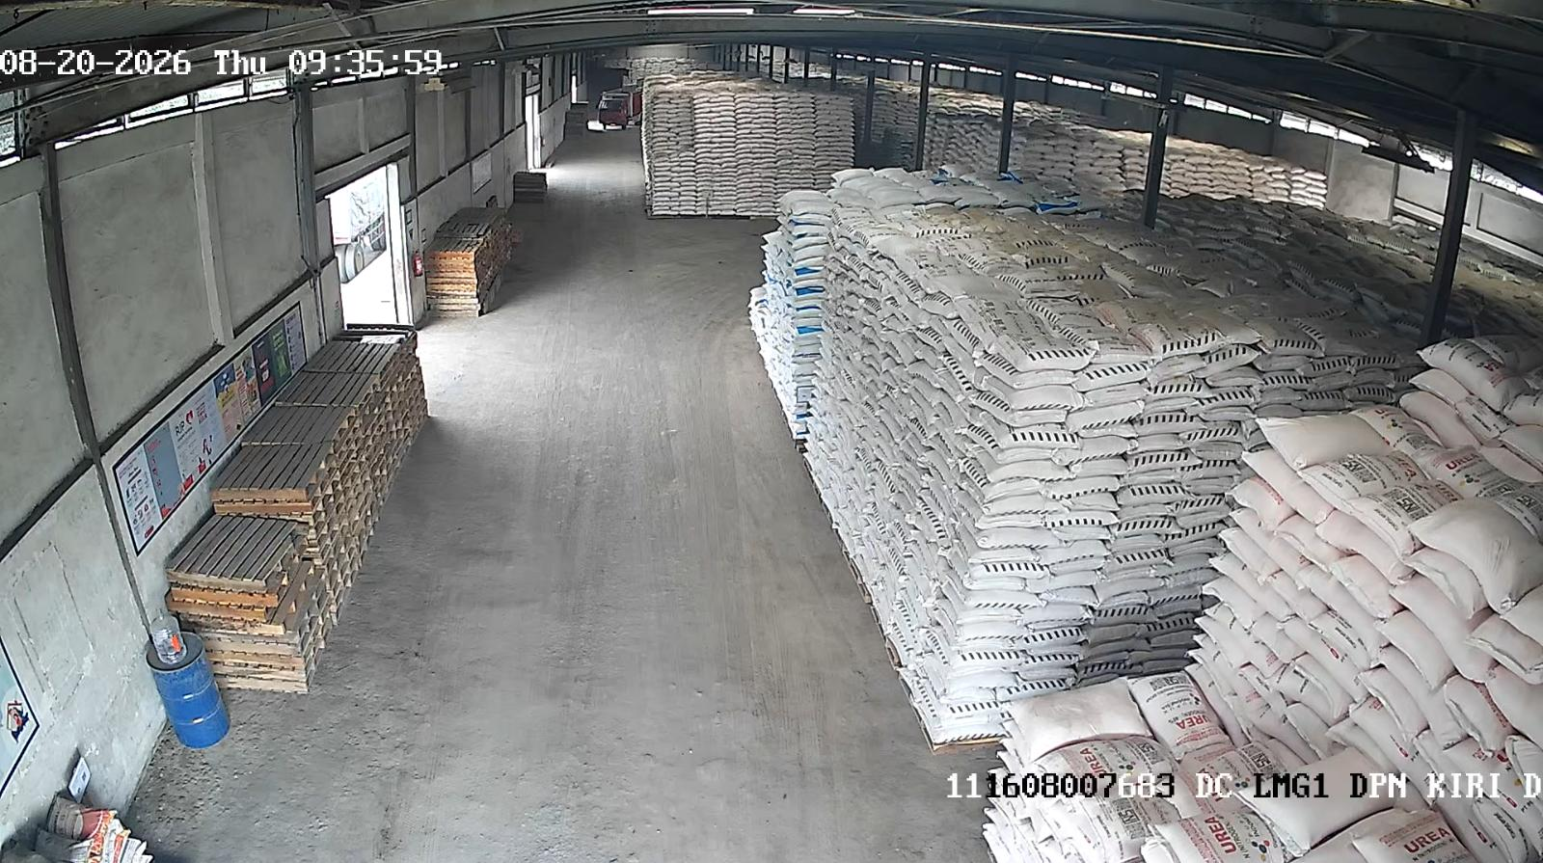
GPP Bondowoso - Wonosari (B3DU/D3GD) — JAWA TIMUR
GPP Jember - Rambipuji (B379/D312) — JAWA TIMUR
Jenis | Stok Fisik | Out. SO | Intransit | Stok Admin
NPK | 15.00 | 184.00 | 76.50 | -92.50
Urea | 2,554.70 | 165.00 | 38.80 | 2,428.50
Jenis | Stok Fisik | Out. SO | Intransit | Stok Admin
NPK | 199.65 | 347.50 | 38.25 | -109.60
Urea | 4,142.60 | 392.50 | 38.80 | 3,788.90
GPP Kediri - Ngadiluwih (B3BW) — JAWA TIMUR
GPP Lamongan - Kota (B386) — JAWA TIMUR
Jenis | Stok Fisik | Out. SO | Intransit | Stok Admin
NPK | 92.90 | 196.90 | 155.40 | 51.40
Urea | 1,141.55 | 148.60 | 42.20 | 1,035.15
Jenis | Stok Fisik | Out. SO | Intransit | Stok Admin
NPK | 481.00 | 274.15 | 0.00 | 206.85
Urea | 2,156.70 | 296.35 | 222.70 | 2,083.05

Slide 8
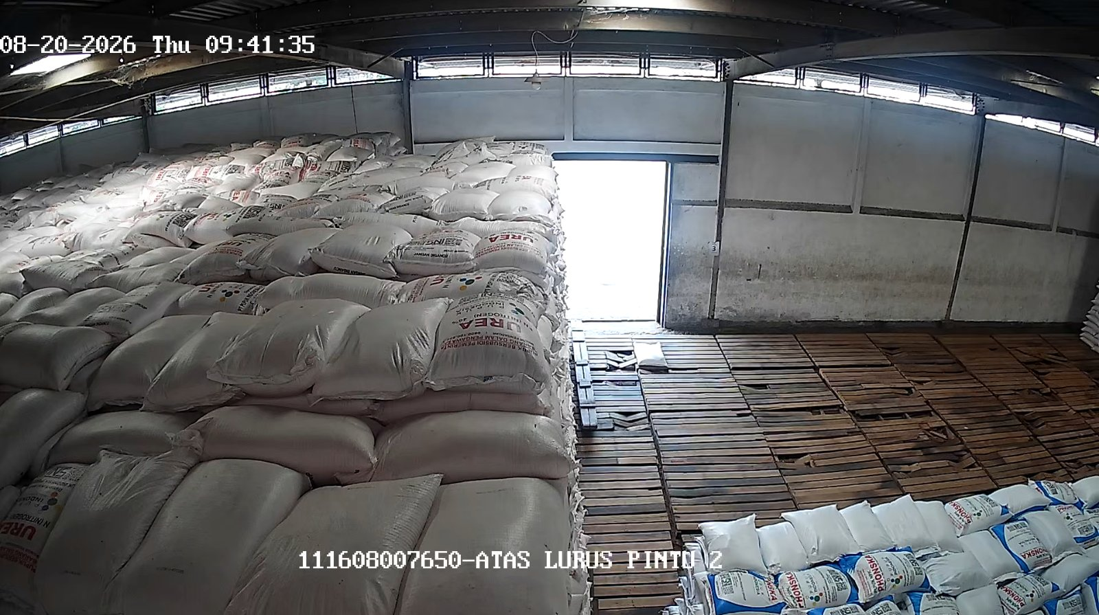

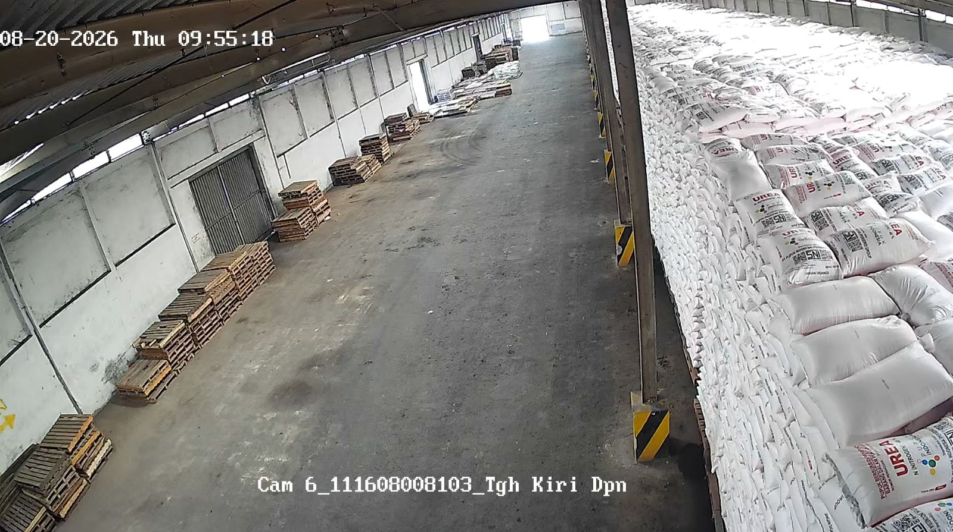
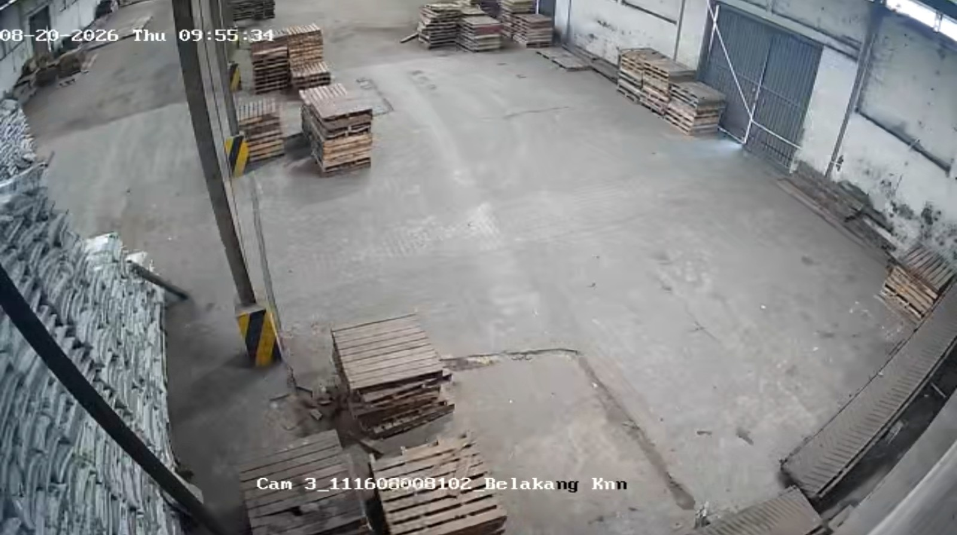
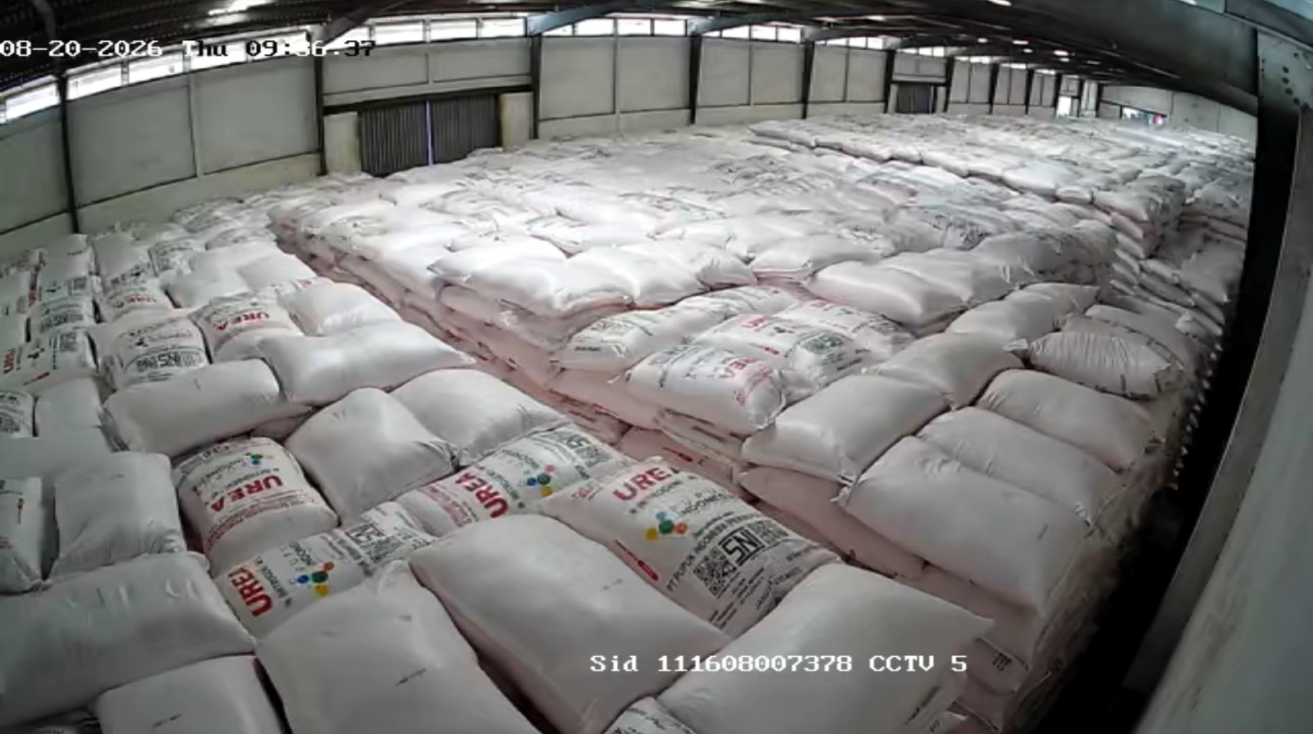
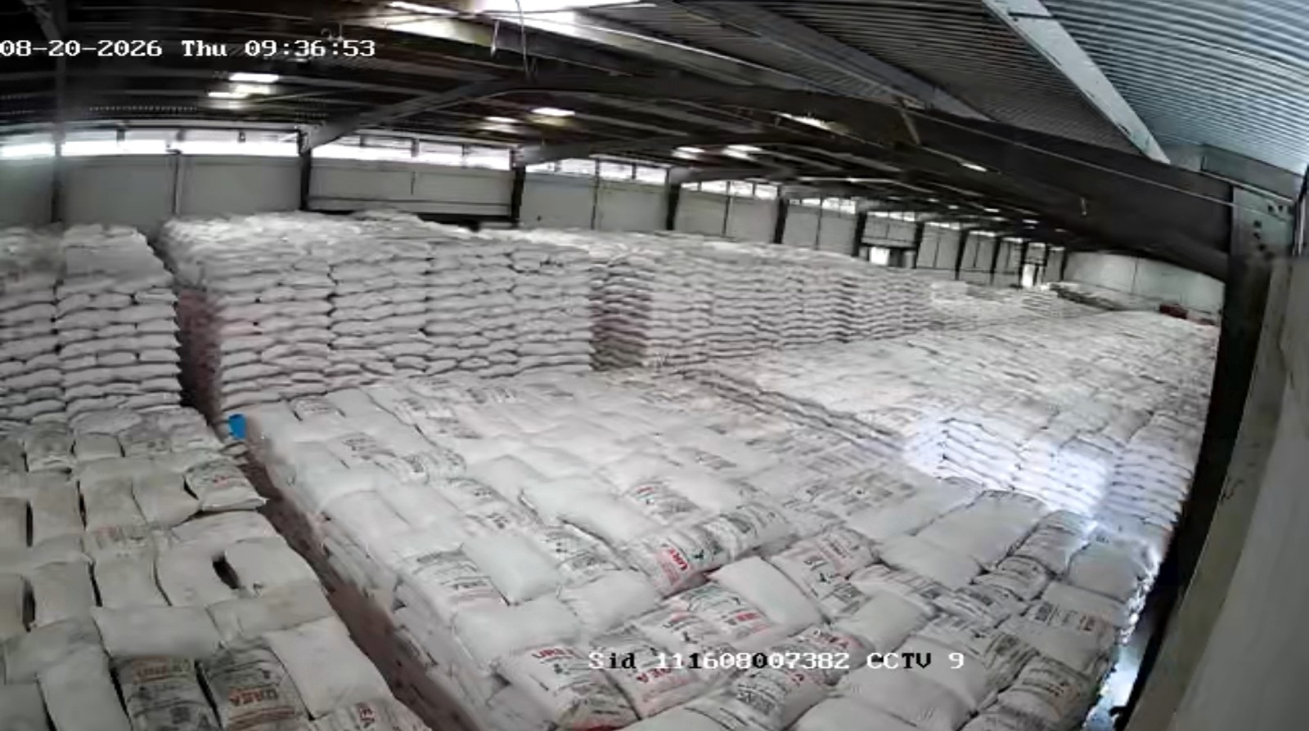
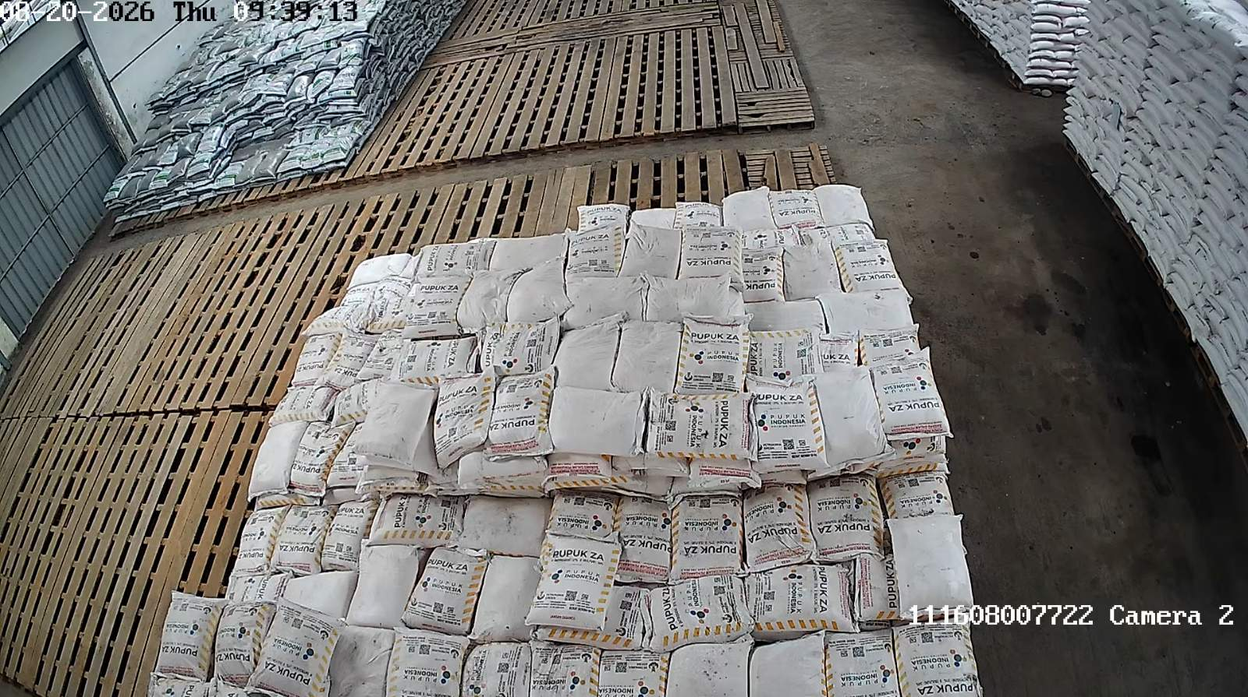
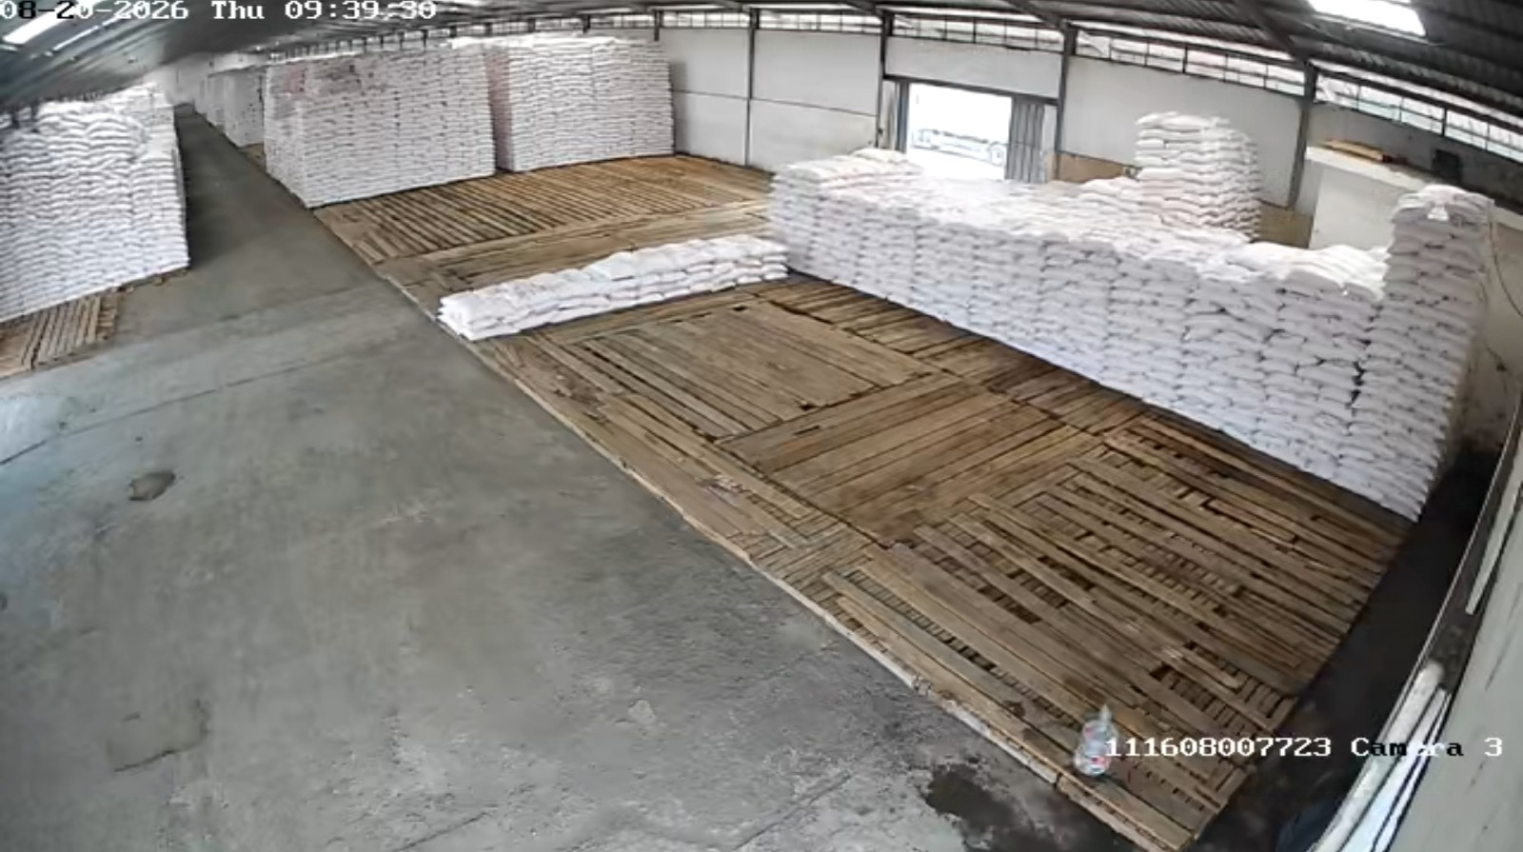
GPP Madiun - Kaligunting (B3AT/D3AK) — JAWA TIMUR
GPP Malang - Pakisaji (B3CR) — JAWA TIMUR
Jenis | Stok Fisik | Out. SO | Intransit | Stok Admin
NPK | 41.45 | 232.20 | 59.25 | -131.50
Urea | 1,510.30 | 248.75 | 286.50 | 1,548.05
Jenis | Stok Fisik | Out. SO | Intransit | Stok Admin
NPK | 0.15 | 1,206.55 | 396.45 | -809.95
Urea | 2,057.20 | 257.30 | 53.30 | 1,853.20
GPP Mojokerto - Sooko (B394/D3AZ) — JAWA TIMUR
GPP Nganjuk - Pehserut (B3BY) — JAWA TIMUR
Jenis | Stok Fisik | Out. SO | Intransit | Stok Admin
NPK | 129.65 | 60.50 | 0.00 | 69.15
Urea | 3,313.10 | 82.00 | 55.75 | 3,286.85
Jenis | Stok Fisik | Out. SO | Intransit | Stok Admin
NPK | 21.75 | 366.80 | 178.15 | -166.90
Urea | 3,405.15 | 367.90 | 69.00 | 3,106.25

Slide 9
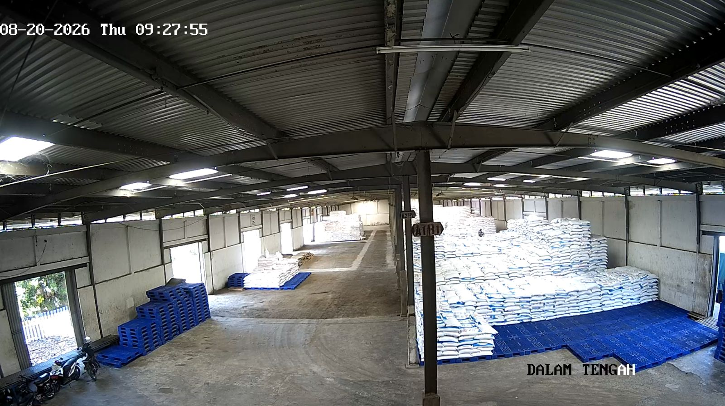
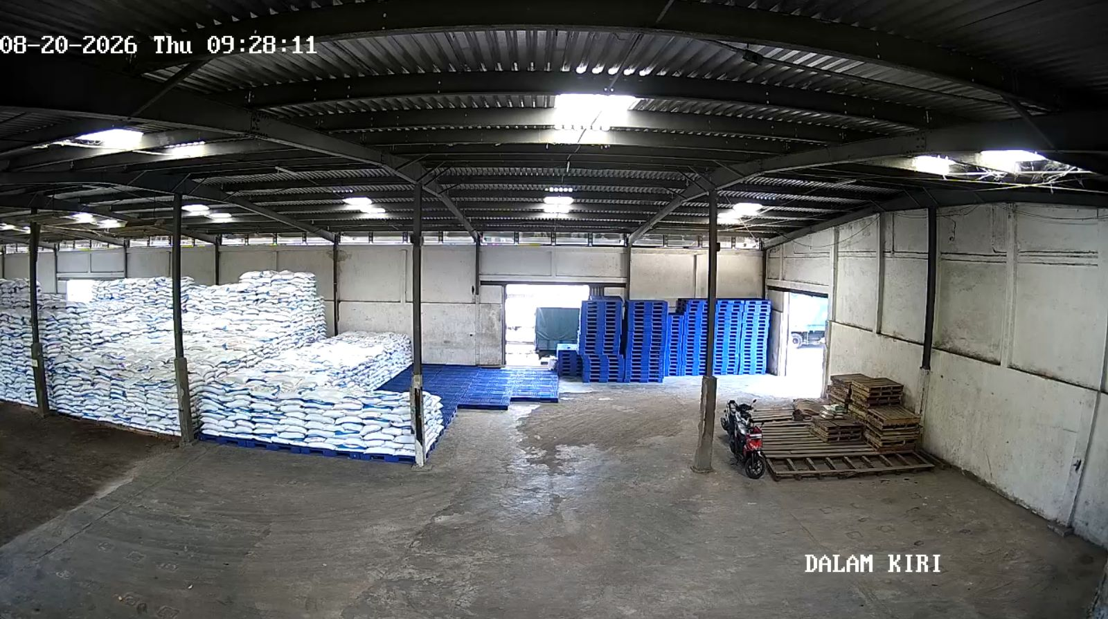
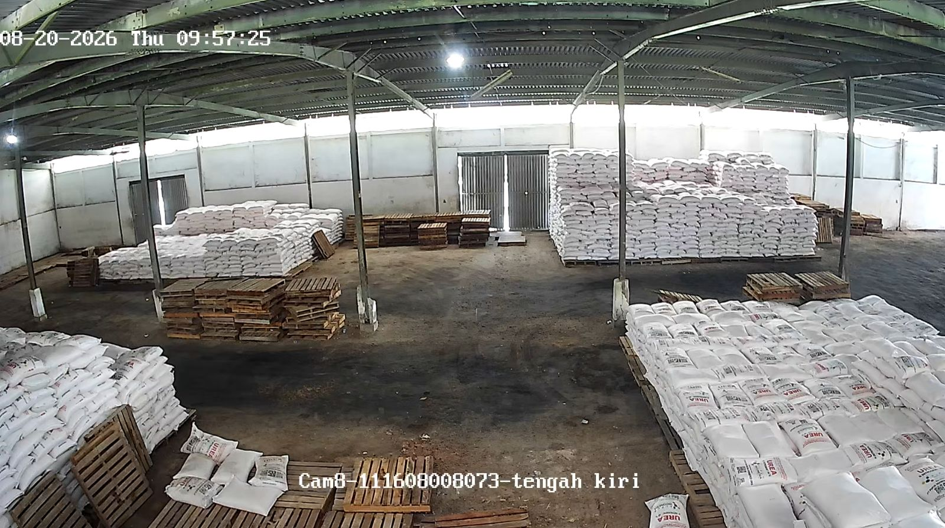
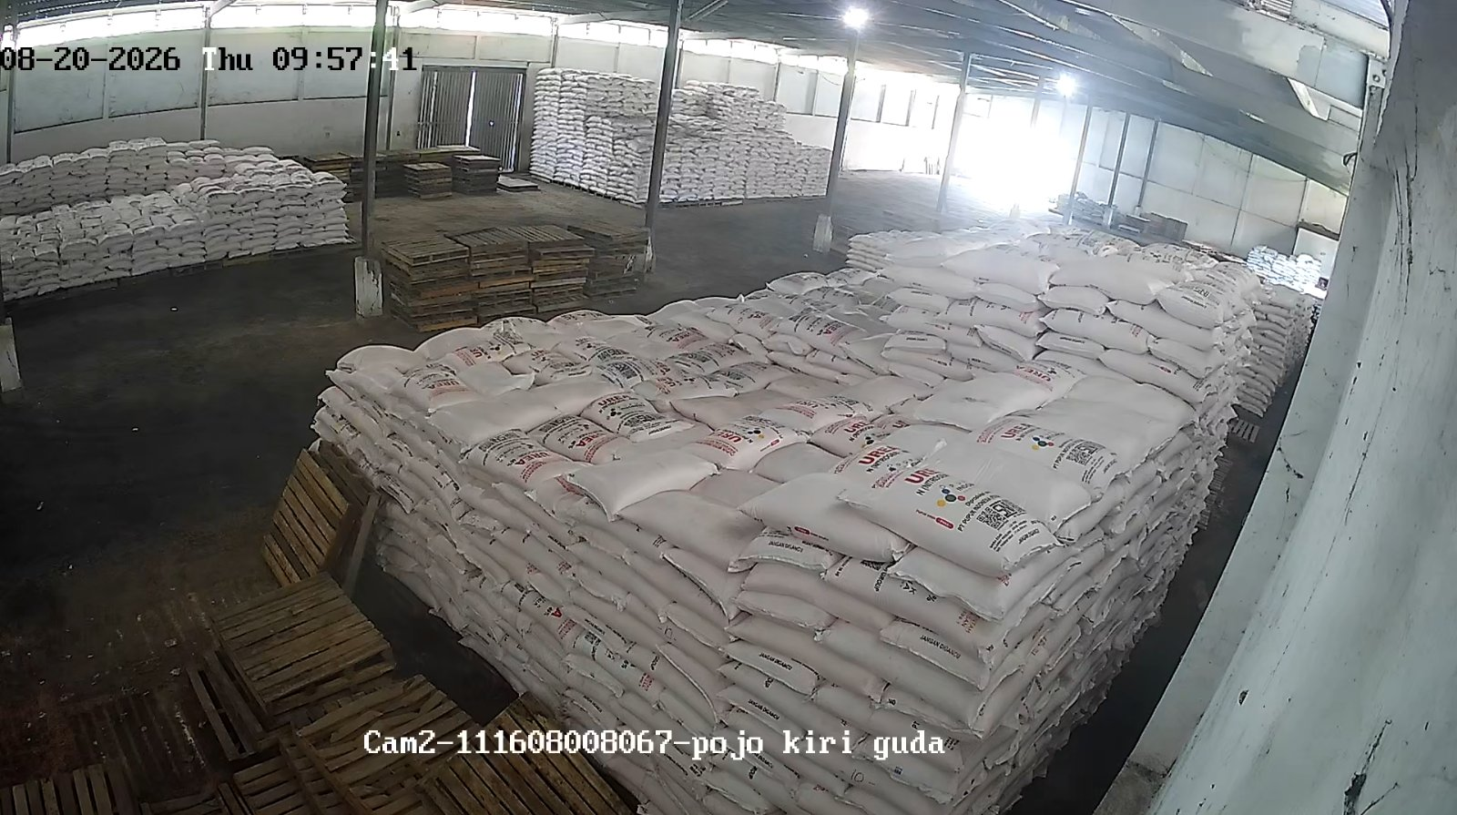
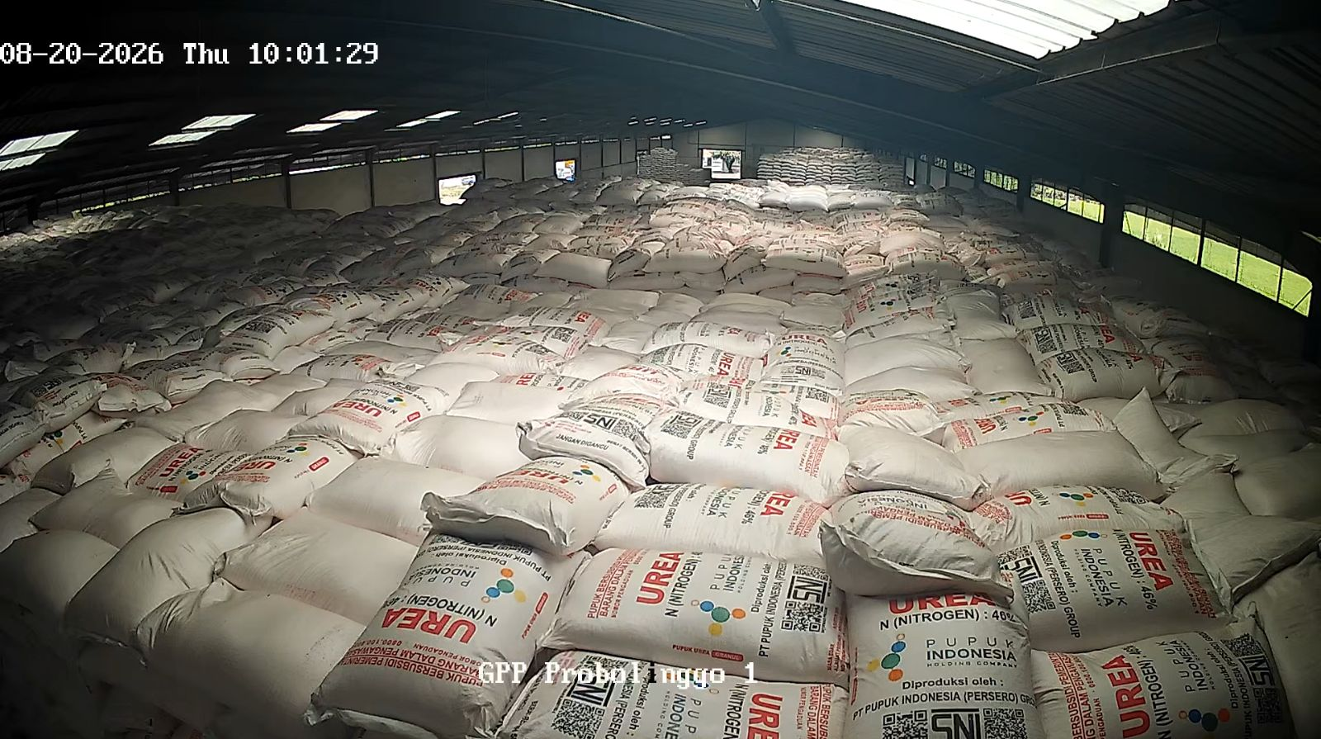
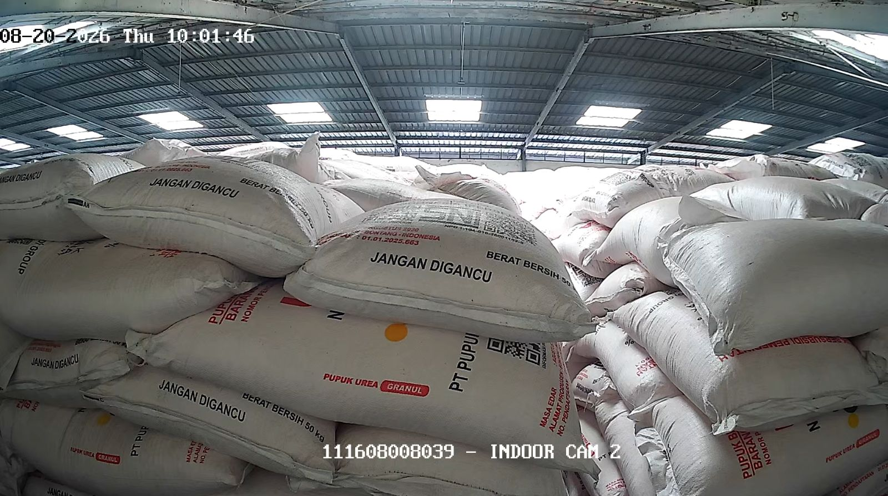
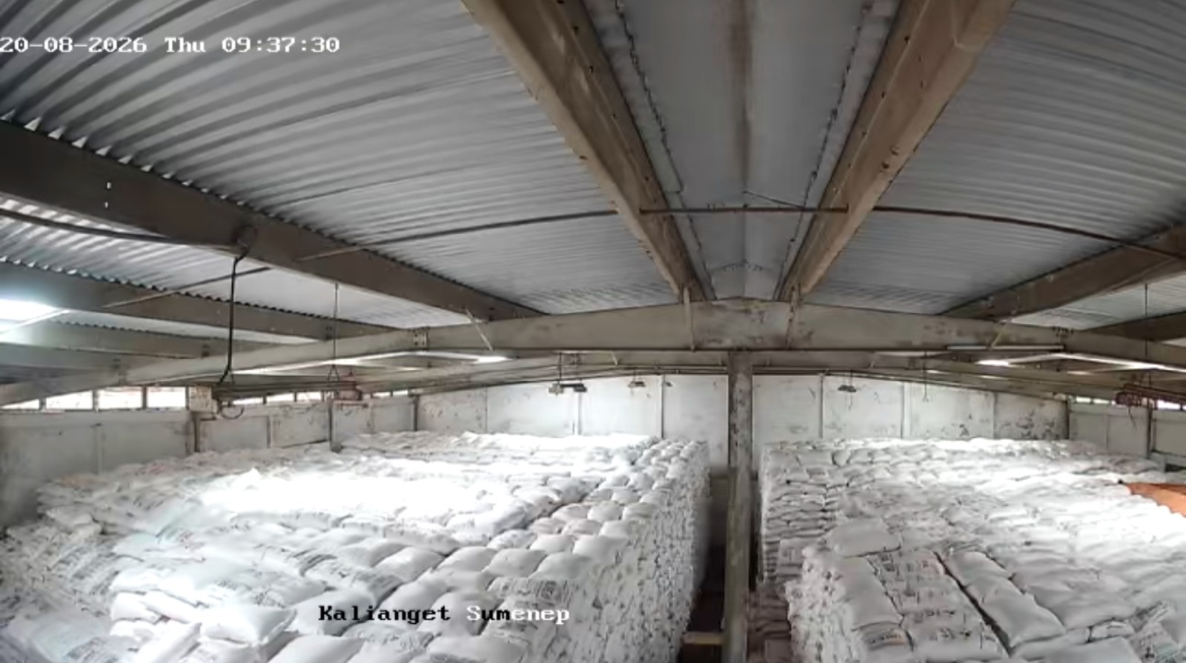
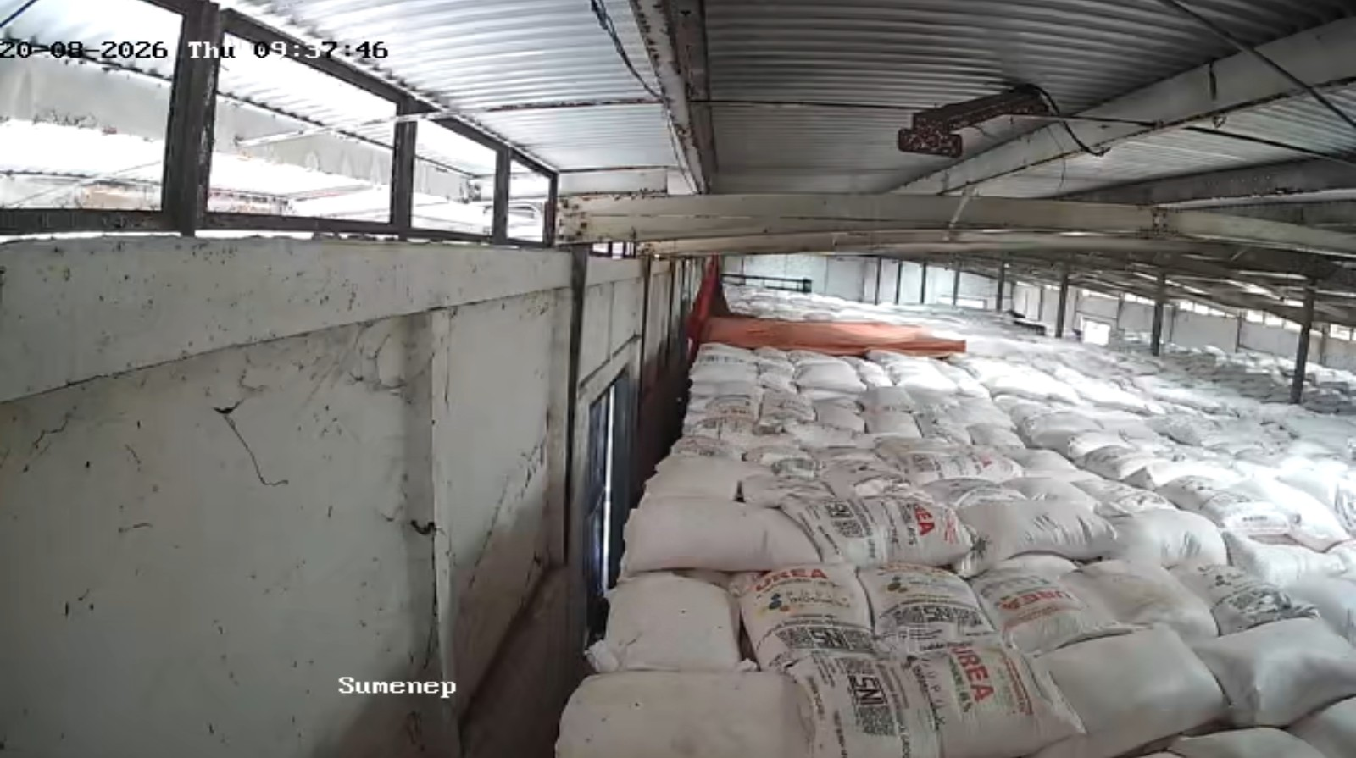
GPP Situbondo - Kalibagor (B3DV/D3GE) — JAWA TIMUR
GPP Sampang - Kamuning (B3C1) — JAWA TIMUR
Jenis | Stok Fisik | Out. SO | Intransit | Stok Admin
NPK | 514.20 | 42.00 | 586.55 | 1,058.75
Urea | 1,288.70 | 144.00 | 0.00 | 1,144.70
Jenis | Stok Fisik | Out. SO | Intransit | Stok Admin
NPK | 10.30 | 10.00 | 40.70 | 41.00
Urea | 323.00 | 20.00 | 66.00 | 369.00
GPP Probolinggo - Tongas (B3DQ/D329) — JAWA TIMUR
GPP Sumenep - Kalianget (B3CA) — JAWA TIMUR
Jenis | Stok Fisik | Out. SO | Intransit | Stok Admin
NPK | 262.75 | 208.00 | 161.75 | 216.50
Urea | 1,870.25 | 239.00 | 0.00 | 1,631.25
Jenis | Stok Fisik | Out. SO | Intransit | Stok Admin
NPK | 63.50 | 20.00 | 63.00 | 106.50
Urea | 1,555.45 | 10.00 | 126.00 | 1,671.45

Slide 10
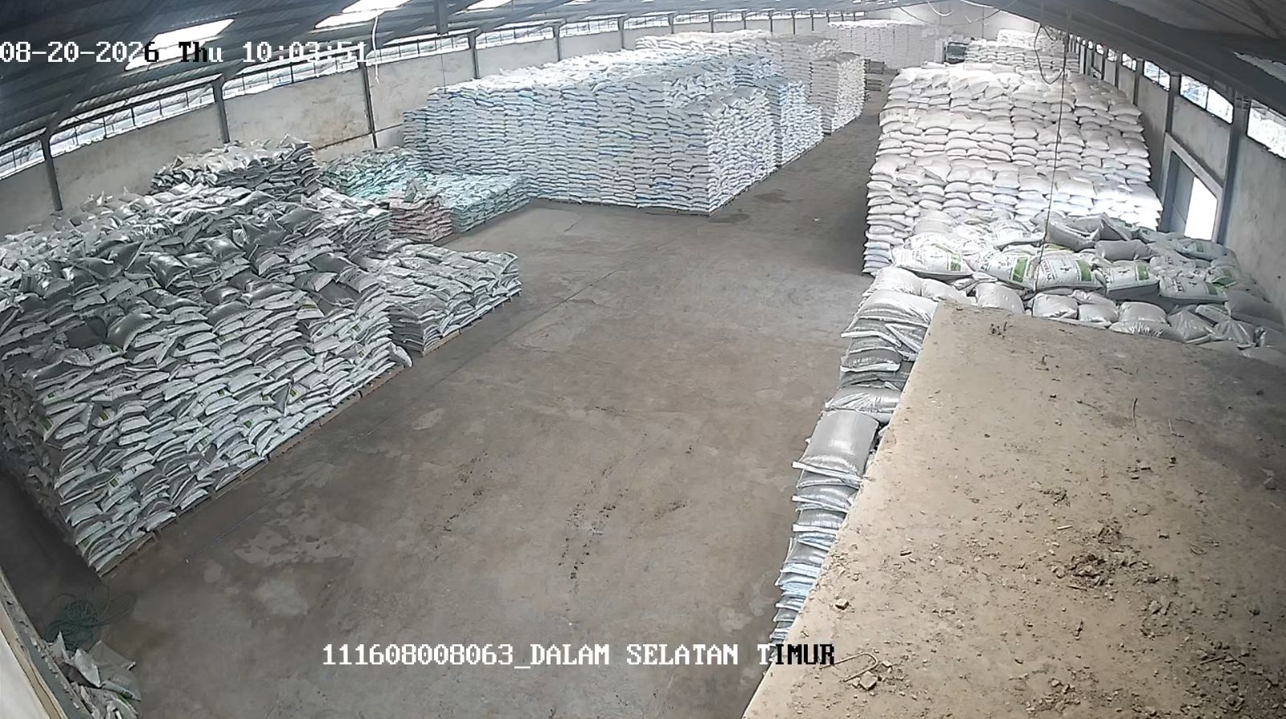
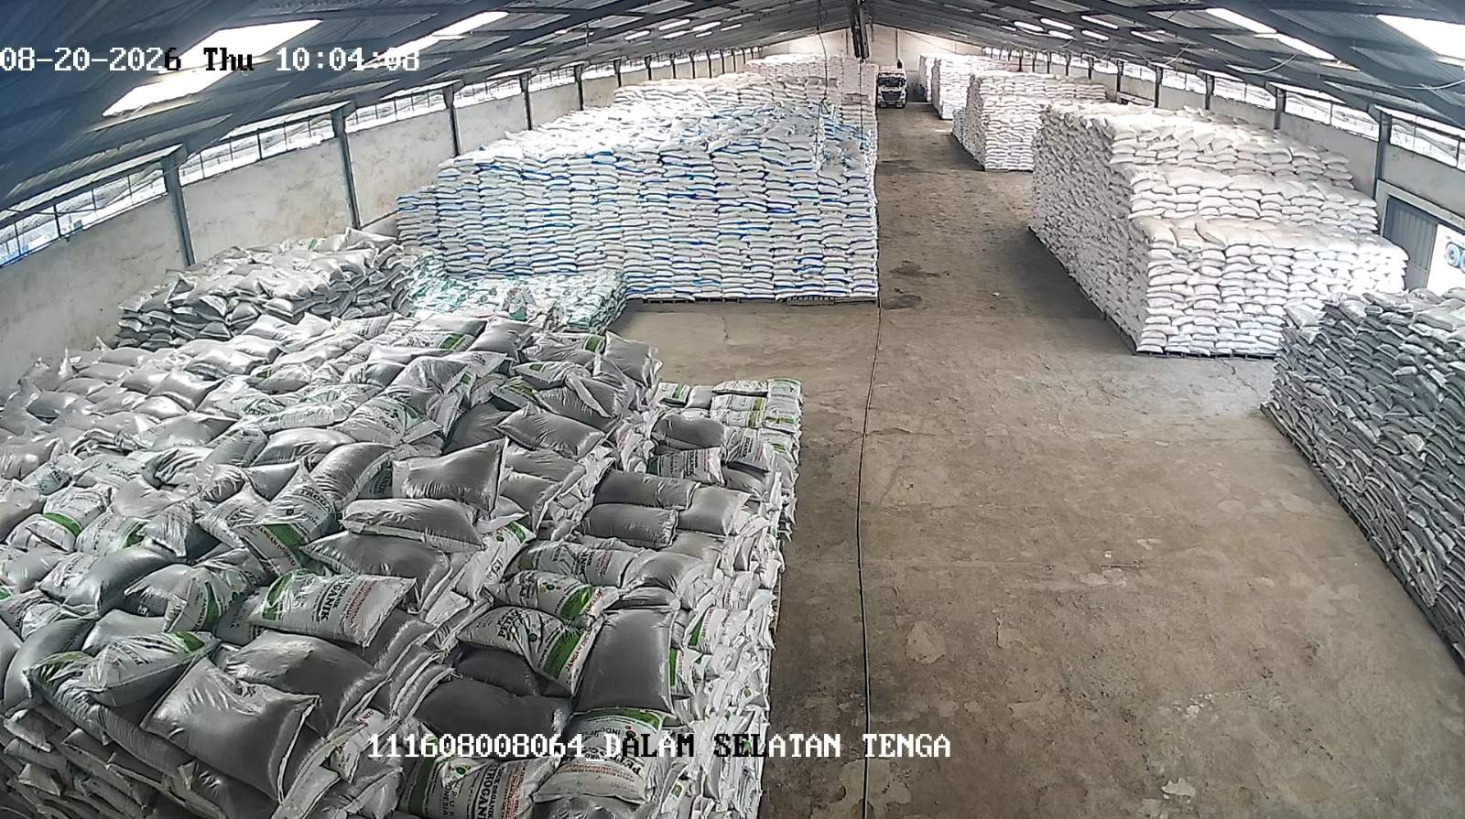
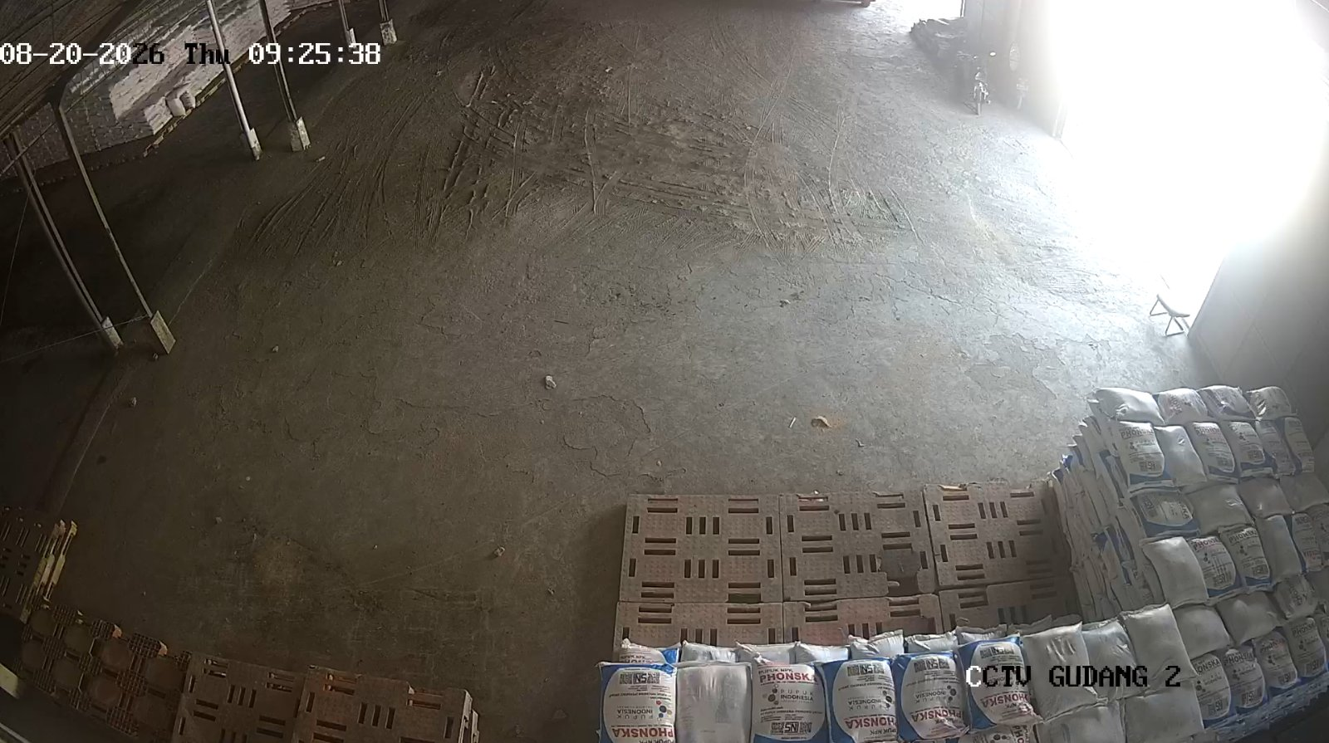
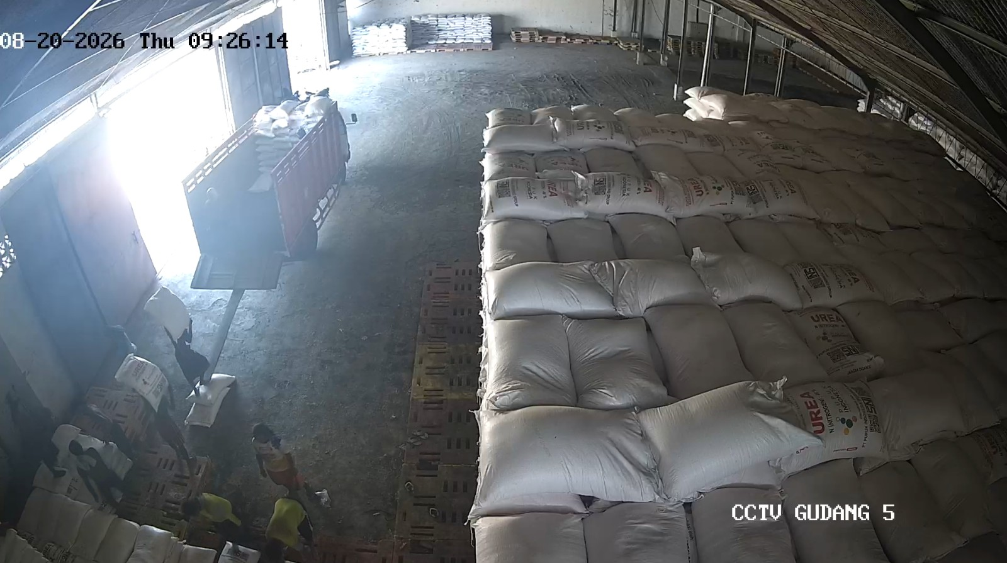
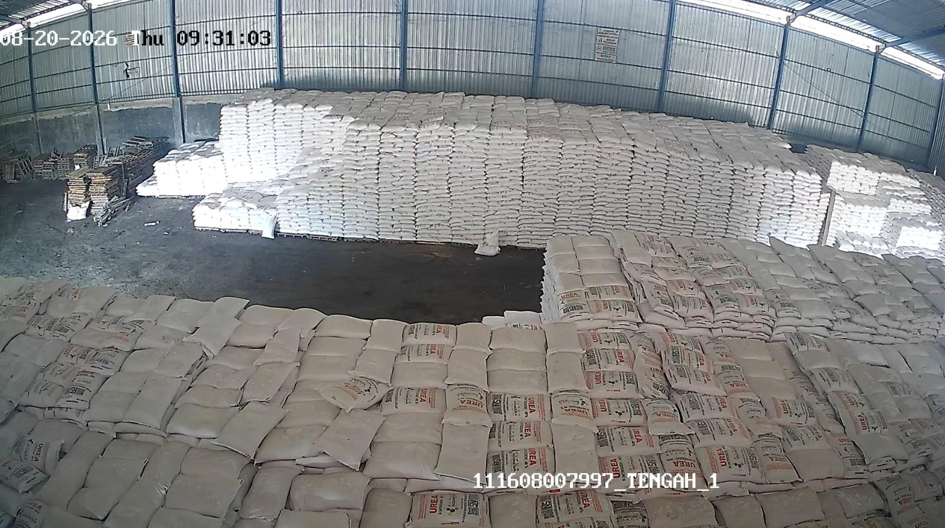
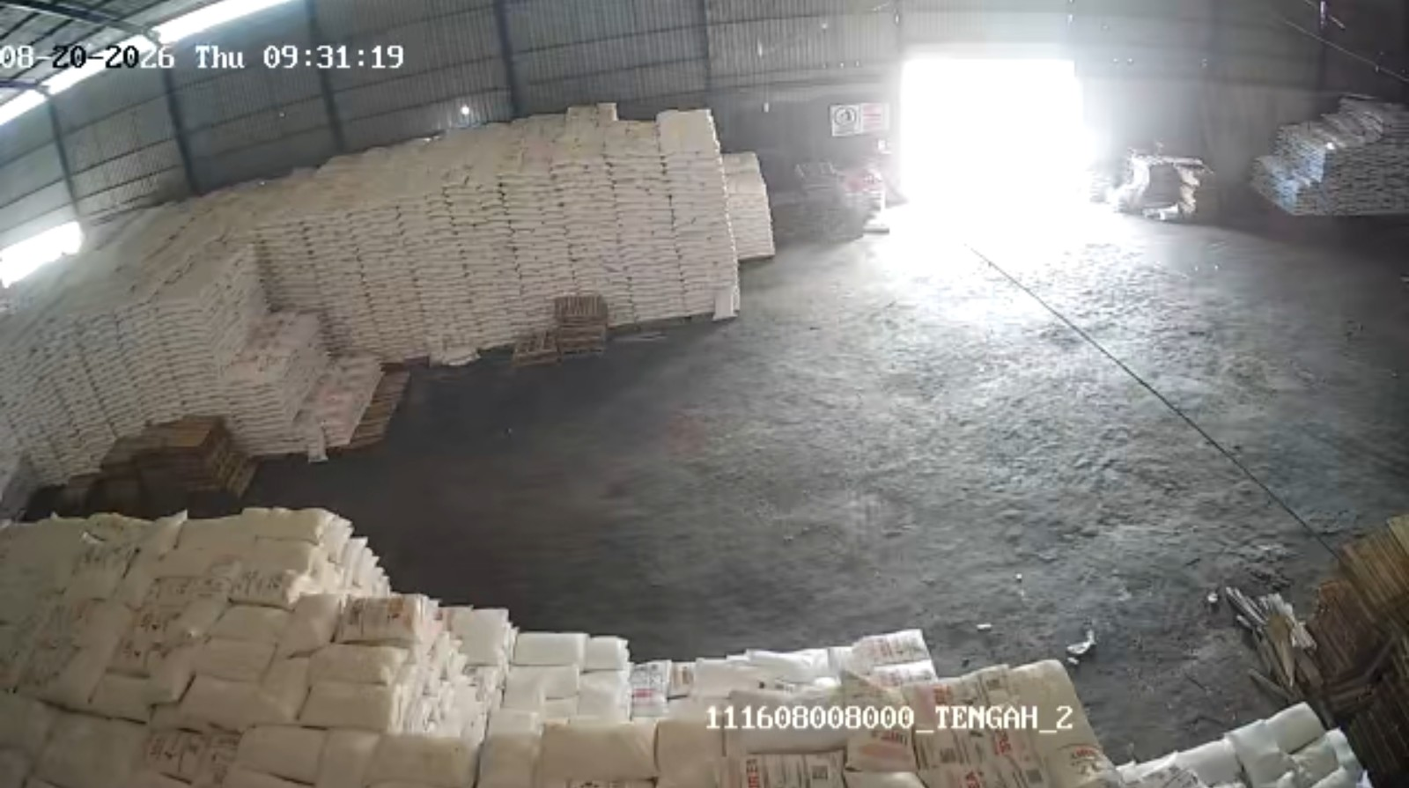
GPP Tuban - Palang (B3AG) — JAWA TIMUR
Jember - Kranjingan (B3DT/D3GP) — JAWA TIMUR
Jenis | Stok Fisik | Out. SO | Intransit | Stok Admin
NPK | 507.50 | 314.00 | 104.50 | 298.00
Urea | 1,834.30 | 297.00 | 170.50 | 1,707.80
Jenis | Stok Fisik | Out. SO | Intransit | Stok Admin
NPK | 22.95 | 279.00 | 111.20 | -144.85
Urea | 781.20 | 288.00 | 38.80 | 532.00
Jember - Puger (B381/D3AI) — JAWA TIMUR
Jombang - Gatsu (B382/D3AJ) — JAWA TIMUR
Jenis | Stok Fisik | Out. SO | Intransit | Stok Admin
NPK | 99.22 | 323.00 | 168.20 | -55.58
Urea | 1,319.60 | 285.00 | 0.00 | 1,034.60
Jenis | Stok Fisik | Out. SO | Intransit | Stok Admin
NPK | 27.95 | 125.00 | 131.60 | 34.55
Urea | 1,981.20 | 227.00 | 0.00 | 1,754.20
CCTV Depan (Tidak tersedia)
CCTV Dalam (Tidak tersedia)

Slide 11
Jombang - Jatipelem (B3C3) — JAWA TIMUR
Jenis | Stok Fisik | Out. SO | Intransit | Stok Admin
NPK | 38.75 | 346.00 | 172.10 | -135.15
Urea | 1,749.80 | 247.00 | 40.45 | 1,543.25
CCTV Depan (Tidak tersedia)
CCTV Dalam (Tidak tersedia)

