Slide 1

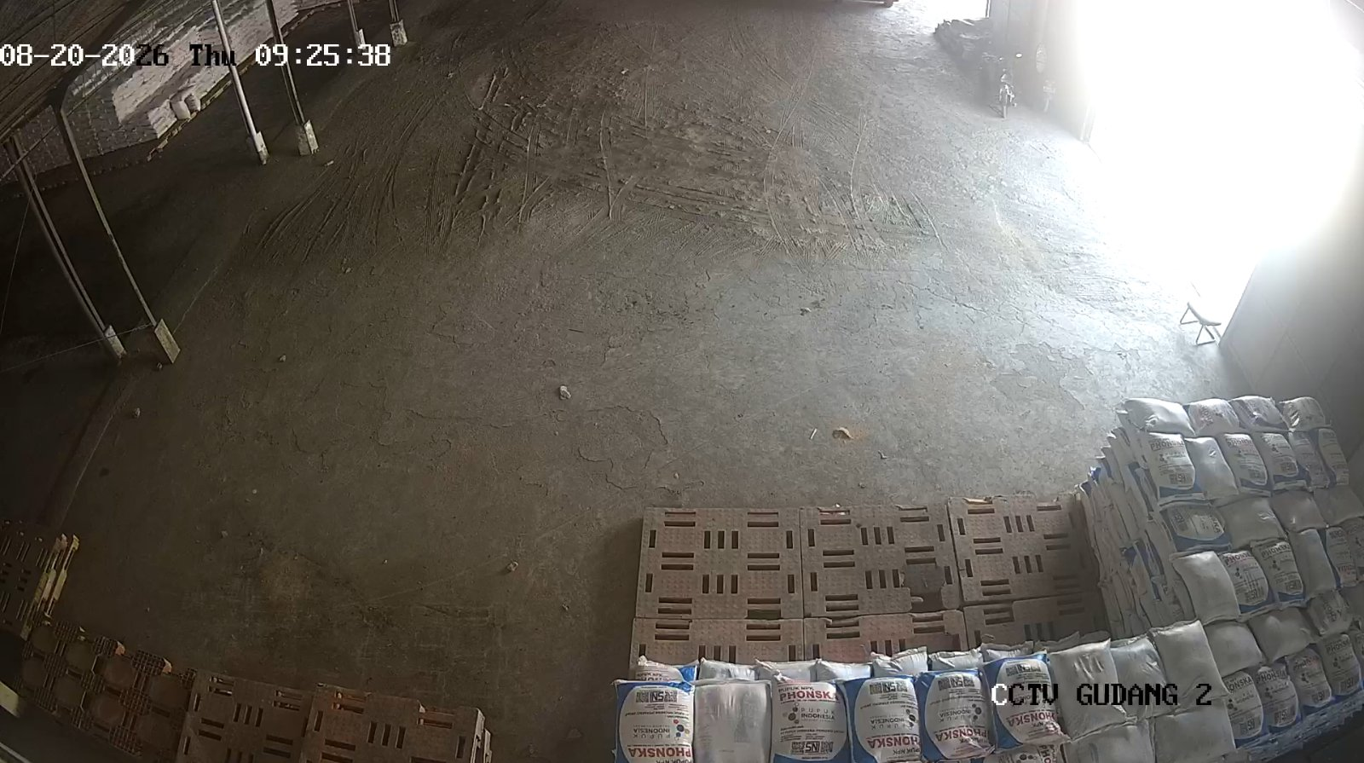
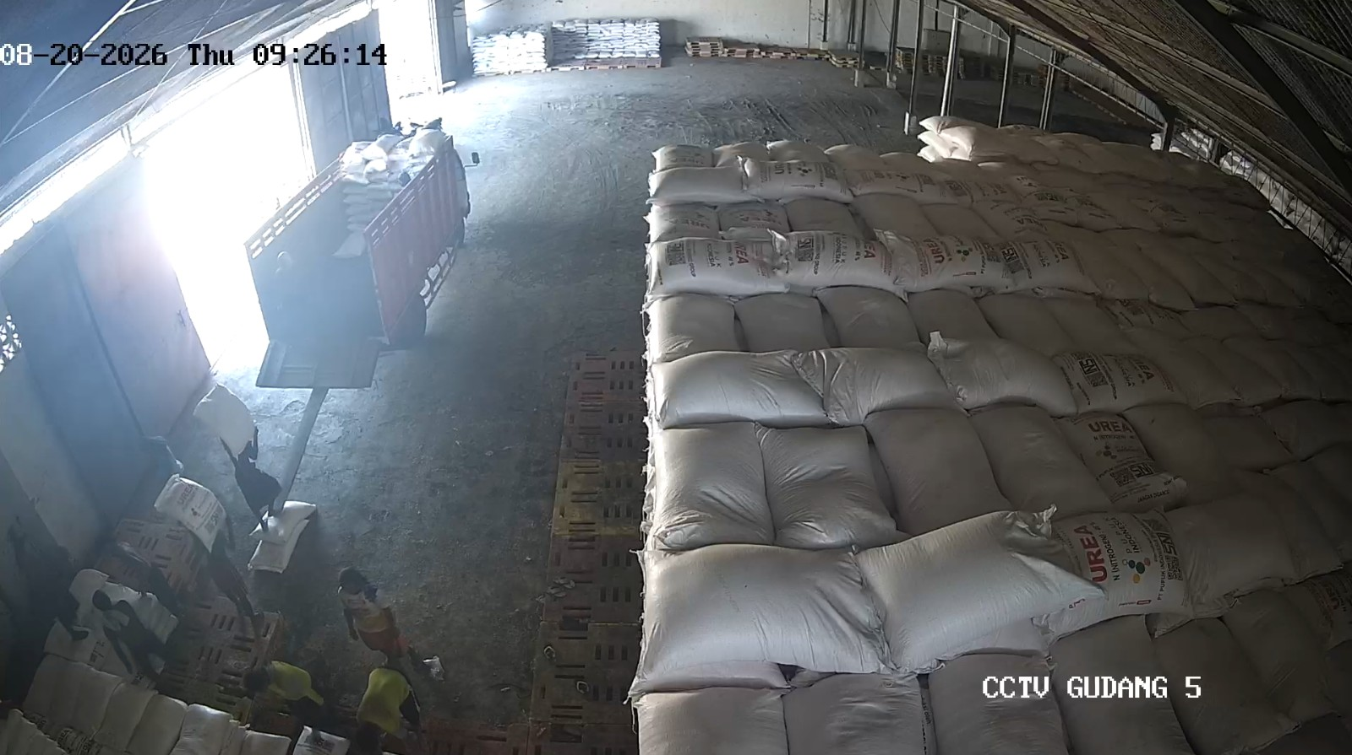
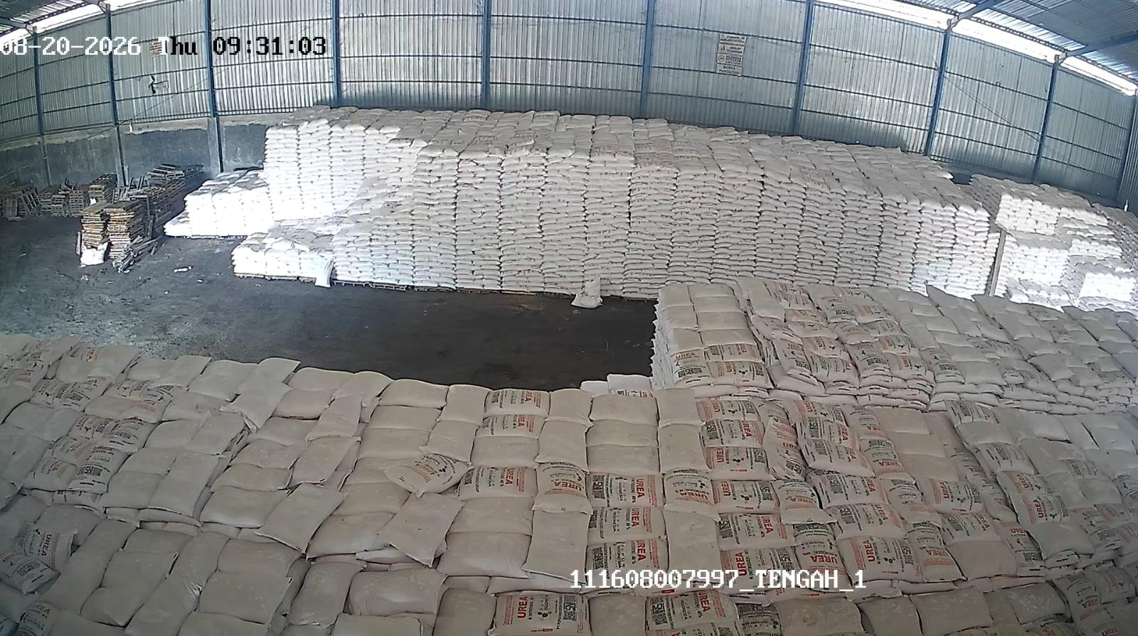
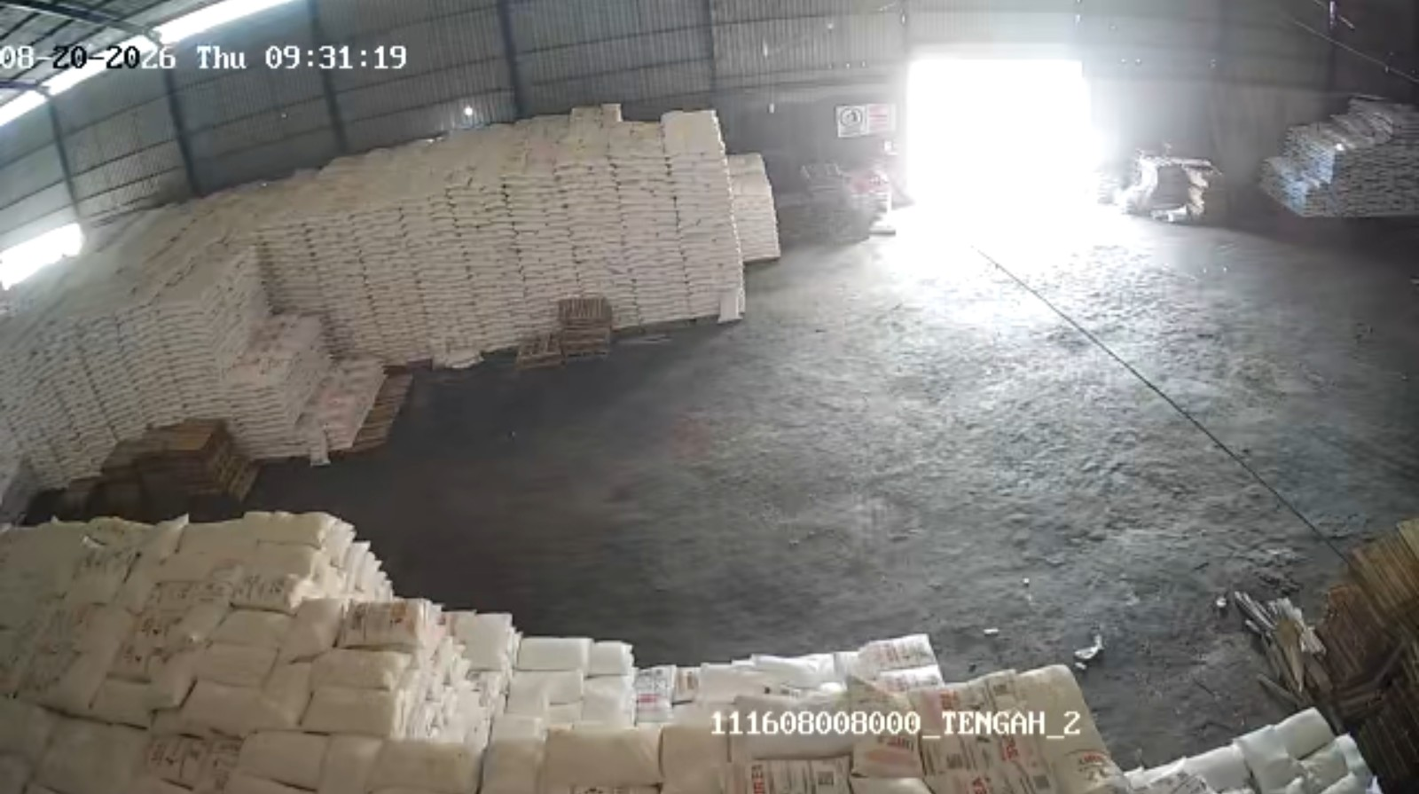
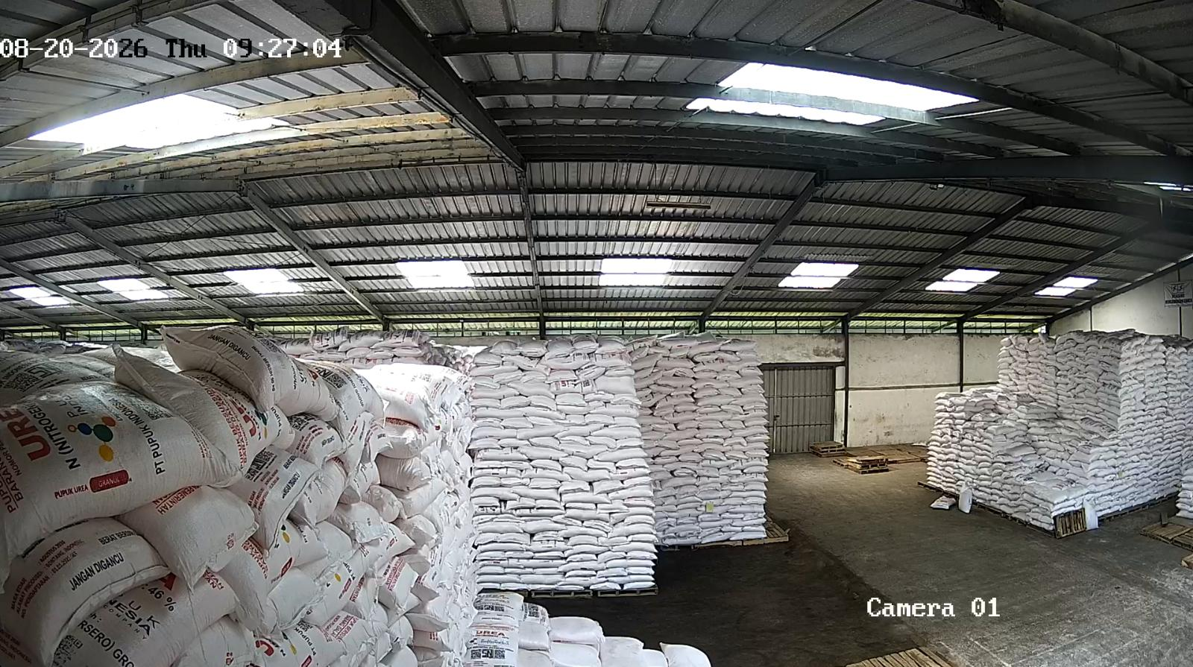
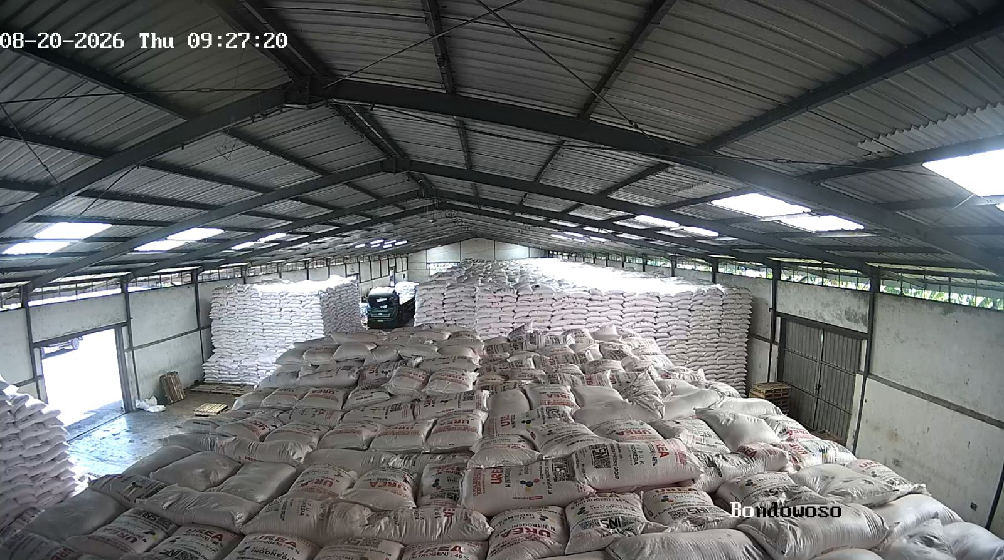
Laporan Stok Harian — 20 August 2026
Jember - Kranjingan (B3DT/D3GP)
Jember - Puger (B381/D3AI)
Jenis | Stok Fisik | Out. SO | Intransit | Stok Admin
NPK | 22.95 | 279.00 | 111.20 | -144.85
Urea | 781.20 | 288.00 | 38.80 | 532.00
Jenis | Stok Fisik | Out. SO | Intransit | Stok Admin
NPK | 99.22 | 323.00 | 168.20 | -55.58
Urea | 1,319.60 | 285.00 | 0.00 | 1,034.60
GPP Bondowoso - Wonosari (B3DU/D3GD)
GPP SRAGEN (F332)
Jenis | Stok Fisik | Out. SO | Intransit | Stok Admin
NPK | 15.00 | 184.00 | 76.50 | -92.50
Urea | 2,554.70 | 165.00 | 38.80 | 2,428.50
Jenis | Stok Fisik | Out. SO | Intransit | Stok Admin
Urea | 1,076.15 | 498.85 | 247.45 | 824.75
CCTV Depan (Tidak tersedia)
CCTV Dalam (Tidak tersedia)

Slide 2
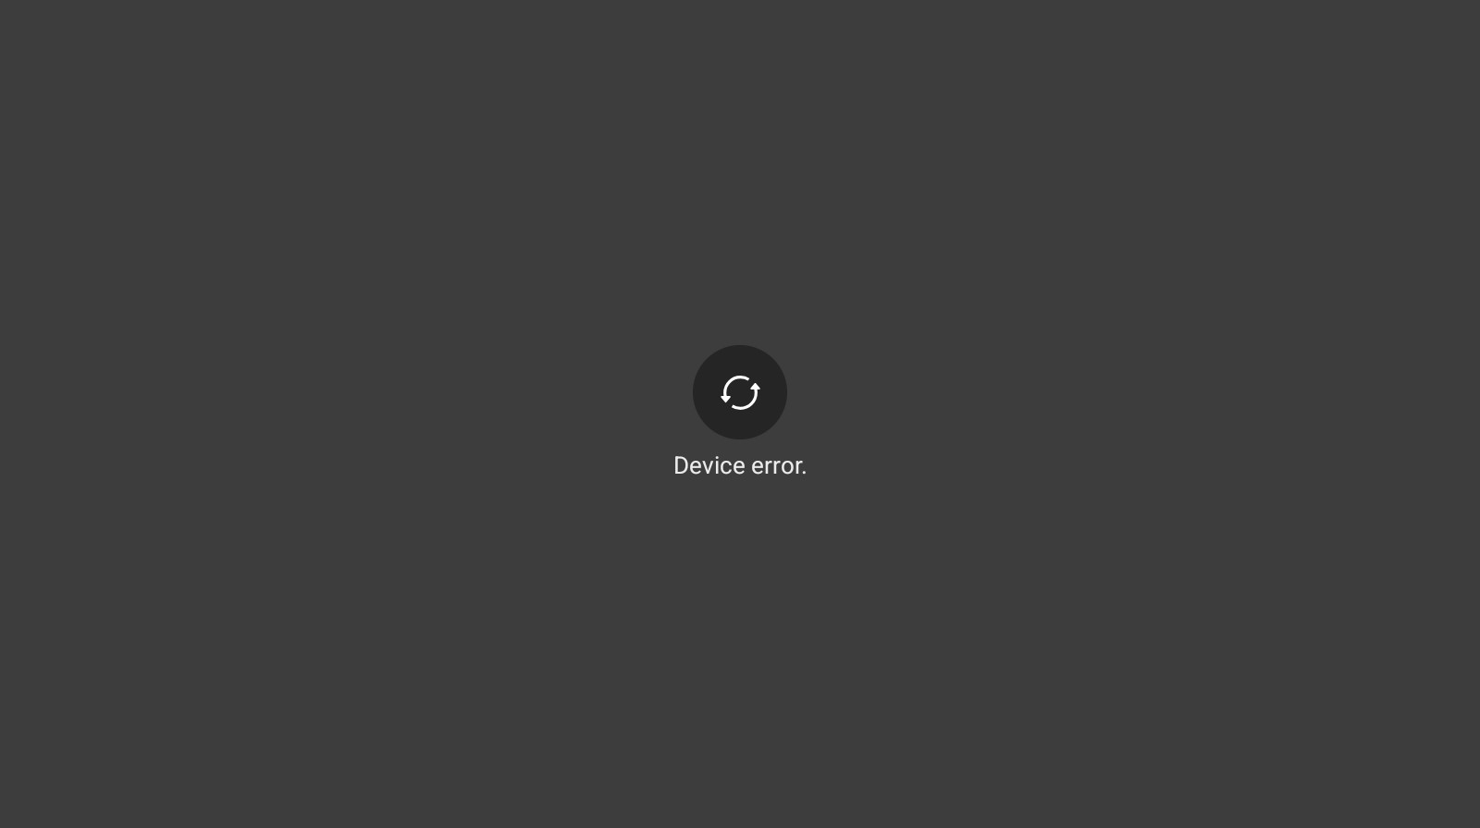
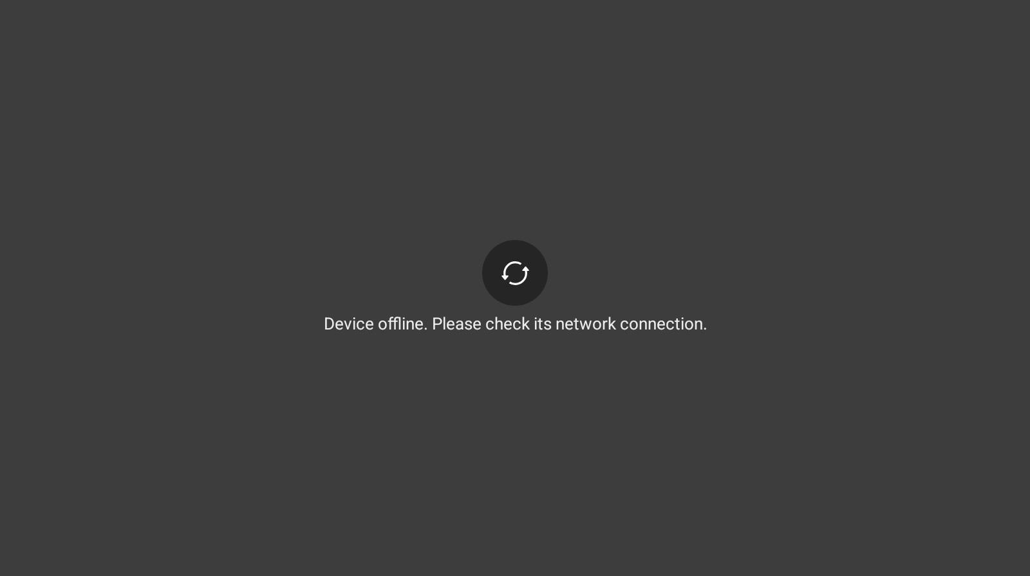
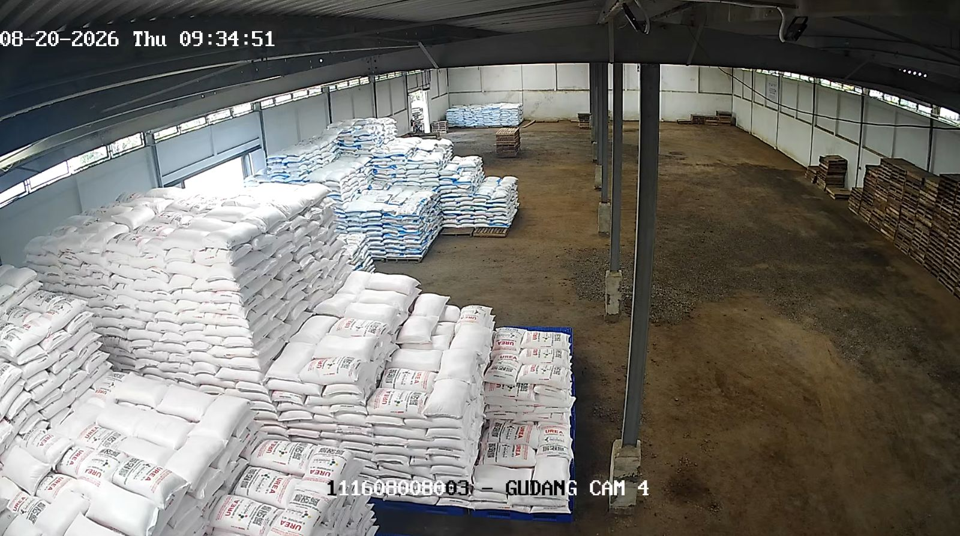
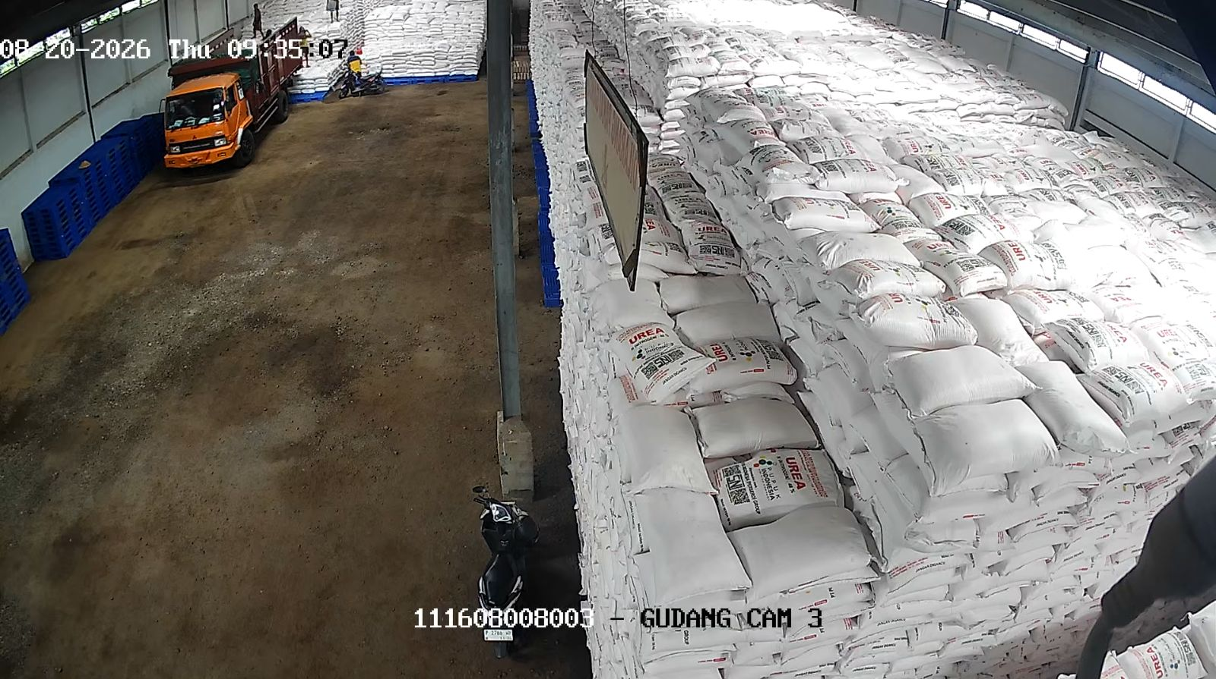
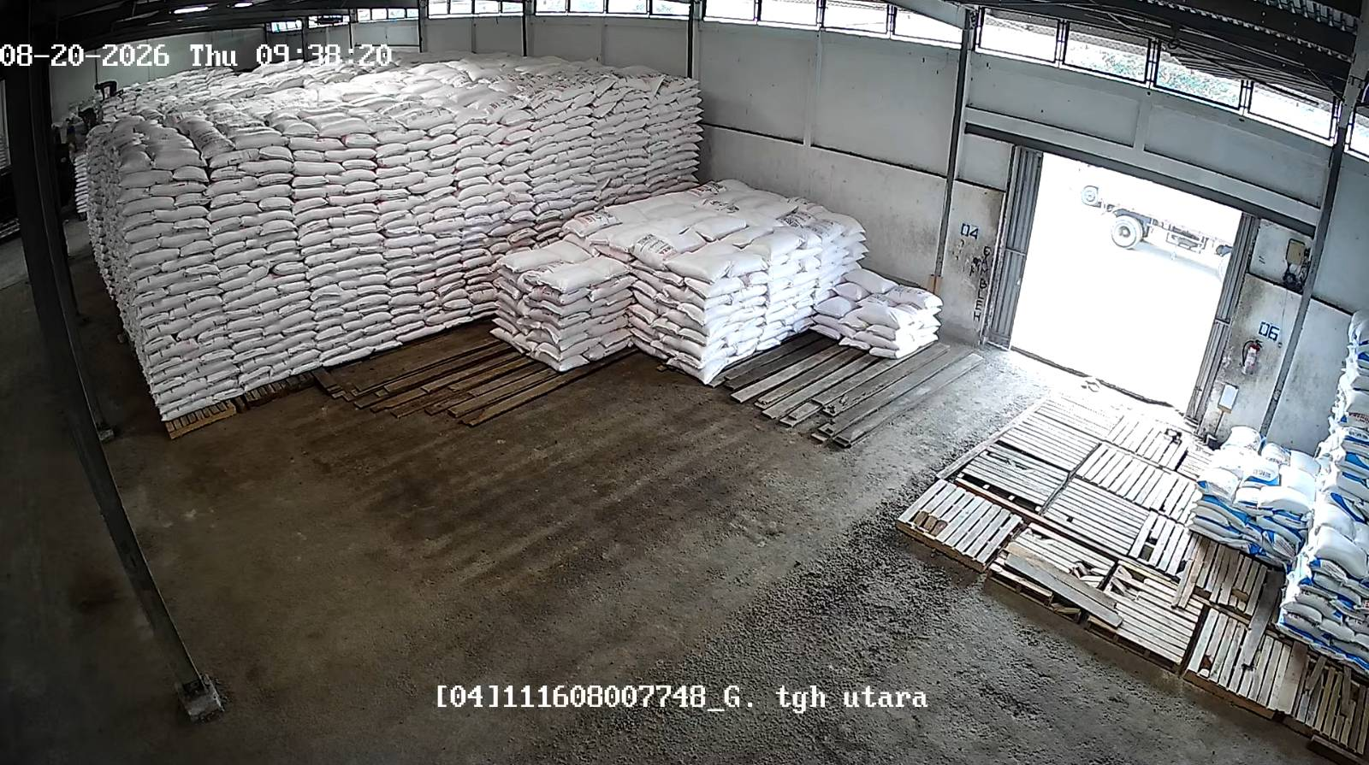
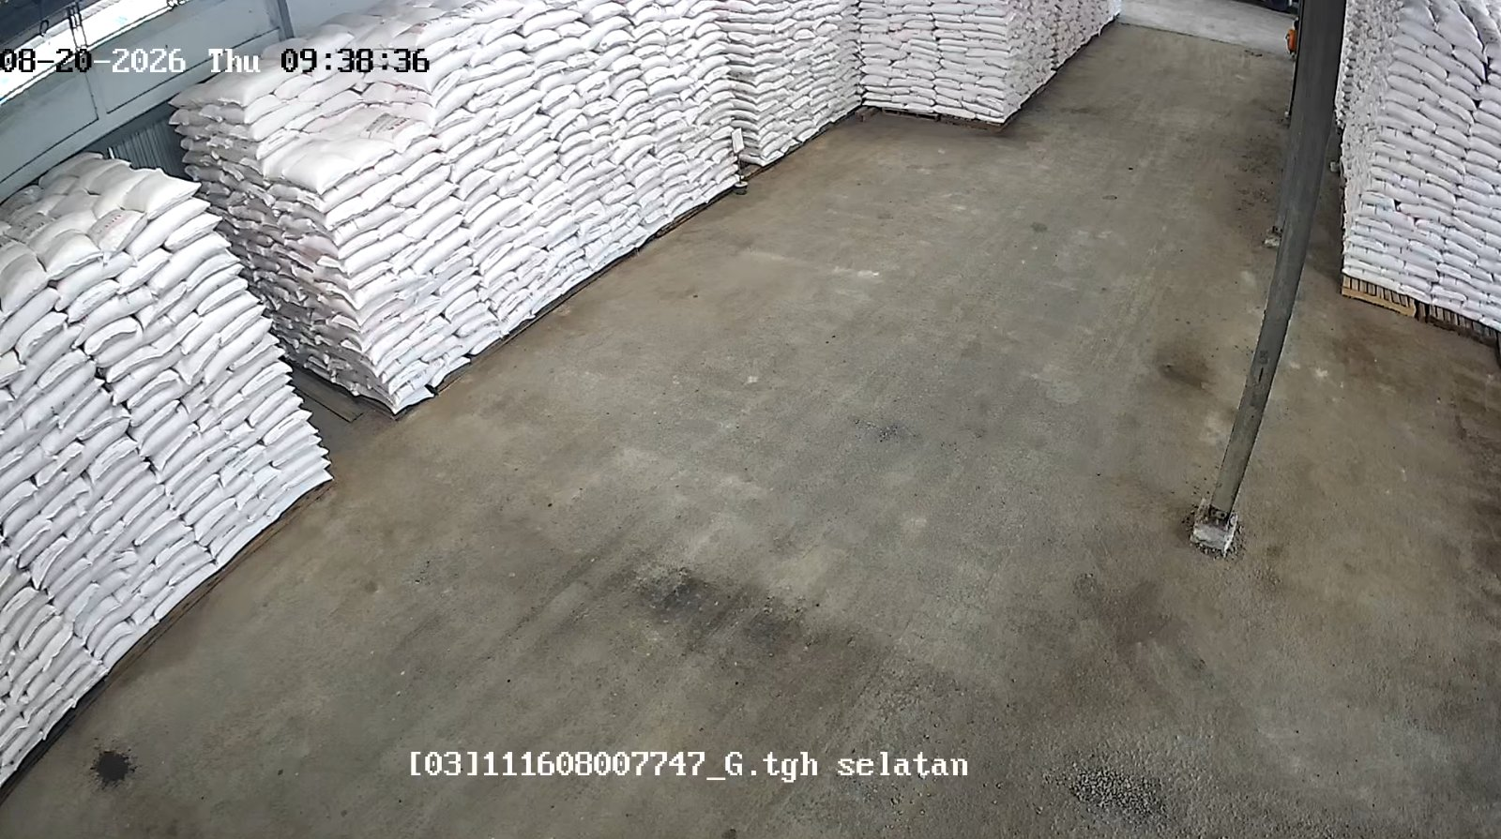
Laporan Stok Harian — 20 August 2026
Asahan (D3HK/E310)
Bojonegoro - Sumberejo (B372)
Jenis | Stok Fisik | Out. SO | Intransit | Stok Admin
NPK | 287.30 | 78.50 | 45.00 | 253.80
Urea | 1,107.25 | 36.00 | 76.00 | 1,147.25
Jenis | Stok Fisik | Out. SO | Intransit | Stok Admin
NPK | 243.30 | 115.00 | 0.00 | 128.30
Urea | 3,744.15 | 132.00 | 187.50 | 3,799.65
GPP Banyuwangi - Kabat (B3DW/D307)
GPP Kediri - Ngadiluwih (B3BW)
Jenis | Stok Fisik | Out. SO | Intransit | Stok Admin
NPK | 171.90 | 81.00 | 315.25 | 406.15
Urea | 1,579.95 | 245.00 | 0.00 | 1,334.95
Jenis | Stok Fisik | Out. SO | Intransit | Stok Admin
NPK | 92.90 | 196.90 | 155.40 | 51.40
Urea | 1,141.55 | 148.60 | 42.20 | 1,035.15

Slide 3
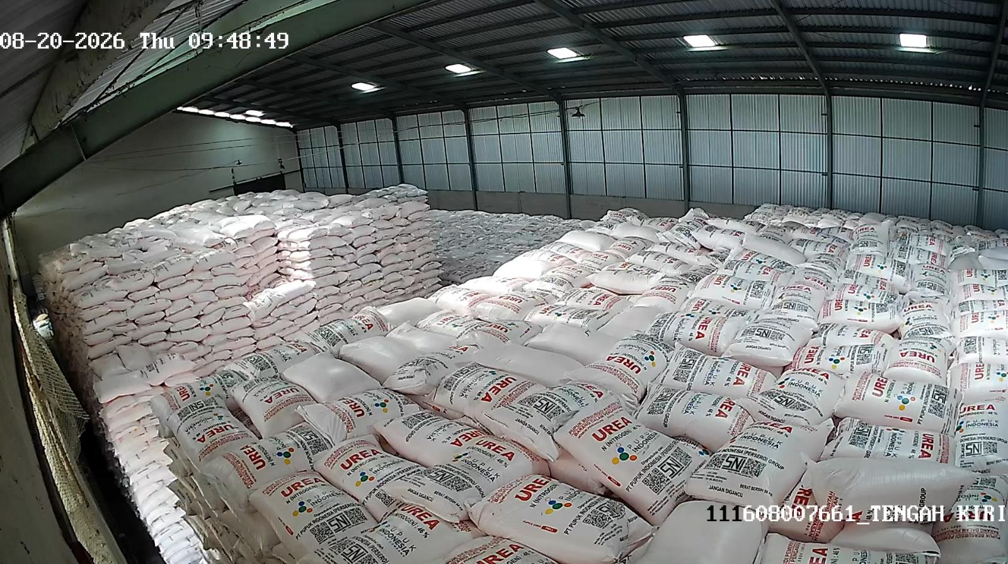
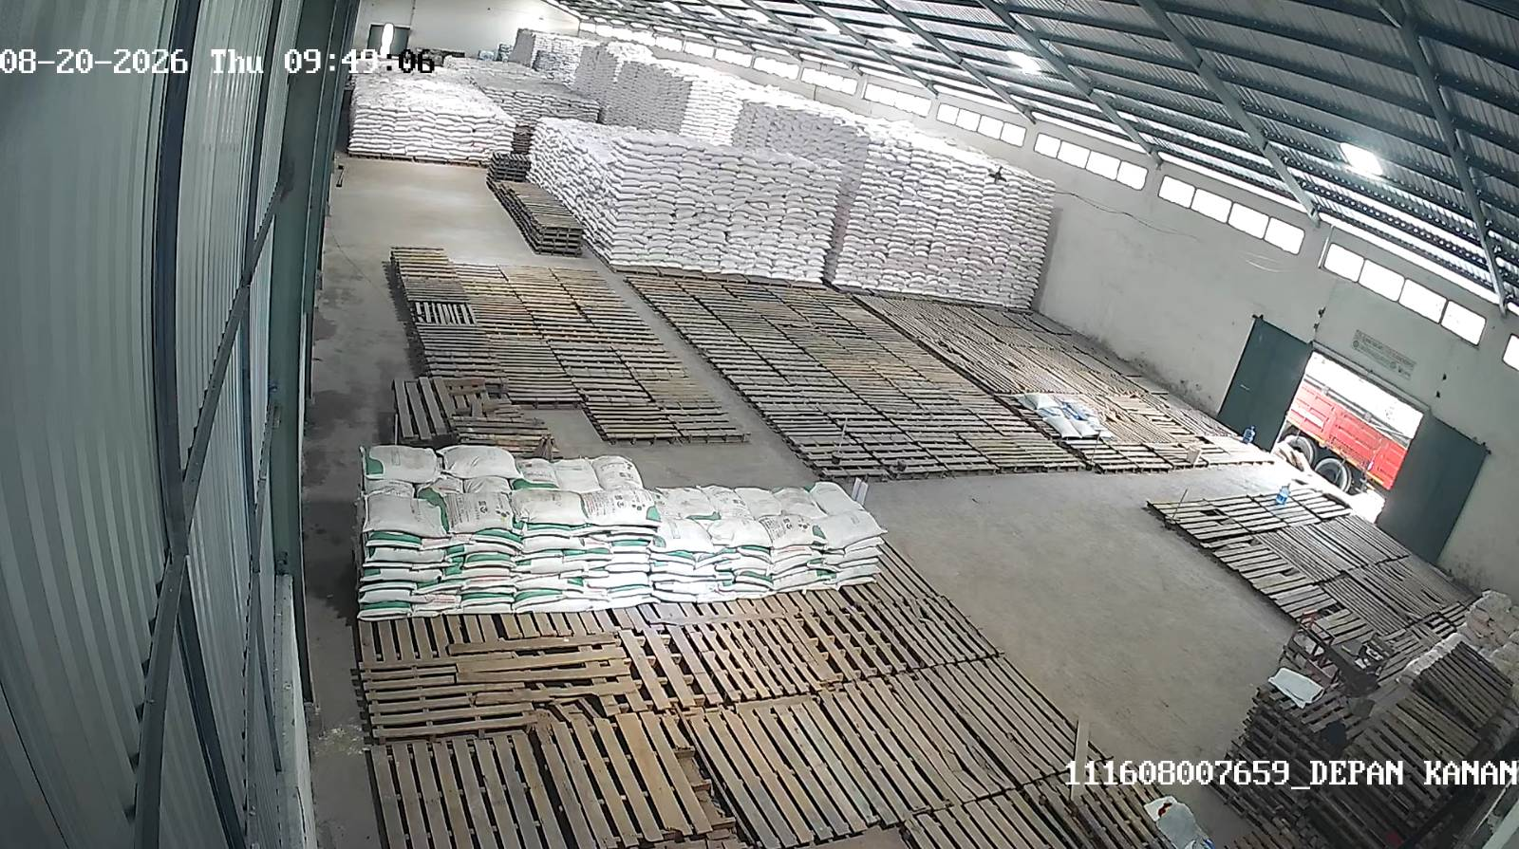
Laporan Stok Harian — 20 August 2026
Magetan - Maospati (B391/D3AW)
Jenis | Stok Fisik | Out. SO | Intransit | Stok Admin
NPK | 5.90 | 348.00 | 151.60 | -190.50
Urea | 1,343.40 | 133.50 | 213.00 | 1,422.90

