Slide 1

Final Capstone: Fantasy Premier League Optimization
Farhan Kassam • 04.11.2023

Slide 2
Introduction
Problem Statement
Can I more accurately predict the highest scoring FPL team on a given week than FPL’s expected points model?
Value
Competitive edge against players across the world

Slide 3
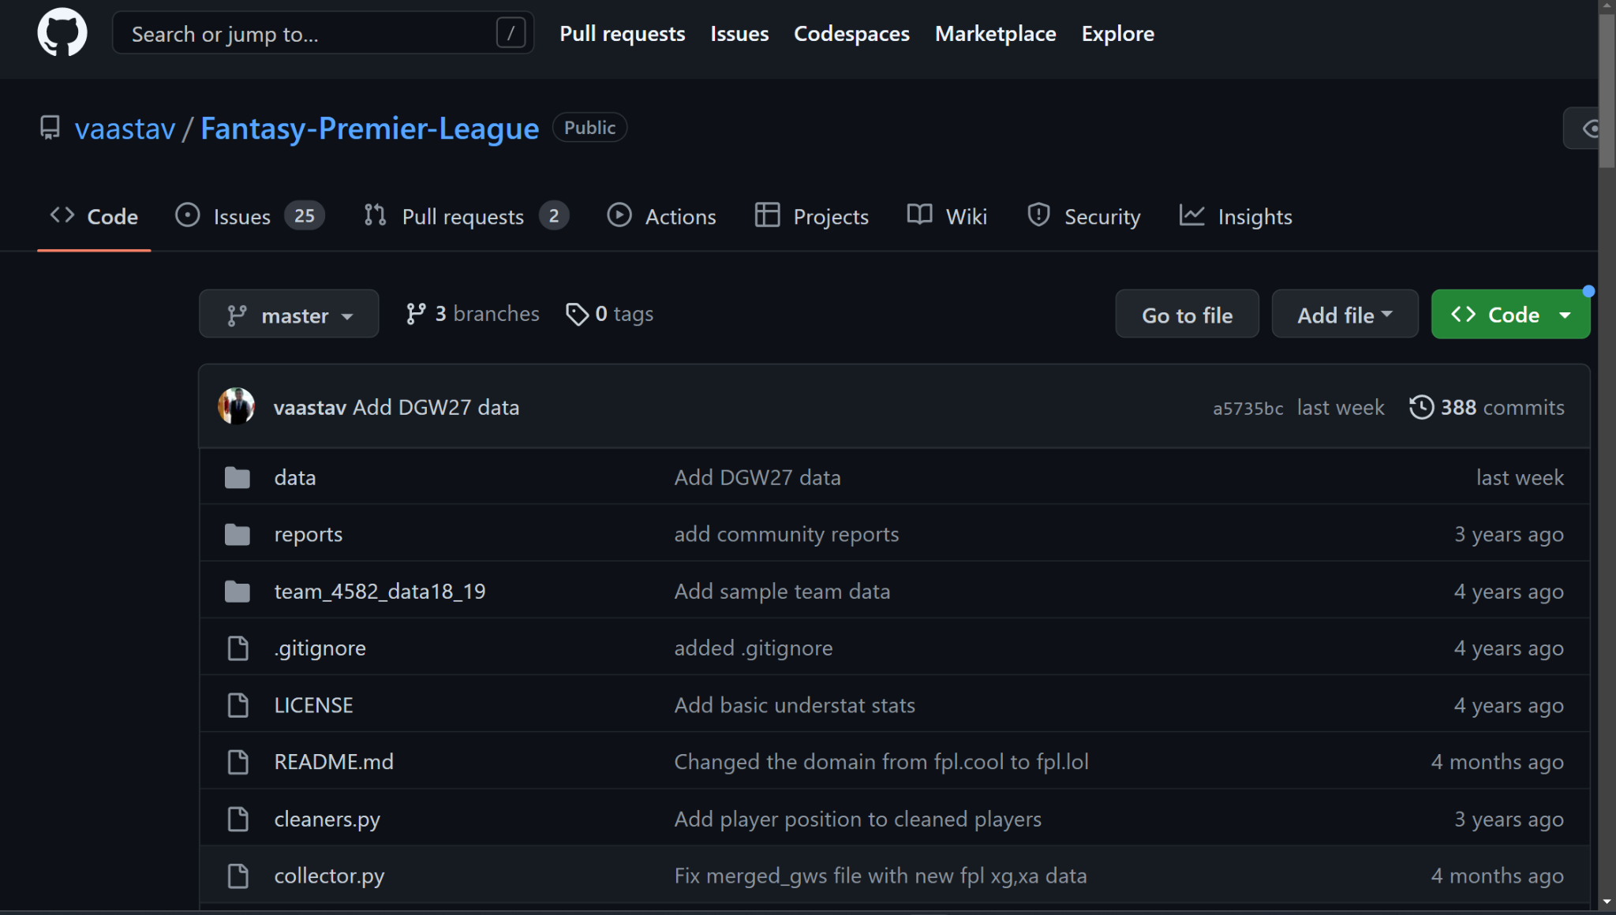
Data Collection
Public GitHub Repository
Updated Weekly
Used merged gameweek data
Stored in .csv files

Slide 4
Data Description
Overview
Review of 22/23 Season for GW 1-24
41 columns and 15866 rows
Rows of each player for each gameweek
Feature Descriptions
Player statistics such as:
Influence, Creativity, Threat
Expected Goals, Assists, Goal Involvement
Name, position, team, GW, total_points

Slide 5
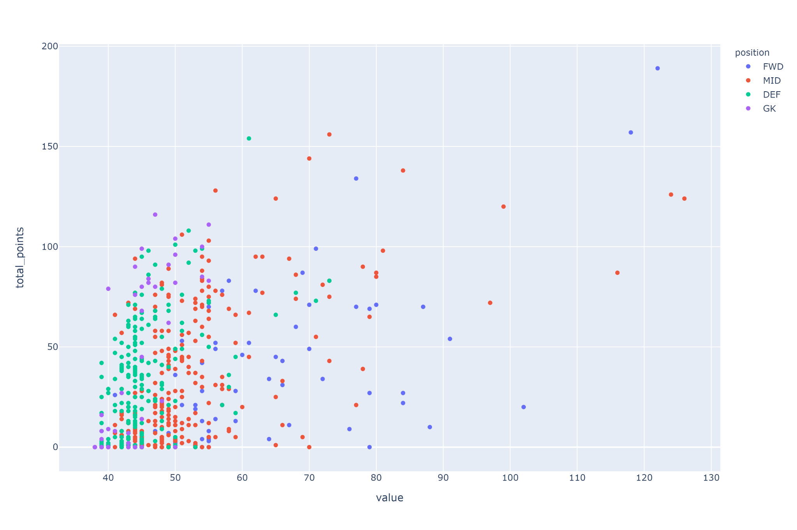
Actionable Insights
What I Found?
The best value for points in each position

Slide 6
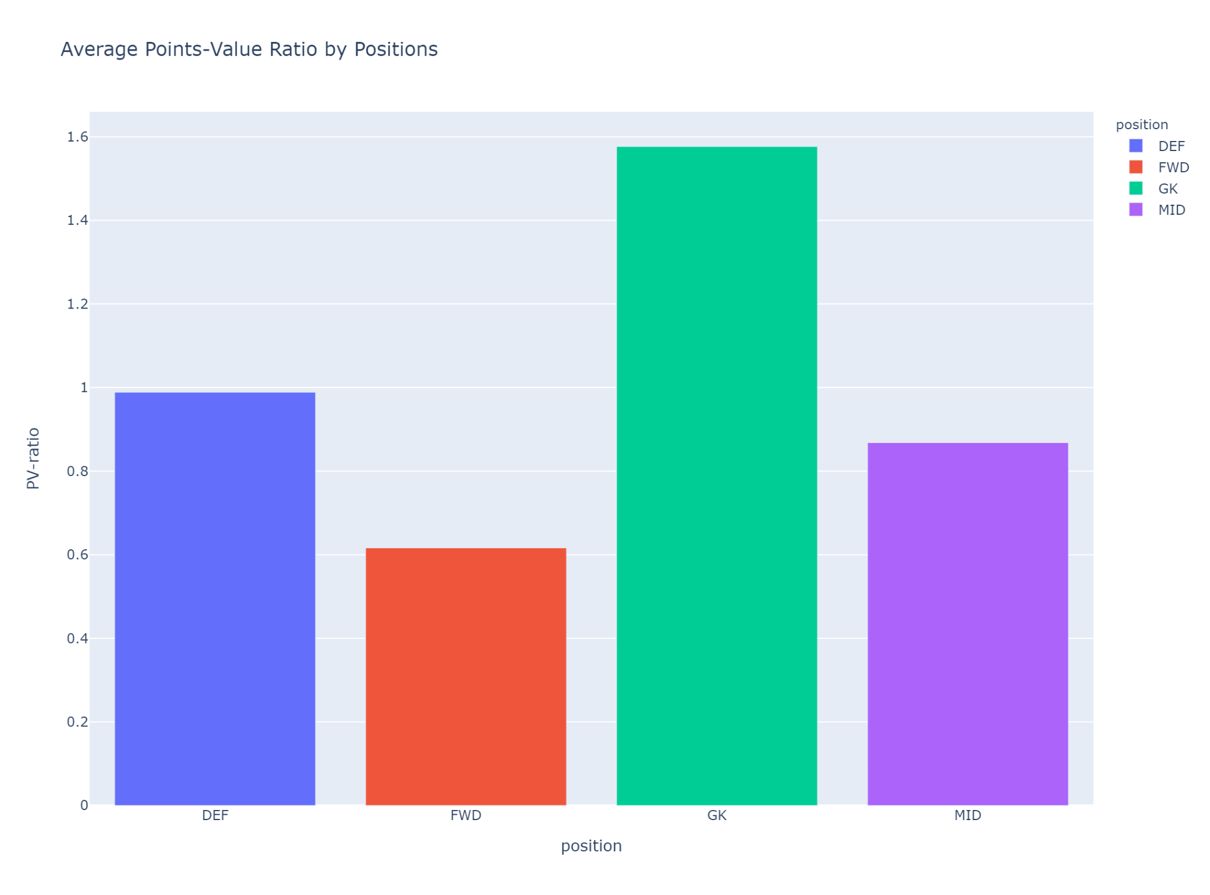
Where should we invest?
What I Found?
On average, goalkeepers and defenders yield the most points for value
The Problem?
Bias in FPL points system to reward attacking contributions more than defensive

Slide 7
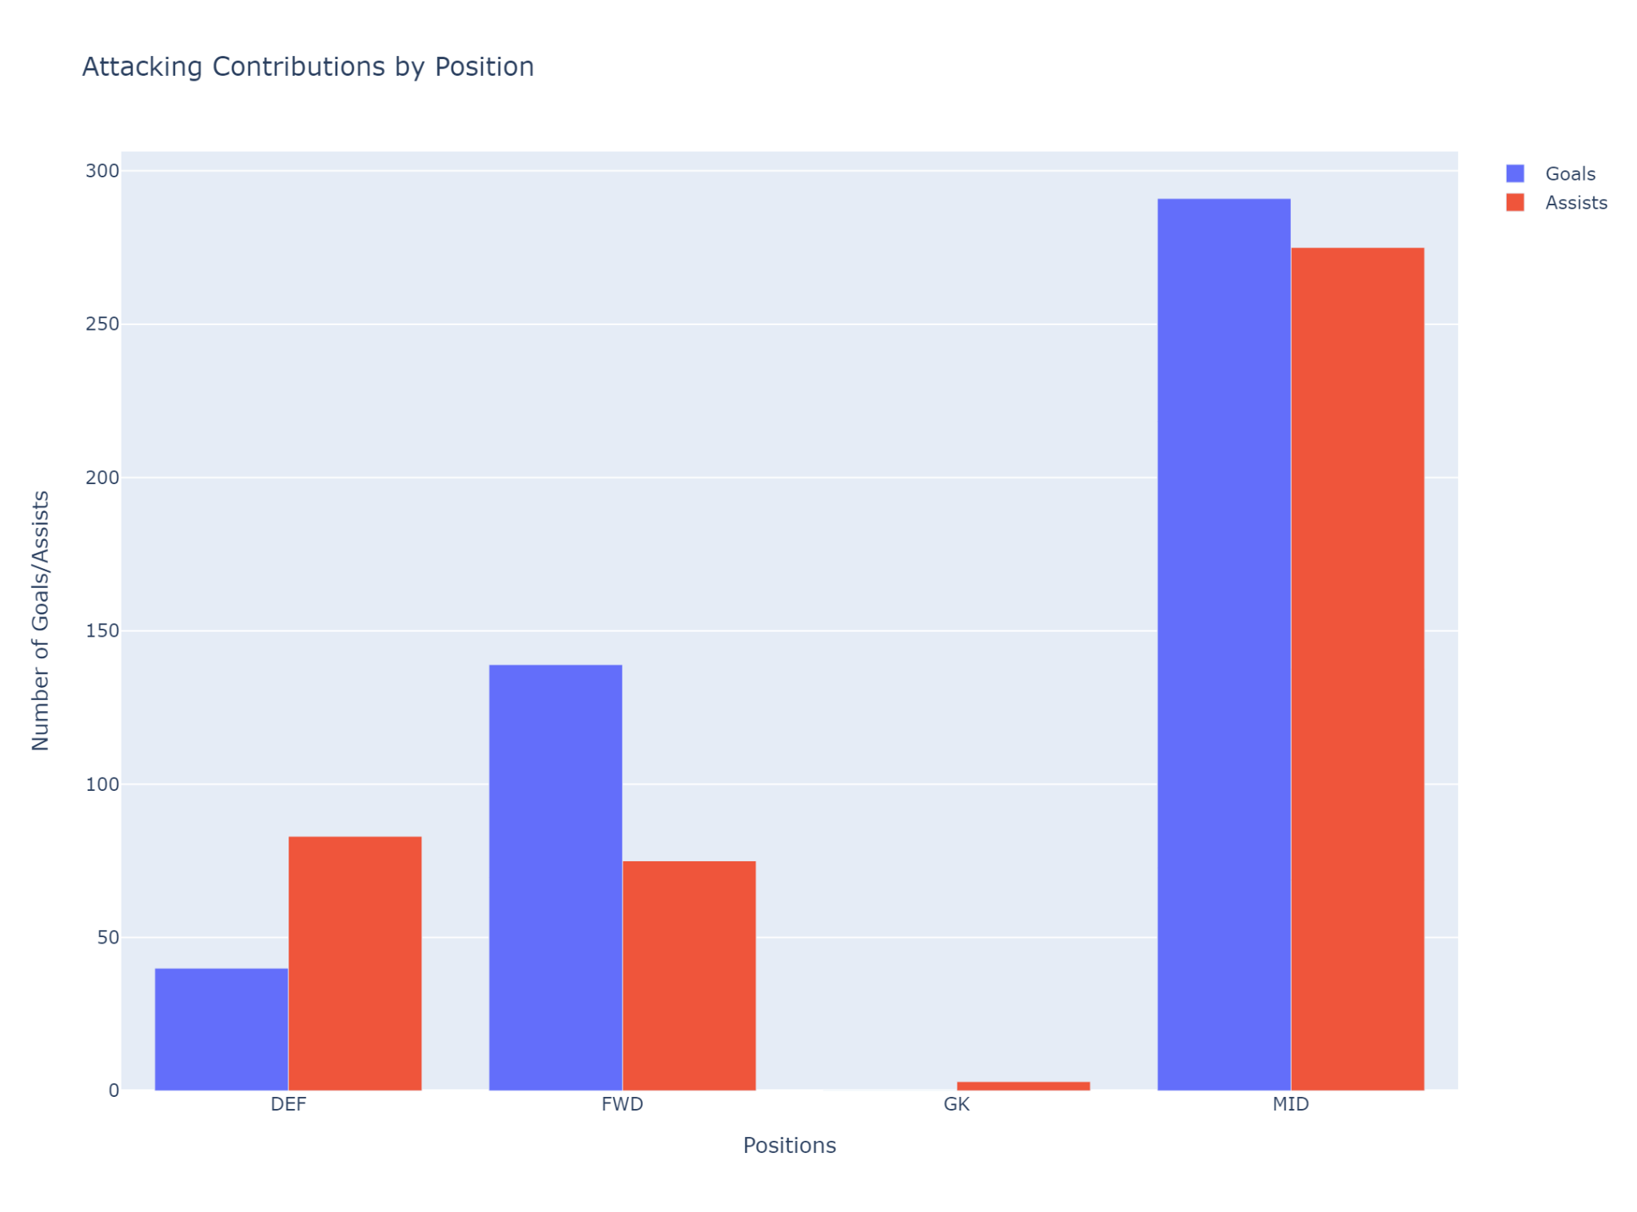
Attacking Contributions
What I Found?
Midfielders yield the best attacking returns

Slide 8
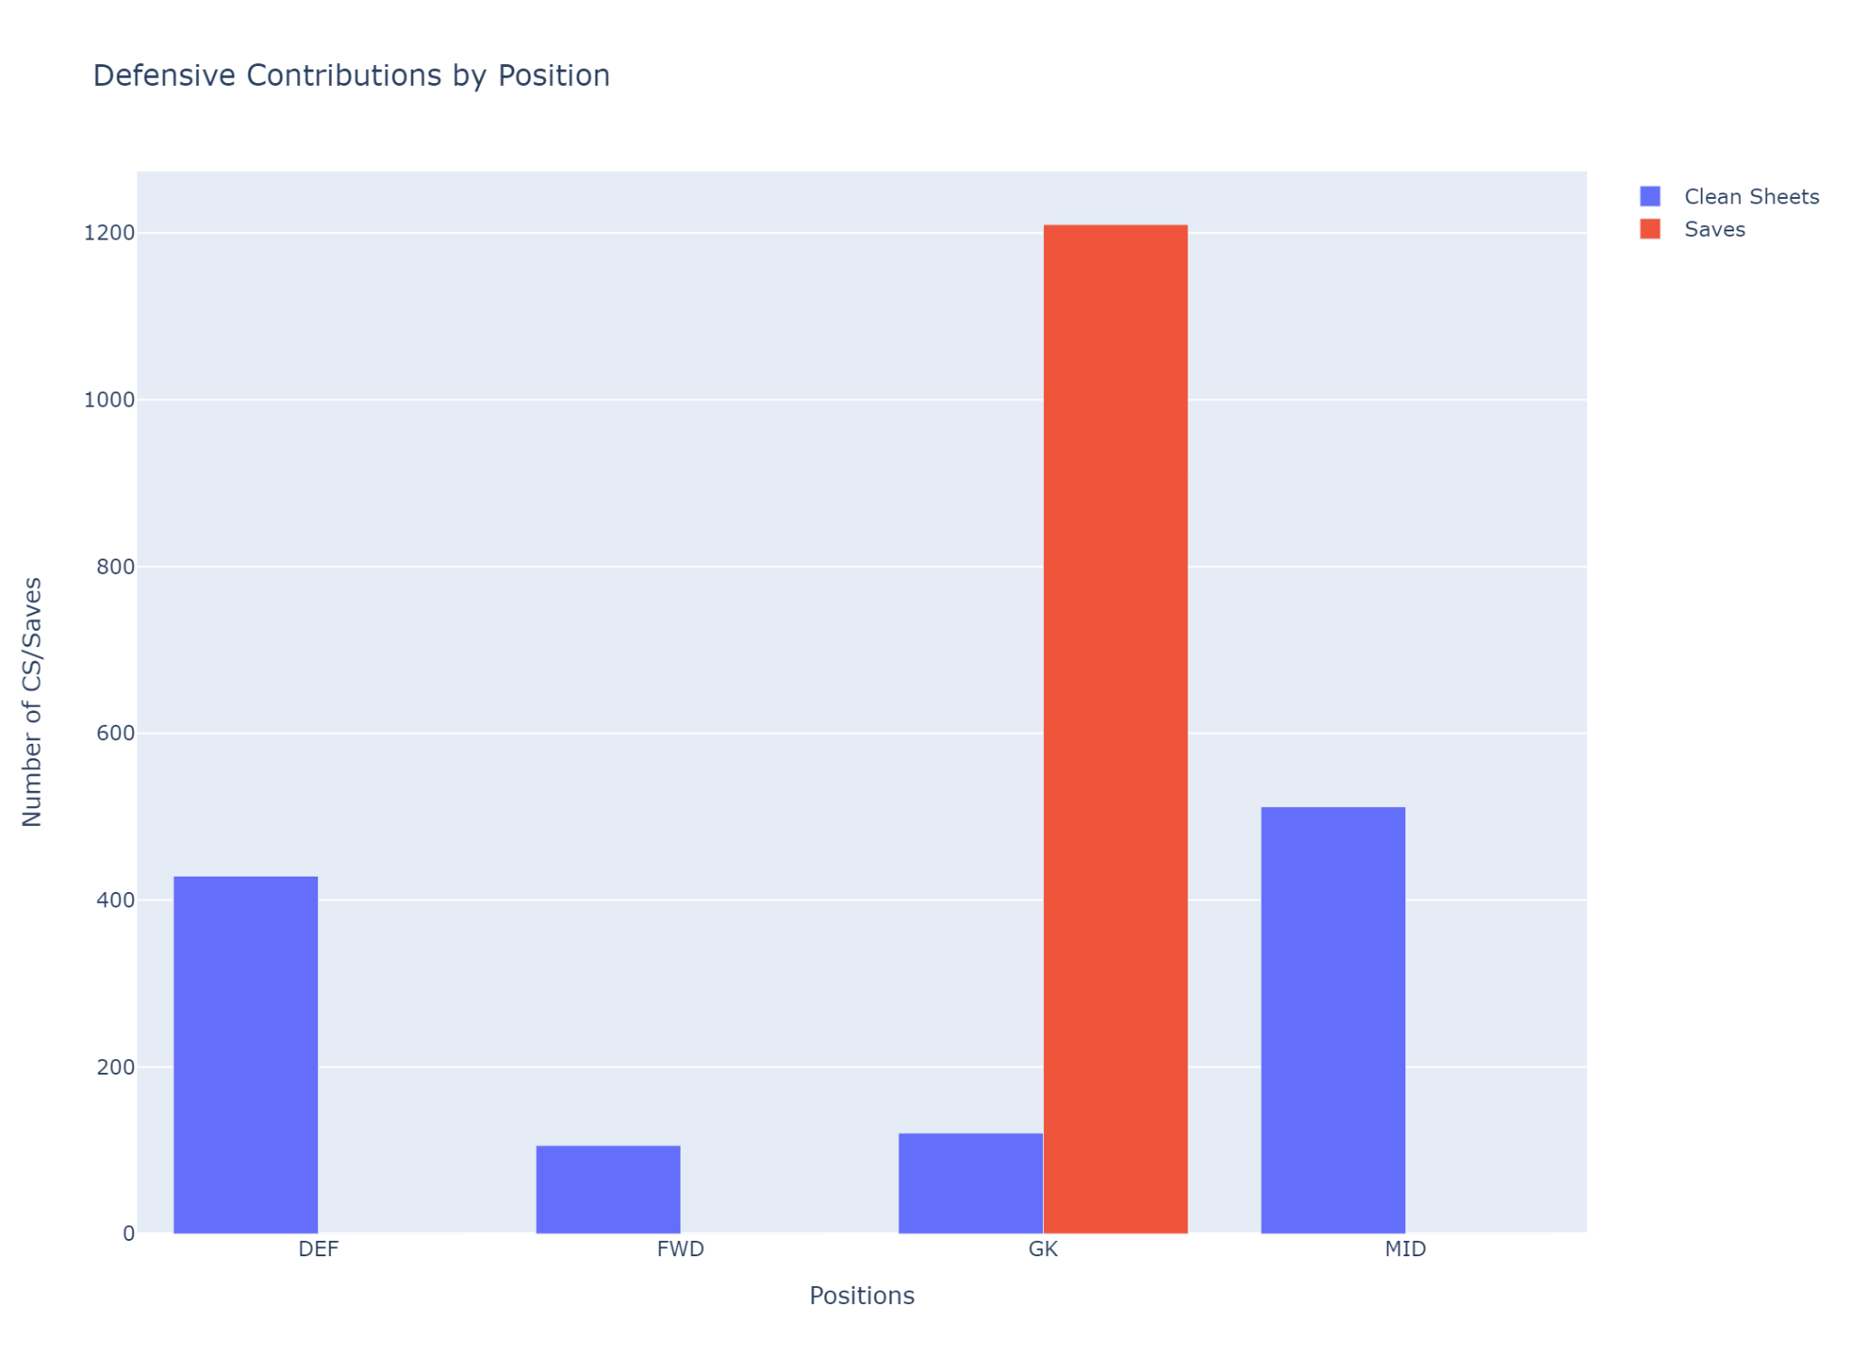
Defensive Contributions
What I Found?
Goalkeepers and defenders yield the most defensive returns
Lower overall contributions than attacking

Slide 9
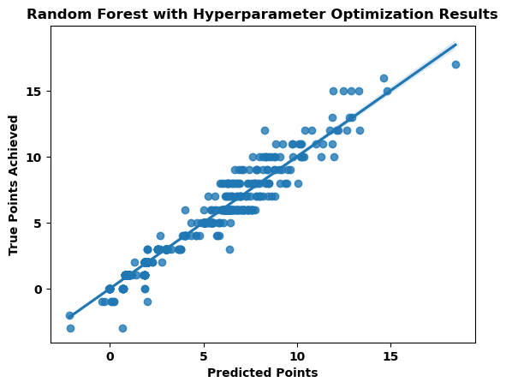
Data Modelling: The Results
Model Accuracy
Training: 97%
Test: 96%
Important Features
Goals_scored, assists, clean_sheets, influence

Slide 10
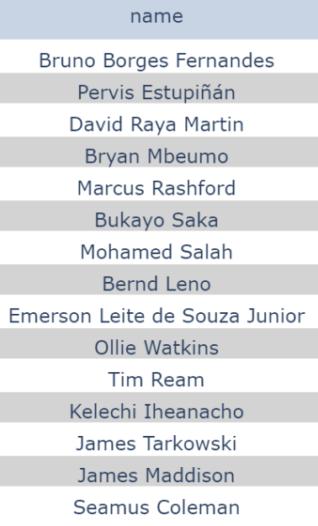
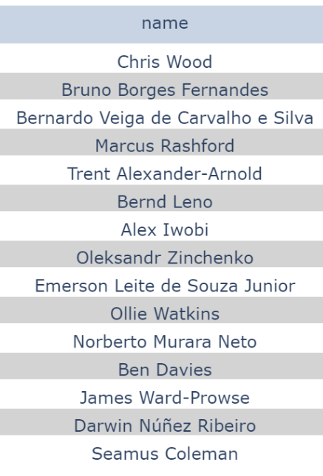

Comparing Team Sheets for GW 24
FPL xP
My Pred
True
FPL xP team and my team: 40%
FPL xP team and true squad: 46%
My team and true squad: 80%

Slide 11
Conclusion & Next Steps
Problems
Poor feature selection, predicting points on actual results.
For Now
Continue to use MILP to select a team based on FPL’s point predictions.
Next Steps
Carefully select features that are indicative of a player’s form and expected statistics to predict performance/points in future matches.

Slide 12

Thank You!
Contact Info:
farhankassam0@gmail.com
linkedin.com/in/farhan-kassam/

