Slide 1

Final Capstone: Fantasy Premier League Optimization
Farhan Kassam • 04.11.2023

Slide 2
Introduction
Problem Statement
Can I more accurately predict the highest scoring FPL team on a given week than FPL’s expected points model?
Value
Competitive edge against players across the world

Slide 3
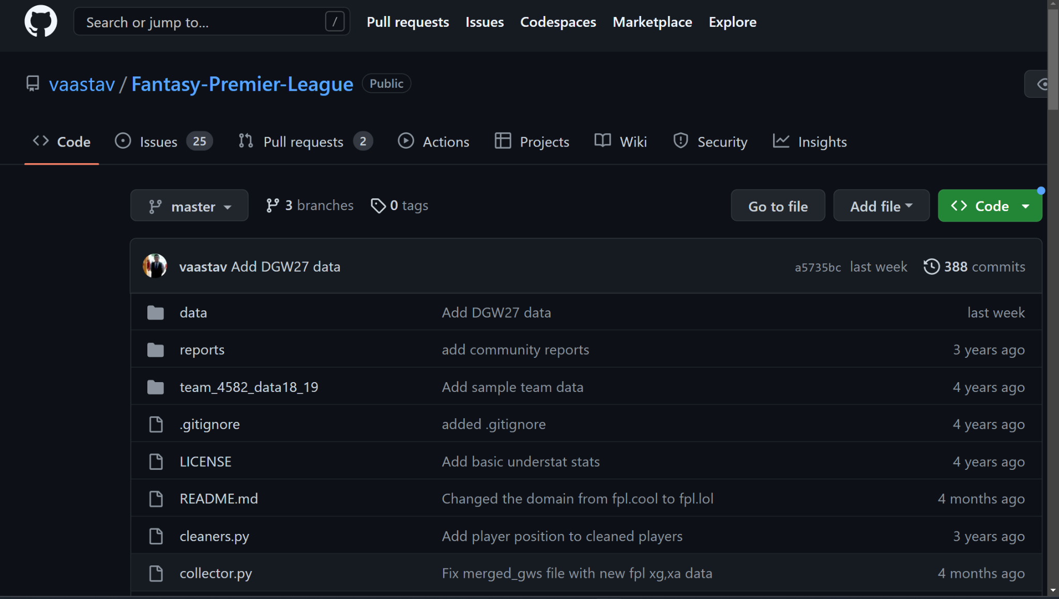
Data Collection
Public GitHub Repository
Updated Weekly
Used merged gameweek data
Stored in .csv files

Slide 4
Data Description
Overview
Review of 22/23 Season for GW 1-24
41 columns and 15866 rows
Rows of each player for each gameweek
Feature Descriptions
Player statistics such as:
Influence, Creativity, Threat
Expected Goals, Assists, Goal Involvement
Name, position, team, GW, total_points

Slide 5
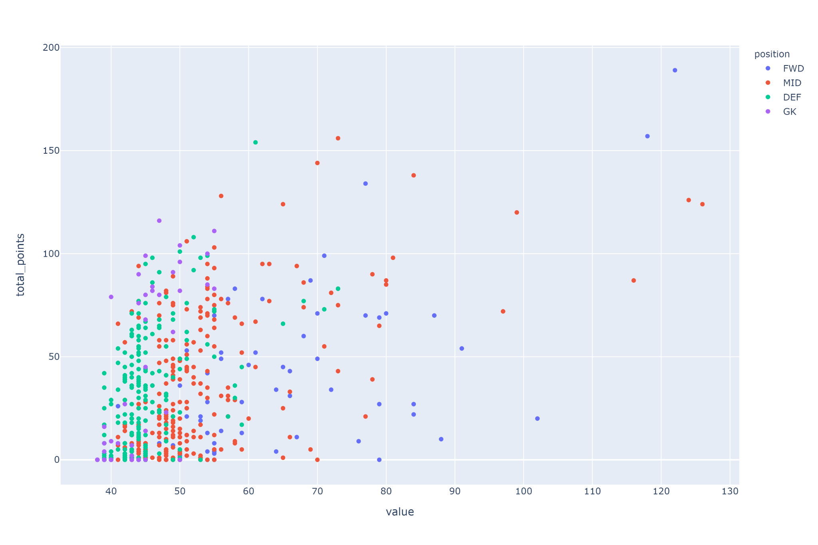
Actionable Insights
What I Found?
The best value for points in each position

Slide 6
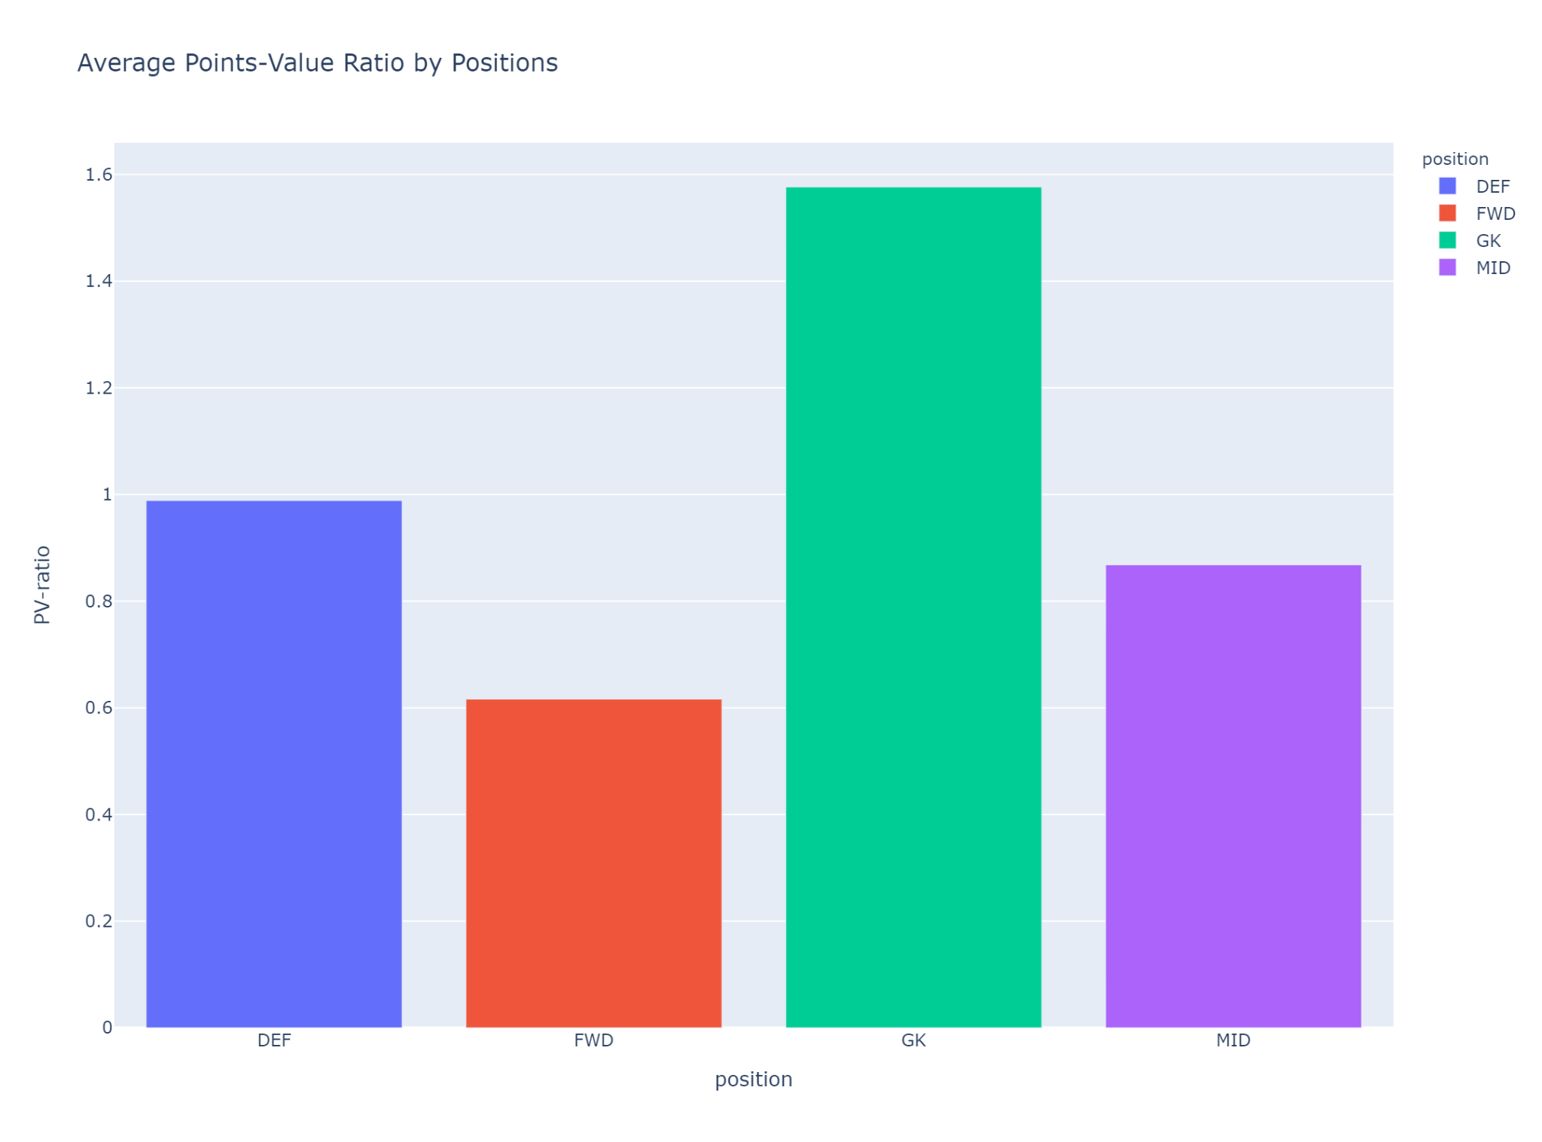
Where should we invest?
What I Found?
On average, goalkeepers and defenders yield the most points for value
The Problem?
Bias in FPL points system to reward attacking contributions more than defensive

Slide 7
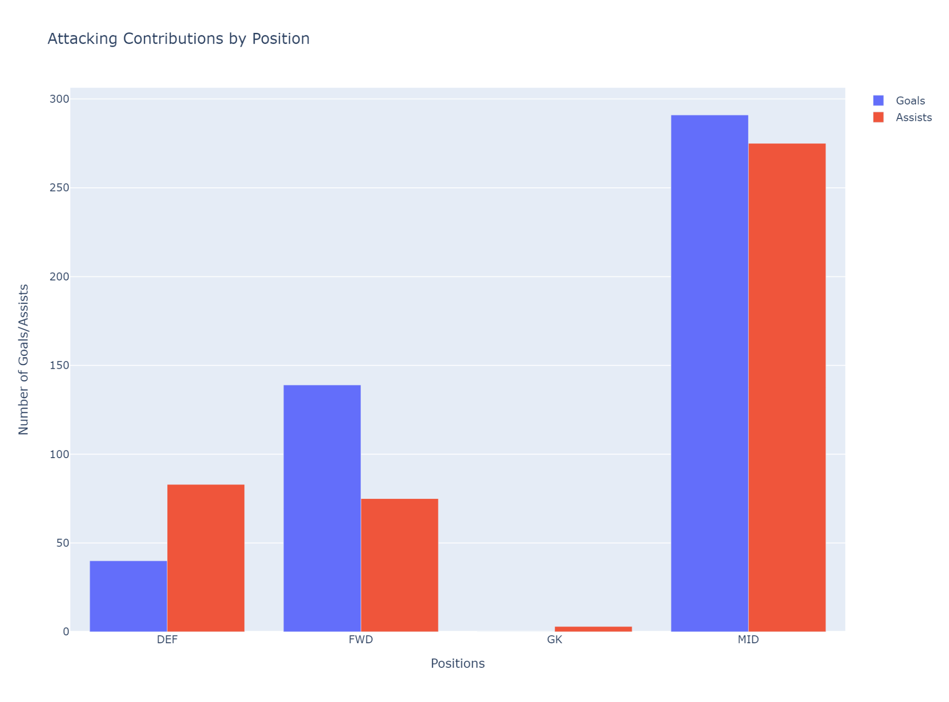
Attacking Contributions
What I Found?
Midfielders yield the best attacking returns

Slide 8
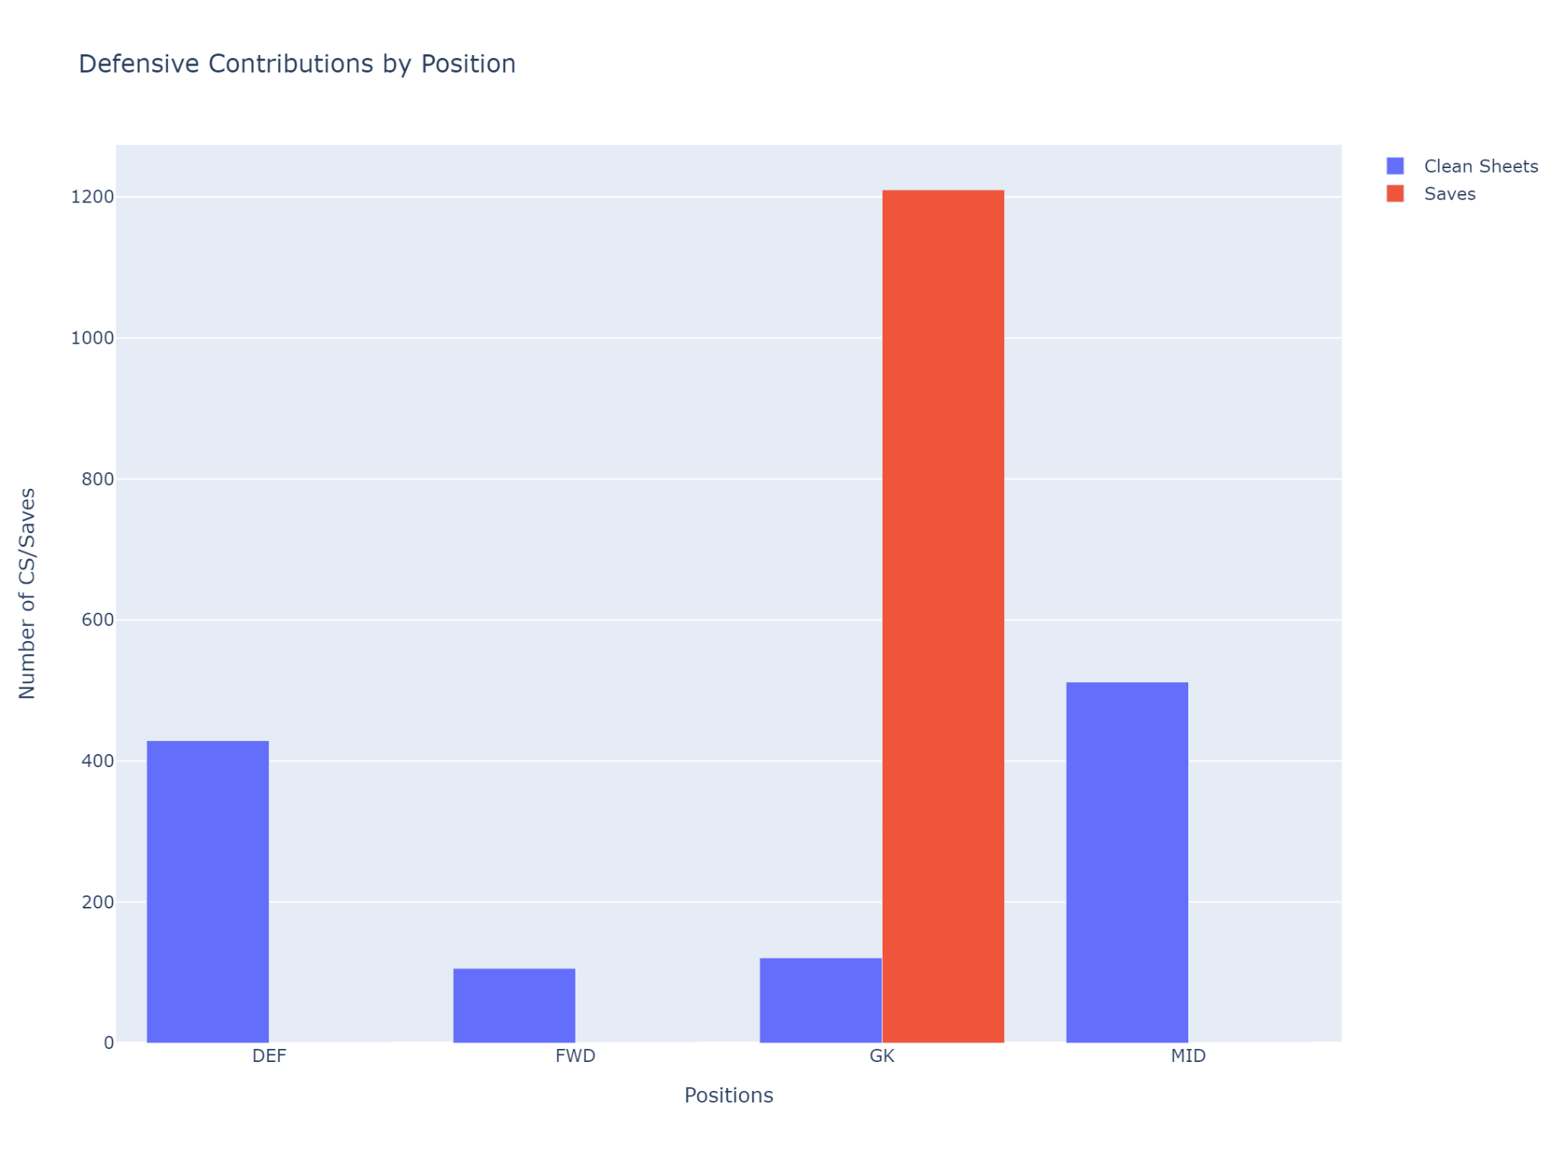
Defensive Contributions
What I Found?
Goalkeepers and defenders yield the most defensive returns
Lower overall contributions than attacking

Slide 9
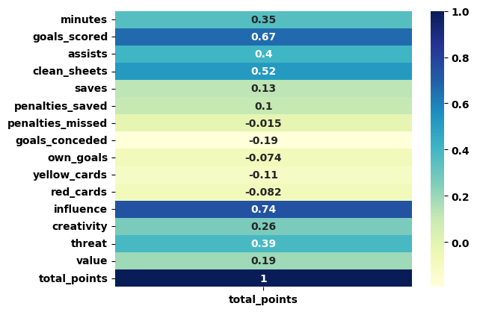
Data Modelling: Feature Selection

Slide 10
Data Modelling: The Results
Model Important Features
goals_scored with a positive correlation of 0.095
assists with a positive correlation of 0.087
clean_sheets with a positive correlation of 0.205
influence with a positive correlation of 0.473

Slide 11
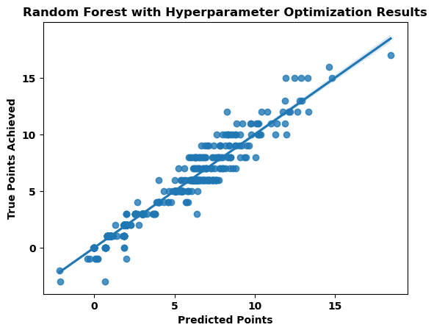
Data Modelling: The Results
Model Metrics
Calculated using r-squared
The amount of variability in points earned that can be explained by the model
Training: 97%
Test: 96%

Slide 12
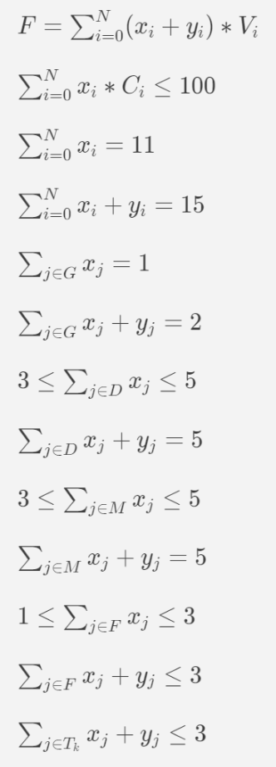
The Knapsack Problem
Quick Summary
You have a set of items
Each item has a weight and a value
You have limited capacity in your knapsack
Select the items that maximize your value
Objective in FPL
Maximize total_points for selected players
Constraints
Cost Budget of 100m
Positional Constraints
Club Constraints

Slide 13
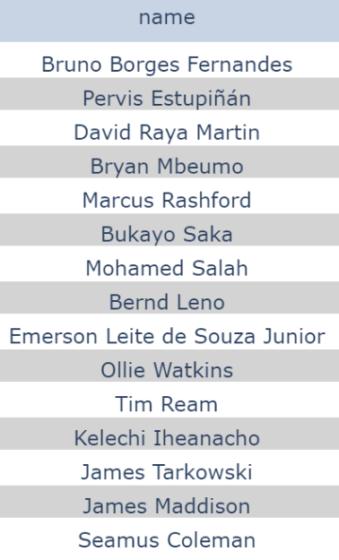
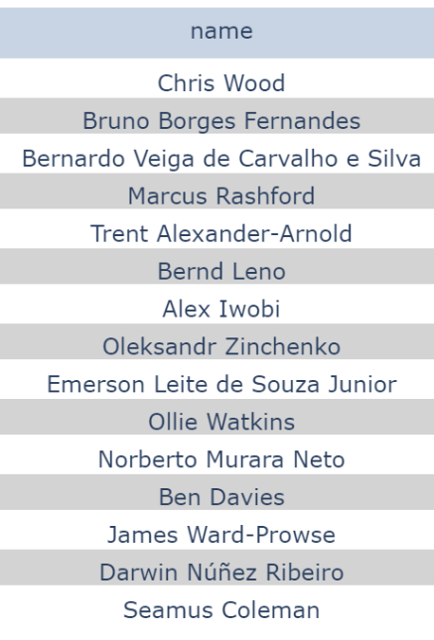

Comparing Team Sheets for GW 24
FPL xP
My Pred
True
FPL xP team and my team: 40%
FPL xP team and true squad: 46%
My team and true squad: 80%

Slide 14
Conclusion & Next Steps
Problems
Poor feature selection, predicting points on actual results.
For Now
Continue to use MILP to select a team based on FPL’s point predictions.
Next Steps
Carefully select features that are indicative of a player’s form and expected statistics to predict performance/points in future matches.

Slide 15
Thank You!

