Slide 1
ARL Notification List Project
Farhan Islam
Mark Mansi

Slide 2
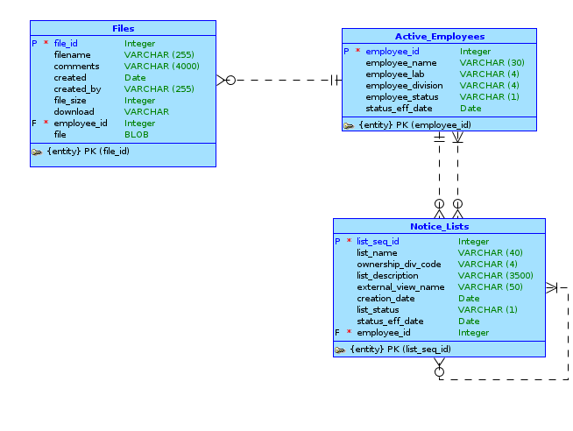
Conceptual Model

Slide 3
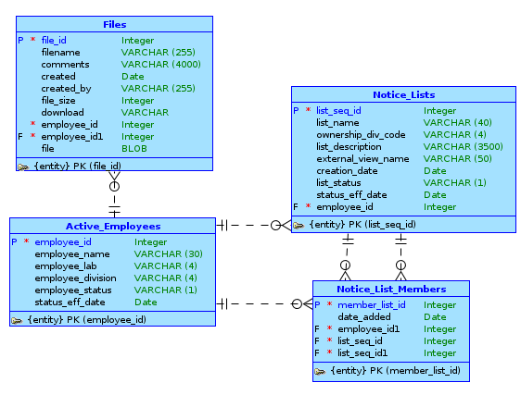
Logical Model

Slide 4
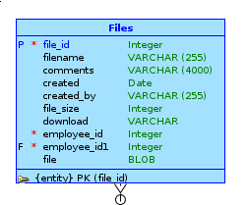
Must-haves and Good-to-haves
Added the Files table for file upload/download
Plan to create APEX interactive reports using joined tables for most other features

Slide 5
Questions for Client: Mailing Lists
“Mailing lists themselves can only be created by users with special access privileges.” (Project details)
  Which users have "special privelages"? Are they only active emps?
  Is this a good-to-have or a must-have?
Can we assume that a list has only one owner/maintainer?

Slide 6
Questions for Client: Users & Files
Can a user be have more than one division or lab?
Why is file upload/download a must-have? What is there to upload?

Slide 7
APEX Questions
How to associate users from the active_employees table with data from tables to get special privelages or list ownersip?
How to create a searchable shuttle item in form?
What is a master detail form and how to use it?

