Slide 1
Does weather affect people decision to rent bikes?
Muhammad Farhan Maulana

Slide 2
Exploring the data
First, let’s take a look at the bird-eye view of the data.
All codes are available in the file exploration.R

Slide 3
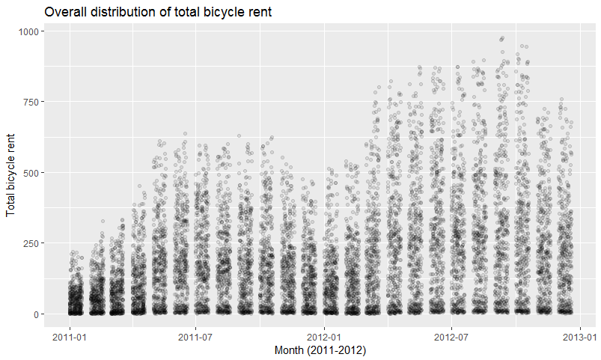
There is a trend of increasing rent mid year, and it continue to drop towards the end. But, is the same trend applies for registered and casual renters?

Slide 4
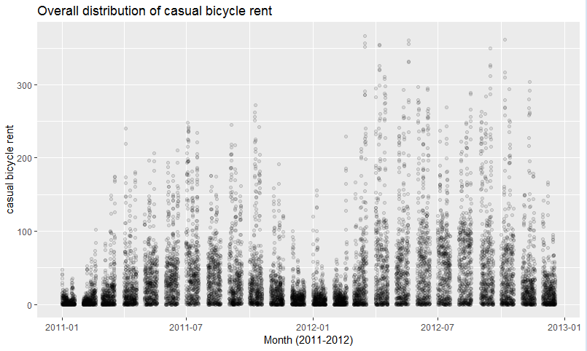
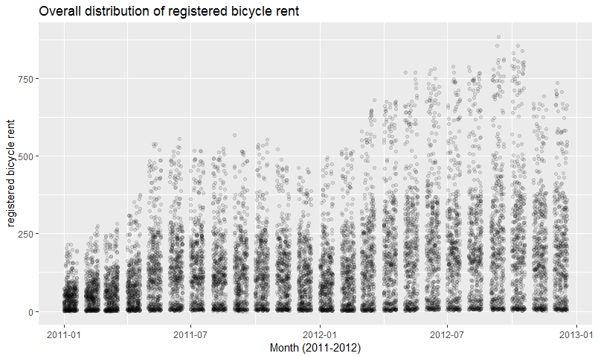
Yeah, that’s right. It also applies to both casual and registered renters. So, for further analysis, we can only use total count for the sake of simplicity.

Slide 5
Using Poisson Regression
Because of the count data as dependent variable, the right statistics tool is Poisson regression
By using Poisson regression, we can test whether we can build proper model of the count based on other variables.

Slide 6
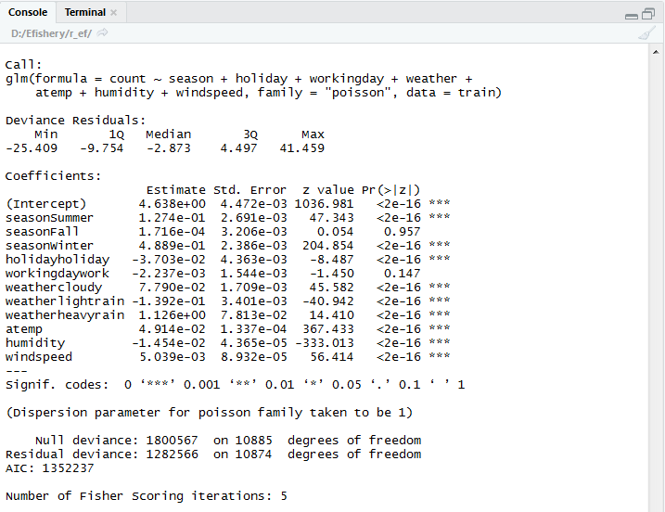
Here, I used all independent variables except temp. This is due to the dependencies of this variable to atemp, and I think atemp alone are the better predictor.
Cameron and Trivedi (2009) recommended using robust SE to control for mild violation of the distribution assumption.

Slide 7
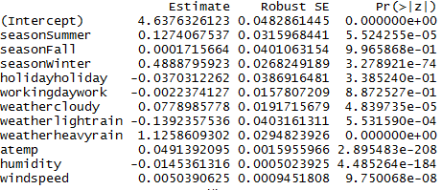
Result of Robust SE calculations
This means, expected log count for a one-unit increase in – let’s say, felt temperature – is 0.05. It would be safe to say that the warmer the weather, the more people will rent the bikes.
Another interesting fact here is that people prefer to rent bikes at weekends than working days. Yet, generally, if there is a special holiday, maybe people rather stay at home.
Compared to clear weather, it’s much more preferable to rent bikes when it is cloudy and low humidity.
Note: High expected log count on heavyrain is an outlier, where it is on workday.

Slide 8

But, how do we check if the data fit the model well?
Using goodness-of-fit chi-squared test, we can check if the data fit the model well.
The p-value is statistically significant, meaning that the data do not fit the model well. To conclude, we have problem for overdispersion.

Slide 9
So, what I’m going to do is
Omit some variables
Looking more specifically (like, the data in each month)
Check the model again
If the model seems good, we can continue to make prediction.

